Slide 1
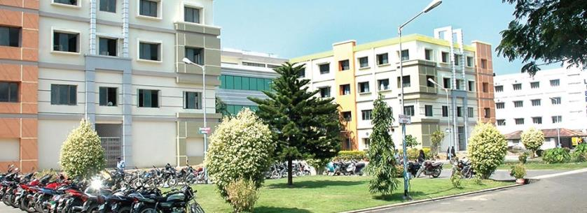
Zinc Oxide Eugenol Impression Paste
SIBAR INSTITUTE OF DENTAL SCIENCES
Department of Prosthodontics
Dr. Ramya, Sr.lecturer

Slide 2
Dental impression : A dental impression is defined as the negative record of the tissues of the mouth . It is used to reproduce the form of the teeth and surrounding tissues

Slide 3
Classification
There are several classification. According to philips science of dental materials impression materials are classified on the basis of setting and elasticity.
Mode of setting | Rigid | Elastic
Set by chemical reaction(irreversible) | Impression plaster, zinc oxide eugenol. | Alginate, polysulfide, polyether, silicone,
Set by temperature change(reversible) | Compound, waxes | Agar hydrocolloid.

Slide 4
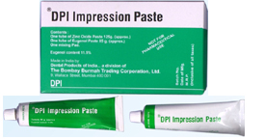
Zinc Oxide Eugenol
ADA Specification no. 16
Type 1 or hard
Type 2 or soft
Available as: Base paste(white in colour) Accelerator or reactor or catalyst paste(red in colour)

Slide 5
Composition
Base paste
Zinc oxide – 87%
Vegetable or mineral oil – 13%
Accelerator paste
Oil of cloves or eugenol – 12%
Gum or polymerized rosin – 50%
Calcium chloride and color – 5%
Filler (silica) – 20%
Lanolin – 3%
Resinous balsam – 10%

Slide 6
Setting reaction
Setting reaction is an acid base reaction to form a chelate.
This reaction is also known as chelation and the product is called zinc eugenolate.
Zno + H2O Zn(OH)2
Zn(OH)2 +2HE ZnE2 +2H2O
(Base) (Acid) ( Salt)

Slide 7
Setting time
 | Initial setting time | Final setting time
Type 1 | 3-6 min | 10 min
Type 11 | 3-6 min | 15 min

Slide 8
Factors controlling setting time
Longer mixing time, shortens setting time.
High atmospheric temperature and humidity accelerate setting.
Setting can be delayed by cooling mixing slab, spatula or adding small amount of retarder or oils or waxes.

Slide 9
Manipulation
Mixing is done on an oil-impervious paper or glass slab.
Two ropes of paste of same length and width, are squeezed on mixing slab.
A flexible stainless steel spatula is used for mixing.
Two ropes are combined until a uniform colour is obtained.
Mechanical rotary mixing are also used.
Mixing time is one minute

Slide 11
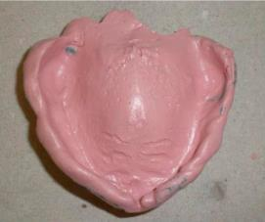
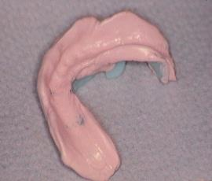
Properties
Good consistency and flow.
Detail reproduction.
Rigid and having good strength.
Good dimensional stability.

Slide 12
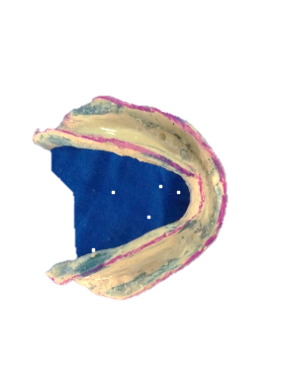
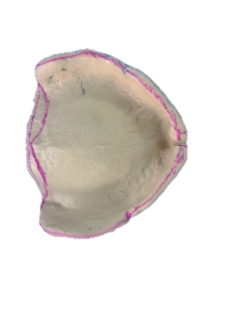
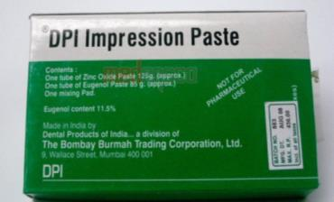
Uses
Secondary Impression material for edentulous patients.
Bite registration paste.
Temporary relining material for dentures.

Slide 13
Advantages
It has enough working time to complete border moulding.
It can be checked in mouth repeatedly without deforming.
It registers accurate surface details.
It is dimensionally stable.
Does not require separating media since it does not stick to cast material.
Minor defects can be corrected.

Slide 14
Disadvantages
Requires special tray for impression making.
Sticky in nature and adheres to tissues.
Burning sensation of eugenol causes tissue irritation.
Highly in elastic in nature.

Slide 15
Disinfection
The impression is rinsed and placed in disinfect solution
Rinsing removes saliva and other contaminants
Recommended disinfectant is 2% gluteraldehyde solution, Iodophor

Slide 16
Non-eugenol pastes
Non-eugenol paste are developed to overcome the burning sensation caused by eugenol.
Bactericides and other medicaments are also incorporated.
Used in eugenol irritant patients

Slide 17
Composition
Base paste
Zinc oxide
Gum
Accelerator paste
Coconut fatty acids
Lorothidol ( fungicide)
Rosin
Chlorothymol ( bactericidal)

Slide 18
Setting reaction
Zinc oxide reacts with carboxylic acid
ZnO + 2RCOOH (RCOO)2Zn +H20
Setting time is around 15 minutes

