Slide 1
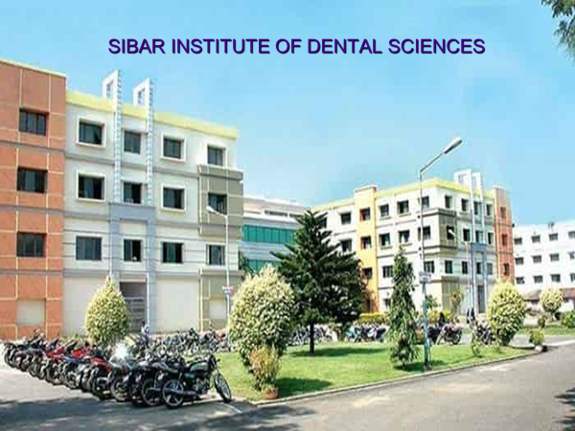
SIBAR INSTITUTE OF DENTAL SCIENCES

Slide 2
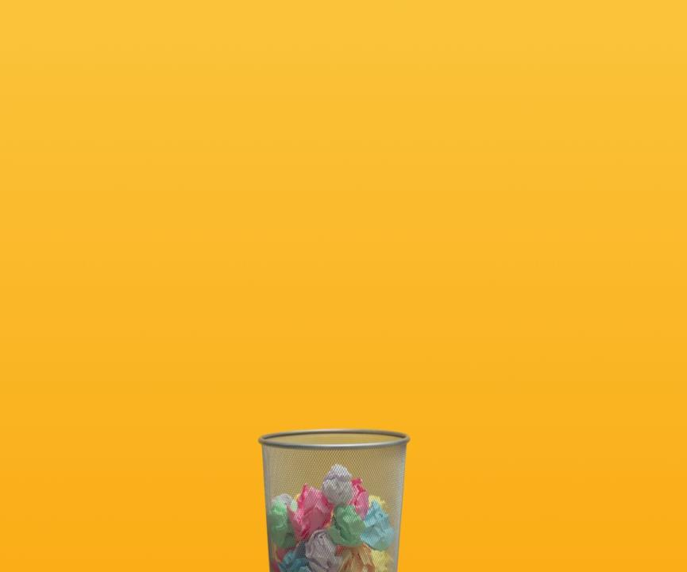
Good MORNING
Good morning
Recycle for a better life

Slide 3
Waste Management

Slide 4
Contents:
Introduction
Sources of health care waste
Rationale of waste disposal
Classification
Categories of waste generated in different department of dental hospital
Treatment and disposal technique for health care waste
Color coding for different wastes

Slide 5
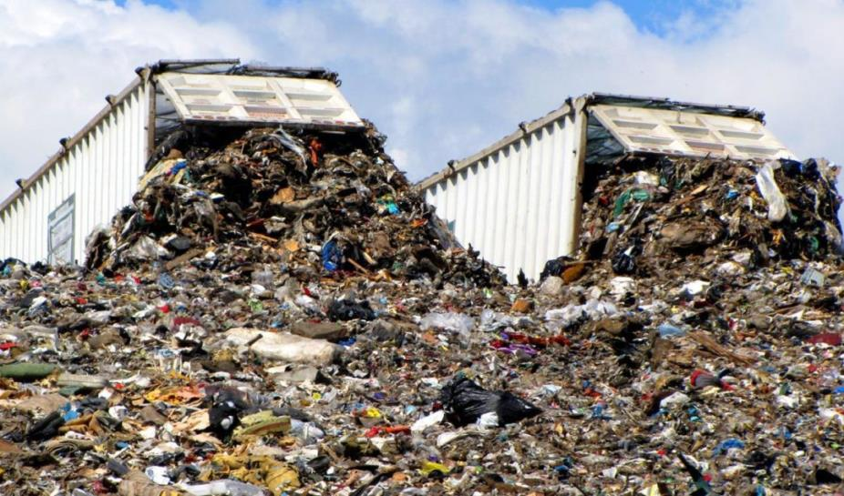
Types of Wastes?
Notes:
Solid
Liquid
Gaseous
Radioactive

Slide 6
Solid Wastes
Liquid wastes
Garbage (food waste)
Rubbish (paper, plastic, wood, metal, glass)
Demolition (bricks, pipes)
Sewage treatment residue (sludge)
Dead animals
Manure and other discarded material
Sewage (waste water containing solid and liquid excreta)
Sullage (waste water which does not contain human waste)

Slide 7
What happens if not managed?

Slide 8
How will you manage waste?

Slide 9
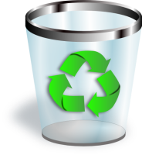
Storage
Collection
Transport
Processing
Recycling

Slide 11
Disposal of solid wastes

Slide 12
Disposal of
solid wastes
Manure pits
Composting
Incineration
Burial
sanitary land fill
Dumping

Slide 13
DUMPING
Easy but most unsanitary method
Refuse is dumped in low lying areas partly as a method of reclamation of land.
As a result of bacterial action, it decreases considerably in volume and gets converted to humus.

Slide 14
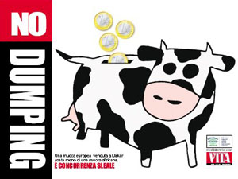
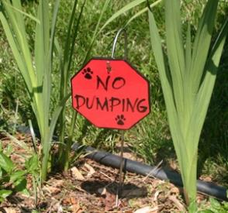
Draw backs of dumping:
The risk of either people or animals (flies and rodents) coming into contact with infectious pathogens is obvious.
Smell and unsightly appearance.
Dispersed by action of wind.
Drainage from dumps contributes to pollution of surface and ground water.
Notes:
Health-care waste should not be deposited on or around open dumps.

Slide 15
CONTROLLED TIPPING/SANITARY LANDFILL
Sanitary landfills are designed to have at least 4 advantages over open dumps :
Geological isolation of waste from the environment.
Appropriate engineering preparation before the site is ready to accept waste.
Staff present on site to control operations.
Organized deposit and daily coverage of waste.

Slide 16
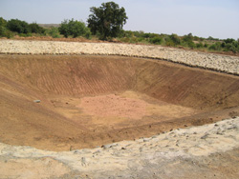
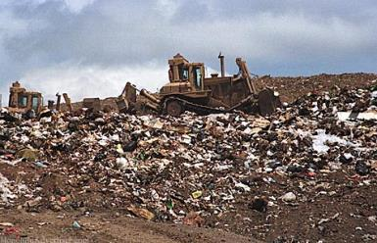
Controlled tipping/ sanitary landfill
Open dumping

Slide 17
Controlled tipping/sanitary landfill
The following methods are used in this operation:
Trench method
Ramp method
Area method
Notes:
The word “modified sanitary landfill” has been applied to those operations where compaction and covering are accomplished once or twice a week.

Slide 18
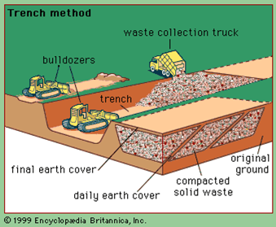
a. Trench method -
Controlled tipping/sanitary landfill
Where level ground is available trench method is used.
A long trench is dug out 6-10 feet deep and 12-36 feet wide.
The refuse is compacted and covered with excavated earth.
Notes:
reclamation

Slide 19
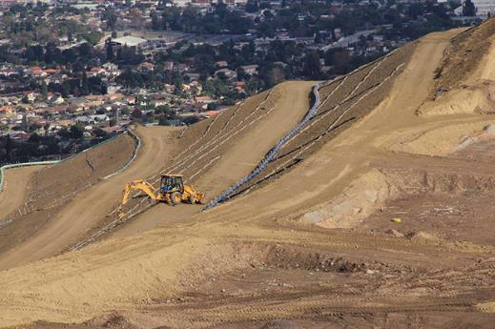
b. Ramp method -
This method is well suited where the terrain is moderately sloping.
Some excavation is done to secure the covering material.

Slide 20
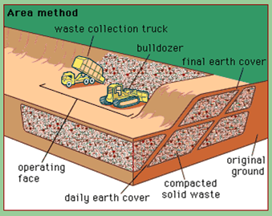
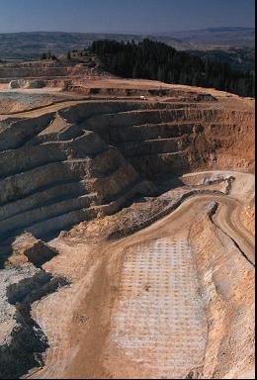
c. Area method -
This method is used for filling land depressions.
The refuse is deposited, sealed with mud.
It requires supplemental earth.
Notes:
Require supplemental earth from outside sources

Slide 21
DEEP BURIAL
This method is suitable for small camps.
A pit or trench should be dug about 2 meters deep.
On each occasion, when wastes are added to the pit, a layer of 10 cm of soil shall be added to cover the wastes.
Notes:
The location of the deep burial site will be authorised by the prescribed authority.
The institution shall maintain a record of all pits for deep burial.

Slide 22
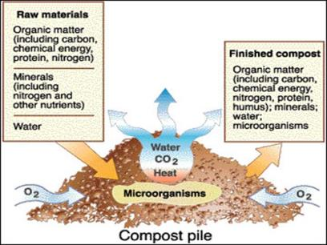
COMPOSTING
Bangalore method (anaerobic)- hot fermentation process
Mechanical (aerobic)

Slide 23
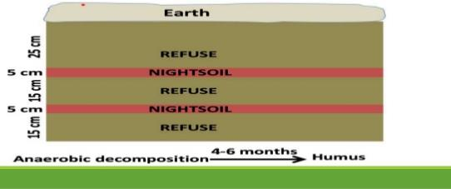
Bangalore method:
This anaerobic method was developed by the Indian Council of Agricultural Research at the Indian Institute of Science, Bangalore.
Depths greater than 3 ft are not recommended because of slow decomposition.
The pits should be located at least 800 m away from the city limits.

Slide 24
First a layer of refuse is spread at the bottom of the trench. Over this, nightsoil is added. Then alternate layers of refuse and nightsoil are added till the heap rises 1 ft above the ground level.
The top layer should be of refuse, at least 9 inches in thickness. Then the heap is covered with excavated earth and compacted.
Within 7 days as a result of bacterial action considerable heat (over 60°C) is generated in the compost mass. The intense heat which persists over 2 to 3 weeks, causes decomposition of the material.
At the end of 6 months, decomposition is complete and the resulting material is a well decomposed, odourless, innocuous material with manurial value

Slide 25
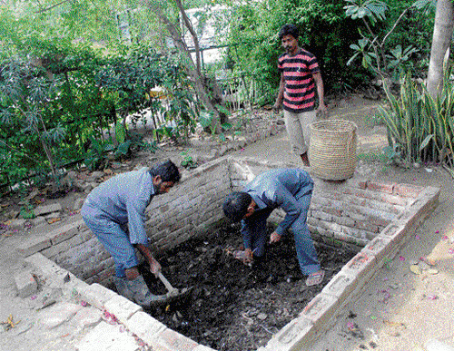
MANURE PITS

Slide 26
Biomedical waste management

Slide 27
According to bio-medical waste (management and handling) rules, 1998 of India:
DEFINITION: “Bio-medical waste” means any waste, which is generated during the diagnosis, treatment or immunization of human beings or animals or in research activities pertaining thereto or in the production or testing of biologicals.

Slide 28
SOURCES OF BIOMEDICAL WASTE
The institutions involved in generation of bio-medical waste are
Government hospitals
Private hospitals
Nursing homes
Physicians offices/ clinics
Dentists office /clinics
Dispensaries
Primary health care centers
Medical research and training establishments
Mortuaries
Blood banks and collection centers

Slide 29
Animal houses / Slaughter houses
Laboratories
Research organizations
Vaccination centers
Bio- technology institutions/ production units
All these health care establishments generate waste and are therefore covered under Bio-medical waste rules,1998 of India.

Slide 30
CLASSIFICATION
(WHO (1999) classification of health care waste)

Slide 31
S.no | Waste category | Description and example
1 | Infectious waste | Waste suspected to contain pathogens e.g. Laboratory cultures; waste from isolation wards; tissues (swabs) materials or equipment that have been in contact with infected patients; excreta
2 | Pathological waste | Human tissues or fluids e.g. body part; blood and other body fluids; fetuses
3 | Sharps | Sharp waste e.g. needles infusion sets; scalpels knives blades; broken glass
4 | Pharmaceutical waste | Waste containing pharmaceuticals e.g. pharmaceuticals that are expired or no longer needed; items contaminated by or containing pharmaceuticals (bottles, boxes)
5 | Genotoxic waste | Waste containing substances with Genotoxic properties e.g. waste containing cytostatic drugs (often used in cancer therapy); genotoxic chemicals
6 | Chemical waste | Waste containing chemical substances e.g. laboratory reagents; film developer; disinfectants that are expired or no longer needed solvents
7 | Waste with high content of heavy metals | Batteries; broken thermometers; blood pressure gauges; etc
8 | Pressurized containers | Gas cylinder; Gas cartridges
9 | Radioactive waste | Waste containing radioactive substance e.g. unused liquids from radiotherapy or laboratory research; contaminated glass ware, packages or absorbent paper; urine and excreta from patients treated or tested with unsealed radionuclide sealed sources

Slide 32
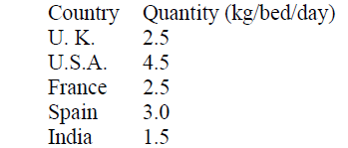
Amount of hospital waste generated
B. Ramesh Babu, A.K. Parande, R. Rajalakshmi, P. Suriyakala, M. Volga. Management of Biomedical Waste in India and Other Countries: A Review. J. Int. Environmental Application & Science, 2009;4(1):65-78.

Slide 33
The main group at risk are
Medical doctors/Dental doctors, nurses, health care auxiliaries, and hospital maintenance personnels
Patients in health care establishments
Visitors to health care establishments
Workers in support service allied to health care establishments such as laundries, waste handling and transporting
Workers in waste disposal facilities such as land fills or incinerators including scavengers
There are chance of environmental pollution as result of improper handling and management of such waste.

Slide 34
Bio-Medical waste management
in India
Bio-Medical waste (Management and Handling) Rules 1998, prescribed by the Ministry of Environment and Forests (MoEF), Government of India, came into force on 28th July 1998.
These rules apply to all persons who generate, collect, receive, store, transport, treat, dispose, or handle bio medical waste in any form.

Slide 35
STEPS IN WASTE DISPOSAL
Segregation
Decontamination
Deformation/destruction
Containment/Label/Transport
Treatment & Disposal

Slide 36
1. Segregation
Biomedical waste shall not be mixed with other wastes.
Shall be segregated into containers/bags at the point of generation and as soon as possible.
Segregation reduces chances of injury and reduces the quantity of hazardous waste.
Notes:
The key to minimization and effective management of health care waste is segregation (separation)
Identification of the waste & appropriate handling
Treatment and disposal of waste by type reduce costs and do much to protect public health.
should take place as close as possible to when the waste is generated and should be so maintained in storage areas and during transport.
The most appropriate way of identifying the categories of health care waste is by sorting the waste into colour-coded plastic bags / containers.

Slide 37
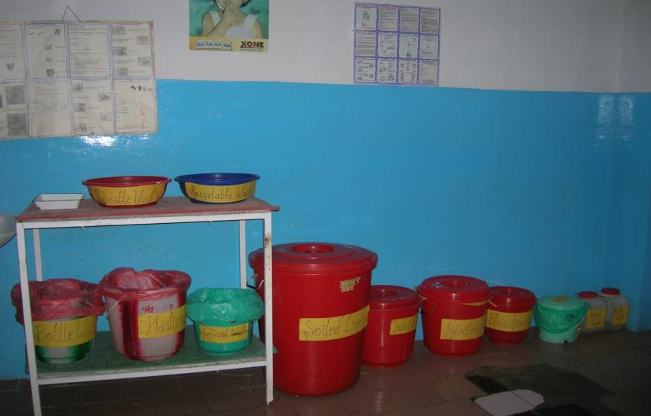
Waste segregation at source

Slide 38
Categories of Bio-Medical Waste & Colour coding and type of container for disposal of bio-medical wastes (SCHEDULE I & II)
Cat | Waste category | Contents | Colour code | Type of container
1 | Human anatomical | Human tissues, organs, body parts | Yellow | Plastic bag
2 | Animal waste | Animal tissues, organs body parts, carcasses, bleeding parts, fluid blood and experimental animals used in research, waste generated by veterinary hospital colleges, discharges from hospitals and animal houses | Yellow | Plastic bag
3 | Microbiology and biotechnology waste | Laboratory cultures stocks, specimen of micro organisms live or attenuated vaccines, human and animal cell culture used in research and industrial laboratories, wastes from production of biological toxins, dishes and devices used for transfer of cultures | Yellow | Plastic bag/disinfected container

Slide 39
4 | Waste sharps | Needles, syringes, scalpels, blades, glass etc that may cause puncture and cuts. This includes both used and unused sharps | white translucent | puncture proof, leak proof container
5 | Discarded medicines and cytotoxic | Waste comprising of outdated, contaminated and discarded medicines | Yellow | Plastic bag
6 | Soiled waste | Items contaminated with blood and body fluids including cotton, dressing, soiled plaster casts, linen, bedding, other material contaminated with blood | Yellow | Disinfected container/ plaster bag
7 | Contaminated waste (recyclable) | Waste generated from disposable items other than the waste sharps such as tubing, catheters, intravenous sets etc | Red | Disinfected container/ plastic bag

Slide 40
8 | Liquid chemical waste | Waste generated from laboratory, washing, cleaning, housekeeping and disinfecting activities | Yellow | Separate collection system
9 | Glassware, metallic body implants | Broken gasses, contaminated glass | Blue | Cardboard box
10 | Chemical waste | Waste generated from chemicals used in the production of disinfection materials and insecticides etc | Yellow | Plastic bag

Slide 41
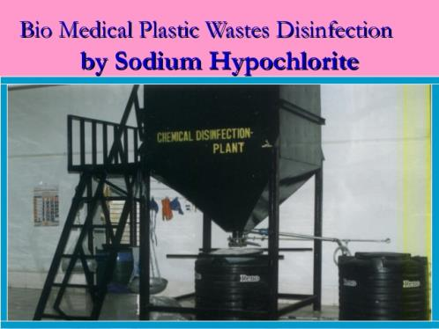
2. Decontamination
Disinfection reduces chances of infection.

Slide 42
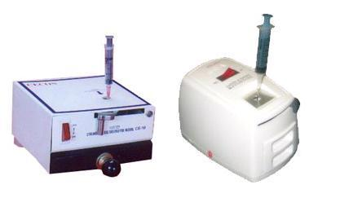
3.Deformation/Destruction
Prevents reuse / remarketing of the needles, syringes and gloves.
Needle cutter or burner is used.

Slide 43
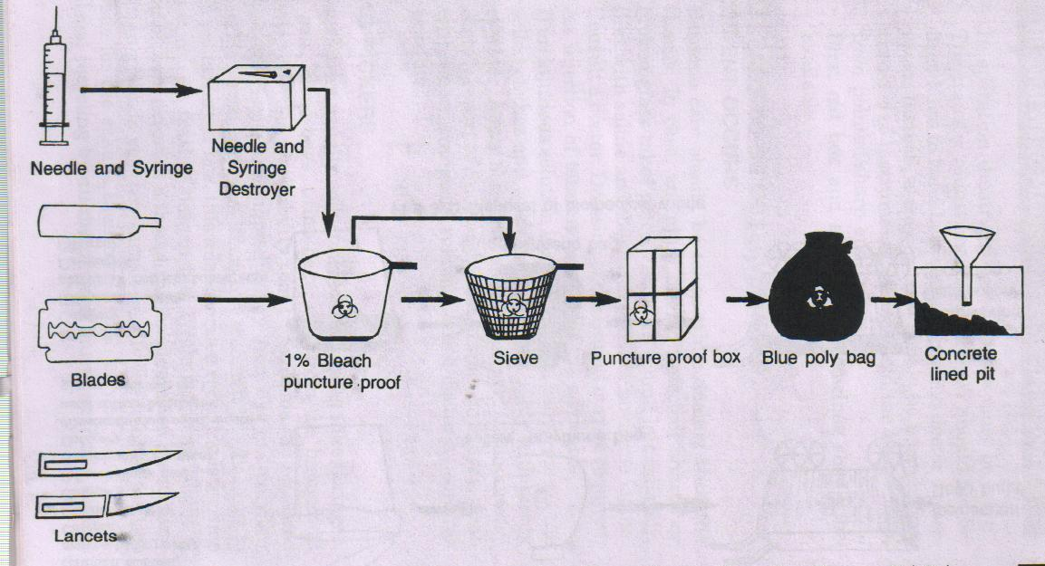

Slide 44
4.Containment/Label/Transport
Containment
Some can not be disposed off on a daily basis.
Eg: Needles, POP casts, mercury, lead foils, fixer solutions
Use a puncture proof narrow mouthed plastic container to collect the waste sharps.
No untreated biomedical waste shall be kept stored beyond a period of 48 hours.

Slide 45
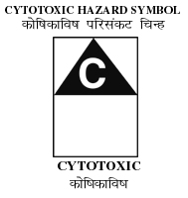
Label
The containers shall be labeled.
Notes:
All waste bags or containers should be labeled with basic instructions on their content and information on the waste producer. This instructions may be written directly on the bag or container or on preprinted labels, securely attached.
It is also recommended that the 2 digits of the yr of manufacture of the packing specified on the package, as well as special code designating the type of packaging.
Waste category
Date of collection
Place in hospital where produced (ex. wards)
Waste destination

Slide 46
Uses of labeling:
In cases of problems involving questions of liability, full and correct labeling allows the origin of the waste to be traced.
Labeling also warns operative staff and the general public of the hazardous nature of the waste.
The hazards posed by container contents can be quickly identified in case of accident, enabling emergency services to take appropriate action.

Slide 47
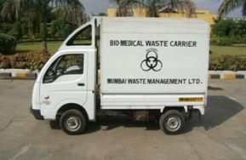
Transportation
Use heavy duty gloves while handling waste sharps especially while transporting – avoid transporting manually – use trolley.
Untreated biomedical waste shall be transported only in such vehicle as may be authorised for the purpose by the competent authority as specified by the government.

Slide 48
5.Treatment & disposal
Biomedical waste shall be treated and disposed of in accordance with Schedule I
Every occupier, where required, must set up treatment facilities like incinerator, autoclave, microwave system for the treatment of waste, or, ensure required treatment of waste at a Common Bio-medical Waste Treatment Facility (CBWTF) or any other waste treatment facility.
Notes:
Incineration, mutilation/shredding prevents reuse/send to the recycler or bury in concert pit.
Biomedical waste shall be treated and disposed of in accordance with Schedule I

Slide 49
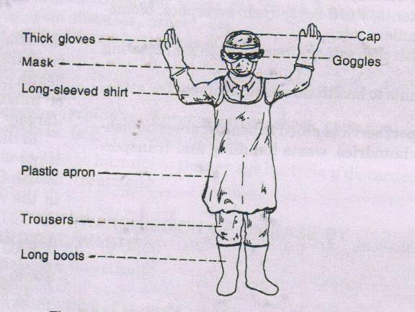
Personal protective equipments for staff handling waste
Do not forget
“Immunization”
Notes:
Protective eye wear
Double strength gloves/ rubber gloves
Boots
Aprons
mask

Slide 50
TREATMENT AND DISPOSALTECHNOLOGIES FOR HEALTH-CARE WASTE
Incineration
Chemical disinfection
Wet and dry thermal treatment
Microwave irradiation
Encapsulation
Land disposal
Inertization

Slide 51
INCINERATION
Incineration is a high temperature dry oxidation process.
The process is selected to treat waste that cannot be recycled, reused or disposed off in a land fill site.
It reduces organic and combustible waste to inorganic incombustible matter and results in a very significant reduction of waste volume and weight.
Notes:
Industrialized countries…….. Bt limited in india

Slide 52
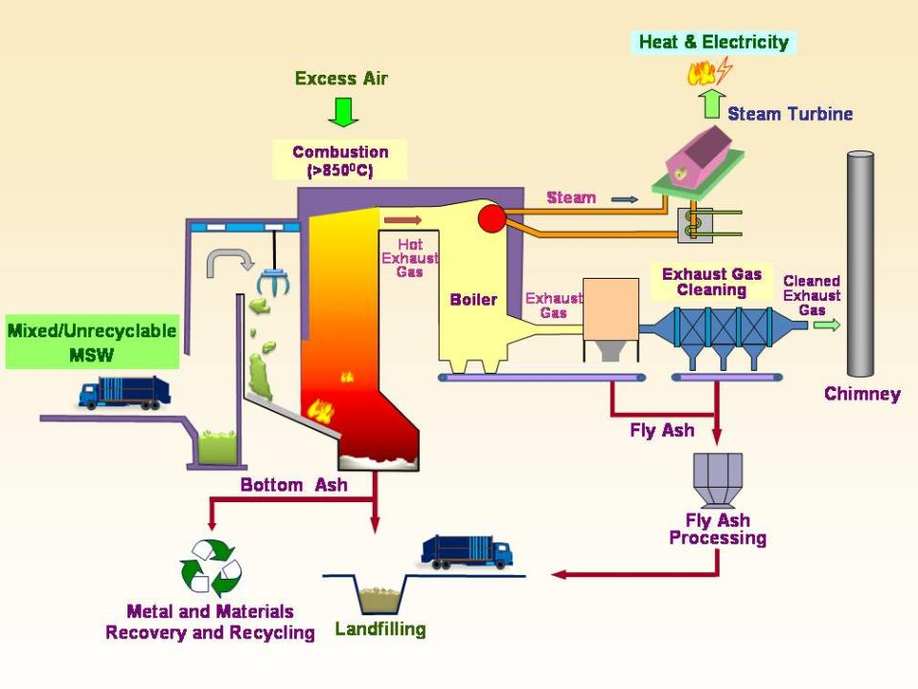
Notes:
A furnace or combustion chamber
A platform for tipping the refuse.
Stokers for raking the refuse forward.
Baffle plate to drive out all fumes

Slide 53
Types of Incinerators-
Double chamber pyrolytic Incinerators - infectious health-care waste.
Single chamber furnace - only if pyrolytic incinerators are not affordable. These incinerators treats waste in batches.
Rotary kiln – operates at high temperature. Capable of causing decomposition of genotoxic substances and heat-resistant chemicals.
Notes:
(a) Double-chamber pyrolytic incinerators which may be especially designed to burn infectious health-care waste;
(b) Single-chamber furnaces with static grate, which should be used only if pyrolytic incinerators are not affordable; and
(c) Rotary kilns operating at high temperatures, capable of causing decomposition of genotoxic substances and heat-resistant chemicals.

Slide 54
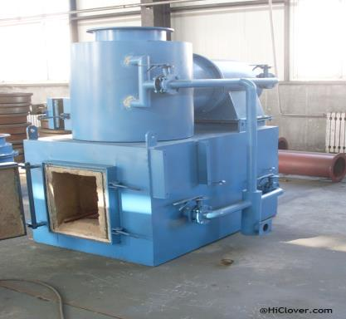
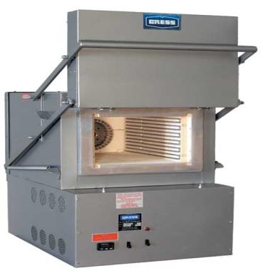
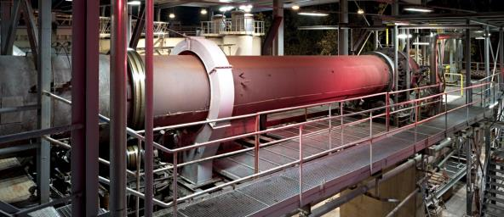
Double chamber pyrolytic Incinerators
Single chamber furnace
Rotary kilns

Slide 55
Disadvantages of incinerators
Preliminary separation of dust and ash from refuse is required.
Manipulative difficulties.
Trained personal is required.
Its very expensive.
Moisture presence during rainy season affects burning of refuse.

Slide 56
CHEMICAL DISINFECTION
Chemicals are added to kill or inactivate the pathogens.
It is most suitable for treating liquid waste such as blood, urine, stools and hospital sewage.
However, solid wastes including microbiological cultures, sharps etc. may also be disinfected chemically with certain limitations.
Notes:
Chemical disinfection is most suitable for treating liquid waste such as blood, urine, stools or hospital sewage. However, solid wastes including microbiological cultures, sharps etc. may also be disinfected chemically with certain limitations.

Slide 57
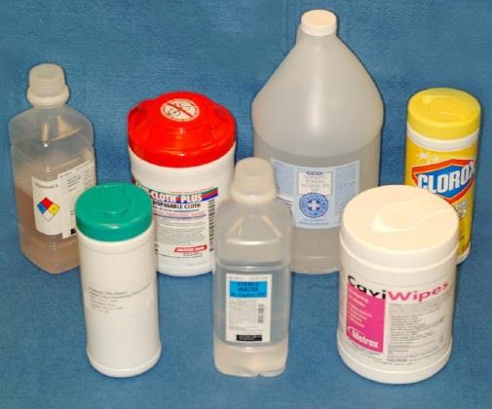
Formaldehyde
Ethylene oxide
Glutaraldehyde
Sodium hypochlorite
Chlorine dioxide
(reddish-yellow gas)

Slide 58
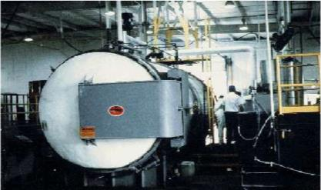
WET THERMAL TREATMENT
It is similar to autoclave sterilization process.
Exposure of infectious waste to high temperature, high pressure steam, and is similar to the autoclave sterilization process.
The process is inappropriate for the treatment of anatomical waste and animal waste, and will not efficiently treat chemical and pharmaceutical waste.
Notes:
WET THERMAL TREATMENT : Wet thermal treatment or steam disinfection is based on exposure of shredded infectious waste to high temperature, high pressure steam, and is similar to the autoclave sterilization process. The process is inappropriate for the treatment of anatomical waste and animal carcassess, and will not efficiently treat chemical and pharmaceutical waste.

Slide 59
Standards :
a temperature of not less than 121⁰ C and pressure of 15 pounds per square inch (psi) for an autoclave residence time of not less than 60 minutes; or
a temperature of not less than 135⁰ C and a pressure of 31 psi for an autoclave residence time of not less than 45 minutes; or
a temperature of not less than 149⁰ C and a pressure of 52 psi for an autoclave residence time of not less than 30 minutes.

Slide 60
MICROWAVE IRRADIATION
Most microorganisms are destroyed by the action of microwave of a frequency of about 2450 MHz and a wave length of 12.24 nm.
The water contained with in the waste is rapidly heated by the microwaves and infectious components are destroyed by heat conduction.
The efficiency should be checked by bacteriological and virological tests.
Microwave treatment shall not be used for cytotoxic, hazardous or radioactive wastes, body parts and large metal items.
Notes:
Most microorganisms are destroyed by the action of microwave of a frequency of about 2450 MHz and a wave length of 12.24 nm. The water contained within the waste is spidly heated by the microwaves and the infectious Domponents are destroyed by heat conduction. The efficiency :: Ihe microwave disinfection should be checked routinely
" : ugh bacteriological and virological tests.

Slide 62
ENCAPSULATION
High density polyethylene containers or metal drums are filled with waste.
Then filled with immobilizing medium like plastic foam, cement motor or clay.
After the medium is dried, they are sealed and disposed in landfills.
Simple, low-cost and safe.
Shall be provided for treated sharps.

Slide 63
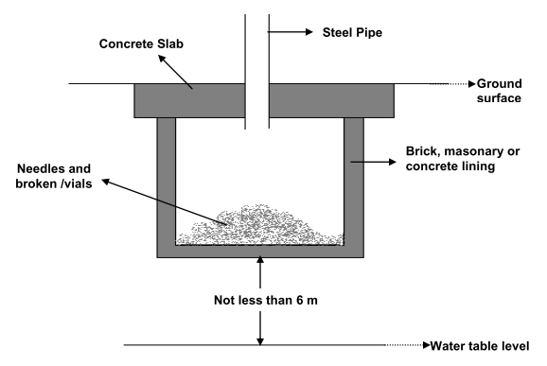
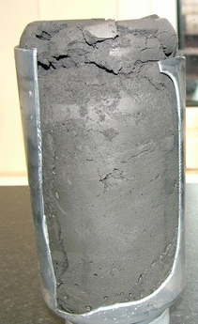

Slide 64
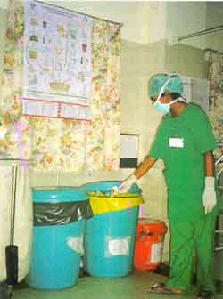
Safe and effective management of Bio-medical waste is not only a legal necessity but also a social responsibility.

Slide 65
FAQ’s
Waste management
Methods of disposal
Methods of waste management
Incineration
Bangalore technique
Categories of Bio-medical waste

Slide 66
QUIZ
Which type of wastes are biomedical wastes?
a. Waste from industries
b. Waste from hospitals
c. Waste from communities
d. All of the above
What does the poor disposal of biomedical Waste cause?
a. Infectious diseases
b. Medical issues
c. Allergies
d. All of the above

Slide 67
3. What type of waste disposals do all hospitals need?
a. Biomedical Waste disposal
b. Furnace waste disposal
c. Recycling waste disposal
d. None of the above
4. Bio hazardous sharps containers must be rigid, leak resistant and puncture proof.
a. True
b. False

Slide 68
Thank you

