Slide 1
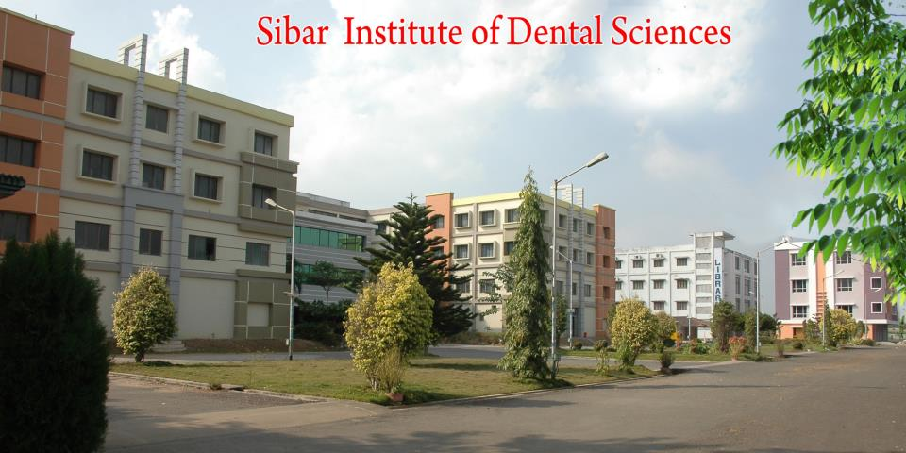
SMOKING AND PERIODONTAL DISEASE
Dr. B. Appaiah Chowdary, Reader
SIBAR INSTITUTE OF DENTAL SCIENCES
DEPARTMENT OF PERIODONTICS

Slide 2
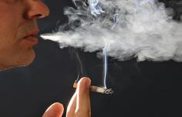
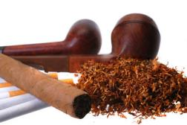
Introduction
Tobacco leaf introduced to Columbus by native Americans and was called Tobago or Tobacca.
Cigarettes became popular in 20th century.

Slide 3
Cigarette smoking –single most important & modifiable factor for a plethora of diseases. Periodontal disease added to this ever increasing list.

Slide 4
FORMS OF TOBACCO

Slide 5
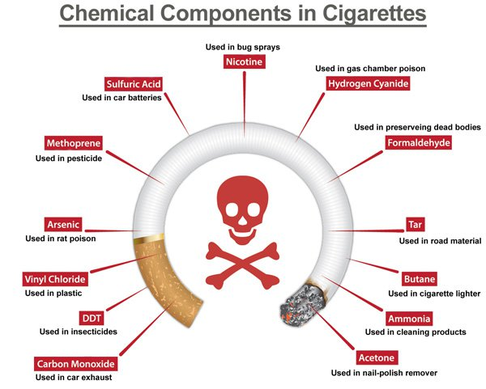
Constituents of tobacco smoke
More than 4000 chemicals have been found to be present in tobacco smoke.

Slide 6
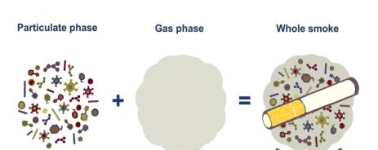
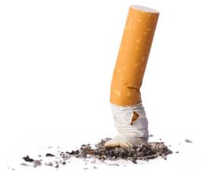
Particulate Phase
Tar
Polynuclear aromatic hydrocarbons
Nicotine
Phenol
Cresol
Naphthylamine
N - Nitro Sonornicotine
Benzopyrene
Trace metals (eg: Nickel, arsenic, polonium 210)
Indole
Carbazole
Catechol
Gas phase
Carbon monoxide
Nitrosamines
Hydrazine
Vinyl chloride
Oxides of nitrogen
Hydro Cyanic acid
Acetaldehyde
Acrolein
Ammonia
Formaldehyde

Slide 7
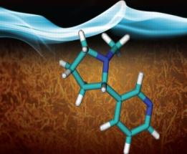
Nicotine
Gingival crevicular fluid concentration of nicotine is 300 times more than that of plasma concentration in smokers.
Nicotine binds to root surface
Elevates proinflammatory cytokines
Impairs wound healing

Slide 8
Systemic redistribution of tobacco smoke constituents into saliva and GCF
Ph from flue-cured cigarettes is acidic (ph 5.5) (gori et al. 1998)
Pipe and cigar tobacco are usually air cured – alkaline (ph 8.5)
Nicotine-unionized-readily absorbed by oral tissues

Slide 9
Cotinine
Formed by cytochrome P450-mediated c-oxidation of nicotine - half-life of approximately 20 hours (Benowitz et al. 1983, Jarvis et al. 1988)
Nicotinine
Short half-life (t1/2·1–2 h, Pilotti 1980)
Thiocyanate
Salivary thiocyanate has a half-life of 10 to 14 days (Galanti 1997)
Determine current smoking status.
-Cotinine in body fluids-optimal method -to establish recent tobacco smoke exposure. including secondary (passive) smoke -sensitivity of 96–97% and specificity of 99–100%

Slide 10
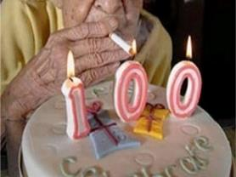
Classification of smokers
Centers for Disease Control and Prevention
Current smokers
>100 cigarettes over their lifetime-smoker at the time of interview
Former smokers
>100 cigarettes in their lifetime –not current
Never smokers
Not smoked >100 cigarettes in their lifetime

Slide 11
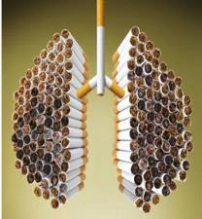
Terminologies
Pack-years
Number of packs of cigarette smoked/day multiplied by the number of years smoked
ETS Pack-years
Exposure within a confined space to ETS produced by an active smoker consuming one pack of cigarettes /day for a year. Bennett et.al 1999

Slide 12
ENVIRONMENTAL TOBACCO SMOKE

Slide 13
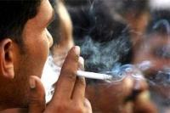
Passive smoking
Second-hand smoking/ environmental tobacco smoking-involuntary inhalation of tobacco smoking
Mildly associated with periodontal disease
NHANES III-(odds- 1.6)passive smokers to develop periodontitis
Elevation of IL-1β, albumin and aspartate aminotransferase in saliva
No significant differences in periodontal pathogens

Slide 14
Smoking & destructive periodontal disease: relative risk
Based on current evidence, the relative risk for a smoker to attract destructive periodontal disease can be estimated to be 5- to 6-fold elevated in comparison with a non-smoker.
RR (Relative risk) is also dependent on the ‘amount of exposure’
A smoker who has smoked 20 cigarettes a day for over 20 years runs a 20-fold increased risk.
(Hyman, Bergstrom 2003)

Slide 15
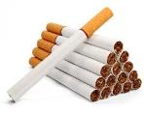
Effect 0f Smoking 0n Plaque and its Development
Higher prevalence of dental plaque than non-smokers
Increased levels of debris observed in smokers have been tentatively attributed to personality traits leading to decreased oral hygiene habits, increased rates of plaque formation, or a combination of the above.

Slide 16
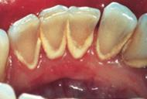
Smoking and Calculus formation
There have been consistent reports of more calculus in smokers than in non-smokers from the earliest epidemiological studies (Martinez-Ganut P 1995).
Some authors reported that significantly more pipe smokers than cigarette smokers had supragingival calculus. This might be because the pH of pipe smoke is higher than that of cigarette smoke, and because pipe smokers circulate the smoke around the mouth, whereas cigarette smoke tends to be inhaled (Albandar JM 2000).
Notes:
Smokers had more calculus than non-smokers, but the effect of smoking was independent of the amount of calculus present.

Slide 17
Moreover, the smoking cycle is much longer in pipe smokers than in cigarette smokers, causing pipe smokers to salivate more (Bergstrom J 2005).
There is an increased calcium concentration in fresh saliva in smokers following smoking (Khan GJ 2005).
Nicotine affects the exocrine glands by an initial increase in salivary and bronchial secretions that are followed by inhibition of the secretions.

Slide 18
The increased amount of calculus found in smokers might therefore be due to an effect of tobacco smoke upon properties of saliva (Erdimir 2006).
The reasons for an elevated calcification rate in smokers are not known, but it has been speculated that it might be coincident with the increased risk in smokers for ectopic calcification. (Bergstrom 2005)
Notes:
The calcium phosphates found in supragingival calculus are in the main derived from the saliva. The organic components may also arise from this source, the proteins and polypeptides constituting the major fraction

Slide 19
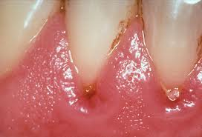
Smoking and gingival inflammation
A reduction in clinical signs of gingivitis has been reported in smokers and this effect has been shown to be independent of plaque levels (Markkanen 2010)
Heavy smokers may have greyish discoloration and hyperkeratosis of the gingiva, an increased number of keratinized cells has been found in the gingiva of smokers. Changes in the epithelium were described as keratotic, hyperkeratotic and hyperplastic (Bajagic V 2006)

Slide 20
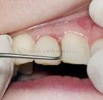
Smoking and gingival bleeding
smoking is known to produce peripheral vasoconstriction but in some subjects this is preceded by vasodilatation. In any particular instance, the effect produced is probably related to the degree of inhalation of the tobacco smoke and the rate of nicotine absorption (Muller HP 2002)
Nicotine from cigarette stimulates the sympathetic ganglia to produce neurotransmitters including catecholamines (These affect the alpha-receptors on blood vessels which in turn causes vasoconstriction (Trauth JA 2001).

Slide 21
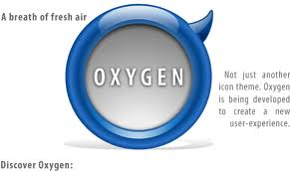
Smoking & Oxygen tension in gingival tissues
Oxygen saturation of hemoglobin is affected by cigarette smoking, and attempts have been made to measure this in the gingival tissues.
In healthy gingiva smokers appear to have lower oxygen saturation determined by using tissue reflectance spectrophotometry, but in the presence of inflammation converse was shown

Slide 22
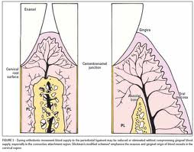
Effects on the Gingival Vasculature
The vasculature has also been examined in histological and immunocytochemical studies
It was found that high proportion of small vessels compared with large vessels in smokers than non-smokers but no difference in the vasculature density.--- Mirbod 2001

Slide 23
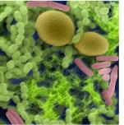
Smoking and oral microorganisms
Cigarette smoking could cause a lowering of the oxidation-reduction potential (Eh), and this could cause an increase in anaerobic plaque bacteria (Kinane DF 1997).
There was a statistically significant increase in the proportion of Gram-positive to Gram-negative bacteria in 3-day-old plaque from smokers, when compared with the non-smokers (Stoltenberg JL 1993).

Slide 24
Tobacco smoke contains phenols and cyanides, which can account for antibacterial and toxic properties. Smokers harboured significantly higher levels and were at significantly greater risk of infection with Tanarella forsythia than non-smokers (Zambon JJ 1996).
Adjusting for disease severity, Porphyromonas gingivalis was also more likely to subgingivally infect smokers than non-smokers However, there was not a significantly higher relative risk for infection with this bacterium.
(Sayers NM 1999).

Slide 25
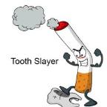
Smoking and gingival recession
Gingival recession in smokers was greater than that in non-smokers and the difference was statistically significant.
Significant positive associations were noted between gingival recession and age, and between gingival recession and plaque index between smokers and non-smokers
(Nikolaos Andreas 2011)

Slide 26
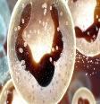
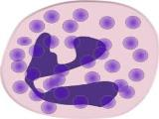
PMN function
Important role in the defense of the marginal periodontal tissues against bacterial invasion.
PMN activity to be severely depressed by a solution of tobacco-smoke where as phagocytosis and bactericidal activity were affected. (Corberand 1980)
Smokers have higher blood PMN counts than do non-smokers and chemotaxis of PMN s from smokers was suppressed relative to nonsmokers (Mac Ferlene 1992)

Slide 27
Tobacco-induced degranulation events in neutrophils, tobacco-induced alterations to the microbial flora, and tobacco induced increases in pro-inflammatory cytokine burden could each, influence MMP-8 levels in the periodontal tissues of smokers.

Slide 28
Effect of smoking on periodontal therapy
smoking exerts a negative influence on the outcome following non-surgical as well as surgical periodontal therapy.
(Bergstrom 2004)
smoking negatively influences the outcome following implant therapy and risk for implant failure is increased in smoker patients (Bain 2003)
smokers contribute the vast majority of therapeutic failures or refractory cases (Magnusson 1994)

Slide 29
Following non-surgical therapy including scaling, root planing and professional tooth cleaning, healing in terms of gingival bleeding reduction and pocket depth reduction was less favorable in smokers as compared to nonsmokers.
(Jansson 2002)
A study by Grossi et al. 1997 showed that current smokers have less healing and reduction in subgingival Tanarella forsythensis and Porphyromonas gingivalis after treatment compared to former and non-smokers, suggesting that smoking impair periodontal healing.

Slide 30
Antimicrobial Therapy in Smokers
This practice may be justified by evidence suggesting subgingival pathogens are more difficult to eliminate in smokers following scaling and root planing (Grossi 1997)
Soder et al. 2001 concluded there was little adjunctive effect of systemic metronidazole on non-surgical therapy in smokers

Slide 31
Soft and Hard Tissue Grafting
Recession sites were treated using connective tissue with a partial thickness pedicle graft (Harris JJ 1994) and a coronally positioned flap alone, or with a bioabsorbable membrane (Amarante ES 2000) found difference in root coverage between smokers and non-smokers.
When guided tissue regeneration procedures were used smokers had significantly less root coverage (57%) compared to non-smokers (78%). Trombelli 1997

Slide 32
Regenerative therapy in interproximal and furcation defects
Whether treatment includes the use of osseous graft alone, bioabsorbable membrane alone, or bioabsorbable membranes in combination with osseous grafts, less than 50% as much improvement in clinical attachment levels in smokers compared to nonsmokers, which amounted to differences ranging from 0.35 mm to 2.9 mm.
(Cortellini 1996)

Slide 33
Implant Therapy
In the studies reviewed, 0% to 17% of implants placed in smokers were reported as failures as compared to 2% to 7% in non-smokers.
The 3-year data demonstrated 8.9% of implants placed in smokers failed as compared to 6% in individuals who had never smoked or had quit smoking.
The majority of implant failures in smoking occurred prior to prosthesis delivery.
(Georgia 2004)

Slide 34
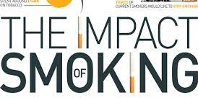
Maintenance Therapy
After four different modalities of treatment with Maintenance therapy - every 3 months for 7 years
Smokers consistently had deeper pockets than nonsmokers and less gain in attachment when evaluated each year for the 7-year period.

Slide 35
Supportive Periodontal Therapy and Need for Re-treatment
Reduced response to all modalities of periodontal treatment
Dental implant survival
Susceptibility to recurrence
Re-treatment

Slide 36
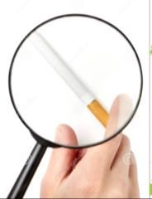
Assessment of tobacco smoke exposure
Assessment
Self –reported questionnaire
Biochemical Assessment
Plasma, Serum, saliva, Urine
Expired Air
Nicotine, Cotinine, Thiocyanate
Carbon monoxide

Slide 37
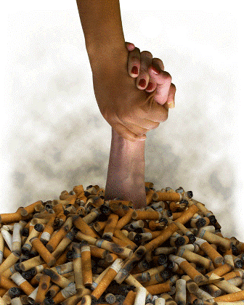
Role Of Dental Professionals In Tobacco Cessation
Negative impact on periodontium-additional motivation to quit
Models
5A’s
Brief intervention programme
Comprehensive Intervention programme

Slide 38
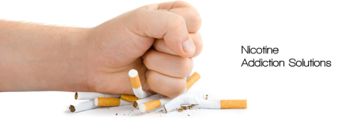
The basic steps are known as “5 A’s” -: (Glynn and Manley)
ASK – Ask your patients about tobacco use
ADVISE – Tobacco users to quit
ASSESS - Tobacco user’s willingness to quit
ASSISST – Tobacco user’s in developing a quit plan
ARRANGE – Tobacco user’s follow up contact

Slide 39
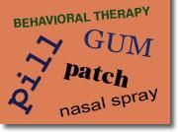
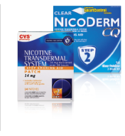
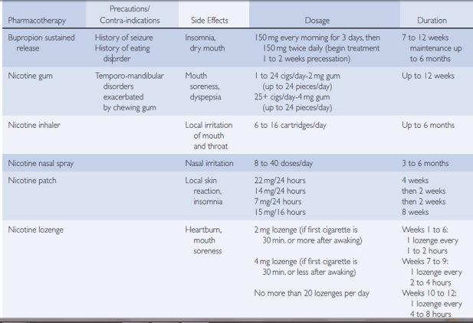
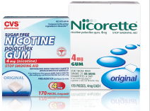
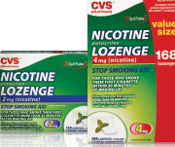
Clinical Practice Guidelines for tobacco cessation

Slide 40
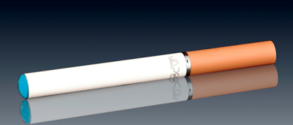
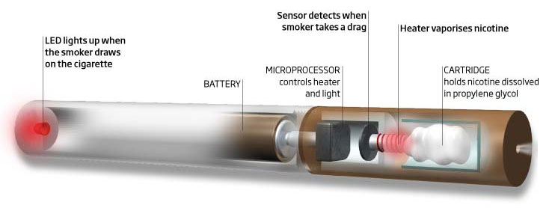

Slide 41
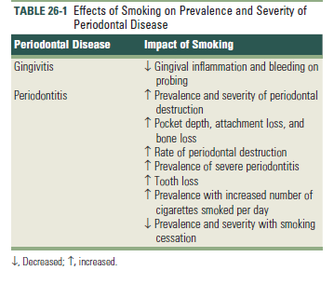

Slide 42
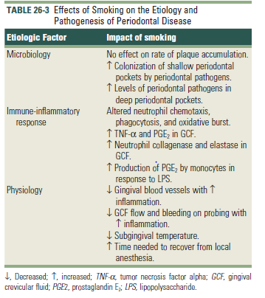

Slide 43
