Slide 1
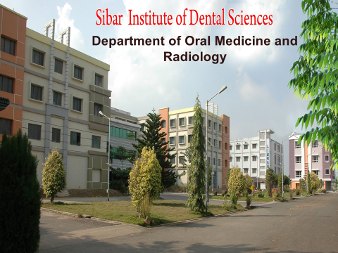

Slide 2
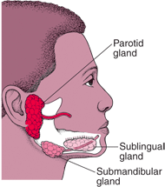
SALIVARY GLAND DISORDERS
Dr. M. Sanjana
Dept. of Oral Medicine and Radiology

Slide 3
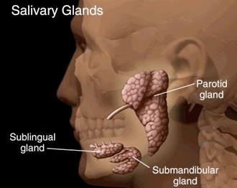
CLASSIFICATION:
1. Major and minor
2. Serous, mucous and mixed.
3. Exocrine and mesocrine.
Notes:
These are smaller salivary glands confined to the mucous coat Of the oral cavity .
These glands usually consists of small groups of secretary units opening via short ducts directly into the mouth.
The main function of these glands is not to produce saliva but to secrete minor amounts of saliva onto the mucosal surface to keep the mucosa moist.
These include .Labial glands, buccal glands, palatine glands, gloss palatine glands, Lingual glands, and Incisive and retromolar glands.

Slide 4
Diagnostic approaches to the patient with salivary gland disease
Evaluation of dry mouth
Symptoms of salivary gland dysfunction
Past & present medical history
Clinical examination
Saliva collection
Salivary gland imaging

Slide 5
Symptoms of salivary gland dysfunction
Decreased fluid in the oral cavity.
Dryness of oral mucosal surface including the throat.
Difficulty chewing, swallowing, speaking.
Inability to swallow dry foods.
Pain is a common complaint.
Mucosa may be sensitive to spicy & coarse food which limits the patients enjoyment of meals.

Slide 6
Past and present medical history
A critical first step is the thorough medical history.
It reveals medications or medical conditions that are known to be associated with salivary gland dysfunction.
Patient who has received radiotherapy for head & neck malignancy or individual who has recently started taking tricyclic anti depressants.
Patient should also be questioned concerning dryness at other body sites.

Slide 7
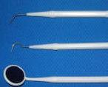
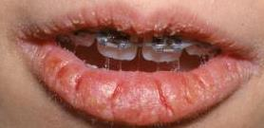
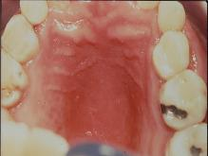
Clinical examination
Mucosal dryness.
Lips are often cracked, peeling & atrophic.
Buccal mucosa pale & corrugated appearance.
Tongue may be smooth & reddened with loss of papillation.
Patients report that their lips stick to the teeth & oral mucosa adhere to dry enamel.
Marked increase in erosion, caries,particularly decay on root surface & even cusptip.
Candidiasis most commonly of erythematous form.
Positive lip stick & tongue blade sign.

Slide 8
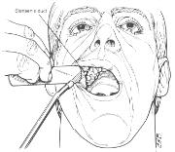
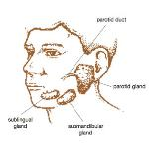
Enlargement of salivary gland is seen frequently – distinguish between inflammatory, infectious or neoplastic etiologies.
Major salivary gland should be palpated to detect mass or to determine if saliva can be expressed from ductal orifice by compressing the gland with bimanual palpation.
The consistency of saliva should be examined .
Saliva should be clear, watery & copious.
Viscous or scant secretions suggests - chronically reduced function.
Cloudy exudate ( mucoid accretions & clumped epithelial cells) – bacterial infections

Slide 9
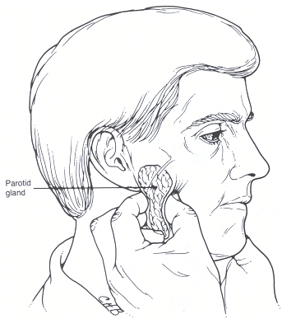
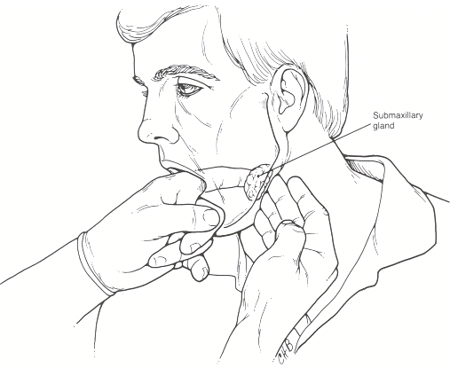

Slide 10
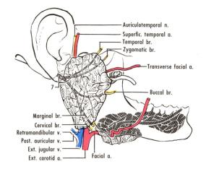
1) Developmental abnormalities
A) Aplasia
B) Atresia
C) Aberrancy
D) Accesory salivary ducts
E) Diverticuli
2) Obstructive - Sialolithiasis ( salivary stones)
3) Mucoceles
4) Ranula
5) Inflammatory & reactive lesions – Necrotizing sialometaplasia
Notes:
Aplasia or agenesis of salivary gland is rare although it may occur together with other developmental defects especially with malformations of first branchial arch.
Rampant dental caries in children who have no other symptoms has led to diagnosis of congenitally missing salivary glands.
Parotid gland agenesis reported in conjunction with several congenital cond like hemifacial microstomia, mandibulofacial dysostosis, cleft palate, LADDD syndrome, Trecher collin syndrome, anopthalmia.
Parotid gland hypoplasia associated with Melkerson- Rosenthal syndrome.
Congenital fistula formation within ductal system has been associated with branchial cleft abnormalities, accesory parotid ducts, diverticuli.
Aberrant salivary glands have been reported in variety of locations including middle ear cleft, external auditary canal, neck, posterior mandible, pituitary, cerebellopontine angle.
Submandibular salivary gland sits in lingual posterior surface of mandible between angle of the mandible & first molar below the level of inferior alveolar nerve – Staphne’s cyst.
The gland is usually asymptomatic & radiographically appears as well- circumscribed unilocular radioluscency.
Accessory salivary ducts are common & donot require any treatment.
The most common location is superior & anterior to stenson’s duct.
Diverticuli - diverticulum is a pouch or sac protruding from wall of the duct.
In major salivary ducts it often causes pooling of saliva & recurrent sialadenitis. Diagnosis is by sialography.
Patients are advised to regularly milk the involved gland.
Darier’s disease – salivary duct abnormalities.

Slide 11
6) Radiation induced pathology
7) Allergic sialadenitis
8) Viral diseases - Mumps ( Epidemic parotitis)
CMV infection
HIV infection
Hepatitis c virus infection
9) Bacterial sialadenitis
Metabolic conditions - Diabetes
Anorexia nervosa/ Bulimia
Chronic alcoholism
Medication induced salivary dysfunction
Functional - Xerostomia
Sialorrhea

Slide 12
13) Systemic conditions with salivary gland involvement
14) Immune conditions - a) Benign lymphoepithelial lesion
( Miculicz’s disease)
b) Sjogren’s syndrome
15) Granulomatous conditions - a) Tuberculosis
b) Sarcoidosis

Slide 13
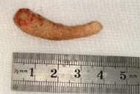
SIALOLITHIASIS
Sialolithiasis refers to the formation of stones in the salivary glands. Stones are most commonly found in the submandibular gland, where stones can obstruct Wharton's duct.
Etiology of sialolith formation is still unknown.
Central nidus of salivary organic material become calcified & form sialolith.
Researches have investigated that possibility of altered salivary hydrogen conc, abnormal serum calcium & phosphorus levels & diet as causes of sialolith formation.
Notes:
Several factors like inflammation, irregularities in ductal system, local irritants & anticholinergic medication may cause pooling of saliva in ducts which is thought to produce stone formation.

Slide 14
Structure of sialoliths is crystalline & composed primarily of hydroxyapatite. Chemical composition is calcium phosphate & carbon with trace amounts of Mg, Kcl & ammonium.
80-90% of sialolith’s - submandibular salivary gland.
5-15% in parotid gland
2-5% in sublingual or minor salivary gland.

Slide 15
Stone Composition
Organic; often predominate in the center
Glycoproteins
Mucopolysaccarides
Bacteria!
Cellular debris
Inorganic; often in the periphery
Calcium carbonates & calcium phosphates in the form of hydroxyapatite
Marchal F, Dulguerov P. Sialolithiasis Management.
Arch Oto, 129:951, 2003

Slide 16
Higher rate in submandibular gland bec
1) Tortuous course of whartons duct
2) High ca & phosphate levels
3) Dependent position of gland which leave them prone to stasis.
Gout can cause salivary calculi composed of uric acid.
Obstructive sialadenitis due to intra parotid deposits of gold salts in pts receiving sodium aurothiomalate (gold salt compound) trt of rheumatoid arthriris.

Slide 17
Reasons sialolithiasis may occur more often in the SMG
Saliva more alkaline
Higher concentration of calcium and phosphate in the saliva
Higher mucus content
Longer duct
Anti-gravity flow
Rice DH. Salivary Gland Disorders. Med Clin North Am. 1999; vol 83, 197.

Slide 18
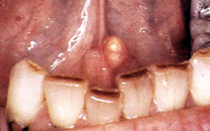
Clinical presentation – history of acute painful & intermittent swelling of affected major salivary gland.
Degree of symptoms dependent on extent of salivary duct obstruction & presence of secondary infection.
Involved gland is usually enlarged & tender.
Stasis of saliva may lead to infection, fibrosis & gland atrophy.
Fistula, sinus tract or ulceration may occur over stone in chronic causes.
Soft tissue surrounding the duct may show severe inflammatory reaction.
Palpation may confirm presence of stone.

Slide 19
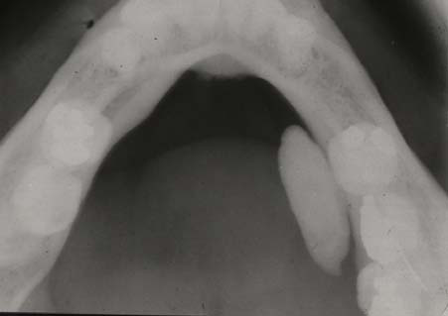
Complications like acute sialadenitis, ductal stricture & ductal dilatation.
Radiographic examination –
Occlusal view – submandibular salivary gland.
AP view of face or by placing intra oral film adjacent to duct.
Notes:
Plain films, computed tomography (CT), magnetic resonance imaging (MRI), and ultrasound are all commonly used in evaluation of salivary gland pathology.
Sialography can still provide useful information in particular circumstances.
Nuclear medicine provides very specific information regarding certain lesions as well.
Plain films can detect calculi but their effectiveness is limited by superimposition of bone on the areas of interest.
Computed tomography is good at detecting small calcifications or calculi and does a reasonable job evaluating mass lesions.

Slide 20
Ultrasound provides information about superficial lesions. This modality is limited by bone reflectivity so cannot assess some of the deeper structures such as the parapharyngeal extension of the parotid gland.
Radionuclide scanning: evaluate the effect of the obstruction on glandular dynamics & functions.
Phleboliths can be mistaken radiographically for sialoliths.

Slide 21
Treatment of Acute phase- primarily supportive.
Stones at or near the ductal orifice can often be removed transorally by milking the gland but deeper stones require surgery.
75% of normal function can return if stone can be removed from with in the duct & if it lies in the intraglandular portion of duct entire gland should be removed.
Lithotripsy is gaining popularity as it is noninvasive treatment for sialoliths.
Current protocols use ultrasonography to detect the stone & extracorporeal lithotripsy to fragment the stone.

Slide 22
Complications associated with this procedure include transient hearing changes, hematoma at site & pain.
Intracorporeal lithotripsy requires specialized equipment & so performed at only few centres.
Stone removal through sialoendoscopy
Laser surgery with CO2 laser.
Radiologically guided basket retrieval
In cases of severly impacted hilar calculi or intraparenchymal calculi that are associated with frequent recurrent episodes of sialadenitis, excision of the submand.gl. or superficial parotidectomy is warranted.

Slide 23
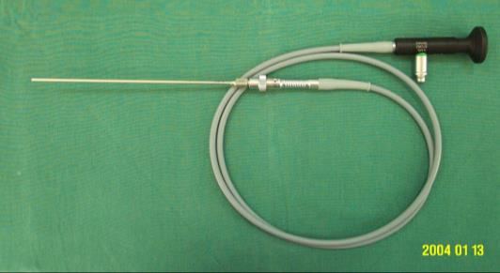
Diagnostic sialendoscopy
Interventional sialendoscopy

Slide 24
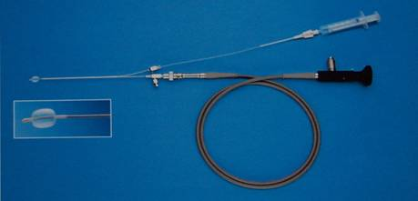
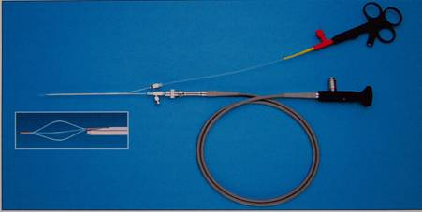
Ballon tipped catheter Graspingwire basket

Slide 25
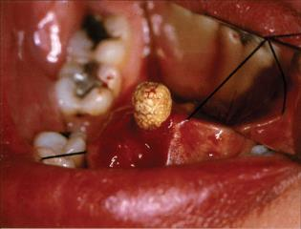
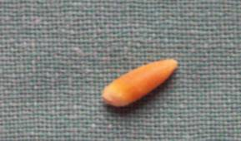
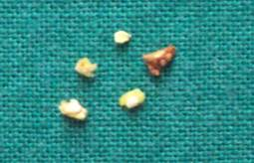
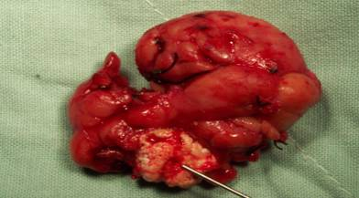

Slide 26
Causes of salivary gland hypofunction
1) pharmaceuticals
2) Radiation therapy – External beam radiation
Internal radionuclide therapy.
3) Oncologic chemotherapy.
4) Systemic diseases - Sjogrens syndrome
Granulomatous diseases( sarcoidosis,TB)
Graft versus host disease
Cystic fibrosis, Bells palsy, Diabetes
Amyloidosis, HIV, Thyroid disease
Late stage liver disease
5) Psychological factors
6) Malnutrition ( anorexia, bulimia, dehydration)
7) Idiopathic disorders

Slide 27
MUCOCELES
Mucocele is a clinical term that describes swelling caused by accumulation of saliva at the site of traumatized or obstructed minor salivary gland duct.
2 types - Extravasation type – caused by trauma
Retention type – due to obstruction of duct
Clinical presentation - Extravasation mucocele occurs commonly on lower lip. Buccal mucosa, tongue, floor of the mouth & retromolar region.
History of traumatic event
Discrete painless smooth surfaced swelling range from few mm to cm in diameter.

Slide 28
Mucocele

Slide 29
Superficial lesions – blue hue
Development of bluish lesions after trauma are highly suggestive of mucocele other lesions including salivary gland neoplasms, soft tissue neoplasms, vascular malformations & vesiculobullous diseases should be considered.
Treatment – surgical excision
Removal of associated salivary gland to prevent recurrence.
Intralesional injection of corticosteroids has been succesfully used to treat mucocele.

Slide 30
Ranula
Large mucocele located on floor of the mouth.
It may be either mucous extravasation phenomenon or retention cyst & are most commonly associated with sublingual salivary gland duct.
The term ranula is used bec it often resembles swollen abdomen of frog.
Painless , slow growing soft & movable mass located in floor of mouth.
Deep lesion herniates through mylohyoid muscle & extend along fascial planes is referred to as plunging ranula.
Radiography should be performed to rule out sialolith.

Slide 31
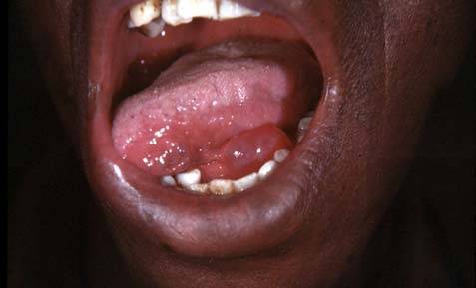
Ranula

Slide 33
Treatment – ususlly treated surgically.
Marsupilization procedure that unroofs the lesion is initial treatment of choice especially for smaller lesions.
If recurrence occur excision of the lesion including gland is recommended.
Intralesional injection of corticosteroid have been used succesfully.

Slide 34
Necrotizing sialometaplasia
It is benign self-limiting reactive inflammatory disorder of salivary tissue.
Initiated by local ischemic event.
Clinically mimics malignancy & failure to recognize results in unnecessary radical surgery.
Clinical presentation - it has rapid onset.
Occurs predominantly on palate & can occur on lips, retromolar pad region.
Lesion present as erythematous nodule & once mucosa breaks down deep ulceration with yellowish base forms associated with moderate pain.

Slide 35
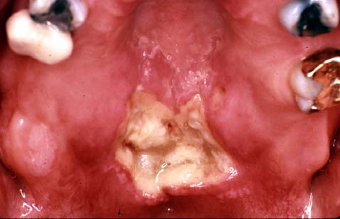
Necrotizing sialometaplasia

Slide 36
Lesion often occurs following oral surgical procedures, restorative dentistry or administration of LA & in pts suffering from bulimia.
Treatment -
It is imp to understand the etiology & biologic behavior of this lesion.
Adequate biopsy specimen is essential since H/P features are unique – necrosis of salivary gland, pseudoepitheliomatous hyperplasia of mucosal epithelium & squamous metaplasia of salivary ducts without malignant cells. Lobular architecture is preserved .

Slide 37
It is self limiting, lasts approx 6weeks & heals by secondary intention.
Debridement & saline rinses may help in healing process.
Recurrence & impairement are not usually encountered.

Slide 38
Allergic sialadenitis
Enlargement of salivary glands has been associated with exposure to various pharmaceutical agents & allergens.
Acute salivary gland enlargement, often accompanied by itching over the gland.
It can be due to allergic reactions or some represent secondary infections resulting from medications that reduce salivary flow.
Phenobarbital, phenothiazine, ethambutol, sulfisoxazole, iodine compounds, isoproterenol & heavy metals.
The possibility of infection or autoimmune diseases should be considered.

Slide 39
Allergic sialadenitis is selflimiting.
Avoiding the allergen, maintaining hydration & monitoring for secondary infection are recommended.
Systemic diseases –Diffuse bilateral salivary gland enlargement: often associated with diabetes mellitus, cystic fibrosis, thyroid disease, malnutrition, obesity, autoimmune disorders (Sjögren) –Granulomatous disease: tuberculosis, atypical Mycobacterium, sarcoidosis, cat-scratch disease

Slide 40
Viral diseases
Associated with acute non suppurative salivary gland enlargement.
Paramyxo virus, CMV, HIV, Epstien- Barr virus, parainfluenza virus & chorio meningitis virus infection have been linked to acute non suppurative salivary gland enlargement

Slide 41
Mumps
It is caused by RNA Paramyxo virus & is caused by direct contact with salivary droplets.
Mumps have recommended since 1970.
CDC currently recommends an initial vaccination at 12-18 months of age & second dose at 4-6 years of age.
Clinical presentation :
Occurs in children 4-6 yrs of age.
Incubation period 2-3 weeks followed by salivary gland inflammation & enlargement, preauricular pain, fever, malaise,head-ache, myalgia.
Mostly involves parotid & 10% of cases involve submandibular gland alone.

Slide 42
Symptoms lasts for approx 7days.
Diagnosis is made by demonstration of antibodies to the mumps S & V antigens and to haemagglutination antigen & serum amylase levels elevated.
Complications include meningitis,encephalitis, deafness, myocarditis, thyroiditis, pancreatitis, oophoritis also occurs.
Males experience epididymitis & orchitis resulting in testicular atrophy & infertility.

Slide 43
CMV infection
CMV is a beta herpes virus.
It can be cultured from blood, saliva,feces, respiratory secretions, urine & otherbody fluids.
It is non epstein barr virus induced infectious mononucleosis.
Horizontal transmission occcurs through blood transfusions, allograft transport, sexual contact.
Infections in new born & young children can be fatal.
Clinical presentation :
It often occurs in young adult population & present as an acute febrile illness that include salivary gland enlargement.

Slide 44
Trans placental transmission of CMV can result in prematurity, low birth weight & various congenital malformations.
Infected new borns suffer from hepatitis, myocarditis, hematological abnormalities, pneumonitis, nervous system damage.
CMV is considered clinical marker for AIDS.
CMV infection is strongly associated with increased incidence of fungal & bacterial infections

Slide 45
Diagnosis is based on elevated titre of antibody to CMV.
current method of diagnosis includes culture, antigen detection, CMV DNA detection.
Careful diagnosis of primary infection is required in the pregnant woman based on the most sensitive serologic assays (immunoglobulin M [IgM] and IgG avidity assays).
However, the final step for definite diagnosis of congenital HCMV infection is detection of virus in the blood or urine in the first 1 to 2 weeks of life.

Slide 46
Treatment :
To date, treatment of congenital infection with antiviral drugs is only palliative both prior to and after birth, whereas the only efficacious preventive measure seems to be the development of a safe and immunogenic vaccine, including recombinant, subunit, DNA, and peptide-based vaccines now under investigation.
Immunocompromised pts with IV gancyclovir, foscarnet or cidofovir.

Slide 47
HIV infection
Neoplastic & non-neoplastic salivary gland lesions occurs with increased frequency in HIV patients.
Clinicians should consider AIDS related tumors Kaposi sarcoma & lymphoma. sjogrens syndrome like phenomenon is also seen in HIV patients.
HIV salivary gland disease describes xerostomia & benign unilateral & bilateral salivary gland enlargement in HIV positive patients.
HIV salivary gland disease is associated with CD8 cell lymphocytosis of salivary gland & with diffuse lymphocytosis syndrome.

Slide 48
Clinical manifestation :
Salivary gland swelling which may or may not be associated with xerostomia. Parotid gland involvement in 98% & 60% of pts have bilateral enlargement.
It resembles sjogrens syndrome & they can be distinguished by evaluating salivary flow rates, opthalmologic evaluation (assesment of lacrimal function & tear film), autoimmune serologies, minor salivary gland biopsy.

Slide 49
Involved major salivary gland may can be imaged with ultrasonography, CT, MRI. multiple cystic masses are characteristic of HIV associated benign lymphoepithelial hypertrophy.
Treatment : is primarily symptomatic.
Benign parotid gland enlargement - surgery.
Antiretroviral drugs alone have shown minimal effects.
Two other methods include aspiration of cysts & tetracycline sclerosis.

Slide 50
BACTERIAL SIALADENITIS
Most commonly in pts with reduced salivary gland function.
It was formerly refered to as ‘surgical parotitis”.
Today majority of bacterial infections occur in pts with disease or medication induced salivary gland hypofunction.
Reduction in salivary flow - dimnished mechanical flushing – bacterial colonization in oral cavity – invade salivary duct – acute bacterial infection.
Geriatric patients are more susceptible to bacterial sialadenitis due to poor oral hygiene & medication induced xerostomia.

Slide 51
Sialadenitis occurs most frequently in parotid gland than submandibular gland.
submandibular gland may be more protected by high level of mucin in saliva which has potent antimicrobial activity & tongue movt tend to clear floor of mouth and protect wharton duct.
Clinical presentation :
Sudden onset of unilateral or bilateral (20%) salivary gland enlargement.
Involved gland will be painful, indurated & tender to palpation.

Slide 52
Purulent discharge from duct orifice & this sample of exudate should be cultured for aerobes & anerobes.
Most commonly cultured organisms include staph aureus, strep viridans, strep pneumoniae, Escherichia coli, Haemophilus influenzae.
Due to dense capsule covering the gland it is difficult to determine by physical examination alone whether an abscess has formed.
Ultrasonography or CT is recommended for visualizing possible cystic areas.

Slide 53
Ascending Salivary Gland Infection

Slide 54
Treatment :
Empiric IV administration of penicillinase – resistant antistaphylococcal antibiotic is indicated.
To milk the involved gland several times through out the day.
Increased hydration & improved oral hygiene .
If does not resolve incision & drainage should be considered.
Availability of broad- spectrum antibiotics has eliminated mortality in noncritically ill pts.

Slide 55
METABOLIC CONDITIONS
DIABETES :
It is common endocrine disorder in geriatric patients.
Long term complications such as renal hypertension, neuropathies & ophthalmic diseases may occur.
Patients with uncontrolled diabetes had lower salivary flow rate & compositional changes than controlled diabetic patients.
The etiology of diabetic SG dysfunction is not clear, but it has been suggested due to autonomic nervous dysfunction.

Slide 56
ANOREXIA NERVOSA / BULIMIA :
The enlargement appears to be related to nutritional deficiencies & to the habit of induced vomiting.
Salivary gland enlargement usually resolves when patients return to normal weight & discontinue unhealthy eating habits.
Total & salivary specific amylase levels are increased with bulimia.
To facilitate early diagnosis & treatment dentist should be aware of common oral findings –

Slide 57
Enamel erosion, xerostomia, salivary gland enlargement, mucosal erythema & cheilitis.
CHRONIC ALCOHOLISM :
It is associated with salivary gland dysfunction & bilateral salivary gland enlargement usually parotid.
Exact etiology is unclear but decreased salivary flow is believed to be due to dehydration & poor nutrition.
Histologic examination demonstrate fatty tissue changes.

Slide 58
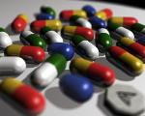
MEDICATION INDUCED SALIVARY DYSFUNCTION
There are over 400 medications that are listed as having dry mouth as an adverse effect.
Notes:
The drugs most commonly implicated include: alpha receptor antagonists for treatment of urinary retention; amphetamines; anticholinergics; antidepressants (serotonin agonists, or noradrenaline and/or serotonin re-uptake blockers); antihistamines; antihypertensive agents; antimigraine agents; antipsychotics such as phenothiazines; appetite suppressants; atropinics; benzodiazepines,hypnotics, opioids, and drugs of abuse; bronchodilators; cytokines; cytotoxics; decongestants and 'cold cures'; diuretics; histamine H2 antagonists and proton pump inhibitors; muscarinic receptor antagonists for the treatment of overactive bladder; opiates; protease inhibitors; radioiodine; retinoids; and skeletal muscle relaxants (Scully, 2003).

Slide 59
Several different mechanisms account for drug-related dry mouth, but an anticholinergic action underlies many: The M3- muscarinic receptors (M3R) mediate parasympathetic cholinergic neurotransmission to salivary (and lacrimal) glands, but other receptors may also be involved (Kawaguchi and Yamagishi, 1995).
DRUG-RELATED SALIVARY GLAND PAIN
Antihypertensives, anti-thyroid agents, chlorhexidine, cytotoxics, ganglion-blocking agents, iodides, phenothiazines, and sulphonamides may cause salivary gland pain, as may drugs causing dry mouth (Glass, 1989).

Slide 60
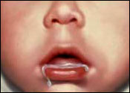
HYPERSALIVATION:
This is relatively uncommon in adults and is also known as “SIALORRHEA”
This may be idiopathic or caused by mucosal irritation.
Clinically drooling of saliva occurs as a result of under lying neurological disorder.
Problem lies in decrease swallowing efficiency and frequency and is rarely related to a genuine salivary hyper function.
Drooling causes severe problem to patients, like it can cause maceration of the skin at the angle of the mouth and chin followed by colonization of opportunistic infections.
Drooling may also be seen in mentally handicapped patients and also as a side effect to neuroleptic drugs.

Slide 61
Examples : Cerebral palsy
Myotropic lateral sclerosis,
Parkinson’s disease.
Other causes for sialorrhea are , Acute inflammation of oral mucosa
Fractures of jaw bones
During eruption of teeth in infants
Schizophrenia
Epilepsy
Acrodynia (mercury poisoning)
Rabies
Familial dystonias.

Slide 62
XEROSTOMIA
Xerostomia is a subjective feeling of dry mouth resulting due to
Hyposalivation
Change in saliva composition.
salivary gland problem in geriatric patients due to age changes
Xerostomia is sometimes colloquially called PASTIES or COTTONMOUTH.

Slide 63
ETIOLOGY
I) Iatrogenic causes :includes,
A) Drugs & Medicines.
B) Irradiation.
C) Chemotherapy
D) Graft v/s host reaction
II) Auto immune diseases : such as ,
A) Rheumatoid arthritis.
B) Sjogrens syndrome.
C) Sarcoidosis.
III) Neurological disorders :
A) Mental depression
B) Bell’s palsy
IV) Hormonal disorders: like Diabetes mellitus and hypo / hyper thyroidism.
V) Infections: like HIV, Hepatitis C infection, Epidemic parotitis etc.
VI) Hereditary disorders: like Cystic fibrosis and Ectodermal dysplasia.

Slide 64
VII) Metabolic disturbances : such as occurring in Malnutrition, Bulimia, Anorex Nervosa, Dehydration states, Vitamins deficiencies.
VIII) Local salivary diseases: includes Sialolithiasis
Sialadinitis
Carcinoma.
IX) Other conditions involving
Parotidectomy procedures
Impaired masticatory performance
Menopause and
Aplasia of gland

Slide 65
SIGNS AND SYMPTOMS:
Patient usually experiences the following signs and symptoms they are as follows.
Oral mucosal dryness and soreness.
Burning oral sensation.
Dysphonia ( difficulty in speech )
Dysphagia ( difficulty in swallowing )
Difficulty in chewing the food.
Dysgeusia or Hypogeusia ( impairment of taste )
Difficulty in wearing artificial dentures
Acid reflexes, Heart burn and Nausea.
Halitosis ( bad breath )
Sensation of thirst.
Dry, glazed and red mucosa.
Lobulating and fissuring of dorsal part of tongue.
Atrophy of filiform papilla.
Dry, cracked lips.

Slide 66
Non oral symptoms such as Dryness of skin, throat, nose and eyes.
Constipation
Weight loss
Depression
ORAL COMPLICATIONS ARISING DUE TO XEROSTOMIA:
Dental caries which involves smooth surfaces & root surface of teeth which is difficult to control and are parallel to rampant form of caries.
Candidial super infections which causes Burning, taste changes, intolerance to spices, mucosal errythema and angular stomatitis.
Ascending sialdenitis present with pain and swelling of major salivary gland and sometimes present with purulent discharge from the duct.

Slide 67
Diagnosis is also confirmed by certain diagnostic studies such as,
SIALOMETRY: Deals with estimation of salivary flow rates by draining method.
SIALOGRAPHY : Non specific test, in which a radio opaque dye is injected into the Duct (such as iodine based dye). And a radiograph is taken which Shows if the duct is constricted, dilated or there is any calculus Formation.
SALIVARY SCINTISCANNING:
Non invasive procedure, examines all major salivary glands Technetium-99 is used which emits gamma radiation, and is associated with small amount of radiation hazard and is expensive procedure, not always used

Slide 68
MANAGEMENT OF XEROSTOMIA
PALLIATIVE TREATMENT:
Any under lying cause of xerostomia should if possible, be rectified such as diabetes, drugs etc.
Avoiding factors that may increase dryness such as,
Hot dry environment
Dry food such as biscuits
Drugs like tricyclic anti depressants
Alcohol including mouth washes with
alcohol
Smoking etc.
Use of humidifiers at nights, application of lip balms, olive oil, and vit E to keep the mucosa moist.

Slide 69
SALIVA SUBSTITUTES AND ORAL LUBRICANTS
Over the counter formulations like solutions, sprays or gels are useful.
Formulations containing carboxymethyl or hydroxymethyl cellulose, electrolytes and flavoring agents are used.
Salivary replacements or artificial saliva substitutes available as,
1. Gladosane & luborant ----sodium carboxyl methylcellose base available as spray.
2. Oral balance & wet mouth ----- lactoperoxidase, glucose oxidase and xylitol.
3. Saliva orthana ------- mucin spray containing fluoride.
Notes:
These substitutes provide relief for only limited time. And are most useful when used immediately before bed time or speaking.

Slide 70
Application of petroleum derived lubricants like Vaseline should be avoided.
Saliva substitutes may help symptomatically such as water sipping frequently Application of ice chips
Use of synthetic substitute
Home made preparation of saliva substitute consists of using a teaspoon of glycerin in 8 ounce of water.
Use of salivary flow stimulants like chewing a sugarless chewing gum, biotin dry mouth gum, xylifresh and sugar less candies, Salix lozenges and simply application of citric acid on the lateral borders of tongue

Slide 71
IMMUNE CONDITIONS
Benign lymphoepithelial lesion( Miculicz’s disease)
The etiology is unknown.
Auto immune, viral, or genetic factors are the triggers.
This condition affects middle aged women.
Pts with unilateral or bilateral salivary gland swelling due to benign lymphoid infiltration.
Reduced salivary flow – frequent salivary gland infections.
DD includes sjogrens syndrome, lymphoma, sarcoidosis & other diseases asssociated with salivary gland enlargement.

Slide 72
Diagnosis is based on findings of salivary gland biopsy, absence of abnormalities in peripheral blood counts & auto immune serologies in sjogrens syndrome.
Treatment is palliative.
Possibility of neoplastic transformation is a concern.
Detection of monoclonal lymphocytic infiltrate is thought to be suggestive of low grade lymphoma.
Treatment is controversial; some clinicians advocate irradiation therapy where as others recommend monitoring when the disease is limited to salivary glands.

Slide 73
Sjogrens syndrome
It is chronic systemic autoimmune disorder that principally involves salivary & lacrimal glands resulting in xerostomia & xerophalmia, lymphocytic infiltration & destruction of exocrine glands.
Effect on the eye often called keratoconjunctivitis sicca.
Primary sjogrens syndrome (sicca syndrome)
Secondary sjogrens syndrome - sicca syndrome in association with autoimmune diseases.
The cause is unknown but there is evidence of genetic influence.
Relatives of affected patients have increased frequency of other autoimmune diseases.

Slide 74
Sjogren’s Syndrome - Diffuse Submandibular Salivary Gland Enlargement

Slide 75
Dryness results in the clinical appearance of keratoconjunctivitis sicca (KCS) characteristic of Sjogren’s syndrome

Slide 76
Sjögren’s Syndrome - Associations
Rheumatoid arthritis
Systemic Lupus
Scleroderma
Mixed Connective Tissue Disease
Primary Biliary Cirrhosis
Myositis
Vasculitis
Thyroiditis
Chronic Active Hepatitis
Mixed Cryoglobulinaemia

Slide 77
Certain histocompatibility antigens HLAs
HLA-DRw52 is associated with both forms of disease.
HLA-B8 & HLA-DR3 are seen with increased frequency in primary form of disease.
Clinical manifestations :
Patients complains of dry mouth & need to sip liquids frequently.
Oral dryness causes difficulty with chewing, swallowing & speaking without additional fluids.
Pts often have dry cracked lips & angular cheilitis.
Intra orally mucosa appears pale & dry with minimal salivary pooling.

Slide 78
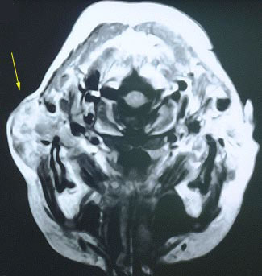
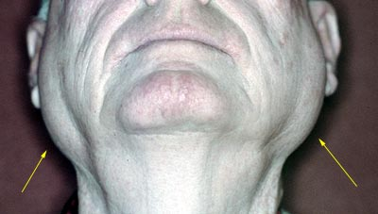
SJOGRENS SYNDROME

Slide 79
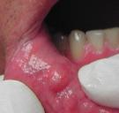
Saliva tends to be thick & ropy & mucocutaneous candidiasis is common in these patients.
Pts experience increased dental caries ,erosion of enamel structure, chronic salivary gland enlargement.
Diagnosis :
The strict criteria include a) objective measurement of decreased salivary & lacrimal gland function.
B) Positive autoimmune serologies.
C) Minor salivary gland biopsy specimen with mononuclear cell infiltration in periductal pattern [ focal score >1].

Slide 80
ESR is high & serum IgG are elevated.
A positive rheumatoid factor RF is found in approx 60% of cases.
Antinuclear antibodies are also present in 75%-85% of patients.
Anti SS-A antibodies can be detected in approx of 40% of patients where as Anti SS-B in about 25%.
Salivary duct autoantibodies also can be demonstrated in secondary sjogrens syndrome.

Slide 81
Analyses demonstrated that lactoferrin and ß2-microglobulin showed the greatest increases in SS patients.
interferon (IFN)-gamma and tumour necrosis factor (TNF)-alpha, which are increased in SS salivary glands

Slide 82
Severe Xerostomia with dry tongue

Slide 83
Sjogren’s Syndrome- Cervical Dental Caries

Slide 84
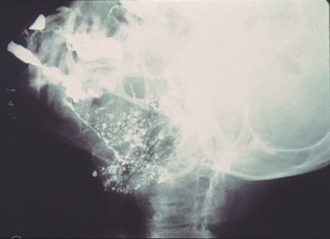
SIALOGRAM X-RAY

Slide 86
Sjogren’s Syndrome - Investigations MRI

Slide 87
Hyperlipidemia is serologically characterized by elevated levels of plasma triglyceride, total cholesterol, or both.
Some patients with hyperlipidemia have symptoms of sicca syndrome (xerostomia and xerophthalmia) that are reminiscent of Sjögren's syndrome. On occasion, these patients also have parotid gland swelling.
Imaging features of the parotid gland, histopathologic features of labial glands of the mouth, and serologic examinations for immunologic abnormalities all indicated a distinct entity of sicca syndrome in patients with hyperlipidemia compared with patients with Sjögren's syndrome.

Slide 88
Sjogrens syndrome

Slide 89
Sialography fails to reveal characteristic features of Sjögren's syndrome in patients with hyperlipidemia and sicca syndrome

Slide 90
Schirmer’s test
Schirmer's test determines whether the eye produces enough tears to keep it moist.
1. Normal which is =>15 mm wetting of the paper after 5 minutes.
2. Mild which is 14-9 mm wetting of the paper after 5 minutes.
3. Moderate which is 8-4 mm wetting of the paper after 5 minutes.
4. Severe which is <4 mm wetting of the paper after 5 minutes.

Slide 91
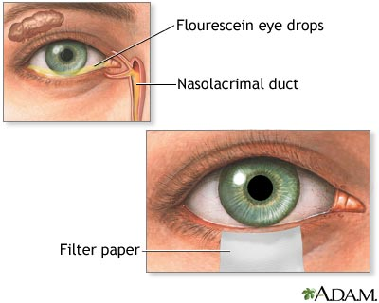
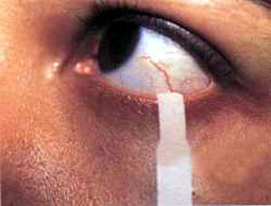

Slide 92
Rose bengal test
An iodine derivative of fluorescein having vital staining properties but unlike fluorescein it is a true histological stain, which binds strongly and selectively to cellular components.
The colour of this stain is red.
It has the disadvantage of causing some pain.
It stains dead or degenerated epithelial cells but not normal cells and is used to help in the diagnosis of corneal abrasion, keratitis, keratoconjunctivitis sicca etc.
Lissamine Green Strips, Zone Quick Tear Test, Bio Glo Strips, Soft Glo Strips .

Slide 93
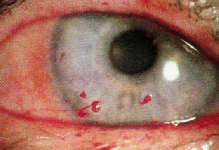
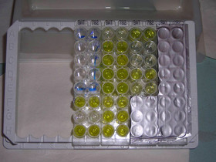
Photograph showing corneal filaments stained with Rose Bengal stain

Slide 94
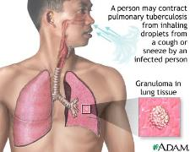
Granulomatous conditions
TUBERCULOSIS :
It is chronic bacterial infections, caused by mycobacterium tuberculosis this leads to formation of granulomas in the infected tissues.
The lungs are most commonly involved but other tissues including salivary glands may be involved.
TB patients may experience xerostomia, salivary gland swelling, with granuloma or cyst formation with in affected gland.

Slide 95
Diagnosis is based on identification of mycobacterium.
Treatment of salivary gland involvement – standard multi drug anti-TB chemotherapy.
Patients who have not respond to chemotherapy regimens have required surgical intervention to address persistent salivary gland pathology.

Slide 96
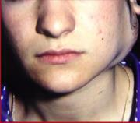
Sarcoidosis
It is chronic condition in which T- lymphocytes, mononuclear phagocytes & granulomas cause destruction of involved tissue.
Occurs mostly in 3rd to 4th decade of life & women are affected more often than men.
Heerfordt’s syndrome is a form of sarcoid that can occur in the presence or absence of systemic sarcoidosis.
Notes:
Syndrome is triad of inflammation of uveal tract of the eye, parotid swelling, and facial palsy.
Patients usually present with bilateral, painless & firm salivary gland enlargement.

Slide 97
Diagnosis is established when clinical & radiographic lesions are supported by histologic evidence of non caseating epitheloid granulomas in more than one organ system .
Serum laboratory abnormalities including hyperglobulinemia, elevated level of angiotensin-converting enzyme, evidence of depressed cellular immunity & occasionally hypercalcemia & hypercalciuria.
The treatment of salivary component of sarcoidosis is primarily palliative. Depending on extent of disease corticosteroids may be administered.
Chloroquine has also been used, alone or in combination with corticosteroids.
Immunosuppresive & immunomodulatory medications can be administered to patients who failed to respond to steroids.

Slide 98
References
Text book of oral medicine – Burkets.
Text book of Oral pathology – Navellie.
Text book of Oral pathology – Shafers.
Text book of oral radiology – white & pharoah.
Text book of oral radiology – Eric whites.
Rice DH. Salivary Gland Disorders. Med Clin North Am. 1999; vol 83, 197.
Marchal F, Dulguerov P. Sialolithiasis Management.
Arch Oto, 129:951, 2003.
Google search.

Slide 99
THANK YOU

