Slide 1
Multivariate Analysis
Dr Srinivas Pachava
MDS, MBA (Hospital Administration), PGDCJ&FS (Post Graduate Diploma in Criminal Justice and Forensic Science)
MSc Psychology
Professor and Head
Department of Public Health Dentistry
SIBAR Institute of Dental Sciences, Takkellapadu, Guntur, A.P.

Slide 2
Presentation Over view
Terminologies/Introduction
Techniques /types
illustrations
Key points
References

Slide 3
Terminologies
Data (discrete observations)
Information (summarizing and adjusting)
Intelligence (integration and processing)

Slide 4
Data
Quantitative(number)
Qualitative (characteristic)

Slide 5
Variable
A variable is any characteristics, number, or quantity that can be measured or counted.
A variable may also be called a data item.
Age , gender,DMFT, business income and expenses, country of birth, capital expenditure, class grades, pocket depth, oral cancer, dental flurosis, eye color and vehicle type are examples of variables.

Slide 6
Types of variable
Variable
Dependent Y
influenced
Independent X
impact, predicts out come
Notes:
periodontal
disease, caries, pulp disease, impacted teeth,
accidents, . . . );
orthodontic facial type (brachyfacial, dolichofacial,
mesofacial);
specialty area in dentistry (endodontics, orthodontics,
pediatric dentistry, periodontics,
implants, prosthodontics, . . . );
type of treatment;
level of oral hygiene (poor, fair, good); and
cause of herpes zoster.

Slide 7
Types of variable
Variable
Categorical
Nominal
Eg: smoker/nonsmoker
Male/female
Type of filling material
Yes or no response of a survey question
Oral cancer- present/absent
Type of radiograph
Cause of tooth extraction
Ordinal
Pain rating-mild/moderate/severe
Stages of cancer
Socioeconomic status
Dental fluorosis
Tooth mobility
Numerical
Discrete
Number of visits to dentists
Number of decayed, filled, missed teeth in school children
Number of teeth
Number of ankolysed teeth
Continuous
Treatment time
Calcium: phosphorous ratio in teeth
Pocket depth in mm
Arch length in mm
Saliva Ph, Microrganisms count
Notes:
periodontal
disease, caries, pulp disease, impacted teeth,
accidents, . . . );
orthodontic facial type (brachyfacial, dolichofacial,
mesofacial);
specialty area in dentistry (endodontics, orthodontics,
pediatric dentistry, periodontics,
implants, prosthodontics, . . . );
type of treatment;
level of oral hygiene (poor, fair, good); and
cause of herpes zoster.

Slide 8
Terminologies
Linear: arranged in or extending along a straight or nearly straight line
Logistic: non linear
Regression: lessening, measure of relation
Coefficient: a numerical or constant quantity placed before and multiplying the variable in an algebraic expression (e.g. 4 in 4x ^{y})

Slide 9
Data
Levels of Data Analysis
Quantitative(number)
Qualitative (characteristic)
Quantitative
Number of Variable
level of data analysis
Univariate
Bivariate
Multivariate

Slide 10
Univariate analysis:
→ Basic form
→ One variable
→ No cause - effect
Describes data and Patterns of data
Ex: number of boys / girls
Analysis by : Measures of central tendency, measures of variance
Represented by : Pie charts, bar charts , histograms, pictograms etc.

Slide 11
Bivariate Analysis :
Two variables
Measures correlation
Ex. Ratio of students who scores above 85 corresponding to their genders
Analysis by : Correlation coefficients, Regression analysis

Slide 12
Correlation: r
→Tells us both the strength and the direction of this relationship.
Is best used for variables that express a linear relationship with one another.
When we assume a correlation between two variables, we are essentially deducing that a change in one variable impacts a change in another variable.
Measure linear association →Pearson correlation → r +1 through 0 to -1

Slide 14
Multivariate Analysis
Encompasses all statistical techniques that used to analyze the data
Different variables or factors → Impact certain situations or outcomes
The extent of each variable correlation with outcome and with each other
Impact | Outcome
Academic dishonesty | Marks obtained
Money spent on advertising | Sales
Hours of exercise | Cholesterol
Time spent on social media | Self-esteem
Method of extraction | Post operative discomfort
Orthodontic force | Quality of treatment
Alcohol | Oral cancer
Temperature | Ice cream sales

Slide 15
Steps in Conducting a Multivariate Analysis
Define the research problem
Determine data structure
Determine the variable types
Determine which multivariate method(s) is/are appropriate for dataset
Estimate the assumptions of multivariate model
Interpret the results
Notes:
Step 1. Define your goals!
Know what you would like to know.
Step 2. Determine your data structure:-
Which variables are independent and which are dependent?
What are the sources of variation?
Step 3. Determine the variable types:-
Are the variables metric or non-metric or of both types?
Can the non-metric variables be somehow converted to metric?
Can we treat the ordinal variables as metric?
In doing so, what do we gain or lose?
Step 4. Determine which multivariate method(s) is/are appropriate for
your data set:-
See Figure 1 for guidance on this point.
Step 5. Determine if there are model/assumption problems with the
chosen method:-
Each method is based on some underlying model/assumptions.
Check wether your data satisfy the underlying model and its
assumptions.
Step 6. If possible/feasible, break the problem into small sequential sub-
problems:-
Do not get stuck thinking that everything must be accomplished
in one go. The smaller sub-problems could be sequentially
handled, perhaps the output from one sub-problem serving as
input to the next sub-problem

Slide 16
Analysis of Multivariate data sets helps in
→ Data reduction without loss of information
Form groups of similar objects
→ Investigating relationships among variables
→ Prediction
→ Hypothesis construction and tests

Slide 17
Techniques
Dependence techniques- cause and effect
Interdependence techniques –structure underlying pattern of data set, seek to give meaning to a set of variables or to group them together in meaningful ways
Contd…..

Slide 18
Types
Regression
Multiple Linear regression
Multiple logistic regression
Multivariate analysis of variance
Factor analysis
Cluster analysis

Slide 19
Multiple linear regression
Relationship between one dependent variable and two or more independent variable
Helps to understand which factors are likely to influence certain outcome allowing to estimate future outcome
Proportion of variance that each independent variable accounts for
Notes:
India recently approved the use of Tocilizumab for certain COVID-19 cases, Tocilizumab (Actemra) is an immunosuppressive drug mainly used for rheumatoid arthritis treatments (RA) and systemic juvenile idiopathic arthritis.
cost about 40,000 rupees for a full treatment
There is no real evidence, based on randomized controlled trials, that Roche’s Actemra (Tocilizumab) helps reduce COVID-19 death rates

Slide 20
The general equation for a straight line may be written as
Yi =β0 + β1X1i + β2X2i
Y is a value on the vertical axis (dependent variable),
X is a value on the horizontal axis (independent variable),
β0- intercept
βshows the amount, by which Y changes for each unit change in X, i.e. Slope of the straight line
Notes:
The parameter β0 is the Y -intercept
of the regression plane. The parameters β0, β1,
and β2 are called partial regression coefficients.
The parameter β1 indicates the change in the mean
response per unit increase in X1 when X2 is held
constant, and the parameterβ2 indicates the change
in the mean response per unit increase in X2 when
X1 is held constant.

Slide 21
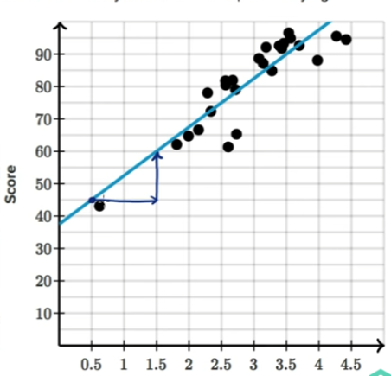
Linear regression showing marks scores and study hours
STUDY HOURS

Slide 22
Linear regression
Older age, not flossing, and presence of diabetic retinopathy were significant predictors of tooth loss.
t distribution: the difference between two means divided by standard deviation, measures the size of the difference relative to the variation in your sample data

Slide 23
Unstandardized coefficients and Standardized coeffcients
Definition | Unstandardized coefficients are obtained after running a regression model on variables measured in their original scales | Standardized coefficients are obtained after running a regression model on standardized variables (i.e. rescaled variables that have a mean of 0 and a standard deviation of 1)
Interpretation | A change of 1 unit in the independent variable X is associated with a change of β units in the outcome Y | A change of 1 standard deviation in X is associated with a change of β standard deviations in Y

Slide 24
Logistic regression
is a classification algorithm. It is used to predict a binary outcome based on a set of independent variables.
The probability of a binary event occurring.
event occurs (1) or it doesn’t (0)
is the dependent variable dichotomous?
Are the independent variables either interval, ratio, or ordinal?

Slide 25
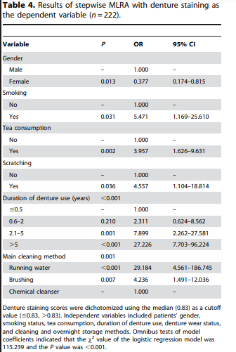
Logistic regression
Potential risk factors for denture staining were female gender (OR = 0.377, P = 0.013), smoking (OR = 5.471, P = 0.031), tea consumption (OR = 3.957, P = 0.002), denture scratching (OR = 4.557, P = 0.036), duration of denture use (reference, #0.5 years; 2.1–5 years: OR = 7.899, P = 0.001; .5 years: OR = 27.226, P,0.001), and cleaning method (reference, chemical cleanser; running water: OR = 29.184, P,0.001; brushing: OR = 4.236, P = 0.007;

Slide 26
Multiple linear regression
Dependence method
Relationship between one dependent variable and two or more independent variables.
Linear relationship
To understand which factors are likely to influence a certain outcome, allowing you to estimate future outcomes.
Logistic regression analysis
Calculate (and predict) the probability of a binary event occurring.
Either the event occurs (1) or it doesn’t (0).
So, based on a set of independent variables, logistic regression can predict how likely it is that a certain scenario will arise
It is also used for classification.

Slide 27
Linear vs logistic

Slide 28
Factor analysis
→ is an interdependence technique which seeks to reduce the number of variables in a dataset.
If you have too many variables, it can be difficult to find patterns in your data. At the same time, models created using datasets with too many variables are susceptible to over fitting.
Factor analysis works by detecting sets of variables which correlate highly with each other.
→ These variables may then be condensed into a single variable.
→ Data analysts will often carry out factor analysis to prepare the data for subsequent analyses.
Notes:
Overfitting is a modeling error that occurs when a model fits too closely and specifically to a certain dataset, making it less generalizable to future datasets, and thus potentially less accurate in the predictions it makes.
Income, education, occupation- socio economic status
Pateint satisfaction with your treatment- rcommend to others, further visits,

Slide 29
Cluster Analysis
Is used to group similar items within a dataset into clusters.
When grouping data into clusters, the aim is for the variables in one cluster to be more similar to each other than they are to variables in other clusters.
This is measured in terms of intracluster and intercluster distance. Intracluster distance looks at the distance between data points within one cluster. This should be small. Intercluster distance looks at the distance between data points in different clusters. This should ideally be large.
Cluster analysis helps you to understand how data in your sample is distributed, and to find patterns.

Slide 30
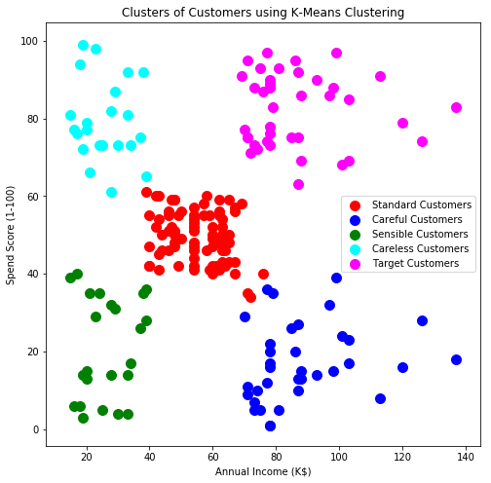

Slide 31
Multivariate analysis of variance (MANOVA)
To measure the effect of multiple independent variables on two or more dependent variables.
independent variables are categorical, while the dependent variables are metric in nature.
A categorical variable is a variable that belongs to a distinct category—for example, the variable “employment status” could be categorized into certain units, such as “employed full-time,” “employed part-time,” “unemployed,” and so on.
A metric variable is measured quantitatively and takes on a numerical value.
In MANOVA analysis, you’re looking at various combinations of the independent variables to compare how they differ in their effects on the dependent variable.
Notes:
Engine type, categorized as E1, E2, or E3
Material used for the rocket exterior, categorized as M1, M2, or M3
Type of fuel used to power the rocket, categorized as F1, F2, or F3
Your metric dependent variables are speed in kilometers per hour, and carbon dioxide measured in parts per million. Using MANOVA, you’d test different combinations (e.g. E1, M1, and F1 vs. E1, M2, and F1, vs. E1, M3, and F1, and so on) to calculate the effect of all the independent variables. This should help you to find the optimal design solution for your rocket.

Slide 32
Multivariate analysis: variables sélection
The final model dépends on variables selected:
At the study design:
Decide which variables to adjust or to control for
How the variable will be coded
Which interaction should be considered
At the analytical phase:
Which variables must be entered in the model
Variables must be forced
P value
➔ Neccesity of STRATEGY

Slide 33
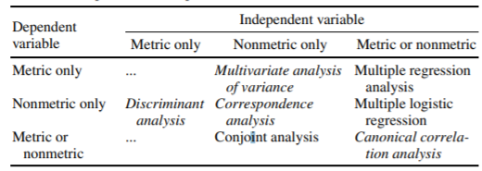
A general guide to choosing multivariate statistical tools based on nature of independent and dependent variables
Hair, J. F., Jr., Anderson, R. E., Tatham, R. L., and Black, W. C. 1998. Multivariate Data Analysis. 5th ed. Prentice Hall, Englewood Cliffs, NJ.

Slide 34
Conservative Dentistry
Evaluation of the outcome of endodontic treatment
Y
Periapical index score
Radiographical outcomes
Clinical parameters
(tooth function loss, mobility, presence of sinus tract, subjective discomfort,Presence of endo –perio lesions
X
Age
Oral Hygiene maintenance
Dietary habits
Dental visits
Systemic health of the individual

Slide 35
Factors affecting the success and management of retention phase in orthodontic treatment
Y
Space management
Loss of rotation control
Retainer maintenance
X
Pretreatment malocclusion
Patient compliance
Oral hygiene status
Follow up
Special needs of the patient
awareness

Slide 36
Factors affecting the success and management of retention phase in orthodontic treatment
Y
Space management
Loss of rotation control
Retainer maintenance
X
Pretreatment malocclusion
Patient compliance
Oral hygiene status
Follow up
Special needs of the patient
Awareness

Slide 38
key takeaways
The aim of multivariate analysis is to find patterns and correlations between several variables simultaneously
Multivariate analysis is especially useful for analyzing complex datasets, allowing you to gain a deeper understanding of your data and how it relates to real-world scenarios
There are two types of multivariate analysis techniques: Dependence techniques, which look at cause-and-effect relationships between variables, and interdependence techniques, which explore the structure of a dataset
Key multivariate analysis techniques include multiple linear regression, multiple logistic regression, MANOVA, factor analysis, and cluster analysis—

Slide 39
References:
Hair, J. F., Jr., Anderson, R. E., Tatham, R. L., and Black, W. C. 1998. Multivariate Data Analysis. 5th ed. Prentice Hall, Englewood Cliffs, NJ.
Jain, Sandhya, and Merin Kuriakose. "Discriminant analysis simplified."International Journal of Contemporary Dental and Medical Reviews .2019:1-3
Shiker MA. Multivariate statistical analysis. British Journal of Science. 2012;6(1):55-66.
Katz MH. Multivariable analysis: a primer for readers of medical research. Annals of internal medicine. 2003 Apr 15;138(8):644-50.
Dailey, R. J., & Kim, J. S. 2008. Biostatistics for oral healthcare. 1sted.John Wiley & Sons.

Slide 40
References
You tube

Slide 41
Thank you
Sincere Acknowledgments
Dr. V. Tejeswhini
Dr. N. Sneha
Dr. V. Divya Bhavani
Dr. M. Anuhya

