Slide 1
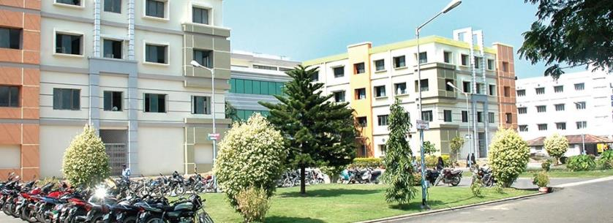
SIBAR INSTITUTE OF DENTAL SCIENCES Department of prosthodontics
PRINCIPLES OF TOOTH PREPARATION
Dr. Sandeep
Professor

Slide 2
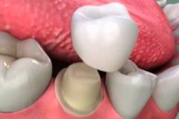
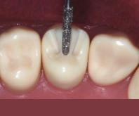

Slide 3
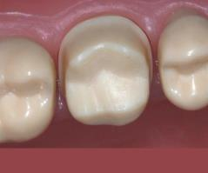
Introduction
DEFINITION
The process of removal of diseased and/or healthy enamel and dentin and cementum to shape a tooth to receive a restoration (GPT - 9)

Slide 4
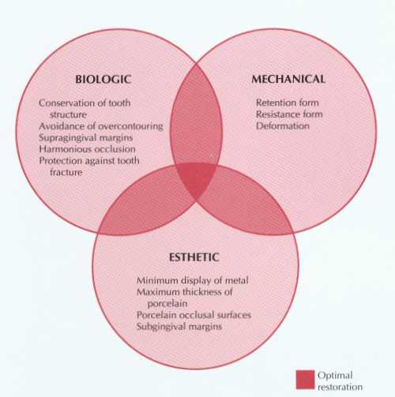
Principles of tooth preparation
According to Rosensteil

Slide 5
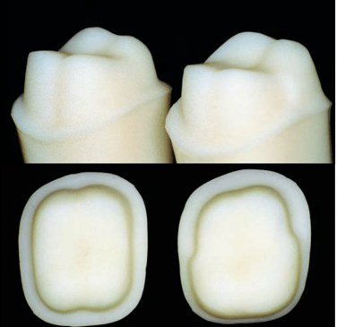
According to shillinburg
Conservation of tooth structure
Retention and Resistance
Structural durability
Marginal integrity
Preservation of periodontium

Slide 6
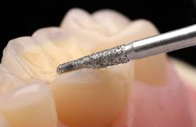
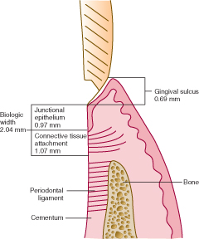
Biological considerations

Slide 7
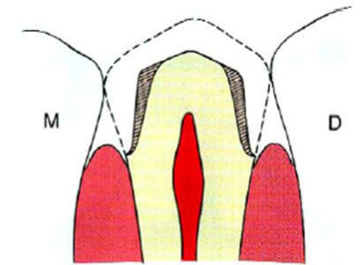
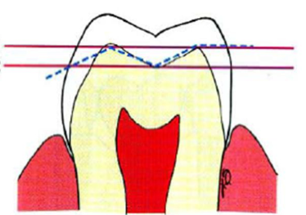
Conservation of tooth structure
Guidelines :
Minimal taper
Follow anatomic planes

Slide 8
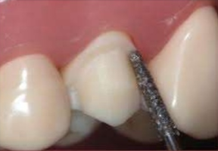
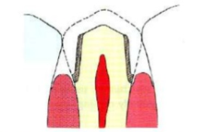
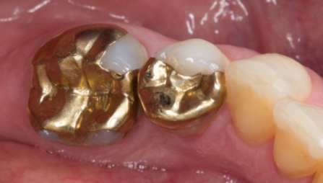
Conservative finish line
Unnecessary extension of
preparation apically
Prefer partial veneer preparation

Slide 9
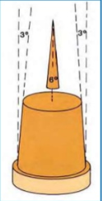
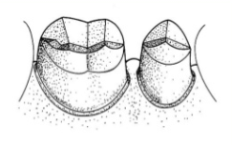
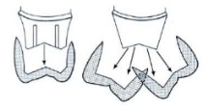
Resistance and Retention
Taper
>
>
surface area retention
Freedom of displacement
Retention path of insertion & removal

Slide 10
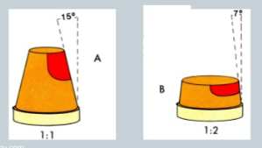
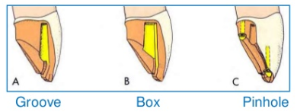
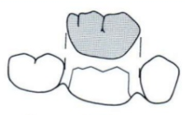
Height of preparation
Substitution of
internal features
Path of insertion

Slide 11
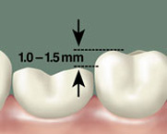
Structural durability
Occlusal reduction
Crown material | Functional cusp | Non-functional cusp
Gold crown | 1.5 mm | 1 mm
PFM | 1.5-2 mm | 1-1.5 mm
All-ceramic crown | 2 mm | 2 mm

Slide 12
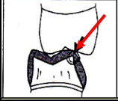
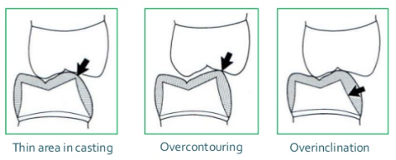
Functional cusp bevel
Lack of functional cusp bevel

Slide 13
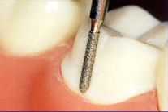
Axial reduction

Slide 14
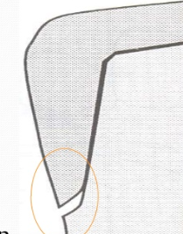
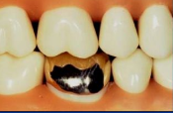
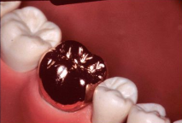
Marginal integrity
Incomplete seating of restoration
Complete seating of restoration

Slide 15
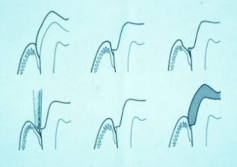
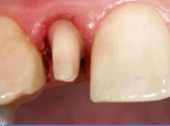
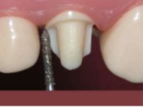
Preservation of periodontium
Finish line location
health of periodontium
Subgingival margins
Supragingival margins

Slide 16
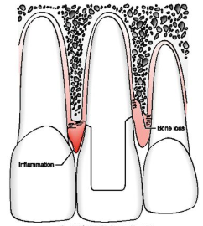
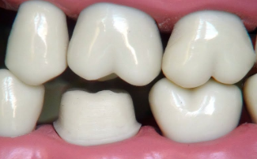
Violation of biologic width
Smooth & easily cleansable

Slide 17
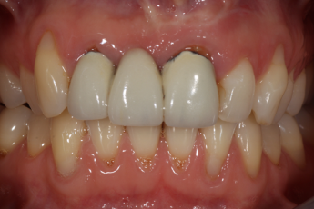
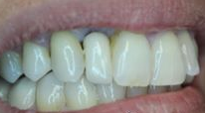
Overcontoured restoration
Under contoured restoration

