Slide 1
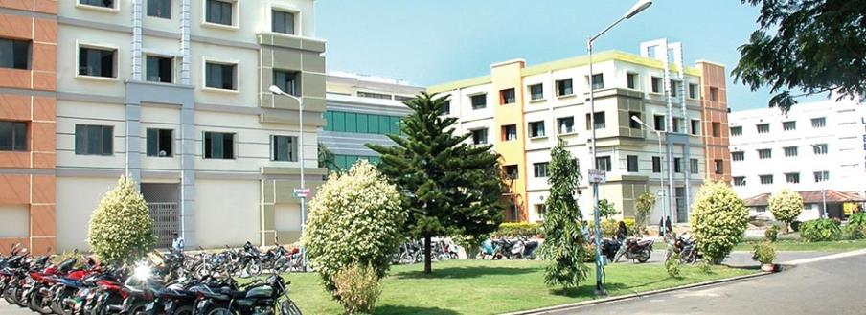
SIBAR INSTITUTE OF DENTAL SCIENCES
Department of Prosthodontics
Designing principles of RPD
Dr. Prakash, Professor

Slide 2
CONTENTS
Introduction
Principles of designing
Stress considerations
Forces influencing the magnitude of stress
Biomechanical consideration of individual component
Philosophies of designs
Essentials of designing
Procedure of designing
Design considerations in some clinical situations
Troubleshooting

Slide 3
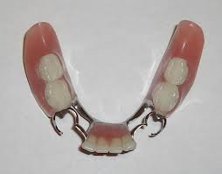
INTRODUCTION
Notes:
The primary objective of partial denture design is the preservation of the remaining teeth, their supporting structures, the residual alveolar ridges and the oral mucosa in a healthy condition, while at the same time replacing the missing teeth for improving aesthetics, mastication and speech.
Emphasis must thus be placed first on the biological aspects of Partial Denture restorations, rather than upon the purely technical aspects.

Slide 4
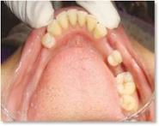
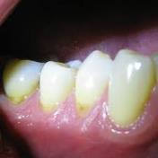
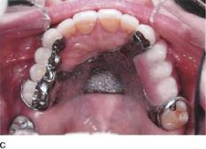
INDICATION FOR REMOVABLE PARTIAL DENTURES
1.Long standing edentulous area
2.No abutment tooth posterior
to the edentulous space
3.Reduced periodontal support
for remaining teeth
4.Need for cross arch stablization
Stewart’s Clinical removable partial Prosthodontics 4th edition pg-8

Slide 5
5.Excessive bone loss within
the residual ridge
6.Physical or emotional
problem exhibited by the
patient
Stewart’s Clinical removable partail prosthodontics 4th edition pg-8

Slide 6
PRINCIPLES OF DESIGN
1953,Dr.A.H.Schmidt gave the basic principles of designing
1.Dentist should have thorough knowledge
2.Treatment plan must be based on complete examination and diagnosis of individual patient.
3.Dentist must correlate the pertinent factors and determine a proper treatment plan.

Slide 7
4.RPD should restore the function without injury to remaining oral structures
5.It is a form of treatment and not a cure.

Slide 8
STRESS CONSIDERATION IN A PARTIAL DENTURE
Horizontal
Torsional
Vertical
Dislodging forces
Displacing forces

Slide 9
VERTICAL STRESS
Displacing stresses
:
These are the least harmful and are borne well if within physiologic limits
Notes:
Those forces which are the result of downward
stresses along
the long axis of
the teeth in a crown
to apex direction and
the relatively vertical
stresses on the ridge
mucosa.

Slide 10
DISLODGING STRESSES :
These are the forces which tend to lift the partial denture from it’s rest position
Notes:
These are the forces which tend to lift the partial
denture from it’s rest position. Reciprocal dislodging action occurs when
wide edentulous spaces
are interrupted by few
teeth thus inviting an
antero-posterior or
lateral tilt of prosthesis.

Slide 11
HORIZONTAL STRESS
These lateral stresses are most damaging.
Notes:
They originate as a component of rhythmic chewing stroke. These forces are effective in
mesio-distal and
buccolingual direction.
These lateral stresses
are most damaging.

Slide 12
TORSIONAL STRESS
It is a twisting rotational type of force. It’s a combination of vertical and horizontal force
Notes:
It is a twisting rotational type of force. It’s a combination of vertical and horizontal force.
Torsion is noted most
frequently where a
long segment acts
upon the first abutment
it engages. Where the
ridge mucosa has higher
resiliency torque is higher. Torque applies rotation about a fixed point.

Slide 13
FORCES ACTING ON PARTIAL DENTURE

Slide 14
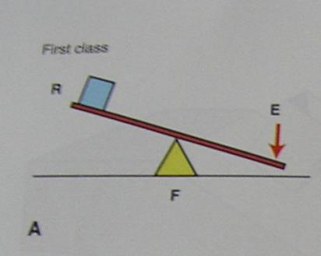
LEVER
Is a rigid bar supported somewhere along its length..
The point where the bar is supported is called the fulcrum
Three classes of levers (based on location of fulcrum, resistance and direction of effort (force).
Class I
Class II
Class III
McCracken’s Removable Partial Prosthodontics 11th edition
Notes:
A lever amplifies an input force to provide a greater output force, which is said to provide leverage. The ratio of the output force to the input force is the ideal mechanical advantage of the lever.The bar can only move about the fulcrum
Lever should be avoided in the design
Althought he movement of the denture will be minimal the lever that I imposed onto the abutment is great and is detramental.

Slide 15
CLASS I LEVER
Fulcrum lies in the centre,
Resistance is at one
end and force at the other.
McCracken’s Removable Partial Prosthodontics 11th edition

Slide 16
CLASS II LEVER
Fulcrum is at one end effort
at the opposite end and
resistance in the centre.
McCracken’s Removable Partial Prosthodontics 11th edition

Slide 17
CLASS III LEVER
Fulcrum is at one end,
resistance at opposite
end and effort is in the centre.
McCracken’s Removable Partial Prosthodontics 11th edition

Slide 18
INCLINED PLANE
.
Forces against an inclined plane may result in deflection of that which is applying the forces or may result in movement to the inclined plane, neither of these is desirable
Stewart’s clinical Removable Posthodontics 4th edition

Slide 19
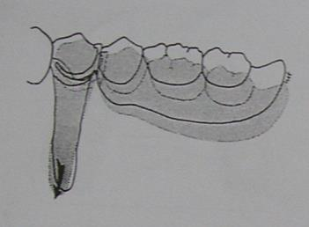
FULCRUM ON HORIZONTAL PLANE:
Extends through the rest of principle abutments.
Rotational movement of the denture in the sagittal plane.
Stewart’s clinical Removable Posthodontics 4th edition
Notes:
Resulting forces on abutment tooth from rotation in sagital plane is usually in mesioapical or distoapical direction with the greatest magnitude in apical direction..
The denture movement occurs towars or away from the denture base

Slide 20
DENTURE BASE MOVES AWAY FROM SUPPORTING TISSUES:
Counteracted by:
Direct retainer and Indirect retainer
McCracken’s Removable Partial Prosthodontics 11th edition

Slide 21
DENTURE BASE MOVES TOWARDS THE
SUPPORTING TISSUES:
Counteracted by:
Occlusal rest.
Tissues of supporting ridge
McCracken’s Removable Partial Prosthodontics 11th edition

Slide 22
FULCRUM ON THE SAGITTAL PLANE
Stewart’s clinical Removable Posthodontics 4th edition
Notes:
Extends through the occlusal rest on the terminal abutment and along the crest of the ridge.
Movement is in the frontal plane

Slide 23
Counteracted by:
Rigidity of major and minor connector and their ability to resist torque.
Close adaptation of the denture base along the lateral slopes and the buccal slopes of the palate and ridge.
Direct retainer design
McCracken’s Removable Partial Prosthodontics 11th edition

Slide 24
FULCRUM LOCATED IN MIDLINE JUST LINGUAL TO THE ANTERIOR TEETH (FULCRUM IS VERTICAL)
Rotational movement of denture in horizontal plane
or
flat circular movements of the denture
Stewart’s clinical Removable Posthodontics 4th edition

Slide 25
Counteracted by :
Stabilizing components (reciprocal arm and minor connector)
Rigid major connector
Close adaptation of denture base
McCracken’s Removable Partial Prosthodontics 11th edition

Slide 26
FACTORS INFLUENCING MAGNITUDE OF STRESSES TRANSMITTED TO ABUTMENT TEETH
1.Quality of support of ridge
- Form Of Residual Ridge
- Type Of Mucosal Covering
2. Length of span
3.Clasp factor
- Design
- Length
Stewart’s clinical Removable Posthodontics 4th edition

Slide 27
-Material
-Amount Of Tooth Contact
4. Occlusion
- Type of teeth
-Harmony of occlusion
5.Areas of the base to which load is applied
Stewart’s clinical Removable Posthodontics 4th edition

Slide 28
QUALITY OF SUPPORT OF RIDGE
Better support by ridge→ less stress on abutment teeth
Large well formed ridges→ absorb greater stress→ less stress on abutment
Broad ridges with parallel
sides→ longer flanges on
the denture base→ stabilize
the denture against lateral
forces.
Stewart’s clinical Removable Posthodontics 4th edition

Slide 29
TYPE OF MUCOSA
Influences magnitude of stresses transmitted to abutment teeth.
Healthy mucosa →capable
of bearing greater functional
loads than thin atrophic
mucosa
Soft, flabby, displaceable mucosa
Contribute little to vertical support of denture allows excessive movement of denture→ stress transmitted to abutment teeth
Stewart’s clinical Removable Posthodontics 4th edition

Slide 30
LENGTH OF SPAN
Longer edentulous span
Longer denture base
Greater force transmitted to
abutment teeth
Every effort be made to retain a posterior abutment to avoid class I and class II situation.
Stewart’s clinical Removable Posthodontics 4th edition

Slide 31
CLASP AS A FACTOR IN STRESS
More flexible the retentive arm of clasp → less stress to abutment tooth
But, flexible clasp arm → provides less stability against horizontal forces→ increase stress on residual ridge.
Decision should be made whether abutment or ridge requires more protection
Stewart’s clinical Removable Posthodontics 4th edition
Notes:
Hence wrought retentive clasp was rcommended for cla 1 2

Slide 32
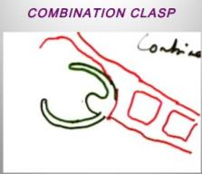
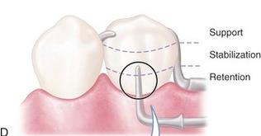
In examination phase decide whether ridge or abutment tooth require more protection
If periodontal support good
less flexible clasp like vertical projection clasp
If periodontal support weak
use more flexible clasp like combination clasp

Slide 33
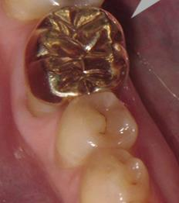
TYPE OF ABUTMENT TOOTH SURFACE
Surface of gold crown offers more frictional resistance to clasp arm movement than does enamel surface of tooth.
Greater stress exerted on tooth restored with crown than with intact enamel.
Stewart’s clinical Removable Posthodontics 4th edition

Slide 34
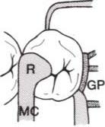
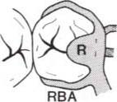
AMOUNT OF CLASP SURFACE IN CONTACT WITH TOOTH
Greater the area of tooth to metal contact between clasp and tooth
more will be stress exerted on the tooth.
Stewart’s clinical Removable Posthodontics 4th edition

Slide 35
OCCLUSION AS A FACTOR
Disharmonious occlusion
generate horizontal stresses
when magnified by factor of leverage
can transmit destructive forces to both abutment teeth and residual ridge.
Stewart’s clinical Removable Posthodontics 4th edition

Slide 36
TYPE OF OPPOSING OCCLUSION
Play important role in determining amount of stress generated by occlusion
Natural teeth→ can exert closing force upto 300 pounds/inch square, whereas, complete denture upto 30 pounds/inch square.
Therefore RPD constructed against removable prosthesis is subjected to much less occlusal stress than one opposed by natural dentition.
Stewart’s clinical Removable Posthodontics 4th edition

Slide 37
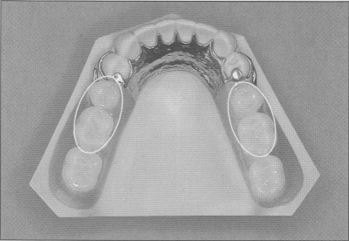
Ideally, the occlusal load should be applied on the center of the denture base.

Slide 38
AREA OF DENTURE BASE TO WHICH LOAD IS APPLIED
Less movement of base if load applied adjacent to the abutment tooth than if it is applied to the distal end of the base.
Movement may be 4 times greater at distal end of base than next to the clasp.

Slide 39
BIOMECHANICAL CONSIDERATION OF INDIVIDUAL COMPONENT

Slide 40
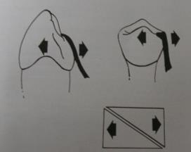
Rest
If angle greater than 90 degrees
Forces not along long axis but will create an inclined plane effect
Slippage of prosthesis away
from the abutment
Orthodontic like forces
McCracken’s Removable Partial Prosthodontics 11th edition
Notes:
In such case a secondary rest have to be given

Slide 41
CINGULUM REST VS INCISAL REST
Cingulum rest nearer to center
of rotation
Less tipping of tooth
Incisal rest
Longer minor connector required
Magnifies the forces being transferred to the
abutment tooth

Slide 42
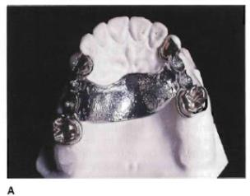
MAJOR CONNECTOR
In the maxillary arch the use of a broad palatal major connector that contacts several of the remaining natural teeth through lingual plating can distribute stress over a large area.
The major connector must be rigid and must receive vertical support through rests from several teeth.
McCracken’s Removable Partial Prosthodontics 11th edition

Slide 43
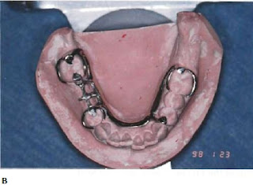
In the mandibular arch the lingual plate major connector that is properly supported by rests can aid in the distribution of functional stress to the remaining teeth.
The rigidity of the lingual plate major connector contributes to the effectiveness of cross arch stabilization.

Slide 44
MINOR CONNECTOR
The most intimate tooth to partial denture contact takes place between the minor connector and the guiding planes on the abutment tooth surface.
This close metal to enamel contact serves two purpose
First it offers horizontal stability to the partial denture against lateral forces on the prosthesis.
Secondly stabilization against lateral stresses
McCracken’s Removable Partial Prosthodontics 11th edition
Notes:
Minor connectors can be defined as the connecting link between the major connector or base of a removable partial denture to other units of a prosthesis such as clasp assembly,indirect retainers,rests etc

Slide 45
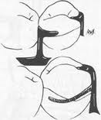
DIRECT RETAINER
Any unit of
removable dental
prosthesis that engages
an abutment tooth in
such a manner as to
resist displacement of
the prosthesis away
from basal seat tissue.
McCracken’s Removable Partial Prosthodontics 11th edition
Notes:
The ability of the direct retianer to fucntion is greatly depending upon the stabilit and support provided by the major minor connector and the rest and tissue surface

Slide 46
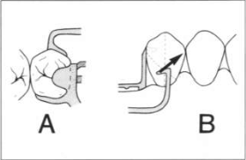
Clasp tip in infrabulge area→ resist the movement in occlusal direction because to release from tooth → it has to undergo deformation.
Degree of resistance to deformation determines the amount of clasp retention.
Retention varied by:
Depth of undercut
Flexibility of clasp arm positioned in undercut
Wrought
clasp
Cast
clasp
Stewart’s Clinical removable partial Prosthodontics 4th edition

Slide 47
STRATEGIC CLASP POSITIONING AS A MEANS OF STRESS CONTROL
Leverages can be controlled to a large extent by means of clasps, if there are sufficient abutment teeth and they are strategically distributed in the dental arch.
If number and location of potential abutments is less than ideal→ harmful effects can be decreased by strategic placement of clasps.
Stewart’s Clinical removable partial Prosthodontics 4th edition

Slide 48
QUADRILATERAL CONFIGURATION
Indicated most often in class III arches (with modification space on opposite side)
McCracken’s Removable Partial Prosthodontics 11th edition
Notes:
When 4 abutment teeth available for clasping and partial denture confined within 4 clasps→ all leverages neutralized.
Ideal (for support and leverage control)

Slide 49
TRIPOD CONFIGURATION
Class II situations
Distal abutment on one
side of arch missing→
leverage controlled to
some extent by creating
tripod configuration
of clasp placement.
McCracken’s Removable Partial Prosthodontics 11th edition

Slide 50
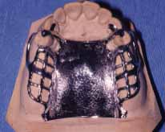
BILATERAL CONFIGURATION
For class I situations
Not considered ideal, but best option available
Stress must be controlled by other means.
McCracken’s Removable Partial Prosthodontics 11th edition

Slide 51
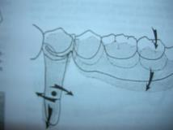
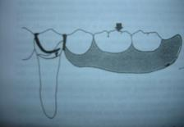
Clasp design
a. Circumferential cast clasp
The conventional circumferential cast clasp originating from a distal occlusal rest on the terminal abutment tooth and engaging a mesiobuccal retentive undercut should not be used on a distal extension RPD.
The ‘reverse circlet’ a cast circumferential clasp that approaches a distobuccal undercut from the mesial surface of a terminal abutment tooth, is acceptable.

Slide 52
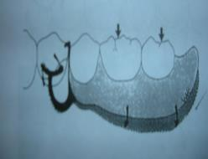
b. Vertical projection or bar clasp
It is used on the terminal abutment tooth on a distal extension partial denture when the retentive undercut is located on the distobuccal surface.
It is never indicated when a tooth has a mesiobuccal undercut.
As the denture base is loaded towards the tissue, the retentive tip of the ‘T’ clasp, rotates gingivally to release the stress being transmitted to the abutment tooth.

Slide 53
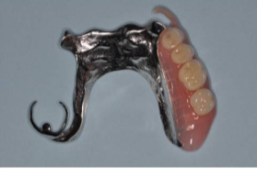
c. Combination clasp
When a mesiobuccal undercut exists on an abutment tooth adjacent to distal extension edentulous ridge, the combination clasp can be employed to reduce the stress transmitted to the abutment tooth.
Wrought alloy wire, by virtue of its internal structure is more flexible than a cast clasp.

Slide 54
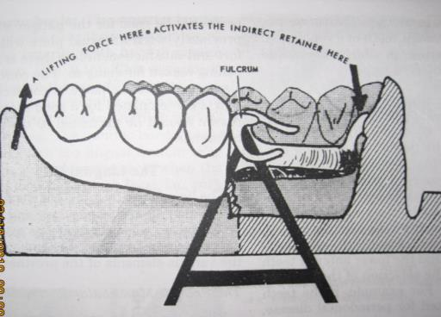
INDIRECT RETAINER

Slide 55
Function: To prevent the denture base from moving away from its seat because of cheek and tongue forces, sticky food.
It uses mechanical advantage of leverage by moving the fulcrum line farther from the force
McCracken’s Removable Partial Prosthodontics 11th edition

Slide 56
2. Contributes to support and stability of the partial denture→ counteracts horizontal forces applied to the denture.

Slide 57
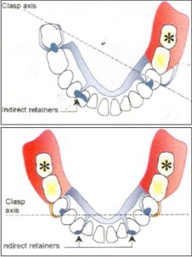
Effectiveness of indirect retainer depends upon:
Its distance from the fulcrum line
greater the distance between fulcrum line and IR→ more effective

Slide 58
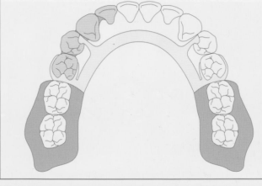
Splinting of abutment teeth
Splinting two or more teeth actually increases the periodontal ligament attachment area and distributes the stress over a larger area of support.
Splinting of canine and premolar is preferred.

Slide 59
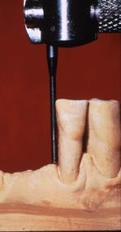
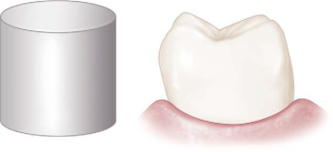
Guiding planes
Guiding planes Should be as parallel to the long axis of abutment teeth.
Should be located on the abutment surface adjacent to the edentulous area.
Should be established on several abutment teeth
Notes:
Proximal guiding plane surfaces should be about 2/3rd as wide as the distance between the tips of adjacent buccal and lingual cusps or
about 1/3rd of the buccal lingual width of the tooth.
Vertically it should extend 2/3rd of the length of the enamel crown portion of the tooth from the marginal ridge cervically.
Care must be taken to avoid creating buccal or lingual line angles.

Slide 60
PHILOSOPHIES OF DESIGN
Stress Equalization
Physiologic Basing
Broad stress distribution
Notes:
Of the various philosophies relating to RPD design, none is backed by scientific research or statistics.
This is not to say that none of the various methods of design has proved to be clinically acceptable.
On the contrary, all have produced excellent clinical results if attention to detail has been observed.

Slide 61
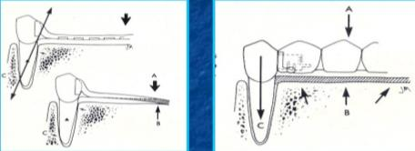
Stress Equalization/stress direction
The resiliency of the tooth supported by periodontal ligament in an apical direction is not comparable to the greater resiliency and displacement of the mucosa covering the dentulous ridge.
It is the belief of this school of thought that the rigid connection between the denture base and the direct retainer on the abutment teeth is damaging.

Slide 62
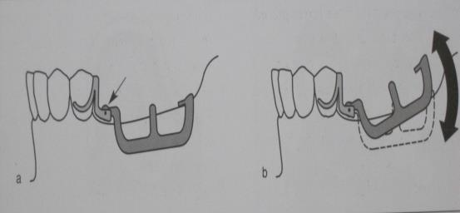
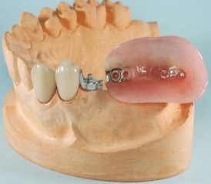
Thus some form of stress director or stress equalizer is essential to protect the abutment teeth.
The most commonly used ones are composed of a hinge device interposed between the minor connector of the abutment tooth and the denture base.

Slide 63
ADVANTAGE
DISADVANTAGE
Minimal direct retention is required- as denture base acts more independently.
Has the massaging or stimulating effect on the underlying bone and soft tissue. Which minimizes tissue change and resulting Rebasing procedures.
Construction of stress director is complex and costly.
Constant maintenance required.
Difficult or impossible to repair.
Lateral movements of base can lead to rapid resorption of the ridges.

Slide 64
PHYSIOLOGIC BASING
The belief is that the equalization can best and most simply be accomplished by some form of physiologic basing.
The physiologic basing is produced either by
Displacing or depressing the ridge mucosa during the impression making procedure
Relining the denture base after it has been constructed.
Notes:
This design philosophy agrees to some extent to the first school about the relative lack of movement of the abutment teeth in an apical direction
But denies the necessity of using stress directors to equalize the disparity of vertical movement between the tooth and mucosa.

Slide 65
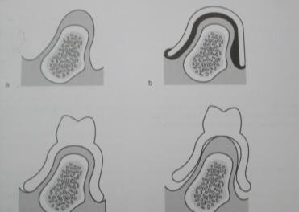
Displacing the mucosa during the impression procedure records it in its functioning and not the anatomic form.
This denture base formed over displaced tissue, will adapt more readily to the depressed tissue when occlusal force acts and will be better able to withstand the force that is generated

Slide 66
ADVANTAGES
DISADVANTAGES
Intermittent base movement has a physiologically stimulating effect on the underlying bone and soft tissue.
Less need for relining and Rebasing.
Simplicity of design and construction because of minimal retention requirements.
Denture is not well stabilized against lateral forces.
There will be always premature contact when mouth is closed .
It may be uncomfortable sensation to the patient.
It is difficult to produce effective indirect retention.

Slide 67
Broad Stress distribution
Distributing the forces of occlusion over as many teeth and as much of the available soft tissue area as possible.
This is accomplished by the use of additional rests, indirect retainers, clasps and broad coverage denture bases

Slide 68
ADVANTAGES
DISADVANTAGES
Teeth can be splinted .
Prosthesis are easier and less expensive to construct.
No flexible or moving parts so less danger of distorting the denture.
Indirect retainers and other rigid components provides excellent horizontal stabilization.
Less relining required.
Greater bulk may cause prosthesis to be less comfortable.
Increased amount of tooth coverage can lead to dental caries

Slide 69
WHERE IS THE PROSTHESIS SUPPORTED.
Tooth supported
Tooth - tissue supported:

Slide 70
TOOTH SUPPORTED
The most ideal support units are the RESTS.
The abutment selected for the support has to be evaluated for
Periodontal health.
Crown- root ratio.
Crown –root morphology
Location of the tooth in the arch
The opposing dentition
Notes:
Prepared on the occlusal, incisal, cingulaum surfaces

Slide 71
TOOTH- TISSUE SUPPORTED
Depends on 6 factors:-
Quality of residual ridge
The extent to which the ridge will be covered by mucosa
The accuracy and type of impression registration
The design characteristics.
The occlusal load applied
Notes:
Primarily comes from the overlying soft tissue.
Underlying alveolar bone.

Slide 72
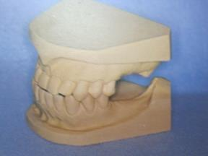
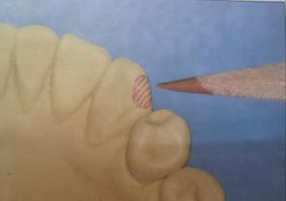
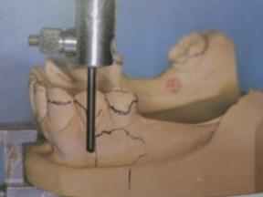
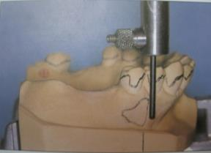
STEP BY STEP DESIGNING
Diagnostic cast Area of recontouring
survey lines Desired undercut is measured
Notes:
Color coding:
Red: placement of tripod marks areas of recontoured rest seats (solid rest)
Black: survey lines information on base of the cast
Blue :portions to be made of acrylic
Brown: To outline the metallic part all the
component

Slide 73
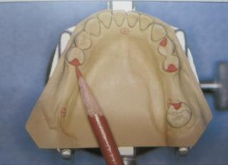
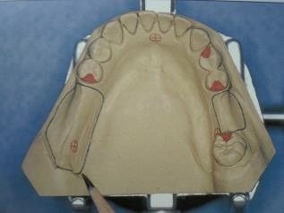
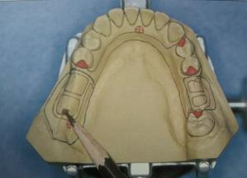
Desired rest seat-red desired denture base-blue
Major connector-brown

Slide 74
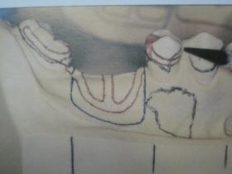
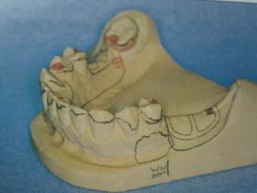
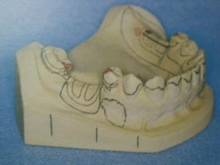
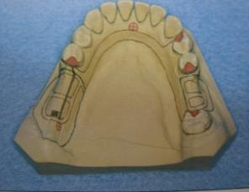
s
Retentive elements - Left side
right side

Slide 75
Design considerations in some common clinical conditions

Slide 76
Design considerations for Kennedy’s Class I & Class II
Direct retention :
Close adaptation of the denture base , restoration of form and function and preservation of soft tissue are key concerns.
The position of the undercut is very critical as it determines the type of clasp.
Clasp :
For class I two clasps on each terminal abutment are needed.
For class II three retentive clasps are required.

Slide 77
Rest :
Rest seat should be prepared on the tooth with the maximum support.
Should be placed adjacent to edentulous area.
Indirect retainer :
For class I - 2
For class II – 1 on the dentulous side
Denture base :
A broad coverage without any functional interference is required.
Occlusion :
It should coincide with the CR of the patient.
It should not have any premature contacts.

Slide 78
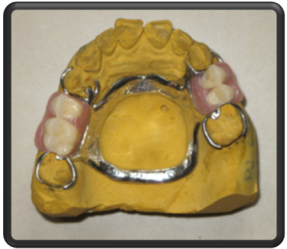
Design considerations for Kennedy’s Class III
Direct retention :
The damage to the abutment tooth is very less.
The position of under cut is not critical.
Clasp :
Four clasps are placed
Indirect retention :
Usually not needed.
Denture base :
Functional impression not required.

Slide 79
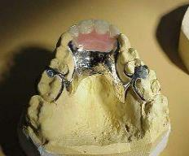
Design considerations for Kennedy’s Class IV
Stress pattern varies for this class.
More tilting forces on abutment teeth as teeth are placed anterior to the crest of ridge.
These forces can be minimized by
Shorter the edentulous area lesser the tipping forces.
Preservation of labial alveolar bone.
Retaining the natural teeth as intermediate abutment.

Slide 80
Trouble shooting in designing rpd

Slide 81
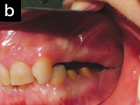
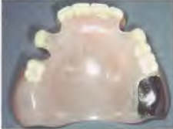
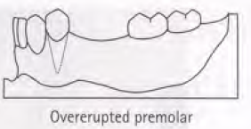
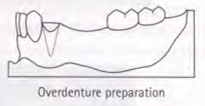
Disruption of occlusal plane due to over eruption of opposing teeth.
Modifying the opposing tooth
Conversion of the tooth to an over denture abutment.
Orthodontic intrusion.
In severe cases extraction
Understanding partial denture design ,Oxford university Press,KW Tyson,Yemm,Scott

Slide 82
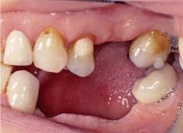
Tilted teeth
Placing a short rest
Placing a rest with broad occlusal coverage
Ring clasp
Orthodontic correction
Extraction

Slide 83
Deep bite
Extending the major connector which acts as a backing to teeth surface.
Not including that area in the RPD construction

