Slide 1
Dr. P. Chandrashekar
Professor

Slide 2
 Periodontium : defined as those tissues supporting and investing the tooth and consists of cementum, periodontal ligament (PDL), bone lining the alveolus (socket), and that part of the gingiva facing the tooth.
 These tissues form a specialized joint : gomphosis
 Ectomesenchymal origin

Slide 3
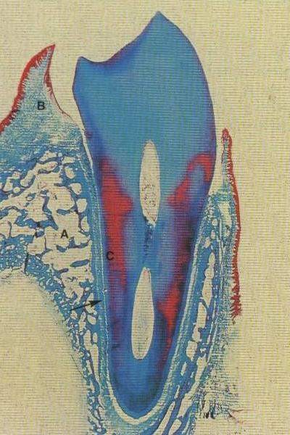
Gingiva
Alveolar bone
Cementum PDL space

Slide 4
 PDL – soft, specialized connective tissue situated between the cementum covering the root of the tooth and the bone forming the socket wall.
 Width of PDL – ranges from 0.15 to 0.38mm.
 PDL space decreases - with age
non-functional &
permanent teeth
Development
 A thin layer of cells of the dental sac, continuous with the cells of the dental papilla lies adjacent to the dental organ.
 It has been suggested that the term dental follicle be
reserved for mesenchyme follicle.
this layer of cells and the perifollicular for the cells that surround the dental

Slide 5
Dental follicle cells divide and differentiate into –
 The cementoblasts that deposit cementum on the developing root.
 The fibroblasts of the developing PDL.
 The osteoblasts of the developing alveolar bone
 PDL occurs after the cells of Hertwig’s epithelial root sheath have separated, forming the strands known as the epithelial rests of Malassez
Contents
Cells
Extracellular substance

Slide 6
Cells
Principle cells of the PDL are concerned with synthesis &
resorption of
alveolar bone
fibrous CT of ligament
cementum
Divided into three categories :
synthetic cells - osteoblasts
cementoblasts
fibroblasts
resorptive cells – osteoclasts
cementoclasts
fibroblasts
epithelial cells – epithelial rests of malassez

Slide 7
Other types of cells – mast cells
- macrophages
Hemopoietic line
Synthetic cells
For a cell to produce protein – transcribe RNA
synthesize ribosomes in the nucleolus
transport them to the cytoplasm and
increase its complement of rough ER and Golgi apparatus, for translation and transport of the protein

Slide 8
Osteoblasts
Bone forming cells lining the tooth socket.
Constitute a modified endosteum and not a periosteum.
Collagen fibres of the ligament that penetrate the alveolar bone intervene between the cells.
Cuboidal & exhibits a basophilic cytoplasm (extensive ER).
Round nucleus tends to lie towards the basal end of the
cell

Slide 9
Fibroblasts
Fibroblasts in various stages of differentiation and their progenitors, found in PDL.
Surrounded by fibres and ground substance.
Large cells with an extensive cytoplasm containing an abundance of organelles associated with protein synthesis and secretion.
Remodelling of collagen (synthesis and degradation).
In longitudinal section, under LM, the cells of the ligament are oriented parallel to the bundles of collagen fibres.

Slide 10
Cementoblasts
Cement forming cementum.
cells lining the surface of
Cuboidal – Rich in cytoplasm and have large nuclei.
Cells which cementum processes.
are actively depositing
acellular
– no prominent cytoplasmic
Cells actively depositing cellular cementum – abundant basophilic cytoplasm & cytoplasmic processes

Slide 11
Cementoblasts
osteoblasts

Slide 12
Resorptive cells
Osteoclasts
 Cells that resorb bone
 Large and multinucleated
 Multinucleated osteoclasts precursor cells similar to eosinophilic cytoplasm
: formed circulating
by fusion of
monocytes –
 LM – the cells sometimes occupy bays in bone (Howship’s lacunae )

Slide 13
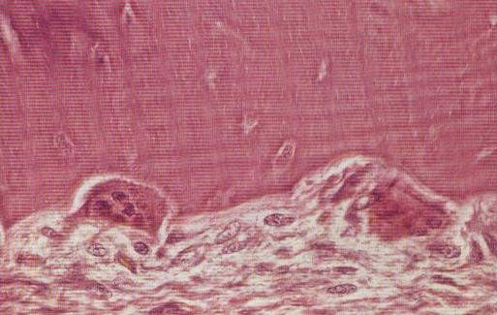
Howship’s lacunae
osteoclast

Slide 14
 EM – cytoplasm exhibits numerous mitochondria and lysosomes, abundant golgi saccules and free ribosomes but little RER.
 The part of the plasma membrane lying adjacent to the bone that is being resorbed, is raised into characteristic folds – ruffled or striated border

Slide 15
Cementoclasts
 Resemble osteoclasts and are found in normal functioning PDL.
occasionally
 Unlike alveolar bone, cementum does not undergo remodelling.
 Resorption occurs under certain circumstances
– mononuclear cementoclasts or multinucleated giant cells, which some times resemble the osteoclasts, are found on the surface of the cementum.

Slide 16
Epithelial cells
 Remnants of developmental epithelial root sheath of Hertwig.
 These cells can be distinguished from adjacent fibroblasts by – 1. Close packing of their cuboidal cells
2. Their tendency to stain more deeply
 The rests lie about 25 µm from the cementum surface
 Distribution of epithelial cells according to site and age:
1st and 2nd decades – most prevalent in the apical
zone.
3rd and 7th decades – located cervically in the gingiva above the alveolar crest.

Slide 17
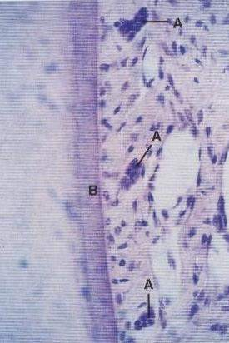
 Under certain pathological conditions: cells of the epithelial rests undergo rapid proliferation and produce a variety of cysts, tumors that are unique to jaws .
Cementum
Epithelial rests

Slide 18
Defence cells:
Mast cells:
 Small, round or oval cell having a diameter of about 12 to 15 µm.
 Characterized by numerous cytoplasmic granules, which obscure the small round nucleus.
 Granules : Stain with metachromatic dyes such as –
Azure – A & PAS.
 Granules contain : heparin
: histamine
: serotonin (some animals)

Slide 19
 EM – Mast cell cytoplasm contains :
Free ribosomes
Short profiles of RER
Few round mitochondria
Prominent golgi apparatus
Membrane bound granules
 Physiologic role of mast cell heparin is not clear.
 Mast cell histamine plays a role in : inflammatory
reaction.

Slide 20
 Degranulate in response to antigen-antibody formation on their surface.
 Release of histamine into the ECM : proliferation of endothelial cell and mesenchymal cells.
 Play an important role in regulating : endothelial and fibroblast cell population.

Slide 21
Macrophages
 Predominantly located adjacent to the blood vessels.
 Macrophages can be distinguished from fibroblasts by the presence of phagocytosed material in the cytoplasm.
 EM – the surface of the cell is generally raised in microvilli and the cytoplasm contains numerous free ribosomes.
 RER is sparse.
 Contains numerous lysosomes.
 Functions
: Phagocytosing dead cells
: Secreting growth factors that regulate the proliferation of adjacent fibroblasts

Slide 22
Extracellular substance
Fibres
– Collagen
Oxytalan
Reticulin
Elastin
Constitute fibres of human PDL
Constitute fibres of BM within the PDL
Ground substance
Proteoglycans
Glycoproteins

Slide 23
Collagen
 High mol wt. protein to which, a small number of sugars and a hetegenous collection of small glycoproteins are attached.
 21 different types – similar chemical structure, unique chemical characteristics.
 Type I and III.

Slide 24
 Collagen macromolecules are rod like, arranged to form fibrils
 EM: Fibrils show a highly ordered periodic banding pattern (LS)
 LM: because of their small diameter, cannot be resolved. Diameter greater than 0.2 µm under high magnification.
 Fibrils packed together to form bundles or fibres.

Slide 25
Principle fibers : Collagen fibers gathered into bundles,
clear orientation relative to the PDL space.
Arranged in five particular groups
Alveolar crest group : Radiate from the crest of the
alveolar process and attach themselves to the cervical part of the cementum.
Horizontal group : Run at right angles to the long axis
of the tooth from the cementum to the alveolar bone
Oblique group : Attached in the cementum running
obliquely to insert into bone coronally
: numerous

Slide 26
4. Apical group : Radiate from the apical region of the root
to the surrounding alveolar bone.
5. Interradicular group : From the crest of interradicular
septum, the bundles extend to the
furcation of multirooted teeth.
Sharpey’s fibres : embedded portion of principle fibres in
cementum or bone
Intermediate plexus : under LM , the principle fibres that run a wavy course from cementum to bone appear as those fibres arising from cementum and bone joined in the midregion, giving rise to a zone of distinct appearance.

Slide 27
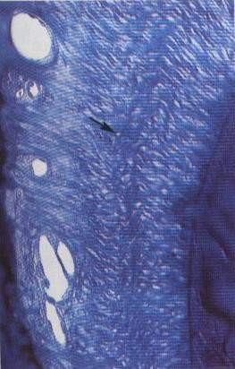
Intermediate plexus

Slide 28
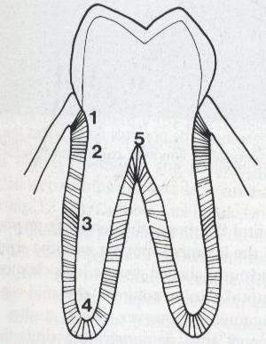
Alveolar crest fibres
Horizontal fibres Interradicular fibres
Oblique fibres
Apical fibres

Slide 29
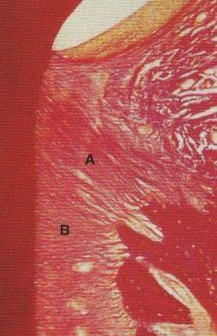
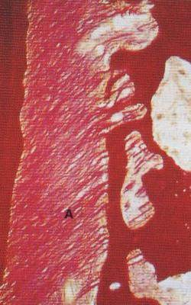
Dentoalveolar crest fibres
Horizontal fibres
Oblique fibres

Slide 30
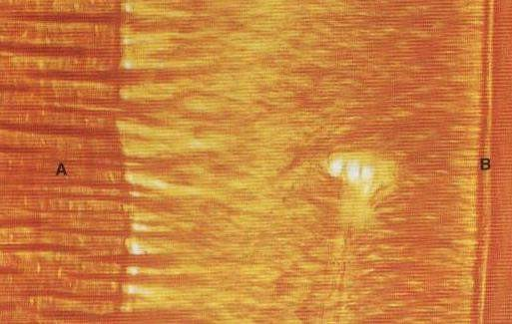
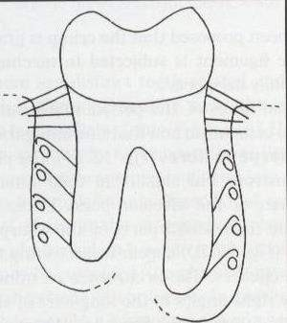
Sharpey’s fibres within the AB
Sharpey’s fibres within the cementum
Sharpey’s fibres within the AB

Slide 31
Oxytalan
 May be an immature elastic fibre, found in human PDL
 Under LM, can be demonstrated only with specialized stains for elastic fibres, in prior oxidized tissues.
 EM : Resemble developing elastic fibres.
 Run in an axial direction, with one end embedded in cementum or bone and other in the wall of a blood vessel.
 Play a role in supporting the blood vessels of the PDL

Slide 32
Ground substance
 The space between cells, fibres, blood vessels and nerves in the PDL is occupied by ground substance.
 All anabolites reaching the cell from microcirculation and catabolites passing in opposite direction must pass through ground substance.
 Not recognizable in tissue prepared by routine methods
for LM & EM, but only by histochemical methods.
 Two major group of substances-
Proteins and polysaccharides but of different type and arrangement.
Proteoglycans Glycoproteins
proteoglycans carry a much negative charge than glycoproteins.

Slide 33
Histochemistry : A technique that attaches a material that can be recognized microscopically to specific chemical groups in the substance to be demonstrated
For LM : Specific substance is a dye that can be recognized by its color (alcian blue 8GX & toluidine blue – proteoglycans)
: Periodic acid- schiff method (glycoproteins)
For EM : Electron – dense material (Ruthenium red –
Proteoglycans)
: Periodic acid – Silver methenamine (glycoproteins)
Fibronectin : Particular glycoprotein that occurs in filamentous form in the PDL.

Slide 34
Interstitial tissue
 Blood vessels, lymphatics, and nerves of the PDL are surrounded by loose CT and easily recognizable under LM. These areas have been termed interstitial tissue.
Blood vessels : arterial vessels derived from three sources
Branches from apical vessels that supply the dental pulp
Branches from intra-alveolar vessels
Branches from gingival vessels
Lymphatics : a network of lymphatic vessels, following the path of the blood vessels, provides the lymph drainage of the PDL : the flow is from the ligament towards and into the adjacent bone

Slide 35
Nerves :
usually associated with blood vessels pass through foramina in the alveolar bone, including the apical foramen, to enter the PDL
Cementicles : Calcified bodies in PDL
: older individuals
: may be free in the CT
: may fuse into large calcified masses
: may be joined with the cementum
: as the cementum thickens with age, it may envelop these bodies
: excementosis
: degenerated epithelial cells form the nidus for their calcification

Slide 36
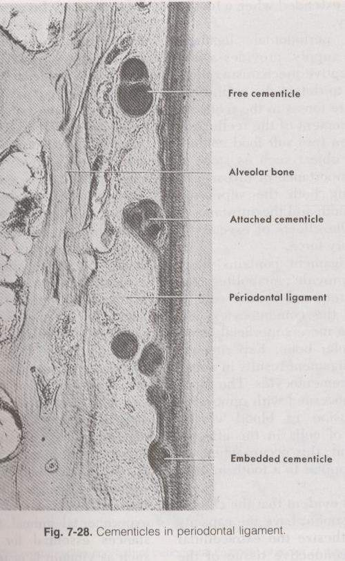

Slide 37
Functions
Supportive : tissue of attachment between tooth and alveolar bone
: responsible for resisting displacing forces and for protecting the dental tissues from damage caused by excessive occlusal loads
Sensory : provides a most efficient proprioceptive mechanism Nutritive : contains blood vessels ,which provide anabolites and
other substances required by the cells of the ligament, by the cementocytes, and by the more superficial osteocytes of the alveolar bone
Homeostatic : cells of the PDL have the capacity to resorb and synthesize the ECM of the CT of the ligament, alveolar bone and cementum.
: ankylosis (loss of vit –c necessary for collagen synthesis)

Slide 38
Clinical considerations
Primary role is to support tooth in the bony socket
Thickness varies – in different individuals
in different teeth in the same individual
in different locations on the same tooth
 The thickness movements of
of PDL is maintained by functional the tooth (thin in functionless and
embedded teeth, wide in teeth under excessive occlusal load).

Slide 39
Clinical considerations
 The most imp clinical condition affecting the PDL is
chronic inflammatory periodontal disease.
 Important changes takes place within PDL with orthodontic loading – pressure and tension regulated.

