Slide 1
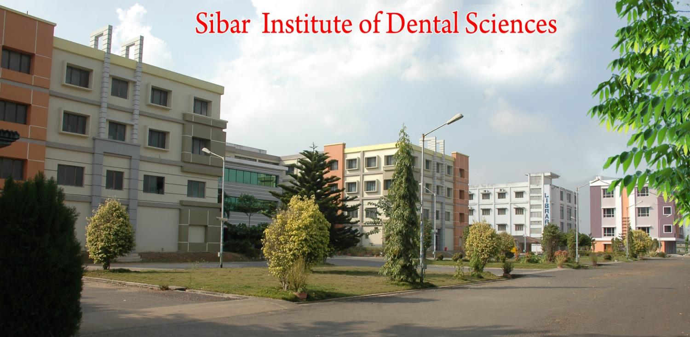
PERIODONTAL PLASTIC AND ESTHETIC SURGERY
DR. K. LAKSHMIKANTH, PROFESSOR
SIBAR INSTITUTE OF DENTAL SCIENCES
DEPARTMENT OF PERIODONTICS

Slide 2
The Term Mucogingival Surgery Was Introduced By Friedman To Describe Surgical Procedures For Correction Of Gingiva And Oral Mucous Membrane With Reference To 3 Specific Problems i.e,
1.Attached Gingiva 2.Shallow Vestibule 3.Aberrent Frenum

Slide 3
1996-World work shop in Periodontology renamed it as Periodontal Plastic Surgery-a term proposed by Miller in 1993 to include following areas,
- Periodontal Prosthetic Corrections
- Crown Lengthening
- Ridge Augmentation
- Esthetic Surgical Corrections - Coverage of denuded root surfaces
- Reconstruction of Papillae
- Esthetic Surgical Corrections Around Implants
- Surgical Correction Of Unerupted teeth around Orthodontics

Slide 4
Periodontal Prosthetic Surgery Is Defined As The Surgical Procedure Performed To Correct Or
Eliminate Anatomic,developmental/ Traumatic Deformities Of The Gingiva Or Alveolar Mucosa.
It Includes
- Widening The Attached Gingiva
- Deepening Of Shallow Vestibule
- Resection Of Aberrant Frena

Slide 5
Problems Associated With Attached Gingiva:
Width Of Attached Gingiva
How To Measure
Esthetic Concern: High Smile Line
Width Of Attached Gingiva Around Abutments,subgingival Restorations
Widening Of Attached Gingiva Accomplishes The Following Objectives:
1.Plaque Removal Around Gingival Margin
2.Improves Esthetics
3.Reduces Inflammation Around Restored Teeth

Slide 6
Problems Associated With Shallow Vestibule: Vestibule Depth Is Measured From Gingival Margin To Bottom Of The Vestibule.
In Gingival Recession - Vestibular Depth Is Reduced - Hampers Proper Oral Hygiene.
Adequate Vestibular Depth Is Needed For Proper Placement Of Removable Prosthesis

Slide 7
Problems Associated With Aberrant Frenum: A Frenum That Encroaches On The Margin Of The Gingiva May Interfere With Plaque Removal And Tension On This Frenum May Tend To Open The Sulcus.

Slide 8
TECHNIQUES FOR INCREASING WIDTH OF ATTACHED GINGIVA:
To simplify and better understanding following classification given.
1)Gingival augmentation apical to area of recession.
Pedicle or
A graft
Free mucosal
No attempt is made to treat denuded area
It increases width of attached gingiva

Slide 9
2) Gingival augmentation coronal to area of recession .
Pedicle
A graft
Free mucosal (covering denuded root)
Increases width of the attached gingiva.
Improves esthetics also.

Slide 10
1) Gingival Augmentation Apical To Recession
Includes A)free Gingival Autograft B)free Connective Tissue Autograft
C)apically Positioned Flap.

Slide 11
Are Used To Create Zone Of Attached Gingiva Initially Described By Bjorn 1963.
Indications:
Progreesive Gingival Recession And Inflammation
2) Non Pathologic Dehiscences And Fenestrations.

Slide 12
1) Classic technique
a) Preparation of recipient site
b) Obtain a graft from donor site
c) Transfer and immobilize the graft
d) Protect the donor site

Slide 13
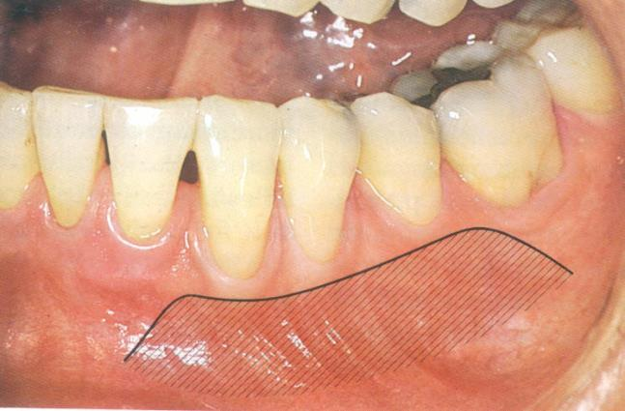
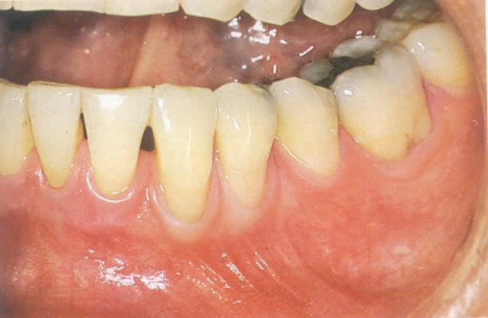
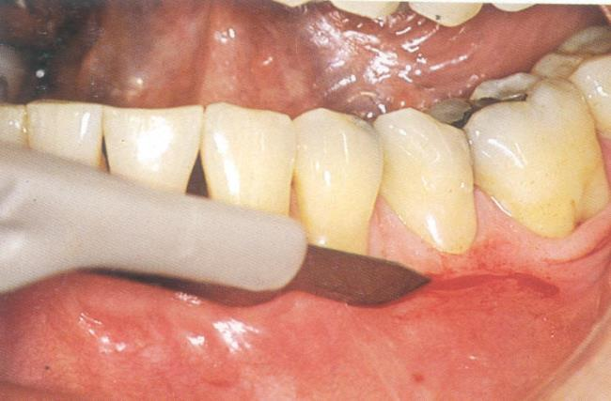
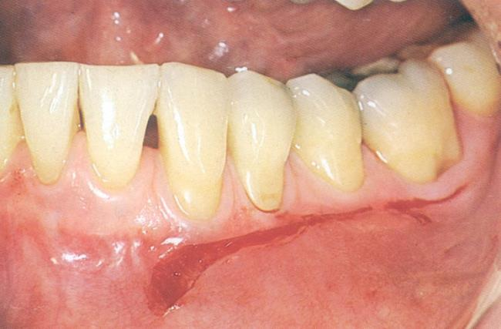

Slide 14
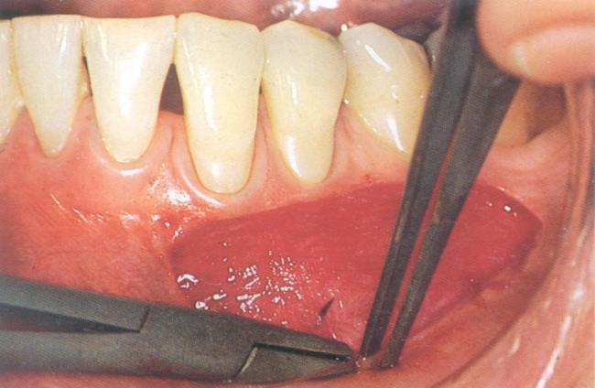
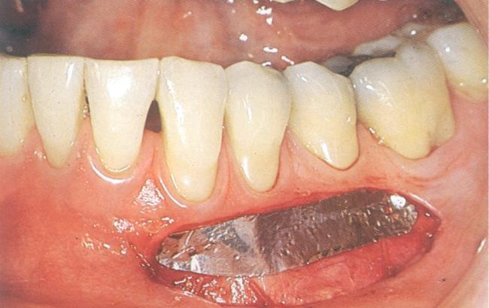
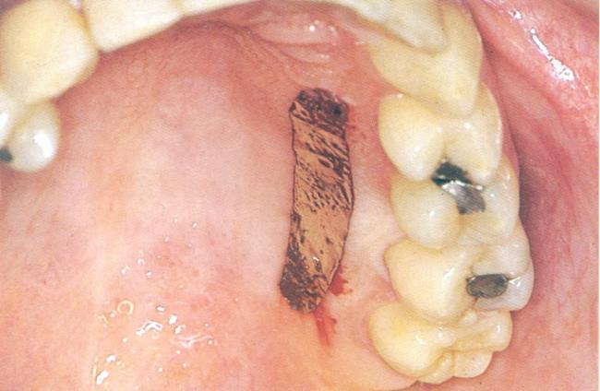
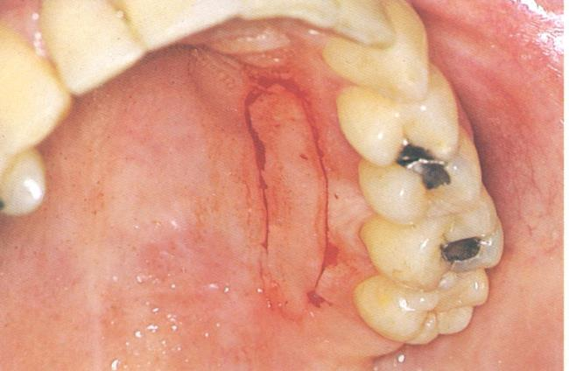

Slide 15
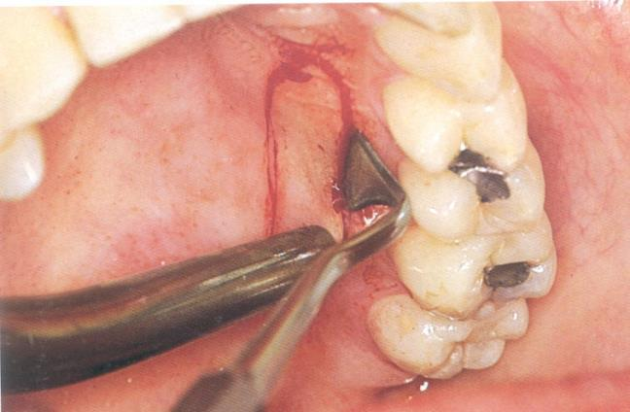
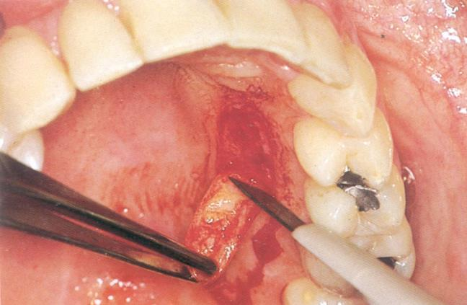
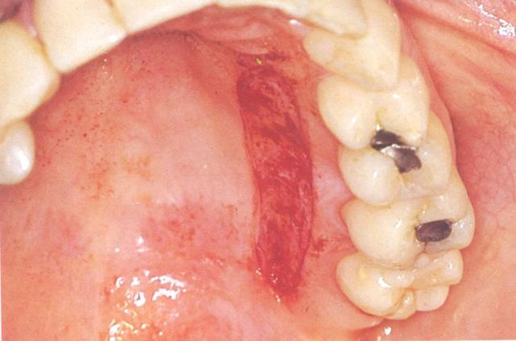
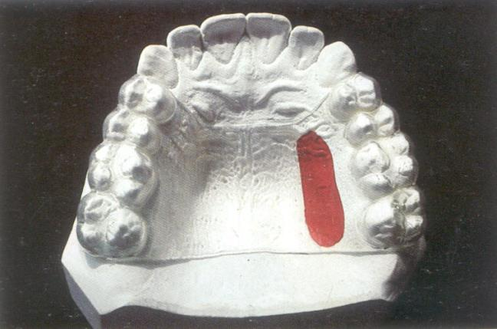

Slide 16
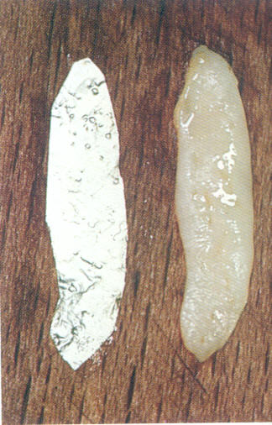
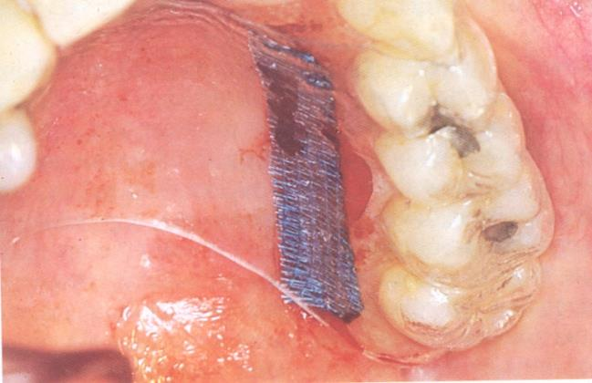
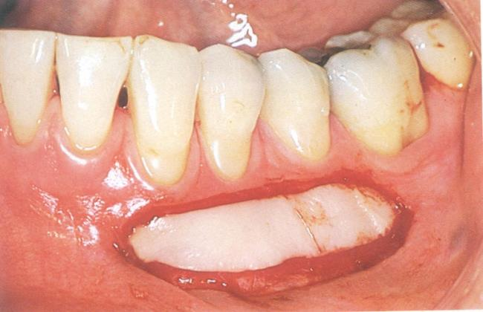
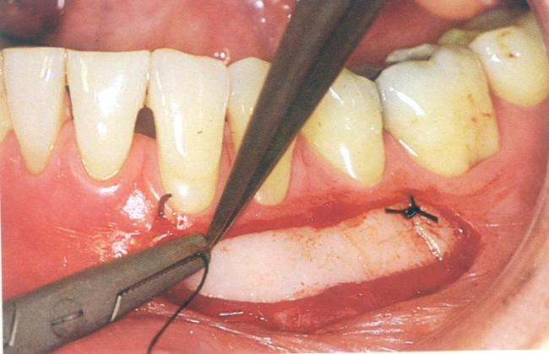

Slide 17
2) Variant techniques
a) Accordion technique
b) Strip technique
c) Combination technique

Slide 18
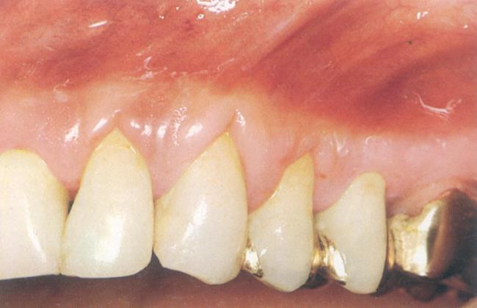

Slide 19
STRIP TECHNIQUE

Slide 20
Healing Of The Graft
Success Of The Graft Depends On The Survival Of The Connective Tissue.
Connective Tissue Withstands And Determines The Fate Of The Graft.
Initially Graft Survival By A Diffusion Of Fluid From Host Bed, Adjacent Gingiva And Alveolar Mucosa.
The Fluid Is A Transudate From Host Vessels Provides Nutrition And Hydration Which Is Essential.

Slide 21
1st Day - Connective Tissue Becomes Edematous And Disorganized
Degeneration
Lowered Edema
Lysis Of Some Of Its Elements
As Healing Progresses
New Granulation Tissue Forms

Slide 22
2nd And 3rd Day:
Revascularisation Of Graft
Capillaries From The Recipient Bed Penetrate Into Graft To Form A Network Of New Capillaries And Anastomose With Pre-existing Vessels.
Central Portion Of The Graft Is Lost To Vascularize At 10 Days.
7 To 8 Days
The Graft Is Firmly Adherent To The Recipient Bed A Thin Layer Of New Epithelium Is Present With Retepegs

Slide 23
Microscopically
Healing Of Graft : Intermediate Thickness (0.75 Mm) By 10.5 Weeks.
Thicker Graft (1.75 Mm) By 16 Weeks.
Functional Integration Of Graft.
Occurs By 17 Days, Graft Eventually Blends With Adjacent Tissue & Becomes Pink- Firm&healthy

Slide 24
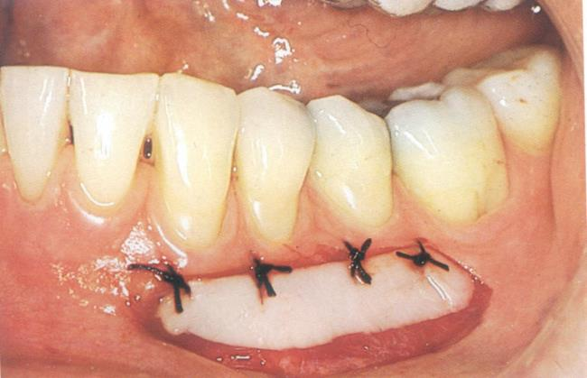
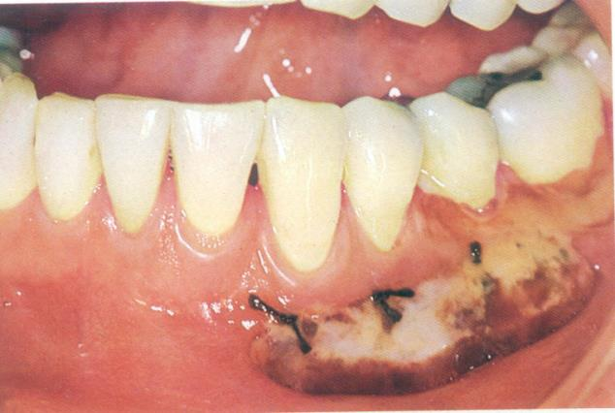
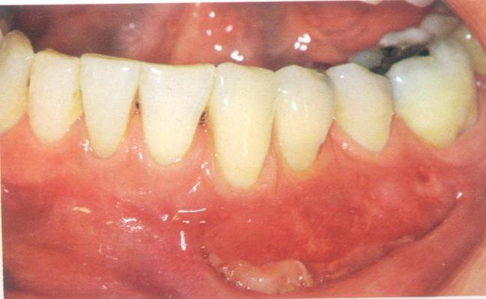

Slide 25
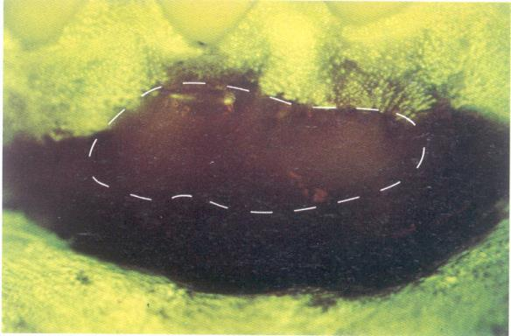
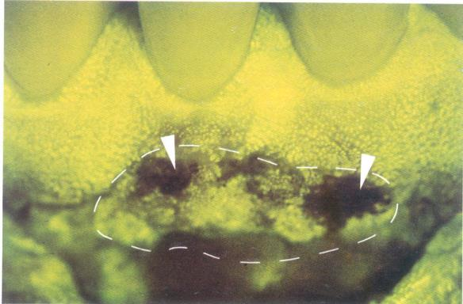
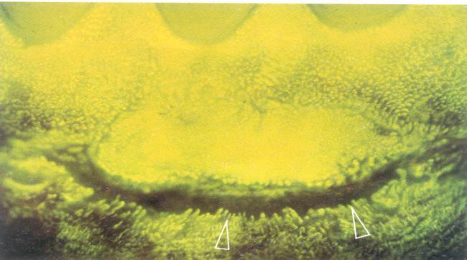

Slide 27
Gingival Augmentation coronal to the recession Classification of recession:
1) Sullivan and Atkins 1960:
Shallow Narrow
Shallow Wide
Deep Narrow
Deep Wide
2) W.D Miller 1985: Class I
Class II
Class III
Class IV
Prognosis
Class I - Good To Excellent
Class II - Good to Excellent
Class II - Partial root coverage
Class IV - Very poor prognosis

Slide 28
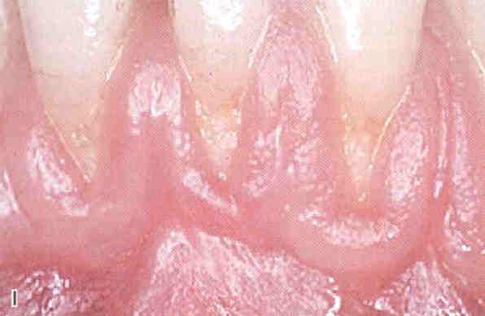
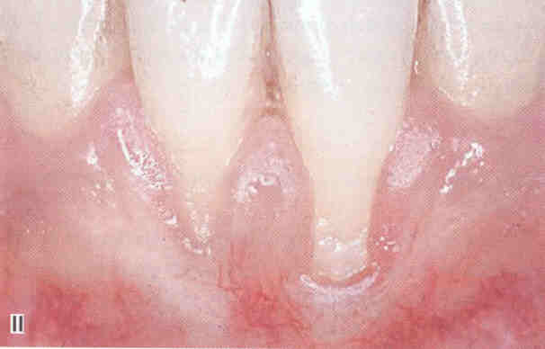
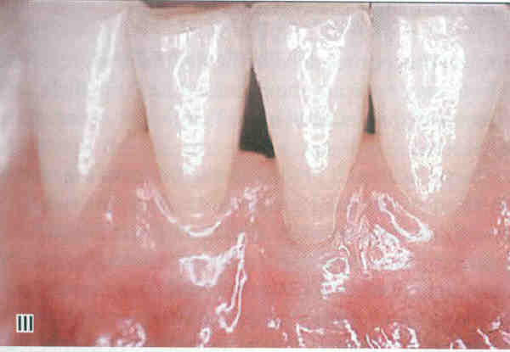
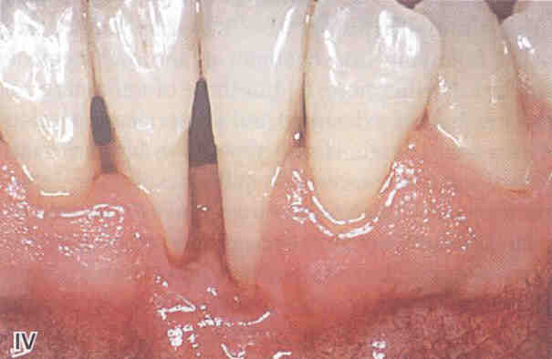

Slide 29
Following techniques used for Gingival Augmentation coronal to the recession:
Free gingival graft
Free connective tissue autograft
Pedicle graft
Laterally Reposiotioned
Coronally Repositioned
Semilunar pedicle(Tarnow)
Sub epithelial connective tissue graft(Langer)
Guided Tissue regenration
Pouch and Tunnel technique

Slide 30
Free gingival autograft:
Miller applied this technique for successful root coverage.
1) Root planing with citric acid application.
2) Prepare recipient site.

Slide 31
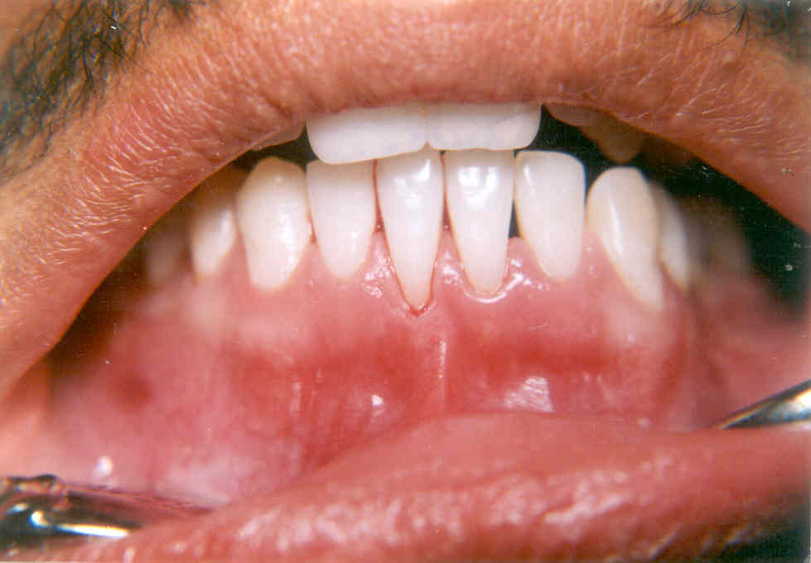
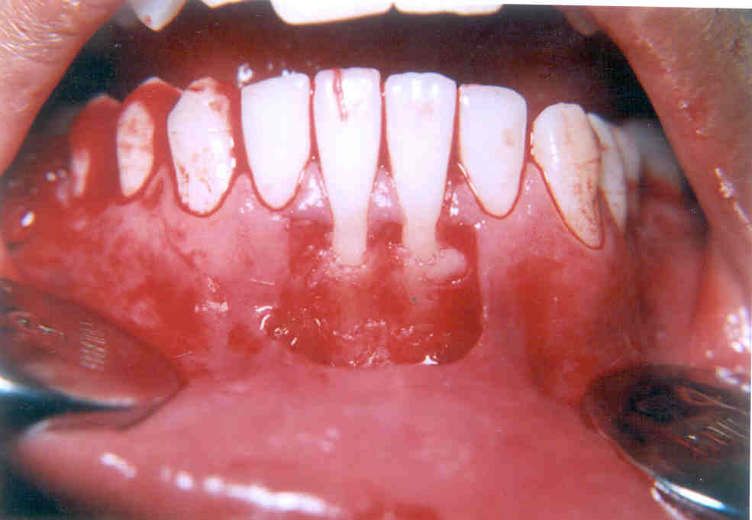

Slide 32
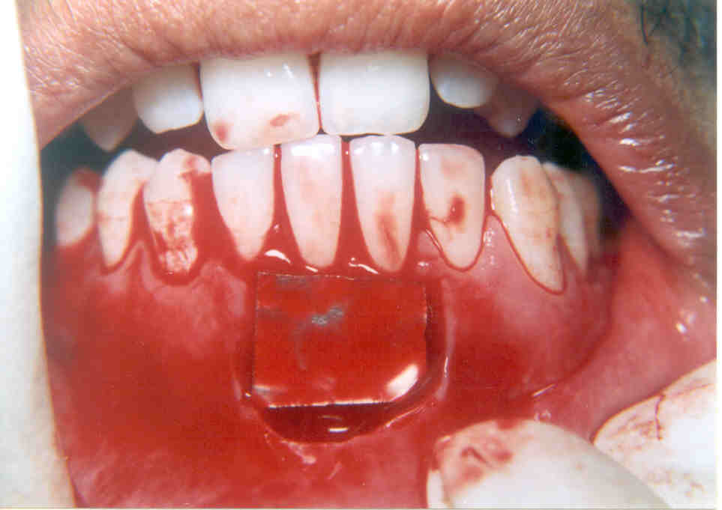
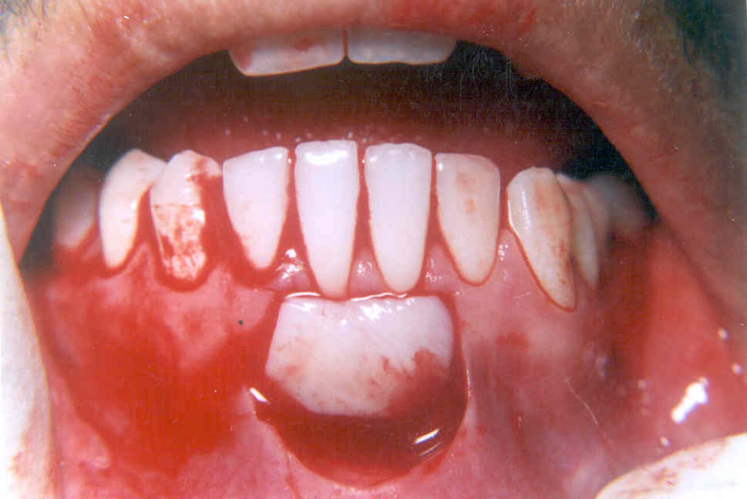

Slide 33
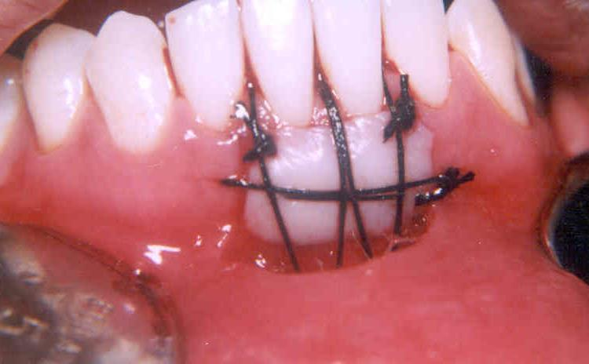
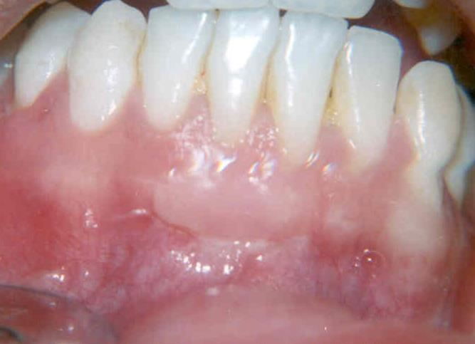

Slide 34
Free Connective tissue graft:
Described by Levine in 1991.
Difference of this with with previous technique is that the donor tissue is connective tissue.

Slide 35
Pedicle autograft
-Described by Grupe and warron(1956).
-Standard technique – It covers isolated areas of recession with sufficient vestibular depth.
Steps
1) Prepare the recipient site.
2) Prepare the flap.
3) Transfer the flap.
4) Protect the flap and donor site.

Slide 36
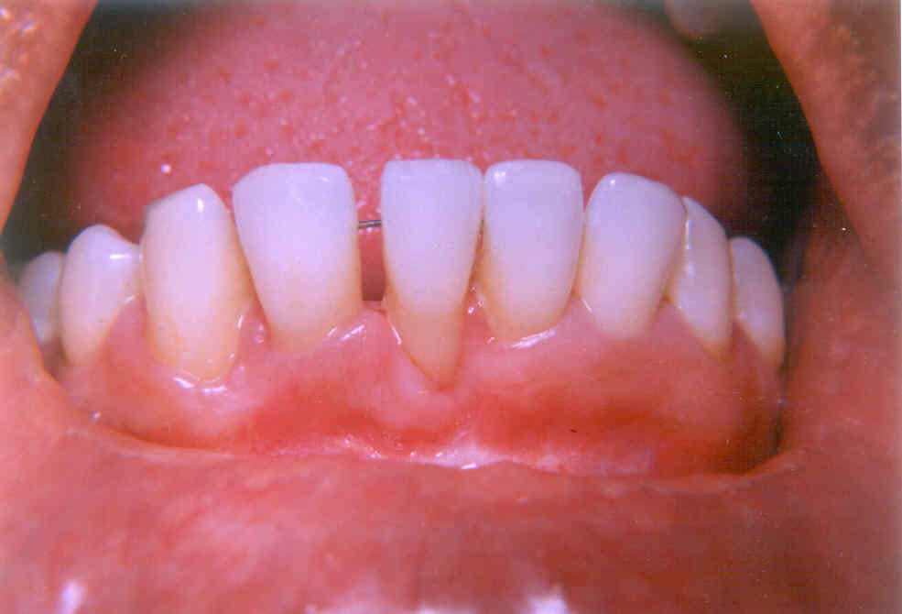
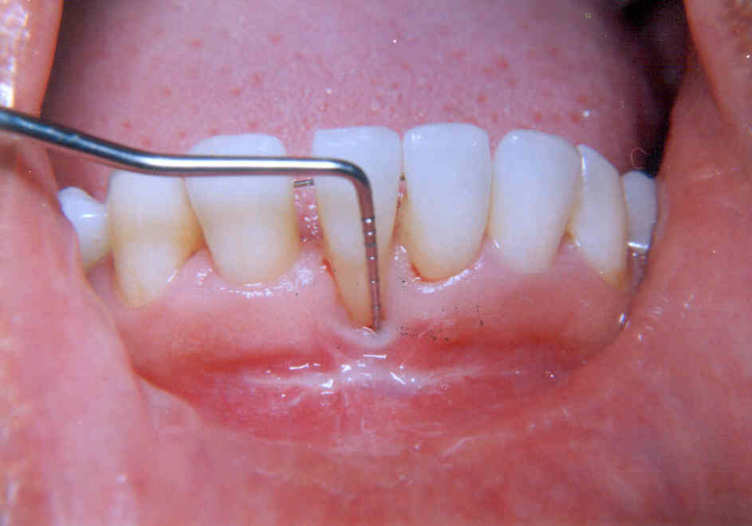

Slide 37
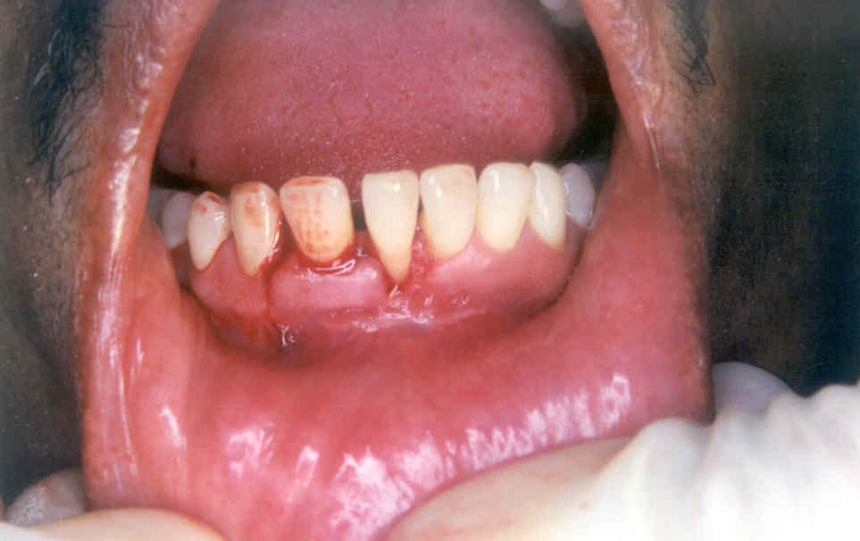
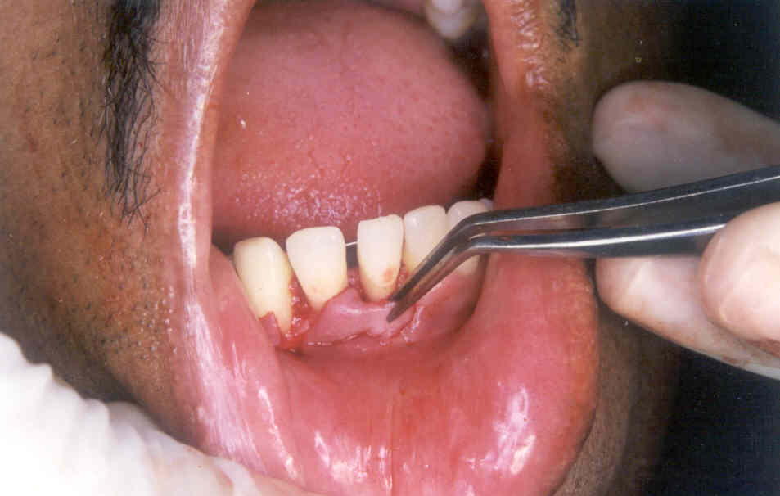

Slide 38
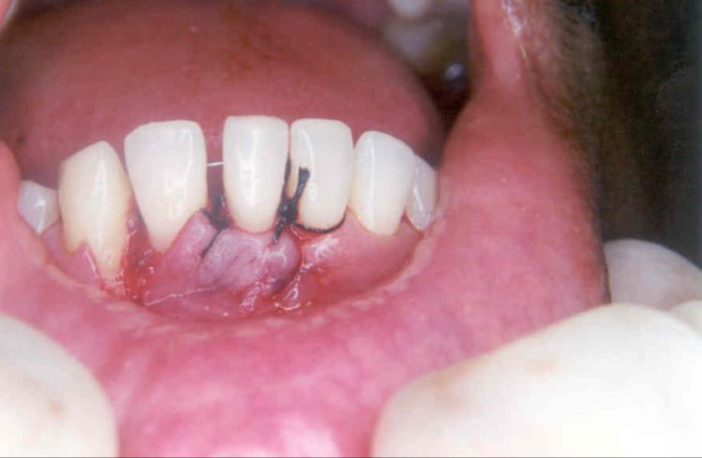
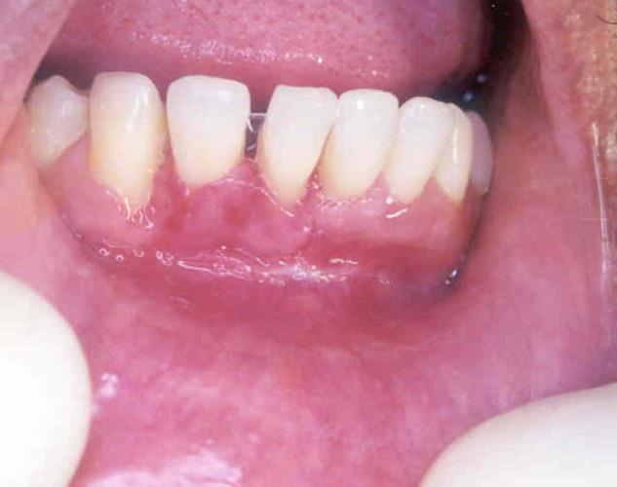

Slide 39
Coronally Displaced Flaps:
Purpose: coronally position the flap to cover the root.
If sufficient width of attached Gingiva is there-
Steps: - Two vertical incisions extending beyond mucogingival junction.
- Second crevicular incision, raise mucoperiosteal flap.
- Scale and plane the root surface.
- Place the flap coronal to1mm pretreatment level.
- Suture it, periodontal dressing may be given.
If insufficient width of attached Gingiva is there- Procedure can be done in 2 stages
1. Free gingival autograft with increased width of attached gingiva.( this creates several mm of keratinized attached gingiva apical to denuded root)
2 months later-
Second stage operation to coronally reposition the flap can be performed.

Slide 40
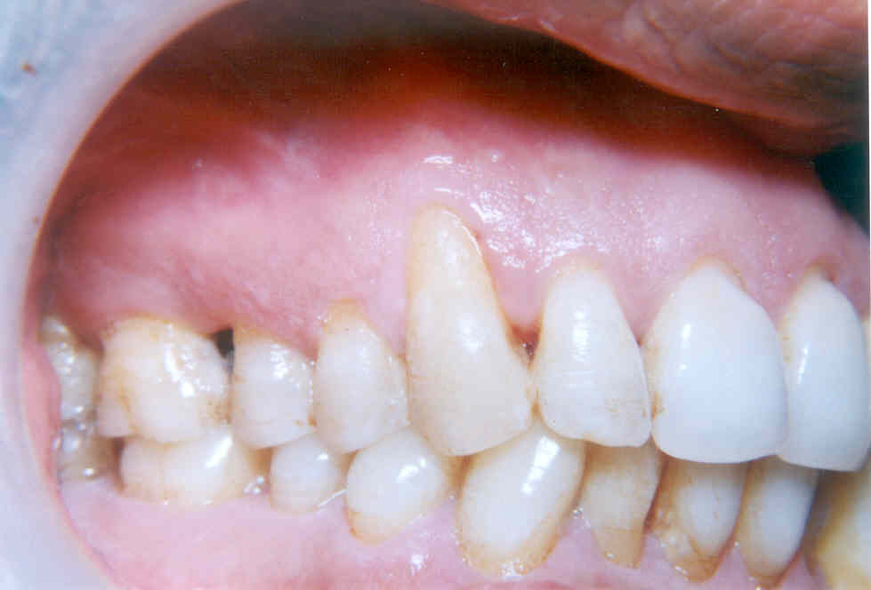
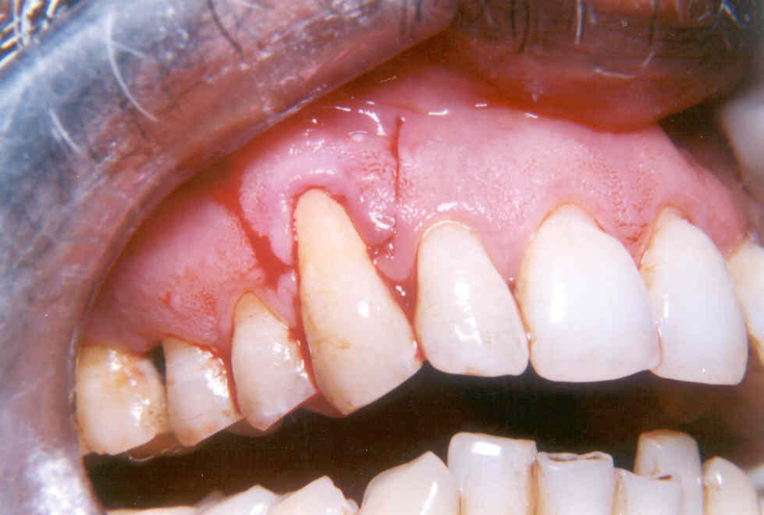

Slide 41
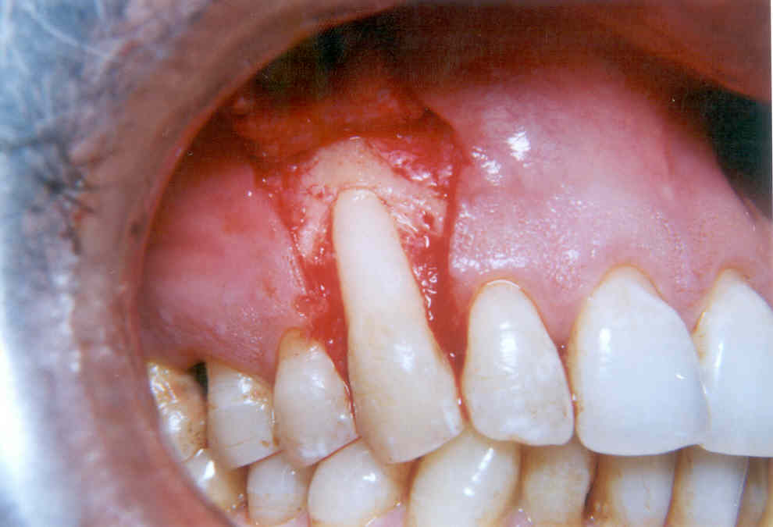
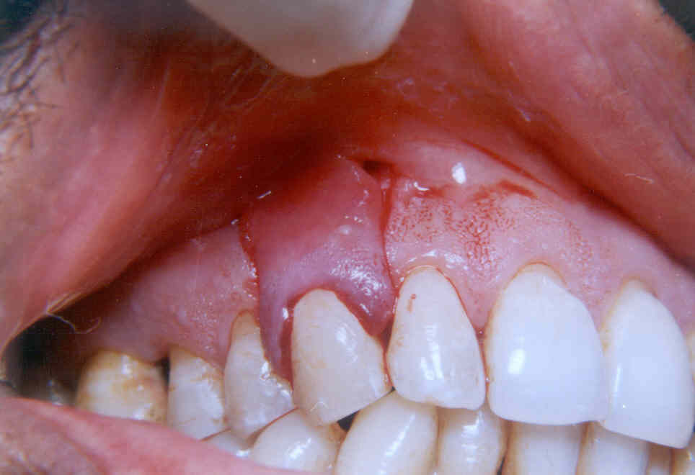

Slide 42
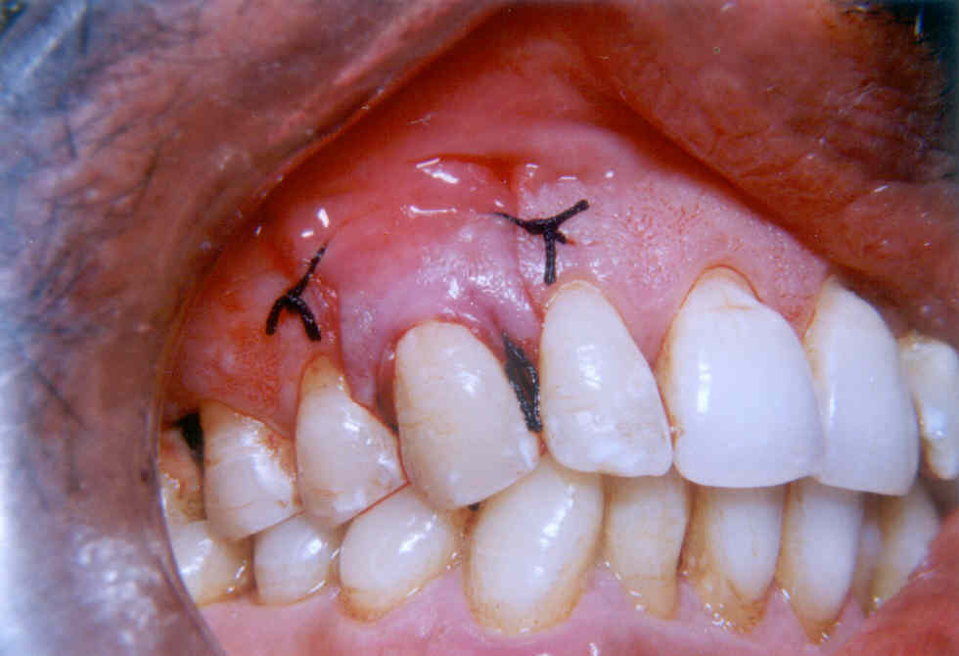
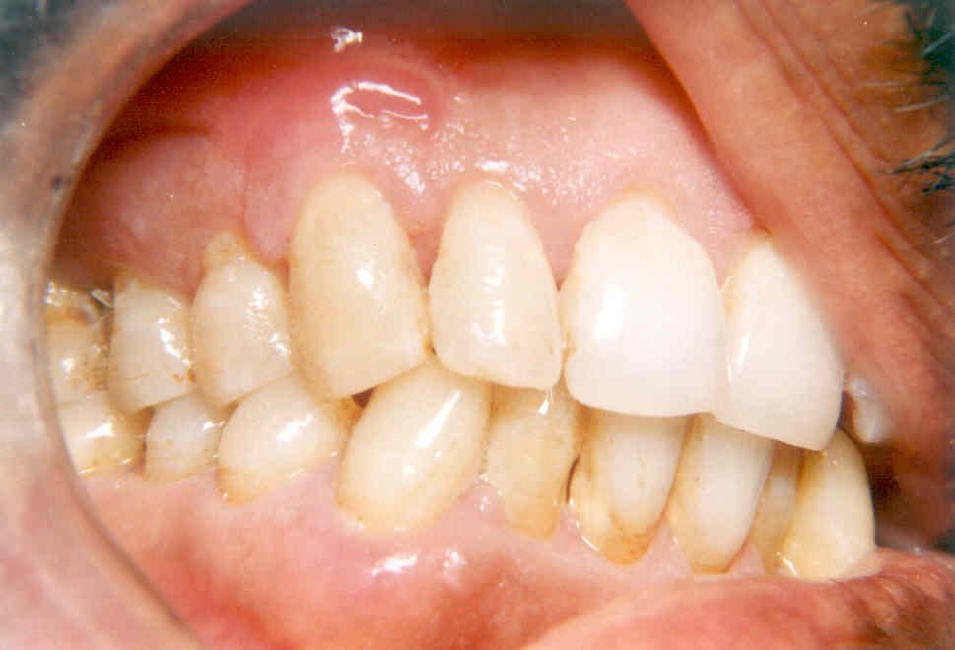

Slide 44
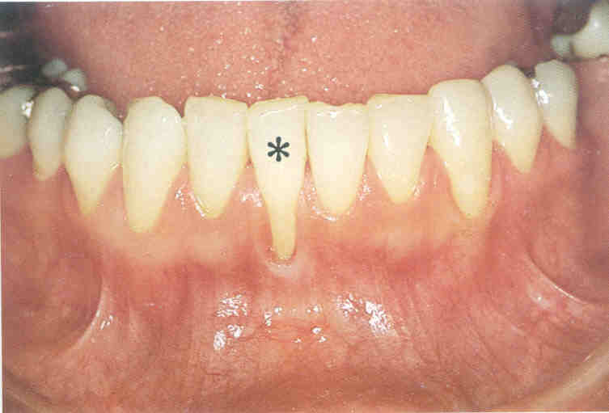
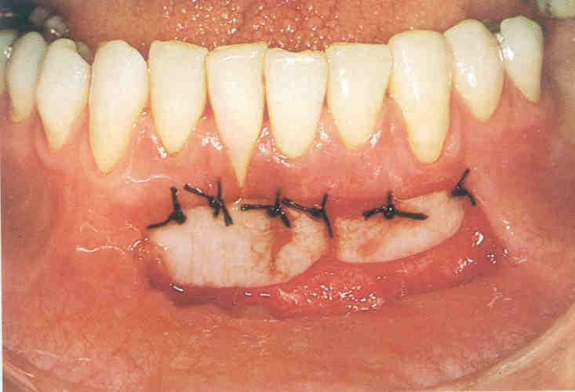

Slide 45
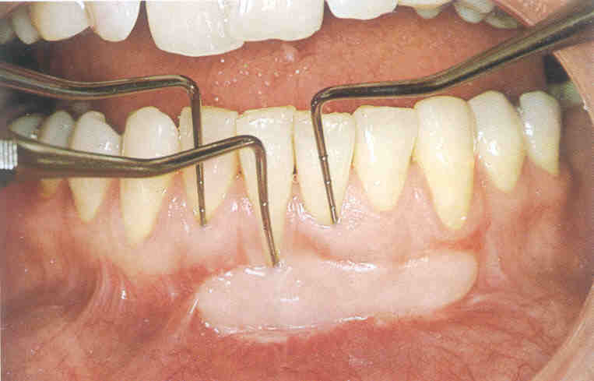
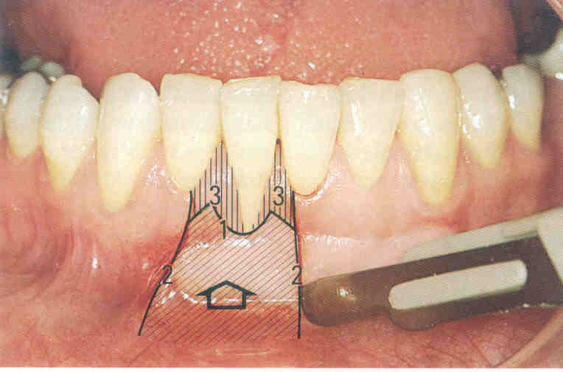

Slide 49
Tarnow’s Procedure
Semilunar coronally positioned flap to cover denuded root
1) A semilunar incision is which follows the curvature of gingival margin, ending at
2mm to 3mm short at one tip of interdental pappila.
2 Crevicular incision is made to split the incision.
3) The tissue will collapse coronally, covering denuded root. Hold the tissue with gauge
for few minutes.
Advantage: High success in maxilla.
2mm to 3mm of gingival recession can be covered.

Slide 54
Subepithelial connective tissue graft :
Described by Langer.
Indication: - for multiple gingival recession.
- Sufficient vestibular depth should be present.
Steps:
1) Vertical incision to prepared recipient site.
2) Raise mucosal flap.
3) Obtain a connective tissue from palate.
4) Connective tissue is sandwiched in the split flap .
5) Suture with resorbable material.

Slide 55
Guided Tissue regeneration for Root coverage:
Pini - Prato and colleagues have described.
1) Full thickness flap is reflected to the mucogingival line and
Partial thickness flap 8mm apical to mucogingival line.
2) Guided Tissue regeneration membrane is placed on the denuded root surface, it is
trimmed and adapted to cover atleast 2mm marginal periosteum.
3) Position the flap coronally.
4) Suture it.

Slide 60
Pouch and Tunnel technique:
Advantage: -Minimize incisions.
-Provide abundant blood supply to the donor site.
-Pouch allows intimate contact of donor tissue to the recipient bed.
Esthetic improvement.
-Good results with maxillary anterior with sufficient
vestibular depth.
Steps:
-Sulcular incision made around the of recession.
-Using either curette/blade, a tunnel is created beneath the adjacent buccal papillae.
-Split thickness pouch is created apical to the papillae, which has been tunnled.
-Connective tissue derived from palate is placed under the pouch or tunnel with a portion
covering the denuded root surface.
-Suture the flap by placing it more coronally.

Slide 68
Techniques to deepen the vestibule:
- Numerous surgical techniques have been proposed.
- Vestibuloplasty with nongraft procedures were not successful.
- predictable depening of vestibule;e can be accomplished by use of autogenous free grafting.

Slide 69
Technique for removal of frenum:
Frenum: it is a fold of mucosal membrane enclosed with muscle fibers, that attaches the
Lips, cheeks, gingiva and alveolar mucosa.
Tension on the frenum may pull the marginal gingiva away from the tooth.
So, - Plaque control is difficult.
- Gingival inflammation.
- Pocket formation.
-Mobility and Migration.
Frenectomy and Frenotomy:
Frenectomy: Complete removal of frenum including its underlying attachment to the bone.
Frenotomy: Incision of the frenum.

Slide 70
Purpose: - Relocate the frenum.
- Create a zone of attached gingiva.
- Plaque control become easier.

Slide 75
SMILE DESIGN

Slide 78
GBR
GTR
• Wound completely covered by flap (closed system)
• Sterile condition maintained during healing
• Membrane stable
• Adaptation of membrane easy
• Space making easy
• High predictability
• Open wound (open system)
• Sterile condition not maintained
• Membrane stabilization difficult
• Adaptation of membrane difficult
• Space making difficult
• Low predictability

Slide 79
Management of Root surface
Notes:
Removal of granulation tissue of osseous defect
Removal of Calculus, root planing, finishing using curets and finishing burs
T Hcl – 5 min (optional)

Slide 80
Management of Bone surface
Notes:
De cortication ( #1/2 round bur)
Membrane
Wide & deep osseous defects, 1 wall defect in which spacemaking is difficult, extensive furcation involvement – Bone grafts + GTR

Slide 81
Onlay Blocks
Onlay: “Placed over”
Useful for augmentation of moderate and severe horizontal and vertical ridge defects
Source of blocks : mandibular symphisis, ramus, iliac crest, rib grafts.
Basic technique:
Full thickness flap is elevated at the surgical site.
Cortical plate of bone at the recipient site is drilled with round bur: to improve vascularity.
Block is scored on inner aspect to obtain as close a adaptation as possible with the recipient site.
Fixation screws used to stabilize graft in place and to minimize micromotion to allow bone regeneration.
Small gaps can be filled with allogratfs, cancellous grafts.
No membrane is required. Membrane is used only if primary closure cannot be achieved.

Slide 82
ONLAY BLOCK GRAFTS

Slide 83
ONLAY BLOCK GRAFTS

Slide 84
Thank you
Hair pin road Austria

