Slide 1
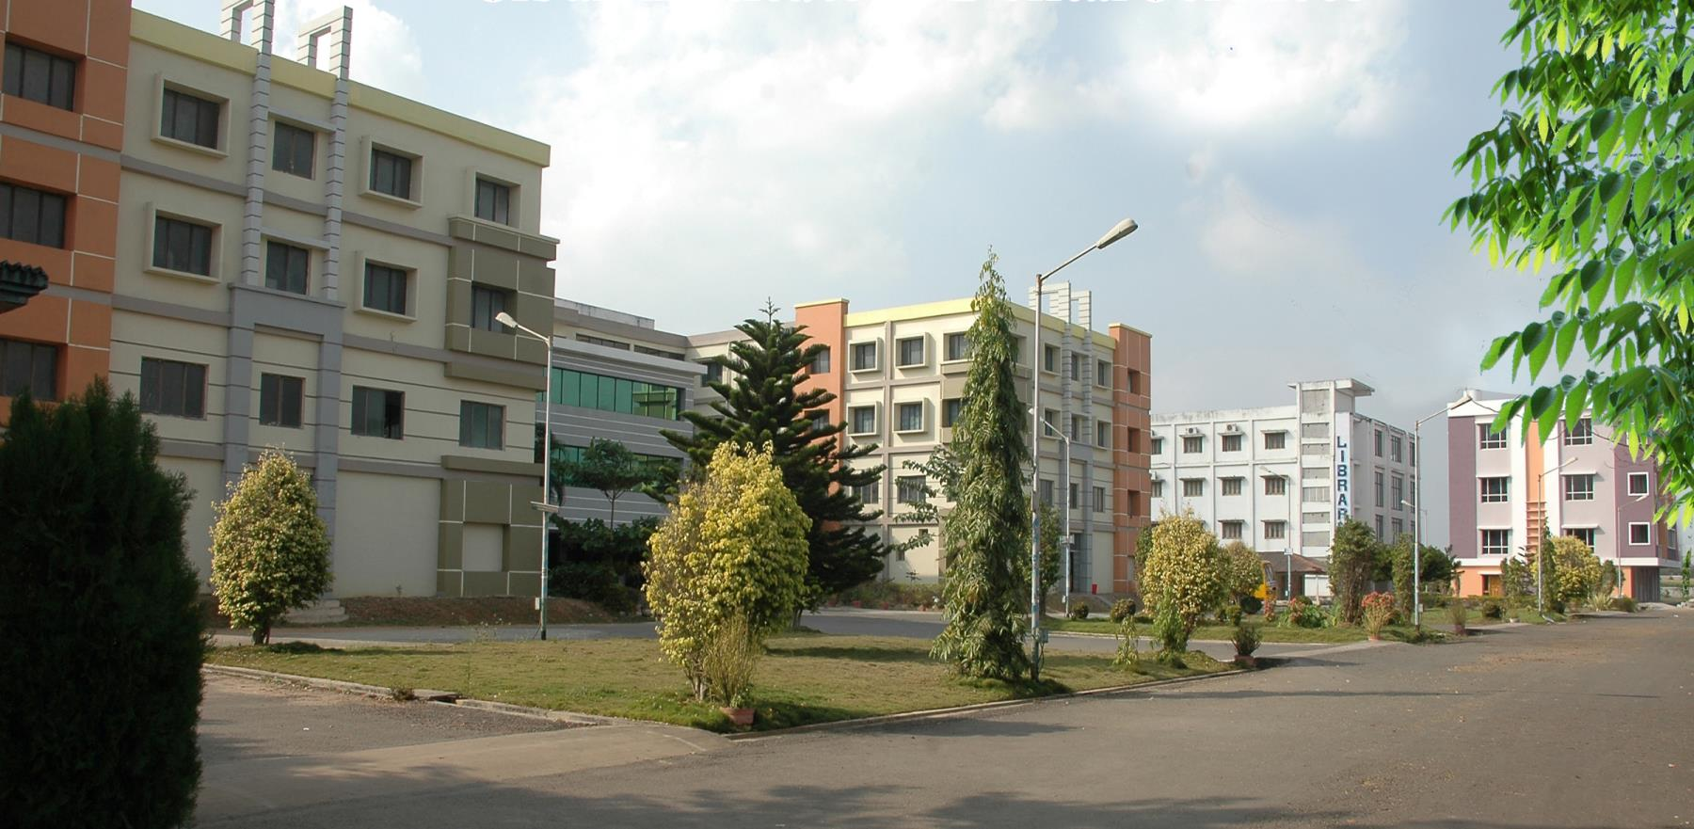

Slide 2
OCCUPATIONAL HAZARDS IN DENTISTRY
Dr.t.devaki
Professor
Dept . Of. Public health dentistry
SIBAR INSTITUTE OF DENTAL SCIENCES

Slide 3
CONTENTS
Introduction
History
Occupational hazards
Physical
Chemical
Biological
Mechanical
Psychological
Occupational hazards: department-wise
OSHA guidelines
Conclusion
References

Slide 4
What is a hazard?
A hazard is any source of potential damage, harm or adverse health effects on something or someone under certain conditions at work.

Slide 5
OCCUPATIONAL HEALTH
Occupational health has been defined by WHO as “the promotion and maintenance of the highest degree of physical, mental and social well being of workers in all occupations; the prevention among workers of departures from health caused by their working conditions; the protection of workers in their employment from risks resulting from factors adverse to health and the adaptation of work to man and of each man to his job”.

Slide 6
OCCUPATIONAL HAZARD
Occupational hazard refer to a risk or danger as a consequence of the nature or working conditions of a particular job.

Slide 7
HISTORY
BERNADINO RAMAZZINI, referred as father of occupational medicine in 18th century published his systemic study of occupational diseases in a book entitled “DE MORBIS ARTIFICUM DIATRIBE” in the year 1713.
The book had three principles causing occupational hazards which he recognised; they are as follows:
1. Fixed working posture
2. A continuous repetitive motion
3. Psychological stress

Slide 8
OCCUPATIONAL HAZARDS
Any person may be exposed to five types of hazards depending on his occupation:
Physical
Chemical
Biological
Mechanical
Psychosocial

Slide 9
PHYSICAL HAZARDS
Physical agent is defined as an entity without substance or with minimal matter, such as radiation, atmospheric variations, noise, and vibrations.
These agents encompass a wide range of potential health risks.
Many of these hazards can be minimized by some simple precautions.

Slide 10
HEAT
Electrical hazards
Spirit lamps and burners used during prosthesis making
Effects: Painful shocks, burns etc.

Slide 11
LIGHT
Poor illumination:
Causes- eye pain, headache and eye fatigue
Excessive brightness:
Causes- discomfort and visual fatigue
Prevention:
Sufficient and suitable lighting
Natural or artificial is advised

Slide 12
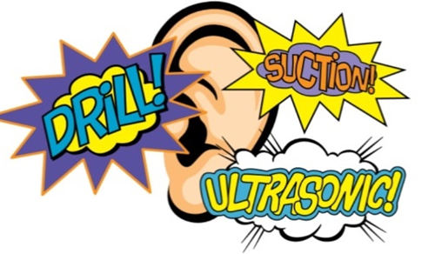
NOISE
Air-driven high-speed hand pieces, suction, ultrasonic scaler.
Effects: Hearing loss,
interference with communication,
acoustic stress and impaired power of concentration
Prevention:
Personal protection by using ear plugs and muffs which reduce high intensity sounds

Slide 13
RADIATION
Non- ionising radiation injury - Exposure to Dental Curing Light and Lasers
Causes- conjunctivitis and keratitis
Prevention - Protective eye wear during usage
Ionising radiation injury - Exposure to radiation
Causes- acute erythema, dermatitis, chronic skin cancer, bone marrow suppression, damage to eye including cornea, Somatic and genetic effects, Congenital defects, skin cancer.
Prevention - Lead gloves and lead apron.

Slide 14
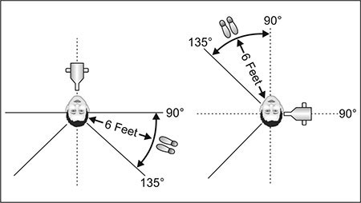
PREVENTION MEASURES
The basic methods to reduce occupational exposure include:
Position and distance rule: operator should stand at least 6 feet at an angle between 90 and 135 degree to the primary beam.
Operator should never hold the film in place.
Never hold the radiographic tube during exposure

Slide 15
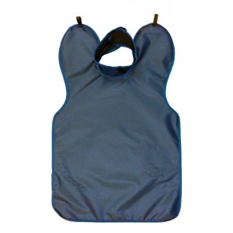
PREVENTION MEASURES
Use of thermo luminescent dosimeter or film badge to monitor radiation.
Patient protection by use of
Rectangular collimator
Filtration of low energy rays
Use of high speed films
Patient shielding by use of lead barrier

Slide 16
VIBRATION
The mechanical vibrations produced by some dental equipment like ultrasonic scalers and handpieces result in chronic extrinsic compression of the nerves in the hand.

Slide 17
SHARPS
Includes – needle prick injuries and injuries from sharp objects and spicules of bone and teeth
Needle cut injuries are also known as pre-cutaneous injuries; they are most efficient method of transmitting blood-borne infections.
Glassware and sharp needles, lancets, blades, broken ampules, test tubes are hazardous.
Cuts, scratches, abrasions are potential locations for infections.
Prevention: Safe working procedures and wearing of double gloves.

Slide 18
CHEMICAL HAZARDS
Dentists are exposed to various types of chemicals that are hazardous while providing care.
These chemicals act in three ways:
Local action
Inhalation
Ingestion

Slide 19
SILICA & BERYLLIUM
Silica: Inhalation of dust containing free silica or silicon dioxide in ceramic laboratories leads to silicosis.
Beryllium: Some of the dental alloys contain beryllium and if it inhaled while working on items such as dental crowns, bridges, and partial denture framework, they can cause Chronic Beryllium Disease (CBD).
Causes contact dermatitis
Highly toxic and result in respiratory irritation

Slide 20
FORMALDEHYDE
Formaldehyde is one of the chemical agents routinely used in the clinical set up mainly for disinfection of operatory area.
Liquid and vapour forms of formaldehyde may cause severe abdominal pain, nausea, vomiting and eye irritation.

Slide 21
XYLENE
Xylene is used in histological laboratories for tissue processing, staining and cover slipping and also in endodontic retreatment as a guttapercha solvent.
Exposure to xylene can occur via inhalation, ingestion, eye or skin contact.
Effects: Dizziness, headache, mental confusion from inhalation of vapour.
Acute: Eye and mucous membrane irritation from vapour and liquid forms.
Chronic: If xylene contains benzene as an impurity, repeated breathing of vapour for a long period may cause leukemia.

Slide 22
PREVENTIVE MEASURES
Substitution
Local exhaust ventilation
Proper protective equipment

Slide 23
METHACRYLATES
Methacrylate found in dental polymer materials can even result in contact dermatitis.
The free monomer during polymerisation can cause a wide range of adverse health effects like irritation to the skin, eyes or mucous membranes, allergic dermatitis, asthma and paraesthesia in the fingers.
Asthma due to acrylate compounds is also an important allergic occupational hazard.
Certain central nervous system disturbances may also be noted like headache, pain in the extremities, nausea, loss of appetite, fatigue, sleep disturbances, irritability, loss of memory and changes in blood parameters.

Slide 24
NITRIC OXIDE
N2O commonly called as laughing gas, is an anaesthetic agent used in operating rooms.
Workers are exposed to N2O while administering the anaesthetic gas to patients.
If used in high concentrations during anaesthetic administration, it may cause increased absorption and thereby liver and kidney damage with neuralgic disease and congenital abnormalities.
The harmful effects of occupational exposure to Nitrous oxide includes reduced fertility, spontaneous abortions, and neurological, renal and liver diseases.
Mental performance, audio-visual ability and mental dexterity is also affected in susceptible individuals.

Slide 25
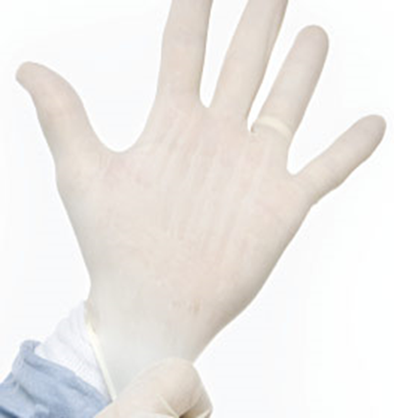
LATEX
Latex gloves is the main cause of allergic skin reaction in the dental office.
Latex allergy symptoms manifest as urticaria, conjunctivitis associated with lacrimation and swelling of eyelids, mucous rhinitis, bronchial asthma and anaphylactic shock.
PREVENTION:
Most allergic reactions can be managed by medication.
Sufferers from latex allergy are advised to work in latex free environment
and use vinyl, nitrile or 4H gloves.

Slide 26
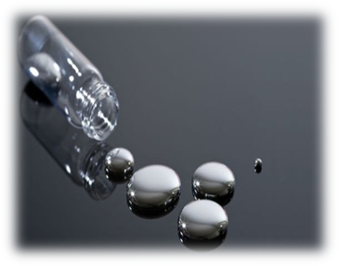
MERCURY
The dental profession primarily encounters mercury toxicity from two sources:
Inhalation of vapors
Direct absorption into the tissues from handling mercury containing compounds.

Slide 27
SOURCES OF CONTAMINATION:
Removing old amalgam restorations
Faulty amalgamators
Leaking amalgam capsules
Expressing excess mercury over the floor

Slide 28
SYMPTOMS OF CHRONIC MERCURIALISM
Muscular tremors progressing to convulsions
Loss of appetite, nausea, diarrhea
Nervous excitability, insomnia
Mental depression, speech disorders
Dark pigmentation of the marginal gingiva
Metallic taste and excessive salivation

Slide 29
PREVENTIVE MEASURES
Water irrigation and high suction
Good ventilation
Proper collection and disposal of amalgam
Use of pre-capsulated alloys with low mercury levels
Excess and spilled mercury should be collected in fixer containing break resistant bottles.

Slide 30
BIOLOGICAL HAZARDS
Biological hazards or biohazards are biological substances (viruses, bacteria and fungi, as well as parasitic worms and some plants) that are considered as possible threats to the health of living organisms.
They are constituted by infectious agents of human origin and include viruses, bacteria, and fungi.
Dentists may get infected either by
Direct contact
Indirect contact-Needle prick injury, Aerosols in saliva, Organic dust particles

Slide 31
Four main pathways of spreading biohazards in dental medicine are:
Blood-borne route
Saliva-droplet route
Direct contact with a patient and contaminated equipment
Water-droplet route

Slide 32
The United States Centres for Disease Control and Prevention categorizes various diseases in levels of biohazard, Level 1 being minimum risk and Level 4 being extreme risk.
Biohazard Level 1: includes bacteria and viruses (Escherichia coli, varicella, etc.) causing simple diseases.
Biohazard Level 2: includes bacteria and viruses that cause only mild disease to humans, or are difficult to contract via aerosol in a lab setting (hepatitis A, B, C, HIV, etc).
Biohazard Level 3: includes bacteria and viruses that can cause severe to fatal disease in humans, but for which vaccines or other treatments exist (anthrax, tuberculosis, etc).
Biohazard Level 4 are viruses (currently there are no bacteria classified at this level) that cause severe to fatal disease in humans, and for which vaccines or other treatments are not available (Novel Corona virus, Ebola virus, etc).

Slide 33
AEROSOLS
Aerosols is defined as particles less than 50 micrometers in diameter.
Dental aerosols may be defined as suspensions of extremely fine air-borne particles that are liquid, solid or combinations of both.
These are ejected from operating site and suspended in the air and are airborne infection in dentistry.
Air turbine hand pieces, air-water sprays, some rotary instruments, ultrasonic scalers, dental lathes all produce aerosols that have the potential to cause disease primarily due to inhalation.

Slide 34
Dental aerosols may have three components:
Bacteria and viruses
Particles of tooth structure
Particles of dental materials

Slide 35
Aerosols of enamel, dentin, amalgam, and composite resins are produced during high speed cutting or finishing. These particles are known to be contaminated with microbes.
The use of high-velocity suction is recommended to reduce aerosols and lower the health risk.

Slide 36
PREVENTIVE MEASURES
Personal protection equipment
Rubber dam
Suction (high velocity)
Preoperative mouth rinse
Good ventilation
Spray operatory with disinfectant

Slide 37
PREVENTIVE MEASURES
Flush water lines on dental units
Avoid instruments that produce splatter
Sterilization of dental instruments, and
Protective vaccination of dentists especially against hepatitis B

Slide 38
MECHANICAL HAZARDS
Mechanical hazards are created as a result of either powered or manual use of tools, equipment or machinery.
Musculoskeletal disorders and neurological injuries are common health problems reported among dentists.
Common musculoskeletal problems are, low back pain, shoulder pain, headache, hand and wrist pain.
Dentistry procedures incorporate such postural situations which increases the risk of twisting and contorting the body, varicose etc.

Slide 39
PREVENTIVE MEASURES
Changing posture
Using support
Safe reaching
Normal arm posture
Using comfortable equipment
Managing time

Slide 40
PSYCHOLOGICAL HAZARDS
Psychological hazards mainly include stress, chronic tiredness and burnout syndrome.
Exposure to psychosocial hazards in the workplace not only produces psychological damage such as depression and anxiety, but also causes somatic disorders such as cardiovascular diseases, hypertension, neurological disorders, insomnia and headaches, etc.
Stress is the main psychological hazard seen in the dental office.
Chronic stress in the work environment is one of the leading factors for burnout syndrome and could have a deleterious effect on health.

Slide 41
Failure associated with improper treatment planning and an inappropriate diagnosis can be stressful to both doctor and patient.
As a consequence, the dentist is susceptible to develop increased tension, high blood pressure, fatigue, sleeplessness, touchiness and depression.
Stressful situations can be resolved with thorough knowledge of psychology, good communication skills and by establishing proper relation between the dentist and the patient which also decides the outcome of the treatment.

Slide 42
OCCUPATIONAL HAZARDS: DEPARTMENT-WISE

Slide 43
ORTHODONTICS
Occular problems – laser, curing lights
Hearing problems – suction, saliva ejector, compressor
Aerosol contamination – impression material, scaling, debonding procedures

Slide 44
ORAL & MAXILLO-FACIAL SURGERY
Infection – blood and body fluids
Physical injuries – sharps and complex armamentarium
Chemical injuries – exposure to formaldehyde, iodine & isopropyl alcohol, anaesthetic gases

Slide 45
CONSERVATIVE DENTISTRY & ENDODONTICS
Mercury poisoning
Hearing problems
Radiation hazards
Aerosol contamination

Slide 46
PERIODONTICS
Hearing problems
Occular problems
Infections

Slide 47
ORAL MEDICINE & RADIOLOGY
Radiation hazards
Infections

Slide 48
PEDODONTICS
Nitrous oxide hazards
Aerosol contamination

Slide 49
PROSTHODONTICS
Physical injuries – sharps and high speed projectiles during trimming and polishing
Allergies – methacrylate, glutaraldehyde
Occular injuries

Slide 50
ORAL PATHOLOGY
Formaldehyde hazards
Infections

Slide 51
PUBLIC HEALTH DENTISTRY
Infections – dental camps, Mobile Dental Unit (MDU)
PREVENTIVE MEASURES:
Sterilizing instruments by boiling or by using pressure cooker ( if available).
Disinfection of items that cannot withstand sterilization temperatures using anti-microbial chemicals.
Using protective equipment and aseptic precautions all the time.
Pre-procedural mouth rinsing using anti-septic mouthwash.
MDU should be fumigated a minimum of once every month.

Slide 52
OSHA GUIDELINES

Slide 53
OSHA is part of the United States Department of Labour
Congress established the agency under the Occupational Safety and Health Act, which President Richard M. Nixon signed into law on December 29, 1970.
To ensure safe and healthful working conditions for working men and women by setting and enforcing standards and by providing training, outreach, education and assistance.

Slide 54
BLOOD-BORNE PATHOGENS STANDARD
A written exposure control plan, to be updated annually.
Use of universal precautions.
Consideration, implementation and use of safer engineered needles and sharps.
Use of engineering and work practice controls and appropriate personal protective equipment (gloves, face and eye protection, gowns).
Hepatitis B vaccine provided to exposed employees at no cost.

Slide 55
Medical follow-up in the event of an “exposure incident” .
Use of labels or color-coding for items such as sharps disposal boxes and containers for regulated waste, contaminated laundry and certain specimens.
Employee training.
Proper containment of all regulated waste.

Slide 56
HAZARD COMMUNICATION STANDARD
A written hazard communication program.
A list of hazardous chemicals (such as alcohol, disinfectants, anaesthetic agents, sterilant and mercury) used or stored in the office.
A copy of the Material Safety Data Sheet (MSDS) for each chemical (obtained from the manufacturer) used or stored in the office.
Employee training.

Slide 57
IONIZING RADIATION STANDARD
A survey of the types of radiation used in the facility, including x-rays.
Restricted areas to limit employee exposures.
Employees working in restricted areas must wear personal radiation monitors such as film badges or pocket dosimeters.
Rooms and equipment may need to be labelled and equipped with caution signs.

Slide 58
EXIT ROUTE STANDARDS
These standards include the requirements for providing safe and accessible building exits in case of fire or other emergency.
Exit routes sufficient for the number of employees in any occupied space.
A diagram of evacuation routes posted in a visible location.

Slide 59
ELECTRICAL STANDARDS
OSHA electrical standards apply to electrical equipment and wiring in hazardous locations.

Slide 61
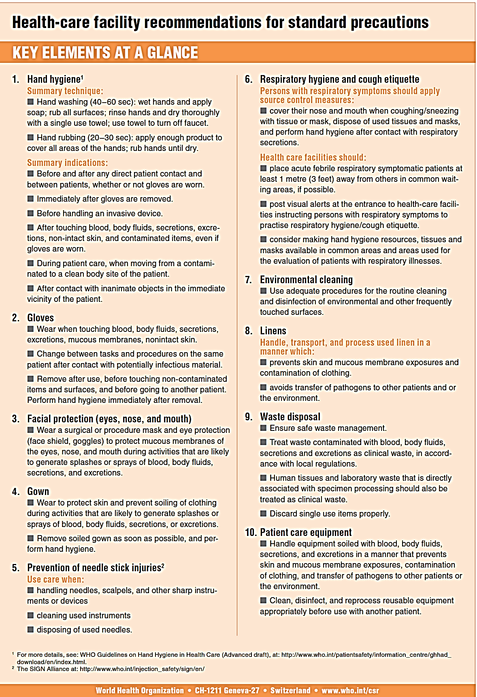

Slide 62
CONCLUSION
Dental professionals are at greater risk of exposure to numerous Occupational Health Hazards. Sufficient knowledge and adequate information regarding occupational hazards and its prevention will contribute in providing quality care to patients. Hence, there is a need to recognize possible hazards and to implement specific measures to control and reduce these hazards.

Slide 63
REFERENCES
K.Park. Park’s textbook of preventive and social medicine 2019: 25th edition, M/s Banarsidas Bhanot publishers : 864-880.
Sandeepa NC, Salha Hossien Ali, Tahani Abdullah Al-Qahtani. Occupational Hazards and preventive practices among Dentists in Saudi Arabia-a cross-sectional survey. ACTA Scientific Dental Sciences 2019;3(1): 145-153.
Chinta Siva Naga Yasaswi, Neerisetty Prasnthi, Bommireddy Vikram Simha, Tieumala Dabburi, Kommineni Harish Chowdary, Yaddanapalli Suresh Chand. Occupational Hazards in Dentistry and Preventing them. Int J Med Rev 2018;5(2): 60-67.
Marin Vodanovic, Ivan Galic, Jeta Kelmendi, Renata Chalas. Occupational Hazards in Contemporary Dentistry. Journal of Medical Sciences 2017;44: 25-41.

Slide 64
Kommuri Sahiti Reddy, Dipak Sadhan Paul Majumder, Dolar Doshi, Suhas Kulakarni B, Srikanth Reddy M, Padma Reddy. Occupational Hazards in Dentistry. J Res Adv Dent 2017;6(2): 110-122.
Solanki J, Gupta S. Occupational Hazards among Western Indian private dental practitioners: A questionnaire-based descriptive study. J Indian Assoc Public Health Dent 2017;15: 48-52.
Shiva Kumar GC, Sahana S, Prahant Mishra. Occupational Hazards in the detal office-an overview. International Journal of Contemporary Medicine, Surgery and Radiology 2017;2(1): 29-31.
Reddy V, Bennadi D, Satish G, Kura U. Occupational Hazards in Dentists: A Descriptive Study. Journal of Oral Hygiene and Health 2015;3(5)

Slide 65
Abhishek Mehta, Mohit Gupta, Nancy Upadhyaya. Status of Occupational Hazards and their prevention among dental professionals in Chandigarh, India: A comprehensive questionnaire survey. Dent Res J 2013;10(4): 448-451.
Jamshid Ayatollahi, Fatemah Ayatollahi, Ali Mellat Ardekani, Rezvan Bahrololoomi, Jahangir Ayatollahi, Ali Ayatollahi, Mohammad Bagher Owlia. Occupational Hazards to dental staff. Dent Res J 2012;9(1): 2-7.
SS Chopra, SS Pandey. Occupational Hazards among Dental Surgeons. Medical Journal of Armed Forces India 2007;63(1): 23-25.

Slide 66
https://www.who.int/csr/resources/publications/standardprecautions/en/ last accessed on 17-05-2020.
https://www.osha.gov/aboutosha last accessed on 17-05-2020.
https://en.wikipedia.org/wiki/Occupational_Safety_and_Health_Administration last accessed on 17-05-2020.
https://www.osha.gov/pls/publications/publication.athruz?pType=Industry&pID=64 last accessed on 17-05-2020.

