Slide 1


Dr. B. Venkat Ramana Reddy
Professor & Principal

Slide 2

Sinus → Hollow
To denote → Cavity
Paranasal Sinuses → “ These are air filled extenstions of the respiratory part of the nasal cavity into various cranial bones”
Frontal
Ethmoidal
Maxillary
Sphenoidal

Slide 3
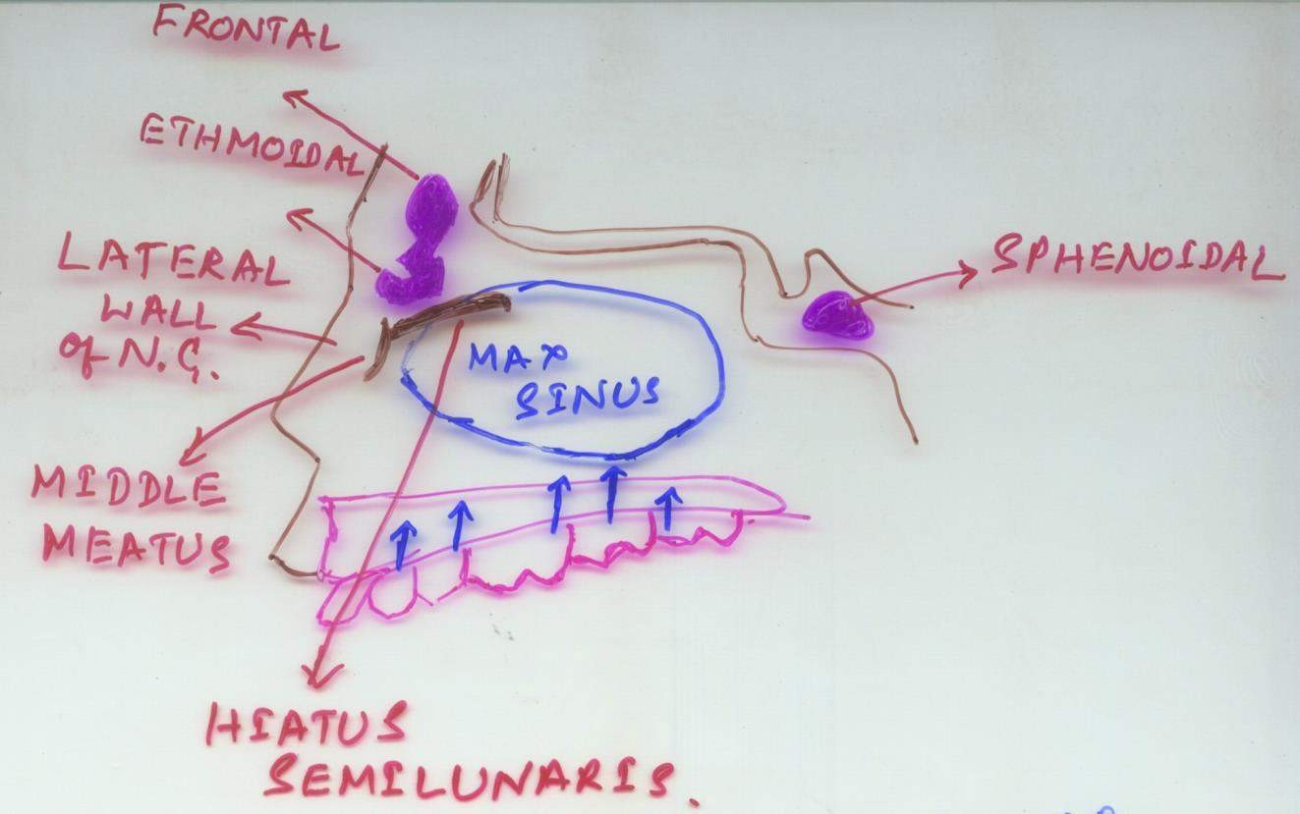

Slide 4

Maxillary sinus
Largest
1st to develop
Highmore → “Sinus of Highmore”
“It is the Pneumatic space that is lodged inside the body of the maxilla and that communicates with the environment by way of the middle nasal meatus and the nasal vestibule.”

Slide 5
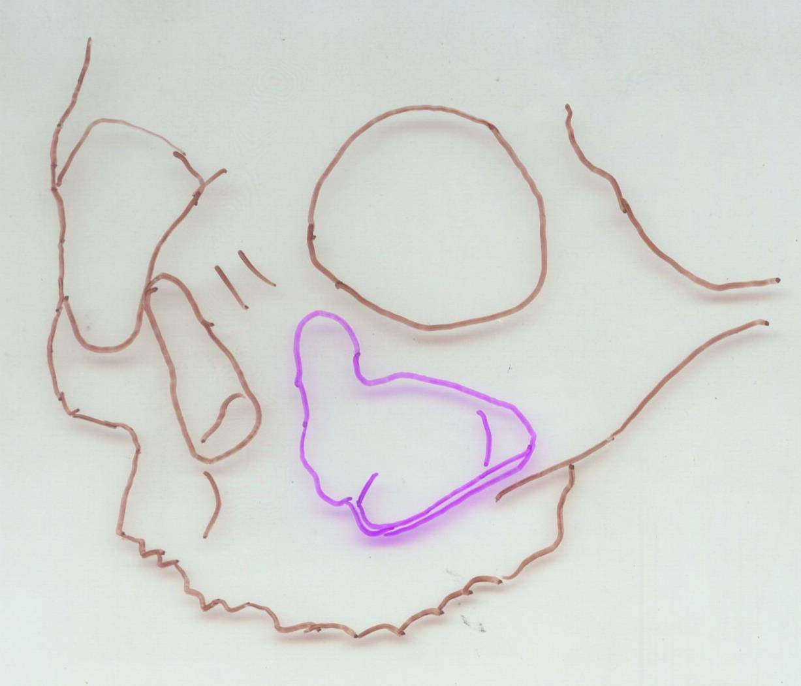

Slide 6
Development → 10 week IUL
Primary Pneumatization
Secondary Pneumatization
→Growth of mucous membrane sacs
Ethmoidal cartilage of Middle meatus
→Expansion into the bone

Slide 7
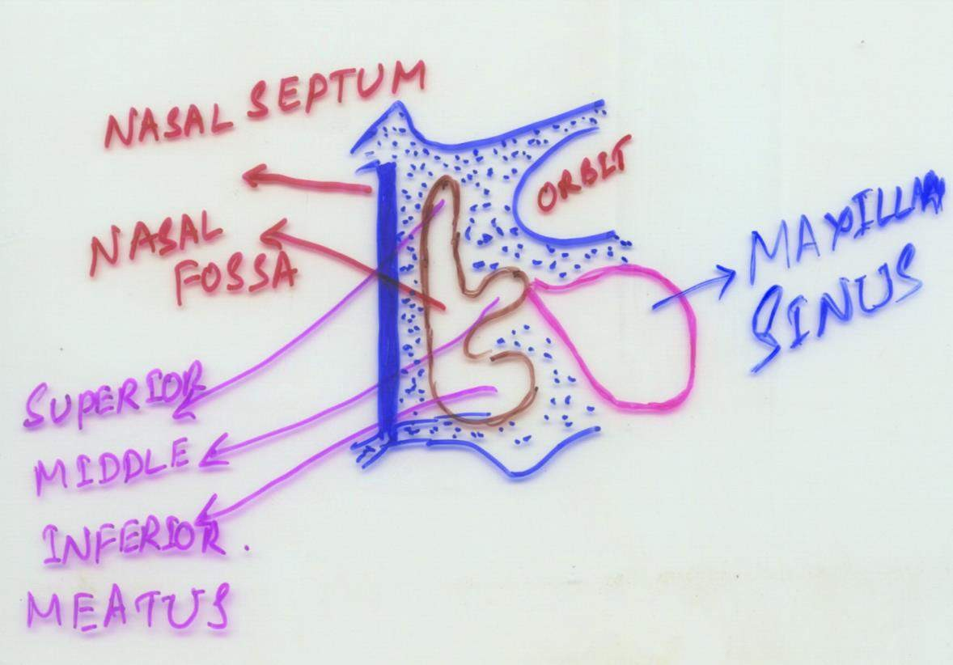

Slide 8
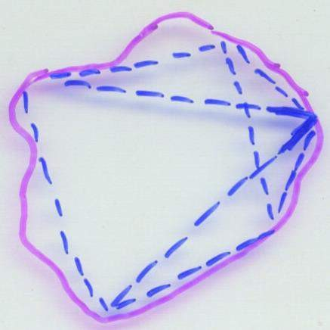
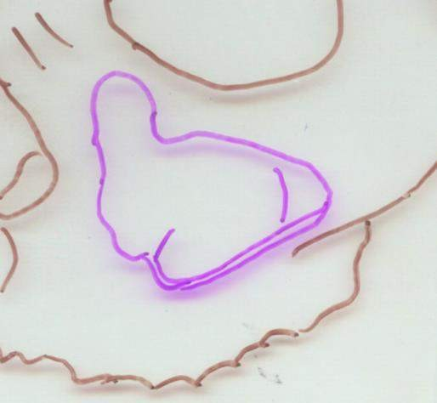
Birth → Tubular
Childhood → Ovoid
Adults → Pyramidal
Base
Apex

Slide 9
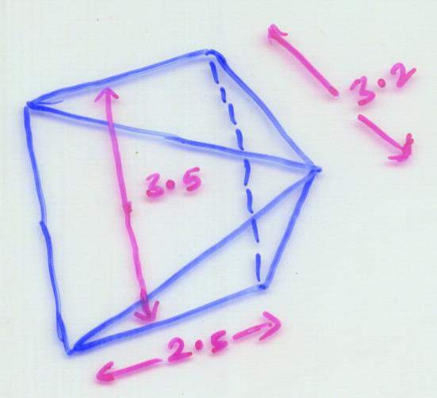
Anatomy
Body of Maxilla
  Apex
  Base
  4 sides
Dimensions
  Height → 3.5 cm
  Anteroposterior →  3.2cm
  Width → 2.5cm
  Volume → 30 ml

Slide 10

Margins
Superiorly → Orbital floor
Inferiorly → Alveolar Process
Anteriorly → Facial surface of Maxilla
Posteriorly → Infra temporal surface
Orbital floor
infratemporal surface
Alveolar surface
Facial surface of the maxilla

Slide 11
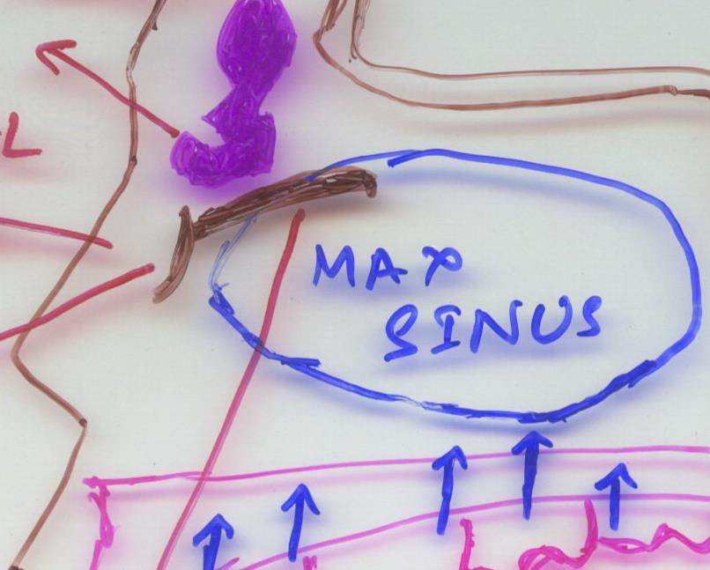
Opening
Maxillary sinus
Hiatus semilunaris
Nasal cavity ( Through ostium )

Slide 12
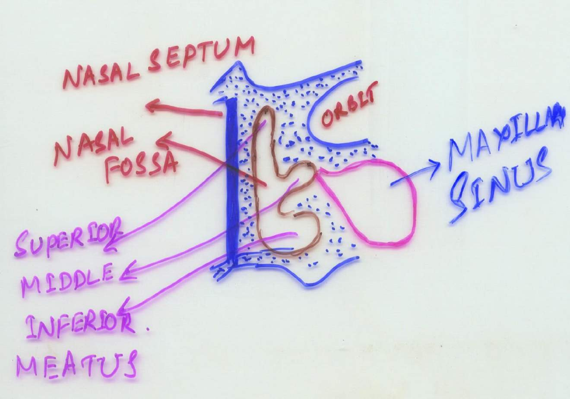

Slide 13
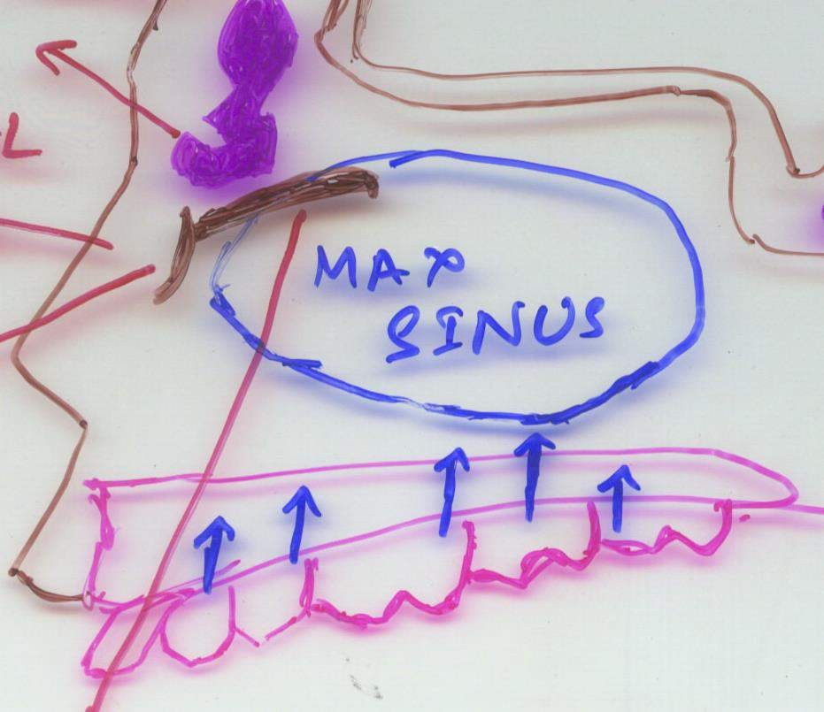
Proximity of Teeth
2nd Molar
1st Molar
3rd Molar
2nd Premolar
1st Premolar
Canine

Slide 14
Arterial Supply:-
  Facial Artery
  Infraorbital Artery
  Greater Palatine Artery

Slide 15
Nerve Supply:-
-Infra-Orbital Nerve
-Anterior, Middle and Posterior Alveolar nerves
Lymphatic Drainage:-
-Into the Submandibular Lymph nodes

Slide 16
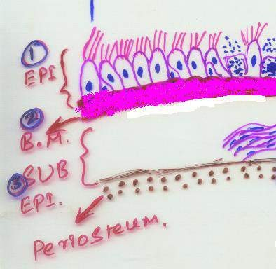
Histology
Epithelial Layer
Basal Membrane
Subepithelial layer
Periosteum

Slide 17
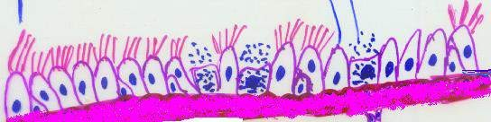
Epithelial layer
Pseudo-Stratified Ciliated Columnar

Slide 18


The epithelium is derived from the olfactory epithelium of the middle nasal meatus and therefore undergoes the same pattern of differentiation as does the respiratory segment of the nasal epithelium proper.
4 types of cells
  Ciliated Columnar cell
  Non - ciliated Columnar cell 3.Goblet cell
4.Basal cell

Slide 19
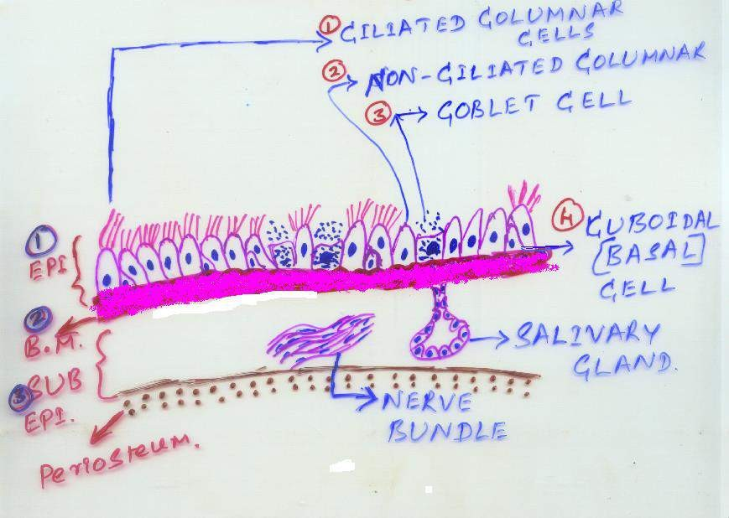
Sub epithelial gland

Slide 20
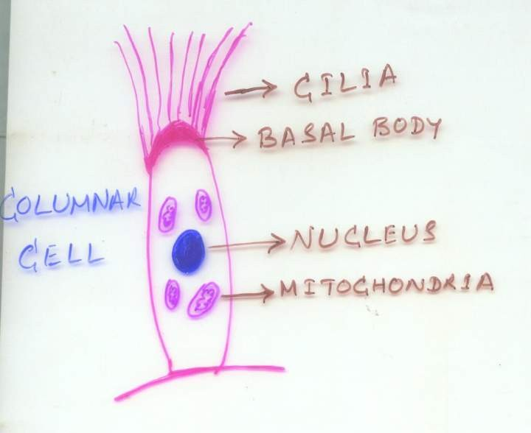
1.Ciliated Columnar cell:-
  Numerous
  Centrally placed Nucleus
  Mitochondria

Slide 21
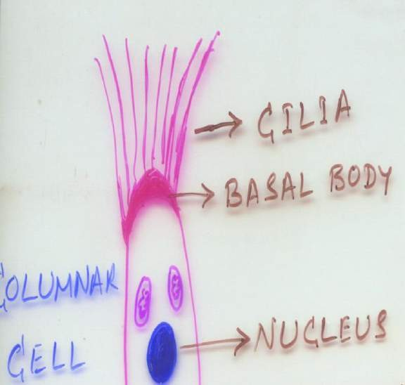
Cilia:-
–9 +1 pairs of Microtubules
–Basal bodies – attaches – Apical segment of Cilia
–Moves → Mucous, Foreign bodies
–Immotile cilia syndrome

Slide 22
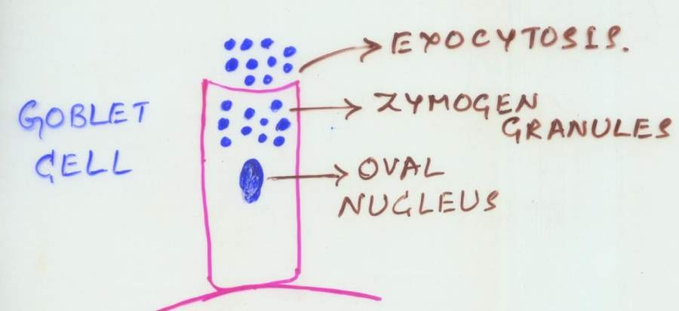
2. Goblet cell
-Modified Columnar cells
-Oval Nucleus
-Apex → Zymogen granules - Exocytosis
-Basal → Organelles for secretion
→rER and SER

Slide 23
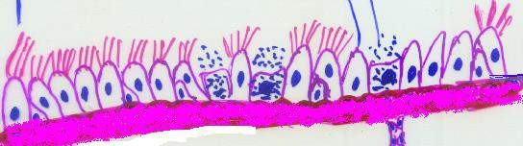
3.Non-ciliated Columnar Cell
Oval nucleus, More cell organelles
4.Basal Cell
-Undifferentiated cell

Slide 24
Basement Membrane
Type IV Collagen
Laminin
Proteoglycans
Glycosaminoglycans

Slide 25
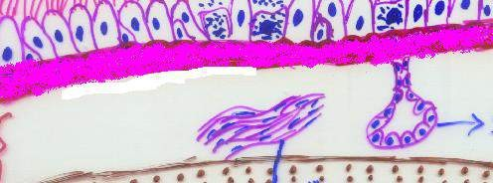
Sub-Epithelial Layer
Serous :-
Water Lipids Proteins
Mucous :- Glycoproteins
+ MPS
Serous / Mucous Glands
Nerve fibers
Blood vessels
Fibroblasts
Collagen

Slide 26
Functions
Resonance
Lightens – Skull
Resists – Shock
Humidification – air
Protects brain against cold
Traps – Foreign material – moves - Nasopharynx

Slide 27
Developmental Anomalies
Enlargement → Pituitary gigantism
Size / Absent → Apert ‘s Syndrome
→ Congenital Syphilis
→ Cleft Palate
→ Treacher-collin syndrome
Supernumerary Sinus

Slide 28
Clinical Consideration
Common cold –Rhinitis – Sinusitis
Dental Abscess
Root fragment
Fracture
Deviated nasal septum – DNS
Tumors / Cysts

Slide 29
Oro-Antral Communication / Fistula
Extraction
Trauma
Surgical
Osteomyelitis
Gumma
Nose-blow test
C/F
Regurgitation of fluid
Epitaxis
Alteration of resonance
Foul odour

Slide 30



