Slide 1

MAXILLARY SINUS
Antrum of Highmore
Dr Vidya Sagar MDS,
Senior Lecturer,
Department of OMFS,
SIBAR Institute of Dental Sciences.

Slide 2
Contents
Introduction
Growth and Development
Anatomy
Functions
Diseases related to maxillary sinus
Maxillary Sinusitis
Oro - Antral communication and Fistula
Covid-19 and Mucormycosis
References

Slide 3
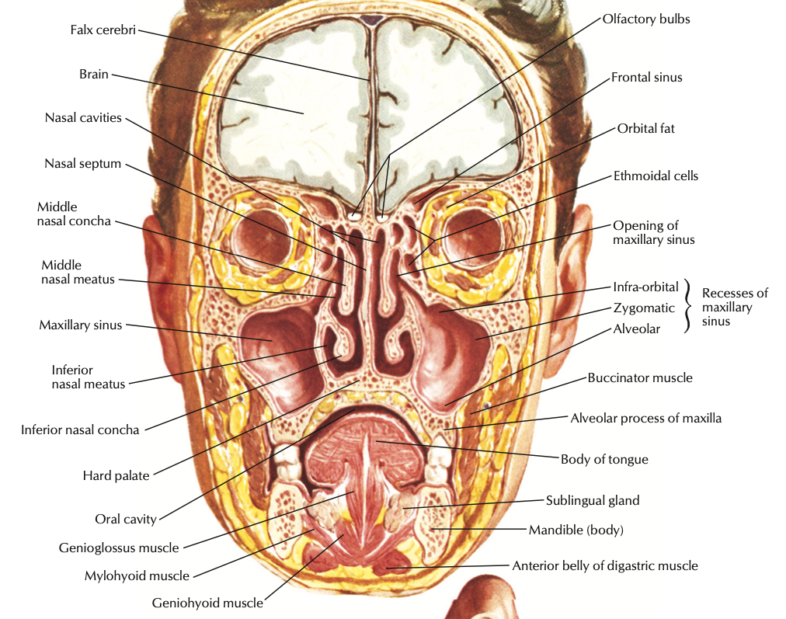
Introduction
Air sinuses
Paranasal air sinuses are air filled, mucosa - lined cavities in the facial skeleton that communicate with the nasal airway.
The complex anatomy, as well as their functions makes the sinuses an interesting and rewarding to study.

Slide 4
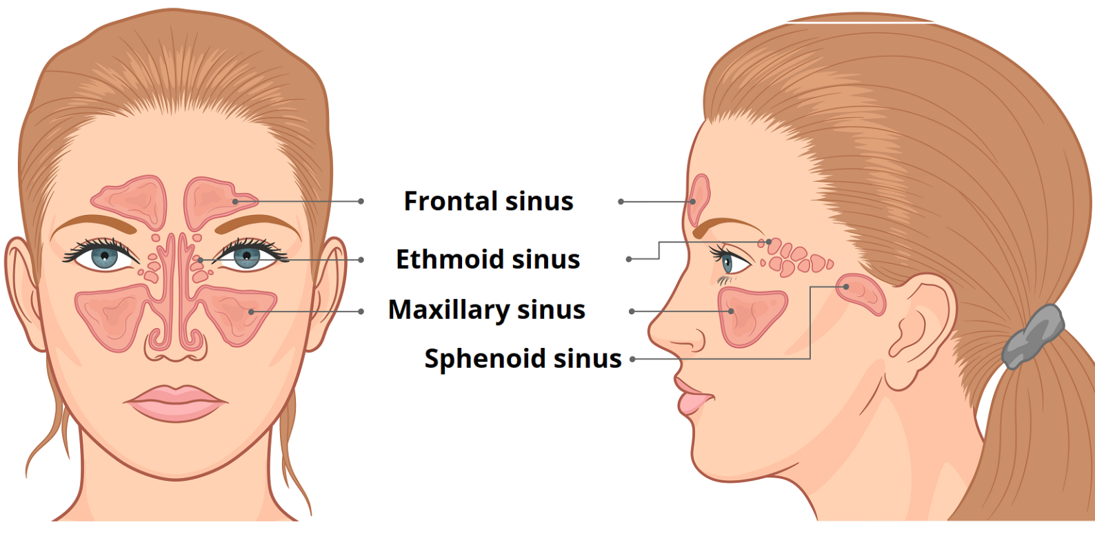
PARA NASAL SINUSES
Frontal Sinus - paired
Ethmoidal Sinus :
  Anterior
  Middle
  Posterior
Sphenoidal Sinus - single
Maxillary Sinus - paired

Slide 5
Growth and Development
The maxillary sinus is the first of the para-nasal sinuses to develop.
It appears as a lateral evagination or pouch of the mucous membrane of the middle meatus of the nose at about the third month of the IUL.
The neck of the pouch remains small and forms the future ostium.
The growth of the antrum occurs by pneumatization and it is proportional to that of the body of the maxilla.
At birth the maxillary sinus is a shallow cavity about 2cm long anteroposteiorly, 1cm wide and 1cm in height situated on the lateral wall of the nose.
It shows biphasic growth at 0-3 yrs and 7-12 yrs of life and reaches its maximum size by 18 yrs of age.

Slide 6
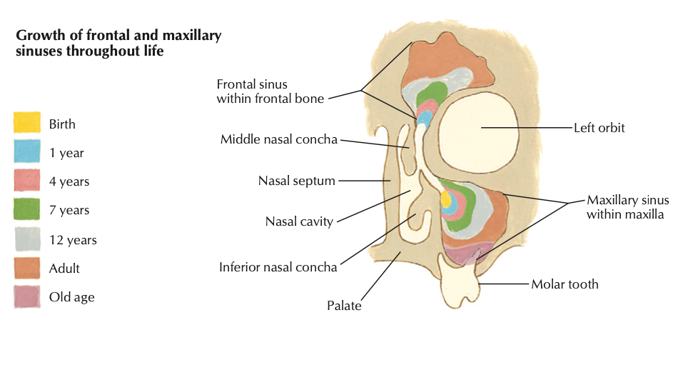

Slide 7
Surgical Anatomy
Largest paranasal sinus.
Lies within the body of the maxilla.
Pyramidal in shape with apex extending into the zygomatic process and the base is formed by the lateral wall of the nose/maxilla.
The size of an average maxillary sinus is :
  Anteroposterior - 35mm
  Mediolateral - 27 mm
  Superoinferior - 37 mm
Adult maxillary sinus has a volume of 15-30 ml.

Slide 8
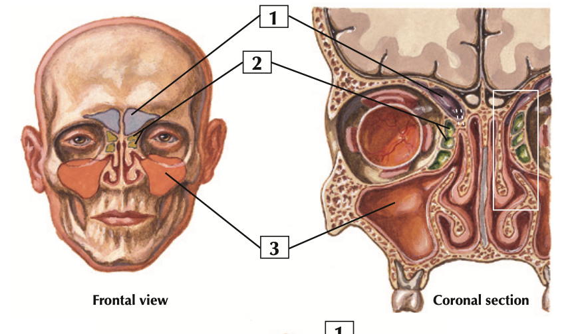
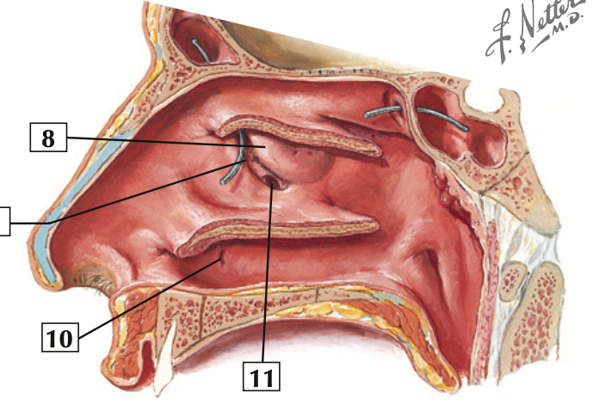
OSTIUM OF MAXILLARY SINUS
Opening of the maxillary sinus is in the middle meatus (lower part of Hiatus semilunaris).
The Ostium lies approximately 2/3rd height on the medial wall of the sinus, making spontaneous drainage difficult.
Blockage of the ostium can easily occur when there is inflammation of the mucosal lining of the ostum.

Slide 9
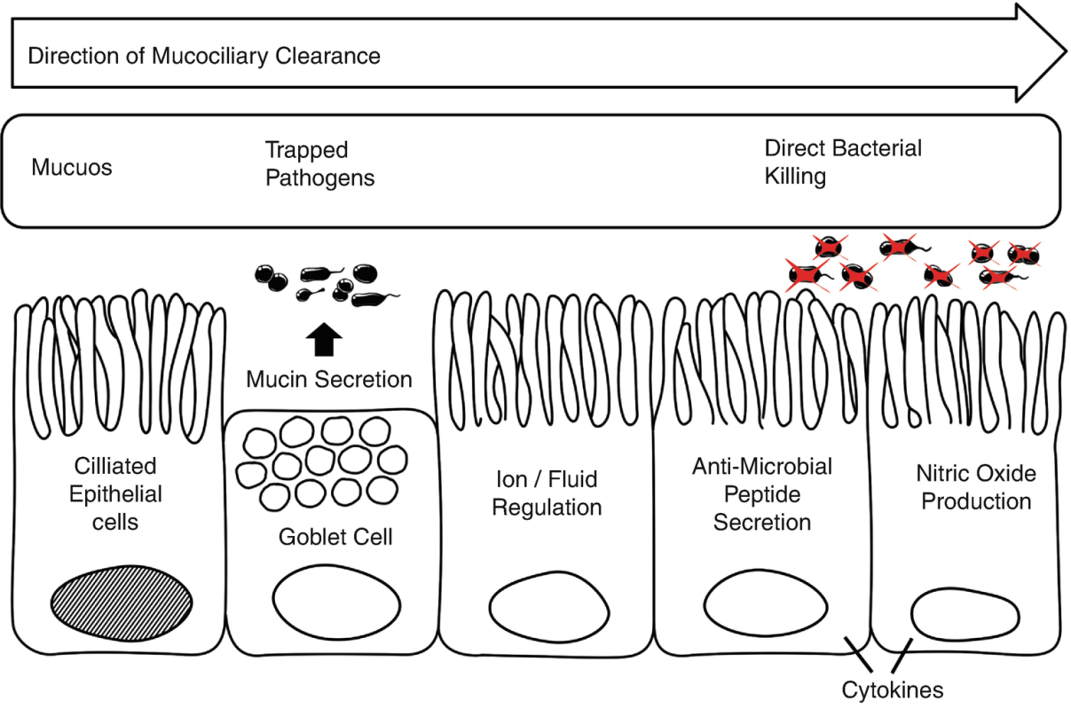
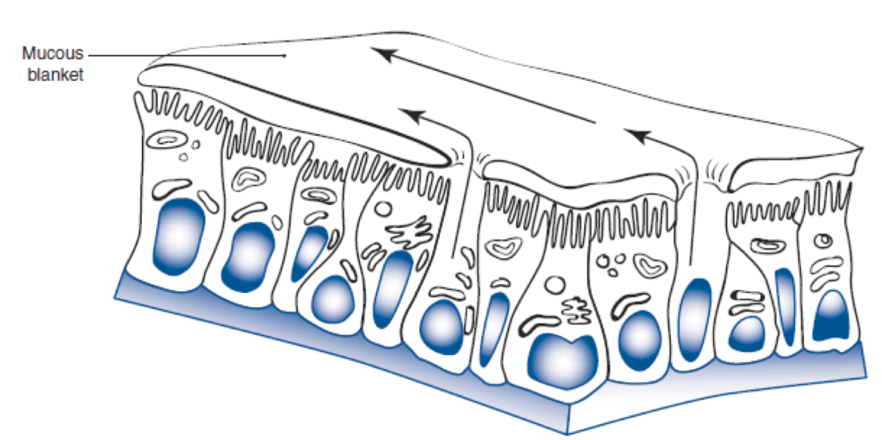
Schneiderian membrane
Pseudo stratified columnar ciliated epithelium (2.16-3.11 mm thick)
Mucous secreting cells (Goblet cells)
Sweeping motion of the cilia clears the sinus secretions along with trapped dust particles and microbial agents.

Slide 10
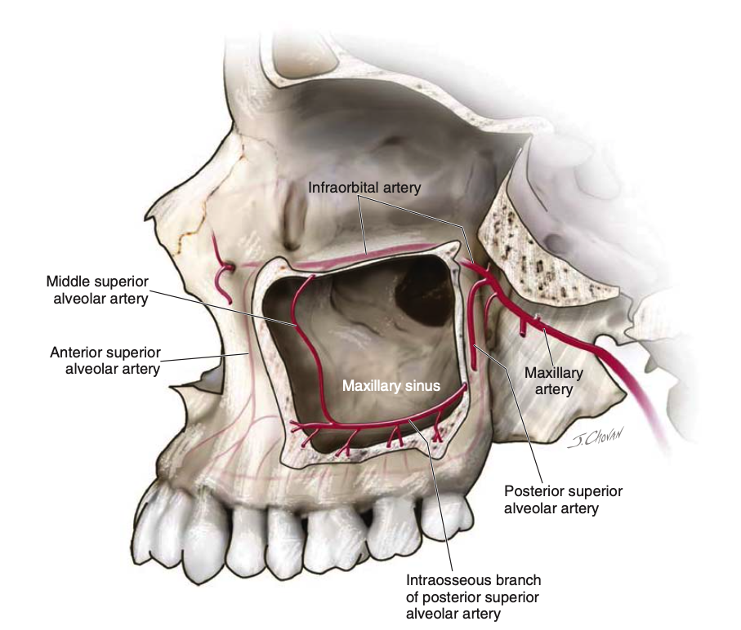
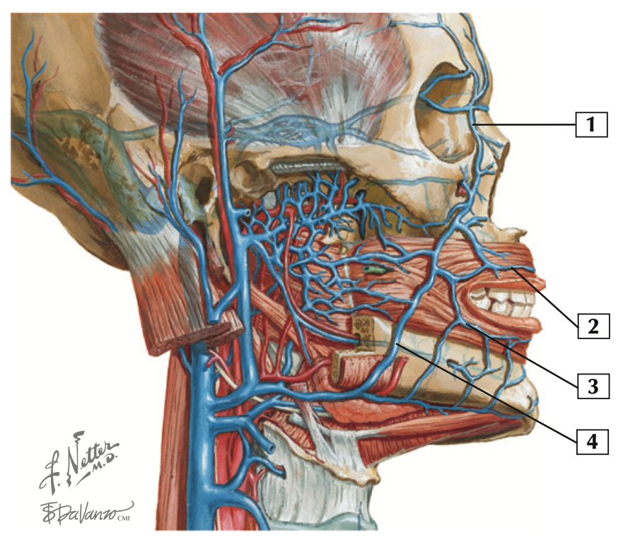
BLOOD SUPPLY
Arterial supply :
  Maxillary artery
    Infra orbital artery
    PSA artery and its intra osseous branches
  Facial artery
Venous drainage :
  Facial vein
  Pterygoid plexus

Slide 11
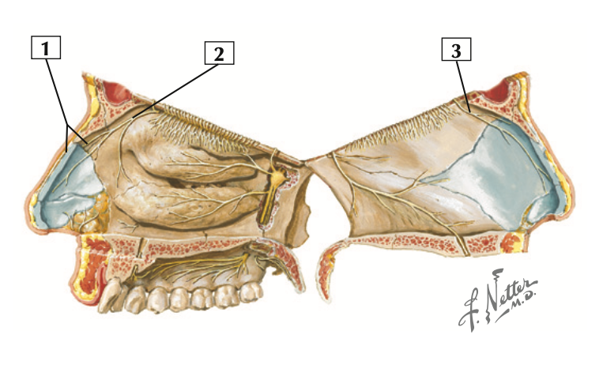
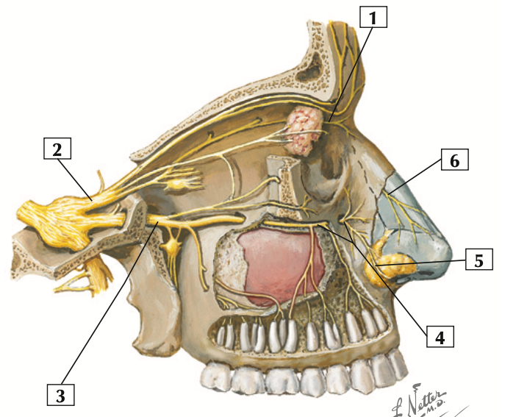
NERVE SUPPLY
CN V2 (Maxillary) branches :
  PSA
  MSA
  Infra orbital
  Lateral and Internal nasal branches

Slide 12
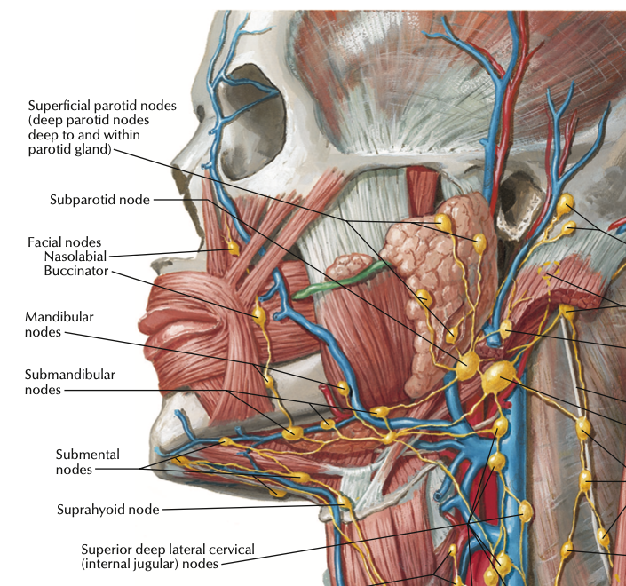
LYMPHATIC DRAINAGE
Submandibular nodes
Upper deep cervical nodes

Slide 13
Functions of the sinus
Reduce the weight of the skull
Humidification and warming of the inspired air
Absorption of shock to the face or skull
Secretion of mucous to assist air filtration and moisten the inspired air
Mechanical rigidity
Pressure damping
Vocal resonance and diminution of auditory feedback
Increases the olfactory area and assists in olfactory function
Heat insulation for intracranial structures

Slide 14
Diseases related to the sinus
Classification
  Infections :
    Acute Maxillary Sinusitis
    Chronic Maxillary Sinusitis
  Bone dysplasia :
    Fibrous dysplasia
    Paget’s disease
  Cysts :
    Odontogenic cysts
    Maxillary antral cysts
  Benign tumors :
    Odontogenic tumors
    Adenomas
    Calcifying fibroma
    Osteoma
Malignant tumors :
    SCC
    Osteosarcoma
  Invasive tumors :
    Salivary gland tumors / Adenocarcinoma
    Basal cell carcinoma

Slide 15
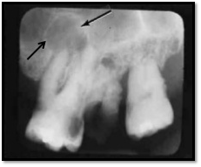
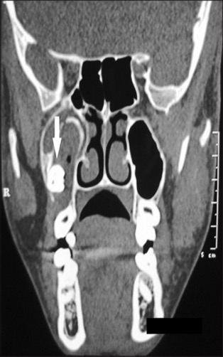
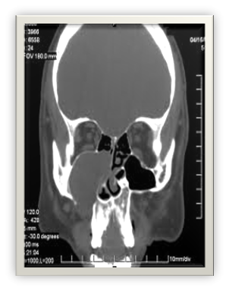
Cysts
Dentigerous cyst
Radicular cyst
Mucous retention cysts
Antral mucoceles

Slide 16
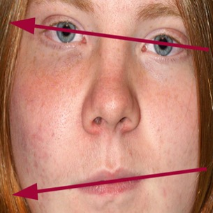
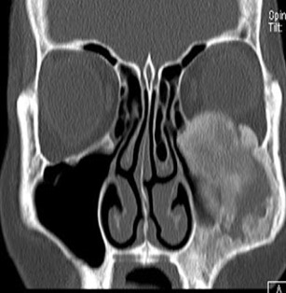
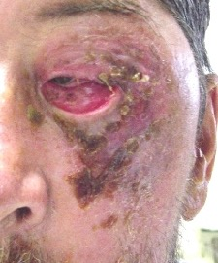
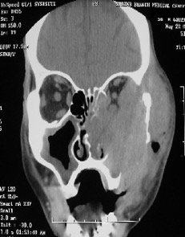
Tumors
Ameloblastoma is the most common benign tumor
Malignant tumors like SCC and BCC are aggressive and invasive in nature and may extend onto the base of the skull, orbit and nasal regions

Slide 17
Infections
Bacterial and viral sinusitis are most common
Odontogenic infections of maxillary teeth can also result in maxillary sinusitis
Fungal infections are most dangerous and need extensive debridements and medical management.

Slide 18
Maxillary sinusitis
Classification
Acute Maxillary Sinusitis : duration of 4 weeks or less
Sub-acute Maxillary Sinusitis : 4 - 12 weeks
Recurrent Subacute Maxillary Sinusitis : at least 4 times per year lasting for 7 to 10 days
Chronic Maxillary Sinusitis : at least 12 weeks

Slide 19
Maxillary sinusitis
Odontogenic origin
Etiology :
  Odontogenic infections like - periodical abscess, common cold, URI
  Allergic reactions - pollen, chemical agents
  Oro-antral communication and/or fistula.
  Traumatic injuries
  Displaced tooth/root into the sinus
  Cystic / tumorous lesions of maxilla

Slide 20
Maxillary sinusitis
Odontogenic origin
Clinical features :
  Sinonasal symptoms :
    Unilateral nasal obstruction
    Rhinorrhoea
    Foul order &/ taste
  Dental symptoms :
    Severe throbbing pain in the periradicular region
    Mobility of tooth involved (depends on periodontal status of the tooth)

Slide 21
Maxillary sinusitis
Odontogenic origin
Diagnosis :
  It is important to accurately differentiate the odontogenic cause for sinusitis, as the pathophysiology, microbiology and treatment differ from other forms of maxillary sinusitis.
  Radiographic imaging provides useful information in the diagnosis.
Management :
  Elimination of the source of infection.
  Antibiotic prophylaxis and Nasal decongestants should be used.

Slide 22
Acute Maxillary Sinusitis
At least 4 weeks of infection
H Influenzae, Strp. Pneumoniae, Maraxella catarrhalis are the most common organisms causing sinusitis
Etiology :
  Mucosal swelling from microbial infections / allergic reactions
  Ciliary disability
  Anatomic abnormalities :
    Conchal bullosa
    DNS
    Paradoxical Turbinates
    Malformed Uncinate process
  Trauma involving Maxilla
  Prolonged nasal intubation
  Space occupying lesions

Slide 23
Diagnostic criteria for Rhinosinusitis
Rhinosinusitis Task Force of the American Academy of Otolaryngology Head and Neck Surgery, 1977
MAJOR CRITERIA | MINOR CRITERIA
FACIAL PAIN / PRESSURE / FULLNESS | HEADACHES
NASAL OBSTRUCTION / CONGESTION | FEVER (OTHER THAN ACUTE RHINOSINISITIS)
NASAL OR POSTNASAL DISCHARGE / PURULENCE | HALITOSIS
HYPOSMIA /ANOSMIA | FATIGUE
FEVER | DENTAL PAIN
 | COUGH
 | EAR PAIN / PRESSURE / FULLNESS
Diagnosis is made if :
Two or more Major signs and symptoms.
One major and two or more Minor signs and symptoms.
Nasal purulence on examination.
J. DAVID OSGUTHORPE, M.D., Medical University of South Carolina, Charleston, South Carolina Am Fam Physician. 2001 Jan 1;63(1):69-77.

Slide 24
CHRONIC MAXILLARY SINUSITS
Duration of at least 12 weeks
ETIOLOGY :
  Persistent dental focus
  Chronic Rhinitis
  Chronic infection from other sinuses
  Allergic conditions

Slide 25
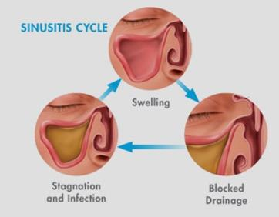
Pathophysiology of Chronic Sinusitis
Chronic inflammation - hyperplasia / atrophy
Multiple polyp formation / generation of epithelium
Ostium shows edematous changes causing complete blockade
Drainage of the sinus will be affected.

Slide 26
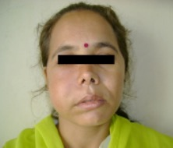


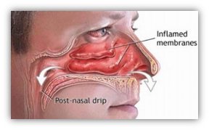
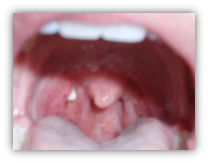
Clinical features
Extra oral :
  Head ache
  Facial pain
  Nasal obstruction
  Nasal / Postnasal discharge
  Fatigue
  Hyposmia / Anosmia
  Cough
  Ear pain
Intra oral :
  Halitosis
  Presence of fistula
  Discharge of pus from fistula into the mouth

Slide 27
Clinical examination
Inspection : extra oral swelling / asymmetry /erythema in the middle third of the face
Palpation : palpation on the anterior wall of the sinus on the facial aspect above the premolar area reveals pain
Intra orally, tenderness / paresthesia of upper molar/ premolar teeth is seen.
Transillumination test : a negative transillumination test represents the presence of pus / fluid / mucosal thickening / solid mass

Slide 28

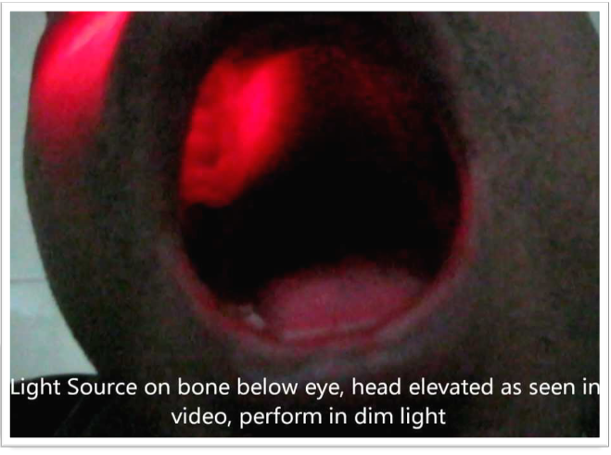


Slide 29
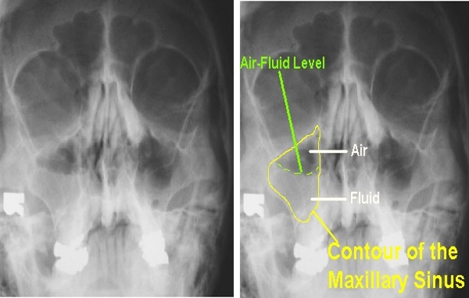
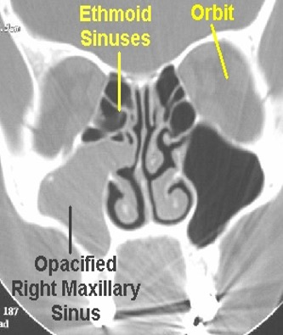
Radiographic examination
Intra oral :
  IOPA
  Occlusal views
Extra oral :
  Caldwell view (occipito-frontal view)
  Warter’s view (occipito-mental view)
  Submentovertex view
  CT

Slide 30
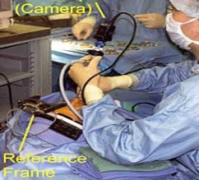
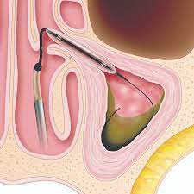
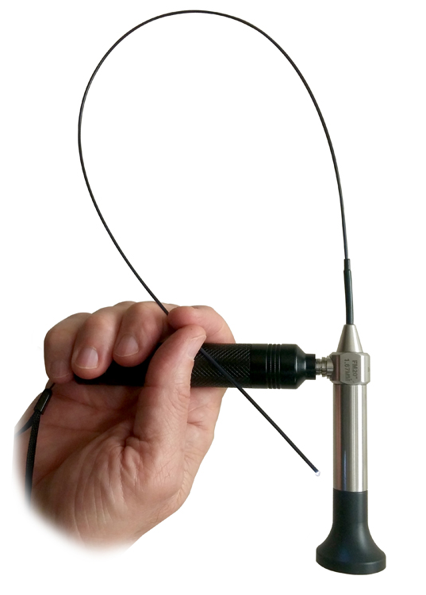
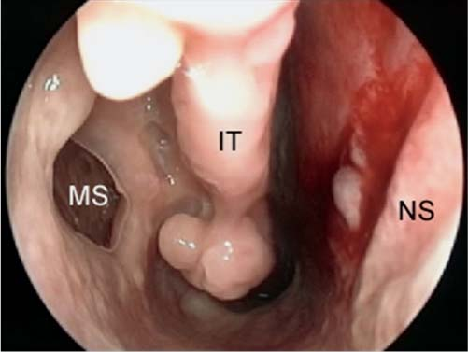
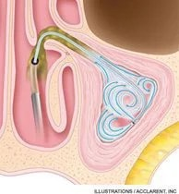
Endoscopy

Slide 31
MANAGEMENT
MEDICAL :
  Antibiotics
  Steroids
  Decongestants / mucolytics
  Analgesics
  Antihistamines
  Nasal sprays & saline irrigations
SURGICAL :
  Sinus aspiration and leverage
  Needle sinusotomy
  Caldwell luc operation
  FESS (functional Endoscopic Sinus Surgery)

Slide 32
Medical management
ANTIBIOTICS :
  Amoxicillin + clavulanate, Metronidazole
  Cefuroxie, cefodoxime
  Erythromycin + sulfonamides
ANALGESICS :
  Acetaminophen with codeine, hydrocodone
SYSTEMIC DECONGESTANTS :
  Phenylpropamolamine, alpha adrenergic agonists
TOPICAL DECONGESTANTS :
  Nasal sprays - Oxymetazoline
TOPICAL STEROIDS :
  Budesonide, fluticasone
ANTI-HISTAMINES :
  Cetrizine
Saline lavage and steam therapy
MUCOLYTICS : tincture benzoin, potassium iodide

Slide 33
Indications for surgery
Bilateral extensive and massive obstructive nasal polyps with complications
Chronic adult rhino-sinusitis with mucocele or mucopolycele formation
Invasive fungal rhino-sinusitis.
Types of Surgery :
  Sinus aspiration and leverage
  Needle sinusotomy
  Caldwell luc operation
  FESS (functional Endoscopic Sinus Surgery)

Slide 34
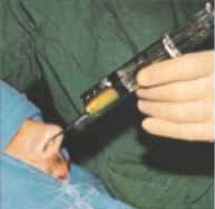
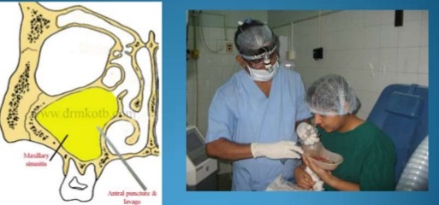
Sinus Aspiration and Lavage
Sinus approaches through the lateral nasal wall antrostomy and a wide bore syringe is used to aspirate the contents of the sinus

Slide 35
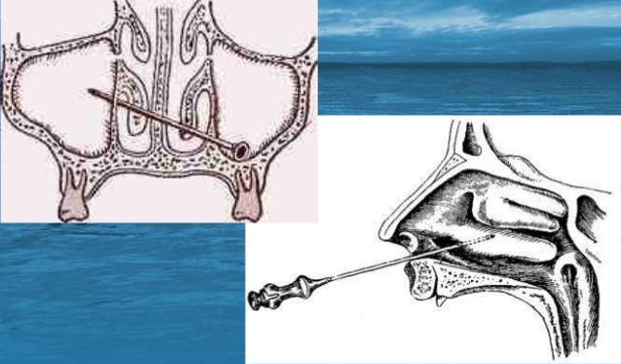
Nasal Amtrostomy

Slide 36
Cladwell-Luc Operation
First described by George Caldwell in 1893 and the by Henri Luc in 1897.
Indications :
  Removal of root, tooth or foreign body from sinus
  Treatment of acute sinusitis resistant to medical therapy
  Excisional biopsy of a suspected malignant tumor of MS
  Management of chronic sinusitis with hyperplastic lining
  Antrochoancal polyp
  Enucleation of odontogenic cysts / mucocele
  Control of active hemorrhage following trauma
  Lifting the floor of the orbit in blow out fractures

Slide 37
Caldwell-Luc surgical procedure
The procedures can be performed under local anesthesia with sedation or in general anesthesia.
Semilunar incision is given in the buccal vestibule (from canine to 1st molar).
Mucoperiosteal flap is raised.
Antrostomy is done in the anterior wall of the sinus using power driven burs / chistles.
Antral lining curetted and antrum is derided and irrigated.
Iodoform ribbon gauze is placed & nasal antrostomy done if required for the drainage.
Wound is closed in water tight manner using interrupted sutures.

Slide 38
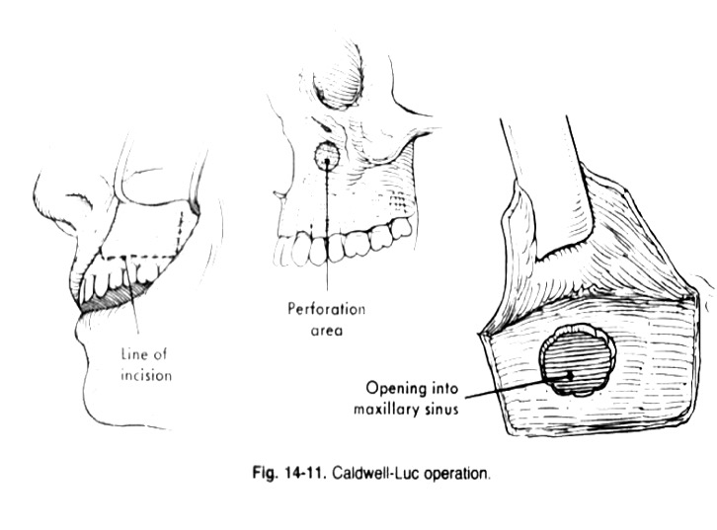

Slide 39
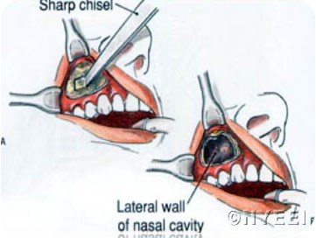
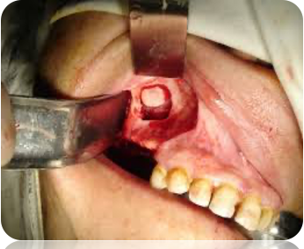

Slide 40
Postoperative management
Antibiotics, Analgesics for 5 days
Pack removal on 5th day
Tincture benzoin inhalation TID
Otrivin nasal drops TID, not more than 3 or 4 days
Not to blow the nose or sneeze for 1 week
Soft diet
No vigorous gargling

Slide 41
Complications
Infra-orbital / PSA nerve paraesthesia
Recurrent sinusitis
Persistent oedema of cheek
Damage to maxillary teeth
Persistent bleeding

Slide 42
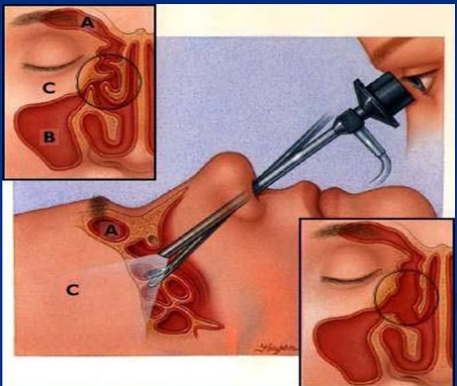
Functional Endoscopic Sinus Surgery
Classically describes as intra nasal endoscopic technique
To establish adequate sinus drainage without a negative impact on sinus mucosal physiology and function
FESS - opening of OMC (osteo-meatal complex), thereby allowing adequate ventilation and drainage of the sinuses

Slide 43
Oro-Antral communication

Slide 44
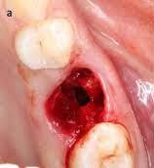
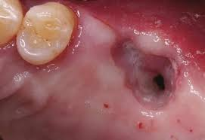
Definitions
Oro - antral communication is an unnatural communication between oral cavity and maxillary sinus.
Oro - antral fistula is an epithelized, pathological, unnatural communication between the oral cavity and maxillary sinus

Slide 45
Etiology
Extraction of tooth
Destruction of the portion of the floor of sinus by periodical lesions
Perforation of floor of the sinus and sinus membrane with injudicious use of instruments
Forcing a tooth or root into sinus during attempted removal
Extensive trauma to face
Surgery of maxillary sinus, removal of large cystic lesions encroaching on the sinus cavity
Chronic infections of the maxillary sinus such as osteomyelitis
Teratomatous destruction of maxilla such as gamma involving palate
Infected maxillary implant
Malignant disease such as malignant melanoma

Slide 46
Symptoms
FRESH COMMUNICATION:
  Escape of fluids from mouth to nose
  Epistaxis
  Escape of air from mouth to nose
  Enhanced column of air - vocal resonance
  Excruciating pain

Slide 47
Symptoms
LATE STAGE :
  Persistent, purulent or mucopurulent, foul, unilateral nasal discharge from the affected nostril
  Postnasal drip
  Possible sequale of general systemic toxemic condition - fever, malaise, morning anorexia, frontal & parietal headache and in extreme cases anosmia, cacosmis
  Popping out of an antral polyp
  Pain - not as dominant as in early stages

Slide 48
Diagnosis
Recognition of the antral floor being attached to the roots of the extracted tooth
Nose blowing test
Cotton wisp test
Mirror fogging test
Water holding test
Radiographic examination - CBCT / CT

Slide 49
Management
For early cases :
  If the opening is small (2-6 mm) preserving the blood clot in the socket by means of suture is enough
  Nasal precautions
  Antibiotic therapy
  Close review

Slide 50
For large perforations (7mm / >) :
  Communications should be sealed from external environment by using local flaps
  Sinus precautions and other previous measures
Additional measures :
  White head varnish pack
  Denture plate to cover the operated area

Slide 51
For delayed cases :
  > 24 hrs of exposure, gingival margins gets infected.
  So the surgical closure is done after 3 weeks to allow for healing of gingival margins
  In cases with purulent discharge, patient develop symptoms of acute / chronic sinusitis - maxillary sinus should be irrigated gently with normal saline
  Cases of > 1 month communications require surgical closure.

Slide 52
Surgical procedures
The surgical procedures include :
  Buccal flaps : Von Rehrmann flap (1936), Moczair modification
  Palatial flaps : Ashley’s flap, Kruger modification
  Combination
  Tongue flaps
  Buccal pad of fat grafting
  Bridge flap
  Alloplastic materials

Slide 53
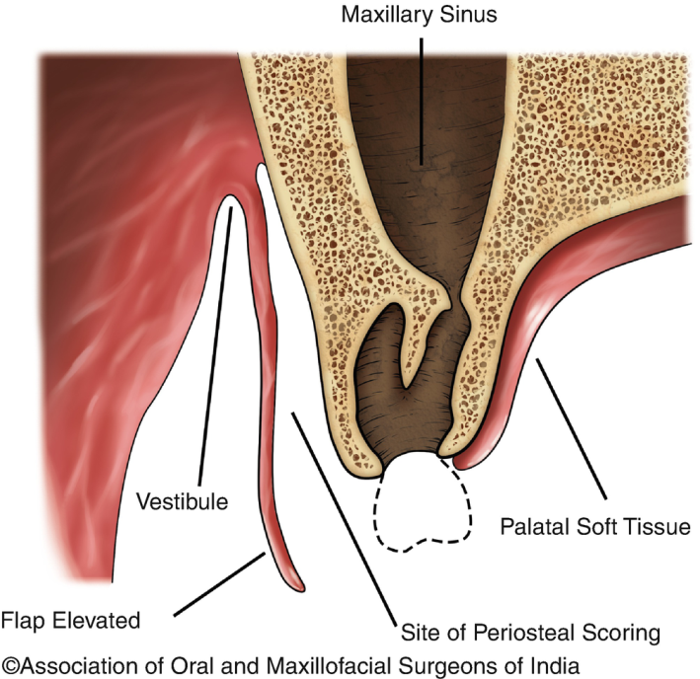
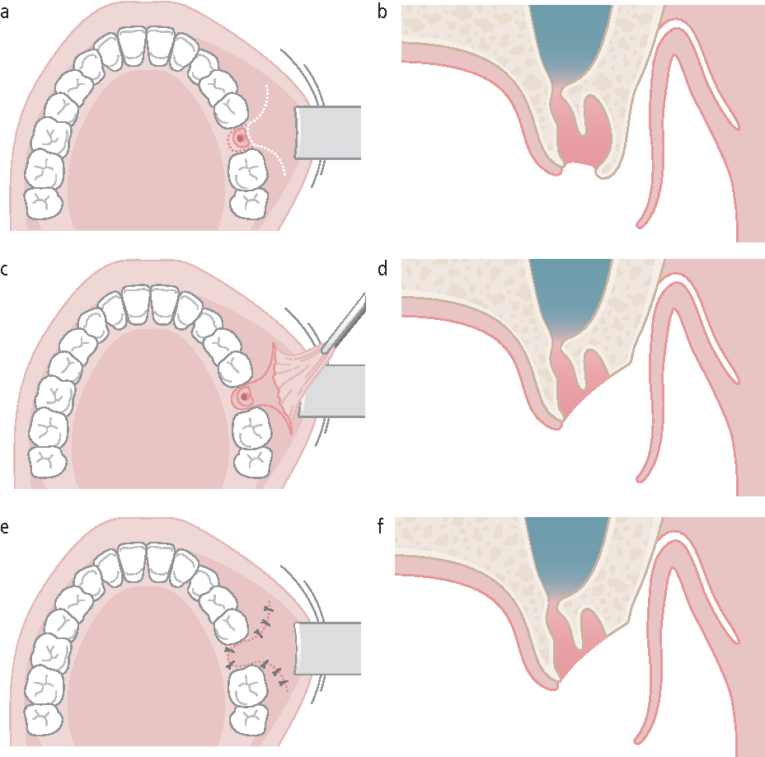
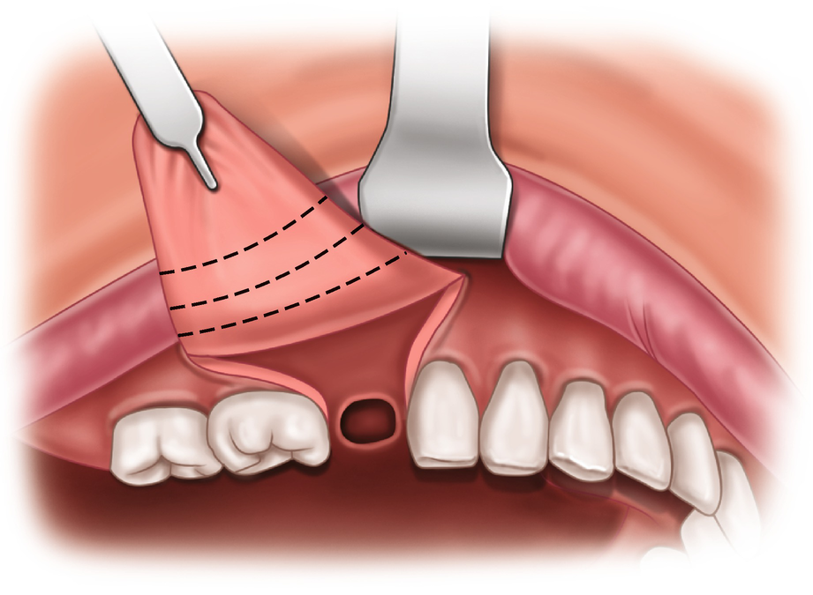

Slide 54
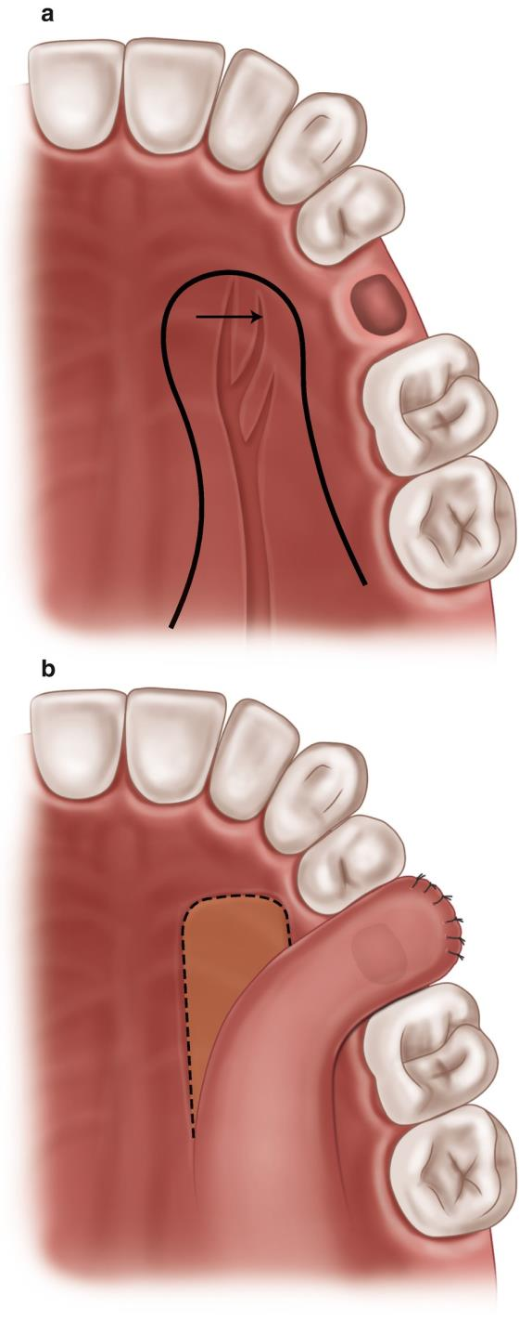
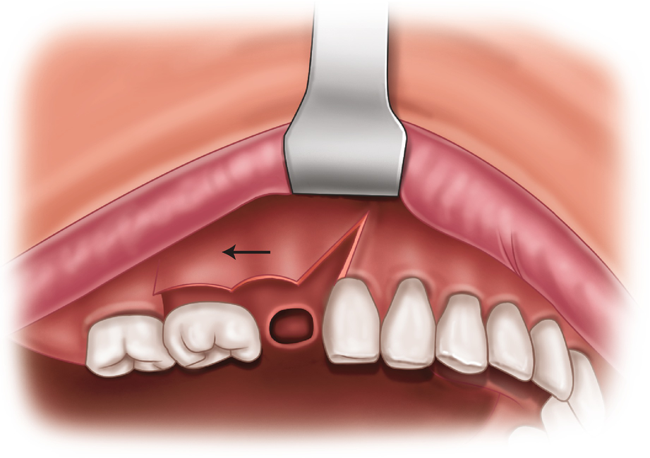
  Moczair modification
  Ashley’s flap

Slide 55
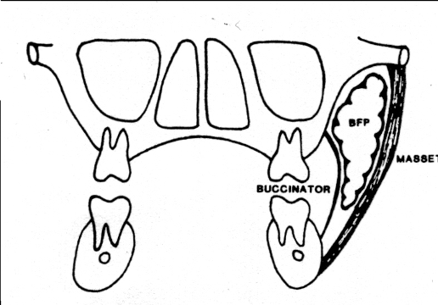
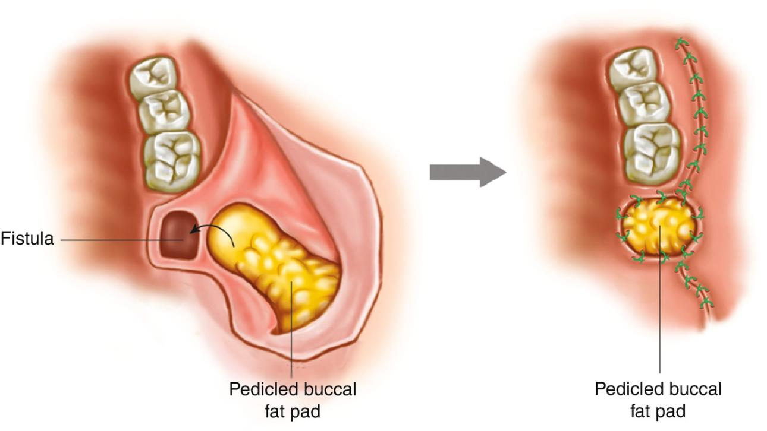
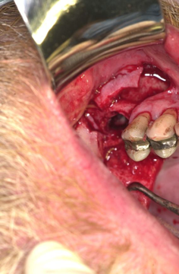
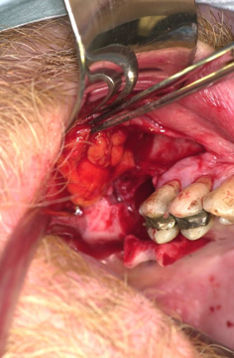
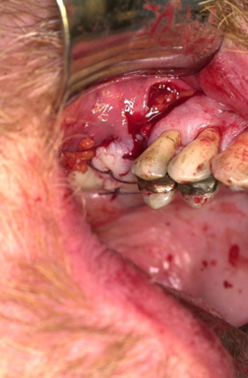
BUCCAL FAT PAD FLAP

Slide 56
Precautions to avoid OAC/F
Warn the patient about the risk of OAC/F
Use peristomes
Raise a flap that can be converted into buccal flap
Remove the bone round the tooth in question
Section of tooth
Elevate with care
Check the socket after extraction

Slide 57
Assessment
Previous history of OAC/F
Bone quality, quantity, density
Anatomical position
Previous radiotherapy
Extent or proximity of antrum
Associated ankylosis/ hypercementosis
Root morphology

Slide 58
COVID-19 & MUCORMYCOSIS

Slide 59




Slide 60



Slide 61






Slide 62
References
Nutter Anatomy
Killey & Kay Maxillary Sinus and its Dental Implications
Balaji textbook of Oral and Maxillofacial Surgery.
J. DAVID OSGUTHORPE, M.D., Medical University of South Carolina, Charleston, South Carolina Am Fam Physician. 2001 Jan 1;63(1):69-77.

Slide 63



Contact :
Dr Vidya Sagar MDS ,
SL, Dept of OMFS,
SIDS.
+91 8500738505
drvidyasagarbsurgery@sids.ac.in
Post your queries and questions without spamming… Thank you.

