Slide 1

ISOLATION OF OPERATING FIELD
SIBAR INSTITUTE OF DENTAL SCIENCES,GUNTUR
DEPARTMENT OF CONSERVATIVE
DENTISTRY AND ENDODONTICS
Dr. ANILA B.S.
READER
Notes:
5,6,7

Slide 2
Table of contents:
Introduction
What is Infection prevention and control?
Goals of Isolation
Methods of Isolation
1.Cotton rolls
2.Cellulose wafers
3. Rubber dam
4. saliva ejectors
5. High volume evacuator
6. Throat shields
7. other adjuncts
8.Recent advances in isolation
conclusion

Slide 3
Introduction:
Oral cavity is an extremely difficult area to work.
The cheeks and tongue, the gingival tissue and the saliva complicate the access to and visibility of the tooth.
Aerosol production: Transmission of Infection
Also fluids like saliva, blood, gingival crevicular fluid ,water spray from handpiece may be present.

Slide 4
The production of absolute dryness by the exclusion of mouth secretions and humidity from the operation is essential to the correct performances of most operative procedures.
Isolation allow the proper manipulation and insertion of restorative materials & help in achieving best possible results.

Slide 5
What is Infection prevention and control?
Infection prevention and control is a scientific approach with:
practical solutions designed to prevent harm, caused by infections to patients and health care workers,
grounded in principles of infectious diseases, epidemiology, social science and health system strengthening, and
rooted in patient safety and health service quality

Slide 6
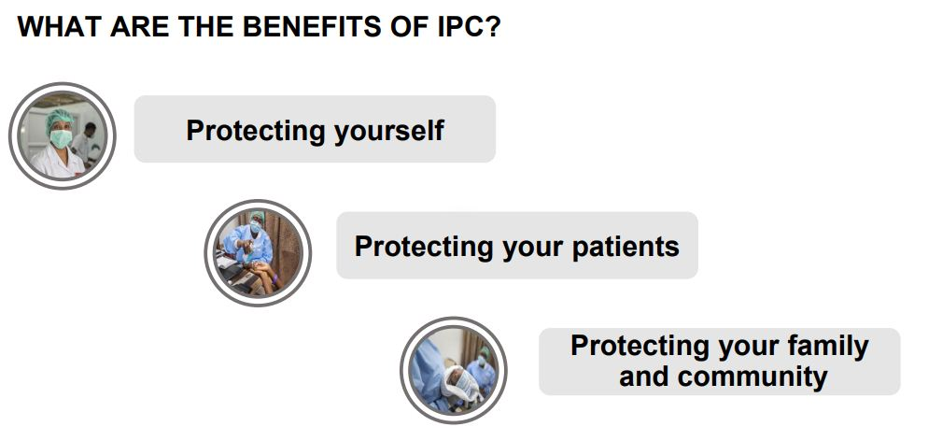
Courtesy:World Health Organization

Slide 7
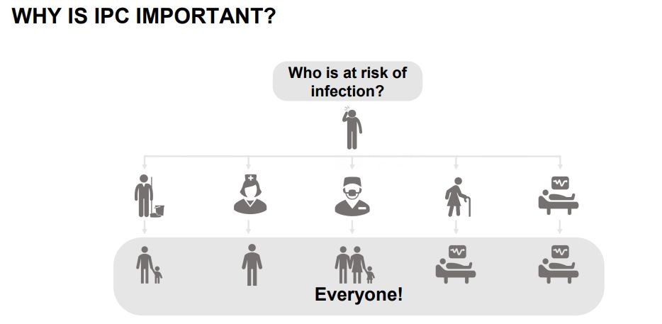
Courtesy:World Health Organization
Notes:
5,6,7

Slide 8
Goals of Isolation:
Control of moisture
Retraction of soft tissues
Protection of soft tissues & prevent aspiration of small instruments.
Improved quality of treatment

Slide 9
METHODS OF ISOLATION
Direct Method
Indirect Method
Cotton rolls.
Cellulose wafers.
Rubber dam.
Saliva ejector.
High volume evacuator.
Throat shields.
Other adjuncts: Mouth props, Retraction cords.
Comfortable position of patient.
Local anesthesia.
Drugs.
-Anti sialogogues.
-Anti anxiety drugs.
-Muscle relaxants.

Slide 10
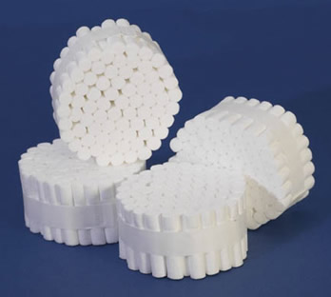
Cotton rolls
Provides satisfactory dryness.
Placed in areas of mouth, Where salivary gland ducts exit so that they can absorb the saliva.

Slide 11
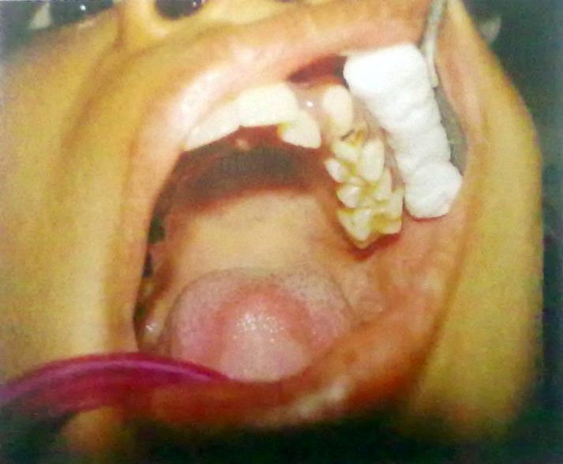
For MAXILLARY TEETH-
In facial vestibule related to involved teeth.

Slide 12
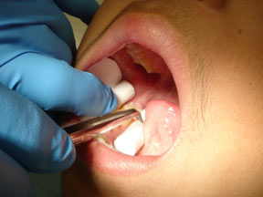
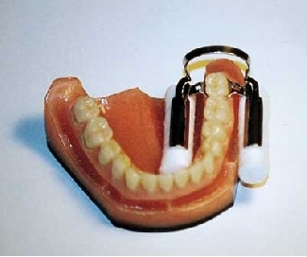
For MANDIBULAR TEETH-
In facial & lingual vestibule. Lingually, a large roll is rolled into position between tongue & involved teeth.

Slide 13
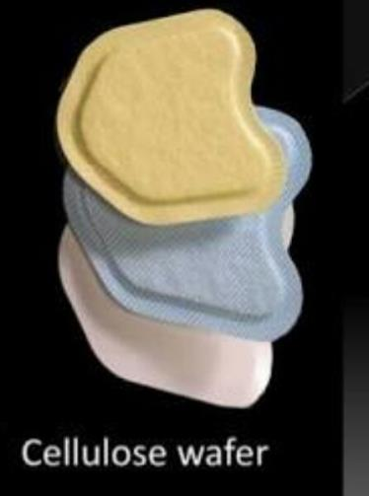
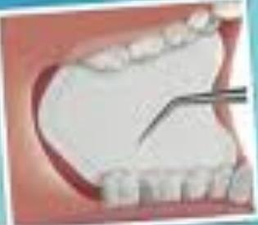
Cellulose wafers
Cellulose wafers are used in conjunction with cotton rolls .
In facial aspect of Posterior teeth to absorb saliva secreted by parotid gland.

Slide 14
Rubber Dam
Use of Rubber dam ensures
absolute moisture control in mouth.
It isolates one or more teeth that are to be worked upon from the rest of the mouth.
Introduced by
Sanford C Barnum in 1864

Slide 15

Armamentarium:
Rubber dam sheet
Rubber dam frame or holder
Rubber dam retainers or clamp
Rubber dam punch
Rubber dam template
Rubber dam clamp forceps
Rubber dam napkin
Rubber dam lubricant
Other retainers: Dental floss, wedgets (elastic cords),Modelling compound.

Slide 16
Advantages of Rubber dam:
Maintains clean, dry operating field.
Maximum access & visibility.
Improves the properties of restorative material.
patient protection.
Clinician's protection.
Prevents aspiration of foreign bodies.
Retracts & protects soft tissue.
Increases operating efficiency.

Slide 17
Disadvantages of Rubber dam:
Patient objection
Time consumption
Minor trauma to gingiva/cervical cementum during clamp removal
In case of metal crowns: show microscopic defects followiong clamp removal
Ceramic crowns:tend to # if clamps are allowed to grip margins.

Slide 18
Indications of Rubber dam:
Endodontic procedures
Excavation of deep caries
Adhesive restorations
Bleaching
Subgingival restorations
High risk patients

Slide 19
Contraindications of Rubber dam:
Asthmatic patients with breathing problems
Extremely malpositioned tooth
Patients with latex allergy
Presence of some fixed orthodontic appliance.

Slide 20
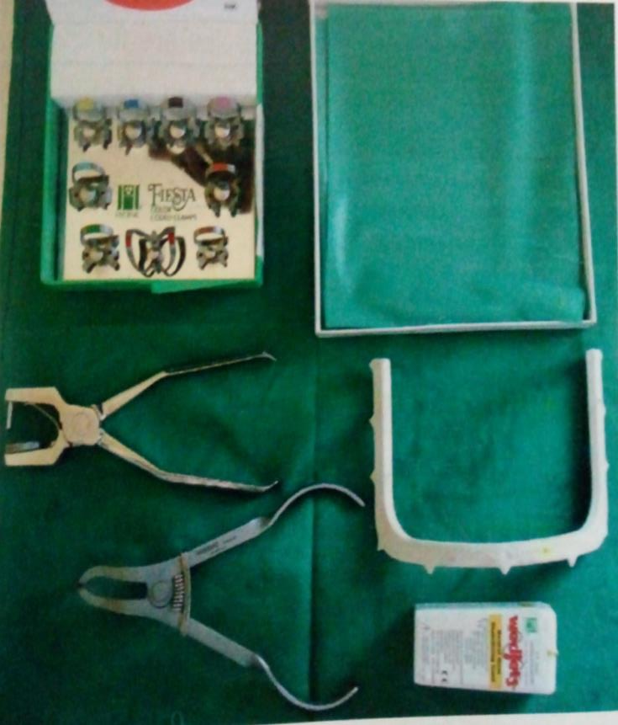
Armamentarium of Rubber dam

Slide 21
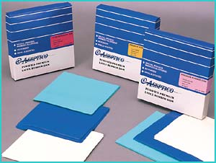
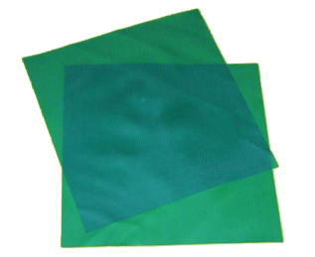
Rubber dam Sheet:
-Made of latex rubber
-Availability:
5x5 inch square ( 12.5x12.5 cm) – used for children
6x6 inch square ( 15x15 cm)- used for adults
-Colors:Green or blue or gray– provide good contrast with teeth.
Sides :
Rubber dam sheet has dull and shiny side.
Dull side is less reflective and placed facing the operator.

Slide 22
Rubber dam sheet thickness:
Thinner dams are used where contacts are too tight
Thin and medium dams are adequate for endodontic therapy.
Heavy thickness dam: Recommended for isolation in operative dentistry- more effective in retracting tissues and more resistant to tearing.
Extra Heavy & Special Heavy thickness dams are used for procedures : bleaching, subgingival lesions, class V cavities – better gingival retraction.
GUAGE | THICKNESS
THIN | 0.006” (0.15mm)
MEDIUM | 0.008” (0.20mm)
HEAVY | 0.010” (0.25mm)
EXTRA HEAVY | 0.012” (0.30mm)
SPECIAL HEAVY | 0.014” (0.35mm)

Slide 23
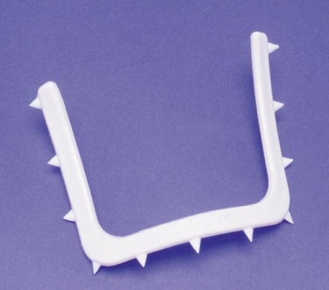
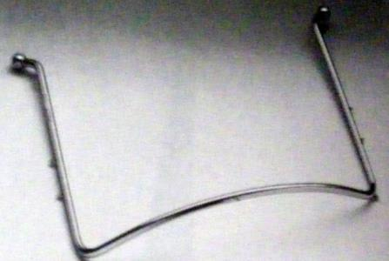
Rubber dam frame:
Plastic frame
Metallic frame
Hygenic frame
Young’s frame
USE-
-Placed below the rubber dam sheet, holds the borders of rubber dam sheet preventing it from falling into patient’s mouth.
-All frames have retentive pegs or projections over which dam can be stretched to provide clear operating field.
Notes:
- Disadvantage of plastic frame:
1. Do not withstand sterilization.
2. Have short life span.
-Advantageous when radiographs are part of procedure ( because it is radiolucent)

Slide 24
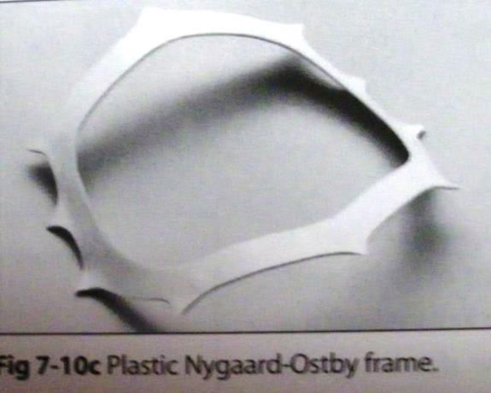
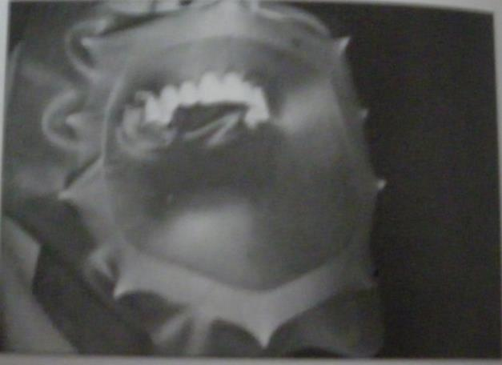
Nygaard – Ostby Frame:
Normally positioned on tissue surface or inside surface of dam and touches patient’s face.

Slide 25
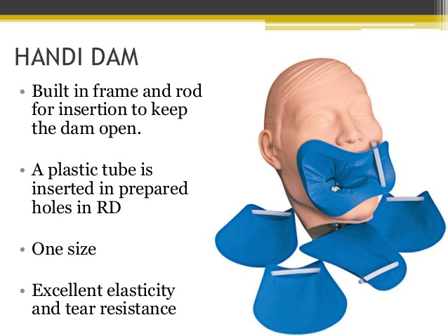
(Pre attached frame)

Slide 26
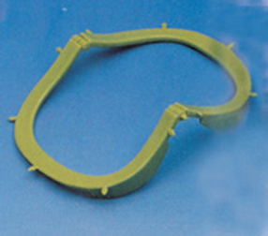
Le Carde Articule (articulated frame)
New frame from France which is an articulated frame. Developed by Dr. G. Saveur.
It is curved to fit the face.
It is hinged in the middle to fold back allowing easier access for radiographic film placement.
Saveur oval frame

Slide 27
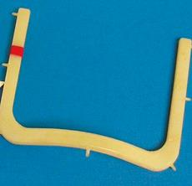
Starlite Visu Frame
It is a ‘U’ shaped radiolucent plastic frame.
There is less tension because of shape.
It is easier to use than Nygard Ostby frame when taking radiographs of molars.
Placed either above or below the rubber dam sheet.
Requires no absorbent napkin and
stands away from the face of
the patient.

Slide 28
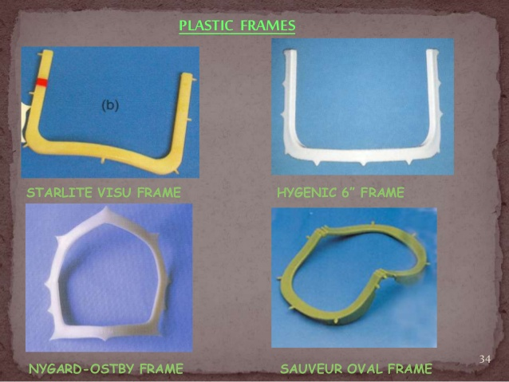

Slide 29
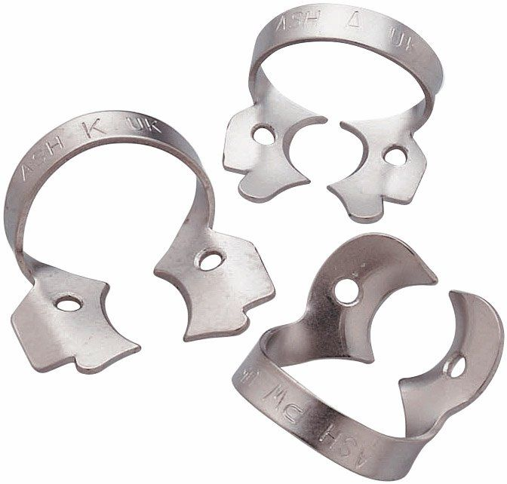
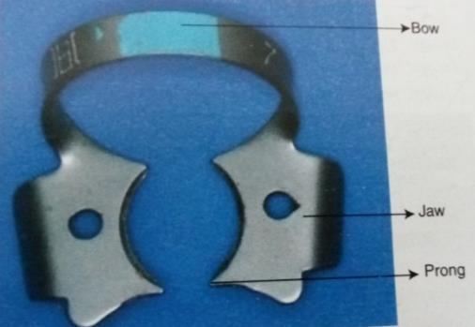
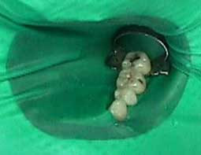
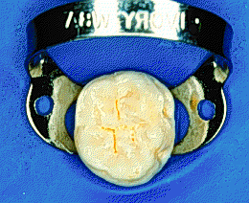
Rubber dam retainers/clamps:
Uses:-
- Metal retainers that fit neck of tooth and hold Rubber dam sheet in position.
- They also provide gingival retraction.
- They make 4 point contact on tooth & grasp the tooth at gingival margin.

Slide 30
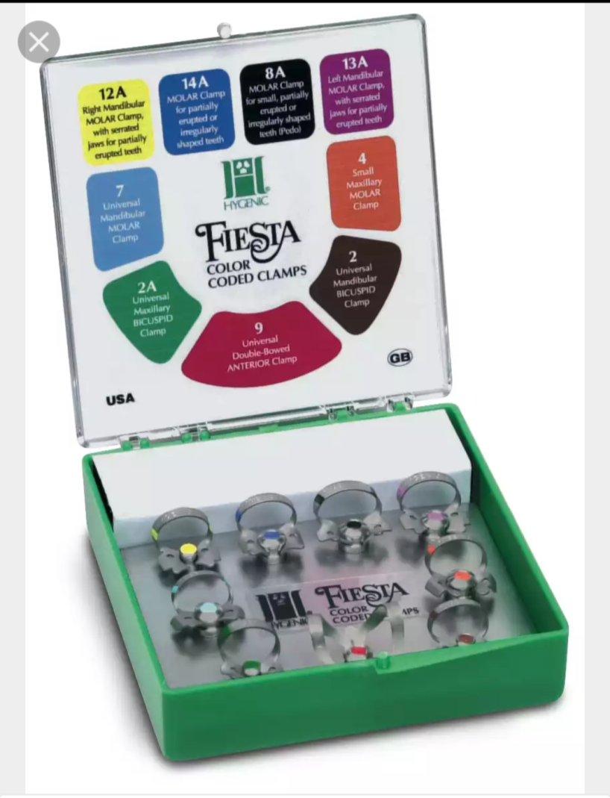
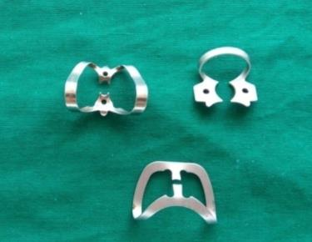
Hygenic FIESTA Rubber dam clamps
Notes:
Red:9-Universal double bowed anterior clamp
Green:2A-Universal maxillary premolar clamp
Brown:2-Universal mandibular premolar clamp
Skyblue:7-Universal mandibular molar clamp
Orange:4-small maxillary molar clamp
Yellow:12A-Right mand. Molar clamp with serrated jaws for partially erupted teeth
Blue:14A-Molar clamp for partially erupted or irregularly shaped teeth
Black:8A-Molar clamp for small partially erupted or irregularly shaped teeth(pedo)
Pink:13A-Left mand. Molar clamp with serrated jaws for partially erupted teeth

Slide 31
Classification of clamps/Retainers:
According to material made from they can be
Metallic
Tempered carbon steel
Stainless steel
Non Metallic
Polycarbonate clamps
According to jaw design
All clamps can be divided into two main groups
Bland
Retentive
According to the tooth they are used on
1) Anterior Clamp, 2) Premolar Clamp, 3) Molar Clamp

Slide 32
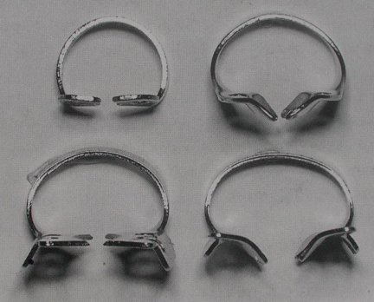
Jaw design : Bland and Retentive clamps
Bland clamps have jaws which are flat and bent, directed towards each other. They grasp the tooth at or above the gingival margin and cause minimal gingival damage
Retentive clamps have jaws directed more gingivally so that they can grasp the teeth below the gingival margin. Used more in partially erupted teeth.

Slide 33
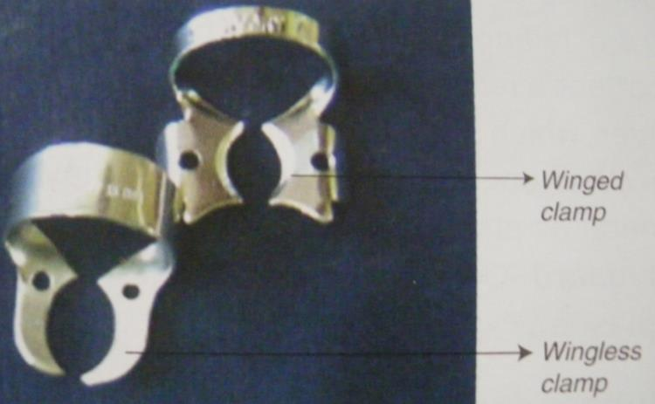
Both bland and retentive can be further sub divided into:
Winged and
Wingless type.

Slide 34
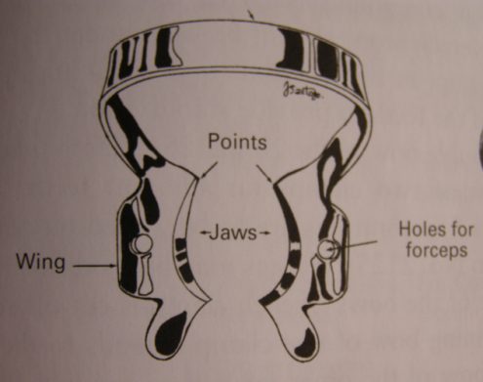
Winged Retainers:
Have both anterior and lateral wings.
Wings are designed to provide extra retraction of rubber dam from operating field.
Disadvantage: Wings interfere with placement of matrix bands, retainers & wedges.

Slide 35
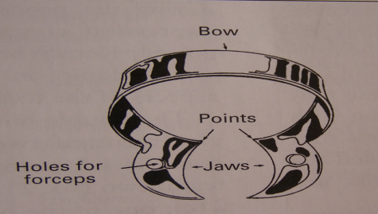
Wingless retainers:
-Wingless clamps are without wings.
This clamp is placed over the anchor tooth & then the dam is stretched over it.
They are indicated by letter ‘W’ in front of clamp number.
Few examples:
W 7 - mandibular molar anchor teeth.
W 8 - maxillary molar anchor teeth.
W 4 - most premolar anchor teeth.

Slide 36
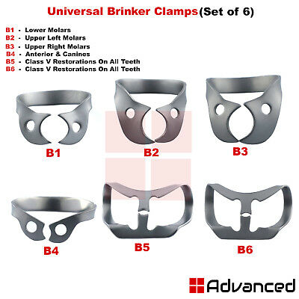
Brinker clamps (Coltene,Hygenic)
Provide Maximum tissue retraction without laceration of gingival tissues.
Set of 6 clamps.

Slide 37
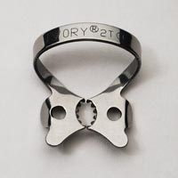
Tiger clamps
Retainers with serrated jaws –tiger clamps, increase stabilization/retention in case of broken down teeth.

Slide 38
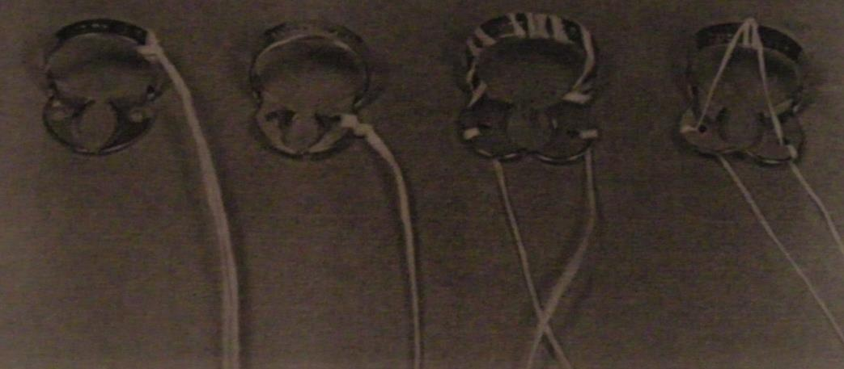
Tying retainers with dental floss:
Bow of retainer should be tied with dental floss, before retainer is placed in mouth.
Uses of floss:
It allows retrieval of broken parts, if they are accidentally swallowed or aspirated.
Tight contacts: Pass the dental floss- allows easy passage of Rubber Dam sheet.
12 inches approximately is tied

Slide 39
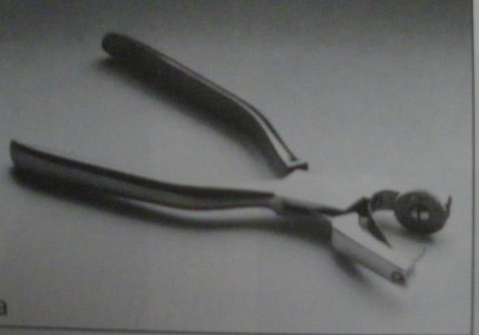
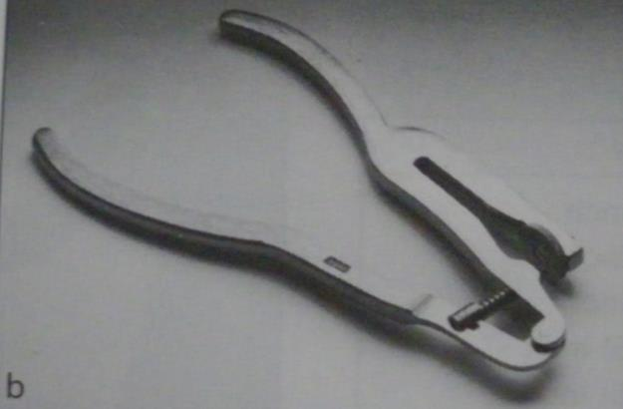
Rubber dam punch:
To cut holes on rubber dam sheet.
2 designs:
Ainsworth design Ivory design

Slide 40
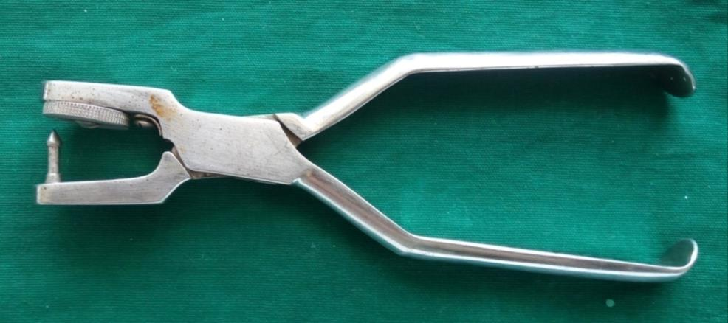
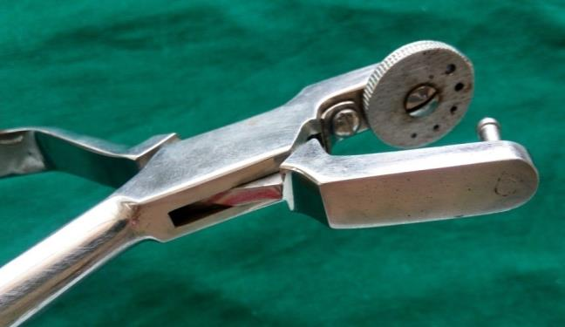
Rubber dam punch(Ainsworth Design)
-Punch:To cut holes in Rubber Dam sheet
-Precision instrument which has
rotating metal disc with 6 holes of
varying sizes & tapered sharp
pointed plunger.
Smaller holes-incisors,canines,premolars.
Larger holes-molars

Slide 41
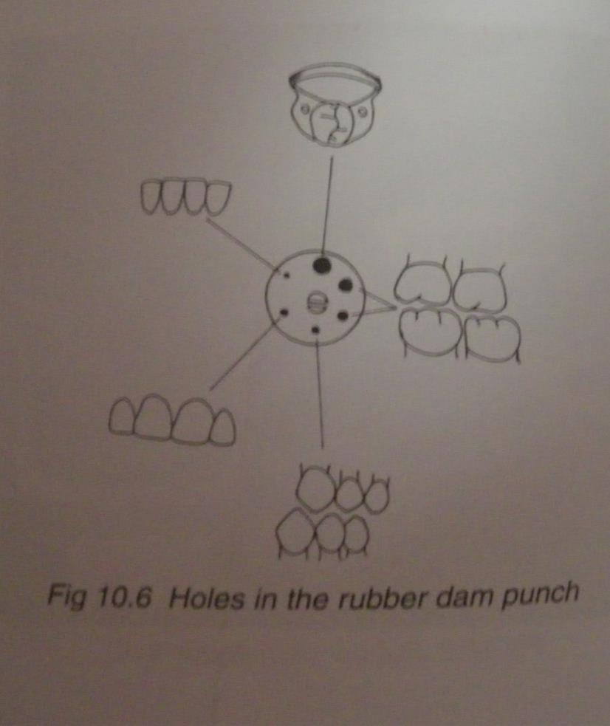
Rubber dam punch holes:

Slide 42
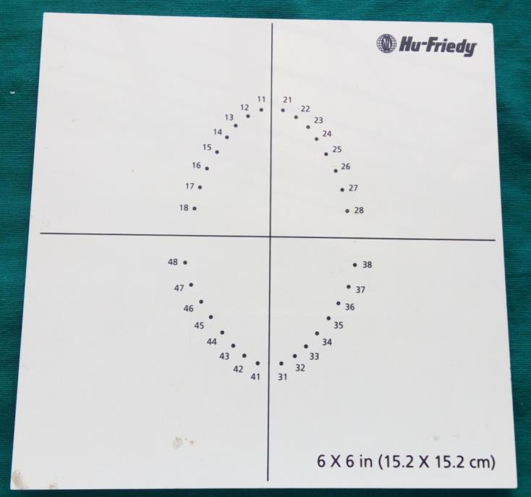
Rubber dam template
Use: -Rubber dam template helps in marking
dots on Rubber Dam sheet according to average position of teeth.
-Distance b/w holes :1/4inch (6.3 mm)

Slide 43
Points to remember:
Marks for maxillary central incisors are positioned approx 1 inch from top edge of rubber dam sheet so that, patients upper lip is covered when dam is in place.
Distance b/w holes is equal to distance from centre of one tooth to centre of adjacent tooth, measured at level of gingival tissue.
It is apprx 1/4 inches (6.3 mm).
Holes are punched according to arch form with adjustments in case of missing or malaligned teeth.
Distance b/w holes -excessive
-less
-correct
Notes:
Excessive: dam will wrinkle between the teeth,
Less: chances of tear is possible.

Slide 44
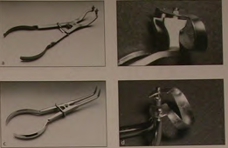
Rubber dam clamp forceps
Instrument used for placing, adjusting & removing clamp.
Ivory type
Stokes type

Slide 45
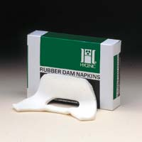

Rubber dam napkin:
Soft, absorbent, disposable napkin.
Placed b/w rubber dam and patients skin.
Reduces allergic reactions in sensitive patients.
Provide greater comfort for the patient.
Absorbs saliva from the corner of the patient’s mouth.
L
Small
Large

Slide 46
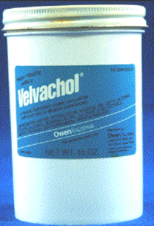
Rubber dam lubricant:
Water soluble lubricants are applied in area of punched holes.
Facilitate easy passage of dam through proximal contacts.
Commercially a product Velvachol (water based gel) available.

Slide 47
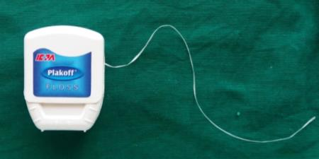
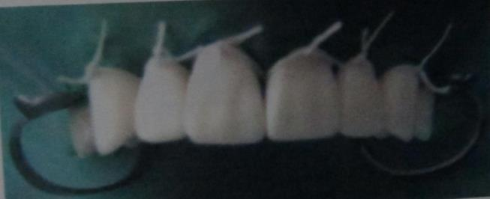
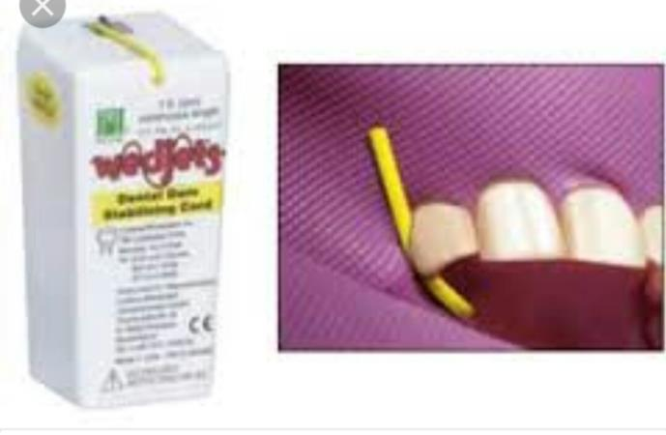
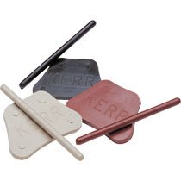
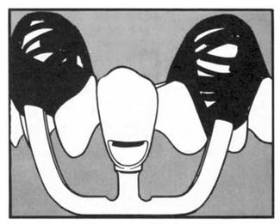
Other retainers:
Dental floss
Wedgets (elastic cord)
Strip of RD material.
Modelling compound
Dental floss
Modelling compound
Wedgets
Notes:
Modelling compound:Specially required for anchoring and stabilizing no.212SA retainer. compound in form of stick heated over alcohol flame can be used to stabilize clamps.

Slide 48
Rubber dam placement techniques:
Preparation of the mouth:
Teeth cleaned
Contacts checked with floss
Rough contact smoothened with proximal contact disk.
Lips and corners of mouth lubricated with vaseline.
Preparation of dam:
Selection of RD sheet
Marking & Punching holes.

Slide 49
Isolation with rubber dam:
Single tooth isolation:
1.Pit & fissure sealants
2.Class I restorations
3.Class v restorations
4.Endodontic procedures
3 techniques of placement:
Clamp placement prior to rubber dam
Clamp and rubber dam placed together
Clamp placement after rubber dam
Multiple teeth isolation:
1.Bleaching
2.Class II restorations
3.Multiple restorations

Slide 50
Preparation of the rubber dam:
Stage 1:
Selection of the Dam:
Heavy and Extra heavy : Restorative procedures.
Medium :Endodontic procedures.
Natural rubber dams: advantageous in case of endodontic radiography.
Better retraction of tissues than thin dams; and is easier to place than heavier dams

Slide 51
Preparation of the rubber dam:
Stage 2:
Marking the holes:
Punch an Identification hole in upper left corner for ease of location of that corner while applying dam to the RD frame.
Distance b/w holes is equal to distance from centre of one tooth to centre of adjacent tooth, measured at level of gingival tissue.
It is approx 1/4 inches (6.3 mm).
Isolation of a minimum of 3 teeth is recommended. But when endodontic therapy is indicated only the tooth to be treated is isolated.
Marks for maxillary central incisors are positioned approx 1 inch from top edge of rubber dam sheet so that, patients upper lip is covered when dam is in place

Slide 52
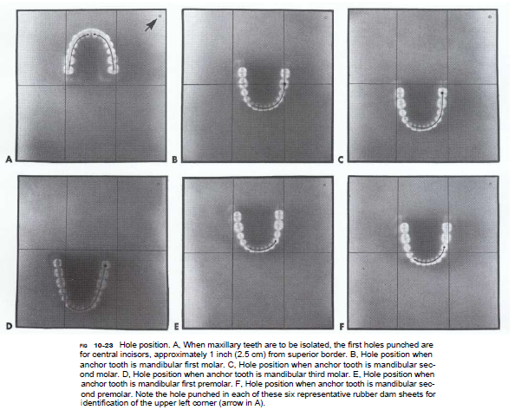
Notes:
To determine proper position mentally divide RD into 3 vertical sections: left, middle, right.

Slide 53
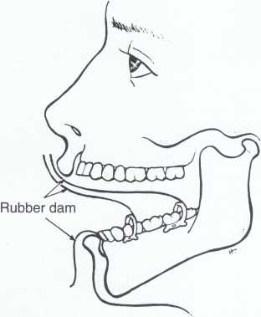
The farther posterior the mandibular anchor tooth, the more dam material is required to come from behind the retainer over the upper lip.

Slide 54
Preparation of the rubber dam:
Stage 2:
Position of the holes:
Single tooth isolation:
It should be near the centre of RD sheet with in the area of the sheet corresponding to the quadrant under treatment.
Multiple teeth isolation:
Templates are used to indicate average positions of the holes.

Slide 55
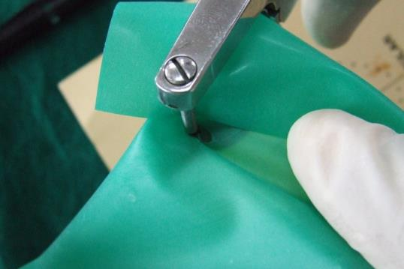
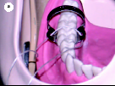



Technique 1: CLAMP Rubber dam sheet

Slide 56






Technique 2:Clamp & Rubber dam placed together

Slide 57




Technique 3: RD SHEET CLAMP
Tec

Slide 58


Slide 59
Application Procedure Steps:
Step 1:Testing and lubricating the proximal contacts.
Step 2:Puncing the holes
Step 3:Lubricating the Dam
Step 4:Selecting the Retainer
Step 5:Checking the Retainer’s stability or retention on anchor tooth
Step 6: Positioning dam over retainer
Step 7:Applying napkin
Step8:Positioning the napkin
Step 9: Attaching RD sheet to RD frame
Step 10:Passing the dam through posterior contact (with the help of floss)
Step 11:Passing septa through the contact.
Step 12: Inverting the dam interproximally and faciolingually
Step 13: Checking properly placed RD
Step 14: Checking access and visibility

Slide 60


Slide 61







Step 9
Step 10
Step 11
Step 12
Step 12
Step 13
Step 14

Slide 62

Removal of the dam:

Slide 63

Removal steps

Slide 64

Variations with age:

Slide 65
Sterilization:
Rubber dam sheet and napkin and any floss or wedgets used are disposable.
Rubber dam frame,clamps,clamp forceps are cleaned and sterilized in autoclave between each patient.
Rubber dam punch need nit be sterilized frequently , since it only contacts the rubber dam before it is placed in patient’s mouth.
Clamps or punches made with carbon steel are sterilized using hot air sterilization.

Slide 66

clear plastic form shaped like a hat without a top;
this is trimmed and fitted around clinical crown that cannot be clamped,
to hold the rubber dam in place
Notes:
Liquid dam:It is a resinous material applied on the labial aspect of the tooth surface prior to power bleaching,also to block out undercut prior to impression taking.
Cushees:Increase clamp performance & patient comfort.;Help protect natural tooth structure & delicate restorations.;Reduces clamp slippage.;Sterilizable & reusable
Hat dam: clear plastic form shaped like a hat without a top; this is trimmed and fitted around clinical crown that cannot be clamped, to hold the rubber dam in place

Slide 67

Quick dam:
A new type of dam which Comes with an attached flexible plastic frame or rim that support the dam intra-orally and eliminate the need for a frame.

Slide 68

Non latex Dental Dam: patients, doctors and assistants with latex allergies and those who are sensitized to latex.
For patients, doctors and assistants with latex allergies and those who are sensitized to latex.

Slide 69

Dry Dam:
Consists of a small sheet of rubber set into the centre of an absorbent paper sheet with light elastics on either side to pass over the ears.
Does not require a frame.
Useful:bleaching due to the absorbent nature of the paper.

Slide 70

Insta dam:
It is Pre punched rubber dam mounted
on frame.

Slide 71



Optradam:
Anatomically shaped rubber dam combines the benefits of a lip & cheek retractor with the total isolation of a rubber dam.
Its high flexibility,anatomical shape,patented inner ring design allows it to be placed quickly & easily.
2sizes:regular-adults
Small-children

Slide 72

Opti dam:
-It is first three dimensional rubber dam with a nipple design & anatomical frame offering easy application & high patient comfort.
-Nipples on the dam indicate the tooth positions.
-3D design & anatomical frame:
Perfectly matches the cotours of the mouth in order to provide perfect fit of the dam.
-Optidam :anterior & posterior.

Slide 73

Opti dam:

Slide 74
(Pre attached frame)

Slide 75

Throat shield:
2x2 inch gauze sponge is spread over tongue and posterior part of mouth.
Throat shield is used when rubber dam is not used and there is danger of aspirating small objects.

Slide 76

Saliva ejector &
High volume evacuator
Saliva ejector aspirates saliva from floor of mouth.
High volume evacuator removes solid debris along with water unlike the ejector.
Requirements:
Not traumatize the lip or cheek mucosa.
Not interfere with instrumentation.
Needs to be used with other adjuncts like cotton rolls & gauze.

Slide 77


2 types of saliva ejectors :
(1) Plastic (2) Metallic
Plastic ejectors - are disposable & inexpensive.
Metallic ejectors - are autoclavable & has rubber tip to avoid irritating the delicate tissue on floor of mouth.
Plastic
Metallic

Slide 78


High volume evacuator:
This device suction out water spray of airotor.
Speed of suction is high.
2 types: -Plastic
- Metallic: autoclavable

Slide 79
Advantage:
Provides adequate dry field along with advantage of washed field
improves access & visibility.
Rapid clearance of cutting debris from the tooth.
No dehydration of oral tissues.

Slide 80


Svedopter:
Notes:
Drawback:Access to mandibular surfaces of teeth is limited.

Slide 81

Isolite system:
Retraction,protection,aspiration and illumination.
Hands free suction and retraction unit.
4 sizes available:
Pediatric
Adult(small,medium and large)

Slide 82

Notes:
Svedopter:Metal saliva

Slide 83
OTHER ADJUNCTS

Slide 84


Mouth prop:
It benefits for both operator & patient – Patient mouth kept open to desired extent. Placed posteriorly on side opposite to treatment site.
Lengthy appointments.
2 types:
et type.
Ratchet type
Block type

Slide 85

MOUTH PROP:
Advantages:
It Provides relief from muscle fatigue & muscle pain.
Used in prolonged treatments because of sufficient mouth opening.

Slide 86


Retraction cords:
Retraction cords are gently forced into the gingival sulcus to displace gingiva laterally from the tooth.
Synthetic fibres or readymade cotton
Various sizes: 000,00,0,1,2&3.
Braided or Nonbraided.

Slide 87
Drugs
It can decrease excessive salivation.
Anticholinergic drugs to control salivary flow ;reduce vol of serous saliva.
Atropine sulphate
- given 1-2 hrs before the procedures.
orally - 0.3-1 mg
i.m/ i.v. - 0.6-2 mg.
Propantheline bromide
- given 30-45 min before the procedure.
orally - 7.5 – 15 mg
Notes:
Antianxiety drugs:benzodiazepines(diazepam,lorazepam,alprazolam)
Muscle relaxants,antipsychotics,antihypertensives,antiemetics,antispasmotics,antihistamines.

Slide 88
Local Anesthesia
- In addition to vasoconstrictor in it, brings about a reduction in pain & salivation.
- Adverse effect:-
Rashes, angioedema, dermatitis, anaphylaxis, headedness, dizziness, bradycardia, hypotension, arrhythmia, vascular collapse.

Slide 89
Conclusion
In order to practice the highest standards of dentistry, proper control of operating field is necessary.
Isolation of working area & moisture control enhance the quality & quantity of restorative treatment.

Slide 90
References
Textbook of operative dentistry – Marzouk
Art & science of operative dentistry – Sturdevant’s
Textbook of operative dentistry – Vimal K Sikri
Textbook of operative dentistry – Ramya Raghu
Textbook of operative dentistry – Nisha Garg

Slide 91


