Slide 1
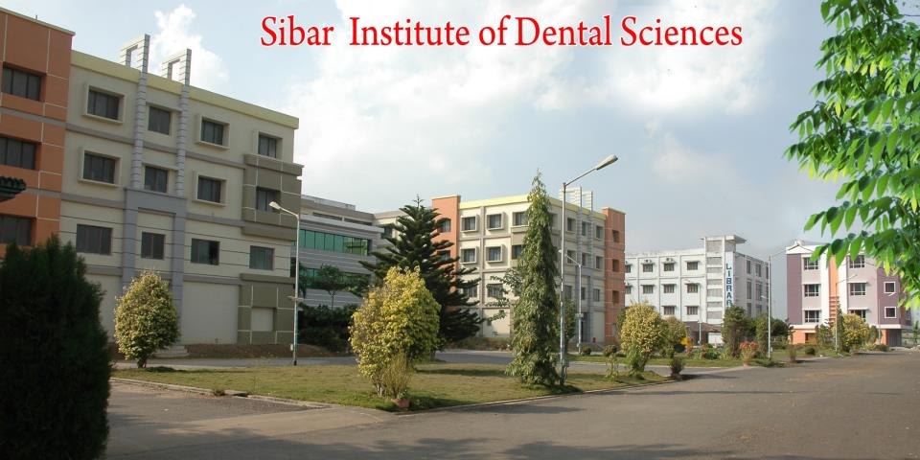
GINGIVAL INFLAMMATION
DR. CH. CHAITANYA, SENIOR LECTURER
SIBAR INSTITUTE OF DENTAL SCIENCES
DEPARTMENT OF PERIODONTICS

Slide 2
Inflammation: is defined as an observable alteration in tissues associated with changes in vascular permeability and dilation, often with the infiltration of leukocytes into affected tissues.
These changes resulting the Erythema, Edema, Heat, Pain, and loss of function being the cardinal signs of inflammation
Typically inflammation can progress through three stages:
Acute
Sub-Acute and
Chronic.

Slide 3
The body responds to an infection by developing an inflammatory response.
Early work investigating gingival inflammation described the progression from a state of health to a state of inflammation and tissue loss and divided the progression into four stages.
The gingiva is no exception, and inflammation in the
gingiva is termed gingivitis.

Slide 4
Components of Gingival Inflammation:
Gingival inflammation has two components:
Acute inflammatory component,
with vasodilation,
edema, and
polymorphonuclear infiltration, and the
Chronic inflammatory component,
with B and T lymphocytes and
capillary proliferation forming a granulomatous response.

Slide 5
Pristine Gingiva: It is virtually impossible to obtain pristine or noninfiltrated, histologically healthy gingival samples from humans. Nonhuman experiments are therefore the major source of material for the study of the temporal, histopathology sequences from healthy gingiva to an advanced, destructive lesion (periodontitis) (Page and Schroeder, 1976).
Despite extensive research, we still cannot distinguish definitively between normal gingival tissue and the gingivitis in early stages. However the normal gingiva is characterized by:

Slide 6
Histologic characteristics of healthy gingiva
Normal junctional epithelium
Few phagocytosing polymorphonudear cells from the subepithelial vasculature in the junctional epithelium
Minimal exudates from the sulcus
Normal fibroblasts, connective tissue, collagen fibers, and alveolar bone

Slide 7
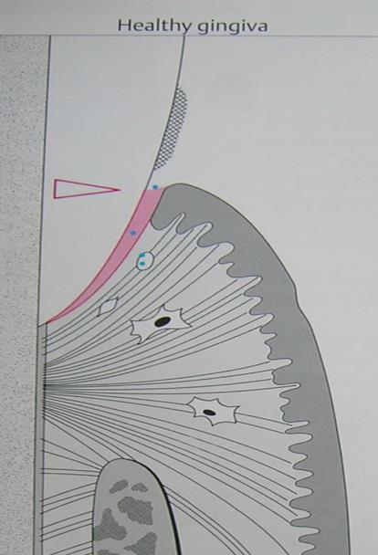
Little plaque accumulation
Normal JE
Few PMNs
Dense Collagen Fibres
Intact Fibroblasts

Slide 8
Initial & Early lesion
The initial lesion occurs within 2 to 4 days of free plaque accumulation.
The early lesion within 4 to 14 days. Both lesions represent relatively acute stages of gingivitis and are the histologic precursors of the established lesion in adults.
In children, however, the ''early lesion" may persist for prolonged periods.

Slide 9
Manifestations of Stage I Gingivitis: The Initial Lesion
The first manifestations of gingival inflammation are vascular changes consisting of
dilated capillaries and
increased blood flow.
These initial inflammatory changes occur in response to microbial activation of resident leukocytes and the subsequent stimulation of endothelial cells.

Slide 10
Subtle changes can also be detected in the junctional epithelium and perivascular connective tissue at this early stage. For example,
the perivascular connective tissue matrix becomes altered, and
there is exudation and deposition of fibrin in the affected area. Also,
lymphocytes soon begin to accumulate.

Slide 11
The increase in the migration of leukocytes and their accumulation within the gingival sulcus may be correlated with an increase in the flow of gingival fluid into the sulcus.
The character and intensity of the host response determine whether this initial lesion resolves rapidly.

Slide 12
Microscopically, some classic features of acute inflammation can be seen in the connective tissue beneath the junctional epithelium.
Changes in blood vessel morphologic features
widening of small capillaries or venules and
adherence of neutrophils to vessel walls (margination) occur within 1 week and sometimes as early as 2 days after plaque has been allowed to accumulate.

Slide 13
polymorphonuclear neutrophils (PMNs), leave the capillaries by migrating through the walls (diapedesis, emigration).
They can be seen in increased quantities in the connective tissue, the junctional epithelium, and the gingival sulcus.

Slide 14
Manifestations of Stage II Gingivitis: The Early Lesion
The early lesion evolves from the initial lesion within about 1 week after the beginning of plaque accumulation.
Clinical signs of erythema may appear, mainly because of the proliferation of capillaries and increased formation of capillary loops between rete pegs or ridges,

Slide 15
bleeding on probing may also be evident.
Gingival fluid flow and the numbers of transmigrating leukocytes reach their maximum between 6 and 12 days after the onset of clinical gingivitis.

Slide 16
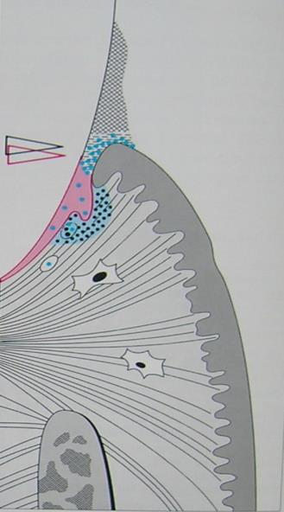
The amount of collagen destruction increases. 70% of the collagen is destroyed around the cellular infiltrate.
The main fiber groups affected appear to be the circular and dentogingival fiber assemblies.
Heavier Plaque accumulation
Transmigration of PMNs across JE
Early infiltration of Lymphocytes observed

Slide 17
Fibroblasts show cytotoxic alterations, with a decreased capacity for collagen production.
Microscopic examination of the gingiva reveals
A leukocyte infiltration in the connective tissue beneath the junctional epithelium, consisting mainly of lymphocytes (75%, with the majority T cells),
Some migrating neutrophils, as well as macrophages, plasma cells, and mast cells.

Slide 18
All the changes seen in the initial lesion continue to intensify with the early lesion. Junctional epithelium becomes densely infiltrated with neutrophils, as does the gingival sulcus, and the junctional epithelium may begin to show development of rete pegs or ridges

Slide 19
STAGE III GINGIVITIS: THE ESTABLISHED LESION
Pathogenesis
After increased gingival plaque accumulation and longterm exposure (more than 2 to 3 weeks) to bacterial challenge, early acute gingival inflammation is followed by established gingival inflammation.
Nonspecific line of defense is now reinforced by mobilization of the specific host immune response, via antibodies produced by plasma cells, and the specific cell-mediated immune response by T cells.

Slide 20
This is characterized at the cellular level by an accumulation of B lymphocytes, T lymphocytes, plasma cells, and macrophages in the inflamed gingival connective tissue.
On the other hand, the number of fibroblasts is reduced. Destruction of the collagen fibers and the extra­cellular matrix also occurs, as does an increase in the volume of infiltrate in which blood vessels proliferate.

Slide 21
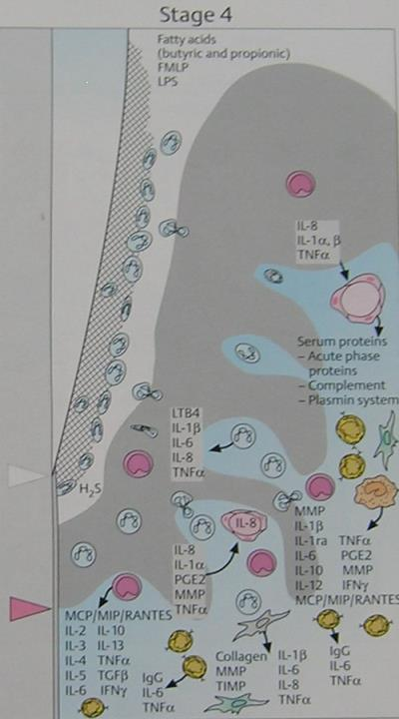
Plasma cells dominate
Homeostasis is disturbed
Activated PMNs secrete cytokines, leukotrienes & MMPs
Activated Fibroblasts secrete MMPs & TIMPs
MCP : Monocyte Chemoattractant Protien,
MIP : Macrophage Inflammatory Protien
RANTES : Regulated on activation normal T cell expressed and secreted

Slide 22
Manifestations of Stage III gingivitis: The Established Lesion
In chronic gingivitis, which occurs 2 to 3 weeks after the beginning of plaque accumulation,
the blood vessels become engorged and congested,
venous return is impaired, and
the blood flow becomes sluggish.
The result is localized gingival anoxemia, which super imposes a somewhat bluish hue on the reddened gingiva.

Slide 23
Extravasation of erythrocytes into the connective tissue and breakdown of hemoglobin into its component pigments can also deepen the color of the chronically inflamed gingiva.

Slide 24
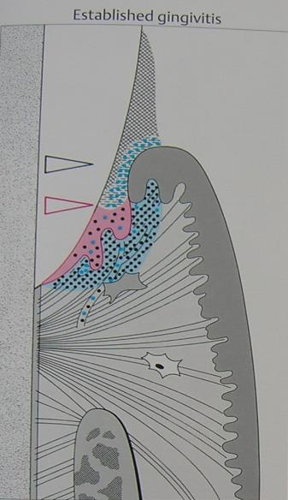
Epithelial attachment is apically displaced
No loss of CT attachment
Dense Inflammatory infiltrate into deeper structures

Slide 25
The predominance of plasma cells is thought to be a primary characteristic of the established lesion.
However, several studies of human experimental gingivitis have failed to demonstrate plasma cell predominance in the affected connective tissues, including one study of 6 months duration.
Increases in the proportions of plasma cells were evident with long-standing gingivitis, but the time for the development of the classic "established lesion" may exceed 6 months.

Slide 26
STAGE IV GINGIVITIS: THE ADVANCED LESION
Extension of the lesion into alveolar bone characterizes a fourth stage known as the advanced lesion or phase of periodontal breakdown.
Microscopically, there is
fibrosis of the gingiva and
widespread manifestations of inflammatory and immunopathologic tissue damage.

Slide 27
In general at this advanced stage, plasma cells continue to dominate the connective tissues, and neutrophils continue to dominate the junctional epithelium and gingival crevice.
Gingivitis will progress to periodontitis only in individuals who are susceptible. However, whether periodontitis can occur without a precursor of gingivitis is not known at this time.

Slide 28
