Slide 1
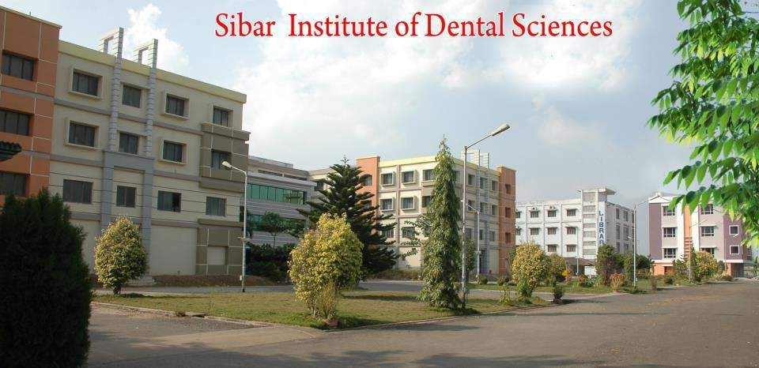

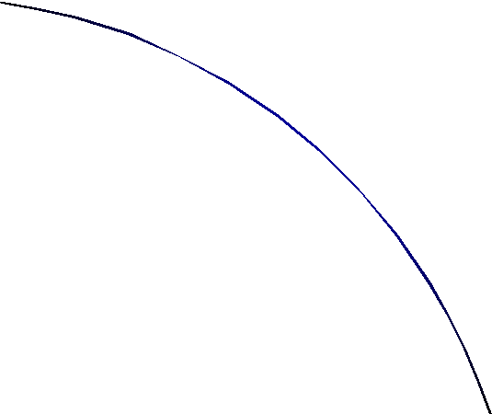

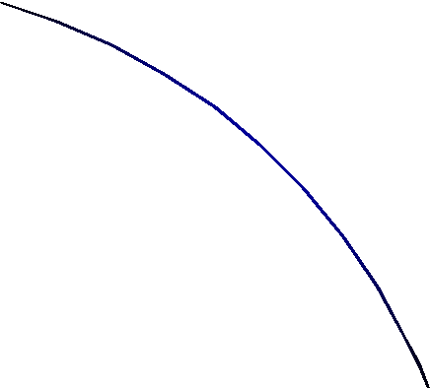

FURCATION INVOLVEMENT AND TREATMENT
DR. K. KISHORE KUMAR, PROFESSOR
SIBAR INSTITUTE OF DENTAL SCIENCES
DEPARTMENT OF PERIODONTICS

Slide 2






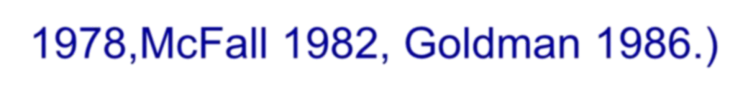



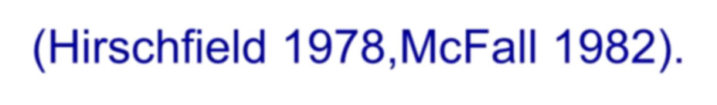
INTRODUCTION
Long term follow-up of periodontal treatment indicates periodontal lesions in the majority of patients will respond well. The one exception to this seen to be lesions in multi-rooted teeth that have advanced into the furcation area between the roots.(Hirschfield 1978,McFall 1982, Goldman 1986.)
In teeth with furcation lesions a tooth mortality rate for periodontal reasons of 31%-57% has been observed over periods averaging about 20 years compared to an overall tooth mortality for all teeth of only 7%-10%.(Hirschfield 1978,McFall 1982).

Slide 3













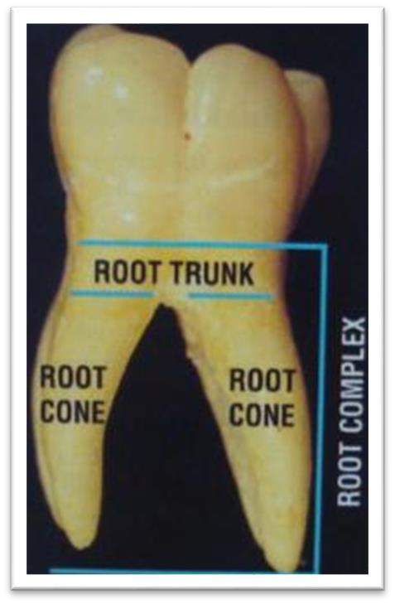









BASIC TERMINOLOGY
Root Complex: is the portion of a tooth that is located apical to the CEJ. It is divided into two parts: the root trunk and the root cone.
Root trunk: it represents the undivided region of the root.
The height of the root trunk - the distance between the CEJ and the separation line(furcation) between two root cones.
Root cone: is included in the divided region of the root complex.
Two or more root cones make
up the furcated region of the root complex.

Slide 4
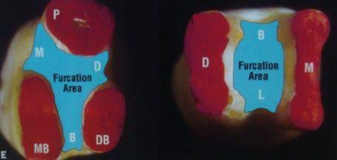
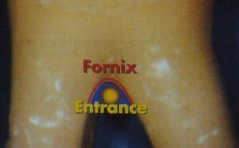
⚫ Furcation: is the area located between individual root cones.
Furcation entrance: is the transitional area between the undivided
and the divided part of the root.
Furcation Fornix: is the roof of the
furcation.

Slide 5
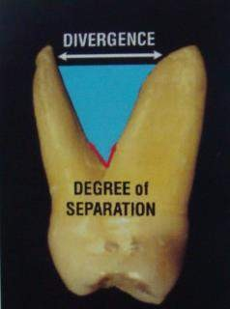
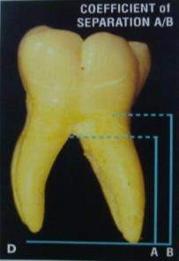
Degree of separation: is the angle of separation between two roots.
Divergence: is the distance between two roots; this distance normally increases in apical direction.
Coefficient of separation: is the length of the root cones in relation to the length of the root complex.

Slide 6













































































ANATOMY OF FURCATIONS
Trunk length and entrance width
The close relationship between the CEJ and the furcation entrance in teeth with a short trunk may result in early FI and loss of attachment due to periodontitis(Gher&Vernino 1980,Larato 1975).
The average length of the root trunk of maxillary 1st molars is 3mm at the mesial,5mm at the distal and 3.5mm at the vestibular furcation entrance.
The buccal and lingual furcation entrance in the mandibular 1st molars are located 3mm and 4mm apical to the CEJ.
The length of the root trunk of the 2nd molar is generally

Slide 7










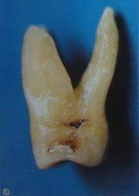
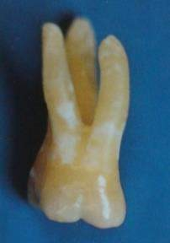
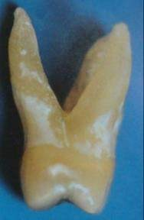




























More variable greater than that of 1st molar.
Mesial, buccal & distal furcation in maxillary 1st molar
Furcation Entrance:
The location of the furcation entrance in the maxillary molars play a role in the onset of furcation involvement.
The mesial furcation is located approximately two thirds towards the palatal aspect of the tooth,whereas the distal

Slide 8




























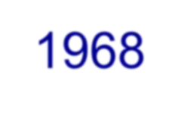

furcation is located in the midsection of the tooth and falls in an interproximal area.the interproximal crater occur commonly in the posterior areas of the mouth; this may be the reason for high frequency of distal furcation involvement.(Saari,Hurt,Biggs 1968).

Slide 9








































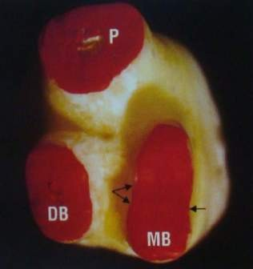
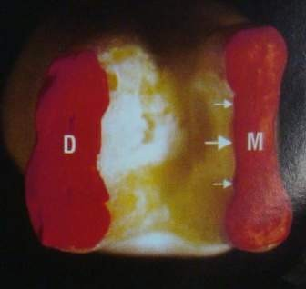
Proximal Root Concavities
Root concavities may compromise a patient’s ability to perform oral hygiene by creating areas difficult to access for plaque removal.(Gher&Vernino 1980).
The proximal surfaces of roots adjacent to the furcations of permanent,first molars have plaque-harboring concavities,especially the mesiobuccal roots of maxillary 1st molar and the mesial roots of mandibular molars.

Slide 10


































⚫ These concavities can exceed 1 mm in depth and are covered by a thicker layer of cementum than the adjacent root convexities. This may result in bacterial plaque and its toxins and ultimately calculus to penetrate farther into the root surface,making their removal more difficult.

Slide 11
















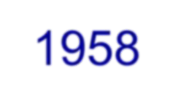
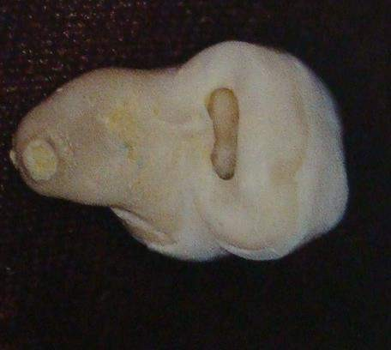
⚫ Bifurcational Ridges: intermediate bifurcational ridges were found in 73% of mandibular first molars out of which 60% were prominent(Everett,Jump,Holder 1958).
Bifurcation ridge interradicular area
in

Slide 12













































































Buccal and lingual ridges were found in 63% of the molars.
In contrast to the intermediate bifurcational ridges,they are made up primarily of dentin covered by thin layers of cementum.These resulted in the roof of the furcation being located more coronally than the entrances.
In maxillary first molars,the roof of the furcation was coronal to all three root separations.(Gher and Dunlap 1985).
These ridges create small hard to reach niches for plaque and calculus to accumulate when the furcation becomes exposed to the oral environment.(Gher and Vernino 1980)

Slide 13











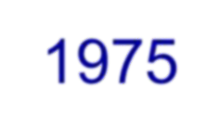
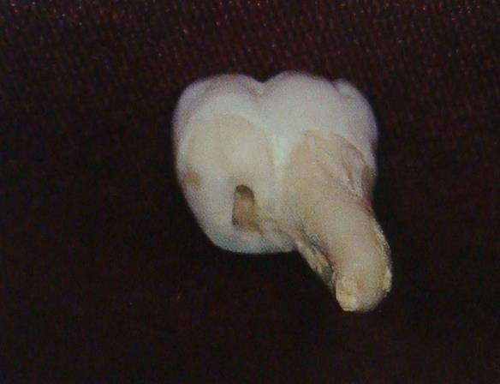
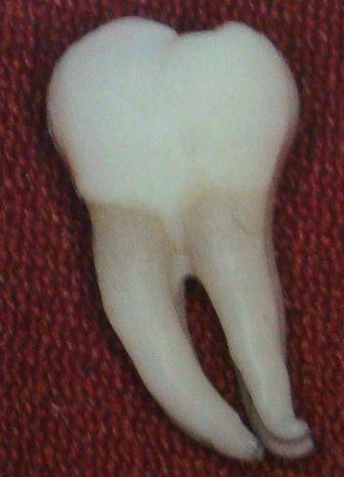
Cervical enamel projections:
⚫ Enamel abnormalities have been described in the furcation regions of molar teeth.(Moskow 1975)
Cervical enamel projections.

Slide 14



































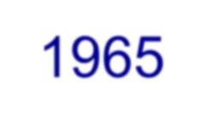









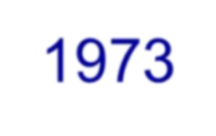


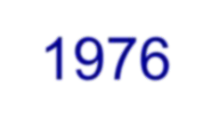
Atkinson first reported the possible relationship between CEPs and periodontal pocket formation.
Master and Hoskins reveled the presence of CEPs in more than 90% of periodontal furcation involvement at mandibular molars.
Several studies have confirmed a positive correlation between presence of CEPs and loss of clinical attachment with furcation involvement in most of the molar teeth(Grewe,Meskin,Miller 1965)
There was a positive correlation between grade of CEPs and furcation involvement.(Bissada1973,Grewe 1965,Swan 1976).

Slide 15

































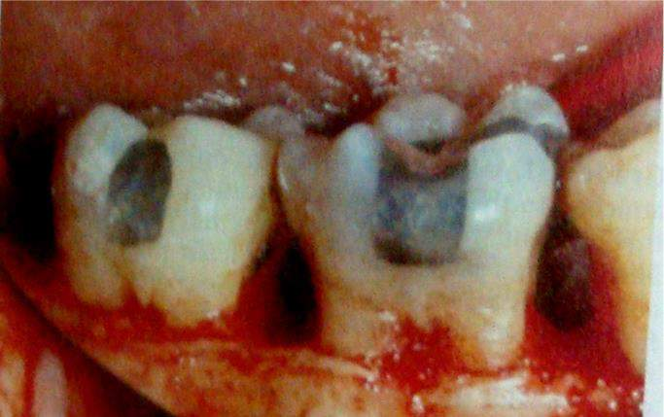












Masters and Hoskins classified CEPs based on their
proximity to the furcation entrance.
Grade I CEP show a definite change in CEJ level, with enamel projecting toward the furcation.
Grade II CEP approach the furcation but do not make
contact with it.
Grade III CEP extend into the furcation.
Furcation involvement in grade III CEP
⚫ If regeneration of the FI is attempted,CEP should be removed because connective tissue will not attach to enamel.

Slide 16


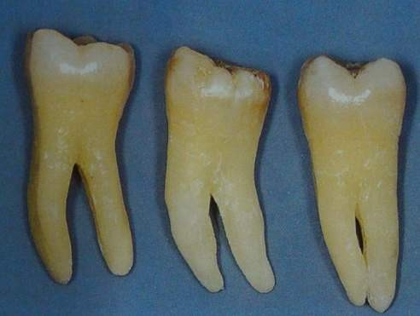











































Furcation morphology:
Furcation morphology in maxillary1st 2nd & 3rd molars
The width of the furcation entrance and the internal morphology of
the furcation limit the access of Instruments for appropriate mechanical debridement.
81% of the first maxillary and
mandibular molar
furcations,the entrance diameter is 1mm or less,and in 58% the diameter is 0.75mm or less (Bower).considering the width of conventional curettes ranges from 0.70mm to 1.1mm it is difficult to properly instrument the furcation area in a clinical situation.

Slide 17































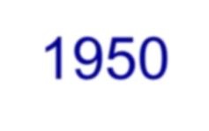

































CAUSE OF FURCATION INVASION
Extension of inflammatory periodontal disease:
⚫ FI are a phase in the rootward extension of periodontal pockets in the regions of furcations. when attachment and
bone loss progress far enough
apically on the furcal surfaces of molar teeth,they eventually involve the
furcations.(Glickman 1950,Page,Schroeder 1976).
Endodontic origin:
⚫ Pulpal pathosis in multirooted teeth invasion.(Lowman,Orban).Accessory
can cause furcal
very often
canals
extend into the furcation region and provide access to this
area for products
of pulpal necrosis,
of the interradicular
causing an
bone,with or
inflammatory lesion
without periapical involvement.(Gutmann,Hiatt).

Slide 18




































Occlusal origin:
⚫ The occlusal traumatic lesion in a multirooted tooth is
characterized histologically,within
the area,by vascular changes that lead to
interradicular periodontal
ligament space remodeling and bone demineralization.
⚫ A radiolucency in the interradicular space in conjunction with increased tooth mobility without a probeable furcation are the typical signs of excessive occlusal forces applied to a molar.(polson).

Slide 19




































Combined origin:
⚫ Pulpal and periodontal disease may occur independently or concomitantly in the same tooth.
⚫ The endodontic lesion may progress communication with the oral cavity
to establish a by
extending
coronally along the periodontal ligament and out through the gingival sulcus or periodontal pocket in an interradicular area.once the endodontic and periodontal lesions join,they are clinically indistinguishable. (Harrington,Simon).

Slide 20





































































CLASSIFICATION
Glickman classified FI into 4 grades
Grade I: Pocket formation into the flute of the furcation,but the interradicular bone is intact.
Grade II: Loss of interradicular bone and pocket formation of varying depths into the furcation but not completely probable to the opposite side of the tooth.
Grade III: Complete loss of interradicular bone with pocket formation that is
completely probable to the opposite side of the tooth.
Grade IV: Loss of attachment and gingival recession that has made the entire furcation clearly visible to clinical examination.

Slide 21
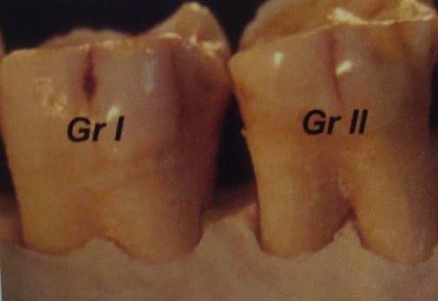
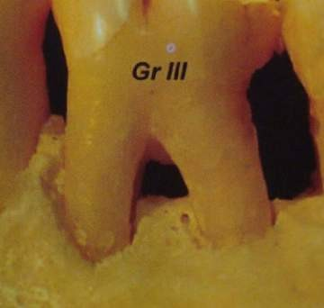
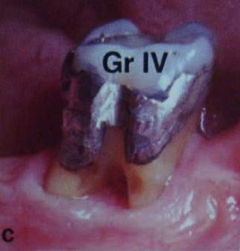
Glickman’s classification of furcation involvement

Slide 22















a descriptive
Goldman and Cohen have incorporated
classification of FI referring to
Grade I incipient Grade II cul-de-sac
Grade III through and through.

Slide 23







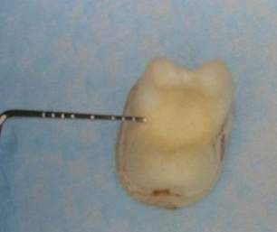


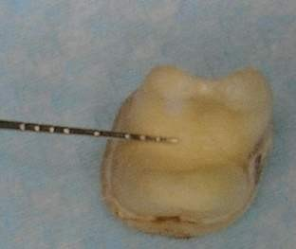





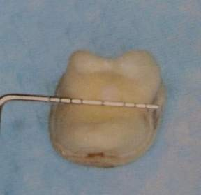





Hamp et al further classified Glickman’s grade II FI:
Degree I: horizontal loss of periodontal tissue support less than 3mm.
Degree II: horizontal loss of support exceeding 3mm but not encompassing the total width of the furcation area.
Degree III: horizontal through and through destruction of the periodontal tissue in the furcation.

Slide 24
























⚫ Fedi merged these two systems into one,in which the Glickman classification of grades I,II,III,and IV is used,but for grade II FI,degree I and degree II are added to indicate horizontal depth less than or greater than 3mm.

Slide 25


































































Based on vertical component of FI:
Eskow and Kapin classified based on vertical loss in thirds of interradicular loss,where as Tarnow and Fletcher classified it in mm:
Subclass A: vertical destruction to one third of the total interradicular height(1 to 3 mm).
Subclass B: Vertical destruction reaching two thirds of the interradicular height(4 to 6 mm).
Subclass C: Interradicular osseous destruction into or beyond the apical third (>7 mm).
Furcations would thus be classified as IA,IB,IC,IIA,IIB,IIC,IIIA,IIIB,IIIC,IVA,IVB,IVC.
These sub classifications are an aid in prognosis and treatment planning.

Slide 26





















































Easley and Drennan’s classification of FI
Normal anatomy: no FI.
Class I: incipient involvement in which the fluting coronal to the furcation entrance is affected but there is no definite horizontal component to the furca.
Class II:
  Type 1- a definite horizontal loss of attachment into the furcation,but the pattern of bone loss is essentially horizontal.there is no definite buccal or lingual ledge of bone.
  Type 2- there is a buccal or lingual bony ledge and a definite
vertical component to the attachment loss.

Slide 27

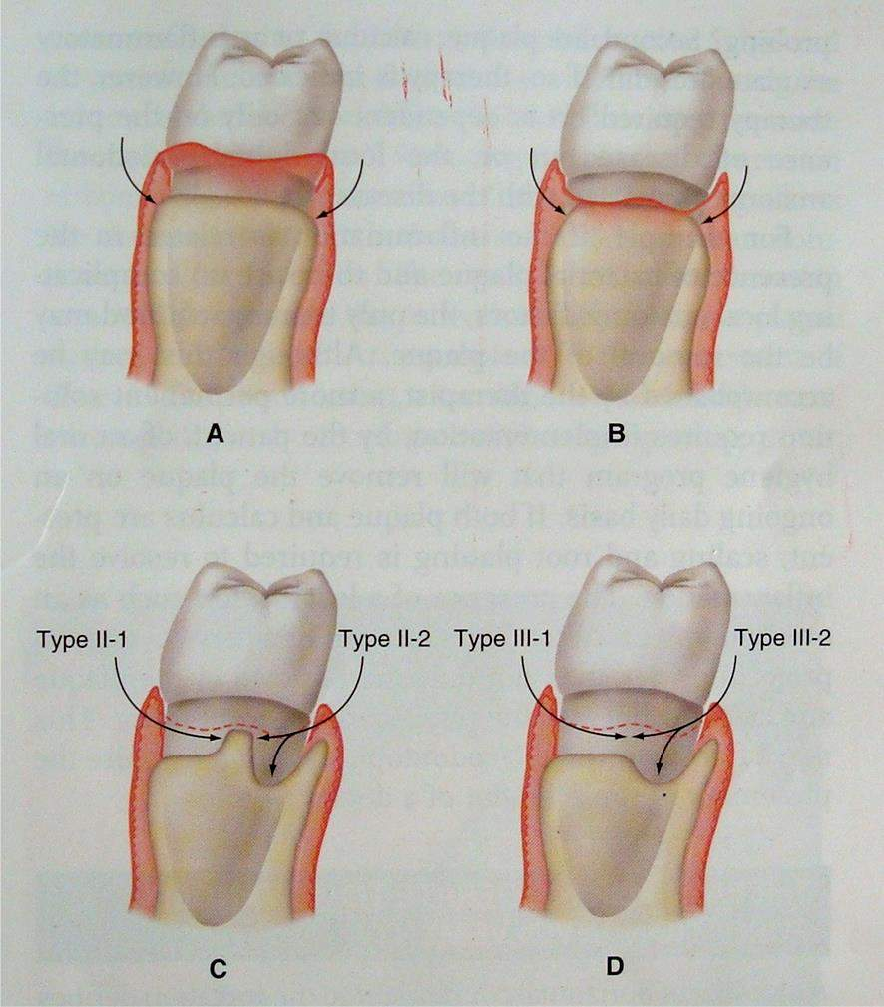







D. Class III: A through and through loss of attachment in the furcation. As with class II furcation
defects,the pattern of attachment loss may be horizontal(1) or there may be a vertical component of
varying depth.

Slide 28






































DIAGNOSIS
Radiographs: FI are often first detected in radiographs if they are made before probing measurements are obtained.
Both paralleling “periapical” and vertical “bite-wing”
radiographs should be taken.
In the radiographs the location of the interdental bone as well as bone level within the root complex should be examined.

Slide 29
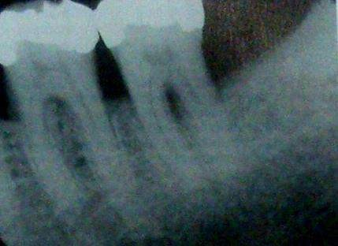


































Radiographic degrees of furcation
appearance of Various
involvement in
maxillary and mandibular molars
⚫ On x-ray films of maxillary molars,a small,triangular,radiolucent shadow
is sometimes seen over the mesial or distal roots in the proximal furcation areas,which has been called as the furcation arrow.(hardekopf,dunlap).

Slide 30
CLINICAL PROBING
A) No.23 explorer
B) Nabers No.1 & 2 probes

Slide 31
Clinical probing:
⚫ In maxillary molars the mesial
furcation entrance is
located closer to the palatal than to the buccal surface.thus the mesial furcation should be probed from the palatal aspect.
Palatal
mesial
approach for
furcation in
maxillary molar.
⚫ The distal furcation entrance is present midway between the buccal and palatal surface hence this furcation could be probed from either the buccal or the palatal aspect.

Slide 32
⚫ Due to anatomic variations and limited access, the clinical assessment of furcation involvement in maxillary premolars is often difficult.
Furcation in maxillary premolar

Slide 33
Probing of the mandibular furcations is relatively easy because there are only buccal and lingual entrances,each located midway mesiodistally.
Vertical attachment loss on the adjacent roots should be probed at the furcation line angle of each root,angling the probe somewhat,to place the tip of the probe slightly into the furca.
Bone sounding or transgingival probing should be done to determine the bone contours associated with FI more accurately after anesthetizing the soft tissue.(Easley,Greenberg,Listgarten).

Slide 34
Measurement of vertical attachment loss at furcation line angles

Slide 35
FURCATION THERAPY
OBJECTIVES:
Elimination of the microbial plaque from the exposed surfaces of the root complex.
Establishment of an anatomy of the affected surfaces that facilitates proper self-performed plaque control.

Slide 36

RECOMMENDED
THERAPY:
Degree I: srp and furcationplasty.
Degree II: furcation plasty,tunnel preparation,root
resection,tooth extraction,GTR at mandibular molars.
Degree III: tunnel preparation,root resection,tooth extraction.
Therapeutic management of early FI
The presence of inflammatory periodontal disease and the etiologic and local factors that are associated with the disease are the keys to making a treatment decision.

Slide 38
Scaling and curettage, gingivectomy, odontoplasty These procedures are used for incipient lesions in which no interradicular bone involvement exists(grade I) and the pockets are suprabony.
Treatment is limited to pocket reduction, gingivectomy, reshaping of tooth structure, odontoplasty to widen the narrow furca entrance.

Slide 39
The therapy required is dependent not only on the presence of disease but on the local dental/periodontal anatomy associated with the disease.(Glickman,Goldman).
Therapy for moderate to advanced furcation involvement:
Therapy for class II furcations varies with the extent of the horizontal and vertical attachment loss,the configuration of any associated bony defect,and the anatomy of the tooth.

Slide 40
Indications for surgical approach:
Inability to adequately instrument the furcation by routine Scaling and root planing through the gingival sulcus.
Persistence of inflammation or exudation after
instrumentation in the presence of good oral hygiene.

Slide 41
Surgical debridement of furcations
The reflection of a flap provides access and visibility to the furcation which facilitates thorough removal of plaque,
calculus and any bacterial contaminants from the root surfaces of the furcation which results in a resolution of inflammation and potentially to reduction in pocket depth.

Slide 42
Odontoplasty and Osteoplasty:
⚫ The addition of odontoplasty and osteoplasty to surgical debridement provides a means of altering the physical dimension of the furcation defects.(Lindhe,Friedman)

Slide 43
Odontoplasty provides a means of reducing the intermediate bifurcation ridge and the extent of dome over the furcation, thereby reducing the volume of the furcation defect.
Osteoplasty reduces the physical dimension of bony ledges and placement of strategic grooving allows the therapist to reduce both the soft and hard tissue component of the furcation.

Slide 44
FURCATIONPLASTY

Slide 45
Limitations:
Limited to mandibular molars;buccal furcation of maxillary molars with early to moderate degrees of involvement;and those furcations where aberrations in root/furcation morphology and significant osseous defects are absent.
The long-term success is dependent on access for plaque removal and the patient’s willingness to perform daily hygiene procedures.

Slide 47
ROOT RESECTION AND HEMISECTION
Root resection involves removing one or more roots from a multirooted tooth.
Clinical terminology
Tooth sectioning: is defined as the division of the tooth into its individual roots.
Root resection: removal of part of the tooth.
Mandibular molars are usually treated by hemisection(also termed bicupidization or separation with or without root removal).
Maxillary molars are generally treated by root amputation.

Slide 48
Objectives:
To resect the open root furcation area and make possible debridement of the residual root.
To eliminate the periodontal pocket by removing the furcation.
To improve the furcation form for dental hygiene.
To preserve maximum periodontal tissue of the residual root.
To control interdental space in the area adjacent to the root.
To treat multirooted teeth where endodontics is impossible.
To treat teeth with severe caries.

Slide 49
ROOT RESECTION AND HEMISECTION:
Indications :(Bassaraba N 1969)
Severe vertical bone loss on one root of a multirooted
tooth not amenable to regeneration/reattachment.
Furcation invasion not correctable by odontoplasty.
Proximal furcation invasion in combination with root approximation.
Furcation invasion that is not maintainable.
Periodontally involved abutment teeth with a hopeless prognosis associated with one root.

Slide 50
6.Vertical or horizontal root fracture.
Uncorrectable root dehiscence.
When endodontic therapy is impossible on one root of a multirooted tooth.
Proper tooth selection for resection

Slide 51
Contraindications to root resection
Advanced bone loss with an unfavorable crown-to-root ratio.
Fused roots that cannot be separated.
If an endodontically inoperable canal would be retained.
If the remaining root(s)would be inadequate to serve as a prosthetic abutment.

Slide 52
If indicated splinting cannot be performed.
When periodontal support after resection is inadequate to withstand normal occlusal forces.
Inability to create a good postsurgical gingival environment.
Socioeconomic conditions.
In the presence of inadequate oral hygiene.

Slide 53
CONTRAINDICATION OF ROOT RESECTION

Slide 54
WHICH ROOT AND WHY
The root that has the least amount of remaining bony
support.
Will obliterate the furcation and contribute to the elimination of any associated periodontal defect.
Provides postsurgical maintainable architecture.
Is the most difficult for the endodontist or restorative dentist to treat.
Least complicates future periodontal maintenance.

Slide 55
VITAL V/S NONVITAL ROOT
RESECTION
⚫ Completing endodontic therapy before RSR has the following advantages:
Facilitates the surgical removal of the root,because it allows more extensive odontoplasty to be performed.(Lindhe).
It reduces the potential contamination of the surgical field
by metallic fragments from a restoration.
Minimizes the potential for postoperative pain.(Smukler,Tagger).

Slide 56
MAXILLARY ROOT RESECTION – SEQUENCE OF TREATMENT
a). Before resection – outlines were made
b) Bone removal over the affected root using round bur.
c) 701 L bur is used for the second cut.A flame shaped enamel finishing bur is used for the third horizontal oblique cut.

Slide 57
d) Oblique cut completed and final internal countouring established with round and oval enamel finishing bur
e) Root tip removed.
f) Final root contour established with No.6 round bur and hand instrumentation.

Slide 58
g) Final osseous surgery completed and flap sutured.
h) Final prostheses.

Slide 59
When furcation involvement is first identified during periodontal surgery RSR can be done first but canal entrances of the remaining roots must be properly sealed.Definitive root canal therapy should be completed within 2 weeks.(Smukler and Tagger 1976).
Hemisection:
It is the surgical process by which a two rooted tooth,usually a mandibular molar,is converted into a single rooted tooth by the removal of one root and the associated portion of the crown.(Gargiulo,Wentz,Orban 1961)

Slide 60
⚫ The economic consequences of hemisection and the advent of other therapeutic methods such as dental implant placement have resulted in a reduction in the frequency of hemisection.
Indications:
Patients who experience vertical root fracture or root
perforation during endodontic therapy.
Patients who have endodontically treated mandibular molars with advanced bone loss on only one root that are serving as terminal abutments of a prosthesis.
Patients who have local anatomy that precludes extraction and simple implant placement.

Slide 61
MANDIBULAR HEMISECTION
A) Pre operative
B) Line drawn along the grade II
furcation after flap reflection
C) Sectioning completed

Slide 62
D) Mesial root extracted
E) Flap placed in position & sutured apically.
G) Post op – 5 years later
F) Final Prostheses

Slide 63
HEMISECTION AND BICUSPIDIZATION

Slide 64
For prognostication the following factors should be considered before RSR and Hemisection:
Periodontal considerations:
A long and wide root with a large crown is the ideal form.
After root resection or hemisection, the crater like osseous defect around the residual root is removed by osseous resection and the periodontal pocket eliminated. A form that facilitates plaque control to be achieved.

Slide 65
In class III furcation involvement,a good prognosis is unlikely unless the root morphology is favorable.if a tooth is used as an abutment in an edentulous area,root resection or hemisection at the stage of class II is best. bone destruction of the residual root is suppressed and periodontal tissue recovered with a good long-term prognosis is expected.
The patient must be capable of thorough hygiene and follow through with scheduled professional care and management.

Slide 66
Endodontic consideration:
⚫ In root canal preparation,excessive enlargement of the root canal must be avoided to reduce the possibility of thin walls.
Restorative considerations
1.A post and core should be used only if the residual tooth structure is fragile and the crown will not adhere.post and core are the main causes of root fractures.(Kastenbaum 1986).
2.All root resected teeth should be reinforced with copings,if possible.

Slide 67
Occlusion should be balanced to avoid a force that might be detrimental to the root resected tooth. if possible, achieve minimal occlusal contact.
The restoration form must be easily cleanable for the
patient’s convenience.
Common reasons for failure
Root fracture because of
  Lack of conservative endodontic treatment.
  Failure to restore teeth adequately with posts and crowns.
  Inadequate provisional or final splinting for stabilization.

Slide 68
Poor tooth selection.
Incomplete sectioning.
Failure to diagnose involvement of other furcations. 5.Failure to correct osseous deformities, resulting in
residual pockets.
Failure to remove residual furcations.
Inability to maintain adequate level of oral physiotherapy about adjacent furcations.

Slide 69
TUNNEL PREPARATION
Tunneling: used to treat deep grade II and III
mandibular furcations.
It is the surgical exposure of the furcation which is indicated for advanced grade II and III lesions in which resection is not possible.
The rationale for this is to provide ready access for plaque removal and to facilitate instrumentation and the application of topical medicaments like fluorides.

Slide 70
It requires roots that are long and divergent and is generally indicated for the mandibular molars.it often fails because of decay in the furcation area(Lindhe 1983).
Hellden (1989) reported that teeth with tunnel preparations have considerably better prognosis than that previously reported.

Slide 71
TUNNELING
A) Pre op radiograph
B) Gr III furcation – pre
op
C) Tunneling procedure
completed
D) Post op – self performed plaque
control can be achieved by use of interproximal brush.

Slide 72
REGENERATION OF
FURCATION DEFECTS:
Furcation defects treated by GTR were demonstrated with histologic documentation of new attachment formation (Gottlow et al. 1986).
Predictable outcome of GTR therapy was demonstrated only in grade II furcation involved mandibular molars(Pontoreiro 1988,Lekovic 1989,Caffese 1990).
The reason for the limited predictability of GTR in furcation-involved teeth may be due to:
The morphology of the periodontal defect, which in the root complex often has character of a horizontal lesion.

Slide 73
hence new attachment formation is dependent on coronal up growth of periodontal tissue.
Limited access for instrumentation.
Exposure of the membrane material and the fornix of the furcation.
Morphology of osseous defects and bone regeneration:
The number of bony walls surrounding the defects influences the predictability of regeneration in furcation defects.
In class II furcation involvement,predictability is high if the inter dental bone level is coronal to the furcation.

Slide 74
The length of the root trunk influences attachment gain in
the furcation.

Slide 75
A) Grade II furca in lingual aspect of mandibular first molar
B) Teflon membrane sutured in position & supported by interproximal alveolar bone.

Slide 76
C) Flap sutured back in position
D) Surgical reentry after 6
months of healing

Slide 77
BONE GRAFTS
The furcation area is characterized by defects, the walls of which are primarily of tooth structure. therefore, although the area is capable of holding a graft,it has little or no vascularity to support the graft,due to this reason the success of graft is limited in furcation defects(Sepe,Saunders)
Grafts are indicated where destruction of furcation is only partial(grade I or II)or where deep vertical lesions have still left some bone on the inner aspects of the roots.(Bowers and Colleagues,2003).

Slide 78
GTR with bone grafts in furcations:
The predictability of connective tissue attachment gain is high using GTR for furcation involvement, but new bone formation is not predictable in the same area.(Schallhorn,Becker).
Reports have shown that bone regeneration is increased by the use of bone grafts in combination with GTR for new bone formation.(Schallhorn and McClain).
The success is likely due to the fact that bone grafts facilitate space making and membrane placement.

Slide 79
GRADE II FURCATION IN MAXILLARY MOLAR TREATED WITH BONE GRAFT & RESORBABLE & NON RESORBABLE MEMBRABE
A) Grade II furcation in buccal aspect of maxillary molar
B) DFDBA placed in the defect

Slide 80
C) a. treated with non resorbable (Gore Tex ) membrane.
b.Treated with resorbable vicryl mesh membrane
D) Surgical reentry after 1
year of healing

Slide 81
Murphy desribed the indications of GTR combined bone
grafts as follows:
Osseous defects of 7-8mm depth. With deeper osseous defects, the effect of combining GTR with bone grafts diminishes because of spontaneous bone fill.
Deep osseous defects where space must be formed and maintained under the membrane.

Slide 82
The WWP and the AAP paper on periodontal regeneration in furcations found the following:(Murphy and Gunsolly 2003;Wang 2005)
GTR provided additional benefits over OFD in CAL, reduced probing in furcations.
Bone replacement grafts enhance GTR treatment outcomes in furcations.
Bioabsorbable and nonabsorbable membranes provide similar outcomes in horizontal probing attachment level furcations.
Only e-PTFE membranes significantly enhanced the vertical probing attachment level in furcations.

Slide 83
Coronally positioned flaps with CA are associated with
better clinical outcomes in furcation defects.
Clinically GTR procedures should be limited to mandibular and maxillary buccal grade II furcation defects.

Slide 84
EXTRACTION
Extraction of a furcation involved tooth must be considered when there is extensive attachment loss; so that no root can be maintained or when the treatment will not result in a tooth/gingival anatomy which allows proper self-performed plaque-control measures.
Implants in place of furcation involved tooth should be considered only if implant therapy will improve the prognosis of the overall treatment.

Slide 85
TOOTH-RELATED FACTORS
Degree of furcation involvement.
Amount of remaining periodontal support. 3.Probing depth.
Tooth mobility
Endodontic conditions and root/root-canal anatomy. 6.Available sound tooth substance.
7.Tooth position and occlusal antagonisms.

Slide 86
PATIENT RELATED FACTORS
Strategic value of the tooth in relation to the overall plan.
Patients functional and esthetic demands. 3.Patients age and health conditions.
4.Oral hygiene capacity.(Hamp, Carnevale and Svardstrom).

Slide 87
CONCLUSION
Molars with varying degrees of FI can be effectively treated and preserved similar to that of teeth with intact furcations.
Effective management of furcation defects requires knowledge of the anatomic problems associated with FI and the application of treatment methods that are consistent with the nature and extent of the involvement.
The keys to successful treatment of molar FI are Early diagnosis, thorough treatment planning, good oral
hygiene by the patient, careful technical execution of the therapeutic modality and a well designed and implemented program of periodontal maintenance.

