Slide 1
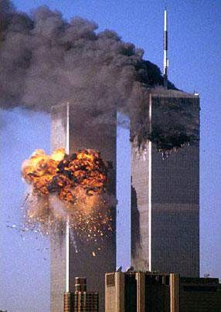

FORENSIC ODONTOLOGY
Forensic Anthropology and
Odontology
Dr. T. Navya
Sr. Lecturer

Slide 2
OVERVEIW OF FORENSIC ODONTOLOGY
Def:
FORENSIC ODONTOLOGY IS DEFINED AS THE
BRANCH OF DENTISTRY tfHICH IN THE INTREST OF LAtf DEALS tfITH PROPER HANDLING AND EXAMINATION OF DENTAL EVIDENCE,PROPER EVALUATION AND PRESENTATION OF SUCH EVIDENCE .
( KIESSER NEILSON 1981 )

Slide 3
FIELDS OF FORENSIC ODONTOLOGY
Age determination
Sex
Race
Finger printing
Identification of victims in mass disasters
Identification of bite marks
Facial reconstruction
  manual
  computer reconstruction

Slide 4
FIELDS OF FORENSIC ODONTOLOGY
CIVIL – NON CRIMINAL:
  IDENTIFICATION OF AN INDIVIDUAL REMAINS WHERE DEATH IS NOT DUE TO ANY SUSPECIOUS CIRCUMSTENSES
  MASSDISASTER – VICTIMS OF FIRE,AIRCRAFT,OR TRANSPORT ACCIDENTS
  CRANIOFACIAL SUPERIMPOSITION FOR
IDENTIFICATION.

Slide 5
2. CRIMINAL:
IDENTIFICATION OF PERSONS FROM THEIR
DENTITION-----DEAD/LIVING
DEALING WITH BITE MARK IDENTIFICATION
- FOOD STUFFS
-ON THE ASSAILANT
-THE VICTIM
RESEARCH

Slide 6
Historical aspect of bitemarks
Identification by teeth goes back as far as 49 A.D. at the time
of Nero.
In India, the first reported case of dental identification was that of Raja Jaichandra Rathor of Kannouj, who died in the battlefield in 1193 whose mutilated body was identified by his false anterior teeth.

Slide 7
The first case involving a bitemark that led to a conviction was a 1972 rape case, Illinois vs. Johnson.
Dental identification was used on Adolf Hitler and Eva Braun at the end of World War II, the New York city World Trade Center bombing, the Waco Branch Davidien siege, and numerous airplane crashes and natural disasters.
Even Saddam Hussain’s identification in Iraq war is by dental identification.

Slide 8
Teeth are often used as weapons when one person attacks another or when a victim tries to ward off an assailant.
It is relatively simple to record the evidence from the injury and the teeth for comparison of the shapes, sizes and pattern that are present.
However, this comparative analysis is often very difficult, especially since human skin is curved, elastic, distortable and undergoing edema.

Slide 9
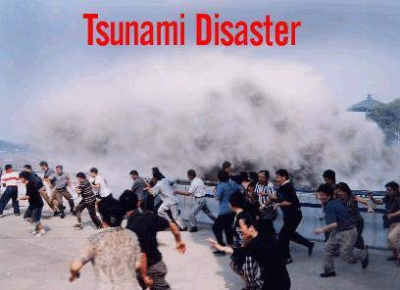
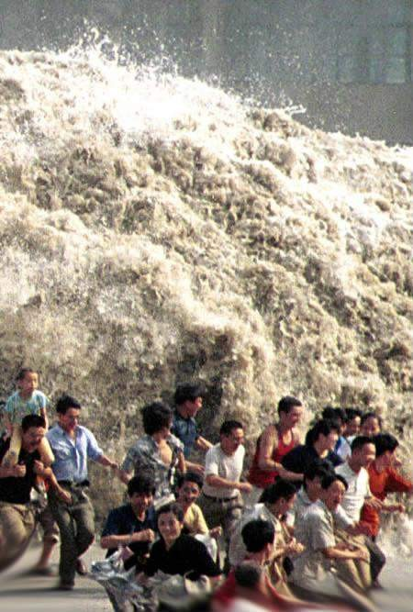

EXPERIENCE IN FORENSIC ODONTOLOGY

Slide 10
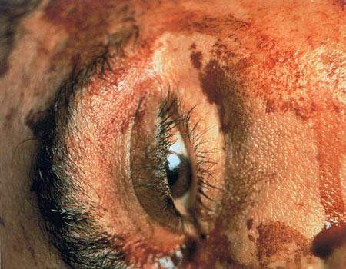
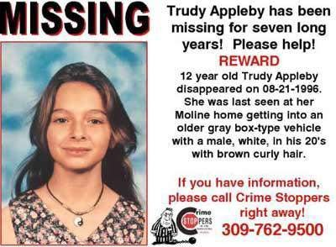
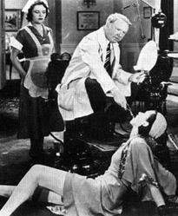
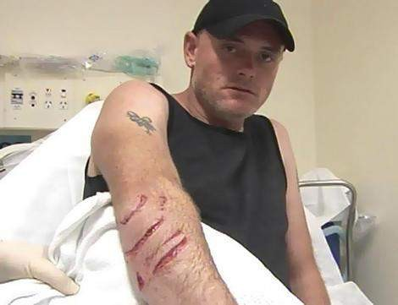
EXPERIENCE IN FORENSIC ODONTOLOGY
Murder victims • Missing persons
DENTAL MALPRATICE
Bite mark cases in criminal trials

Slide 11
IDENTIFICATION
A medical examiner, is an appointed official for identification purpose ,who is a pathologist specially trained in forensic dentistry.
Results of comparison of ante and post mortom data, regardless of method of identification, leads to
A. POSITIVE IDENTIFICATION: where there is sufficient uniqueness among comparable items

Slide 12
PRESUMPTIVE IDENTIFICATION:
where there are commonalities among comparable items
INSUFFICIENT IDENTIFICATION EVIDENCE: where insufficient supportive evidence available.
EXCLUSION OF IDENTIFICATION EVIDENCE: where there are explainable or un explainable
discrepancy among comparable items.

Slide 13
Identification Methods
Visual
Fingerprints/footprints
Radiological/Medical
DNA
Dental

Slide 14
Victim identification Principles
Victim identification should be based on scientific evaluation of biometric data
Biometric means in use:
visual
Fingerprints comparison
DNA profiles
X-ray data
Medical marks and signs
Odontological methods

Slide 15
VISUAL OR PERSONAL RECONGNITION
PERSONAL RECOGNITION:
is least reliable and often based on visual identification of decent by a family member or a friend
this assesses artificial materials such as clothing, jewellery etc.,or personal effects such as scars, tattoos etc.
this evidence can be accidentally or purposefully, exchanged between bodies

Slide 16
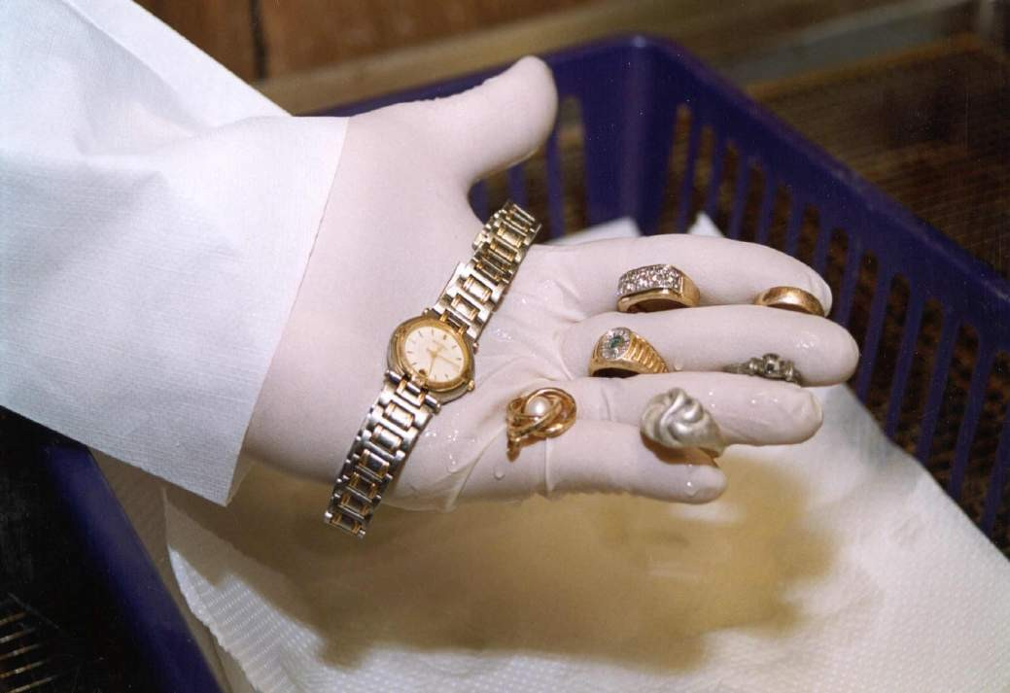
PERSONAL EFFECTS

Slide 17
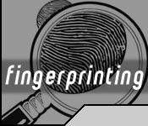
FINGER PRINTING:
  INVOLVES IDENTIFICATION OF RIDGE LIKE PATTERNS ON FINGERTIPS AND PALMS
  UNIQUE FOR EACH PERSON
- GENETICALLY DETERMINED, NOT SIMILAR EVEN FOR HOMOZYGOUS TWINS.
- AS IT IS INHERITED ,STATIC AND REMAINS UNCHANGED THROUGH OUT LIFE, PROVIDES ADVANTAGE,WHEN THEY ARE COMPARED ALONG WITH DENTAL IDENTIFICATION

Slide 18
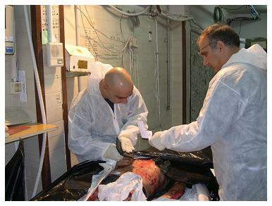
Fingerprinting up taking

Slide 19
PHYSICAL ANTHROPOLOGICAL EXAMINATION OF BONES:
- forensic anthropologist and dentist, often work togethger to resolve problems associated with identification as both disciplines are concerned with analysis of calcified structures of body i.e bones and teeth
- this anatomic material canbe studied clinically and radiographycally, to determine age,sex and race of a person

Slide 20
A. DETERMINATION OF AGE:
Age can be determined clinically and radiographycally based on eruption patterns, calcification times, combined with analysis of calcification centers of hand and wrist.
Lab Procedures Used Includes Study Of Ground Sections Of Teeth For Following Patterns (Gustafson’s Method)
•
  ATTRITION.
  PERIODONTAL ATTACHMENT
  SECONDARY DENTIN.
  ROOT RESORPTION
  TRANSPARENSY
  CEMENTUM APPOSITION

Slide 21
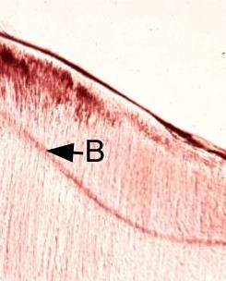
Age Determination
Neonatal Line – allows forensic odontologists to determine if a child
was alive at birth
Ratio of L-aspartic acid to D-aspartic acid (+/- 1.5 years) (L-aspartic acid → D-aspartic acid with time)
Gustafson’s Method – six signs of wear including dentin
density and transparency

Slide 22

Dental films can estimate age up to about 18 years old or completion of third molar formation

Slide 23
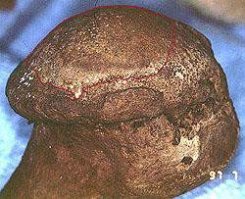
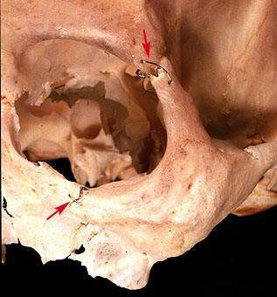
Determination of Age from Bones
Occupational stress wears bones at joints
Surgeries or healed wounds
aid in identification

Slide 24
Determination of Age from Bones
Ages 0-5: teeth are best – forensic odontology
Ages 6-25: epiphyseal fusion – fusion of bone
ends to bone shaft
epiphyseal fusion varies with sex and is typically
complete by age 25
Ages 25-40: very hard
Ages 40+: periodontal disease, arthritis, breakdown of pelvis, occupational stress, unique clues

Slide 25
DNA typing is not only to help apprehend
the guilty , but also to free the innocent ’

Slide 26
Useful if victim has antemortem medical radiographs for comparison
Medical records may document serial numbers from implanted prosthetic devices (joint, heart valve, etc.)

Slide 27
Dental Identification
Unique
  No two individuals have identical dentitions
  Dental care rendered is often unique
  Identification can sometimes be made from one tooth
Durable
  Teeth most durable part of human body
  Remains after decomposition, fire, or trauma

Slide 28
Body Identification by Dental Means
Every Individual has two dentitions during life:
  Primary dentition – pediatric or childhood
  Permanent dentition- adult
Primary tooth development is normally completed by 2 years of age (20 total teeth)
Adult tooth development , including root development, is normally completed 8 years later ( 32 permanent teeth)

Slide 29
Human Remains Identification
Begins at disaster site
  Security cordon established
  Human remains found, tagged and staked with numbers or GPS coordinates
  Locations of remains charted on map of disaster area
  Photographs taken of area
  Removal of remains in human remains pouches

Slide 30
Human Remains Identification
A major task that should begin early after disaster is the establishment of a probable victim list so that antemortem records may be obtained as quickly as possible
  Manifest lists
  Missing person reports
  Eyewitnesses

Slide 31
Forensic Dental Organization
Identification Center Chief
Forensic Dentistry Chief
Antemortem Dental Record Section
Postmortem Dental Exam & Radiology Section
Postmortem record & comparison section

Slide 32
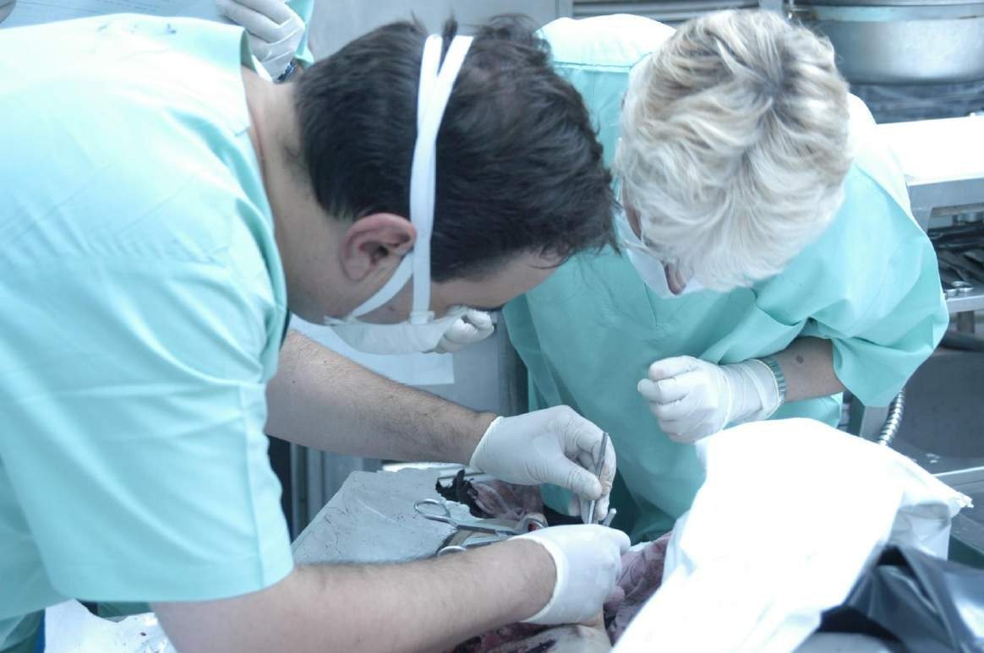
Odontologists on work

Slide 33
Postmortem Identification
Nature of disaster determines amount of time involved with postmortem dental examination
Depending upon condition of victim, usually involves
  Preparation/dissection & cleansing
  Radiographs
  Exam & charting

Slide 34
Postmortem Identification
Facial dissection
Infrequent, but may be required with burned or traumatized remains
  Allows full access to oral cavity for exam and
radiographs
  Reflects soft tissue surrounding oral cavity
  Does not remove maxilla or mandible from the body

Slide 35
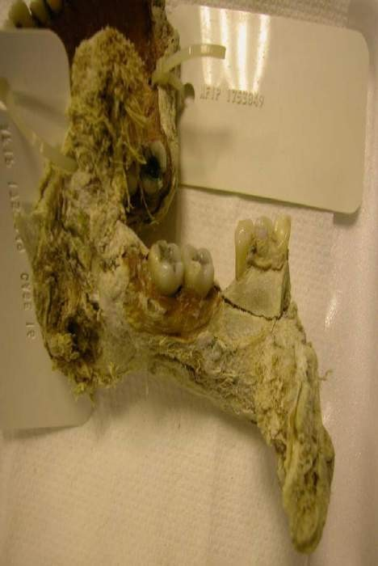
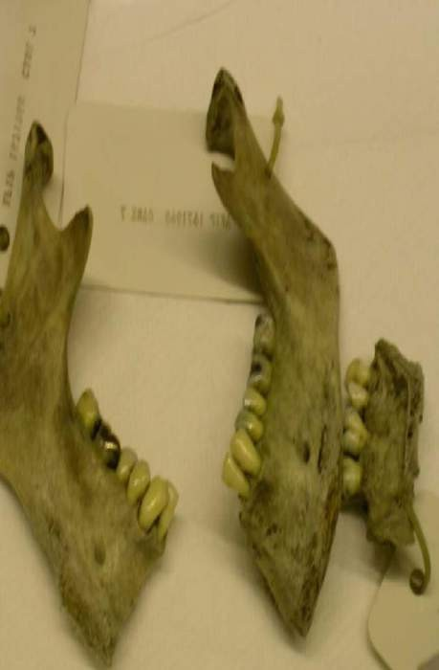
Partial mandible and maxilla fragments

Slide 36
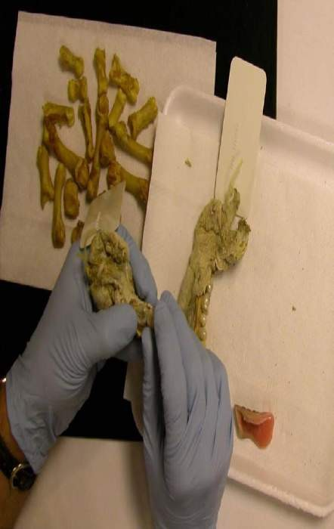
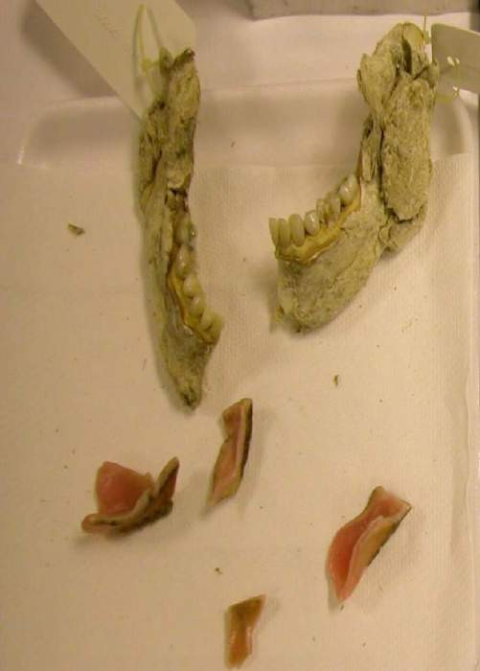
Mixed teeth and prostheses

Slide 37
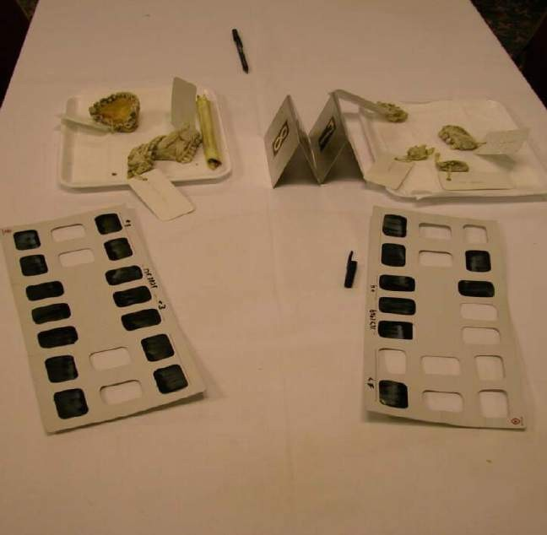
Document postmortem remains –
grouped by number by intake unit on-site

Slide 38
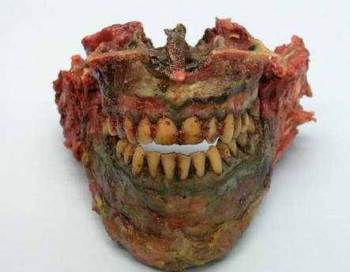
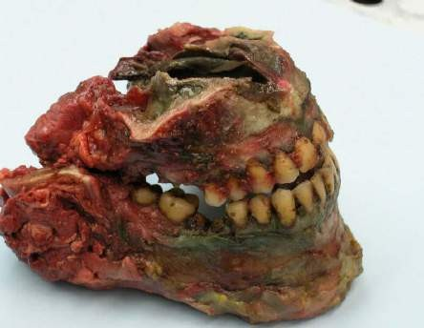
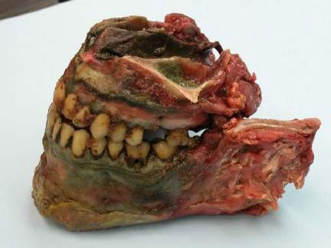
Case identified in mass disaster
Jaws can be articulated outside the body

Slide 39
Postmortem Radiographs
Digital radiographs should be used if available
All radiographs placed on one labeled CD for each postmortem record

Slide 40
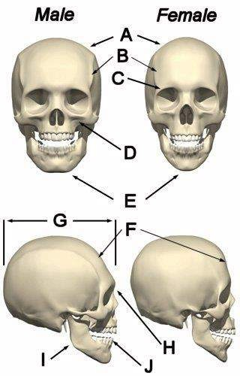
Determination of Sex
2. Cranium second best
Crests and ridges more pronounced in males (A, B, C)
Chin significantly more square in males (E)
Jaw (I, E), mastoid process wide and robust in males
Forehead slopes more in males (F)

Slide 41
Determination of Race
The cranium is the only reliable bone and, even then, can only tell general category as below:
Mongoloid (all of Asian decent and Native American decent)
Negro (everyone of African decent and West Indian decent)
Caucasian (all ‘white’ individuals)

Slide 42
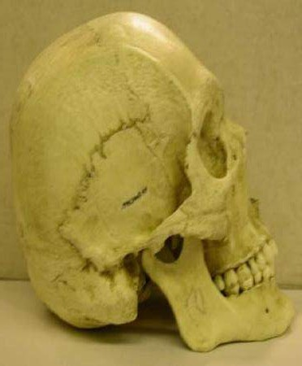
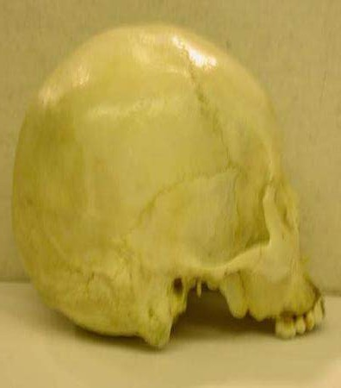
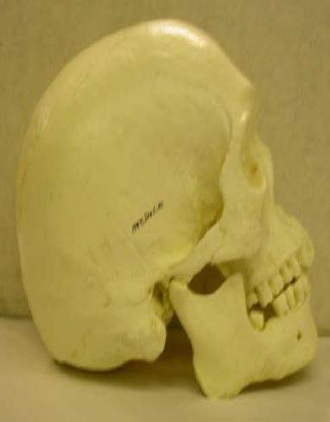
Race Determination
◼• Caucasoid
Mongoloid
• Negroid

Slide 43
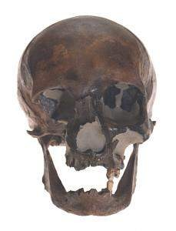
Facial Reconstruction
1. Obtain skull
Determine demographic information (female, Caucasian, early 40s)
Note unique features
(had lost all back teeth on
upper and lower jaw)
Anything known about this individual?
(came to U.S. by boat in 1710 from Europe, died and buried in NY around 1733)

Slide 44
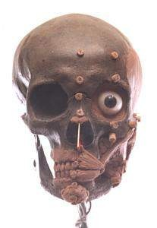
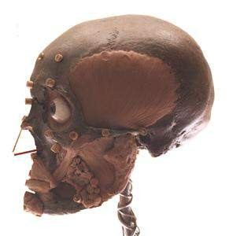
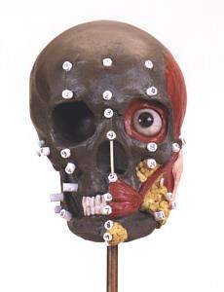
Facial Reconstruction
2. Add tissue depth markers
Based on largely on sex and race
3. Begin to add common fat deposits and underlying muscles

Slide 45
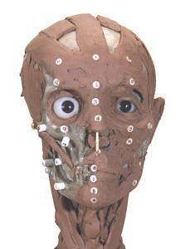
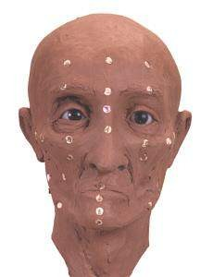
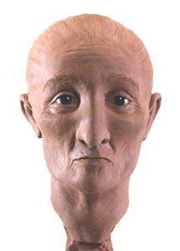
Facial Reconstruction
4. Add muscle to average depth for race
5. Add skin, nose, ears
6. Add features related to age and race (wrinkles, eye and hair color)

Slide 46
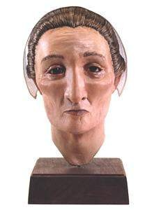
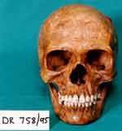
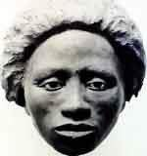
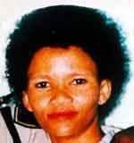
Facial Reconstruction
7. Add clothing etc appropriate for the time period, religious affiliations, etc

Slide 47
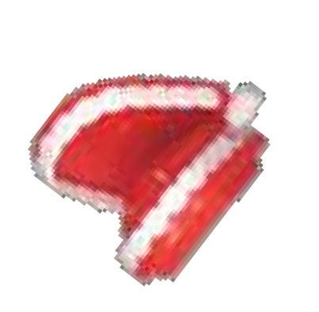
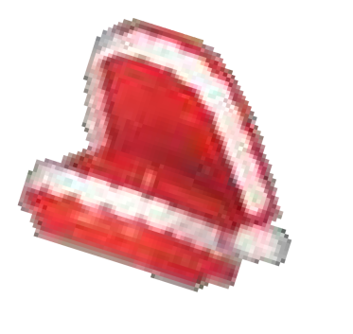
BITE MARK IN FORENSIC ODONTOLOGY
‘ A criminal may lie through his teeth , his teeth-marks will never ’

Slide 48
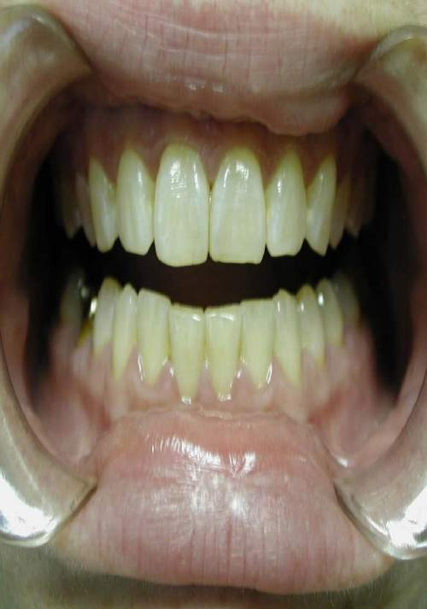
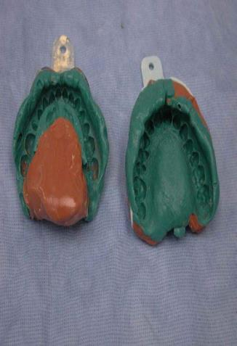
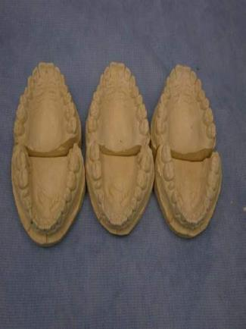
Photograph, impressions of abused are taken

Slide 49
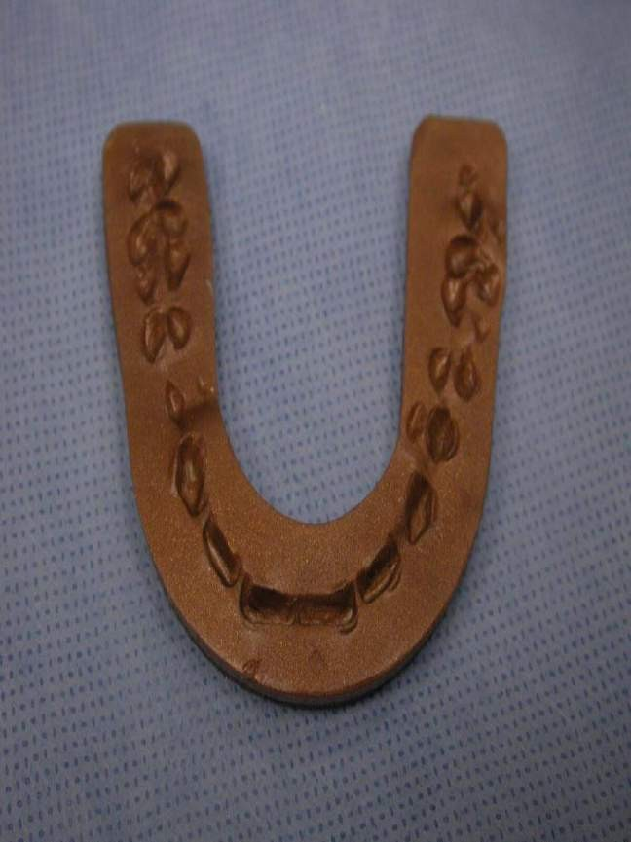
Bite registration of abused dentition in
wax can help match bitemarks on victim

Slide 50
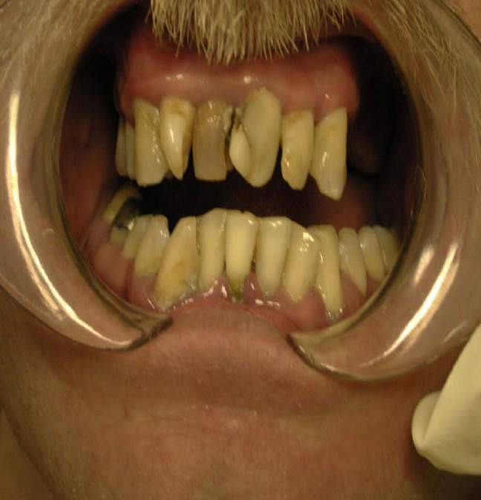
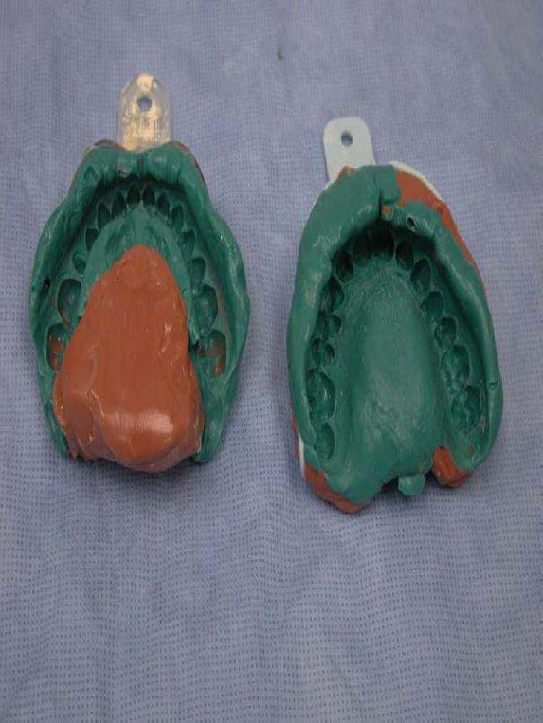
Photograph of suspect taken
Impressions taken

Slide 51
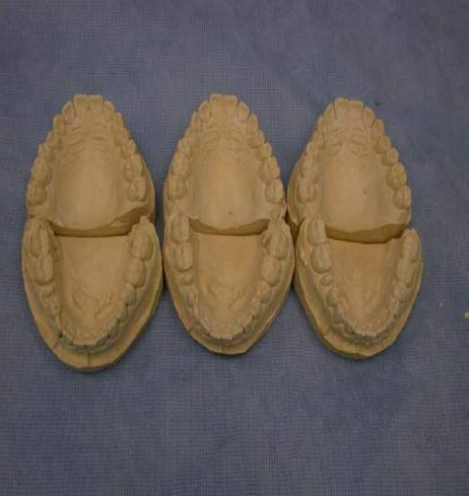
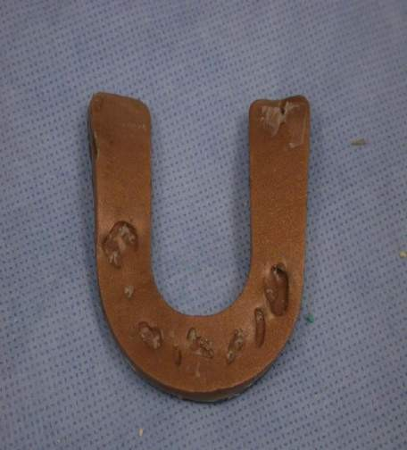
Bite registration of supect dentition in wax can help match bitemarks on abused
Models poured

Slide 52
Comparison of the Bite Mark and
the Suspect’s Dentition
Comparison of saliva swabs
Must conclude pattern is a bite mark
Finding amylase in pattern injury gives a positive correlation saliva was present and lesion is a bite mark
Positive association between ABO blood type in bite mark and saliva means suspect cannot be excluded
Matching DNA is further compelling evidence

Slide 53
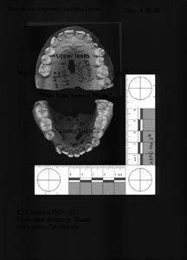
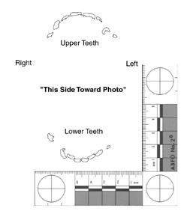
Sample Analysis

Slide 54
Sample Analysis
Bitemark : Upper Jaw
Distance
Cuspid to cuspid
38mm
Suspect; Upper Jaw
Distance
Cuspid to cuspid
42mm
Bitemark: Distance Tooth 6 to Tooth 10 44.25mm
Angle: + 14.5 Degrees
Suspect: : Distance Tooth 6 to Tooth 10 39.65mm
Angle: + 12.52 Degrees

Slide 55
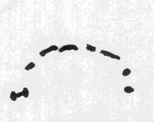
ACETATE OVERLAYS
Most of these techniques involve the fabrication of an acetate overlay
An acetate overlay is an outline of the biting edge of someone’s teeth as traced onto and seen on a clear transparency
They can be fabricated in a number of ways
A review of the literature has found over 15 methods
These include tracing from dental models, photographs, wax bites, photocopies.

Slide 56
The Accuracy of Skin as a Substrate for a Bitemark
The threshold variable in bitemark analysis is the fact that, in cases of physical assault having skin injuries, the anatomy and physiology of the skin, and the position the victim was in affects the detail and shape of the bitemark.
There is one article from the early 1970's that showed how the positioning of the test bite on a bicep varied whether the arm was flexed or pronated.

Slide 57
What is significant is that there is no way to experimentally control or establish the amount of positional variation in an actual bitemark case.
The bottom line is that skin is usually a poor impression material. No significant tests have been published on this subject since 1971 in the odontology literature.

Slide 58
COMPUTER PROGRAMS
Have been developed to overcome some of these problems
Theoretically they can;
  Correct for distortion
  Generate the overlay objectively
  Carry out the comparison objectively
  Reproduce the overlay

Slide 59
What are limitations to both?
What are evidential limitations to bitemarks in the following substances:
  Wax
  Fruit
  Skin
  Paper
  Chewing gum

Slide 60
CRITICISMS OF BITEMARK ANALYSIS
In recent years it has been questioned as a reliable scientific tool. This is based on:
Numerous methods of fabrication
Relies on manual fabrication
Subjective element in fabrication
Subjective element in comparison
Distortion which occurs
As a result of this it has been suggested that bitemark analysis using acetate overlays are inaccurate, subjective and non-reproducible

Slide 61
BITE MARK ANALYSIS

Slide 62
Introduction to the Steps of Bite Mark Analysis
For a physical comparison to be successful, in odontology the Questioned (Q) evidence photograph ( the bitemark) has to be accurately reproduced.
The photograph must be created in a life-size dimension.
The plaster casts of the defendant's teeth are used to analyze similarities and dissimilarities in shape, size, positioning, etc, seen in the bitemark

Slide 63
The Accuracy of Skin as a Substrate for a Bitemark.
In cases of physical assault having skin injuries, the anatomy and physiology of the skin, and the position the victim was in affects the detail and shape of the bitemark.
skin is a poor impression material.
A major issue in bite mark cases is the amount of detail present in the bitemark.
The injury may only be a series of reddened bruises at the time of the original photograph.

Slide 64
If there were no three dimensional (i.e., tooth indentations) that could be used for increased detail the vagaries of inflammation and tissue response to trauma.
The seminal California case for bitemarks was in 1975 (People v Marx). This case involved a deep bite made on a nose that had distinctive three dimensional features.

Slide 65
Bruising and Other Considerations
Recognition of the fact that bruising is actually subcutaneous bleeding demands that the investigator not assume that the reddened areas that appear to be teeth are an accurate representation of individual teeth
The bitemark be thoroughly analyzed first. That means measurements, angles, and other features should be convincingly studied before any suspect(s) teeth be viewed.
The details of intertooth spaces, rotations, and blank spaces between teeth are the principal features of this type of injury.

Slide 66
The Use of Digital Analysis in Bite Marks And the Analysis of Human Dental Identification
The recent development of easily available digital imaging software and image capture devices such as scanners and digital cameras helps the forensic examiner to turn the computer monitor into a comparison microscope with the added benefit of the following functions:
Accurate means of measuring physical parameters of crime scene evidence.
Correction of common photographic distortion and size
discrepancies.

Slide 67
Help eliminate examiner subjectivity.
Better control of image visualization.
Standardization of comparison procedures. Reproducibility of results between separate examiners. Electronic transmission and archiving of image data.

Slide 68
Features of Digital Evidence Image Formats
There are a number of formats in which forensic investigators receive two-dimensional bite-mark evidence. These include floppy disks, zipped (compressed) computer files, Zip Disks (100MB or 250 MB storage capacity) , compact disks (CD), email attachments, and most often photographic prints, slide or negatives.

Slide 69
Resolution
The detail of a digital image is represented by the number of dots per inch (dpi) for scanners and digital cameras. Computer printers output these images in lines-per-inch (lpi). The computer storage necessary to store a photographic quality, 8 ½ " x 11" picture is over 20 Megabytes when 300 dpi is the selected resolution.

Slide 70
Storage of Archival Images
Digital imaging demands that the examiner document each original image and create a duplicate image for later use as a working copy.
Zoom settings on the computer monitor. Adobe Photoshop allows for a multitude of imaging features, functions, enhancements and metric analysis.
The initial working image can be enlarged using the Zoom tool.

Slide 71
Increments of 25% up to 300 and 400% enlargements may be shown on the computer monitor using this tool. The only limitation is the very high resolution image (300 dpi required ) to avoid pixellation (fuzziness) of the magnified picture.

Slide 72
Digital Control of Photographic Distortion
The first issue with this picture is the scale's off-angle position relative to the bitemark.
Angular Distortion
A photograph is a graphical representation of the objects. The degree to which this graphic exactly reproduces those objects is influenced by many variables.
When bitemarks are photographed or dental xrays are used
as evidence, attempts are made to carefully
control perspective variables in an effort to obtain an accurate
representation of the bite mark or dental restoration for later
comparative analysis.
distortion is often introduced into the image.

Slide 73
Photography of bitemarks and similar types of two and three- dimensional physical evidence should have the following features:
Presence of a scale (or some appropriate measuring device) oriented on the same plane as the bitemark or evidence sample.
The orientation of the camera back and the scale is parallel.
The scale is on the same plane as the bitemark thus eliminating parallax distortion. The scale is used to reproduce a life-size image of the object.
Its displacement below or above the object will make this later process inaccurate.

Slide 74
Evaluation of Photographic Distortion
Correction for angular distortion focuses on the size and shape of the ruler present in the image.
The sides of the scale or ruler must be parallel, the incremental lines perpendicular to these sides and equally spaced, and, if present, any circular reference shapes must be round (not oval).
A two-legged scale (actually a two dimensional scale possessing a x,y axis) will have a 90 degree angle created at the intersection of the two legs. An ABFO #2 (Lightning Powder Co.,Inc., Salem Oregon) scale is used.

Slide 75
Placing A Grid on the Image
The degree of distortion can be preliminarily checked by placing a digital circle over the circular reference target and using it to evaluate the scales sides, incremental lines, and angles for parallelism.
The corner of the "L shaped" ruler was in the same plane as the injury pattern and later this could be used to establish the life-size dimensions of the picture. I used 1.5 centimeters of the ruler to accomplish this.

Slide 76

Digitally Created Circle Placed in Corner of "L" Shaped Ruler
and Red Box Showing Undistorted Length of Scale.

Slide 77

Simple Rotation and Cropping of the Bite Mark Image
The evidence image must have the scale oriented along the x/y axis of the entire image in order to perform later manipulation based on this scale.
Excess perimeters in the image may be removed using the Crop tool.
Cropped and Scale Rotated to the proper x,y axis.

Slide 78
Determination of Theta
The next step in evaluating the bite mark photograph is to refer to the circular reference shapes present on the scale. (Using the digital circle as a guideline).
An elliptical shape proves the camera angle was incorrect. The angular amount of non-parallelism is determined by:
Measuring a line across the narrowest distance of the ellipse (minor axis A).
Measuring a line across the major axis of the ellipse (major axis B).
The angle Theta may be determined by solving Theta = COS-1 A/B

Slide 79
Placement of Perfect Circles Over Scale
A non-metric method for detection of angular distortion is to visually compare the reference shapes of the scale with a perfect circle.
Correcting for Photographic Distortion
If it has been determined that significant distortion exists, it must be corrected before the bite mark photograph is resized and/or enhanced. Only then can a meaningful comparison analysis be accomplished.

Slide 80
Type I Distortion
The scale and bite mark on plane but camera back is not parallel to either.
This non-parallelism of the camera can be corrected.
When the image of the scale is brought back to its original size and shape, the image of the bite mark will also be corrected (rectification).
This assumes that the scale itself is on a single plane and there is no parallax distortion relative to the bite mark.

Slide 81
Type II Distortion
If the scale is not on the same plane as the bite mark, rectifying the scale will adversely affect the proportions of the injury pattern. In situations like this it is best not to try to rectify the scale but do the later resize ( 1:1) procedure based on the scale "as is.“
The amount of parallax distortion present will obviously affect the accuracy of the results. The weight given to the results will contribute to the ultimate decision in the case. The investigator must decide what amount of distortion is acceptable in order to produce a meaningful comparison

Slide 82
Type III Distortion
In some cases, one leg of a two-dimensional scale will have perspective distortion but the other leg will not
Here, we can use the non-distorted leg to do the resizing procedures with good results. This would be similar to performing a resize based on a one-dimensional scale (i.e., a straight ruler) in the image.

Slide 83
Type IV Distortion
In this instance, the scale itself may be bent or skewed.
Look at the scale and decide if this type of distortion is present. There can be forensic value if the scale is relatively flat in the area directly adjacent to the bite mark.
Peripheral scale inaccuracies can be discounted. Use only the area next to the mark for the resizing procedures.
Do not use the entire scale. There must be at least a 5 cm. Length of no-distorted scale in close proximity to the bite mark.

Slide 84
Application to other two and three-dimensional objects.
The above scenarios encompass most of the physical distortion seen in bite mark and other evidentiary photographs. When detected and properly corrected, the resulting image modification will result in an accurate resize and a meaningful comparison.

Slide 85
Limitations to this method
There are cases in which the image is so severely distorted, due to poor photographic technique, that it is of no use.
The subject matter must be re-photographed. Unfortunately sometimes physical evidence is transitory, fragile, or evanescent in nature, thus preventing these remedial efforts.
It is important to realize which type of distortion, if any, is present within the original bite mark photograph.

Slide 86
This can often be a difficult task and requires some experience. Also of concern is the fact that we are asking a two-dimensional object (the scale) help us analyze a three-dimensional bite mark.
In some instances, this is not a big problem. For example, if the bite mark is on a relatively flat surface. Other times, with a bite mark on a very curved surface, it is a very significant concern.

Slide 87
The variations present in bite mark cases present challenges to the examiner regarding the value of the injury pattern and the relationship to a suspect's teeth. Photoshop can help in a large number of these cases but, again, it is up to the investigator to understand how much distortion is significant, how it affects the analysis and its impact on the strength of the ultimate opinion.

Slide 88
The final analysis of each case depends upon the quality of the evidence presented. In cases where all the variables are carefully controlled and little distortion exists, greater certainty of opinion is possible than if the quality of the evidence is weak. In come case the quality of the bite mark photograph may be so poor that it precludes a meaningful analysis altogether.

Slide 89
Photographic Standards
This should emphasize the need to follow strict protocol and use a tripod whenever possible when photographing bite mark injuries and other types of physical evidence
Creating Computer Generated Exemplars of Suspect Dentition
A. Simple overlay
A major purpose is to produce a properly rectified, scaled, reproduction of the teeth’s biting edges.
The term Hollow Volume refers to the outline or perimeter of each biting surface. This product is called an overlay.

Slide 90
The final process is to place the overlay onto the bite mark evidence and evaluate the physical correspondence between the two.
The increased accuracy of this digital process is the chief improvement over the conventional methods of overlay production.
The dental examiner uses the computer program to select the biting edges, rather than having to hand draw them directly from the plaster models of the suspect’s teeth.

Slide 91

Scan of dental models. If you look real closely, the outline of the front teeth have been selected as a black outline. From this selection of the biting edges of the teeth, their outline is used to produce the computer- generated overlay

Slide 92

Computer Generated Hollow Volume Overlay
The upper curve of teeth do not rest on top of anything visible in this bitemark. The evidence picture did not contain any discernible upper teeth present in the injury.

Slide 93

The actual computer comparison uses each dental arch
(upper and lower) separately. This is because the examiner's scan of the dental casts has the relationship of the upper and lower teeth just set arbitrarily on the scanner plate.
This position on the scanner plate does not reproduce the actual upper and lower jaw relationship of the suspect.
Digital Comparison

Slide 94
Metric Analysis of Bite Mark Injuries
Bite mark injuries AND suspect(s) teeth possess pertinent physical characteristics which are amenable to digital measurement. The most obvious are:
Arch width (distance from one cuspid across to the other cuspid). Shape of the dental arch (generally can be described as C-shaped, oval, or U-shaped).
Labiolingual position
posteriorly).
Rotational position (twisted). Intertooth spacing.
Tooth width and thickness. Curvatures of biting edges.
Wear patterns and unusual dental anatomy.
(a tooth out of normal alignment anterior

Slide 95
Step One: Analysis of Bite Mark Injury
It is recommended that the injury pattern be completely analyzed before the dentition of a suspect(s) is evaluated.
This insures a measure of blindedness when features of the injury are vague and ambiguous.
This establishes hard data sets for this Questioned sample before commencing the analysis of the suspect’s teeth.
Cuspid to cuspid. X/y axis.
Tooth-widths and thickness. Rotational value of each tooth.

Slide 96

Typical Metric and Spatial Analysis of Bite Mark (Data Points Placed at Central Portion of Each Mark in Injury. Teeth #8 and #9 are not clearly seen in bite mark and are not included. Tooth # 5 has the data point placed in its central fossa. )

Slide 97
Step Two: Analyzing the Suspect Dentition
Identical steps are then performed using the scanned
images of the suspect’s plaster dental casts.
Metric Analysis of Dentition Casts using the following features of each tooth.
Cuspid to cuspid. x/y axis.
Tooth-widths and thickness. Rotational value of each tooth.

Slide 98
Step Three: Comparison Data of Hypothetical Case (only
two features noted in this example))
Bitemark : Upper Jaw Distance Cuspid to cuspid
Suspect;
Upper Jaw Distance Cuspid to cuspid 38mm
42mm
Bitemark: Distance Tooth 6 to Tooth 10 44.25mm
Suspect: : Distance
Tooth 6 to Tooth 10 39.65mm
Angle: + 14.5 Degrees
Angle: + 12.52 Degrees

Slide 99
Features examined
during the comparative dental
identification. This extensive list represents the complexity of these cases, particularly in those instances in which restorative treatment is absent or minimal
Teeth
Tooth position
Teeth present
Erupted
Unerupted
Impacted
Missing teeth
Congenitally
Lost antemortem
Lost postmortem Tooth type
Permanent
Deciduous
Mixed
Retained primary
Supernumerary
a. Malposition Crown morphology
Size and shape
Enamel thickness
Contact points
Racial variations
Crown pathology
Caries
Attrition, abrasion, erosion
Atypical variations, enamel pearls, peg laterals etc.
Dentigerous cyst

Slide 100
Root morphology
Size
Shape
Number
Divergence of roots Root morphology
Dilaceration
Root fracture
Hypercementosis
Root resorption
Root hemisections Pulp chamber/root canal morphology
size, shape and number
Secondary dentine Pulp chamber/root canal pathology
a. Pulp stones, dystrophic calcification
Root canal therapy
Retrofills
Apicectomy
Periapical pathology
Abscess, granuloma or cysts
Cementomas
Condensing osteitis
Dental restorations
Metallic
  Non-full coverage
  Full coverage
Non-metallic
  Non-full coverage
  Laminates
  Full coverage
Dental implants
Bridges
Partial and full removable prosthesis

Slide 101
Periodontal tissues
Gingival morphology and pathology
Contour, recession, focal/diffuse,enlargements, interproximal craters
Colour – inflammatory changes, physiological (racial) or pathological pigmentations
Plaque and calculus deposits
Alveolar process and lamina dura
Height, contour, density of crestal bone
Thickness of interradicular bone
Exostoses, tori
Pattern of lamina dura
Bone loss (horizontal/vertical)
Trabecular bone pattern and bone islands
Residual root fragments
Periodontal ligament morphology
and pathology
Thickness
Widening
Lateral periodontal cysts and
similar

Slide 102





Slide 103
Methods Of Comparing Bitemark Evidence
A 1994 survey of Diplomates of the American Board of Forensic Odontology indicated that they presently use the following analytic methods in the comparison of Bitemark evidence.
Generation of Overlays
Acetate tracing directly from models of the suspect.
Acetate tracing indirect from photocopy of model with
scale.
3.X-ray film overlay created from radiopaque material applied to the wax bite.
Alternative methods
Life-sized photos of model printed on acetate film.
Greater than life-sized photos of models on acetate

Slide 104
Test Bite Media
Wax exemplars (aluwax, baseplate wax, etc.)
Styrofoam C.Volunteer's skin D.Alternative Methods
o
o
Fruits
Clay

Slide 105
Comparison Techniques
Acetate Tracings to life-size photos of wound
Working study model of teeth to life-size photo of wound
Working study model to impression of wound or to actual victim
Acetate overlays of teeth compared to greater than life- size photo of wound:
o o
Five times life-size Three times life-size
Two times life-size

Slide 106
Technical Aids Employed For Analysis
oTransillumination of tissue
oComputer enhancement and/or digitization of mark
and/or teeth
oStereomicroscopy and/or macroscopy oScanning Electron Microscopy oVideotape
oCaliper utilization for measurement

Slide 107
Variations of the Prototypical Bitemark
Variations include additions, subtractions and distortions.
Additional features:
o Central Ecchymosis (central contusion) - when found,
1.
these are caused by two possible phenomena:
positive pressure from the closing of teeth with disruption of small vessels.
negative pressure caused by suction and tongue thrusting.

Slide 108
2.Partial Bitemarks:
oone-arched (half bites).
oone or few teeth.
ounilateral (one-sided) marks - due to incomplete dentition, uneven pressure or skewed bite.
o3.Indistinct/Faded Bitemarks:
o o teeth
Fused Arches - collective pressure of leaves arched rings without showing
individual tooth marks.
o o because center
Solid - ring pattern is not apparent erythema or contusion fills the entire leaving a filled, discolored, circular mark.

Slide 109
o Closed Arches - the maxillary and mandibular arch are not separate but joined at their edges.
o Latent - seen only with special imaging
techniques.
o4.Superimposed or Multiple Bites.
o5.Avulsive Bites.

Slide 110
Terms Indicating Degree of Confidence That an Injury is a Bitemark
Possible Bitemark Probable Bitemark Definite Bitemark

Slide 111




Slide 112


