Slide 1
EXODONTIA
Dr RAJA SATISH _{MDS},
PROFESSOR,
ORAL AND MAXILLOFACIAL SURGERY,
SIBAR INSTITUTE OF DENTAL SCIENCES.

Slide 2
DEFINITION
The ideal tooth extraction is painless removal of the whole tooth, or tooth root, with minimal trauma to the investing tissues, so that the wound heels uneventfully and no post operative prosthetic problem is created.

Slide 3
INDICATIONS
Any tooth that is not useful in the total dental mechanism is considered for removal.
Pulp pathologic conditions, either acute or chronic, in a tooth that is not amenable to endodontic therapy. Grossly destructed tooth that can't be restored
Periodontal disease, acute or chronic, that is not amenable to treatment, grade three mobile teeth
Traumatic effects on the tooth or alveolus beyond repair.
Impacted or supernumerary teeth.

Slide 4
Orthodontic considerations, serial extractions,
Prosthetic considerations
Esthetic considerations
Pathologic condition around bone involving teeth
Teeth in line of fire
Teeth in the line of fracture
Over retained teeth

Slide 5
CONTRAINDICATIONS
LOCAL CONRTAINDICATIONS:
Acute infections with uncontrolled cellulites
Acute pericoronitis
Malignant disease
Irradiated jaws
Uncontrolled diabetes mellitus
Cardiac disease such as coronary artery disease, uncontrolled hypertension, cardiac decompensation, patients on aspirin and other anticoagulants

Slide 6
SYSTEMIC CONTRAINDICATIONS:
Hyperthyroidism
Blood dyscrasias (hemophilia, leukemias, vitamin K deficiency )
Addison's disease or any steroid deficiency, patients on long term steroids
Fever of unexplained origin
Pregnancy
Psychoses and neuroses

Slide 7
Principles of extration
Good mucoperiosteal flap elevation
The beaks should be seated as far apically as possible without compression of the soft tissue.
placement of the beaks of the forceps as parallel as possible to the long axis of the tooth.
when forceps are used , the application of excessive force should be avoided.

Slide 8
METHODS OF EXTRACTION:
Basically two methods of extraction are available:
Intra-alveolar (forceps extraction)
Trans-alveolar (open extraction)

Slide 9
MAJOR MOTIONS TO LUXATE AND EXPAND
1. apical pressure
2. buccal pressure
3. lingual pressure
4. rotational pressure
5. tractional forces

Slide 10
ARMAMENTARIUM
FORCEPS
Basic components of extraction forceps are
BEAK
HINGE
HANDLE

Slide 11
FORCEPS USED IN MAXILLARY TEETH
MAXILLARY ANTERIOR
MAXILLARY PREMOLAR

Slide 12
MOLAR (FIRST QUADRENT)
MOLAR (SECOND QUADRENT)

Slide 13
MAXILLARY COWHORN RIGHT & LEFT
BIONATE FORCEPS

Slide 14
MAXILLARY III MOLAR FORCEPS

Slide 15
FORCEPS USED IN MANDIBULAR REGION
MANDIBULAR ANTERIOR
MANDIBULAR PREMOLAR

Slide 16
MANDIBULAR COWHORN
MANDIBULAR MOLAR

Slide 17
ELEVATORS
MOLT’S PERIOSTIAL ELEVATOR

Slide 18
GENERAL ARRANGEMENTS
POSITION OF THE OPERATOR:
When extracting any tooth except the right mandibular molars, premolars and canines the operator stands on the right hand side of the patients.

Slide 19
For the removal of right mandibular molars and premolars the operator stands behind the patient. Some time the operator must stand upon a raised platform or operating box in order to achieve optimal working position.

Slide 20
HEIGHT OF THE DENTAL CHAIR:
This is an important consideration which is often ignored.
When a maxillary tooth is being extracted, the chair should be adjusted so that the site of operation is about 8cm (3inch) below the shoulder level of operator.
During the extraction of mandibular tooth the chair height should be adjusted so that the tooth to be extracted is about 16cm (6inch) below the level of operators elbow.
When the operator is standing behind the patient the chair should be lowered sufficiently to enable him to have a clear view of the field of operation.

Slide 21
LIGHT:
Good illumination of the operative field is absolute essential for successful extraction of teeth, failure to ensure adequate lighting of the site of operation is a common fault.

Slide 22
MECHANICAL PRINCIPLE OFEXTRACTION
Expansion of bony socket to permit removal of its contained tooth.
The use of a lever and fulcrum to force a tooth or root out of the socket along the path of least resistance
Insertion of wedge or wedges between the tooth-root and the bony socket wall, thus causing the tooth to rise in the socket

Slide 23
EXTRACTION WITH DENTAL FORCEPS
PRINCIPLES OF FORCEPS APPLICATION:
Dental forceps are designed to grasp the root or root mass of the teeth and not the crown
Forceps are applied to the tooth root, the blades are forced along the periodontal membrane

Slide 24
Root is gripped by the edges of the blade “two point contact”, if there is a single linear contact “one point” contact between the root and forceps blade, the tooth will probably be crushed when it is gripped
IDEAL
TWO POINT
ONE POINT

Slide 25
Long axis of the blade should be parallel to the long axis of the tooth root

Slide 26
The forceps should be seated with strong apical pressure to expand crestal bone and to displace centre of rotation as far apically as possible

Slide 27
If the centre of rotation is not far enough apically, it is too far occlusally which results in excess movement of tooth apex. Excess motion of root apex caused by high centre of rotation results in fracture of root apex

Slide 28
Rotational forces useful for teeth with conical roots such as maxillary incisors and mandibular premolar

Slide 29
Tractional forces useful for final removal of tooth from socket

Slide 30
CORRECT GRIP OF FORCEPS:
The position of thumb should be just below the joint of the forceps
The position of handle in the palm of the hand, give the operator a firm grip on, and fine control over the instrument

Slide 31
Little finger is placed inside the handle and used to control the opening of the forceps blade during the application to the root
When the tooth is gripped the little finger is placed out side the handle

Slide 32
CORRECT USE OFLEFT HAND

Slide 33
ALVEOLAR PURCHASE
A tooth fractured at its anatomical neck often can grasped by an anatomical or a root forceps and delivered
An alveolar purchase may be obtained by loosening the buccal or labial gingival cuff with a small sharp curette
The buccal beak of the forceps is then placed under the tissues on the buccal plate pressure on a soft forceps will bite down on the root, and the root, with the cut alveolar plate attached is delivered

Slide 34
ORDER OFEXTRACTION
Maxillary teeth are extracted first since anesthesia becomes effective first in maxilla also debris such as enamel fragments cannot be lost in open mandibular sockets.
Most posterior teeth are removed first for better vision since haemorrhage collects in the posterior region
In a mouth containing teeth difficult to extract the first molar and canine teeth are extracted after their adjacent teeth are extracted so that better purchase is made
If a tooth or root should break it is best to stop and recover the root before proceeding to the next tooth.

Slide 35
POST OPERATIVE INSTRUCTIONS
WOUND CARE:
Bite firmly on gauze pack that has been placed until u arrive home then remove it gently, gauze pack should be in place for about 45min
Do not smoke for 12 hrs because this will promote bleeding and interfere with heeling
BLEEDING
Some blood will ooze from the area of surgery and is normal
You may find a blood stain on your pillow in morning
Do not spit or suck through a straw

Slide 36
DISCOMFORT
Discomfort is common after surgery it can be controlled but not eliminated by taking the pain pills
Take your pain pills with a glass of water and with small amount of food if the pills cause nausea
Do not drive or drink alcohol if you are on medication
DIET
Take large volume of fluids
Cold soft food such ice-cream or yogurt may be the most comfortable for the first day

Slide 37
ORAL HYGIENE
Do not rinse your mouth or brush your teeth for the first 8hrs after surgery
After that rinse gently with warm salt water every 4 hrs
SWELLING
Swelling after surgery is normal reaches peak at 48 hrs and usually lasts 4 to 6 days
Applying ice packs over the area of surgery for the first 12 hrs helps control swelling and help the area to be comfortable
REST
Avoid strenuous activity for 12 hrs after surgery

Slide 38
COMPLICATION OF EXTRACTIONS
Failure to secure anesthesia
Intra operative
Post operative

Slide 39
INTRA OPERATIVE COMPLICATIONS
Fracture Crown of tooth
Fracture of Root of tooth
Fracture of Alveolar bone
Fracture of Maxillary tuberosity
Fracture of Adjacent tooth or opposite tooth
Fracture of mandible
Dislocation of Adjacent tooth
Dislocation of TMJ
Displacement of tooth into the soft tissue
Displacement of tooth into the maxillary antrum
Haemorrage During tooth removal
Damage to adjacent soft tissues
Damage to lingual nerve, inferior alveolar nerve

Slide 40
POST OPERATIVE COMPLICATIONS
Haemorrage
Pain
Swelling
Infection
Trismus
Oro-antral communication

Slide 41
CONTROL OF POST OPERATIVE BLEEDING:

Slide 42
DRY SOCKET

Slide 44
Oro antral communication

Slide 45
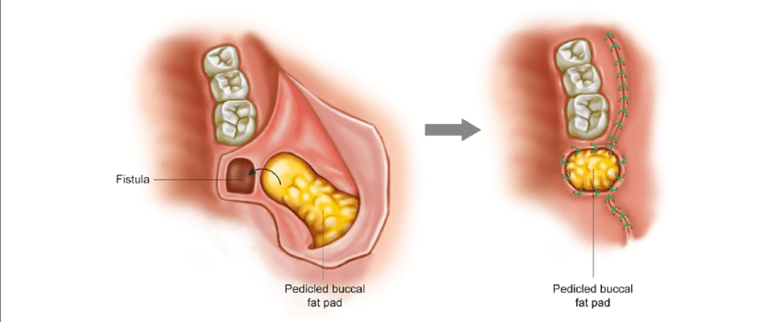
Ashleys palatal rotation flap
Von rehrmans buccal
advancement fllap
Buccal pad of fat

Slide 47
ELEVATORS

Slide 48
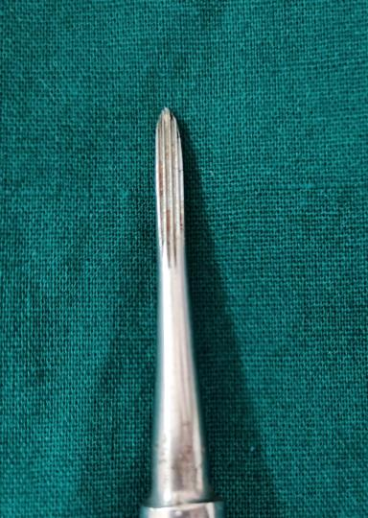
straight elevators

Slide 49
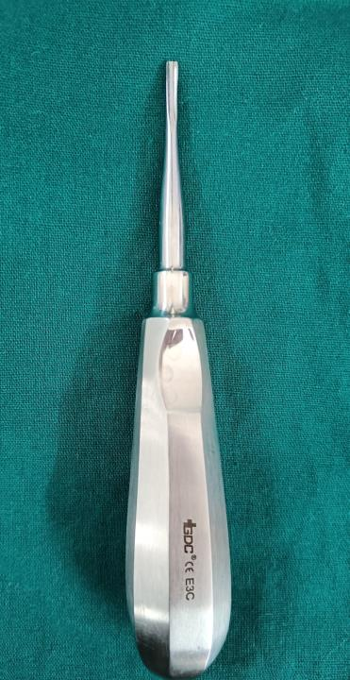
Coupland

Slide 50
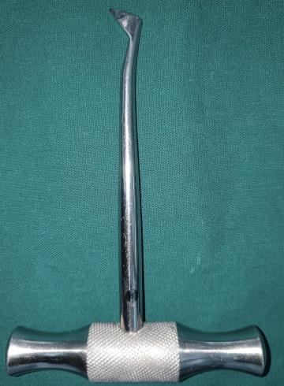
distal
mesial
Crossbar paired

Slide 51
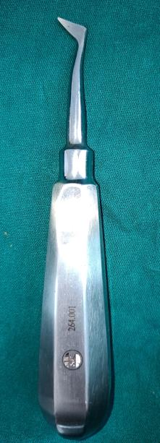
L
R
Cryer’s paired

Slide 52
302
303
Apexo elevators

Slide 53
Warwick jame’s root elevators

Slide 54
USE OF ELEVATORS
Elevators used to reflect mucoperiosteal membranes.
To luxate & remove teeth which cannot be engaged by beaks of forceps. Such as impactions & malposed teeth.
To remove roots.
To remove fractured or grossly carious teeth.
To loosen teeth prior to application of forceps.
To split teeth, which have had grooves, cut in them.
To remove inter radicular bone.

Slide 55
RULES WHEN USING ELEVATORS
The following rules should be observed when using elevators.
Never use an adjacent tooth as fulcrum unless that tooth is to be extracted also.
Never use the buccal plate at the gingival line as a fulcrum, except where odentectomy is performed, or in the third molar areas.
Never use the lingual plate at the gingival line as a fulcrum.

Slide 56
Always use finger guards to protect the patient in case the elevator slips.
Be certain that the forces applied by the elevators are under control, & that the elevator tip is exerting pressure in the correct direction.
When cutting through the interseptal bone take care not to engage the root of an adjacent tooth, thus inadvertently forcing it from its alveolus.

Slide 57
DANGERS IN THE USE OF ELEVATORS.
Improper application of elevators may lead to extraction of an adjacent tooth.
Uncontrolled & heavy forces may lead to fracturing of Maxilla or Mandible.
Uncontrolled & heavy forces may lead to fracturing of alveolar process.
Slipping of elevators may lead to plunging of instrument tip into the soft tissue, with a possibility of perforating the great blood vessels & nerves.

Slide 58
Improperly directed elevator may penetrate into the maxillary sinus.
Improperly directed forces of an elevator may force a root or 3rd molar into the antrum.
Improperly directed forces of an elevator may force a root of lower 3rd molar into the mandibular canal or through the lingual plate into the submandibular or pterygomandibular space.

Slide 59
WORK PRINCIPLES IN USE OF ELEVATORS
Lever & Fulcrum Principle.
Wedge Principle.
Wheel and axle Principle.
Combination of two or more of the above principles.

Slide 60
LEVER & FULCRUM PRINCIPLE
Most frequently used principle. In a lever & Fulcrum principle the position of the fulcrum is between the effort (E) and the resistance (R). In order to gain a mechanical advantage in a lever principle the effort arm on one side of the fulcrum must be longer than the resistance arm, on the other side of the fulcrum

Slide 61
MECHANICAL ADVANTAGE= OUTPUT FORCE/INPUT FORCE. INPUT FORCE OF 10lbs CAUSES AN OUT PUT FORCE OF 30lbs. THEREFORE MECHANICAL ADVANTAGE IS 30lbs/10lbs=3

Slide 62
WEDGE PRINCIPLE.
In this principle the elevator is forced between the root of the tooth & the investing bony tissue parallel to the long axis of the root, by hand pressure or by mallet force.

Slide 64
WHEEL AND AXLE PRINCIPLE
The effort arm is applied to the circumference of a wheel which turns the axle so as to raise a weight.
Ex: Tip of the cross bar placed at furcation and using buccal plate as fulcrum handle is rotated to elevate the tooth.

Slide 66
LINE OF WITHDRAWAL:
It is the path along which the tooth or root will be removed out of the socket with least application of force to it.

Slide 67
APPLICATION OF ELEVATOR

Slide 68
TRANS-ALVEOLAR EXTRACTION
This method of extraction comprises the dissection of a tooth or root from its bony attachments. It is often called open or surgical method.
INDICATIONS:
Any tooth which resists attempts at intra alveolar extraction when moderate force is applied
Retained roots which cannot be either grasped with forceps or delivered with an elevator, especially those in relationship to the maxillary antrum.

Slide 69
A history of difficult or attempted extractions
Any heavily restored tooth, especially when root filled or pulpless
Hypercementosed and ankylosed teeth
Geminated and dilacerated teeth
Teeth shown radiographically to have complicated root patterns, or roots with unfavourable or conflicting lines of withdrawal.

Slide 70
IMPORTANT COMPONENTS OF TRANSALVEOLAR EXTRACTION
Type of anesthesia to be used
Design of the mucoperiosteal flap
The method to be used to deliver the tooth or roots from the socket
Bone removal required to facilitate this

Slide 71
TYPEOF ANESTHESIA:
Teeth may be extracted under either local or general anesthesia and the dental surgeon must assess the indications and contra indications of both before deciding which to use in a particular case

Slide 72
MUCOPERIOSTEAL FLAPS:
These are raised to render the operative site clearly visible and accessible and their design should ensure that they provide adequate visual and mechanical access
The base of the flap should be broader then free end and must contain an unpaired blood supply
The incision should be made with firm pressure upon a sharp scalpel through both the mucosa and periosteal layers of gingiva down to bone

Slide 73
The scalpel should be used as a pen and the soft tissues should be cut at right-angle to the surface of underlying bone
Incision of adequate length should be made in one stroke
When the gingival margin of the standing tooth is involved in the flap it should be incised vertically
Some time it is necessary to reflect the mucoperiosteum from the adjacent tooth which are to be retained

Slide 77
BONE REMOVAL
Alveolar bone must not be sacrificed unnecessarily and removal of it must be limited to what os required to achieve certain objectives bone is usually removed either with a dental bur or by the use of chisel or gouge with hand or mallet pressure.
Bone should excised to provide a point of application for an elevator or forceps and to create a space into which the tooth or root may be displaced.
After the tooth or root has been delivered all sharp edges and bony projections should be removed.

Slide 78
REMOVAL OF BONE BY DENTAL BURS:
Round or rose head burs cut more efficiently, do not clog as readily, and are easier to control than flat fissure types
Bone may be removed with burs either, by simply cutting it away using a size no8 or10 round or flat fissure pattern or by the use of POSTAGE STAMP method
In postage stamp technique a row of small holes is made with a small burs and then joined together with either bone or chisel cuts.

Slide 80
TOOTH DIVISIONS:
The lines of withdrawal of different roots of some multirooted teeth will conflict in these cases the root mass must be divided and the separated roots removed along their individual paths of withdrawal
The root mass must be divided with either ash surgical or standard dental burs (round and fissure patterns)

Slide 81
SOCKET TOILET
Progress of healing and amount of after pain are greatly influenced by performing post operative socket toilet
Unwanted bony prominences should be removed with either rongeur forceps, chisels or burs
Sharp edges are smoothened with either bone files or plain and cross cut vulcanite burs.
The wound should be irrigated with warm normal saline and all bone debris and infected granulation tissue removed by the use of either a Mitchell trimmer or a Cumine scaler.
Flap should be replaced and a decision made as to whether sutures are needed

Slide 82
SUTURING
Every suture is a foreign body and they should only be inserted into the tissues if there is a positive indication for their use
Sutures are inserted either to hold the cut edges of the soft tissue together to promote healing by first intension, to appose loosely the soft tissue to minimize wound contamination with food debris, or to arrest haemorrhage
Sterile black silk is the material of choice and either a simple interrupted suture or an interrupted horizontal mattress suture should be inserted.

Slide 83
TECHNIQUE OF SUTURING
The needle is grasped in needle holders it must never be held by the eye or the point
The area to be sutured is dried with either a sucker or swab so that the cut edges are clearly visible .
The needle is usually passed through the more mobile flap first, the curve of the needle being used to rotate it through the tissues
The suture should be placed closer to the free end of the flap than its base

Slide 85
Thank you

