Slide 1


Slide 2
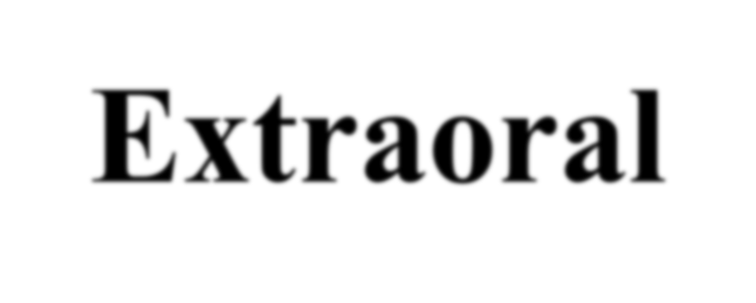

Extraoral Radiology
Dr. B. Naveen Kumar
Dept. of Oral Medicine and Radiology

Slide 3
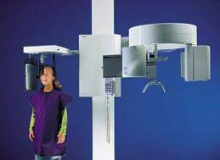
Extraoral Projections
Images can be produced in the dental office
X-ray source can be
  Intraoral X-ray machine
  Combination Pan/Ceph
  Medical
  Dedicated Cephalometric machine

Slide 4
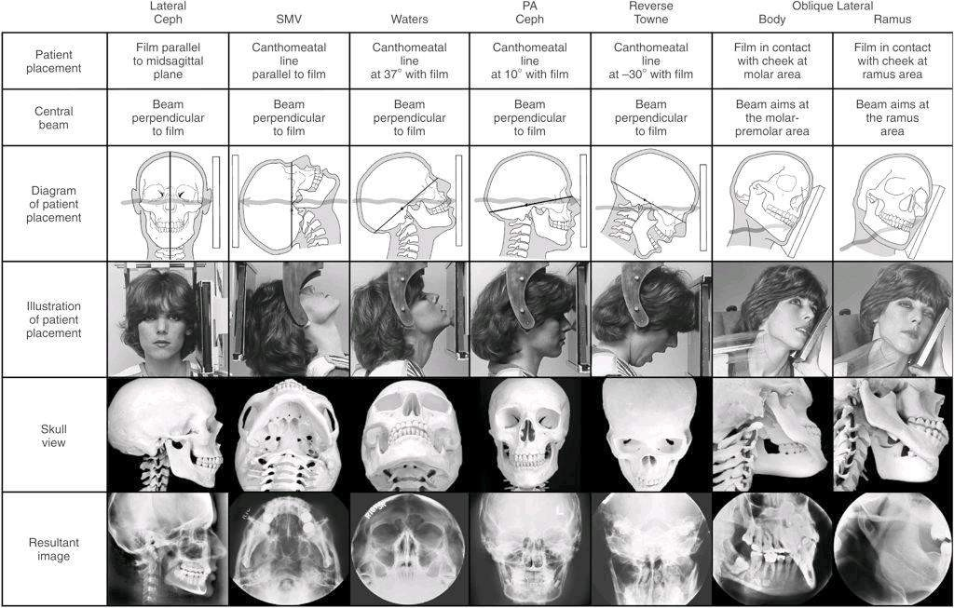
Common Extraoral Views
From: White and Pharoah 5th and 6th editions

Slide 5
Projection of the Central Ray
The central ray is directed perpendicular to the plane of the film in the horizontal and vertical dimensions from a source 91 to 102 cm (36 to 40 inches) away. The source should be coincident with the midsagittal plane of the head at the level of the bridge of the nose.
For cephalometric applications the distance should be 152.4 cm (60 inches) between the x-ray source and the midcoronal plane. This increased distance provides an resultant image with a broader gray scale.

Slide 6
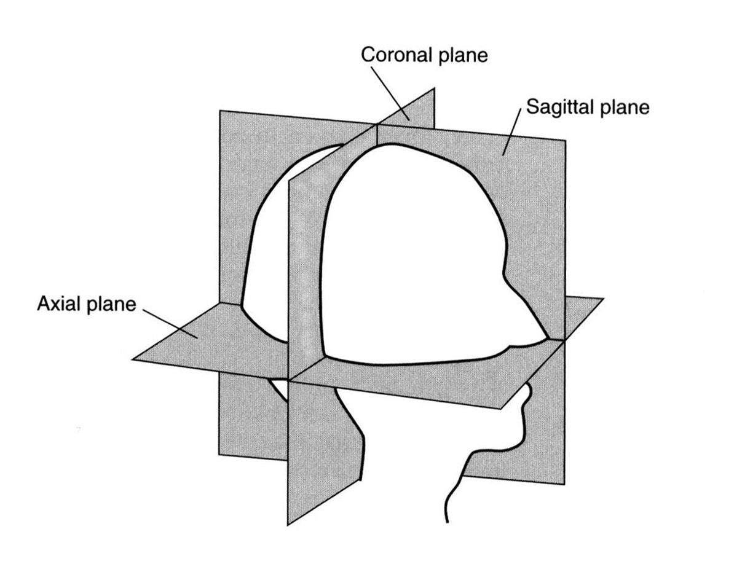
Reference Planes

Slide 7
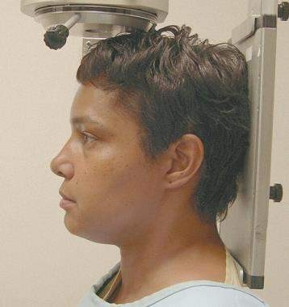
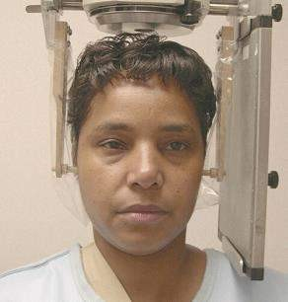
Reference Planes
c
e
a
b
d
a=canthomeatal plane b=Frankfort Horizontal plane
c=coronal plane d=sagittal plane
e=axial plane

Slide 8
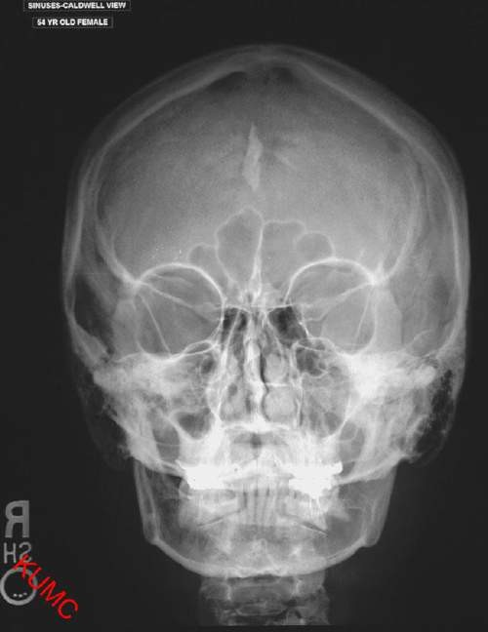
Posteroanterior View
Indications:
  Disease
  Trauma
  Developmental
abnormalities
  Growth and development

Slide 9
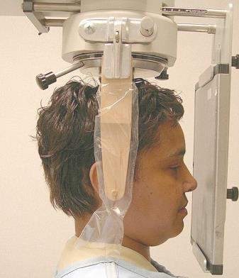
PA Ceph Projection
The image receptor is placed in front of the patient, perpendicular to the midsagittal plane and parallel to the coronal plane
The patient is placed so that the canthomeatal line forms a 10-degree angle with the horizontal plane and the Frankfurt plane is perpendicular to the image receptor. In the PA skull projection, the C-M line is perpendicular to the image receptor.
10°

Slide 10
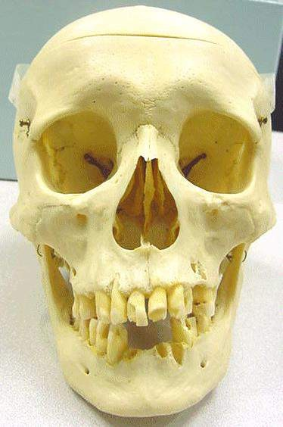
PA Ceph Projection

Slide 11
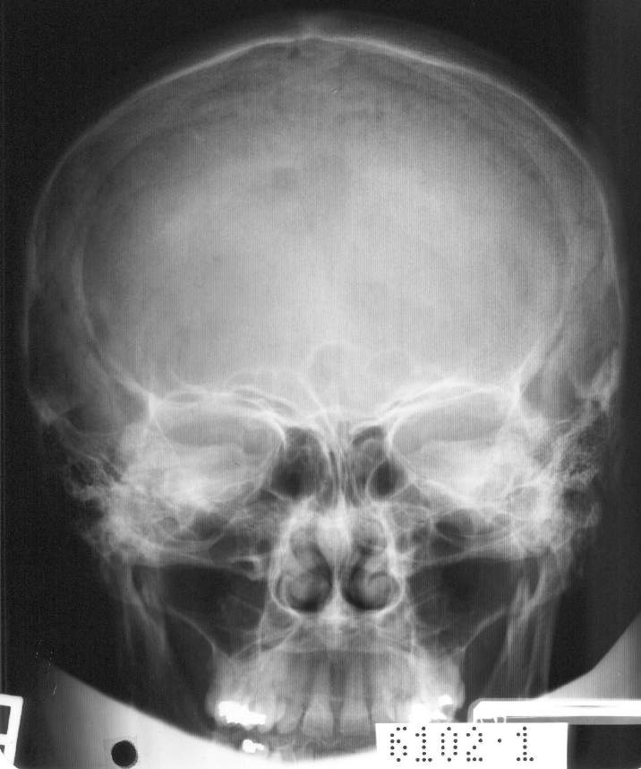
PA Projection

Slide 12
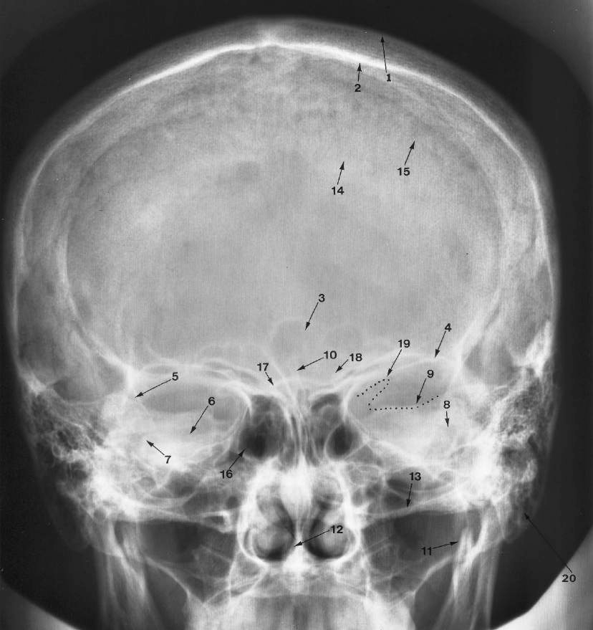
PA
Landmarks

Slide 13
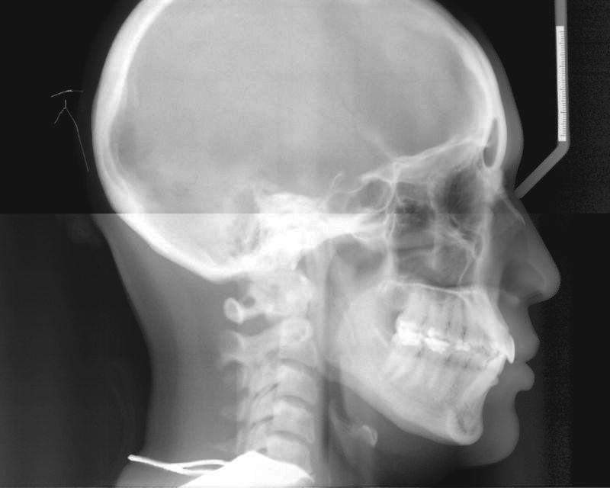
Lateral Skull View
Indications
  Trauma
  Disease
  Developmental
abnormalities

Slide 14
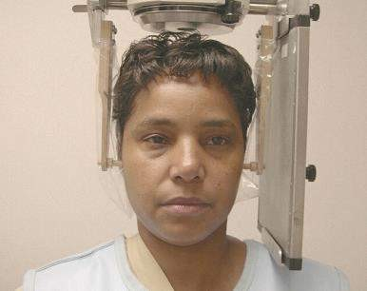
Lateral Cephalometric Projection
The image receptor is positioned parallel to the patient's midsagittal plane. The side of interest is placed toward the image receptor to minimize distortion.
In cephalometric radiography, the patient is placed with the left side toward the image receptor, and a wedge filter at the tube head is positioned over the anterior aspect of the beam to absorb some of the radiation and allow visualization of soft tissues of the face.

Slide 15
Lateral Cephalometric Projection
Uneven magnification of left and right sides
Structures close to the midsagittal plane (e.g., the clinoid processes and inferior turbinates) should be nearly superimposed.

Slide 16
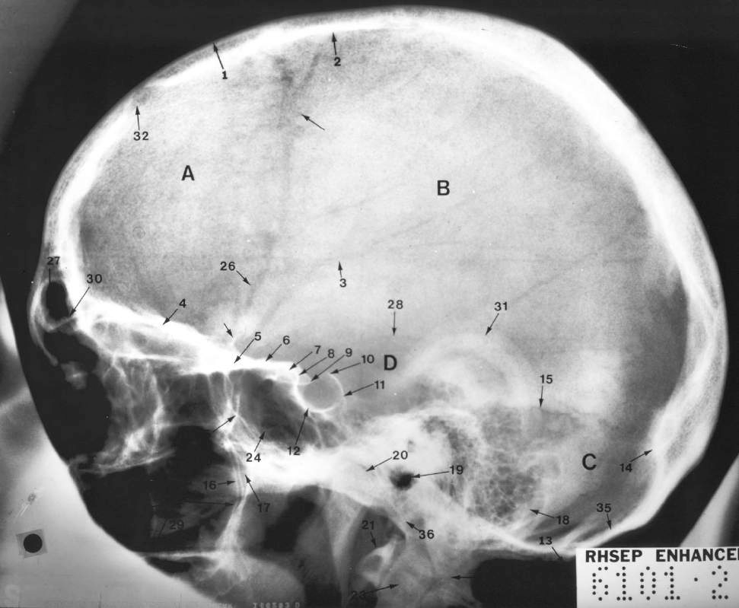
Lateral Skull Landmarks

Slide 17
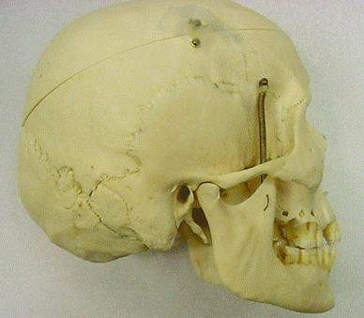
Lateral Cephalometric Projection

Slide 18
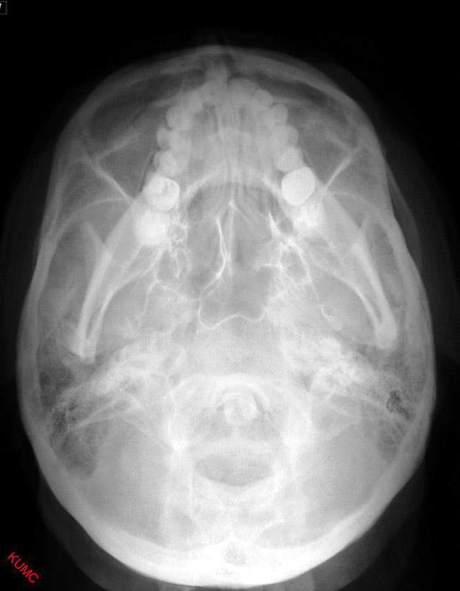
Submentovertex View
Indications
  View base of skull, position of condyles, sphenoid sinuses
  Fractures of the zygomatic arch (Jughandle View)

Slide 19
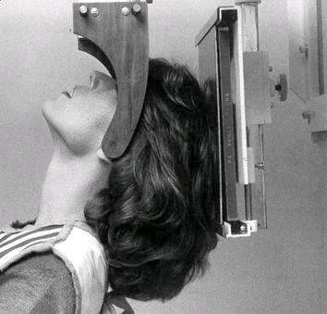
Submentovertex Projection
AKA Base projection

Slide 20
Submento- vertex Projection
Check to see the symmetry
Buccal and lingual cortical plates of the mandible projected as uniform opaque lines

Slide 21
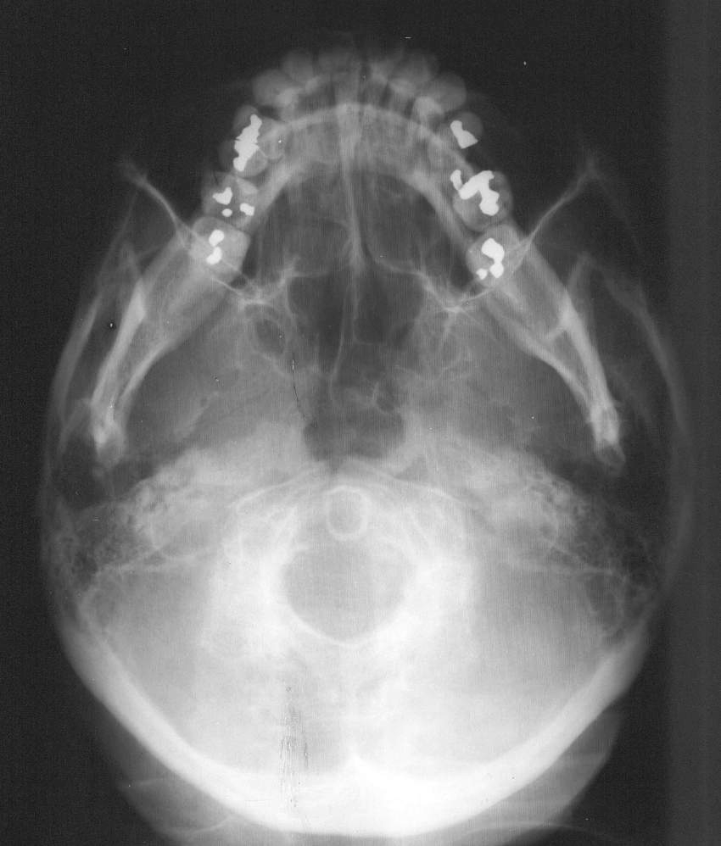
Submento- vertex Projection

Slide 22
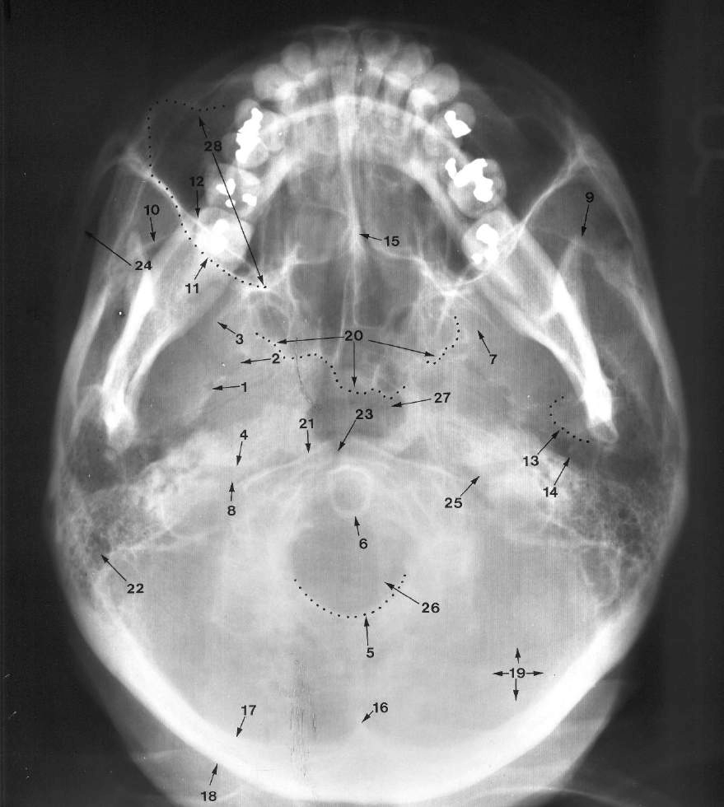
Submento- vertex Landmarks

Slide 23
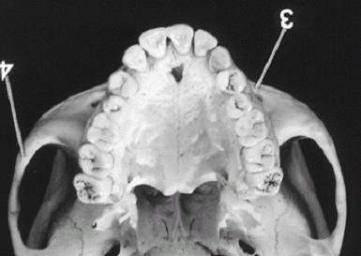
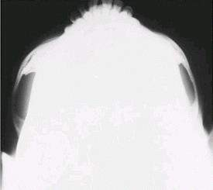
Submentovertex Projection
Jug handle view

Slide 24
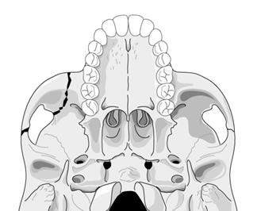
Submentovertex Jughandle View

Slide 25
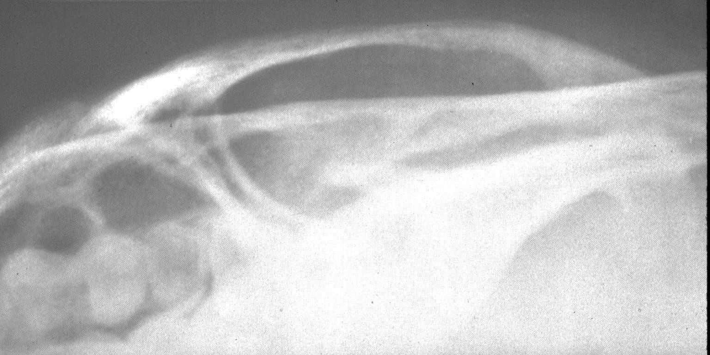
Submentovertex Jughandle View

Slide 26
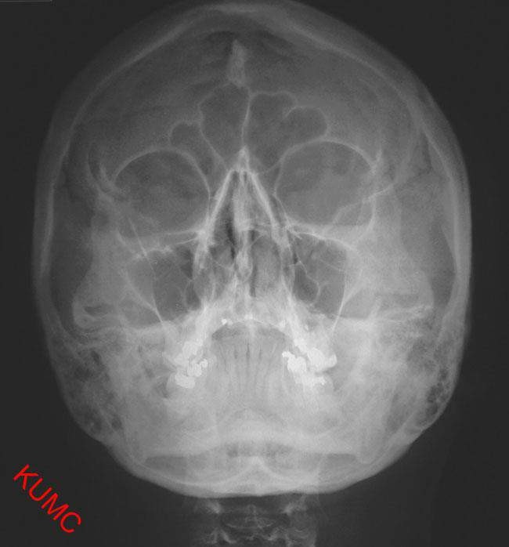
Occipeto-Menton Projection aka Waters View
Indications
  Evaluation of the maxillary sinus
  Evaluation of the
frontal sinus
  View of orbit and nasal fossa

Slide 27
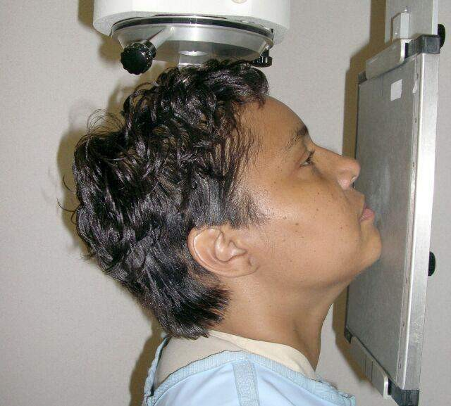
Occipeto-Menton Projection
C-M plane forms
~37° angle with the image receptor

Slide 28
Occipeto-Menton Projection
Petrous ridge

Slide 29
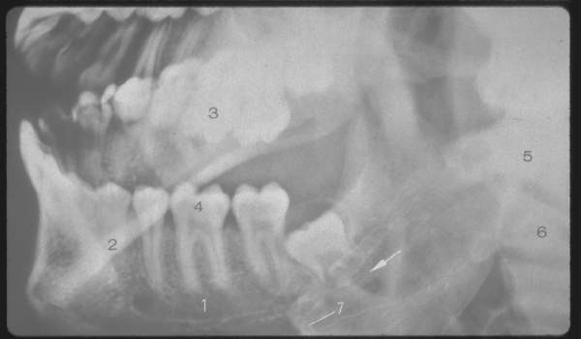
Lateral Oblique Views
Largely replaced by panoramic views
Indications:
  Position of impacted
third molars
  Fractures of the ramus, condyle, or body of the mandible (but not symphysis)

Slide 30
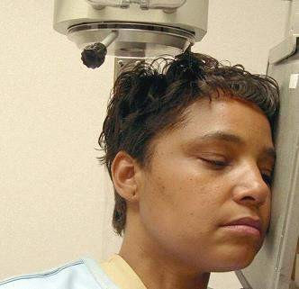
Lateral Oblique Projection
The image receptor is placed against the patient's cheek on the side of interest and centered in the molar-premolar area. The lower border of the cassette is parallel and at least 2 cm below the inferior border of the mandible. The head is tilted towards the side being examined, and the mandible is protruded.
The central ray is directed toward the premolar-molar region from a point 2 cm below the opposite angle of the mandible.

Slide 31
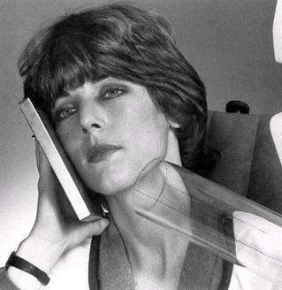
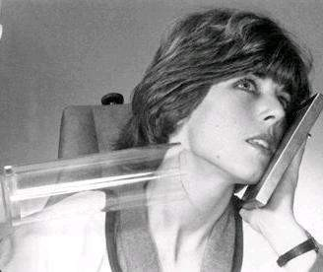
Lateral Oblique Projection

Slide 32
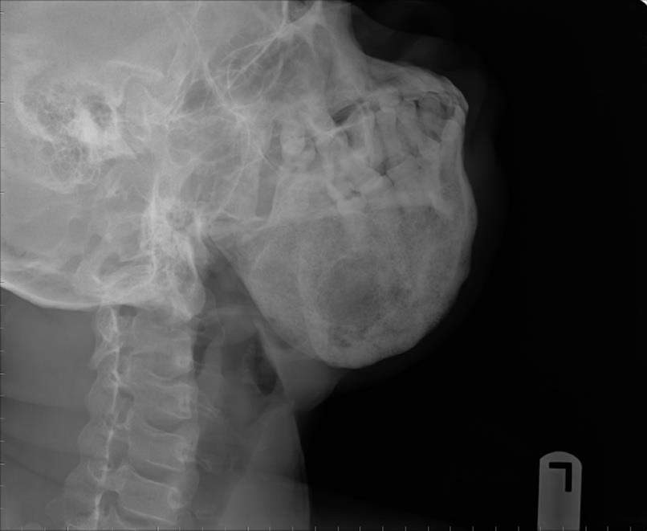
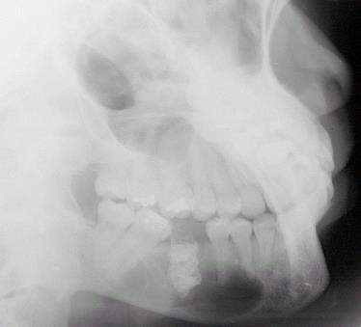
Lateral Oblique Projection-Body
Body of the mandible

Slide 33
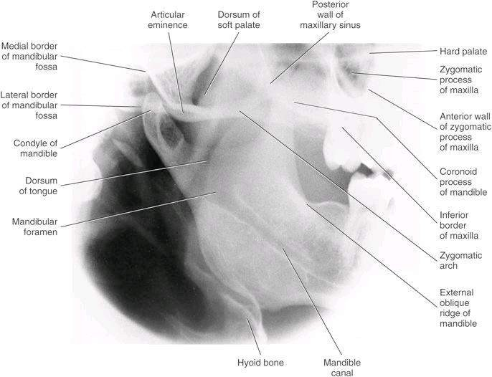
Lateral Oblique Projection- Ramus
Ramus
Also known as Lateral ramus view

Slide 34
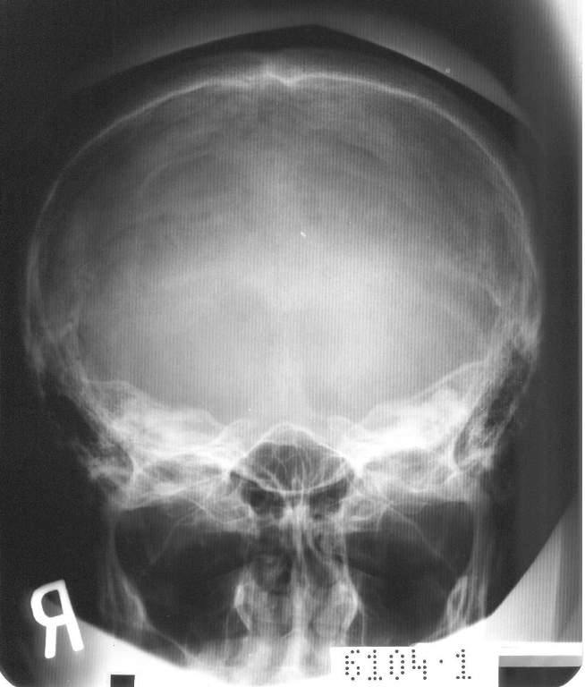
Reverse Towne View
Indications:
  Suspected fracture of the condylar neck
  Shows posterolateral wall of maxillary sinus

Slide 35
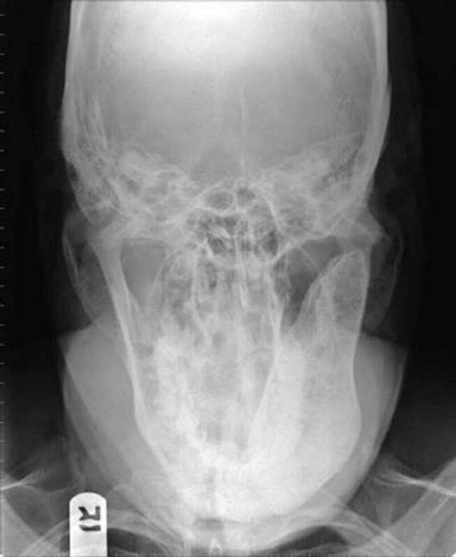
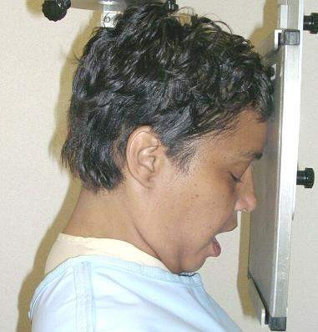
Reverse Towne projection
-30⁰

Slide 36
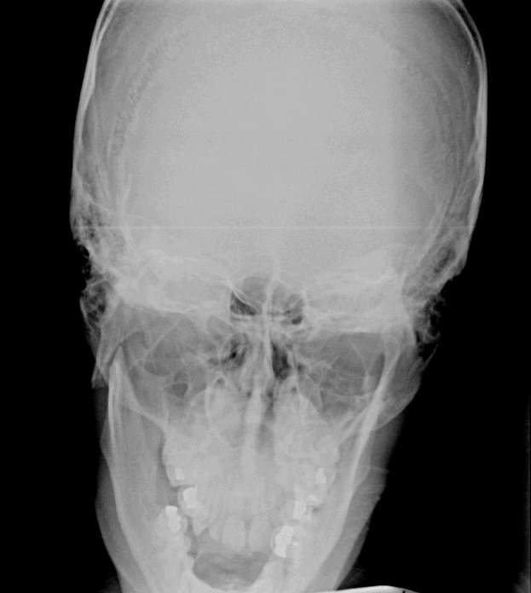
Reverse Towne projection
-30⁰

Slide 37
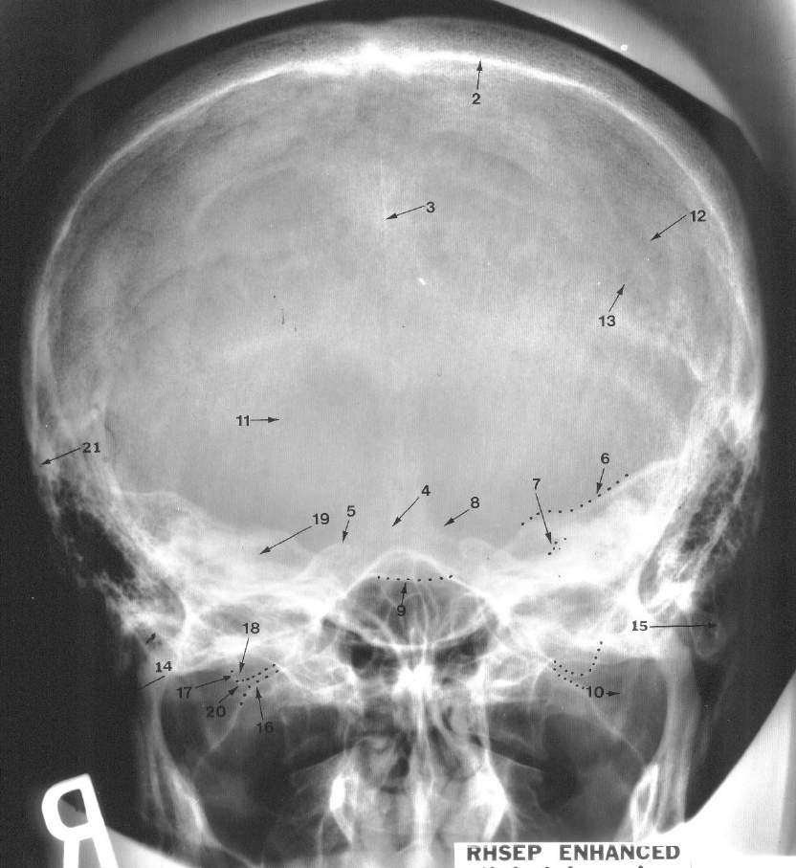
Townes Landmarks

Slide 38
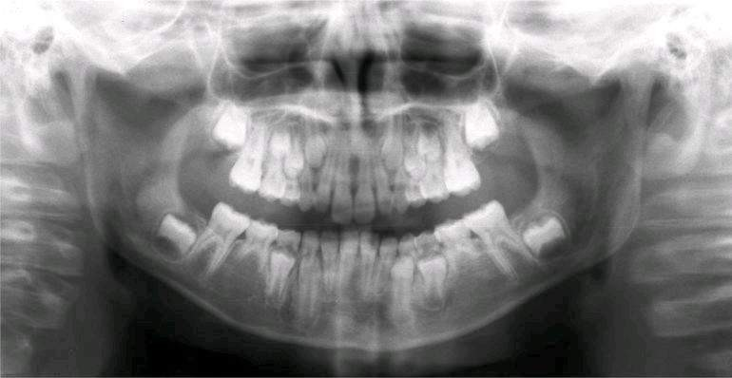
Panoramic View

Slide 39
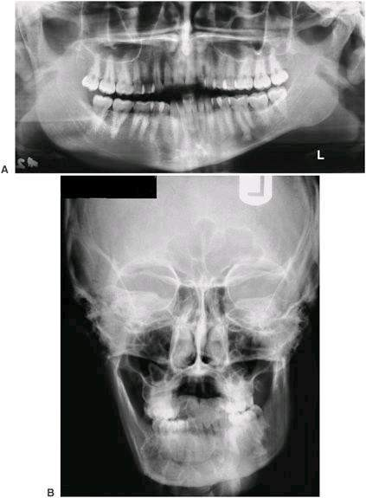
Comparative views

Slide 40
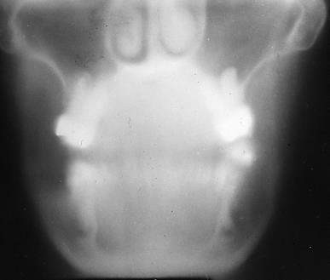
Linear Tomography

Slide 41
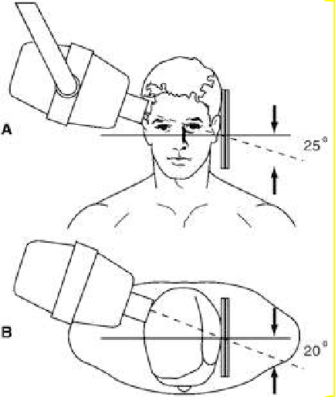
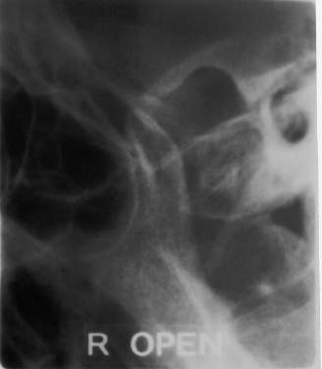
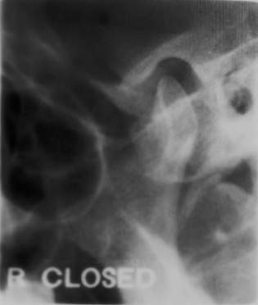
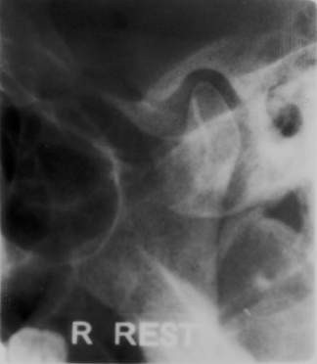
Trans-cranial views

Slide 42
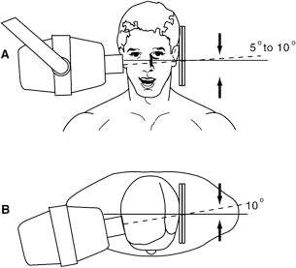
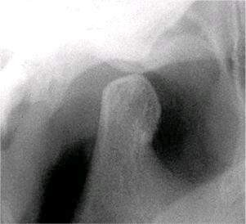
Trans-pharyngeal

Slide 43
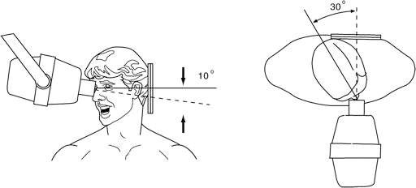
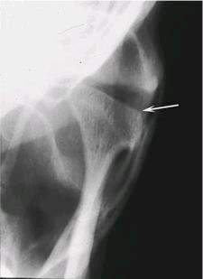
Trans-orbital

Slide 44


