Slide 1
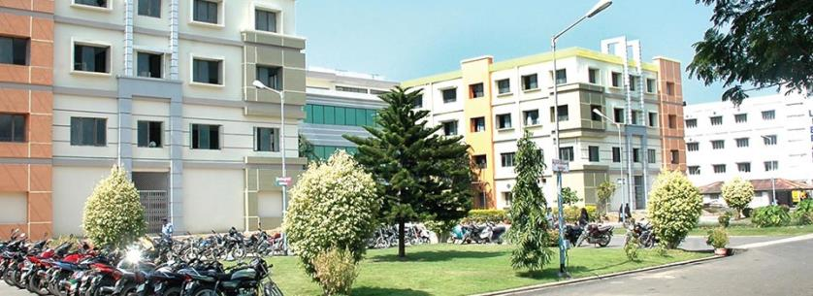
SIBAR INSTITUTE OF DENTAL SCIENCES
Department of prosthodontics
Denture Base Resins
Dr. Suresh, Professor

Slide 2
INTRODUCTION
Dentistry as a speciality is believed to have begun about 3000 BC
The first dental prostheses was believed to have been constructed in Egypt around 2500 BC
Skillfully designed dentures were made as early as 700 BC

Slide 3
DEFINITION
DENTURE BASE: The part of a denture that rests on the foundation tissues and to which teeth are attached (GPT-9)
DENTURE: An artificial substitute for missing natural teeth and adjacent tissues (GPT-9)

Slide 5
Based on thermal behavior
Thermoplastic
Thermosetting
Based on spatial structure
Linear - Homopolymer
Copolymer – Random
Copolymer – Block
Branched - Branched homopolymer
Graft branched copolymer
Cross linked - Homopolymer cross-linked with single cross-linked agent

Slide 6
Based on mode of activation
Heat activated resins
Chemically activated resins
Light activated resins.

Slide 7
Classification based on their use
Temporary permanent
Self cure resins, Heat cure acrylic,
Shellac base plate, Metallic denture bases
Commercial brands commonly used :
Stellon [DPI]
Trevalon [Dentsply]
Lucitone [Bayer]

Slide 8
According to obrein classification of denture base materials
Heat cure auto polymerized injection
PMMA PMMA molded
Conventional high impact
Unfilled reinforced
Carbon polyfiber

Slide 9
THERMOPLASTIC
Resins are softened, molded under heat & pressure.
No chemical change.
Soluble in organic solvents & fusible.
Eg: Acrylic resin
Impression comp.
Plastics in dentistry

Slide 10
THERMOSETTING
Final product cannot be softened by reheating.
Set by chemical reaction.
Insoluble in organic solvents & infusible.
Superior abrasion resistance.

Slide 11
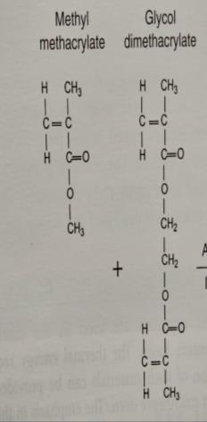
HEAT-ACTIVATED DENTURE BASE RESINS
Available as:
1. Powder and liquid
2. Gels – sheets and cakes.
Composition:
Liquid
Methyl methacrylate -Liquid
Dibutyl phthalate -Plasticizer
Glycol dimethacrylate(1-2%) -Cross linking agent
Hydroquinine -Inhibitor
It is supplied in tightly sealed amber colored bottle.

Slide 12
Powder
Poly (methyl methacrylate)
Other copolymers - 5%
Benzyl peroxide - Initiator
Compounds of mercuric sulfide,
Cadmium sulfide - Dyes
Zinc or titanium oxide - Opacifiers
Dibutyl Phthalate - Platicizer
Dyed organic filler
Inorganic particles like glass fibres or beads.

Slide 13
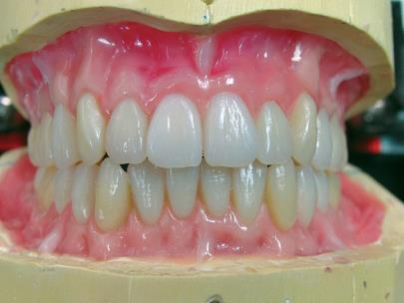
COMPRESSION MOULDING TECHNIQUE:
This is the most commonly used technique in the fabrication of acrylic resin dentures.
Steps:
1. Preparation of the wax pattern.

Slide 14
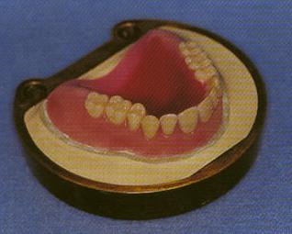
2. Preparation of the split mould
The pattern is invested in a dental flask using dental stone or plaster.

Slide 15
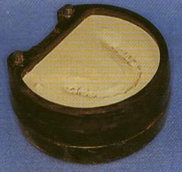
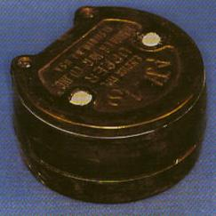
The pattern is invested in a dental flask using dental stone or plaster.

Slide 16
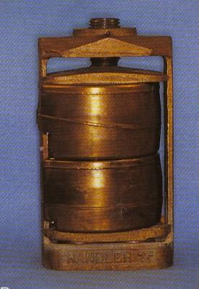
Invested flask with clamp

Slide 17
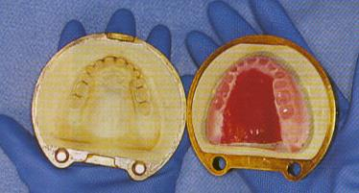
After the stone or plaster sets, it is dewaxed by placing the flask in boiling water for not more than 5 minutes.

Slide 18
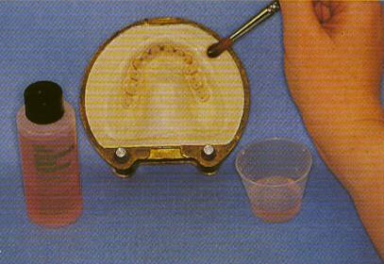
Application of separating Medium:

Slide 19
TYPES OF SEPARATING MEDIA
Tinfoil
Cellulose lacquers
Solution of alginate compounds
Evaporated milk
Soap
Sodium silicate
Starches
Failure to apply separating media ???

Slide 20
4. Proportion:
Mixing of powder and liquid:
Polymer : Monomer = 3 : 1 by volume OR 2 : 1 by weight
Lower polymer/monomer ratio:
( If too much monomer is used)
There will be greater curing or polymerization shrinkage.
Additional time will be required to reach the packing consistency
There will be a tendency for porosity to occur in the denture.

Slide 21
Higher polymer/monomer ratio
(If too little monomer is used: )
Not all the polymer beads will be wetted by monomer and the cured acrylic will be granular.
Dough will be difficult to manage and it may not fuse into a continuous unit of plastic during processing.

Slide 22
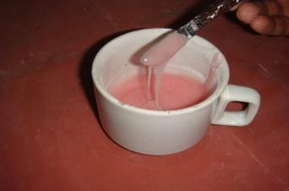
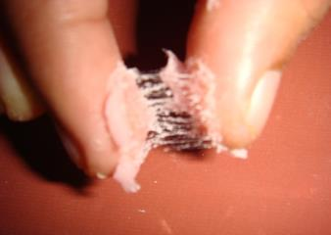
PHYSICAL STAGES OF POLYMERIZATION
Stage I: Wet Sand Stage:
There is little or no interactions, polymer beads remained unaltered, mixture is coarse and grainy
Stage II: Sticky Stage:
The monomer attacks the polymer by penetrating into the polymer. The mass is sticky and stringy (cobweb like) if the mixture is touched or pulled apart.

Slide 23
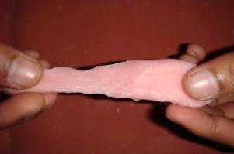
Stage III: Dough or Gel stage:
As the monomer diffuses into the polymer, the mass becomes
more saturated with polymer in solution.
It becomes smooth and dough like.
It does not adhere to the walls of the jar.
It consists of undissolved polymer particles suspended in a plastic matrix of monomer and dissolved polymer.
The mass is plastic and homogenous and packed into the mould at this stage.

Slide 24
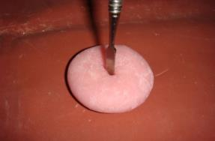
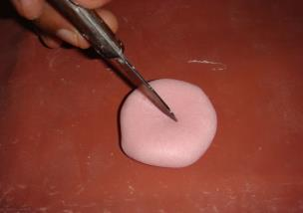
Stage IV: Rubbery stage:
The monomer disappears by further penetration into the polymer and evaporation.
The mass is cohesive, rubber-like, non plastic and cannot be molded.
Stage V: Stiff stage

Slide 25
Dough-forming time:
It is the time from the mixing of monomer and polymer to the dough stage.
ADA specification no 12 - less than 40 min,
It depends on:
Degree of polymerization: Higher the polymerization, lower the time
Particle size: Smaller the particle size, Shorter the time.
Polymer/Monomer ratio: High (less monomer), Shorter the dough time.
Temperature: Higher the temperature, shorter is the time.
Plasticizer: Reduces the dough forming time.

Slide 26
Working time:
It is the time elapsing between stage 2 and the beginning of
stage 4, i.e., dough stage
Dough should be moldable for at least 5 minutes.
The working time is affected by temperature.
In warm weather, the mixing jar is chilled to prolong the working time. Care is taken to avoid moisture.

Slide 27
5. Packing:
The mixture should be packed into the flask at the dough consistency for several reasons:
If it is packed at the sandy or stringy stages- too much monomer
results in porosity in the final denture base.
If packed at the rubbery to the stiff stage, the material will be too
viscous to flow, and metal-to-metal contact of the flask halves will
not be obtained.
Delayed packing will result in loss of detail in the denture,
movement or fracture of the teeth and increase vertical dimension of the denture.

Slide 28
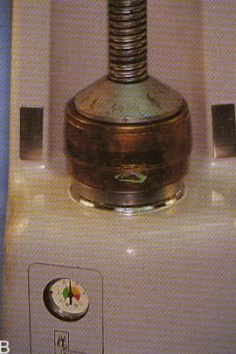
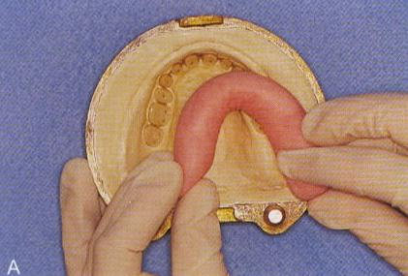

Slide 29
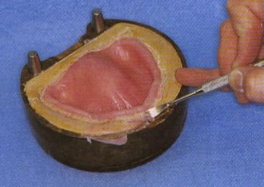
The flask is opened and the flash is trimmed away.
Remove the excess with sharp instrument

Slide 30
Before final closure, the separating film is removed and discarded.
The final closure of the flask, or metal-to-metal contact of the flask halves, is then completed in the press.
Pressure used in compression -1000-2000psi (6.9 -13.8 Mpa)

Slide 31
6. Curing:
After the final closure of the flasks, they should remain at room temperature for 30 to 60 min.
Sometimes this is called as ‘Bench Curing’.
Reasons:
It provides a longer flow period for the dough, thus permitting an equalization of pressures throughout the mould.

Slide 32
Curing cycle:
Following are the recommended curing cycles:
Heat the flask in water at 60` to 70`C for 9 hours.
Heat the flask at 65ºC for 90 minutes, then boil the water for
1 hour for adequate polymerization in thinner portions.

Slide 33
POLYMERIZATION PROCEDURE
When the temperature of the dough increases above 60ºC the molecules of benzoyl peroxide decompose to form free radicals.
A free radical reacts with a monomer molecule, and a new free radical is formed, which in turn gets attached to another monomer molecule.
The chain reaction is thus propagated until a termination occurs.

Slide 34
CHEMISTRY OF POLYMERIZATION
Monomers react to form polymer by a chemical reaction called polymerization.
The most common polymerization reaction for polymers used in dentistry is addition polymerization.
ADDITION POLYMERIZATION
INDUCTION
PROPOGATION
CHAIN TRANSFER
TERMINATION

Slide 35
INDUCTION
1) ACTIVATION
2) INITIATION
ACTIVATION
Free radicals can be generated by activation of radical producing molecule using.
Second chemical
Heat
Visible light
Ultraviolet light
Energy transfer from another compound that acts as a free radical.

Slide 36
INITIATIONSTAGE
Energy source forms free radicals which open double or triple carbon bonds in the monomer
PROPAGATION STAGE
Rapid addition of monomer molecules to free radical - free electrons shifted to end of chain
CHAIN TRANSFER
The active free radical of a growing chain is transferred to another molecule (eg monomer or inactivated polymer chain) and a new free radical for further growth is created termination occurs in the latter.

Slide 37
TERMINATION STAGE
Reaction terminates when insufficient free radicals exist. Reaction also may be stopped by any material that will react with free radical, decreasing the rate of initiation, or increasing rate of termination.

Slide 38
7. Cooling:
The flask should be cooled slowly i.e. bench cooling it for 30 minutes, and then placing it in cold tap water for 15 minutes is satisfactory.
Deflasking:
This has to be done with care to avoid flexing and breaking of the acrylic denture.
9. Finishing and Polishing:
A suspension of finely ground pumice in water is commonly
used for polishing.

Slide 39
INJECTION MOLDING TECHNIQUE
The mould space may be filled by injecting the resin under pressure before it hardens.
A sprue hole and a vent hole are formed in the gypsum mould and the metal flask is constructed such that it will adapt to the injection moulding equipment.

Slide 40
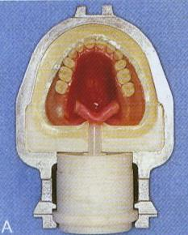
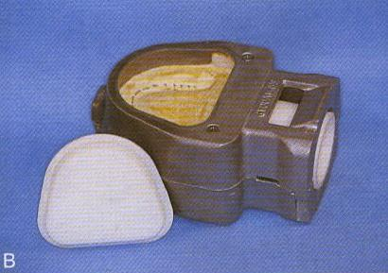
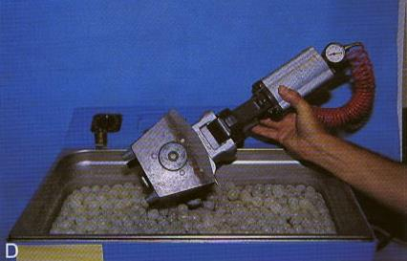
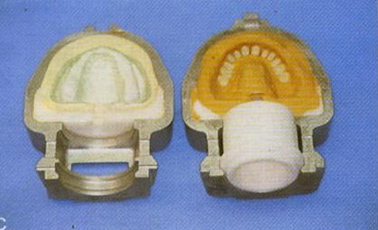

Slide 41
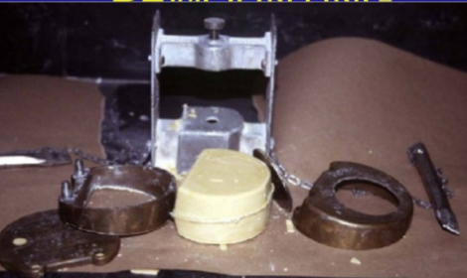
Deflasking procedure

Slide 42
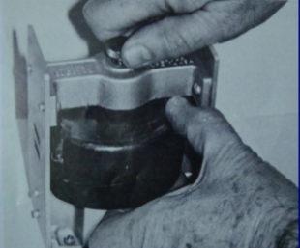

Slide 43
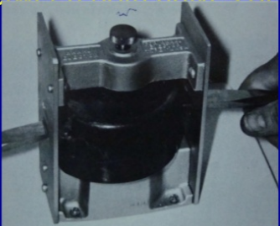
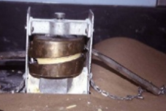

Slide 44
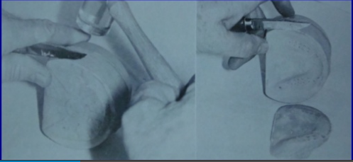
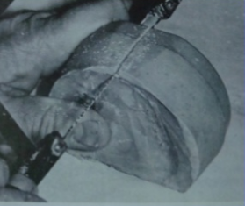
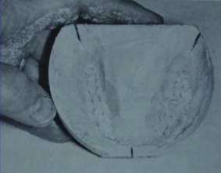

Slide 45
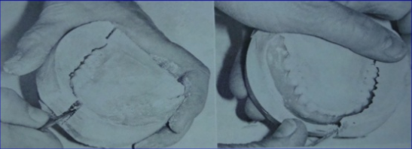
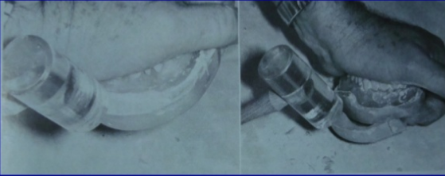

Slide 46
CHEMICALLY ACTIVATED DENTURE BASE ACRYLIC RESINS
They are also known as ‘self-curing’, ‘cold cure’ or ‘auto polymer’ resins.
They polymerize at room temperature.
The initiator benzoyl peroxide is activated by another chemical, (Dimethyl- Para Toludine) which is present in the monomer.
Difference between heat cure and self cure resins is the method of activation of benzoyl peroxide.

Slide 47
COMPOSITION
Liquid:
Methyl methacrylate - Liquid
Dimethyl –p -toludine - Activator
Dibutyl phthalate - Plasticizer
Glycol dimethacrylate 1-2% - Cross linking agents
Hydroquinine - Inhibitor

Slide 48
Powder
Poly (methyl methacrylate)
Other copolymers –5%
Benzoyl peroxide - Initiator
Compounds of mercuric Sulfide,
Cadium sulfide - Dyes
Zinc or titanium oxide - Opacifiers
Dibutyl phthalate - Plasticizer
Dyed organic fillers
Inorganic particles like glass fibres or beads.

Slide 49
Uses:
Occasionally as restorative materials
With inert filler, for the construction of special trays for impression making
For denture repair, relining and rebasing.
For making removable orthodontic appliances
For adding a post dam to an adjusted upper denture.

Slide 50
Advantages and Disadvantages:
Better initial fit, which is because the curing is carried out at room temperature. Thus less thermal contraction.
Colour stability is inferior to that of heat cure resin, due to subsequent oxidation of the tertiary amine.
3. The degree of polymerization obtained with self curing acrylics is not as great as with heat cured ones. therefore likely to have slightly inferior physical properties.
For repairing dentures - self curing resins are preferable to heat cured resins as re-curing causes warpage.

Slide 51
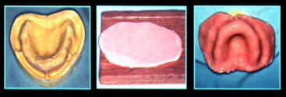
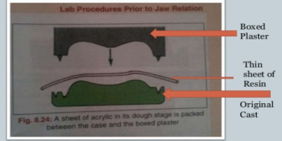
MANIPULATION
Sprinkle on technique
Adapting technique –Finger adopted
Stone mould dough(ZEDIC AND YERMOUND)
Wax confined ( LAVER AND FREDA)
Fluid resin technique
Compression moulding technique
Injection moulding technique

Slide 52
LIGHT-ACTIVATED DENTURE BASE RESINS
This consists of :
Urethane dimethacrylate matrix
Acrylic copolymer,
Micro fine silica fillers, and a
Photo initiator system.
(Camphoroquinone amine)

Slide 53
It is supplied in premixed sheets - claylike consistency.
It s provided in opaque tight packages to avoid premature polymerization.
The denture base material is adapted to the cast while it is in a plastic state.
The denture base can be polymerized without teeth and used as a baseplate.
The teeth are added to the base with additional material and the anatomy is sculptured while the material is still soft.
It is polymerized in a light chamber (curing unit) with blue light of 400-500nm from high intensity quartz halogen bulbs.
The denture is rotated continuously in the chamber to provide uniform exposure to the light source.

Slide 54
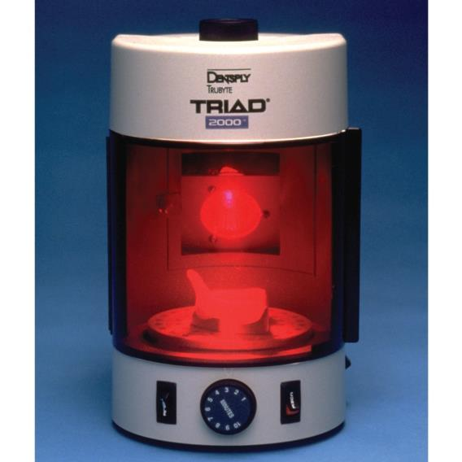

Slide 55
REQUIREMENTS OF DENTURE BASE MATERIALS
Strength and durability
Satisfactory thermal properties
Processing accuracy and dimensional stability
Chemical stability
Insolubility in and low sorption of oral fluids
Absence of taste and odor

Slide 56
Biocompatible
Natural appearance
Color stability
Adhesion to plastics, metals, and porcelain
Ease of fabrication and repair
Moderate cost

Slide 57
PROPERTIES OF DENTURE RESINS
Methyl Methacrylate Monomer:
clear, transparent, volatile liquid
It has a characteristic sweetish odour.
The physical properties of monomer are:
Boiling point - 100.8ºC
Density - 0.945 gm/ml at 20ºC
Heat of polymerization - 12.9Kcal/mol
Volume shrinkage during polymerization - 21%

Slide 58
Poly (methyl methacrylate):
Tasteless and Odorless.
Clear transparent resin which can be pigmented (colored) easily to duplicate the oral tissues.
Compatible with dyed synthetic fillers.
Density: 1.19gm/cm³
Strength:
Compressive and Tensile strength:
Compressive strength - 75MPa
Tensile strength - 52MPa
Self cured resins generally have lesser compressive and tensile strength.

Slide 59
The strength is affected by:
Composition of the resin.
Technique of processing
Degree of polymerization
Water sorption
Subsequent environment of the denture.
Impact strength:
It is a measure of energy absorbed by a materials when it is broken by a sudden blow.
Ideally denture base resins should have high impact strength to prevent breakage when it is accidentally dropped.
Addition of plasticizers increase the impact strength.
Self cured resins have a lower impact strength.

Slide 60
Hardness:
Acrylic resins are having low hardness.
Easily scratched and abraded.
Heat cured acrylic resin : 18-20 KHN
Self cured acrylic resin : 16-18 KHN
Modulus of Elasticity:
Sufficient stiffness for use in complete and partial dentures (modulus of elasticity – 2400 MPa).
Low compared with metal denture bases.
Self cured acrylic resins have slightly lower values.

Slide 61
Dimensional stability
Shrinkage:
Acrylic resins shrink during processing due to two reasons:
1. Thermal shrinkage on cooling
2. Polymerization shrinkage.
Polymerization shrinkage:
The density of the monomer changes from 0.945gm/cc to 1.19gm/cc.
This results in shrinkage in the volume of monomer-polymer dough.
Volume shrinkage - 8%
Linear shrinkage - 0.53%

Slide 62
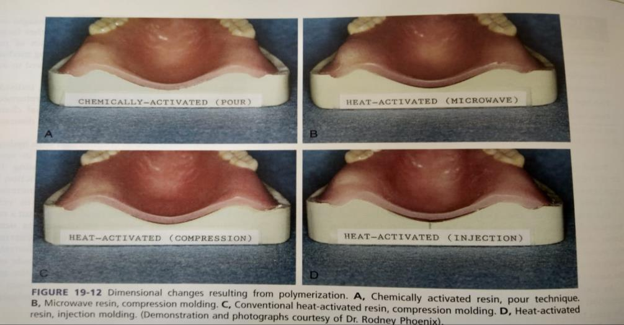

Slide 63
Water sorption:
Acrylic resins absorb water (0.6mg/cm² ) and expand.
Partially compensates for its processing shrinkage.
This process is reversible.
Repeated wetting and drying should be avoided as it may result in warpage of the denture .
Solubility:
Poly (methyl methacrylate) is virtually insoluble in water and oral fluids.
They are soluble in ketones, esters, and aromatic and chlorinated hydrocarbons,
Alcohol causes crazing in some resins.

Slide 64
Thermal properties
Stability to heat:
Poly (methyl methacrylate) is chemically stable to heat.
It softens at 125º C.
It begins to depolymerize between 125ºC and 200ºC
At 450ºC, 90% of the polymer will depolymerize to monomer.
Thermal conductivity:
They are poor conductors of heat and electricity.
Coefficient of thermal expansion:
These materials have a high coefficient of thermal expansion (81x10⁻⁶/ºC).
Addition of fillers reduces the coefficient of expansion.

Slide 65
Color stability:
Heat cure acrylic resins - good colour stability.
Self cure resins is slightly lower
Biocompatibility:
Completely polymerized acrylic resins are biocompatible.
Pure monomer if inhaled over a long period is toxic.
It may also cause allergic reactions in some individuals.
Adhesion:
The adhesion of acrylic to metal and porcelain is poor, so mechanical retention is required.

Slide 66
Shelf life:
It varies considerably.
The acrylic resins dispensed as powder/liquid have the best shelf life.
The gel type has a lower shelf life and has to be stored in a refrigerator

Slide 67
DENTURE DEFECTS
Porosity
Crazing
Warpage
Fracture

Slide 68
Porosity
Presence of voids within structure of resin
Porosity can be of two types
Internal
External
Porosity due to insufficicent material - irregular ,
Porosity due to air entrapment – fluid resin technique
Contraction porosity
Gaseous porosity- volatilization of the monomer,

Slide 69
Internal porosity:
Is in the form of voids or bubbles within the mass of the polymerized acrylic.
Cause – due to vaporization of the monomer (100.8C)
It is confined to the thick portions of the denture base and
It may not occur equally throughout the affected area.
Solution- long low temperature curing cycle is recommended.

Slide 70
External porosity
It occurs due porosities which occur near the surface of denture.
Cause
Lack of homogeneity of dough.
Lack of adequate pressure.
Prevention – use proper monomer – powder ratio, packing in dough stage.

Slide 71
Contraction porosity occurs because the monomer contracts by some 20% of its volume during processing. By using the powder–liquid system, this contraction is minimized and should be in the region of 5–8%.
Contraction pororsity

Slide 72
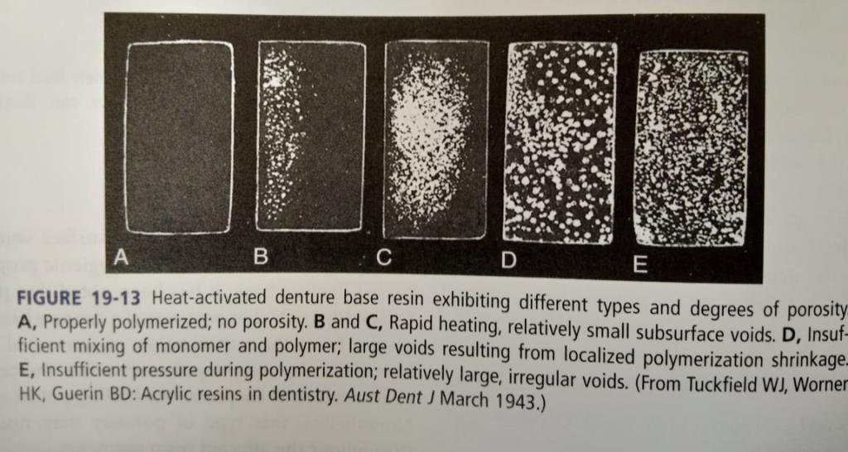

Slide 73
Crazing
Crazing is formation of surface cracks on denture base resin.
Causes –
Incorportion of stress
Attack by solvent (alcohol)
Incorporation of water during processing.
Prevention
Avoidance of solvent
Proper use of separating media
Metal moulds
Use of cross linked acrylic

Slide 74
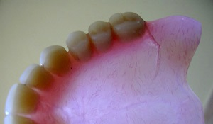
CRAZING

Slide 75
Denture Warpage
Denture warpage is change in shape or fit of denture.
Cause is incorporation of stress in denture
Packing in late dough or rubbery stage.
Stress induced during curing
Improper deflasking
Rise in temp while polishing
Immersion of processed denture in hot water.

Slide 76
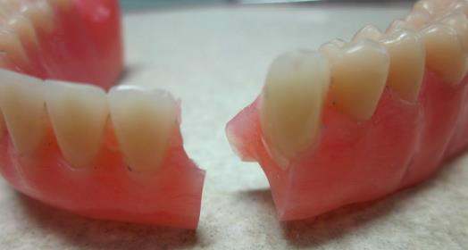
Denture Fracture
Improper de flasking
Denture base excessively thin
Accidental dropping at time of polishing

Slide 77
Change in tooth position
Care to taken at time of dewaxing procedure
Rearticulation to be done after processing the denture to check of occllusal discrepancy.

Slide 78
APPLICATIONS IN DENTISTRY

Slide 79
Applications of Denture base resins
Removable Prosthodontics
Fixed Prosthodontics
CD
RPD
Management of TMD’s
79

Slide 80
Applications in CD’s
1.Custom trays
Self cure acrylic
b)Modified Tray material
c)Light cure acrylic
Self-cure
Light cure
2.Border molding
Fluid Resins & Tissue Conditioners
a)Self cure
b)Heat cure
c)Light cure
3.Functional impression
a)Compression molding
b)Injection molding
c)Fluid resin Technique
c)Microwave processed
4.Denture bases
6.Processing
a)Stent’s in ID’s
b)Bruce Template
c)Repair & Rebase Material
d)Relining material
7. Miscellaneous
Uses & Limitations of Resins in Prosthodontics-132
80

Slide 81
RPD
Custom tray
Denture base
Processing
Miscellaneous
Esthetic clasp materials

Slide 82
Management of TMJ disorders
Occlusal appliance
Stents
Mouth protectors
Anterior positioning and stabilizing appliances

