Slide 1
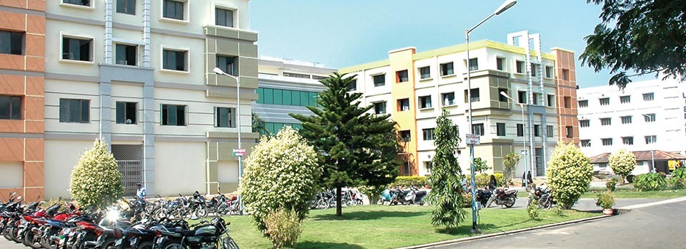
SIBAR INSTITUTE OF DENTAL SCIENCES
Department of Prosthodontics
Casting Defects
Dr. Vineela, Sr.lecturer

Slide 2
Error in the casting procedure often results in defective casting, these defects are known as casting defects.

Slide 3
According to philips
Distortion
Surface roughness and irregularities
Porosity
Incomplete or missing detail

Slide 4
According to Rosensteil
Roughness
Nodules
Fins
Incompleteness
Voids or porosity
Marginal discrepancy
Dimensional inaccuracies

Slide 5
Distortion of the casting is probably related to
distortion of the wax pattern.
Causes:
Can occur from the time of wax pattern preparation to the time of investing due to stress relaxation.
Distortion of the wax pattern occurs during the investment procedure.
Minimized by:
Application of minimum pressure
Manipulation of wax at high temperature
Investing pattern immediately
If storage is necessary, store in refrigerator

Slide 6
Surface roughness
Defined as relatively finely spaced surface imperfections whose height, width and direction establish the predominant surface pattern.
Surface irregularities
Isolated imperfections such as nodules that are not characteristic of the entire surface area
The surface roughness of the casting is greater than the wax pattern from which it is made, because
- the particle size of the investment and
-its ability to reproduce the pattern in microscopic detail

Slide 7
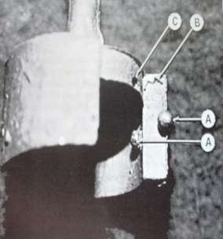
Air bubbles:
Small nodules on the casting are caused by air bubbles, that become attached to the surface during or subsequent to the investing procedure.
Prevented By:
Proper investment technique
Vibration of mix or by vacuum mixing
Application of wetting agent properly and correctly – important that it be applied in a thin layer.

Slide 8
Water films:
Wax is repellent to water, & If the Investment becomes separated from the wax pattern, a water film may form irregularly over the surface.
Appears as minute ridges or veins on the surface.
Prevented By:
Use of wetting agent
Correct L/P ratio (Too high L/P ratio may produce these irregularities)

Slide 9
Rapid Heating Rates
It produces
Fins or spines on the casting
Cause-
because of Flaking of the investment
Prevented by:
Heat gradually at least 60min from room
temperature to 700 c.
Greater the bulk – more slowly heated.

Slide 10
Under heating
Incomplete elimination of wax residues may occur, if the heating time is too short.
This factor is mainly important for low heat
technique.

Slide 11
Prolonged heating
During high heat technique, decomposition or
disintegration of the investment occurs & the walls of the mold are roughened.
Product of decomposition are sulphorous compounds, which contaminates the casting, this is the reason why the surface of the casting does not respond to pickling sometimes.
Prevented by- when thermal expansion technique is used, the mold should be heated to the casting temperature & NEVER HIGHER.

Slide 12
Liquid/Powder Ratio
The amount of water and powder measure should be accurate.
Too little water- investment too thick & cannot be applied to the wax pattern
Too much water- making investment easier but reproduces
poor casting.
Casting pressure
To high pressure – rough surface of the casting
To low pressure – incomplete casting
Average – 0.10 to 0.14 Mpa in an air pressure machine and
- 3 to 4 turns of the spring in centrifugal casting
machine.

Slide 13
Temperature of the alloy:
If alloy is heated too high- surface roughness
Too less- improper melting
Composition of the investment:
Ratio of binder to quartz influences surface texture of casting

Slide 14
Foreign bodies
Any casting that shows sharp, well- defined deficiencies indicates the presence of some foreign particles in the mold. They may be:
Pieces of the investment
Bits of the carbon from the flux
Sulfur components from – decomposition of the gypsum investment and high sulfur content torch flame.
Pattern position
Should not place too close together
Should not place many patterns in same plane
Space between the pattern is atleast 3mm

Slide 15
Impact of metal alloy
Cause:
The direct impact of molten alloy on the weak portion of the mold surface, may fracture or abrade the mold surface regardless of its bulk.
Prevented by:
This type of surface roughness or irregularities can be avoided by proper spruing.
Placement of sprue at 45 degree
Carbon inclusions
Carbon from- carbon crucible,
carbon containing investment,
improperly adjusted torch– can be absorbed by the alloys during casting resulting in formation of carbides or visible carbon inclusion.

Slide 16
Classified as follows:
Solidification defects
localized shrinkage porosity
Micro porosity
Trapped gases
A. pin hole porosity
B. gas inclusion porosity
C. sub surface porosity
III. Residual air

Slide 17
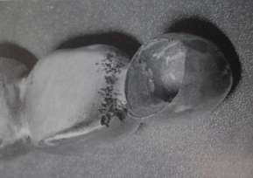
Localized shrinkage porosity
It is caused by premature termination of the molten metal during solidification.
It mainly occurs at sprue-casting junction.
Cause:
Diameter is too narrow
Length of the sprue is too long
Absence of reservoir
Direction of sprue at 90 degree

Slide 18
Prevented by-
Using sprue of correct thickness
Attach sprue to the thickest portion of the wax pattern
Flaring the sprue at the point of attachment
Placing reservoir close to the attachment

Slide 19
Suck back porosity
A hot spot is created by the hot metal impinging on the mold wall near the sprue.
This hot spot causes this region to FREEZE LAST
Since the sprue is already solidified, NO MORE MOLTEN MATERIAL IS AVAILABLE, resulting in
SUCK BACK POROSITY

Slide 20
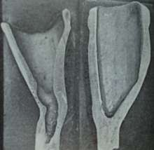
It often occurs at OCCLUSOAXIAL OR INCISOAXIAL LINE ANGLE
PREVENTED BY-
Flaring the point of sprue attachment
Reducing the temperature between the mold & molten alloy

Slide 21
MICROPOROSITY
Occurs from solidification shrinkage, generally in fine grain alloy castings when solidification is too rapid
Not detectable unless the casting is sectioned

Slide 22
Pin hole and Gas inclusion porosity
Characterized by spherical contour, but gas inclusion
porosities are much larger than pin hole porosity.
Occur primarily because most metals dissolve gases when molten, these gases expelled during solidification..
Eg- copper & silver dissolves oxygen platinum & palladium dissolves hydrogen
Also be caused by gas occluded from a poorly
adjusted torch flame or use of oxidizing zone rather than reducing zone.
Casting is usually black, do not clean easily on pickling

Slide 23
Sub surface porosity
Caused by simultaneous nucleation of solid grains and gas bubbles at the first moment that the alloy freezes at mold walls
Prevented by controlling the rate at which the molten metal enters the mold.

Slide 24
Back pressure porosity
Some times referred to as entrapped-air porosity.
found on the inner and outer surface of the casting when the casting or mold temperature is low, that solidification occurs before the trapped air can escape.

Slide 25
Causes
Inability of the air in the mold to escape through the pores in the investment
Prevented by:
Proper burnout
Sufficiently high casting pressure
Adequate L/P ratio
Thickness of investment between tip of pattern and end of ring is not greater than 6mm.

Slide 26
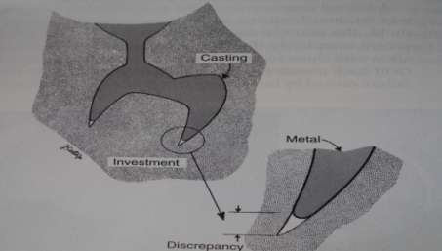
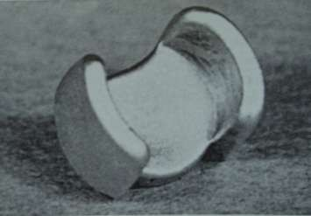
Factors that inhibit the mold filling is:
In sufficient venting
In sufficient casting pressure, pressure should be applied atleast for 4 sec
Incomplete elimination of wax
Lower L/p ratio
Viscosity of the fused metal

Slide 27
THANK YOU

