Slide 1
SIBAR INSTITUTE OF DENTAL SCIENCES

Slide 2
GOOD MORNING

Slide 3
CASE CONTROL STUDIES

Slide 4
CONTENTS:
INTRODUCTION
BASIC STEPS OF CASE CONTROL STUDIES
SELECTION OF CASES
SELCTION OF CONTROLS
MATCHING
MEASUREMENT OF EXPOSURE
ANALYSIS AND INTERPRETATION
EXPOSURE RATES
RELATIVE RISK
ODDS RATIO
BIAS IN CASE CONTROL STUDIES
ADVANTAGES OF CASE CONTROL STUDIES
DISADVANTAGES OF CASE CONTROL STUDIES

Slide 5
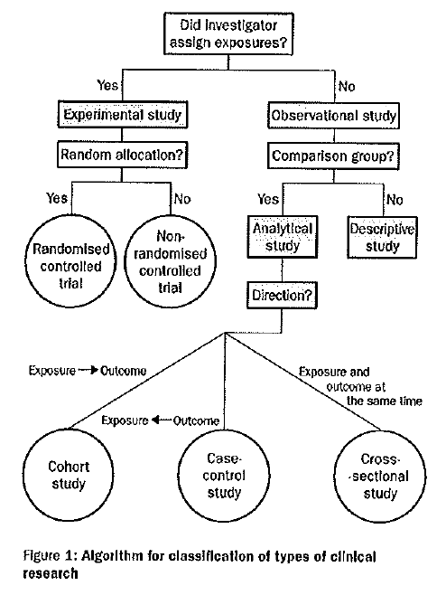
Grimes DA, Schulz KF. An overview of clinical research: the lay of the land. Epidemiology series. 2002; 359: 57-61.

Slide 6
ANALYTICAL EPIDEMIOLOGY
Case control study
Cohort study

Slide 7
CASE CONTROL STUDY/RETROSPECTIVE/CASE REFERENT/TROHOC
Both exposure and disease occurred before the start of study.
The study proceeds from effect to cause.
It uses a control group to support or refute an inference.

Slide 8
TIME
DIRECTION OF ENQUIRY
Exposed (a)
CASES
(PEOPLE WITH DISEASES)
Not exposed (c)
POPULATION
Exposed (b)
CONTROLS
(WITH NO DISEASES)
Not exposed (d)

Slide 9
BASIC STEPS IN CASE CONTROL STUDY
Selection of cases and controls
Matching
Measurement of exposure
Analysis

Slide 10
1. SELECTION OF CASES AND CONTROLS
A) Definition of a case:
a) Diagnostic criteria:
b) Eligibility Criteria
B) Source of Cases
a) Hospitals
b) General population (defined geographic area)
C) Selection of Controls
D) Sources of Controls
a) Hospitals
b) Relatives
c) Neighborhood controls
d) General population (defined geographic area)

Slide 11
2. MATCHING
Matching is defined as the process by which we select controls in such a way that they are similar to cases with regards to certain pertinent selection variables ( E.g., Sex, Age)
Confounding Factors – is defined as one , which is associated both with exposure and disease, and distributed unequally in study and control groups, e.g. role of alcohol in the etiology of esophageal cancer

Slide 12
3. MEASUREMENT OF EXPOSURE
Information about exposure should be obtained in precisely the same manner for both cases and controls. This may be obtained by
1. Interviews
2. Questionnaires and
3. Past records (Cases and Controls).

Slide 13
4. ANALYSIS AND INTERPRETATION
Exposure rates among the cases and controls to suspected factors.
Estimation of disease risk associated with exposure .

Slide 14
a. Exposure Rate:
Table for Frame work of a case control study
Risk factors of or Suspected cases | Cases (Disease Present) with lung cancer | Control ( Disease Absent) without lung cancer
smokers | a | b
nonsmokers | c | d
Total | a+c | b+d

Slide 15
 | Cases (Lung cancer) | Controls (No Lung cancer)
Smokers | 33 (a) | 55 (b)
Non smokers | 2 (c) | 27 (d)
Total | 35 (a+c) | 82 (b+d)
Exposure rates: cases = 33/35 = 94.2%
controls = 55/82 = 67.0%

Slide 16
b. Relative Risk:
Relative risk = Incidence among exposed
Incidence among non exposed
a
c
=
÷
(a+b)
(c+d)
As there is no appropriate denominator or population at risk, it is difficult to calculate accurate RR from case control study.

Slide 17
ODDS RATIO (CROSS PRODUCT RATIO)
Odds ratio is a measure of strength of the association between risk factor and outcome.
 | Disease (yes) | Disease (no)
Exposed (<5/day) | a (33) | b (55)
Not exposed | c (2) | d ( 27)
so odds ratio is = ad/bc
= 33x 27/ 55x2
= 8.1

Slide 18
BIAS IN CASE CONTROL STUDY
Memory or recall bias
Selection
bias
Interviewer bias
Berkesonian bias

Slide 19
ADVANTAGES
Easy to carry out
Rapid and inexpensive
Few subjects are required,
Rare disease can be studied
No risk to subjects
Allows study of several etiological factors
Risk factor can be identified.
No attrition problems.
Ethical problems are minimal

Slide 20
DISADVANTAGES
Problems of bias.
Selection of appropriate control group
Incidence cannot be measured.
No distinction between causes and associated factors
Not suited to the evaluation of therapy

Slide 21
CASE CONTROL STUDY VS COHORT STUDY
CASE CONTROL STUDY | COHORT STUDY
Retrospective | Prospective
Disease has already occurred | Disease is expected to occur in future
Presence of exposure in cases and controls compared | Development of disease in exposed and non –exposed compared
Relatively easy to carry out | Time consuming and difficult to carry out
Useful for rare cases with smaller number | Suitable for common diseases with common exposure
Can only have one outcome, but can have multiple exposure | Can have multiple outcomes
Only derives odds ratio | Derives relative risk, attributable risk etc.,
Substantial biases can occur | Biases are generally lower
Relatively less costly and no dropouts | Expensive and dropout rate higher

