Slide 1
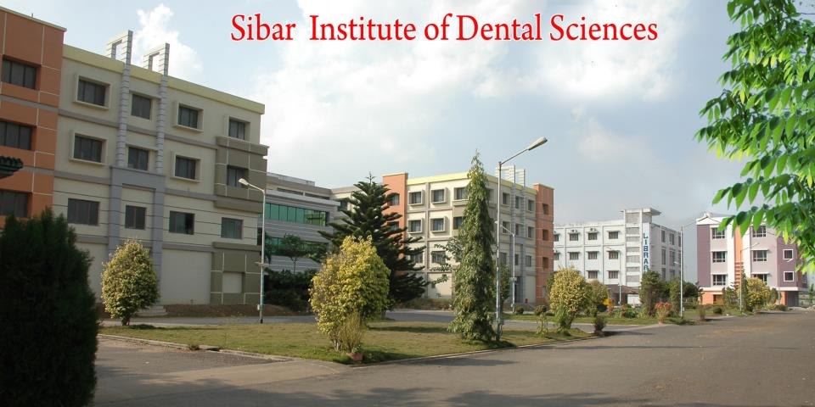
AGING AND PERIODONTIUM
DR. C. RAMYA NAGA SHIVANI, SENIOR LECTURER
SIBAR INSTITUTE OF DENTAL SCIENCES
DEPARTMENT OF PERIODONTICS

Slide 2
Effects of Aging on the Periodontium
Gingival Epithelium:
Thinning and decreased keratinization of epithelium
Increase in epithelial permeability to bacterial antigens
Decreased resistance to functional trauma
Flattening of retepegs and altered cell density
Migration of junctional epithelium apically causing gingival recession

Slide 3
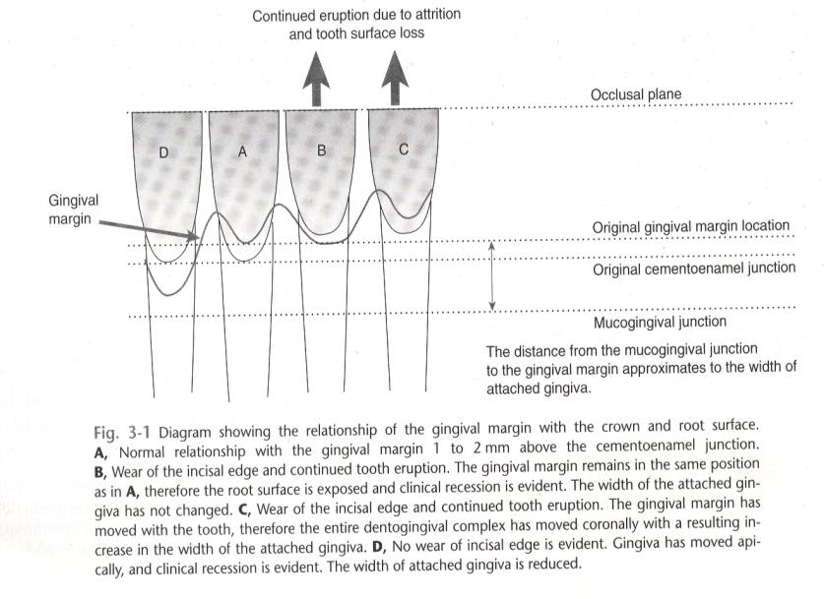
Relationship with gingival margin

Slide 4
GINGIVAL CONNECTIVE TISSUE
Coarser and denser gingival connective tissue
Qualitative and quantitative changes to collagen include
rate of conversion of soluble to insoluble collagen,
mechanical strength, and
denaturing temperature.
These results indicate increased collagen stabilization caused by changes in the macromolecular conformation.

Slide 5
PERIODONTAL LIGAMENT
Decreased numbers of fibroblasts
Decreased organic matrix production
Decreased epithelial cell rests
Increased amounts of elastic fiber
Changes in the width of periodontal ligament

Slide 6
CEMENTUM
Increase in cemental width
Increase may be 5 to 10 times with increasing age
Increase in width is greater apically and lingually

Slide 7
ALVEOLAR BONE
More irregular periodontal surface of bone
Less regular insertion of collagen fibers
Although age is a risk factor for the bone mass reductions in osteoporosis, it is not causative and therefore should be distinguished from physiologic aging processes.
Healing rate of bone in extraction sockets appears to be unaffected by increasing age.
Success of osseointegrated dental implants, which relies on intact bone healing responses, does not appear to be age related.

Slide 8
BACTERIAL PLAQUE
Dentogingival plaque accumulation increases with increase in age which is due to
Increase in hard tissue surface area as a result of gingival recession and
The surface characteristics of the exposed root surface as a substrate for plaque formation compared with enamel

Slide 9
For supragingival plaque, no real qualitative differences have been shown for plaque composition.
For subgingival plaque, increased numbers of enteric rods and pseudomonads in older adults. carriage of these species among older adults.
With increase in age, there is increased role for Porphyromonas gingivalis and a decreased role for Aggregatibacter actinomycetemcomitans

Slide 10
IMMUNE AND INFLAMMATORY RESPONSES
Age has been recognized as having much less effect in altering the host response
Differences between young and older individuals can be demonstrated for T and B cells, cytokines, and natural killer cells but not for polymorphonuclear cells and macrophage activity.

Slide 11
Effects of Aging on the Progression of Periodontal Diseases
Older individuals demonstrated a greater inflammatory response
Age is inevitably associated with an increased loss of connective tissue attachment. This is due to cumulative exposure to a number of potentially destructive processes. These exposures might include plaque-associated periodontitis, chronic mechanical trauma from tooth brushing, iatrogenic damage from unfavorable restorative procedures.

Slide 12
Age is not a true risk factor but a background or associated factor for periodontitis.
A risk factor is defined as “any characteristic, behaviour, or exposure with an association to a particular disease.
Some risk factors, can be modified such as smoking or improved oral hygiene … while other factors cannot be modified, such as geneticfactors
Smoking and baseline attachment level of 6 mm or more were significantly associated with the disease progression.

Slide 13
Aging and the Response to Treatment of the Periodontium
The successful treatment of periodontitis requires both meticulous home-care plaque control by the patient and meticulous supragingival and subgingival debridement by the therapist.
Without effective periodontal therapy, progression of diseases might be faster with increasing age.

