Slide 1

ROTARY INSTRUMENTS IN OPERATIVE DETISTRY
SIBAR INSTITUTE OF DENTAL SCIENCES,GUNTUR
DEPARTMENT OF CONSERVATIVE
DENTISTRY AND ENDODONTICS
Dr. V. SUJANA
PROFESSOR

Slide 2
Contents:
Introduction
Definition
History
Handpieces
-Parts
-Classification
-Criteria to evaluate hand pieces
-High speed and low speed hand pieces (advs,disadvs)
-Coolant spray systems
-Sterilization

Slide 3
Dental burs
-Parts
-Classification
-Modifications in bur design
-Design of dental bur
-Significance of bur design
-Cutting mechanism of dental bur
Diamond abrasives
-Parts
-Classification
-Cutting mechanism of diamond abrasives
Recommendations for cutting(dental burs and abrasives)

Slide 4
Hazards with rotary cutting instruments
Care with rotary cutting instruments
Various speeds in cavity preparation

Slide 5
Introduction
Most cavity preparations require the use of both rotary and hand instruments.
Rotary burs or diamond points are used for cavity preparation and fine refinement of cavity while hand cutting instruments are used to produce intricate details in the cavity preparation and to insert and finish the restorative material.

Slide 6
Definition
The term rotary instruments in dentistry refers to a group of instruments that turn on an axis to perform work such as cutting, abrading, finishing or polishing tooth or restorative materials.

Slide 7
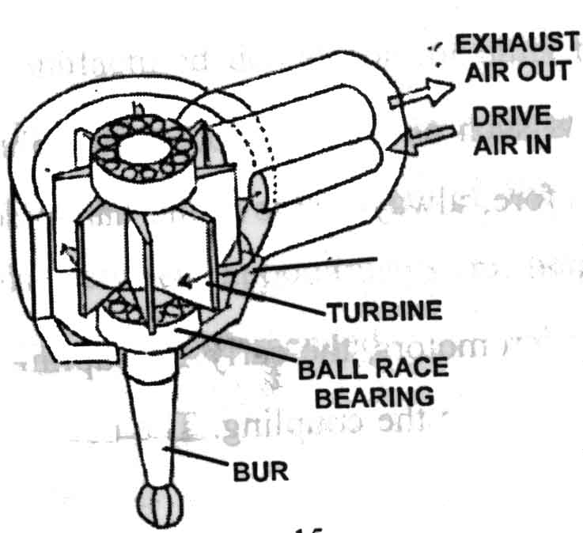
Figure 1
Figure 3
Figure 2

Slide 8
Description of rotary cutting instruments
Handpieces: Power devices
Burs or Diamond abrasives: Cutting tools

Slide 9
Handpieces
A device that holds and transmits power to the rotating instrument.
It helps to position and control the rotating instrument intraorally.

Slide 10
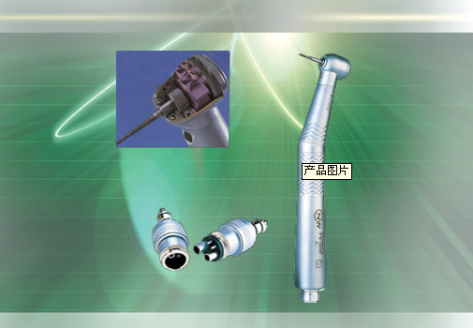
Parts of Dental Hand Piece
Head – the head is the end of the hand piece that holds the rotary instruments,such as burs.
Shank – the shank is the handle portion of the hand piece.
Connecting end – the connecting end is where the hand piece attaches to the power source of the motor.

Slide 11
Classification of Handpieces
1)According to Driving mechanism
  Gear driven hand piece
  Water driven hand piece
  Belt driven hand piece
  Air driven hand piece
  2) Depending upon Angulations
  Straight hand piece
  Contra angled hand piece

Slide 12
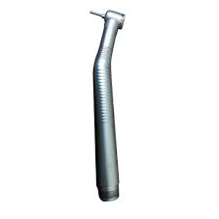
Air driven handpiece:
A small compact unit consists of :
Handpiece,
Control box,
Foot control &
Various connector hoses.
Notes:
When the foot control is activated, compressed air flows through the control box and is carried by flexible hose to the back of the handpiece.
From here, the air is directed to the head of the handpiece and is blown against the blades of a small turbine to produce rotation while the greater part is exhausted at the back of the handpiece or returned to the control box.

Slide 13
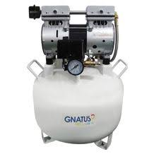
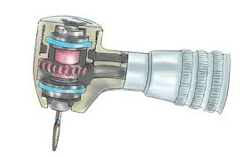
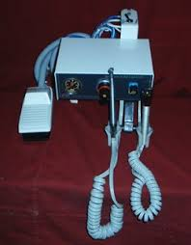
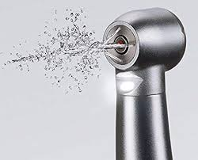
Airotor functioning
Air compressor
Control box
Water spray

Slide 14
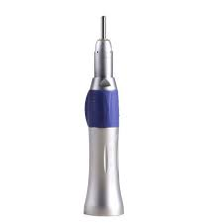
Depending upon Angulations:
Straight handpiece:
Here the long axis of the bur is the same as the long axis of the handpiece.
Laboratory work

Slide 15
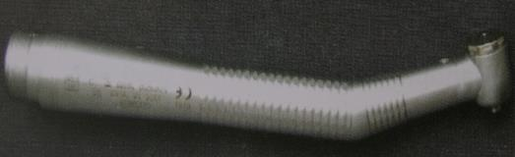
b) Contra-angle handpiece:-
It is the primary hand piece used in the mouth.
The head of the hand piece angled away from, then back toward , the long axis of the handle.
This design brings the head of the bur close to the long axis of the handle of the hand piece .
Balance – Stabilize handpiece
Improve access & visibility

Slide 16
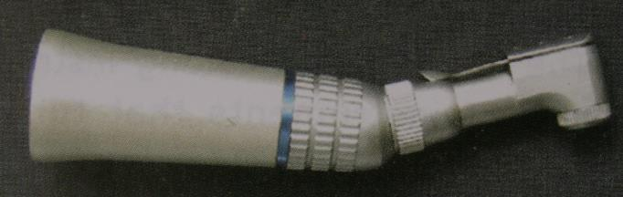
Contra angle handpieces may be of 2 types:-
i) Micromotor handpiece:
Works on : electric micromotor
speed ranges between 500- 50,000 rpm (low speed)
Higher torque
Uses: Used for refining of cavity preparation ,finishing and polishing of restorations in operative dentistry.

Slide 17
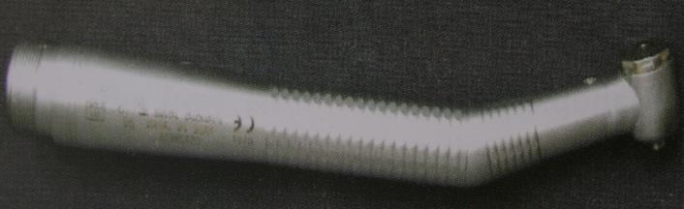
ii) Airotor handpiece
are connected to the air water line of the dental unit & are activated by compressed air.
Speed range is above 200,000 rpm(high speed).
low torque.
Flow through system - direct air water spray at the cutting head of the bur which dissipates the heat generated during cutting action.

Slide 18
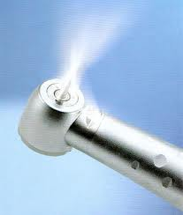
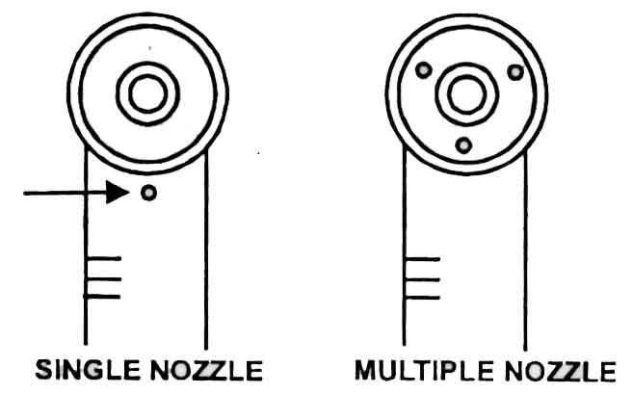
COOLANT SPRAY SYSTEMS

Slide 19

Airotor handpiece
USES:

Slide 20
Head sizes

Slide 21
Criteria to evaluate the handpiece
Friction
Speed and Torque
Vibration

Slide 22
FRICTION
Will occur in the moving parts of a hand piece especially the turbine.
If the heat from friction is not prevented ,the hand piece will not be suitable for dental use.
For this reason bearings are used: ball bearings, needle bearings, glass and resin bearings etc.

Slide 23
Speed:
Speed is defined as number of revolutions per minute(RPM). Or
Number of times a rotating instrument such as bur will make full turn during a minute.
Speed is inversely proportional to torque.

Slide 24
TORQUE
Torque is turning movement of instrument.
Is the ability of hand piece to withstand lateral pressure on the revolving tool without decreasing the speed or its cutting efficiency.
It is more efficient to cut hard materials (enamel,porcelain&metal) at high speeds with low torque and soft carious dentin at low speeds with high torque.

Slide 25
VIBRATION
Is a deleterious aspect of rotary – care is taken.
Excessive wear of the turbine bearings
Bur is bent
will cause eccentric running which creates substantial vibration.

Slide 26
LOW SPEED HAND PIECE | HIGH SPEED HAND PIECE
Uses: -refining of cavity preparations | Uses : -Used for cavity preparations -Crown preparations
-used for finishing of restorations | -Used for removal of old restorations
 | Advantages:-Removes tooth structure with less pressure application
Advantages:-At low speed range, tactile sensation is better | -operator has better control
 | -work is done faster
 | -instruments lasts longer
 | -Patients comfort due to less vibration, less heat generation
 | -Several cavity can be prepared in single visit

Slide 27
LOW SPEED HAND PIECE | HIGH SPEED HAND PIECE
Disadvantages: -Traumatic for both patient & dentist | Disadvantages: -Tend to overcut
-Ineffective & time consuming | -Decrease visibility
-Requires heavy force application leading to heat production | -Decreased tactile sensation
-At low speeds burs tend to roll out of the preparation | -Greater care required
-carbide burs at low speed tends to break | -mechanical injury to soft tissues.
Ex:Micromotor | Ex:Airotor

Slide 28
STERILIZATION
The hand piece of the rotary instruments are used in the mouth must be cleaned and sterilized for reuse.
Sterilized by:
- Autoclave: steam under pressure
  -Chemical vapour pressure sterilization
  -Ethylene oxide (Etox) gas.

Slide 29
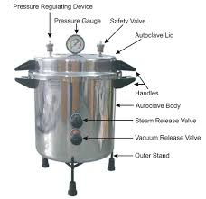
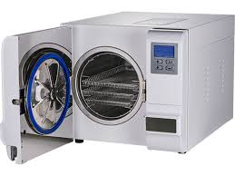
Steam pressure sterilization (Autoclave)
Sterilization cycle of autoclave:
High pressure saturated steam
121·c, 15 lbs,15 minutes : steam autoclave
132·c, 30 lbs,8-10 minutes: Wrapped instruments
132·c, 30 lbs,3 minutes: Unwrapped instruments

Slide 30
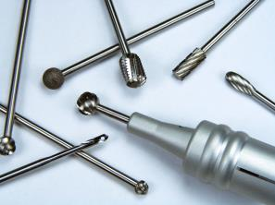
Dental Burs
A bur is a rotary cutting instrument which has a bladed cutting head.
USES:
-cavity preparation ,
-finishing of restorations,
-caries removal.

Slide 31
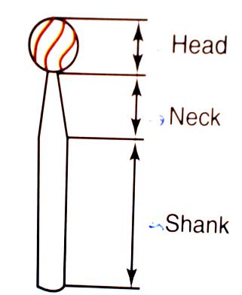
PARTS OF A BUR
Shank
-Fits into the handpiece
-accepts rotary motion
Neck
-connects shank to head of the bur
-transmits rotational forces to the head.
Head
-working end of the bur
-various sizes, shapes & materials.

Slide 32
Classification of dental burs:
1.According to shank design:
Straight handpiece shank.
Latch type angle handpiece shank.
Friction grip angle handpiece shank.
2.According to material of manufacture:
Stainless steel.
Tungsten carbide.
3.According to shape of bur head:
Round .
Straight fissure.
Inverted cone.
Tapered fissure.
Pear shaped.
4.According to size of bur :
Manufacturer’s number: Head diameter.

Slide 33
5.According to their use:
a) Cutting burs
b) Finishing & polishing burs

Slide 34
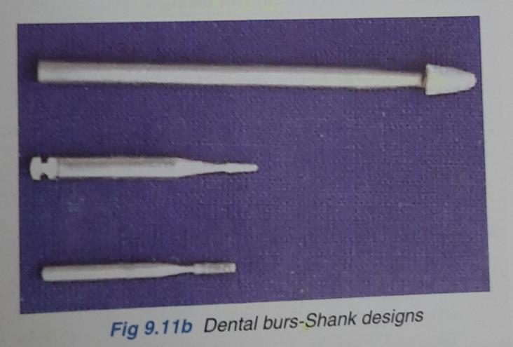
Shank design
Notes:
1.Straight handpiece shank
2. Latch type angle handpiece shank
3. Friction grip angle handpiece shank

Slide 35
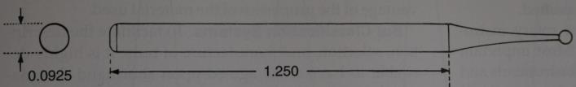
Shank Design:
Straight handpiece shank :-
Is a simple cylinder held in the straight hand piece by a metal chuck.
Commonly used for finishing & polishing completed restorations in lab.

Slide 36
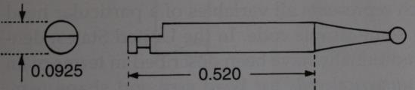
Latch type angle handpiece shank:
Cylindrical in shape but posterior portion of the shank is flattened on one side.
Shank fits into a D shaped socket at the bottom of the bur & bur is retained by retaining latch.
Used in contr-angled micromotor handpiece.
Shorter length permits access to posterior regions of mouth.
Used at low speeds for refining cavity, finishing & polishing of restorations.

Slide 37
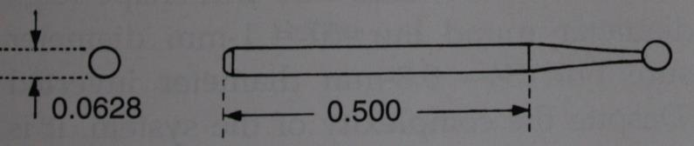
Friction grip angle handpiece shank:-
Used with airotor handpieces.
Shank is simple cylinder held in the handpiece by friction between the shank & metal chuck.
smaller in dimensions than latch type instruments.
good access to posterior regions of mouth

Slide 38
Material of manufacture:
Stainless steel burs:
Cut dentin at slow speeds but dull rapidly at higher speeds.
When dull, the reduced cutting effectiveness creates increased heat and vibration.
USE: - Removing soft carious dentin
- Finishing procedures.
Notes:
- not effective in cutting enamel.

Slide 39
Tungsten Carbide burs:-
Perform better at all speeds & their superiority is greatest at high speeds.
Carbide is stiffer & harder than steel therefore does not dull rapidly
But more brittle & susceptible to fracture when subjected to sudden blow or shock.

Slide 40
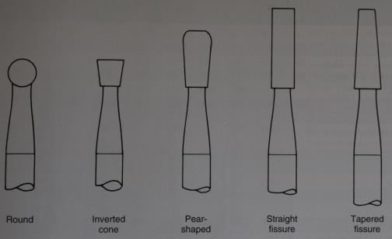
Bur shapes:
Refers to the contour of the bur head.
Round, straight fissure, inverted cone, tapered fissure & pear shaped.

Slide 41
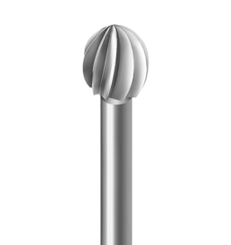
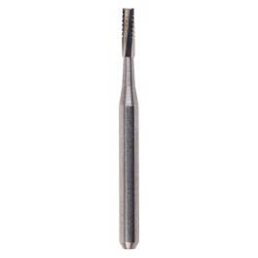
i) Round bur :-
Spherical head shape.
Use –
-Initial entry into tooth
-Placement of retentive grooves & caries removal.
ii) Straight fissure bur :-
elongated cylindrical head.
Use - Preparing walls for amalgam cavity preparation

Slide 42
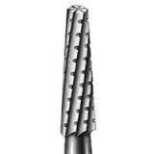
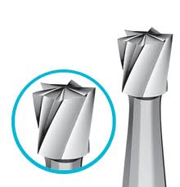
iii) Tapered fissure bur :-
tapered cone shaped head.
Use-
-Tooth preparation for indirect restoration. eg. : Inlays.
-Crown preparation.
iv) Inverted cone bur :-
rapidly tapered cone with the apex of cone directed towards the bur shank.
Use- To provide undercuts for amalgam cavity preparations.

Slide 43
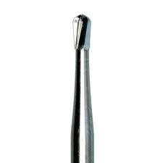
V) Pear shaped bur :-
Elongated inverted cone bur with rounded edges
USE-
-Normal length bur is used for class I tooth preparation for DFG.
-Long length bur is used for amalgam cavity preparations with rounded internal angles.

Slide 44
Bur sizes:
Represents diameter of head.
Standard bur head sizes
Head shapes |  |  | Head diameter (mm)
 |  |  | 0.5 | 0.6 | 0.8 | 1.0 | 1.2 | 1.4
Round Inverted cone Straight fissure Tapered fissure |  |  | 1/4 | 1/2 | 1 | 2 | 3 | 4
 |  |  |  | 33 1/2 | 34 | 35 | 36 | 37
 |  |  |  | 55 1/2 | 56 | 57 | 58 | 59
 |  |  |  |  |  | 700 | 701

Slide 45
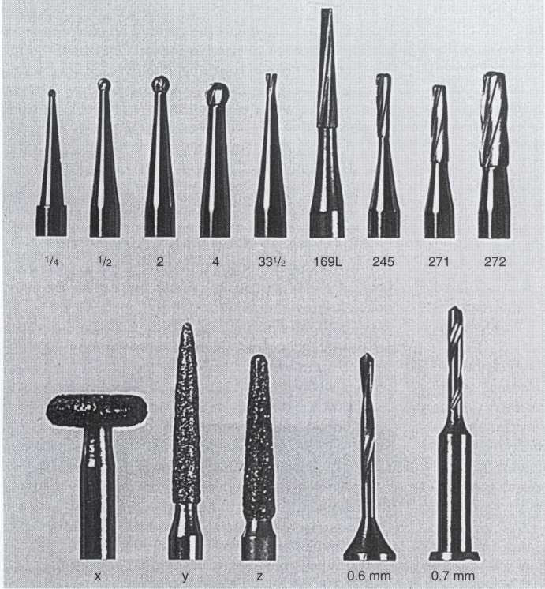

Slide 46
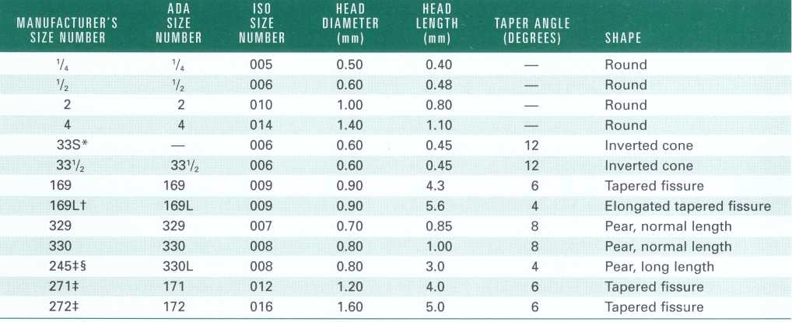

Slide 47
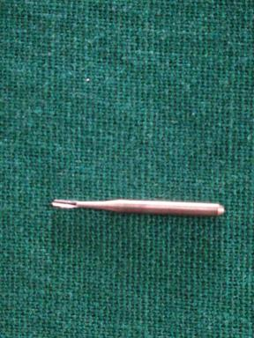

Burs used in amalgam cavity preparations
No.245 bur:
Shape:long length Pear shaped
Head diameter:0.8mm
Head length:3mm
Used in airotor
Uses: for amalgam
cavity preparation with
rounded internal line angles
No.245 bur

Slide 48
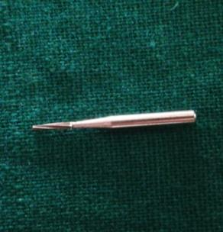

No.169L bur:
Shape: Elongated tapered fissure
Head diameter:0.9mm
Head length:5.6mm
Used in airotor
Uses: for placing retentive grooves(locks) in axio facial & axio lingual line angles in class II amalgam cavity preparations.
No.169L bur

Slide 49
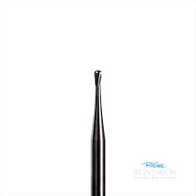
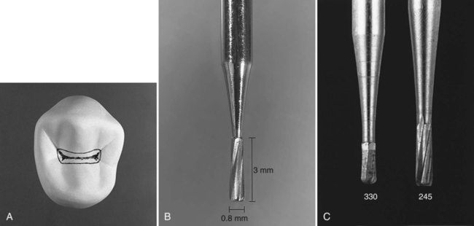
No 330 bur
No 330 bur:
Shape: Pear shaped(normal
length)
Head diameter: 0.8mm
Head length: 1mm
Used in airotor
Uses: Conservative class I cavity
preparations for amalgam.

Slide 50

No ¼ round bur:
Shape: Round
Head diameter: 0.5mm
Head length: 0.4mm
Used in airotor
Uses: for placing retentive
grooves(locks) in in axio facial &
axio lingual line angles in class II amalgam
cavity preparations.

Slide 51

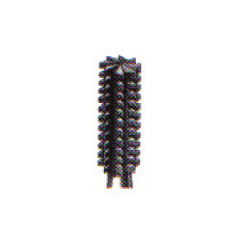
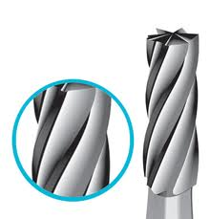
Patterns of blades
Spiral blades
Crosscuts
Axial blades
Notes:
Spiral angle:Burs with small spiral angles preferred at high speed.Produces smooth wall.
Crosscuts:Notches in blade edges.Necessary at low speeds to improve cutting efficiency of bur. But, at high speeds produce rough surfaces…

Slide 52
Modifications in Bur Design :-
Large diameter carbide burs have been replaced by small diameter burs – effective at high speeds.
3 major changes:
Reduced use of crosscuts burs
Extended head lengths on fissure burs
c) Rounding of sharp tip angles
Proposed by Markley and Sockwell
Lower stress

Slide 53
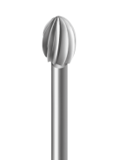
Design of dental burs
Blades: even no.
Cavity preparation: 6,8 or 10 blades
Finishing:12-40 blades
Bur Blades:
Uniformly spaced projections on the bur head
which terminates in the cutting edge.
Bur blade has 2 surfaces: -
a) Blade face / Rake face
b) Blade back / Clearance face
a) Rake face : is the surface of the bur blade on the leading edge of bur.
b) Clearance face: is the surface of bur blade on the trailing edge of the bur.

Slide 54
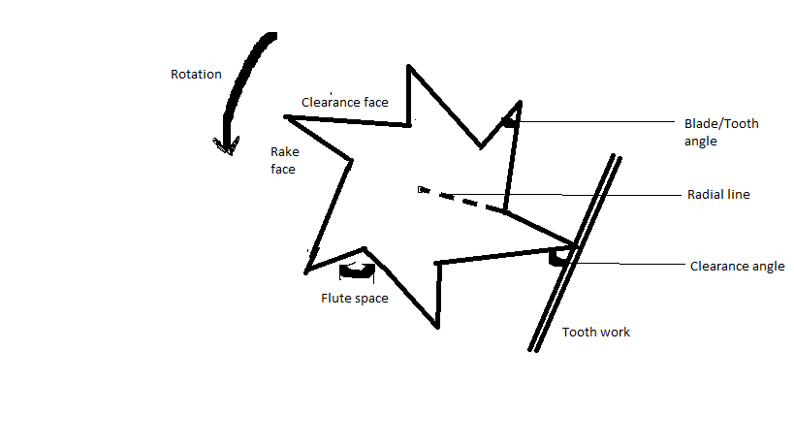
or edge
/

Slide 55
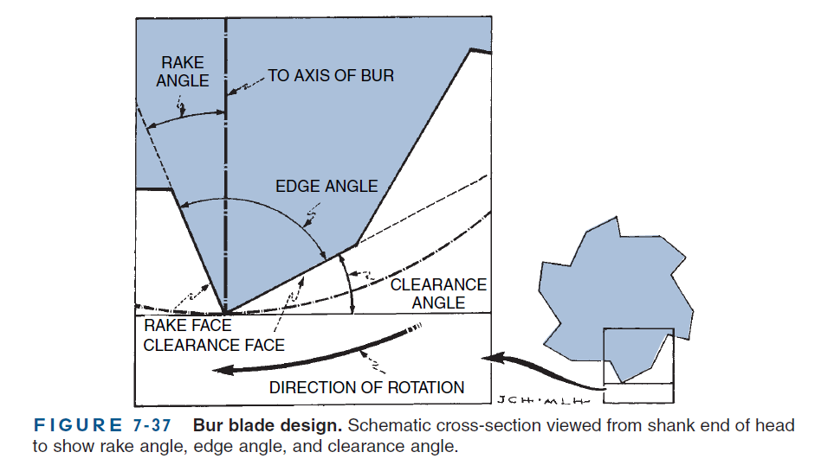

Slide 56
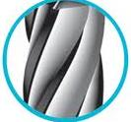
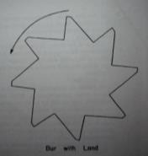
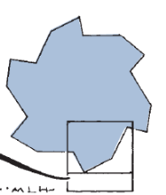
Flute space:-
Depressed areas in between bur blades.
Radial line :- is the line connecting the centre of the bur & the blade.
Land:- is the plane surface immediately following the cutting edge
Flute space
Land
Radial line

Slide 57
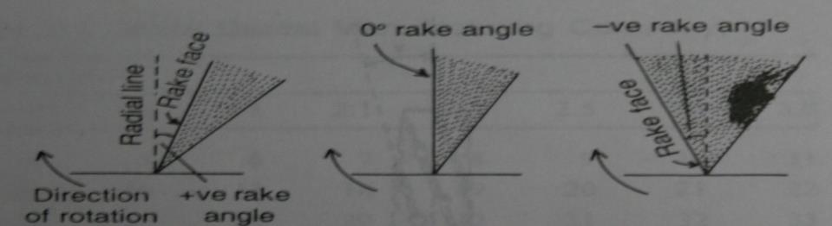
Rake Angle :-
- is the angle between the rake face & the radial line
- It can be positive , negative or a zero rake angle.
Negative - when rake face is ahead of the radial line.
Positive - when rake face trails the radial line.
Zero - when rake face & radial line coincide with each other.

Slide 58
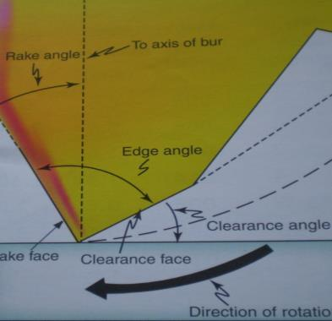
Clearance Angle :-
The angle between the clearance face & the work (ie,Tooth) .
If Land present then CA divided into:
Primary clearance angle:
Angle the land makes with
the work.
Secondary clearance angle:
Angle between back of the bur edge and the work.
Sec
CA
Primary
R

Slide 59
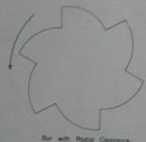
CF
Radial clearance:-
If the clearance face is curved, it is known as radial clearance.
Blade/edge angle:-
Angle between the rake face and clearance face.
Radial clearance
RF

Slide 60
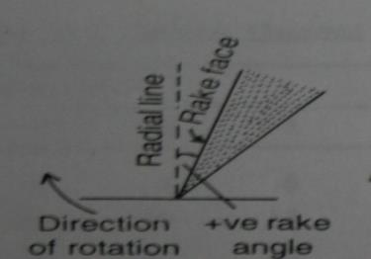
Significance of bur design
The rake angle is the most important design
feature of the bur blade
Positive rake angle –
Adv: increases the cutting efficiency
Disadv:
a) It tends to clog the cut debris in the flute space.
b) reduces the bulk of the bur blade and so more prone to wear & fracture.

Slide 61
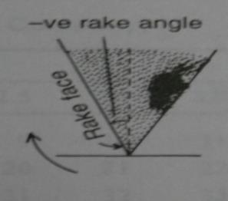
Negative rake angle –
Adv:
Produces smaller chip that moves away from the blade.
Reduces fracture of the cutting edge thus increases the life of the bur.
Notes:
-ote: Carbide burs are made with slight –ve rake angle.

Slide 62
Significance of Clearance angle:
Clearance angle provides a stop to prevent the bur edge from digging into the tooth and provide adequate chip space for clearing the debris.
Large clearance angle result in less rapid dulling of the bur.
An increase in clearance angle causes decrease in edge angle.

Slide 63
Significance of Radial Clearance:
Reduce clogging of the debris and at the same time cutting efficiency of bur is maintained.
Notes:
Clearance faces are curved (radial clearance) or provided with land to allow better clearance space.

Slide 64
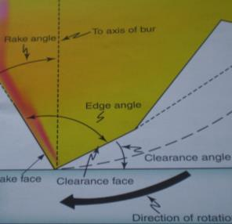
Blade/edge angle when increased reinforces the cutting edge & decreases the chances of the blade edge to fracture.
Burs with blade angle = 90°
As carbide is brittle, it requires greater edge angles to minimize fracture.
Fracture of cutting edge

Slide 65
Neck diameter should be adequate.
-good visibility
-resist lateral forces.

Slide 66
Concentricity and Run-out
Concentricity:
-Symmetry of bur head ( bur is static).
-indicates blades are uniform or not.
Run-out:
-Maximum displacement of bur head from its axis of rotation (bur is in motion).
-occurs when neck is bent or bur head is not in line with axis of bur or bur is not held straight in handpiece chuck.
-it increases vibrations of bur, more heat, excessive removal of tooth structure.
Note: Average clinically accepted Run out is :0.023 mm

Slide 67
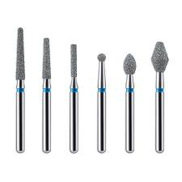
DIAMOND ABRASIVES
These are the second major category of a rotary cutting instruments.
Similar to burs but have diamond abrasives held by metallic bonding on a steel blank instead of blades.
Diamonds (natural or synthetic) crushed to a powder with particles of different sizes which are attached to metal blank.

Slide 68
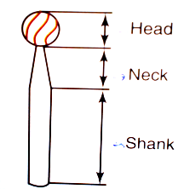
Parts:
-Shank
-Neck
-Head
Advantages:
-Greater resistance to abrasion
-lesser heat generation
-more efficient in cutting enamel .

Slide 69
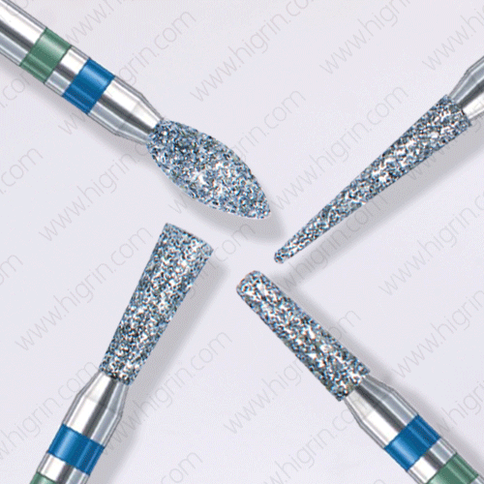

Classification of Dental Abrasives
Shank design: Straight
Latch type
Friction grip
Head shape: Round, Inverted cone, Straight fissure, tapered fissure, wheel, flame, football, needle.
Particle sizes:
Coarse(green): 125-150µm
Medium(blue): 88-125µm
Fine(red): 60-74µm
Extrafine(yellow): 38-44µm.

Slide 70
Recommendations for cutting: Dental burs & abrasives
High speed contra-angle airotor handpiece with adequate air-water spray.
Light pressure
Uses:Tungsten carbide burs: initial punch cuts,cavity preparation for amalgam ,placing secondary retentive features.
Uses:Diamond abrasives: for extensive preparations, extra-coronal preparations(involves more enamel),placing bevels & enameloplasty.
Uses:Stailess steel burs: Soft infected dentin removed with steel burs at slow speed
Notes:
St steel burs:(good tactile sense, not have side cutting effect).

Slide 71
DENTAL BURS | DIAMOND POINTS
-These are bladed rotary cutting instruments | -They are either natural or synthetic diamond chips employed to the bur.
-The blades are sharp and are used for cutting . | -Cutting efficiency depends on grit size, distribution of the abrasive particles
Uses: initial punch cuts,cavity preparation for amalgam ,placing secondary retentive features, removal of old restorations. -efficient in cutting dentin | Uses:for extensive preparations, extra-coronal preparations,placing bevels & enameloplasty. -efficient in cutting enamel
-leaves as rough surface after cutting | -leaves as much smoother surface than a dental bur
-lasts longer | -life lesser compared to dental bur

Slide 72
Hazards with rotary cutting instruments
Pulpal damage:
High speed (without coolant): Mechanical vibrations or heat generation.
-Dessication or Loss of dentinal fluid
-Transection of odontoblastic processes.
RDT>2mm:Less damage
More heat: - Steel burs cut inefficiently
- Diamonds & carbides which are dull or clogged with debris.

Slide 73
Damage to soft tissues:
-Improper care: lips,tongue,cheeks of patient may be injured.
-Could be due to lack of access, visibility, sudden reflex movement by patient, inattention of operator.
Damage to eyes:
-Airborne particles such as bits of old restorations, tooth debris discharged at high speed from patients mouth.
-matrix failure of molded abrasive cutting instruments.

Slide 74
Ear dangers:
-Handpiece wear and eccentric rotating instruments cause increased noise.
-Noise level beyond 75db- hearing damage

Slide 75
Inhalation dangers:
-Aerosols ,vapours(mercury vapours) , tooth debris, micro organisms & restorative materials created by cutting instruments can be inhaled by patient or dentist.
-Irritation and tissue reaction in lungs.

Slide 76
CARE WITH ROTARY CUTTING INSTRUMENT:
Good access and visibility-rubber dam
Proper finger rests
Avoid excessive removal of tooth structure
Deep caries removal - slow speed round steel burs with intermittent light pressure to protect pulp
Use Sharp burs. Avoid dull or clogged burs.
Use air-water spray: clears operating site, lubricates, cleans & cools cutting instrument thus increasing its cutting efficiency and life.
Care for adjacent teeth & gingiva: use retraction, rubber dam & wedge.
Protective glasses & face shields
Ear plugs,anti noise devices.
Disposable masks (filter out bacteria),rubberdam,high volume evacuation-minimize inhalation of vapours.

Slide 77
Various speeds in cavity preparation
SPEED:
- It is defined as the distance traveled by an object during an unit time.
Unit: rpm
Notes:
Speed refers to magnitude of velocity without any direction of motion.

Slide 78
Classification:
According to Studervant:
Low/Slow speed: <12,000 rpm
Medium/Intermittent speed: 12,000-2,00,000rpm
High speed: >2,00,000rpm.
According to Marzouk:
Ultra low speed: 300-3000rpm
Low speed: 3000-6000rpm
Medium high speed: 20,000-45,000rpm
High speed: 42,000-1 lakh rpm
Ultra high speed: >1 lakh rpm
According to charbeneau:
Low speed: 10,000rpm
Increased high speed: 10,000-1,50,000rpm
Ultra speed: >1.5 lakh rpm

Slide 79
Low speed (<12,000rpm)
USES:
Caries excavation
Refining cavity preparation
Finishing and polishing restoration
ADVANTAGE:
Good tactile sense
DISADVANTAGES:
Cutting is inefficient
Time consuming
Needs heavy pressure-heat generation & vibrations
Bur life is reduced
Increased patient discomfort
Operator fatigue

Slide 80
Medium speed: 12,000-2,00,000rpm
USES:
Cavity preparation
Placing retentive grooves and bevels
Areas of limited visibility
ADVANTAGES:
Positive tactile sense
Controlled cutting of tooth structure
DISADVANTAGES:
Slower cavity preparation-Increases operator fatigue & patient discomfort
More heat production

Slide 81
High speed: >2,00,000rpm.
USES:
Most of cavity preparation
Removing old restorations
Tooth reduction for crown preparations.
ADVANTAGES:
Faster preparation – less pressure, heat & vibrations
Bur life enhanced
Operator ease, less apprehension for patient
DISDAVANTAGES:
Less tactile sense - over cutting possible
Iatral errors
Air water spray may impair visibility.

Slide 82
References:
Art & science of operative dentistry – Sturdevant’s
Textbook of operative dentistry – Vimal K Sikri
Textbook of operative dentistry – Ramya Raghu
Textbook of operative dentistry – Nisha Garg

Slide 83
THANK YOU

