Slide 1
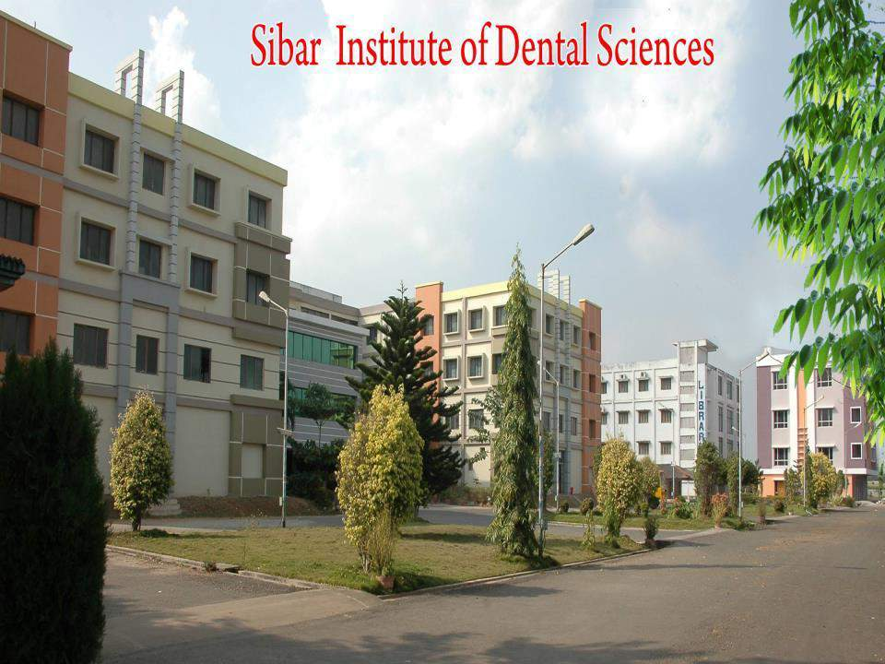
Department of pediatrics and preventive dentistry

Slide 2
Interceptive orthodontics

Slide 3

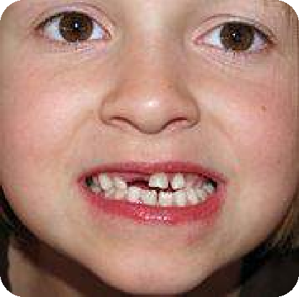
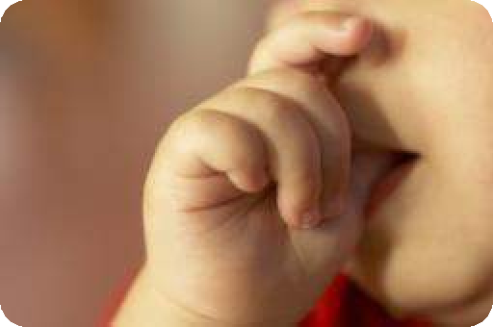


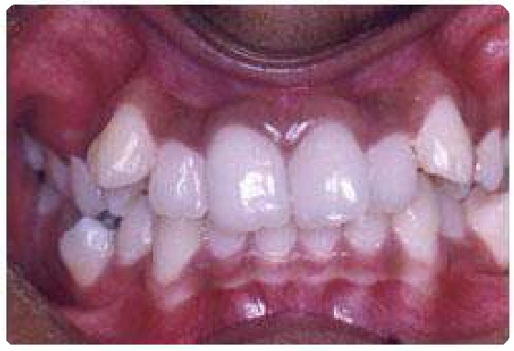
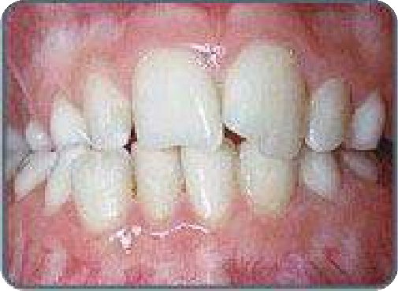



Slide 4




Preventive
Interceptive
Corrective

Slide 6
CONTENTS
Definitions
Indications of interceptive orthodontics
Steps in interceptive orthodontics
Serial extraction
Myofunctional appliances
  Oral screens
  Activator
  Bionator
  Twin block appliance
  Herbst appliance
  Jasper jumper
Pre orthodontic trainer
Muscle exercises
Removal of soft / hard tissue barriers
Conclusion
References

Slide 7
INTERCEPTIVE ORTHODONTICS
DEFINITION - AAO (1969)

Slide 8
“Interceptive orthodontics” basically refers to measures undertaken to prevent a potential malocclusion from progressing into a more severe One.
Is undertaken at a time when the malocclusion has already developed or still developing.
Procedures, are aimed at elimination of factors, that may lead to malocclusion.

Slide 9









Space regaining
Dev. Cross bite
Removal of barrier- eruption
Abnormal habits
Muscle exercises
Serial extraction
Interception of skeletal malrelation

Slide 10
INDICATIONS OF INTERCEPTION
AJO Jan 1998
Indications for early interceptive treatment:
Dental and/or skeletal class II
Dental and/or skeletal class III
Posterior or anterior cross bites.
Over Jet of >6mm.
Maxillary midface deficiency.
Moderate incisor crowding.
Ectopic eruptions.

Slide 11
HOW SAFE IS INTERCEPTIVE ORTHODONTICS ?
Reduces the incidence of premolar extraction.
Decreases extent of 2nd phase of ortho treatment.
Reduces need for surgical orthodontics.
Increases stability of transverse and antero-posterior dimension changes.
Increases long term stability of lower incisor alignment.
Reduces incidence of root resorption
Reduces incidence of mucogingival problems.
Reduces incidence of ectopic cuspid eruption.

Slide 12
SERIAL EXTRACTION
DEFINITION:
– Dewel (1967) :

Slide 13
SERIAL EXTRACTION
History:
Palsson & Bunon: (1743) : removal of one or more irregular teeth would improve the appearance of of the remainder.
Kjellgren (1929) : Serial extraction
Nance (1940) : Progressive Extraction
Hotz (1970) : Guidance of eruption
Nance - Father of serial extraction philosophy

Slide 14
DIAGNOSTIC RECORDS
Intra oral radiographs:
Panoramic radiograph
Cephalometric radiographs:
Facial Photographs:
Study models
Model analysis

Slide 15
Clinical analysis
Class I malocclusion are ideal for serial extractions.
The ideal conditions for serial extractions are:
  A severe hereditary tooth size/ jaw size discrepancy.
  Mesial step mixed dentition developing into a class I
permanent relationship.
  Minimal overjet and overbite relationship.
  Orthognathic facial pattern / Alveodental protrusion.

Slide 16
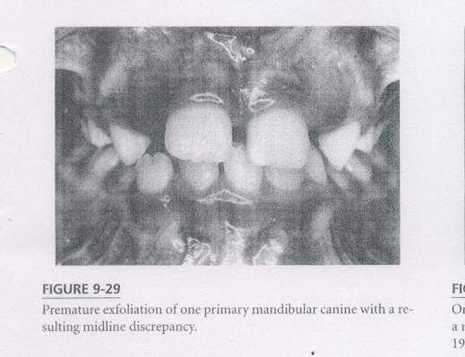
INDICATIONS
I: On the basis of genetically determined tooth size arch length discrepancy:
Midline line shift of mandibular Incisor due to displaced lateral Incisor.

Slide 17
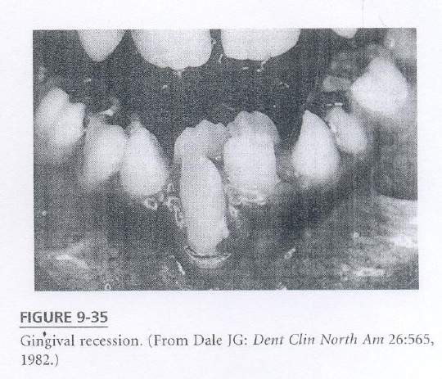
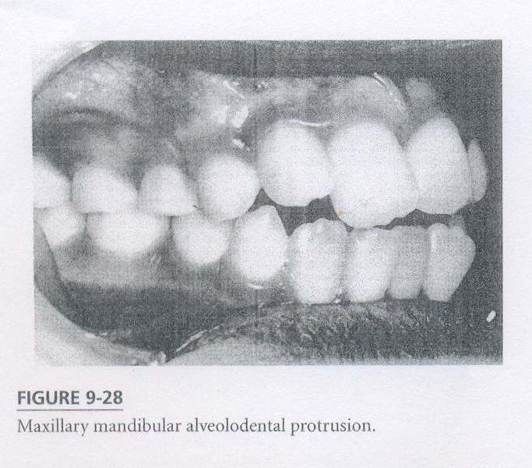
2. Gingival recession on a labially displaced incisor.
3. Crowded maxillary or mandibular teeth that are excessively inclined labially.

Slide 18
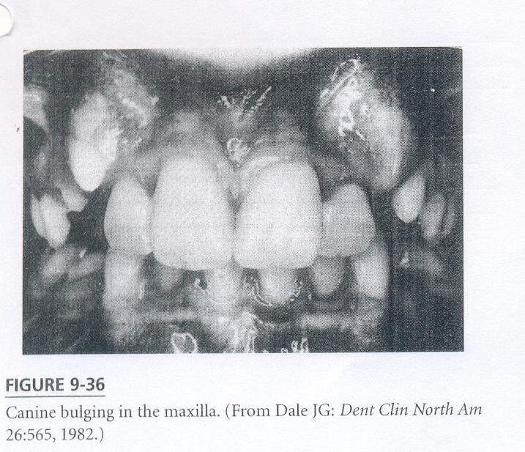
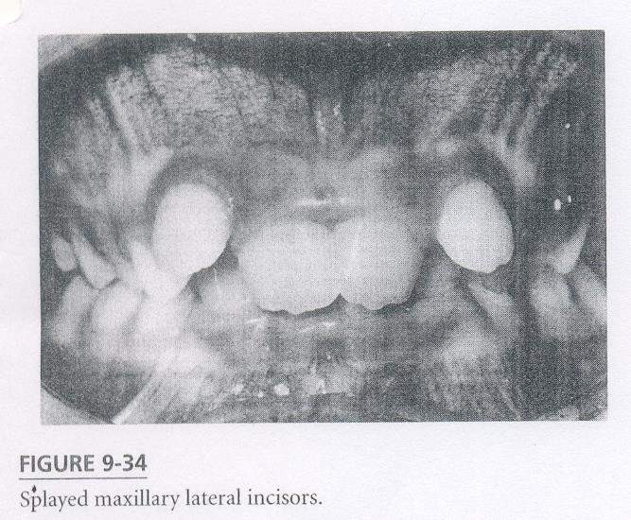

4. Labially but unerupted permanent canine that are extremely prominent.
5. Splayed out perm Max / Mandi Incisor due to crowded position of unerupted canines

Slide 19
Unusual shape, size and no of teeth.
Ectopic eruption of maxillary 1st molar
Premature loss of primary canine
Abnormal / pathological root resorption of primary canine.
Crowded anteriors

Slide 20
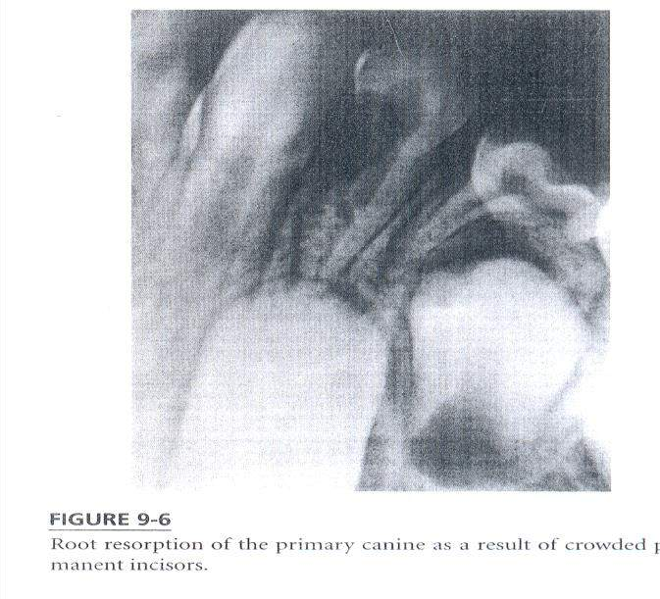
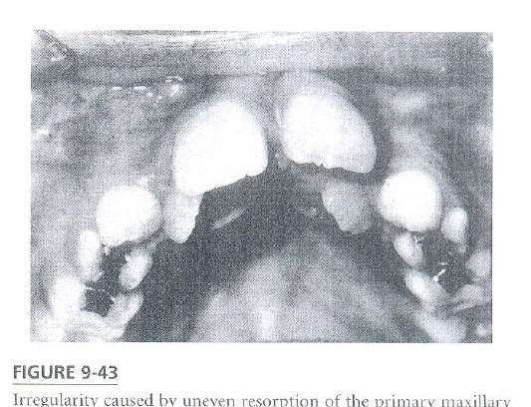
II : Indications due to loss of arch length
:
1. Unusual resorption pattern of certain primary teeth.
2. Aberrant eruption pattern of perm teeth

Slide 21
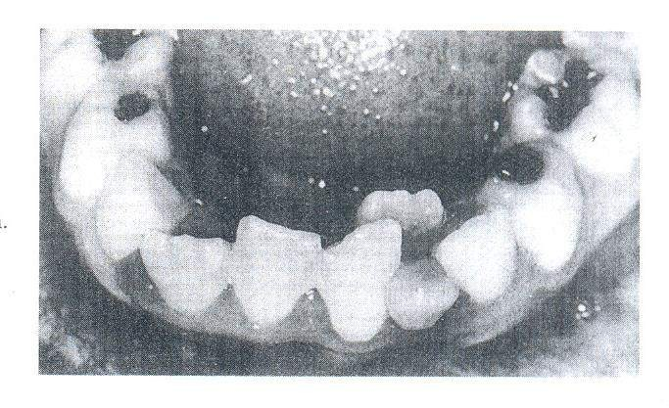
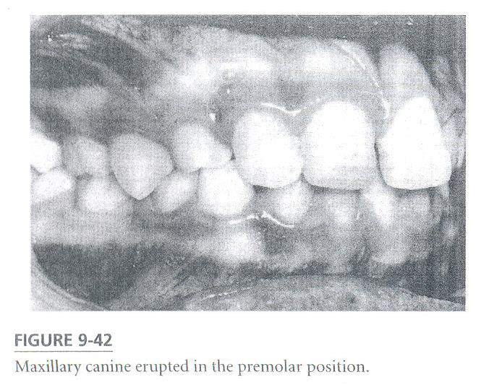
3. Prolonged retention of primary teeth / ankylosis
4. Transposition

Slide 22
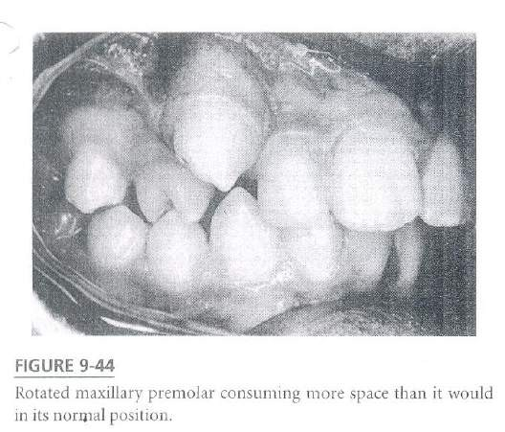
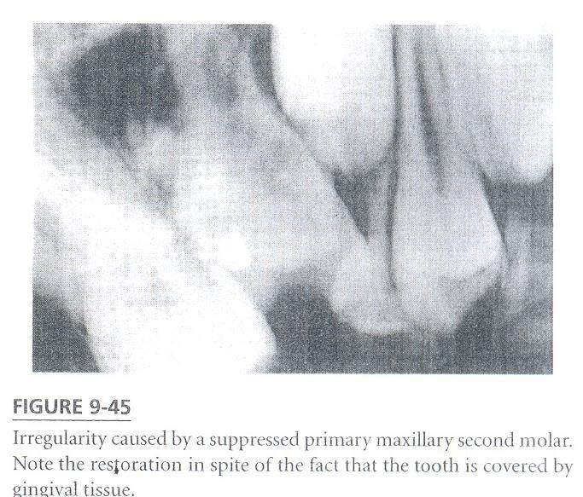
5. Rotation of teeth
6. Suppression of primary teeth

Slide 23
CONTRAINDICATIONS
Skeletal Class II and Class III malformation.
Spaced dentitions
Anodontia / oligodontia
Open bite & deep bite
Midline diastema
Class I malocclusions with minimal space def.
Unerupted malformed teeth Eg: dilacerations
Mild disproportions b /w arch length & tooth material that can be treated by proximal stripping.

Slide 24
ADVERSE EFFECTS
First (Dewel-1967), tendency of developing anterior deep bite following loss of posterior teeth.

Slide 25
Second side effect is failure of premolars to reach their normal occlusal level.

Slide 26
Third : Effect of Serial Extraction has on facial esthetics.
The over emphasis on straight profile has led to extraction of teeth in mixed dentition because the lips appear to be prominent.
Its normal for lip line to have greater convexity during early transitional stages than it will have in mature dentition.
Lip fullness is not a reliable criterion for extraction in early mixed dentition.
The straight profile must be viewed with greater concern because early removal of premolars is likely to cause a concave profile.

Slide 27
Fourth : Nasal development is another
unpredictable hazard
Unrestrained extraction will accentuate nose prominence by reducing skeletal development in dental area.
Moreover growth of chin is unpredictable. If growth in nose and chin exceeds normal range a concave profile is obtained.

Slide 28
ADVANTAGES OF SERIAL EXTRACTION
Removal of deciduous canines allow spontaneous alignment of crowded incisors which simplify later appliance treatment.
Extraction of first premolar before crowding allows permanent canines to drift into natural alignment without any appliance.
It lessens the period of future appliance therapy and cost of treatment.

Slide 29
Selection of teeth for extraction:
When should the teeth be extracted?
Which teeth should be extracted first, the deciduous canines or the 1st molars to allow early eruption of permanent teeth?
Will the extractions prevent incisors and canines form assuming
positions of extreme irregularity?
Is it worth to intercept in early mixed dentition crowding instead of waiting till all the permanent teeth erupt ?

Slide 30
FACTORS IN DECIDING THE OPTIMAL TIME FOR REMOVAL OF TEETH :
Effect of extraction of primary tooth on the eruption of its permanent successors.
The amount of root formation at the time of emergence.
The length of time for root development.

Slide 31
Important note
Serial Extraction is a continuing program of orthodontic guidance over a period of 4-5 years.
Serial Extraction is not sure cut procedure.
Proper knowledge of anatomy of teeth and a
radiograph is a must….…..

Slide 32
THREE STAGES IN SERIAL EXTRACTION PROCEDURE
Three stages in serial extraction procedure:
  Removal of deciduous canines. (c)
  Removal of deciduous first molars. (D)
  Removal of erupting 1st premolars.(4)

Slide 33
TECHNIQUES OF SERIAL EXTRACTION
Dewel’s Method: (CD4)
  There are 3 stages in Serial Extraction Therapy:
    Removal of deciduous canines:
    Removal of first deciduous molars:
    Removal of erupting premolars:

Slide 34
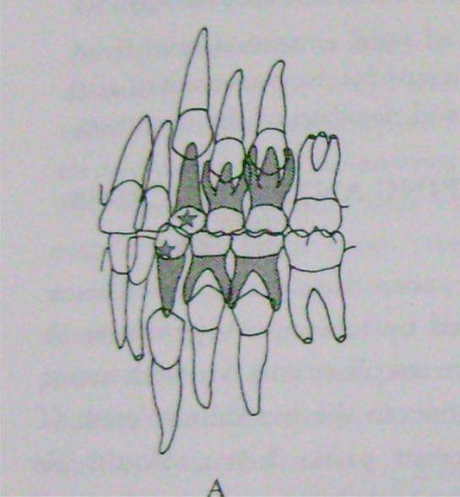
REMOVAL OF DECIDUOUS CANINES
Extraction 8-9 yrs.
To permit eruption & optimal alignment of lateral incisors.
Prevent maxillary lateral incisor in lingual cross bite.
Improvement in the position of central incisor.

Slide 35
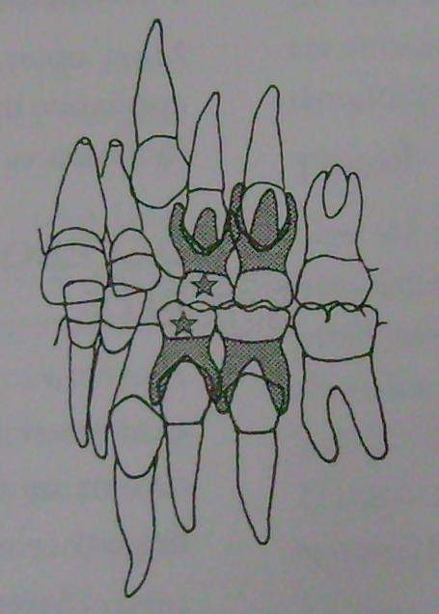
Removal of primary 1st molars
Permit canine to drift distally
into the extracted space.
Earlier eruption of premolars
Slight improvement in anterior crowding

Slide 36
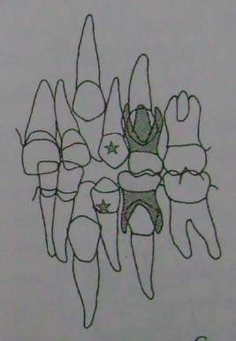
REMOVAL OF ERUPTING PREMOLARS
The erupting premolar, once out of gingival margin is extracted.
If it is carried out correctly and if timing is right it is most exciting to see the bulging canine eminences move distally on their own into the premolar extraction sites.
This is more frequently seen in max than in man arch.

Slide 37
TWEED’S SEQUENCE OF
EXTRACTION
Sequence is :
  At approximately 8 years all deciduous 1st molars are extracted. It is preferable to maintain in deciduous canines to retard eruption of permanent canines.
  4 –10 months following extraction of deciduous 1st molars, the 1st premolar will have erupted upto gingival level. Do not extract till the crown are above the alveolar bone.

Slide 38
– Extraction of 1st premolar and deciduous canines should be, done 4-6 months prior to eruption of permanent canines

Slide 39
ENUCLEATING
WEBER AND JOONDEPH IN 1975
In mandibular arch 3 usually erupts before 4. So if it is found that the 3 is erupting labially then premolar may be enucleated. (Diagnosis for 3 erupting labially – gingival recession of anterior and canine bulge on labial surface).
Advantages of enucleation:
  Fewer visits to the orthodontics therefore decrease in trauma and emotional disturbance.
  Fewer follow up visits.
  In severe maxillary anterior crowding and excessive protrusion, enucleation provides space for retraction of 1 and 2 proper eruption of 3.
  Retraction of 3 easier.
  In crowded high angle cases, enucleation especially of 5 causes mesial migration of posterior segment.

Slide 40
JOONDEPH AND RIEDEL IN 1976
In cases where impaction of 5 is anticipated.
Early extraction of 5 can be considered in patients with,
  Minimal crowding in anterior segment. Arch length deficiency present in posterior segment.
  Presence of posterior arch length deficiency and 7 and 8 are mesially positioned. The 6 cannot be distilised without impacting 7.
  Absence of skeletal or dental protrusion: The extraction of 5 allows maintenance of lower incisor antero posterior position reducing the possibility of flattening of face by lingual movement of anterior teeth.

Slide 41
Advantages:
  Limited lingual tipping of anterior segment, therefore minimal increase in curve of spee and overbite.
  A significant closure of space occurs by mesial migration of 6 and 7.

Slide 42
Disadvantages:
  Early extraction decision is required.
  Early extraction requires delicate surgical intervention to preserve buccal and lingual bone.

Slide 43
Treatment procedure in class I malocclusion
Group A - Anterior discrepancy : crowding
Group B - Anterior discrepancy : Alveolodental protrusion
Group C - Middle discrepancy : impacted canine
Group D - Enucleation in mandible
Group E - Enucleation in mandible & maxilla
Group F - Alternative to enucleation
Group G - Interproximal stripping
Group H- congenital absence

Slide 44
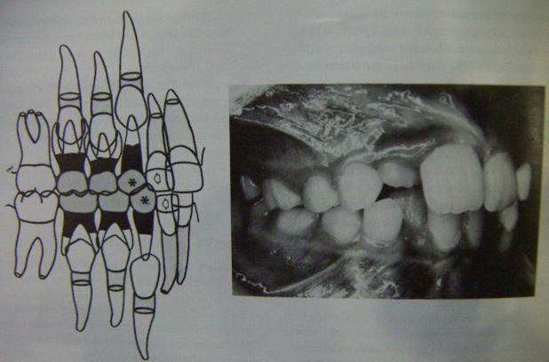
Treatment:
  Class I treatment :
    Group A : Anterior discrepancy : Crowding
Step I

Slide 45
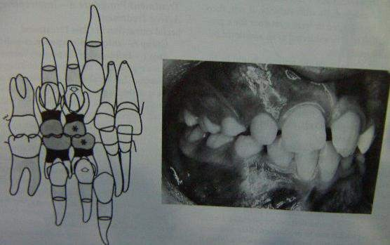
Step II

Slide 46
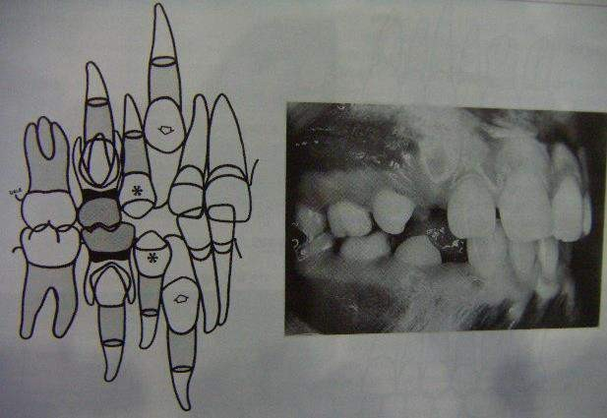
Step III

Slide 47
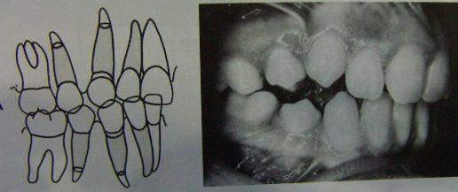
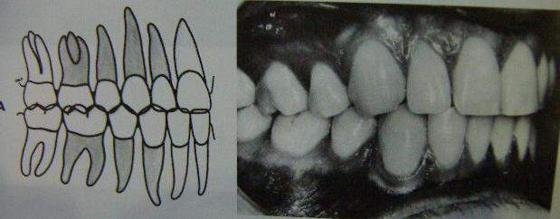
Step IV
Step V

Slide 48
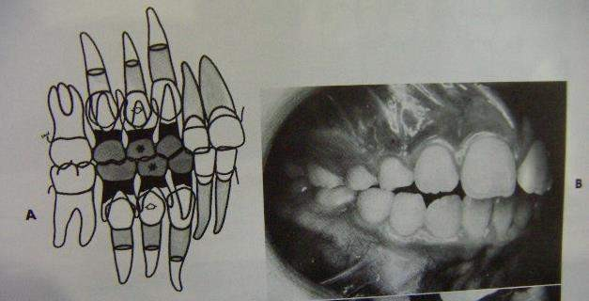
Group B : Anterior discrepancy : Alveoldental protrusion.
Step I

Slide 49
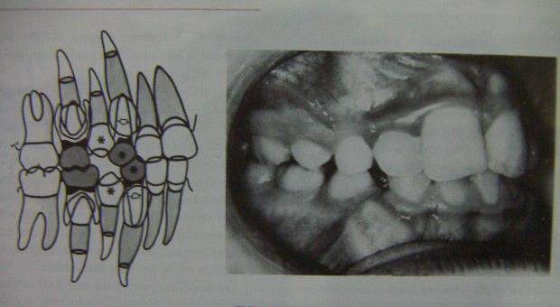
Step II

Slide 50
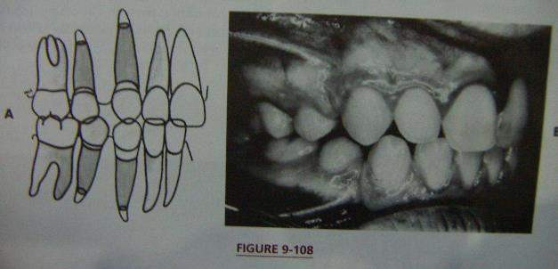
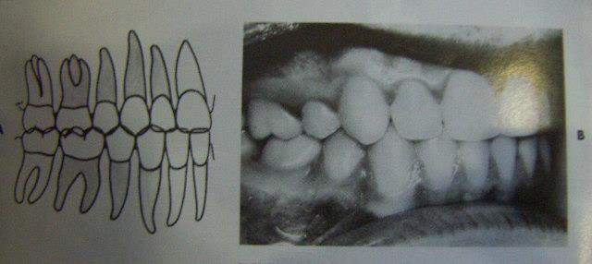
Step III
Step IV

Slide 51
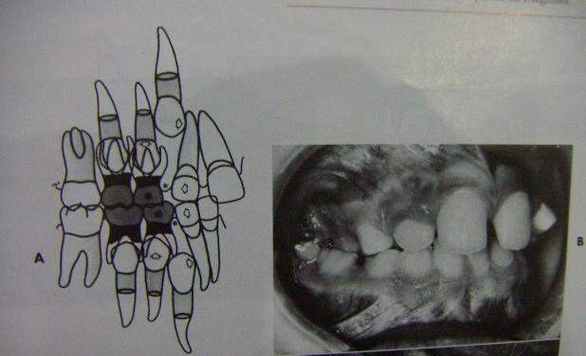
Group C : Middle discrepancy – Impacted canines:
Step I

Slide 52
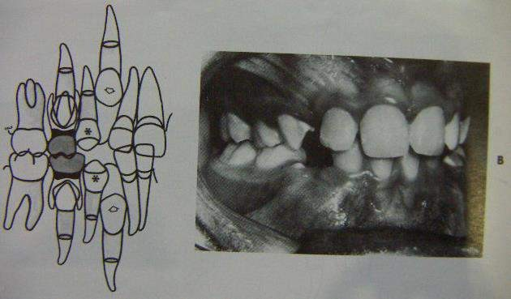
Step II

Slide 53
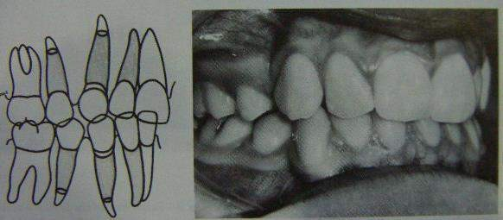
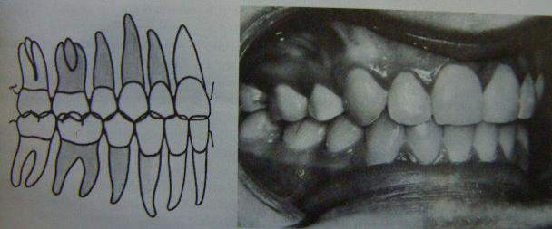
Step III
Step IV

Slide 54
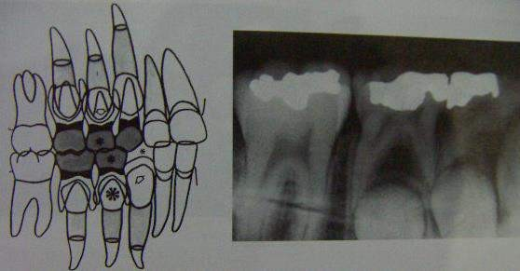
Group D : Enucleation in the mandible:
Step I

Slide 55
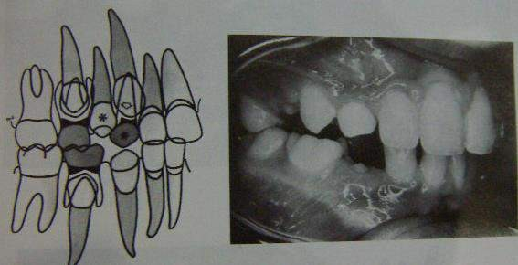
Step II

Slide 56
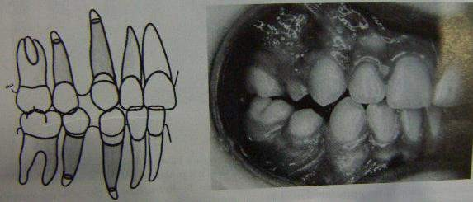
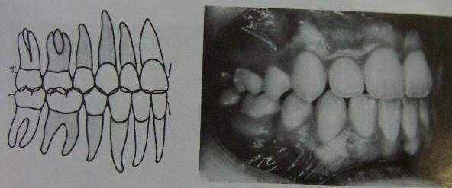
Step IV
Step V

Slide 57
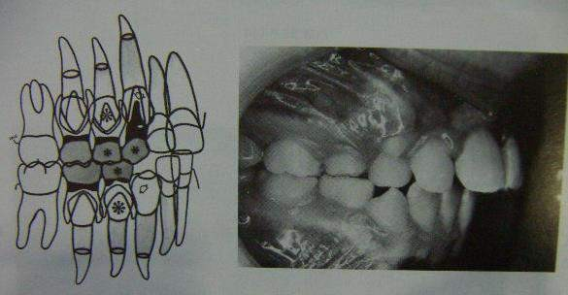
Group E : Enucleation of 1st premolars in maxilla and mandible:
Step I

Slide 58
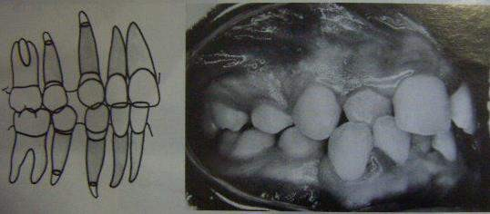
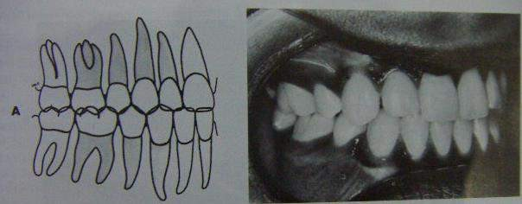
Step II
Step III

Slide 59
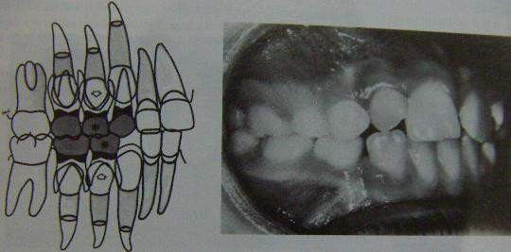
Group F : An alternative to enucleation :
Step I

Slide 60
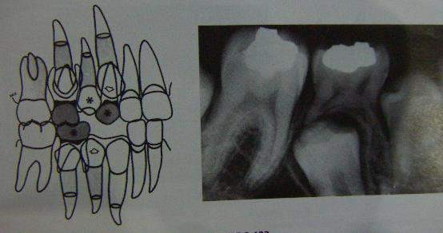
Step II

Slide 61
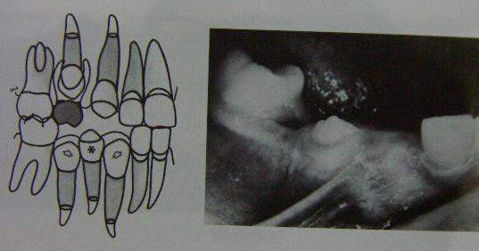
Step III

Slide 62
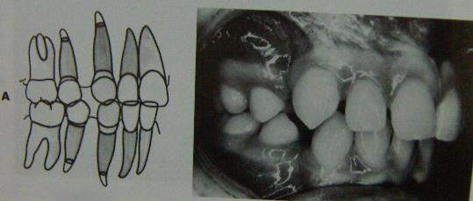
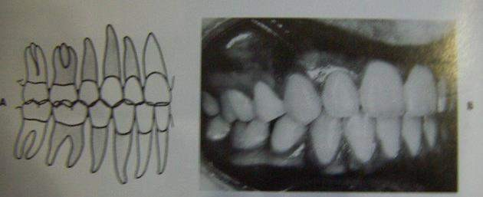
Step III
Step IV

Slide 63
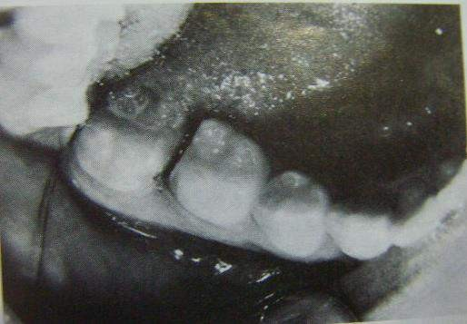
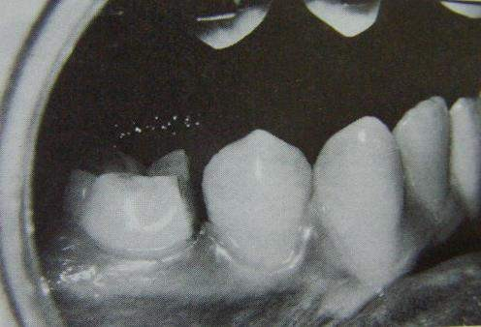
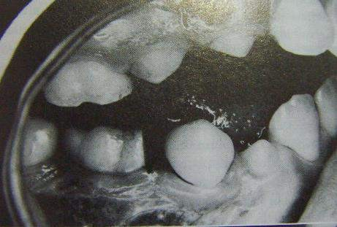
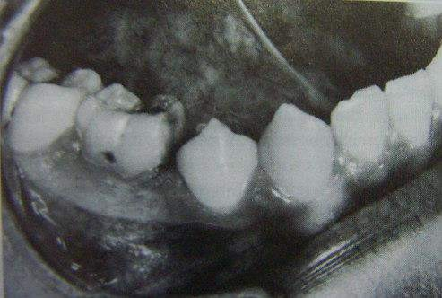
Interproximal reduction :

Slide 64
ORTHODONTIC APPLIANCES USED WITH SERIAL EXTRACTION PROCEDURE.
Maxillary , mandibular lingual arches.
Fixed or fixed removable head gears.
Removable Hawley appliance.

Slide 65
Mandibular lingual arch:
Severe crowding, preventive lingual collapse of lower incisors
Prevents the mesial tipping of lower Perm 1st molars.
Nance palatal arch:
Prevents mesial migration of maxillary Perm 1st Molars
In end to end molar relation.– Nance palatal arch holds the maxillary molars & allows mandi molars migrate mesially = class I relation.

Slide 66
Hawley appliance:
Reduce the excessive overjet, overbite, align rotated incisors.
Limited only for tipping movements, cannot control root positioning in all planes of space
Fixed mechanotherapy:

Slide 67
Advantages of mechanotherapy
Closure of Residual Xn spaces
Improvement in axial inclination
Correction of rotation
Correction of Midline discrepancy
Correction of residual overbite and overjet
Correction of cross bites
Improvement in arch form

Slide 68
MYOFUNCTIONAL APPLIANCES

Slide 69
MYOFUNCTIONAL APPLIANCES
Functional appliances or myofunctional appliances are appliances that depend upon the oro-facial musculature for their action.
DEFINITION:
Frankel (1974)

Slide 70
These appliances either transmit, eliminate or guide the natural forces of the masculature.
Are used for growth modification procedures that are aimed at intercepting and treating jaw discrepancies

Slide 71
They bring about following changes:
An increase or decrease in jaw size.
A change in spatial relationship of the jaws
Change in direction of growth of the jaws
Acceleration of desirable growth

Slide 72
CLASSIFICATION
I. a. Tooth borne passive appliances (E.g., Activator, Bionator)
b. Tooth borne active appliances (E.g., Appliance incorporated with active springs and screws)
c. Tissue borne appliances - Mostly located in the vestibule. (E.g., Frankel`s functional regulator)

Slide 73
a. Myotonic appliances- That depend on muscle mass for
their action.
b. Myodynamic appliance- Depend on muscle activity
for their action.
a. Removable functional appliance
b. Fixed functional appliance –
(E.g., Herbst appliances, Jasper Jumper))

Slide 74
IV. a. Group I appliance -
That transmits muscle forces
directly to teeth.
(E.g., Oral screen, Inclined plane)
b. Group II appliance -
That reposition the mandible and the resultant force is transmitted to the teeth and other structures
(E.g, Activator, bionator)
c. Group III appliance -
These also reposition the mandible but their area of operation is the vestibule
(E.g,, Frankel`s functional appliance)

Slide 75
ADVANTAGES:
Elimination of abnormal muscle function.
Treatment initiated at an early age.
Psychological disturbances associated with malocclusions can be avoided.
Do not interfere with oral hygiene.

Slide 76
LIMITATIONS:
Cannot be used in adult.
Cannot bring individual tooth movement.
Dependent on patients for timely wear.
Require pre functional orthodontic tooth movement.

Slide 77
Treatment principles
Force application
Force elimination
Components of appliances
  Bite planes
  Shields or screens
  Construction or working bite

Slide 78
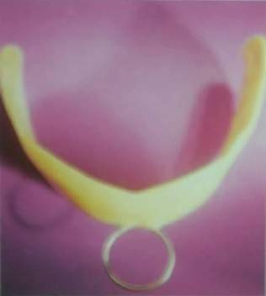
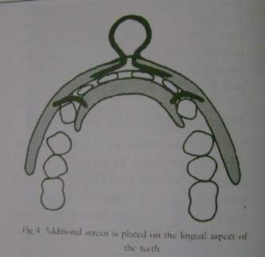
ORAL SCREEN (NEWELL 1912)
MODE OF ACTION
The lip exert pressure through the plastic against the anterior part of the dentition and bone support which leads to the correction of proclination.
The buccal part of the screen is wide enough to keep the orofacial muscle pressure off the posterior teeth, allowing the tongue’s active function mould the posterior segments and helps to expand the narrow dental arches.

Slide 79
Indications :
Interception of habits like –
Correction of mild disto-occlusion
Muscle exercises for correction of hypotonic lip & cheek muscles.
Correction of mild anterior proclination.
Fabrication :
Impression
Sealing of cast in occlusion
Covering of labial surfaces of teeth & alveolar process with wax of 2-3mm thickness.
Fabrication of appliance with self cure or heat cure resin.
Patient is asked to wear the appliance in the night & 2-3 hrs during the day time.

Slide 80

ACTIVATOR
:Kingsley 1879 : Vulcanite palatal plate.
Hotz : Vorbissplate
Viggo Anderson 1908 :Biomechanical working retainer,
He modified a Hawley type of retainer on the max arch for which he added a lower horse-shoe shaped flange which helped positioning the mandible forward.
It was named activator because of its ability to activate
muscle forces.

Slide 81
MODE OF ACTION
Loosely fitting appliance induces a new pattern of
mandibular closure
The patient has to move mandible forward to engage the appliance which results in stretching of elevator muscles of mastication.
This results in kinetic energy which:
  Prevents forward growth of maxillary dento-alveolar
process.
  Distal movement of max dento-alveolar process.
  Reciprocal forward force on mandible.

Slide 82

CONSTRUCTION BITE
It is an intermaxillary wax record used to relate the mandible to maxilla in dimensions of space, used to reposition the mandible in a forward directions well as opening the bite vertically.
Mandible is advanced by 4-5 mm and bite opened by 2-3 mm

Slide 83
Indications:
Class II, div 1 malocclusion.
Class II, div 2
Class III malocclusion
Class I, open bite
Class I, deep bite
Post treatment retention.
Children with decreased lower facial height.

Slide 84
Contraindications:
Correction of Class I problems of crowded teeth.
Excess lower facial height
Not used in children whose lower incisors are severely procumbent.
Limited application in non growing individuals.

Slide 85
ADVANTAGES
Uses existing growth of the jaws.
Pt experiences minimal oral hygiene problems.
Intervals b/w app is long.
App are short.
More economical.

Slide 86
DISADVANTAGES
Requires pt co-operation.
Cannot produce precise detailing & finishing of the occlusion.
Thus post-treatment fixed appliance therapy is needed.
May produce moderate mand rotation.

Slide 87
BIONATOR (BALTER 1950)
– The equilibrium between the tongue and circumoral muscles and the functional space for the tongue are essential for the normal development of the orofacial systems
MODE OF ACTION:
– The bionator doesn’t activate the muscles, but modulates the muscle activity thereby enhancing normal development of inherent growth pattern and eliminating the abnormal environmental factors.

Slide 88
INDICATIONS
Class II div I having following features:
  Well aligned dental arches
  Retruded mandible
  Mild skeletal discrepancy
  Labial tipping of upper incisors
Class III malocclusion
Open bite cases

Slide 89


ACTIONS OF THE BIONATOR
Causes sagital repositioning of mandible thereby increasing the oro functional space.
Causes anterior positioning of the tongue
The appliance prevents the external unfavorable muscle forces by means of vestibular arch and its buccal extension.
Intrusion and extrusion of teeth is obtained by loading or
unloading the teeth with acrylic.

Slide 90


OPEN BITE APPLIANCE
The appliance is constructed in such a way that:
The interocclusal bite blocks prevent the extrusion of posterior teeth.
The extension of the acrylic portion of the lower lingual part into the upper incisor region prevents thrusting of tongue between the anterior teeth which is responsible for causing open bite.

Slide 91

CL III OR REVERSED BIONATOR

Slide 92

FUNCTION REGULATOR

Slide 93
FRANKEL’S PHILOSOPHY AND
MODE OF ACTION
VESTIBULAR ARENA OF OPERATION
According to Frankel, the dentition is influenced by peri- oral muscle function.
Abnormal peri-oral muscle function creates a barrier for the optimal growth of the dento-alveolar complex.

Slide 94
The Frankel appliance is designed to hold away the muscles (buccal and labial) from the dentition. So that the dento- alveolar structures are free to develop.
In addition, the Frankel appliance acts as an exercise device or an oral gymnastic device that aids in correction of the abnormal perioral muscle function.

Slide 95
Types of frankel appliances
  Frankel I
    Frankel Ia
    Frankel Ib
    Frankel Ic
  Frankel II
  Frankel III
  Frankel IV
  Frankel V

Slide 96

Frankel-Ia
  Is used for class I malocclusion where there is minor to moderate crowding and also in cl-I deep bite cases.
Frankel-Ib
  Is used for class II, division 1 malocclusion where overjet does not exceed 5mm.

Slide 97

Frankel-Ic
– is used for Cl - II division 1 malocclusion in which the overjet is more that 7mm.

Slide 98

Frankel-II
  Is used for CL-II and division 2.
Frankel-III
  Is modified by adding a stainless steel protrusion bow behind the maxillary incisors.

Slide 99


Frankel-III - is used in the treatment of CL-III malocclusion.
Here the lip pads are situated in the maxillary, instead of mandibular vestibular labial sulcus.
Labial bow rests against the mandibular teeth and not on the
maxillary incisors.
There is a protrusive bow similar to that of Frankel-II behind the upper incisors to stimulate the forward movement of these teeth.

Slide 100
EFFECTS OF FRANKEL -III
Frankel-III gives both skeletal and dental changes
Maxilla is moved in a forward and slightly downward direction.
The mandible growth is redirected vertically with little
evidence of antero-posterior repositioning of the chin.

Slide 101

FRANKEL-IV
Primarily used in correction of open bite and to a lesser extent in bimaxillary protrusion.
In open bite cases, Frankel-IV redirect the mandibular growth from a downward and backward growth rotation to a upper and forward rotation.

Slide 102

TWIN BLOCK APPLIANCE
Occlusal inclined plane is the fundamental functional mechanism of the natural dentition.
Cuspal inclined plane plays an important role in determining the relation of the teeth as they erupt into occlusion.
In case of class I relation the distal slope of the lower posterior teeth slide with the mesial slope of the upper posterior teeth creating a mesial component of force which is favourable for the normal mandibular development.

Slide 103

In case of distoocclusion, the mesial slope of the lower
posterior teeth slide with the distal slope of the upper posterior teeth creating a distal component of force that is unfavourable to normal forward mandibular development.

Slide 104



MODE OF ACTION OF TWIN BLOCK
The unfavourable cuspal contacts of the distal occlusion are replaced by favourable proprioceptive contact on the inclined plane of Twin block which frees the mandible from its locked distal functional position.
Due to the inclined plane effect a mesial component of force is created that is favourable for the normal development of mandible

Slide 105

ACTION OF TWIN BLOCK IN CL-II DIV- 1 DEEP BITE
The bite is opened by sequential
trimming of upper bite block occluso distally that allows the lower posterior teeth to erupt.

Slide 106

IN OPEN BITE
  The posterior bite blocks remain unreduced and intact through out treatment.
  This results in intrusive effect on the posterior teeth, where
as the anterior teeth remain free to erupt.

Slide 107

CL-II DIVISION 2
In addition to the sequential trimming of upper bite block the
twin block is modified by the addition of two sagittal screw set.
The activation of the screw expand the arch by advancing the upper incisor.

Slide 108

IN CL-III MALOCCLUSION
Treatment malocclusion reversing the
of class-III
is achieved by
inclined plane to apply a forward
occlusal
component of force to the upper arch and a downward and distal force to the mandible in the lower molar region.

Slide 109



HERBST APPLIANCE
Developed by Emil Herbst (1900s).
Uses a telescopic mechanism and encourages forward repositioning of the lower jaw as the patient closes into occlusion.
Pancherz 1982 & McNamara 1990 have shown that both skeletal
and dental adaptations are produced with this appliance.
This was previously used in the mixed dentition period but now primarily used as an appliance in permanent dentition.

Slide 110


INDICATIONS
In class II due to retrognathic mandible
As an anterior repositioning splint in pt having TMJ disorders
Mouth breathers
Uncooperative pts

Slide 111
TREATMENT EFFECTS
Class II to class I molar relation
Increase in mand growth
Distal driving of max molars
Overjet reduction
An inhibitory influence on sagittal max growth

Slide 112

JASPER JUMPER
J.J Jasper 1980
MOA Similar to that of Herbst appliance except for its lack of rigidity.
A coil spring is used instead of rigid telescopic unit as in case of Herbst appliance .
INDICATIONS:
Skeletal class II malocclusion with maxillary excess & mandibular def.

Slide 113

CHIN CUP THERAPY
The main objective is to provide growth inhibition or redirection and posterior positioning of mandible.
A force is usually directed through the condyle or below the condyle.
Most studies recommend an orthopaedic force of 300 to 500 g per side (AJO 1987).
Patients are instructed to wear the appliance 14 hrs/day.

Slide 114
HEAD GEARS
Commonly used orthopedic appliances
Used to intercept or correct skeletal malocclusion by distalising the maxillary dentition or maxilla it self.
350 -450 gms on each side for 12-24 hrs / day.
COMPONENTS :
Face bow
Force element ( elastic / springs )
Anchorage ( head strap/ cervical strap )

Slide 115

PROTRACTION FACE MASK
Hickham 1972.
Mainly used to pull the max ahead simultaneously pushing the mandible distally.
250gm per side for 13 months
1600 -3000 gms for 4-21 days.
12-24 hrs/day.

Slide 116


PRE ORTHODONTIC TRAINER

Slide 117
The Pre-Orthodontic TRAINER is a prefabricated, single size, dental positioner, computer designed to incorporate myofunctional and tooth positioning characteristics.
It comes ready to use, requires
  no impressions and no molding.
  This allows it to be implemented from 6 years of age while the permanent teeth are erupting and the child is still growing (prior to orthodontic treatment).

Slide 118

1. Tooth Channels.
2. Labial Bows
3. Tongue Tag
4. Tongue Guard
5. Lip Bumpers
6. Edge to Edge Class I Jaw Position
– is produced when in place (same as most functional appliances). Combined with prevention of tongue thrusting and forcing the child to nose breathe is how the Class II corrections are achieved in the cases shown (a big assistance to the Orthondontist in future treatment).

Slide 119
MUSCLE EXERCISES
The dental tissues are blanketed from all directions by the muscles
Normal occlusal development depends on normal oro-facial muscle function.
Muscle exercises helps in improving aberrant muscle function.

Slide 120
1. Exercise for the masseter muscle:
Exercise for the lips:
  Stretching of upper lip to maintain lip seal for short hypotonic lips
  Holding and pumping of water back and forth behind the lips.
  Massaging of lips
  Button pull exercise:

Slide 121
3. Exercise for the tongue: (5/16 inch intra oral elastic)
One elastic swallow:
Tongue hold exercise:
Two elastic swallow:
The hold pull exercise:

Slide 122
REMOVAL OF SOFT TISSUE / BONY BARRIERS FROM UNERUPTED TEETH
Thick soft tissue covering
Bone covering

Slide 123






Slide 124
Previous questions
Serial extraction (4m,2007)
Space regainers (2m,2017)
Catalans appliance (2m,2012)
Grabers space regainers (4m,2010)

Slide 125
Suggested books for reading:
Orthodontics current principles: 4th edition- T.M.Graber
Hand book of orthodontics : 4th edition - Moyers
Contemporary orthodontics : 4th edition - Proffit
Orthodontics : 2nd edition - SI.Balajhi
Dentistry for child and adolescent : 8th edition - R.J. McDonald

Slide 126



