Slide 1
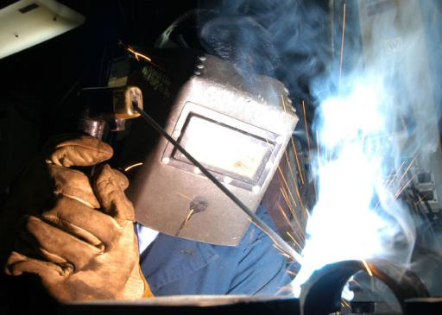
LAB PROCEDURES Soldering & welding; BASE FORMING

Slide 2
CONTENTS:
Introduction
Definitions
Soldering
- Classification of solders
- Classification of fluxes
- Heat source in soldering
- Techniques of soldering
- Soldering failures
Welding
- cold welding
- heat welding
- spot welding
- laser welding
- plasma welding
Clinical implications
Conclusion
References

Slide 3
INTRODUCTION:
The history of joining metals dates back as far as 2500 BC when records disclose that silver was first mined from the Aegean sea.
The technique of soldering in orthodontic field over the past years involved fusing gold wire to gold bands with gold or silver solder.
With the introduction of chrome in 1930’s , high fusing soldering became an art.
AO April 1960

Slide 4
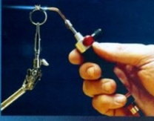
Soldering:
Joining of metals by the fusion of filler metal between them at a temperature below the solidus temperature of the metals being joined and below 450º C.
Brazing:
Brazing is defined as joining of metals by the fusion of a filler metal between them, at a temperature below the solidus temperature of metals being joined and above 450°C

Slide 5
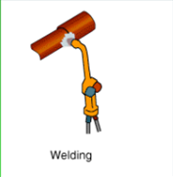
Welding:
joining of two or more metal parts by applying heat, pressure or both
With or with out a filler metal to produce localized union across the interface through fusion or diffusion

Slide 6
One other method of joining metals is cast joining.
It is the process of joining 2/more metal components by casting molten metal into the interlocking region between invested components.

Slide 7
Soldering:
The soldering technique has been known to man several hundred years.
However with the industrial revolution in Europe and North America, there developed a need for higher temperatures and more user friendly materials.

Slide 8
Components of soldering joint:
Parent metal
Solder / filler metal
Flux
Anti flux

Slide 9
Parent metal :
- Metal or alloy to be joined
- Substrate / base metal
- Composition of the parent metal determines
Melting range
Wettability
Solidus temperature

Slide 10
Flux:
- Flow ( Latin)
- Removes oxide layer
- Protects the surface layer from oxidation
- ‘Slag’

Slide 11
Classification of flux:-
According to primary purpose
1) surface protection type
2) reducing type
3) solvent type
According to composition
1) borax fluxes
2) fluoride fluxes
According to ph of the flux
1) acidic flux - Sio2
2) basic flux – Cao , CaCo3
3) neutral flux – flourspar (Ca.F2 ) borax ( Na2B4O2)

Slide 12
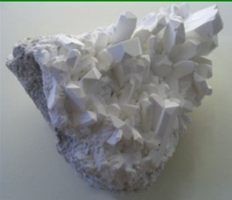
Borax flux:
Persian - Burah
Borax, also known as sodium borate, sodium tetraborate, or disodium tetraborate
A mixture of borax and ammonium chloride
Surface protecting fluxes
Flux of choice for noble metal alloys

Slide 13
Fluoride flux:
Potassium fluoride – 50-60%
Boric acid – 25-35%
Borax glass – 6-8%
Potassium carbonate – 8-10%
Used for base metal alloys even for gold/silver
Super flux:
A combination of high melting salts is used as fluxes to combine the good characteristics of each ingredient
borax glass – 55 parts
boric acid – 35 parts
silica - 10 parts

Slide 14
Anti flux:
- Materials used to restrict flow of flux are known as anti flux
- Applied before applying flux or solder
- eg:- Graphite
- It has a disadvantage of being burned off on prolonged heating at high temperatures
- overcome by whiting (CaCo3 in alcohol and water suspension)

Slide 15
FILLER METAL / SOLDER :
Ideal qualities of a solder consists of
- ease of flow at relatively low temperatures
- ability to wet substrate metal
- strength
- corrosion resistance
- color compatibility

Slide 16
CLASSIFICATION OF SOLDERS
I
Soft solders
Hard solders
II
Precious metal solders
Non precious metal solders

Slide 17
SOFT SOLDER:
- Lead-Tin eutectic alloy
- Plumber’s solder
- low fusion range 260º/less
- lack of corrosion resistance
HARD SOLDER:
- higher melting temperature
- greater hardness and strength
- 2 types are most commonly used
1) gold 2) silver

Slide 18
Gold solder:
- good tarnish and corrosion resistance
- high fusing – 750 to 900 ºc
- composition : Gold – 45 to 81 wt%
Silver – 8 to 30 wt%
Copper – 7 to 20 wt%
- Tin, Zinc, Phosphorous – small quantities

Slide 19
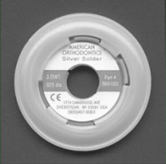
SILVER SOLDER :
Widely used in orthodontic appliances
less tarnish and corrosion resistance
good strength
composition - silver - 10 to 80 %
copper – 15 to 30 %
zinc – 4 to 35 %
low fusing – 600 to 750 ºc

Slide 20
Source of heat in the soldering is gas-oxygen torch.
Type of torch depends on type of fuel
Hydrogen gas – low heat content
Natural gas – 4 times heat content compared to hydrogen gas
Acetylene – high flame temperature
- temperature variations of about 100ºc
- unstable gas
Propane – highest heat content and flame temperature

Slide 21
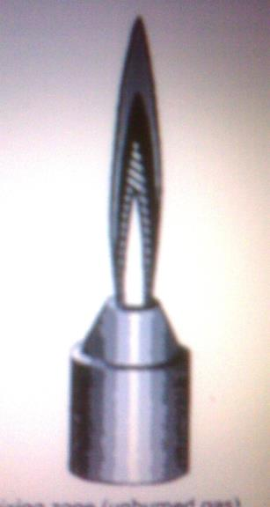
Flame obtained from the heat source can be
divided into 4 zones
1) Cold mixing zone – unburned gas
2) Partial combusting zone – oxidizing
3) Reducing zone
4) Oxidizing zone – burned gas

Slide 22
- Tip of the reducing zone – most efficient burning process
- most heat
- flame should not be removed until soldering process is completed
- unburned portion should not be used

Slide 23
Steps in soldering :
cleaning the surfaces to be joined
assembling the parts to be joined
application of flux and anti flux
application of solder
quenching

Slide 24
Soldering techniques:
Free hand soldering
Investment soldering
Furnace soldering
Infrared soldering

Slide 25
Investment soldering:
Provides accurate alignment of the parts to be joined
Parts to be joined are fastened using sticky wax and invested
Antiflux is applied and investment is preheated
Flux can be applied before / after heat treatment
Soldering is carried out with reducing flame at 750 to 870ºc
Cooled for 5min before quenching
Pickling

Slide 26
Free hand soldering is used more often ,
- work held 3mm beyond tip of blue cone
Soldering – observed in shadow
- temperature judged by color of work

Slide 27
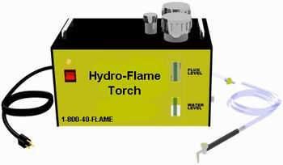
Hydro-Flame Torch:
The Hydro-Flame Torch is an oxyhydrogen generator that operates by converting distilled water into an Hydro-Flame

Slide 28
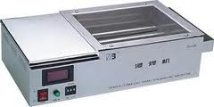
Furnace soldering :
A furnace with enough wattage to provide heat required to raise the temperature of the filler metal to its flow point.
Advantages:
uniform soldering
temperature control
vacuum control oxidation

Slide 29
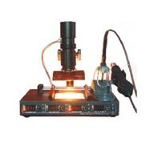
Infrared Soldering:
The unit uses light from a 1000 watt tungsten filament Quartz - iodine bulb mounted at primary focal point with gold plated elliptical reflector
Material to be soldered is placed at the reflectors secondary focal point at which the reflected infrared energy of tungsten light source is focused.
Used for high temperature soldering

Slide 30
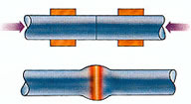
Types 0f joints :
Butt Joint
In a butt joint, two pieces of metal are joined with their ends abutting each other
Strapped Butt Joint
When a supportive piece of metal is soldered over or under the butt joint, it becomes a strapped but joint
Scarf Joint
A scarf joint is similar to a butt joint, but instead of the metal joined edge to edge, both pieces are cut on a diagonal

Slide 31
Lap Joint
A lap joint is formed when two pieces overlap each other and solder is applied between the two pieces
Side Seam Joint
Similar to the lap joint, the side seam joint is stronger than a simple lap joint

Slide 32
Soldering failures
These are due to
- failure to clean the parts to be joined
- improper fluxing
- poor flow of solder
- corrosion
- gas embitterment

Slide 33
Corrosion of soldering joints:
Materials with 20% Zn and 20 – 30% Cu - active in physiological solutions
Uhlig provides a qualitative ranking of corrosion rates:
Good corrosion resistance: “ < 0.005in/year
Satisfactory corrosion resistance: 0.005-0.050 in./year
Poor corrosion resistance >0.050 in/year
Sandia National Laboratories
United States Dept. of Energy

Slide 34
1) Environmental corrosion
2) Galvanic corrosion
3) Stress corrosion
Environmental corrosion : corrosion of any metal or alloy requires that an electrolytic cell be established
oxidation half-reaction reduction half reaction

Slide 35
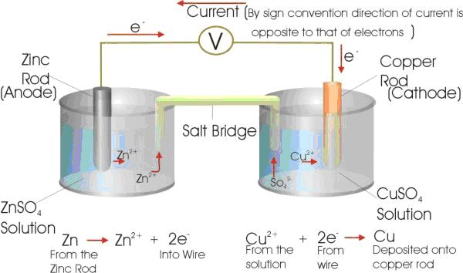
Galvanic corrosion:
Corrosion mechanisms may be accelerated when dissimilar metals are in contact with one another in the presence of moisture or other media this circumstance is referred to as galvanic-assisted corrosion.

Slide 36
Stress Corrosion :
Corrosion processes can be accelerated by applied stresses on a solder joint.
The imposition of mechanical loads on the structure, and in particular, tensile stresses, may cause the solder or base material(s) to have an increased sensitivity to corrosion processes.

Slide 37
Biocompatibility:
Any material containing upto 20% Zn and 20-30% Cu remain active in the physiological solutions.
- As such they tend to be released into the oral fluids.
- The silver soldering used in orthodontics exhibits severe cell toxicity
- Inhibition of proliferation, growth, and development of the cells were observed
Angle Orthodontist, Vol 79, No 5, 2009

Slide 38
WELDING
Joining of two or more metal parts by applying heat, pressure or both
with or with out a filler metal to produce localized union across the interface through fusion or diffusion
Cold welding is done by hammering or pressure
Hot welding - heat of sufficient intensity to melt the metals being joined
oxyacetylene flame or high amperage electricity
JCO 1976 Feb Robert E.Binder

Slide 39
Types of welding :
Resistance welding
- spot welding
- flash welding
- projection welding
Gas welding
Laser welding
Arc welding
- plasma welding
- sheilded metal arc welding

Slide 40
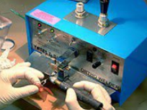
Spot Welding :
power supply,
energy storage unit
switch
welding transformer
welding electrodes

Slide 41
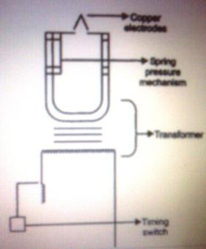
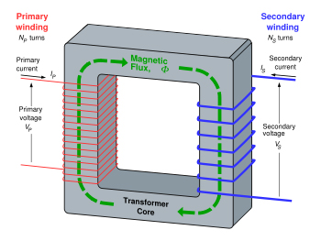
Transformer - converts the high voltage and
low current electricity from the utility
mains into a high current and low voltage
(17 to 45 volts and 55 to 590 amps).
A rectifier converts the AC into DC.
Heat generated in spot welding
H α I2RT

Slide 42
Copper electrodes in orthodontic spot welders - low resistance.
Stainless steels used in most orthodontic materials have 50 times the resistance of copper
welding is achieved by
- large amount of current
- very short duration
- area of high resistance

Slide 43
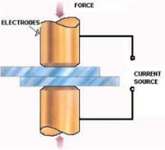
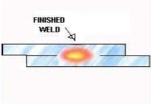
Proper electrode should be selected depending
on the thickness of the material to be welded
broad electrode – thin materials
narrow electrode – thick materials

Slide 44
In spot welding
- comparatively low melting point
- high electric resistance
- low heat conductivity
of the metals are favorable
Welding of stainless steel depends on the proper use of
- current flowing through the circuit
- time duration
- mechanical pressure applied at welding head

Slide 45
Improper application of the above said variables result in poor welding characteristics
Under welding
Over welding – progressive corrosion - weld decay
- sparkling, darkening
A satisfactory weld is one
which is strong
not undergone oxidation (blackening)
not been over compressed

Slide 46
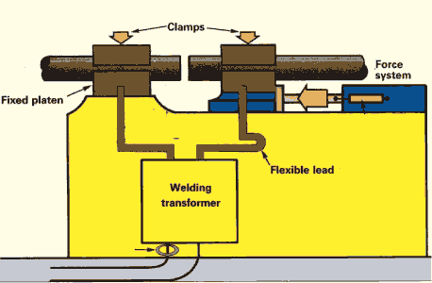
Flash welding:
- Type of resistance welding
- Pressing two ends together, while simultaneously running a current between them.
Joint between the two metals that is free of oxides

Slide 47
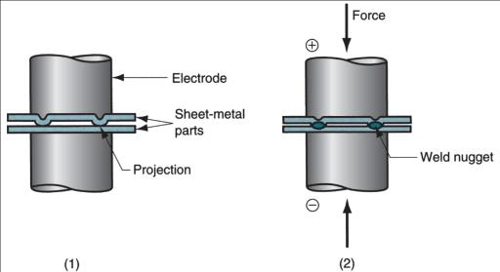
Projection welding:
A resistance welding process in which coalescence occurs at one or more small contact points on the parts
Contact points determined by design of parts to be joined
May consist of projections, embossments, or localized intersections of parts

Slide 48
Gas welding:
- welding operations that burn various fuels mixed with oxygen
- Oxyfuel welding employs several types of gases
Most important oxy fuel welding process is oxyacetylene welding
Two stage reaction of acetylene and oxygen:
First stage reaction (inner cone of flame)
C₂H₂ + O₂ → 2CO + H₂ + heat
Second stage reaction (outer envelope)
2CO + H₂ + 1.5O₂ → 2CO₂ + H₂O + heat

Slide 49
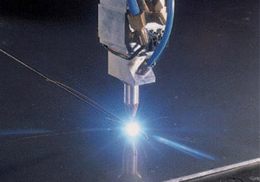
Laser welding :
Since its advent in 1960’s, the operational laser has been in constant transition from laboratory phenomenon to a productive tool.
Laser outputs of 2-10 kW into a very small area
- Power levels in excess of 103-105Wmm-2 are produced on the surface of the parts to be welded
-

Slide 50
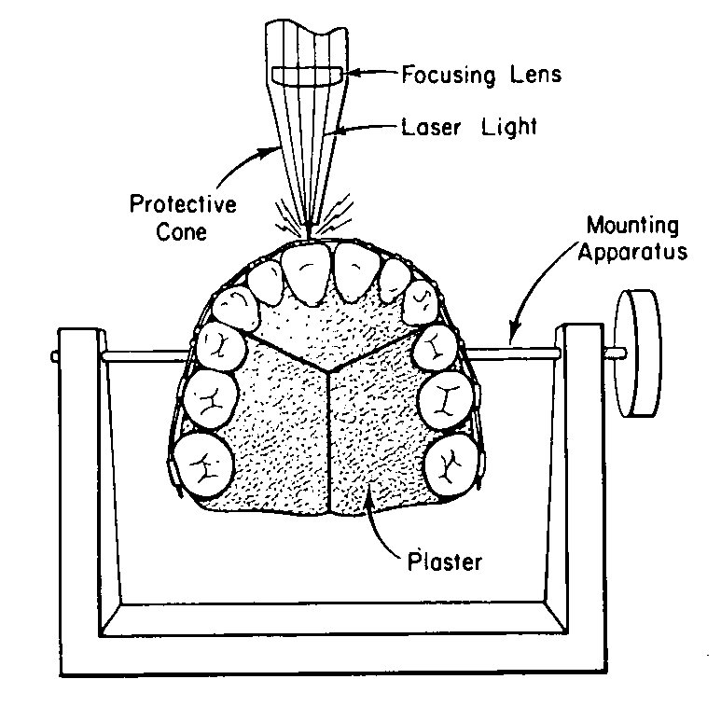
Intra oral laser micro welding:
No damage to the tooth structure was
observable after welding of wires directly
to bands
The maximum band cement interface temperature calculated using a heat transfer model for laser heating was 590 - 620ºc
Pulsed Neodymium lasers are safe to be used with out much effect on the hard tissues.
Colby and Bevis - AO 1978 Oct

Slide 51
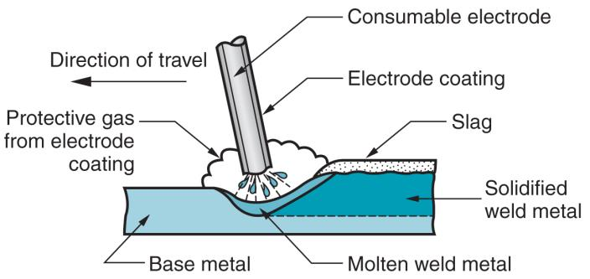
Shielded metal arc welding:

Slide 52
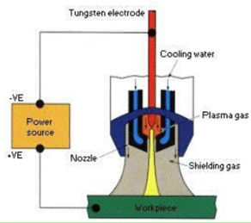
Plasma Welding : The electric arc is formed between an electrode
(which is usually but not always made of sintered tungsten) and the work piece .
The plasma is then forced through a fine-bore copper nozzle which constricts the arc and the plasma exits the orifice at high velocities (approaching the speed of sound) and a temperature approaching 20,000 °C

Slide 53
Several basic PAW process variations are possible by varying the current, plasma gas flow rate, and the orifice diameter, including:
Micro-plasma (< 15 Amperes)
Melt-in mode (15–400 Amperes)
Keyhole mode (>100 Amperes)
A deep, narrow penetration is achievable, with a maximum depth of 12 to 18 mm (0.47 to 0.71 in) depending on the material

Slide 54
Welding of attachments to the arch wire
- ease of force application
- transfer of point of force application toward the center of resistance of tooth
This made the researchers in this field concentrate on developing an
arch wire alloy with superior weld characteristics
- Led to the introduction of titanium-based arch wire alloys especially Beta titanium
JCO 1987 Sep Charles J.Burston

Slide 55
Beta titanium (TMA) wire can be directly welded without solder, producing joints that have high spring back and strength.
Stainless steel wires can be welded; unfortunately, if the weld is hot enough to produce an adequate union, degradation of properties occurs and the welded wires are softened.
Light tack welds can be made with steel, but they must be reinforced by solder

Slide 56
- Timolium, an α-ß alloy with titanium, aluminum, and vanadium
- smooth surface texture
- less friction at the arch wire-bracket interface
- better strength than existing titanium-based alloys
Welding attachments to arch wires can produce change in the physical as well as mechanical properties.

Slide 57
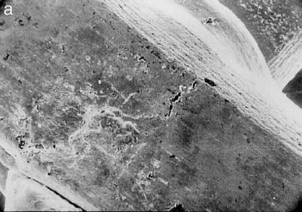
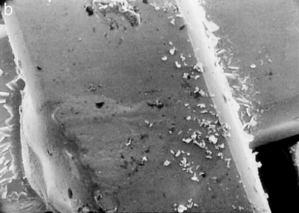
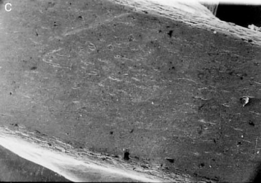
ß-titanium
Stainless steel
Timolium

Slide 58
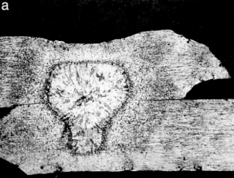
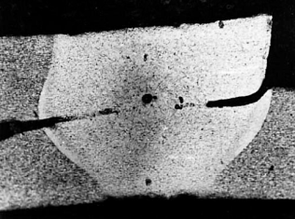
Micro structural changes in ß-titanium and timolium
- ß-titanium exhibited superior welding properties of superior strength, metallographic and surface properties followed by stainless steel and timolium. (AO, Vol 74, 2004 Vinod Krishnan et al )

Slide 59
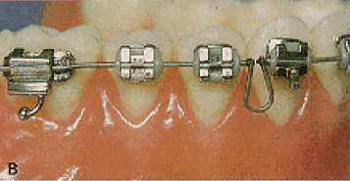
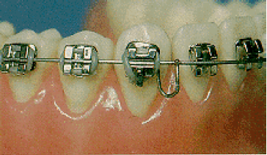
Clinical applications of welding TMA:
- TMA can be welded for both passive and active use.
- Vertical loops can be welded – for space closure & space gaining
- The main continuous arch can be .017"x.025" or .021"x.025" TMA, allowing greater rigidity through out the arch and minimizing possible side effects of lighter wires
Loop should be made of .016" or .018" round TMA

Slide 60
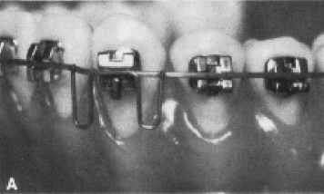
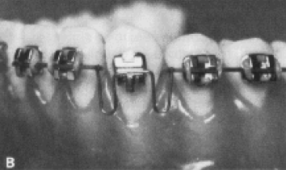
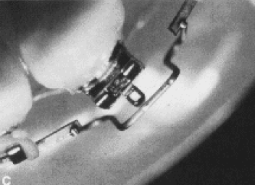
Vertical loops welded for the correction of cuspid alignment

Slide 61
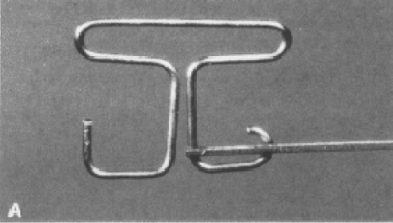
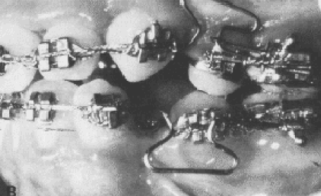
- Composite retraction spring used in the segmented arch technique
- Joining an .018" round wire to an .017" × .025" base arch
- The smaller anterior wire is used to reduce the force and make the force more constant during retraction
- The larger posterior wire insures adequate tip back

Slide 62
Conclusion :
With the advent of the newer material and prefabricated auxiliaries the need for soldering and welding has been decreased to some extent. But there are wide variety of applications of soldering and welding techniques and there is a need to improvise the techniques like intraoral micro-welding etc., to increase the efficacy of the operator.

Slide 63
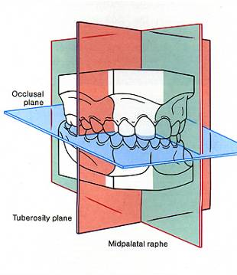
Model analysis is the study of maxillary and mandible dental arches in all the three planes of space.

Slide 64
Study models are important aids in orthodontic diagnosis and treatment planning.

Slide 65
USES OF STUDY CAST
Measurement of arch length & arch width.
Tooth size discrepancies.
To measure the amount of available space.

Slide 66
Drifting, tipping ,eruption status, abnormal curve of spee, prematurities.
Palatal breath, depth &configuration.
Thickness of the alveolar bone, apical base relationship.

Slide 67
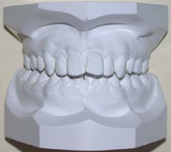
PARTS OF THE STUDY MODELS
Study models can be divided into two parts:
The anatomic portion.
The artistic portion.

Slide 68
Steps in Base fabrication
Occlusal plane of the cast and the base should be pallarel.
Thickness of the cast:
tooth portion-1/3rd
soft tissue -1/3rd
art portion -1/3rd

Slide 69
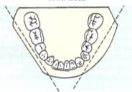
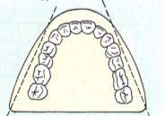
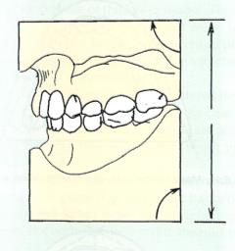
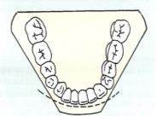
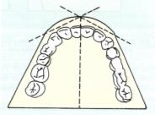
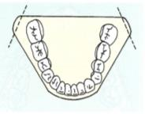
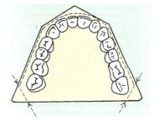
Study Model Fabrication

Slide 70
Posterior surface should be perpendicular to median raphe & base top - for arch asymmetries.
Tuberosity & retromolar details be should preserved.

Slide 71
Gnathostatic technique:
inclination of occlusal plane with the reference to eye-ear (frankfort horizontal) plane.
The cast show the approximate inclination of the occlusal plane in the face of the patient.

Slide 72
REFERENCES:
1)Science of dental materials – Anusavice
2)Orthodontic materials – William Brantley
3)Removable Orthodontic appliances – Phillip Adams
4) An improved soldering technique - AO 1960 April Parker
5)Corrosion issues in solder joint and service – Paul T. Vianko Sandia national laboratories
6)Optimal welding of beta titanium orthodontic wires - JCO 1987 Sep Charles J.Burston
7)Simulated intraoral laser microwelding of orthodontic appliances - AO 1978 Oct Colby and Bevis

Slide 73
8) Weld characteristics of orthodontic arch wire materials AO, Vol 74, 2004 Vinod Krishnan et al
9) Soldering stainless steel - AJO Oct 1963 Wilkinson
10) Orthodontic welding - JCO 1976 Feb Robert E.Binder
11) Cytotoxicity of silver solder in orthodontics Angle Orthodontist, Vol 79, No 5, 2009

