Slide 1


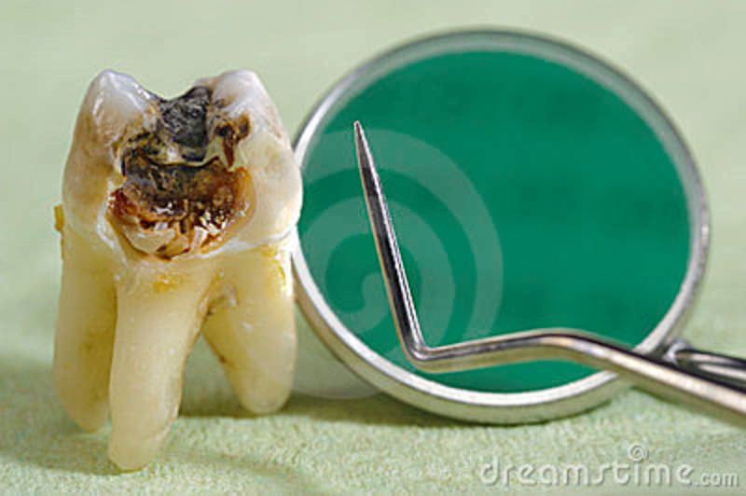
Management of
Deep Carious Lesions
SIBAR INSTITUTE OF DENTAL SCIENCES,GUNTUR
DEPARTMENT OF CONSERVATIVE
DENTISTRY AND ENDODONTICS
Dr. ANIL KUMAR
SENIOR LECTURER
.

Slide 2
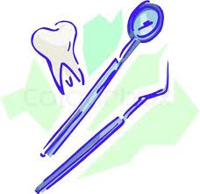
CONTENTS
INTRODUCTION TO DENTAL CAREIS
TYPES OF CARIOUS DENTIN
PATHOLOGY OF DENTAL CARIES
DIAGNOSIS AND PROGNOSIS OF DEEP CARIOUS LESION
FACTORS AFFECTING TREATMENT OUTCOME
INDIRECT PULP CAPPING
DIRECT PULP CAPPING
VARIOUS PULP CAPPING AGENTS CONCLUSION
REFERENCES

Slide 3
INTRODUCTION:
Dental caries is an infectious microbial disease of teeth that result in localized dissolution and destruction of calcified tissues.

Slide 4
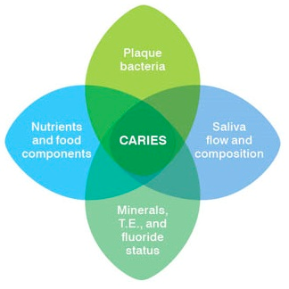
INTRODUCTION
Host factors
Time
Microflora
Dietary factors

Slide 5
INTRODUCTION:
Deep carious lesions are those in which caries penetration is easily observed in the dentin and may involve more than one half of the dentin thickness b/w DEJ & Pulp.
Tooth with a deep cavity will reveal upon excavation of the carious & necrotic dentin: An interface of decalcified and softened dentin.

Slide 6
INTRODUCTION:
Young permanent tooth: Dental pulp-Formative function.
It lays down radicular dentin for a period of 3-4 yrs after the tooth erupts till root development is complete.
Vitality of pulp is maintained

Slide 7
INTRODUCTION:
Loss of vitality of pulp
-Arrests root development
-Short root
-Thin radicular walls
-Wide open apex

Slide 8
TYPES OF CARIOUS DENTIN:
INFECTED DENTIN | AFFECTED DENTIN
Outer carious dentin | Inner carious dentin
Irreversibly denatured collagen: bacteria | reversibly denatured collagen
Not remineralizable | remineralizable
Darker and softer | Less darker and harder
Must be removed | Can be left back

Slide 9
Pathology of dental caries
Early Stages of Dental Caries:
Tubular sclerosis:
Tubules become blocked with apetite crystals.
Reactionary dentin:
Accelerated form of secondary dentin, less regular.
Formed by the odontoblastic layer under the tubules affected by caries.

Slide 10

Later stages of Dental caries:
Zones starting from DEJ towards Pulp-
Zone I :- Decayed zone
Zone II :- Septic zone
Zone III :- Demineralized zone
Zone IV :- Transparent zone
Zone V :- Opaque zone

Slide 11
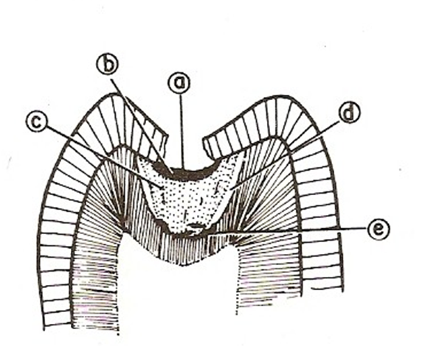
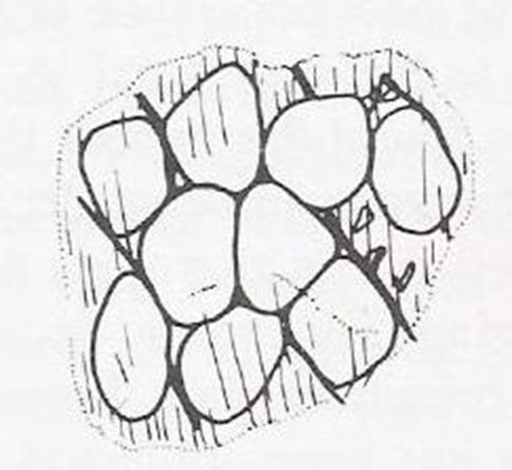
Decayed zone
Completely devoid of minerals
More in acute than chronic
High conc. of microbes found
Colour – light yellow to dark reddish brown
Chronic lesion- more odiferous & darker

Slide 12
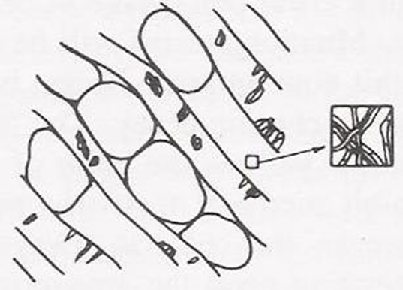
Septic Zone
Highest amount of micro-organisms
Dentinal tubules are widened & cavitated
Colour is same as first zone
Chronic lesion show thicker dimension

Slide 13
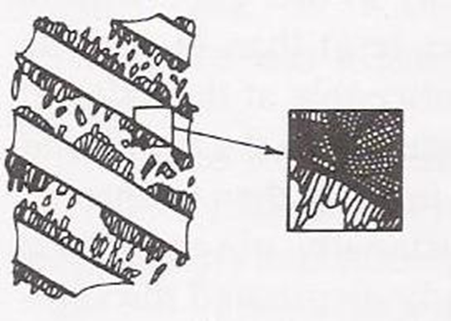
Demineralized Zone
Most significant zone
Dimension greater in acute lesion
Colour - Acute lesion is straw yellow & Chronic lesion is Dark brown
Acute lesion consistency & hardness is lesser

Slide 14
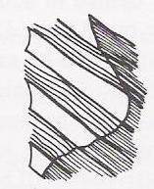
Transparent Zone
Transparent in ground section & radio-opaque in radiograph
Sclerosis & calcific barrier is formed
Extremely hard -19 times harder to normal dentin
More pronouced & harder in chronic lesion

Slide 15
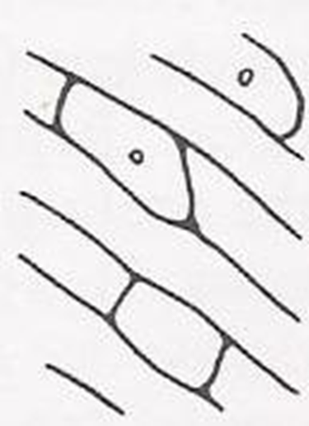
Opaque Zone
Pulpal to transparent zone
Show intratubular fatty degeneration with lipid deposits
More pronouced in acute lesion
Appear radiolucent in a radiograph

Slide 16
Deciding factors for treatment
Reparative capacity of pulp dentin organ.
Soundness of the dentin in the preparation floors & walls.
Reparative capacity of unsound attacked dentin.
Type and extent of any degeneration in pulp dentin organ.
Sealability of the restorative materials used.
Potential further irritation of the P-D organ resulting from preparation, instrumentation, restorative materials and restorative procedures.

Slide 17
DIAGNOSIS OF DENTAL CARIES:
Caries diagnosis:
Risk assessment.
Application of diagnostic criteria to determine the disease state.

Slide 18
Caries risk assessment tools:
Patient history
Clinical examination
Nutritional analysis
Salivary analysis
Radiographic assessment

Slide 19
Patient history :
Knowing certain factors pertaining to the patient’s history can assist in the diagnosis of caries and identification of high risk patients.
Factors include : Age ,gender, fluoride exposure,smoking habits,alcohol intake,medications,dietary habits, economic and educational status and general health.

Slide 20
History factor | Risk increasing observations
Age | Childhood,adolescence
Gender | Women at slightly greater risk
Fluoride exposure | No fluoride in public water supply
Smoking | Risk increases with amount smoked
Alcohol | Risk increases with amount consumed
General health | Chronic illness and debilitation decreases ability to give self care
Medication | Medications that reduce salivary flow
Plaque | High plaque score
Gingiva | Puffy,Swollen and Inflamed; bleeds easily
Existing restorations | large numbers indicate past caries rate.

Slide 21
Nutritional analysis :
Frequent exposure to sucrose increases the likelihood of plaque development by the most cariogenic MS organisms.

Slide 22
Salivary analysis :
Analyzing saliva may provide important information about appropriateness of secretion rates and buffering capacity as well as numbers of both MS and lactobacilli .
(Caries activity tests)

Slide 23
caries activity tests include :
Lacto Bacillus colony count test.
Snyder test.
Swab Test
Albans test
Enamel Solubility test
Buffering capacity test.
Salivary reductase test
Streptococcus mutans in saliva.
Cariostat test

Slide 24
Radiographic assessment :
Dental radiographs provide useful information in diagnosing carious lesions.
Radiographs may show caries that is not visible clinically ,the minimal depth of a detectable lesion on a radiograph is about 500 µm.
Many lesions evident radiographs are not cavitated and should be remineralised rather than restored.

Slide 25
Determining the diseased status-
3 steps procedure :
Detection of lesion
Assessment of its severity
Assessment of its activity

Slide 26
Methods of caries detection
Traditional methods
Advanced methods

Slide 27
Diagnosis of dental caries
Traditional methods:
Patient’s complaint: Sensitivity/Pain
Visual and Tactile examination
Radiographs
Pulp Testing
Direct pulp exposure
Percussion test
Type of Dentin
Test cavity
Selective infiltration or ligamental anesthesia

Slide 28
Advanced methods:
a) Air abrasive
b) Xeroradiography
c) Digital radiographic method
d) Computer -aided radiographic method
e) Digital subtraction radiography
f) Digital fiberoptic transillumination
g) Dyes for detection of caries
h) Electrical conductance measurement

Slide 29
i) Endoscopic filtered fluorescence method
j ) Quantitative laser fluorescence
k) Alternating current impedance spectroscopy
l) Ultrasonic imaging
j) Optical coherance tomography
k) Multiphoton imaging
l) Infrared thermography

Slide 30
Traditional methods:
1) Patient’s complaint :
Patient’s complaint may itself provide a hint about the presence of caries. Patient may complain of sensitivity to thermal changes,mild to moderate toothache etc.

Slide 31
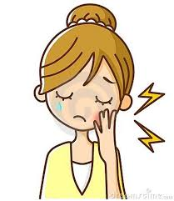
Pain
Pain at night / spontaneous pain: degenerative changes in P-D organ
Pain by external stimuli & relieved by removal of stimuli :
lesser degree of degeneration

Slide 32
2) Meticulous clinical examination :
May Reveal visual sign of caries
Brownish discoloration of pit and fissures.
Opacity beneath pit and fissures or marginal ridges.
Frank cavitation of the tooth surface.

Slide 33
3) Tactile examination :
INSTRUMENTS USED:
Mouth mirror
Explorer
Sharp /blunt probe
Floss -Floss is inserted through the contact area and dragged occlusally against one proximal surface,if it frays or shreds then it is a sign of proximal caries.

Slide 34
CRITERIA OF TACTILE EXAMINATION:
Catch is present.
-Penetration & resistance to removal.
-Catch indicate the demineralization & weakening of tooth surface.
Soft floor of cavitation is palpable with probe.

Slide 35
However,tactile examination has to be done carefully for the following reasons :
Excessive pressure with a sharp explorer tip can cause cavitation.
Infective microorganisms may be transferred to uninfected areas.

Slide 36
MECHANICAL BINDING OF EXPLORER DEPENDS ON :
Shape of fissure
Sharpness of explorer
Force of application
Path of explorer placement

Slide 37
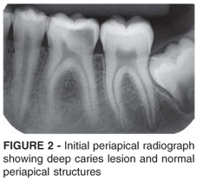
Radiographs:
The proximity of carious lesion to the pulp chamber and the root canal system.
Any pulpal changes in the form of pulpal calcifications.
The thickening of the PDL ligament space with an intact lamina-dura.

Slide 38
Location of the caries cone tip relative to the anatomy of the pulp chamber and root canal system.
Relative size of the apical foramen to that of the pulp and root canal system tissues.
Diameter of the pulp exposure.
Gross evaluation of the mineralization.

Slide 39
Caries diagnosis for pit and fissures :
Non - cavitated :
Cavitated (diseased ) :
No radiolucency below occlusal enamel.
Deep grooves may be present.
Superficial staining may be present in grooves.
Mechanical binding of explorer can occur.
Chalkiness of enamel on walls and base of pit or fissure.
Softening at the base of a pit or fissure.
Radiolucency below occlusal enamel.

Slide 40
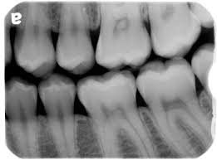
Caries diagnosis for smooth surfaces:
Bitewing radiograph are the most typical method for evaluation of Proximal smooth surface.
Non cavitated :
Cavitated :
Surface intact ,use of an explorer to judge surface must be done with caution.
Opacity of proximal surface may be present.
Radiolucency may be present.
Marginal ridge is not discolored.
Surface broken ,detectable visually or tactilely.
Marginal ridge may be discolored.
Opaque areas in dentin on transillumination.

Slide 41
Uses of bitewing radiographs:
Detecting incipient proximal lesions.
Examining many teeth in one radiograph.
Checking cervical margins of restoration.
Noting the size of pulp chamber.

Slide 42
Advantages :
Non invasive method.
Disclose sites- inaccessible to other diagnostic methods.
Permanent record for monitoring progress or arrest of caries.

Slide 43
Disadvantages :
Two dimensional image of a three dimensional object.
Don’t reveal the earliest stages.
Radiolucency may be due to caries, wear, fracture or cervical burnout.

Slide 44
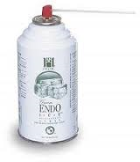
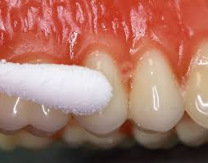
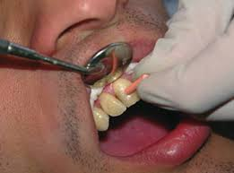
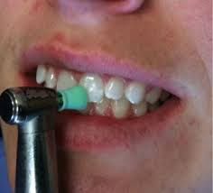
Pulp testing
Thermal pulp testing
Cold test:
Ice sticks
Heat test
Hot water, hot air
Ethyl chloride spray
Endo ice/Refrigerant spray(-26.2·c)
Dry ice/Co2 snow(-78·c)
Hot burnisher
Heated GP
Hot green stick compound
Polishing of crown with rubber cup.

Slide 45
4 possible responses to thermal test:
Nonvital pulp: No response.
Normal pulp: Mild to moderate degree of pain that subsides within 1-2 sec after stimulus is removed.
Reversible pulpitis: Strong momentary painful response that subsides within 1-2 sec after stimulus is removed.
Irreversible pulpitis: Moderate to strong painful response that linger for several seconds or longer after stimulus has been removed.

Slide 46
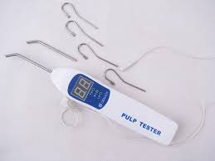
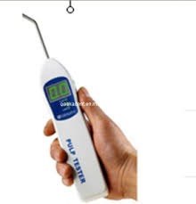
Electric pulp testing:
EPT use electric excitation to stimulate the Aδ sensory fibres within the pulp.
The pulp vitality depends on intrapulpal blood circulation. The EPT uses nerve stimulation instead.

Slide 47
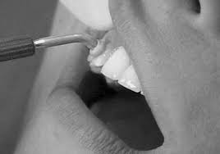
STEPS TO CARRY OUT EPT:
Primarily, the test should be first described to the patient with adequate information.
Teeth to be tested should be isolated with cotton rolls.
Apply an electrolyte on tooth surface (Grossman tooth paste).
It is important to avoid contact of electrolyte with any restoration or adjacent gingival tissue as this could lead to a false response.
Retract patient lip or cheek with free hand, away from the tooth electrode.

Slide 48
Turn the rheostat slowly to introduce minimal current to the tooth.
Patient is asked to indicate when he / she feels tingling sensation on the tooth being tested.
The procedure is repeated for each tooth to be tested.
To eliminate biased decision. EPT is first performed on a normal healthy tooth (control tooth) favorably an adjacent tooth or a contralateral tooth prior to being performed on affected tooth.

Slide 49
Advantages of EPT:
Intensity of stimulus is comfortable to the patient.
Digital display of many EPT provides instant, easy and reliable information.
In some EPT, a red indicators light flashes off and on when max. stimulus is reached.

Slide 50
Disadvantage of EPT:
Cannot be used in patient having cardiac pacemaker.
Cannot be used when gloves are worn.
Some EPT equipments are very expensive.
Not useful in recently erupted teeth with immature apex.
Recently traumatized tooth cannot be tested.
Probe tip of some EPT is removable and falls out easily.

Slide 51
False positive response : when the pulp is necrotic but patient gives positive response.
Reasons:
Conductor / electrode in contact with a metallic restoration or gingiva
patient anxiety.
liquification necrosis
Failure to isolate or dry the teeth.
in multirooted teeth where the pulp may be partially necrotic.

Slide 52
False negative response – when pulp is vital but patient is unresponsive to EPT.
Reasons:
Patient heavily pre-medicated with analgesic, narcotics, alcohol.
inadequate contact with enamel.
recently traumatized tooth.
excessive calcification in the canal.
recently erupted tooth with immature apex.

Slide 53
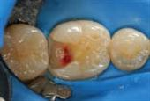
Direct pulp exposure
A pin-point exposure having sound dentin at the periphery of the exposure, with no hemorrhage - Successfully repaired.
A pin-point exposure having sound dentin at the periphery but accompanied by a drop of blood - healthy reparable P-D organ
An exposure having decayed or infected carious dentin – reparability is doubtful

Slide 54
An exposure accompanied by profuse hemorrhage could be an indication of great involvement – beyond repair
An exposure accompanied by inflammatory fluid or pus – beyond repair
Ratio of the exposure diameter < dimensions of pulpal root canal tissues – good healing
The closer the exposure is to anatomical constrictions – less chance of reparability

Slide 55
Percussion sensitivity
Little value in determining the degree of inflammation
May indicate some degree of pathology in the P-D organ
Type of dentin
Sclerotic dentin – reparative activity
Generalised discolured dentin -dying P-D organ

Slide 56
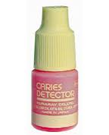
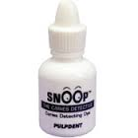
Removal of tooth strucure without L.A
Pain elicited gives clue of pulpal response to external stimuli
Selective infiltration or ligamental anesthesia
To find out the offending teeth in the arch
Use of dyes
Dyes used are – 0.5% basic fuschin in propylene glycol
- 1% acid red solution in propelyne glycol
Irreparable dentin stain RED

Slide 57
Factors affecting outcome of treatment:
Type of injury
Age
Amount of pulpal haemorrhage
Depth of penetration of bacteria
Speed of carious attack on the pulp
Remaining dentin thickness(RDT)

Slide 58
Remaining dentin thickness
(Effective depth )
Effective depth- the area of minimum thickness of sound dentin separating the pulpal tissue from the carious dentin.
Actual effective depth =
Effective depth on radiograph
Enamel thickness
in radiograph
X Actual enamel
thickness

Slide 59
Effective Depth of :
2mm or more – Healthy reparative reaction
0.8mm- 2mm – Unhealthy reparative reaction
Less than 0.3-0.8mm – Pulpal destruction
Thickness of dentin | Effect of toxic substance on pulp
0.5 mm | 25 %
1 mm | 10%
2 mm or more | Minimal or nil

Slide 60
Requirements for deep caries treatment
The pulp is not inflammed
Hemorrhage control
Pulp capping materials
Bacteria tight seal

Slide 61
Requirements for deep caries treatment
All undermined enamel and infected dentin should be removed.
In case of an acute carious lesion, the deepest portion of softened dentin may be left provided-
The P-D organ has been established as being healthy.
The remaining dentin has been established as being reparable.
The softened dentin that is to remain should be located in the deepest part of the pulpal and / or axial wall.

Slide 62
Mechanics of Caries Removal
When using the bur, slow speed is preferred
Large steel round bur
Color and texture of the remaining dentin may be used as a guide.

Slide 63
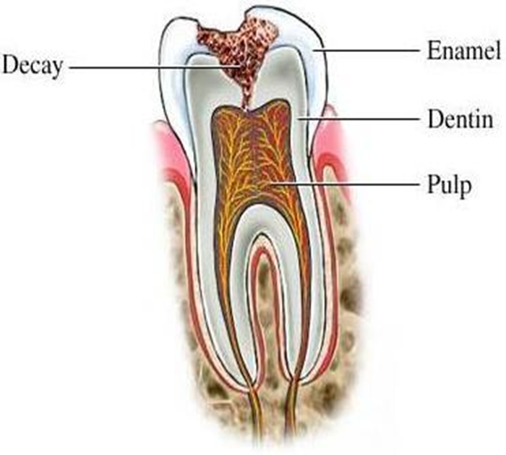
PULP CAPPING
“Endodontic treatment designed to maintain the vitality of the
endodontium”
General conditions before pulp capping :-
Vital tooth, no spontaneous pain history.
Pain not to be seen after stimulus removal
Radiograph – no periapical lesion
Bacteria must be excluded from the site .

Slide 64
INDIRECT PULP CAPPING
“ The application of medicament over the thin layer of remaining carious dentin after deep excavation,with no exposure of pulp”
- Marzouk
“The procedure in which only the gross caries is removed from the lesion and the cavity is sealed for a time, with a bactericidal agent is referred to as indirect pulp treatment.”
- Mc Donald

Slide 65
Objectives:
Valuable therapeutic procedure in treating asymptomatic deep carious lesions.
Reduces risk of pulp exposure and preserves pulp vitality.
Removes the outer layers of the carious dentin, that contain the majority of the microorganisms.
Stimulate pulp to generate reparative dentin beneath the carious lesion.
Remineralizing the carious dentin; arresting carious process.

Slide 66
INDICATIONS:
1. Patient History
a) Mild discomfort from chemical & thermal stimuli
b) Absence of spontaneous pain.
2. Clinical examination
a) Large carious lesion
b) Absence of lymphadenopathy.
c) Normal appearance of adjacent gingiva.
d) Normal color of tooth.
3. Radiographic examination.
a) Large carious lesion in close proximity to the pulp.
b) Normal lamina dura.
c) Normal periodontal ligament space.
d) No interradicular or periapical radiolucency

Slide 67
CONTRAINDICATIONS:
1.Patient History
a) Sharp, penetrating pain that persists after withdrawing stimulus.
b) Prolonged spontaneous pain, particularly at night.
2. Clinical examination
a) Excessive tooth mobility.
b) Parulis in the gingiva approximating the roots of the tooth
c) Tooth discoloration.
d) Non responsiveness to pulp testing tech.
3. Radiographic examination
a) Large carious lesion with apparent pulp exposure.
b) lamina dura not intact.
c) Widened periodontal ligament space.
d) Radiolucency at the root apices or furcation areas.

Slide 68
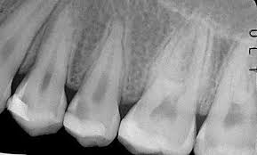
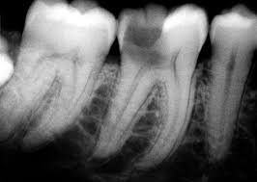
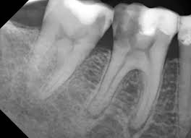
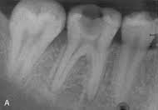
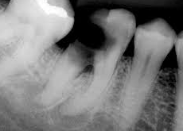

Slide 69
Two appointment technique
1st appointment:
Remove soft,necrotic,infected dentin with a large round bur in a slow speed handpiece without exposing pulp.
Remove peripheral carious dentin with sharp spoon excavators. Irrigate the cavity and dry with cotton.
Cover the remaining affected dentin with a hard setting calcium hydroxide dressing.
Fill the remainder of the cavity with reinforced zinc oxide eugenol cement or a glass-ionomer cement to achieve a good seal.
Do not disturb this sealed cavity for 6-8 weeks.

Slide 70
2nd appointment:
Carefully remove all temporary filling material, especially the calcium hydroxide dressing over deep portions of cavity floor.
The remaining affected carious dentin should appear dehydrated and "flaky" and should be easily removed. The area around the potential exposure should appear whitish and soft –Predentin (not removed).
Cavity preparation should be irrigated and gently dried.

Slide 71
Cover the entire floor with a hard-setting calcium hydroxide dressing.
A base should be placed with reinforced zinc oxide eugenol or glass ionomer cement, and the tooth should receive a final restoration.

Slide 72
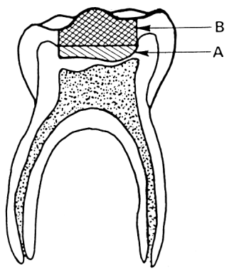
Indirect pulp-capping technique.
Medicament : calcium hydroxide
Temporary restoration.
Following repair, both materials are removed and final restorations are placed.

Slide 73
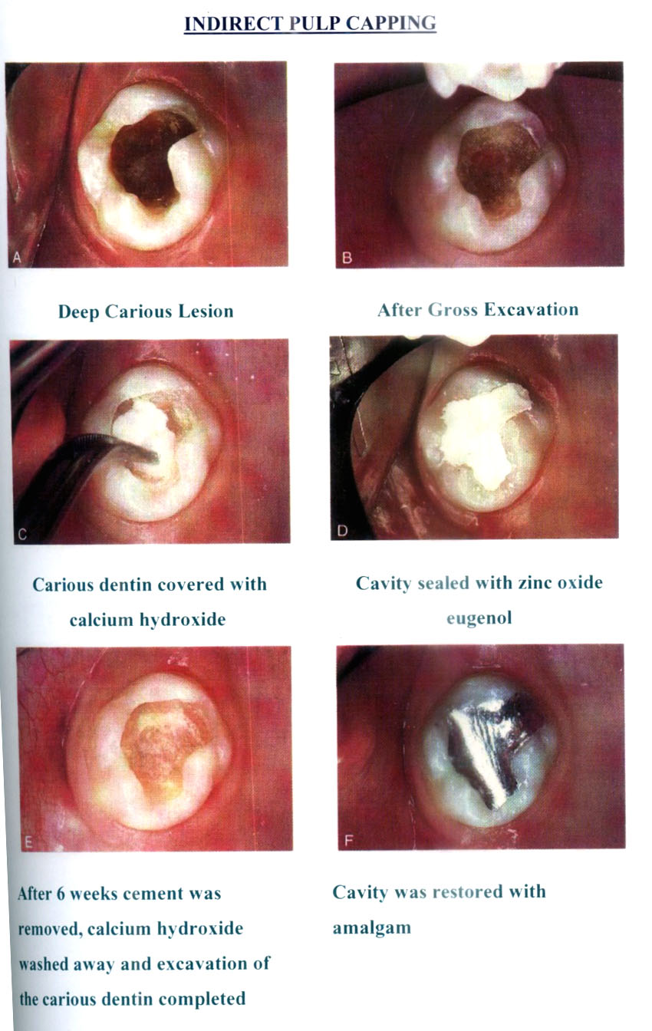

Slide 74
Notes:
Paul Starkey 1 visit IPC

Slide 75
One appointment Vs Two appointment IPC
Success rate of two step procedure – 75 to 98%.
Significant decrease of bacteria in deep caries lesion after being covered with Ca(OH)2 for 1-15 months
Lueng et al & Fair bourn

Slide 76
Response to treatment
Acc. to Sayegh
Three distinct types of new dentin in response to indirect pulp capping:
(1) cellular fibrillar dentin at 2 months post-treatment,
(2) presence of globular dentin during the first 3 months,
(3) tubular dentin in a more uniformly mineralized pattern.

Slide 77
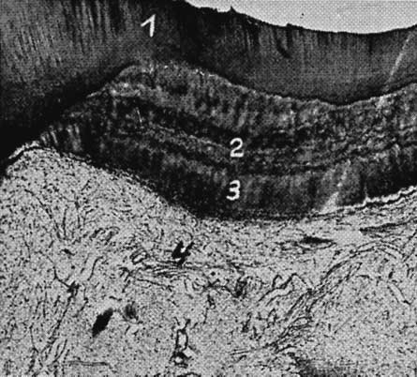
Photomicrograph of four layers of healing:
carious decalcified dentin;
rhythmic layers of irregular irritational dentin;
regular tubular dentin;
normal pulp with slight increase in fibrous elements.

Slide 78
Stepwise excavation
Bjorndal 1990s
Caries is removed in 2 separate appointments, 6-12 months apart.
In first appointment, access to caries gained, cavity prepared, lined with calcium hydroxide & restored with GIC. Left for 6-12 months
When re-entered after 6 months, if dentin found to be darker in colour, harder and dried, suggesting that remaining caries less active after first excavation.
This allows time for pulp dentin complex reaction to take place. Hence, in second excavation visit there is less chances of pulp exposure and also there is more regular tubular tertiary dentin formation.

Slide 79
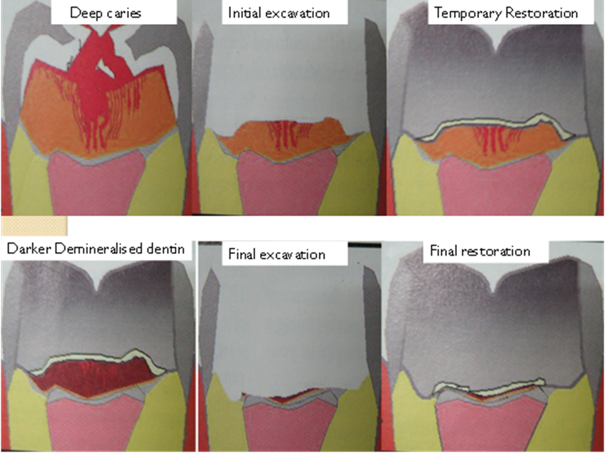

Slide 80
DIRECT PULP CAPPING
“Placement of a biocompatible medicament or a non-medicated material on a pulp that has been exposed in the cause of excavating the last portions of deep dentinal caries or as a result of traumatic injury.”
Objectives:
To seal the pulp against bacterial leakage.
Encourage the pulp to wall off the exposure site by initiating a dentin bridge.
To maintain the vitality of underlying pulp tissue organ.

Slide 81
INDICATIONS:
“Pin point" mechanical exposures that are surrounded with sound dentin.
Exposed pulp tissue should be bright red in color and have a slight hemorrhage that is easily controlled with dry cotton pellets applied with minimal pressure.
Absence of pain.
Size of exposure diameter must be less than 0.5mm.
No bleeding at the exposure site.
The field of operation should be completely aseptic.

Slide 82
CONTRAINDICATIONS:
History of spontaneous and nocturnal toothaches.
Excessive tooth mobility.
Thickening of periodontal ligament.
Radiographic evidence of furcal / periradicular degeneration.
Uncontrollable hemorrhage at the time of exposure.
Purulent or serous exudates from the exposure.

Slide 83
PROCEDURE:
All undermined enamel & unsound dentin is removed.
The cavity floor & exposure site is irrigated with sterile water & dried with cotton pellets.
Suitable therapeutic pulp capping material is used.
ZOE: sound dentin shavings are cut from surrounding walls & deposited at exposure site & covered with ZOE.(8-9weeks)
Ca(OH)2:placed over exposure site.(6-8weeks)
Permanent restoration should then be placed.

Slide 84
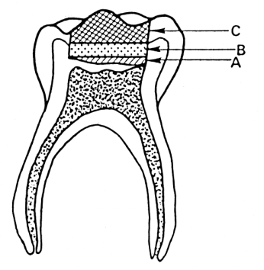
Direct pulp-capping technique.
Capping material covers pulp exposure and the floor of the cavity.
Protective base of zinc oxide–eugenol cement.
Amalgam restoration.

Slide 85
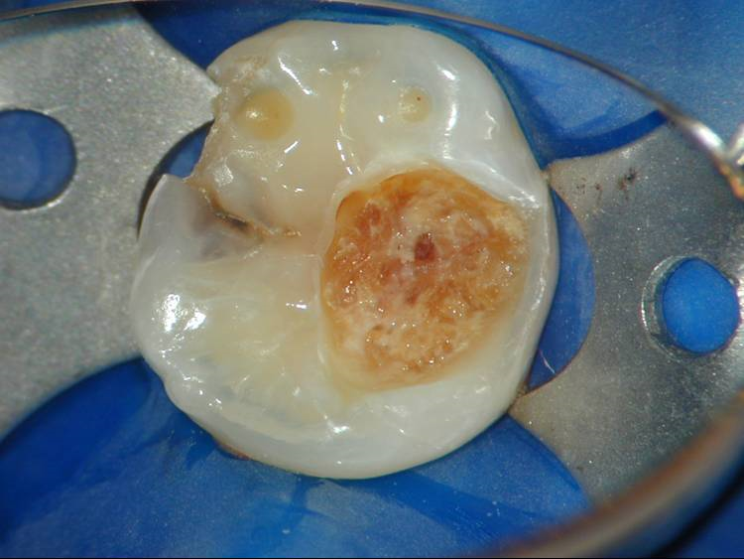
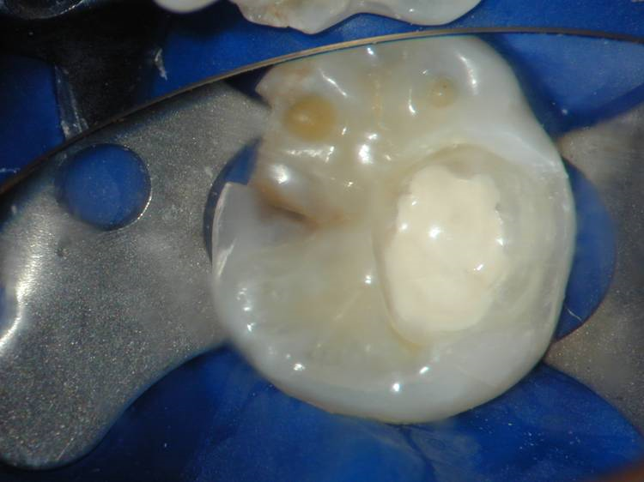
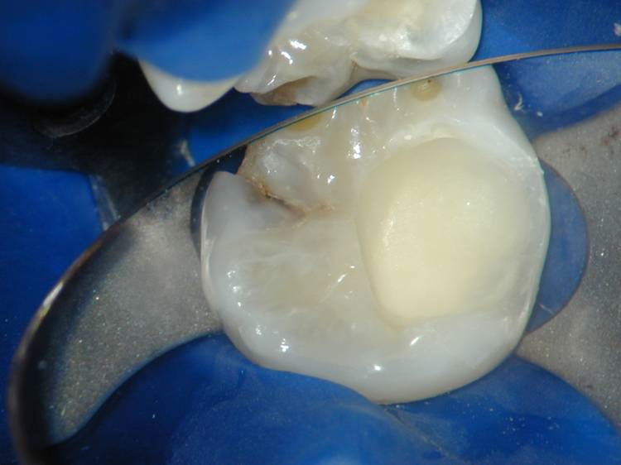
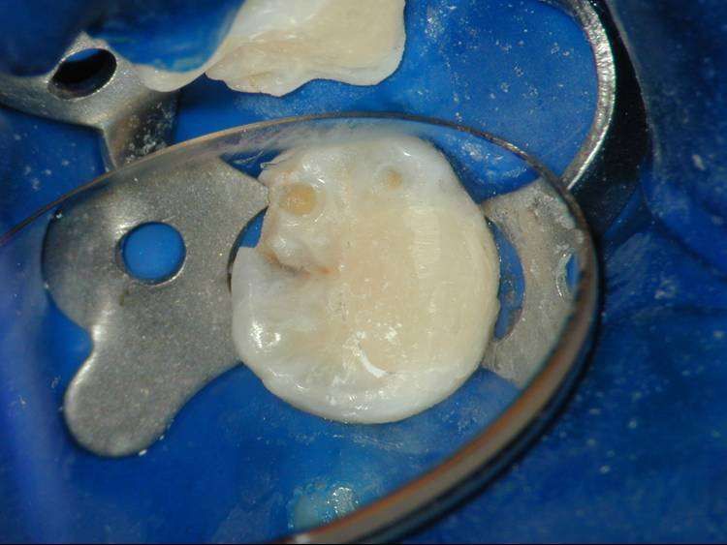

Slide 86
Treatment considerations:
DEBRIDEMENT
HEMORRHAGE AND CLOTTING
EXPOSURE ENLARGEMENT
BACTERIAL CONTAMINATION

Slide 87
Debridement
Necrotic and infected dentin chips are invariably pushed into the exposed pulp during caries removal .This debris may impede healing in the area by causing further pulpal inflammation.
Hence, peripheral masses of carious dentin should always be removed before beginning the excavation where an exposure may occur.
Exposure area should be irrigated with nonirritating solutions- normal saline to keep the pulp moist.

Slide 88
Hemorrhage and clotting
Hemorrhage: controlled with cotton pellet pressure.
Blood clot: must not be allowed to form as it will impede pulpal healing.
The capping material must directly contact pulp tissue to exert a reparative dentin bridge response.

Slide 89
Exposure Enlargement
It removes inflamed and/or infected tissue in the exposed area.
It facilitates removal of carious and non carious debris particularly dentin chips.
It ensures intimate contact of the capping medicament with healthy pulp tissue at the exposure site.

Slide 90
Bacterial Contamination
It has been emphasized that bacterial microleakage under various restorations causes pulpal damage in deep lesions.
Cox et al have shown that pulp healing is more dependent on the capacity of the capping material to prevent bacterial microleakage (adequate seal) rather than the specific properties of the material itself.

Slide 91
Successful Pulp Capping
Dentin bridging.
Maintenance of pulp vitality.
Lack of undue sensitivity or pain.
Minimum pulpal inflammatory response.
The ability of the pulp to maintain itself without progressive degeneration.
Lack of internal resorption and/or intraradicular pathosis.

Slide 92
Pulpotomy
Pulpotomy is defined as the amputation of vital pulp from the coronal pulp chamber followed by placement of a medicament over the radicular pulp stumps to stimulate repair, fixation or mummification of the remaining vital radicular pulp.

Slide 93
Rationale:
When the coronal pulp is exposed by trauma or operative procedures, or caries ingress of bacteria, it produces inflammatory changes in the tissue.
The surgical excision of the infected and inflamed coronal pulp affords temporary, rapid relief of pulpalgia leaving behind the vital uninfected pulpal tissue in the root canal.
Materials used for this procedure either mummify or fix the tissue or promote healing by formation of a bridge.
Notes:
The removal of the inflamed portion of the pulp affords temporary, rapid relief of pulpalgia and further may undergo repair while completing apexogenesis that is root end development and calcification.

Slide 94
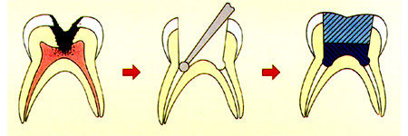
Objectives:
The radicular pulp should remain asymptomatic without adverse clinical signs or symptoms.(pain,sensitivity,swelling)
There should be no postoperative radiographic evidence of pathologic external root resorption.
Internal root resorption can be self limiting and stable.
There should be no harm to the succedaneous tooth.
Notes:
The radicular pulp should remain asymptomatic without adverse clinical signs or symptoms such as sensitivity, pain, or swelling.

Slide 95
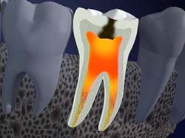
INDICATIONS:
Pulp exposure in primary teeth.
Pulp exposure with a large carious lesion but the radicular pulp free from pathosis.
Absence of abscess and fistula.
No inter-radicular bone loss.
No inter-radicular radiolucency.
At least 2/3rd of root length still present
On young permanent tooth with vital exposed pulp and incompletely formed apices.

Slide 96
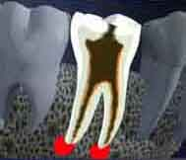
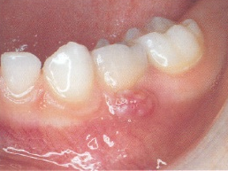
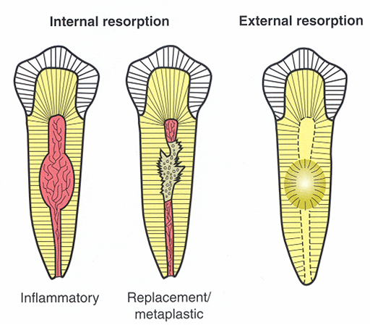
CONTRAINDICATIONS:
Persistent tooth ache.
Tenderness on percussion / mobility present.
Root resorption more than 1/3rd of root length.
Large carious lesion with non-restorable crown.
Highly viscous, sluggish hemorrhage from canal orifice which is uncontrollable.
Notes:
Any sign or symptom, which suggests that inflammation, has extended beyond the coronal pulp into the root canal. These include:
Spontaneous pain.
Tenderness to percussion.
Swelling & fistula.
Pus of serous exudates at the exposure site.
Pathologic mobility.
Uncontrollable hemorrhage from the amputated pulp stumps.
Pathological external root resorption.
Periapical or interradicular radiolucency.
Internal root resorption.
Pulp calcification.
Cardiac conditions.

Slide 97
CLASSIFICATION
1. Pulpotomy can be classified according to treatment objectives given by Ranley et al:
I. Devitalization Pulpotomy (Mummification, Cauterization)
a. Formocresol pulpotomy.
b. Electrosurgical pulpotomy.
c. Laser pulpotomy.
II. Preservation Pulpotomy (Minimal devitalization, Non inductive)
Gluteraldehyde.
Ferric sulfate.

Slide 98
III. Regeneration Pulpotomy (Inductive, Reparative)
Calcium Hydroxide.
Bone Morphgenetic Protein.
Mineral trioxide aggregate.

Slide 99
2. It can also be classified depending upon the number of visits:
I. Single Visit Pulpotomy
II. Multiple Visits Pulpotomy

Slide 100
3. Amount of pulp tissue removed:
a. Partial pulpotomy (cvek’s pulpotomy)
b. Complete pulpotomy (cervical pulpotomy).

Slide 101
Partial Pulpotomy (Cvek’s Pulpotomy)
It is the removal of only the outer layer of damaged and hyperemic tissue in exposed pulps.
It is a mode of treatment which is widely used in the permanent dentition but less so in primary teeth.

Slide 102
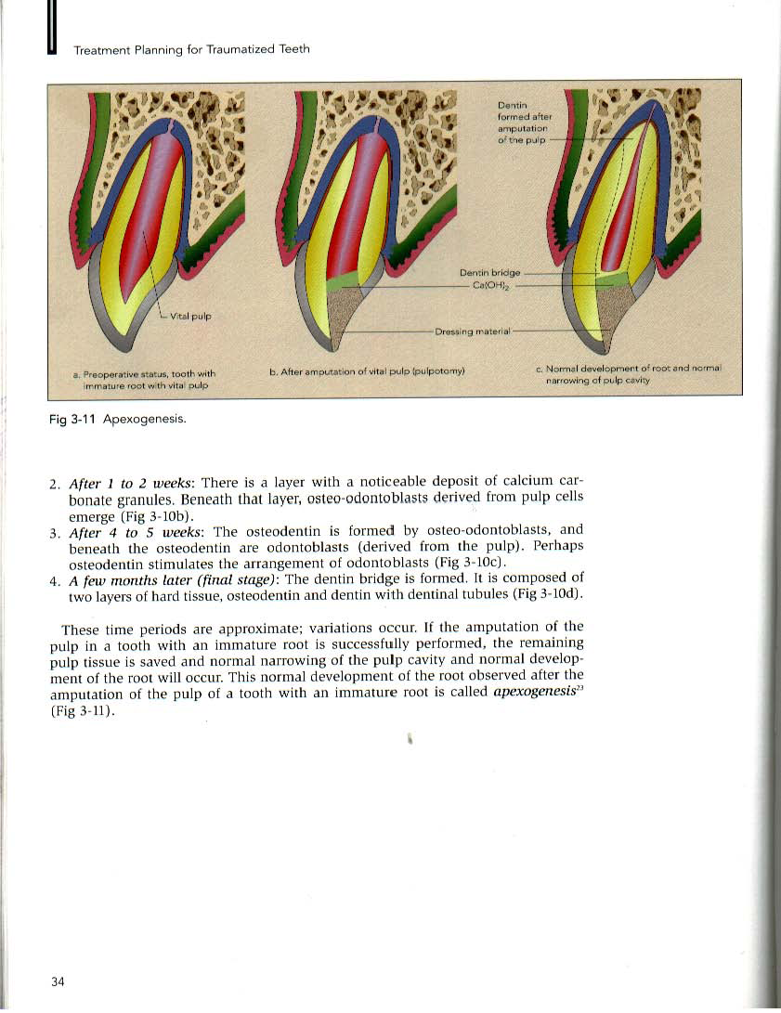

Slide 103
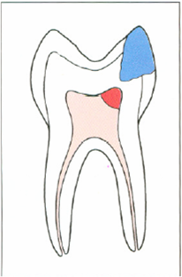

Single Visit Pulpotomy
(Formocresol)
Step 1: Administration of local anesthesia
    Step 2: Apply a rubber dam
    Step 3: Use a sterile No.4 or 8 round bur (slow speed) to remove all carious dentin .
Step 4: Place a No. 330 bur in the high-speed hand piece. Gain occlusal access to the pulp chamber by preparing a Class 1 cavity preparation. Remove all overhanging enamel.

Slide 104
Step 5: Excise the pulpal tissue to the orifices of the root canal. Use a large spoon excavator to remove any remaining pulpal tissue.The pulpal tissue should be amputated to the entrance of the root canals.
Step 6: After completing the amputation, evaluate the hemorrhage. If the pulpal tissue has been removed completely, hemorrhage should be minimal.A vital pulp with minimal chronic inflammation should achieve hemostasis in 3 to 5 minutes.
Step 7: Over the exposed pulp stump,place a sterile cotton pellet moistened with formocresol.

Slide 105
    Step 8: Leave the formocresol in place for 1 minute, and then remove the pellet. The pulp stump should appear blackish brown .If there is bleeding, check for residual pulpal tissue. Reapply formocresol for 2 minutes.
Step 9: Fill the pulp chamber with a thick mixture of zinc oxide-eugenol.
Step 10: Prepare the tooth for a stainless steel crown

Slide 106
Techniques of Pulpotomy:

Slide 107
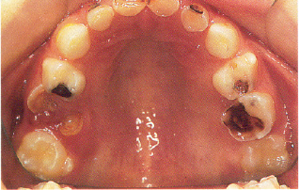

Slide 108

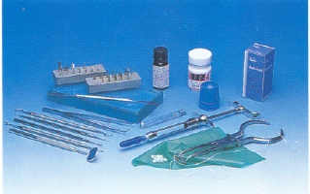

Slide 109

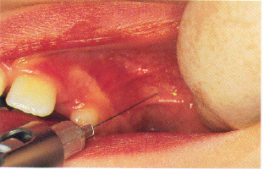
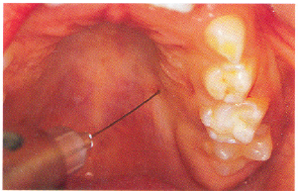
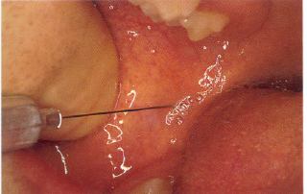
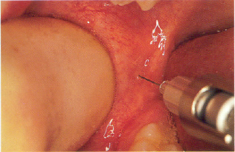

Slide 110



Slide 111



Slide 112


Notes:
Step 5: Excise the pulpal tissue to the orifices of the root canal. Use a large spoon excavator to remove any remaining pulpal tissue.The pulpal tissue should be amputated to the entrance of the root canals.
Step 6: After completing the amputation, evaluate the hemorrhage. If the pulpal tissue has been removed completely, hemorrhage should be minimal.A vital pulp with minimal chronic inflammation should achieve hemostasis in 3 to 5 minutes.

Slide 113



Notes:
Step 5: Excise the pulpal tissue to the orifices of the root canal. Use a large spoon excavator to remove any remaining pulpal tissue.The pulpal tissue should be amputated to the entrance of the root canals.
Step 6: After completing the amputation, evaluate the hemorrhage. If the pulpal tissue has been removed completely, hemorrhage should be minimal.A vital pulp with minimal chronic inflammation should achieve hemostasis in 3 to 5 minutes.

Slide 114


FORMOCRESOL COTTON PELLET
  Cresol 35%
  Formaldehyde 19%
  Glycerine 15%
  Water

Slide 115


Notes:
Cotton pellet moistened with 1:5 conc (Loos n Han) ; 4 minutes (Berger 1965)
Leave the formocresol in place for 1 minute, and then remove the pellet. The pulp stump should appear blackish brown .If there is bleeding, check for residual pulpal tissue. Reapply formocresol for 2 minutes.

Slide 116



Slide 117



Slide 118


Slide 119


PRE AND POSTOPERATIVE RADIOGRAPHS

Slide 120

Single Visit Pulpotomy(Ca(OH)2)

Slide 121
Two Visit Pulpotomy
Indications for two-visit pulpotomy procedure in primary teeth are:
Inability to arrest hemorrhage from the amputated pulp stumps during a single visit formocresol pulpotomy.
Non-vital coronal and/or radicular pulp without the presence of an abscess.

Slide 122
Two-stage procedure:
Paraformaldehyde to fix the entire coronal and radicular pulp tissue.
The paraformaldehyde paste most commonly used has the following composition (Hobson 1970)
^{Hobson’s paste:}
Paraformaldehyde 1.0g
Lignocaine 0.06g
Carmine (colour) 0.01g
Carbowax 1.3g
Propylene glycol 0.5ml

Slide 123
The paste is placed over the pulpal exposure on a small cotton pellet.
The paraformaldehyde paste is sealed into the cavity with zinc eugenol and left for 1-2 weeks.
Formaldehyde gas liberated from the paraformaldehyde permeates through the coronal and radicular pulp, fixing the tissues.
On the second visit, the dressing is removed, there is no need to administer a local anesthetic as the pulp contents should be nonvital, pulpotomy is carried out and then covered with hard setting zinc oxide cement over the radicular pulp before restoring the tooth.

Slide 124
PULP CAPPING AGENTS
Criteria for selection of a pulp capping agent:
Should be biocompatible
Should provide biological seal
Should prevent bacterial microleakage
Various materials used:
1. Calcium hydroxide
2. Zinc oxide eugenol cement
3. Corticosteroids & Antibiotics
4. Polycarboxylate cements
5. Inert materials
6. Collagen fibers
7. Formocresol
8. Hybridizing bonding agents
9. Cell inductive agents
10. MTA
11. Calcium phosphate cement

Slide 125

Calcium Hydroxide
- Introduced by Hermann in 1920
-White odorless powder or 2paste system
-Standard pulp capping material
-Causes coagulation necrosis of adjacent surfaces of pulp tissue.

Slide 126
Composition of Ca(OH)2:
Base paste:
Glycol salicylate – 40%
Calcium sulphate – 30%
Calcium tungstate or Barium sulphate( Radiopacifer) – 16%
Titanium oxide(Inert fillers) – 14%
Catalyst paste:
Calcium hydroxide – 50%
Zinc oxide – 10%
Zinc stearate – 0.5%
Ethylene toluene sulfonamide (Plasticizer) – 39.5%

Slide 127
Composition:
single paste or the light cured calcium hydroxide :
Urethane dimethacrylate
Hydroxymethacrylate (HEMA)
Calcium hydroxide
Polymerization activators
Barium sulphate

Slide 128
Mechanism of action:
When calcium hydroxide comes in contact with the pulp the area of tissues in direct contact would undergo coagulative necrosis.
Also calcium hydroxide can stimulate the formation of calcific barrier when in direct contact thus decreasing the permeability of the dentin.

Slide 129
Antibacterial properties of calcium hydroxide include:
Hydrolyzes bacterial cell wall lipopolysaccharides
Damage to the Bacterial cytoplasmic membrane.
Protein degeneration
Damage to DNA
Neutralizes bacterial endotoxins
reduces anaerobic organisms through carbon dioxide adsorption.

Slide 130
Main effect of ca(oh)2:
Hydroxyl ions: Alkaline PH(11-13)
Stimulate repair and calcification
of dentin.(Dentin bridge)
High PH:Antimicrobial effect.

Slide 132
Different modes of Healing:
pH:11-13
pH:9-10
or
Studies have shown successful results of upto 80% with calcium hydroxide pulp capping of involved primary teeth.

Slide 133
Advantages:
Antimicrobial property.
Promotes healing and repair.
High pH stimulates fibroblasts.
Neutralizes low pH of acids.
Ca(OH)2 stimulates enzyme systems.
Cost effective.
Ease of use.
Fine particles may obturate open tubules.

Slide 134
Disadvantages:
Associated with primary teeth root resorption.
May dissolve after 1year with microleakage.
Acids may degrade the interface during acid etching process.
Does not adhere to vital dentin.
Tunnel defects of dentin bridges after years of placement.

Slide 135
Zinc Oxide Eugenol
Glass and Zander found that ZOE, in direct contact with the pulp tissue, produced chronic inflammation, a lack of calcific barrier and an end result of necrosis.
Watts also found mild to moderate inflammation and no calcific bridges.

Slide 136
Corticosteroids and Antibiotics
suggested for direct pulp capping in the pretreatment phase and also to be mixed with calcium hydroxide.
neomycin and hydrocortisone, Cleocin, cortisone, Ledermix (calcium hydroxide plus prednisolone), penicillin, and Keflin (cephalothin sodium).
Vancomycin & Ca(OH)2: prevent chronic inflammation and stimulate regular reparative dentin bridge.

Slide 137
Inert material
Inert materials:
-Isobutyl cyanoacrylate
-Tricalcium phosphate ceramic
Reduced inflammation and dentin bridging were found.

Slide 138
Collagen fibres
Found to be less irritating than calcium hydroxide with minimal dentin bridging.
collagen was not as effective in promoting a dentin bridge as was Ca(OH)_{2.}
However, dentin bridges were found after 2 months.

Slide 139
Hybridizing bonding agents
Hybridizing dentinal bonding agents provide mechanical adhesion to dentin with microleakage control beneath restorations.
Snuggs et al. demonstrated that pulpal healing occurred, along with bridge formation and teeth showed vital response after 6months.

Slide 140

Mineral trioxide aggregate
It was introduced by Torabinejad at Lomalinda University in 1993.
Composition of MTA:
Portland cement (75%), Bismuth oxide (20%), and gypsum (5%). It also contains trace amounts of SiO2, CaO,MgO,K2SO4 and Na2SO4.

Slide 141
MTA
Advantages include:
Excellent sealing ability
Sets in the presence of moisture
Good compressive strength (70Mpa)
Good biocompatibility
Tissue regeneration (PDL)
Mineralization ((has dentinogenic, osteogenic potential)
Pitt Ford et al. documented superior bridge formation and preservation of pulp vitality with MTA when compared with calcium hydroxide in a direct pulp-capping technique.

Slide 142
Disadvantages of MTA:
Longer setting time
Poor handling properties
Cost is high
Discoloration potential of dental tissue

Slide 143
MTA:
When exposed site is capped with MTA, Zone of necrosis is formed at Pulp-MTA interface.
After MTA hardening calcium oxide is formed.
Calcium oxide react with tissue fluids to form calcium hydroxide.
After contact with pulp tissue MTA presents some structures similar to calcite crystals.

Slide 144
They attract fibronectin-cellular adhesion & differentiation.
Reparative structures induced by MTA were homogenous & in continuity with primary dentin.
Faster hard tissue bridge formation, and pulp tissue free from inflammation.
Normal cytokine activity in bone & cementum regeneration:Cell Inductive potential.

Slide 145
Bioactive Tricalcium Silicate
Bioactive tricalcium silicate has several advantages over calcium hydroxide and MTA.
Goldberg: bioactivity of this material, demonstrating the formation of apatite when immersed in phosphate solution.
Lauren: to induce reparative dentin synthesis (pulp cells-TGF-ß1) and stimulate dental pulp mineralization.
The setting reaction is a hydration of tricalcium silicate, which produces a calcium silicate gel and a calcium hydroxide. In contact with phosphate ions, it creates precipitates that resemble hydroxyapatite.

Slide 146
CONCLUSION
-The aim of conservative pulp therapy is to maintain vitality of coronal and radicular pulp tissue.
- Pulp tissue exposed to oral environment should be protected to preserve its vitality.
- Ca(oh)2 is most popular traditional pupl capping material used.
- Newer materials showed better results clinically.

Slide 147
References:
Art and science of operative dentistry – sturdevants
Textbook of operative dentistry – Vimal K Sikri
Textbook of operative dentistry – Nisha Garg
Textbook of operative dentistry – Ramya Raghu

Slide 148


