Slide 1
SIBAR INSTITUTE OF DENTAL SCIENCES,
GUNTUR
DEPARTMENT OF CONSERVATIVE DENTISTRY AND ENDODONTICS
STERILIZATION, ASEPSIS & ISOLATION
Dr. SAYESH VEMURI
PROFESSOR AND HOD

Slide 2
Contents:
Introduction
Definition
Methods of Sterilization
Various Disinfection modes
Critical,Semi critical,Non critical items
Isolation: Direct and Indirect methods
Rubber dam
Conclusion and References

Slide 3
I N T R O D U C T I O N:
The concept of asepsis and its role in the prevention of infection was put forward nearly Two centuries ago.
Lister, working on antisepsis, initially used phenol (dilute carbolic acid) for contaminated wounds, later applied it in all surgical wounds, also in operating room by nebulization of the solution. Further developments occurred with the introduction of steam sterilization surgical masks, sterile gloves, sterile gowns and drapes etc.

Slide 4
DEFINITIONS:
STERILIZATION:
It is defined as the process by which an article, surface and medium is freed of all microorganisms either in vegetative or spore state.

Slide 5
DISINFECTION:
Means destruction of all pathogenic microorganisms, or organisms capable of giving rise to infection.
Disinfectant (Patterson 1932): A chemical used on nonvital objects to kill surface vegetative pathogenic organisms but not necessarily spore forms or viruses.

Slide 6
ANTISEPTIC:
A chemical that is applied to living tissues such as skin or mucous membrane to reduce the number of microorganisms present through inhibition of their activity or destruction.
BACTERICIDAL AGENTS:
Those agents, which kill the bacteria.
BACTERIOSTATIC:
These are the agents, which inhibit the growth of bacteria.

Slide 7
METHODS OF STERILIZATION
It can be classified into 2 types,
I. Physical agents: It is brought about by 3 main methods
A. Heat
B. Radiation
C. Filtration
II. Chemical agents.

Slide 8
PHYSICAL AGENTS
A. Heat: By two methods,
Dry heat
Moist heat
Dry heat: Can be brought about by
a) Flaming
b) Incineration
c) Hot air oven
Moist heat: Can be brought about by 3 methods,
a) Temperature at 100c
b) Temperature below 100 c
c) Temperature above 100 c

Slide 9
B. Radiation: It is brought about by 2 methods.
a) Ionizing radiation
b) Non Ionizing radiation
C. Filtration: It is brought about by 4 main methods
a)By using earthenware candles.
b)Asbestos disc filters.
c)Sintered glass filter.
d)Membrane filters.

Slide 10
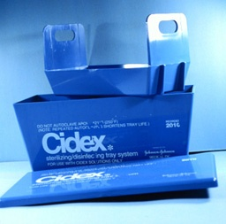
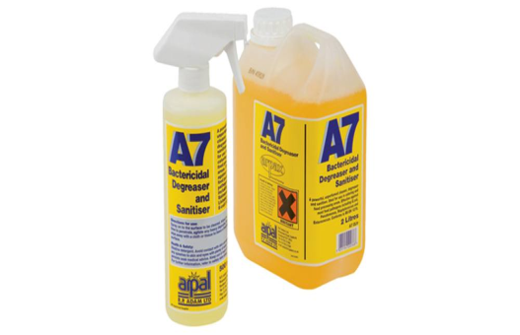
II CHEMICAL AGENTS:
It is brought about by chemical like alcohol, aldehydes, gases, coal tar derivatives surface-active agent, metallic salts dyes, halogens.

Slide 11
CLEANSING OF INSTRUMENTS
According to Lawrence and block (1968) protein and other poly molecular structure, particularly when dry, can serve as a protective covering for microorganisms and prevent penetration of sterilizing medium.
Therefore to allow penetration by heat or chemicals, surgical instruments must be first being scrupulously cleaned of all debris including blood, saliva and necrotic materials.

Slide 12
PHYSICAL METHOD OF STERLIZATION:
I.HEAT:
Sunlight:
Has U-V rays, which destroy the bacteria.
Heat is most reliable method of sterilization.

Slide 13
DRY HEAT METHOD:
The advantage is that it can be easily employed. The major disadvantage is that it has poor penetration power.
A.FLAMING:
The articles are passed on the Bunsen flame.
Articles Sterilized:
1) Inoculating loop of wires.
2) Forceps.
3) Spatulas.
4) Mouths of culture tubes.

Slide 14
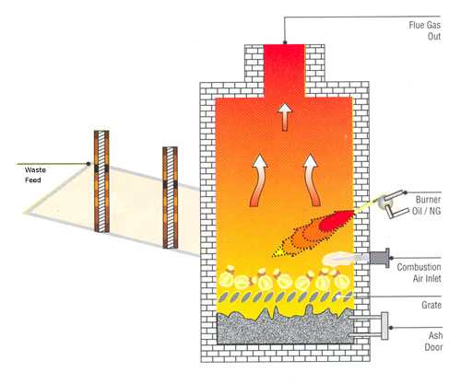
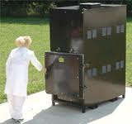
B.INCINERATION:
Contaminated material in bulk is sterilized & disposed by burning in an incinerator.

Slide 15
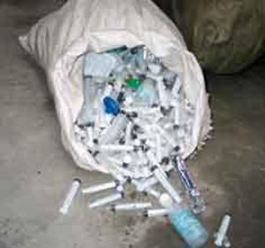
Articles sterilized:
1) All surgical dressings
2) Used disposable syringes
3) All contaminated lab materials
4) Animal carcass
5) Bedding

Slide 16
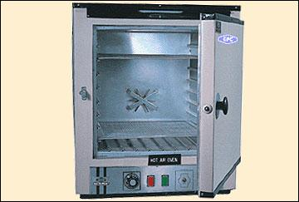
C.HOT AIR OVEN:
Louis Pasteur first discovered this in 1876.
The temperature used is 160c for one hour.
For proper sterilization the temp 160c should be maintained.

Slide 17
Mechanism: Vegetative cells and spores are killed by desiccation and coagulation of cellular proteins.
Uses:This is the preferred method for the sterilization of oils, waxes and powders.
Articles to be sterilized:
1) Surgical instruments
2) Glass ware
3) Oils grease powders
4) Swabs
5) Certain pharmaceutical products

Slide 18
Test for efficiency:
a) Chemical method
b) Biological method
a) Chemical method:
It is carried out by inserting a Browns tube II inside the hot air oven, which develop green spots at 160c , after for one hour.

Slide 19
b) Biological method:
Clostridium tetani on a filter paper strip is placed inside the hot air oven working for 160c for 1hour.
The filter paper strip is inoculated into thioglycolate media & incubated anaerobically at 37c for 5 days.
The result can seen if the spores germinate which indicates hot air oven is not working efficiently.

Slide 20
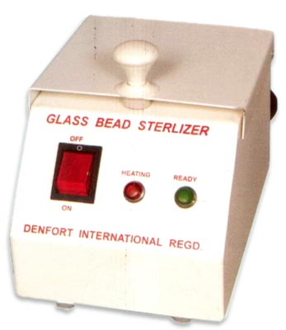
HOT SALT STERILIZER/GLASS BEAD STERILIZER
Apparatus consist of a metal cup in which table salt or glass beads are kept at 425 F – 475 F
Root canal instruments such as broaches, files, reamers are sterilized for 5seconds

Slide 21
B. MOIST HEAT:
1) Temperature below 100C
2) Temp. At 100C
3) Temp. above 100C
1) Temperature below 100C:
Pasteurization of Milk:
There are 2 types of methods.
1) Holder’s process – Temp. is 65c for 30min
2) Flash process – Temp. 72c for 15-20 sec & sudden cooling to 13c

Slide 22
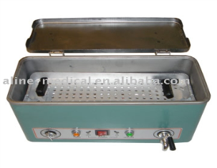
2) Temperature at 100c:
(a)Boiling:
Boiling can destroy most of the non-sporing bacteria but for the destruction it should be boiled for considerable period (10-15mts).
Effective boiling is brought about by adding 2% sodium bicarbonate solution which will promote sterilization.
Certain metallic instruments & glassware can be sterilized by boiling.

Slide 23
(b) Koch’s & Arnolds steam sterilizer
It is used also for intermittent exposure known as tyndallisation. It was discovered by TYNDAL. Temp is 100c for 20 min on 3 successive days.
Advantages:
During the 1st exposure all vegetative bacteria present in the media is killed during the next 24 hours the spores that are present in the media germinate.
During 2nd exposure all the germinated bacteria will be destroyed.
During 3rd exposure complete sterilization is ensured.
It is mainly used to sterilize culture media which contains sugar & gelatin.

Slide 24
3) Temperature above 100c:
Here steam is above the normal pressure.
PRINCIPLE:
A basic principle of chemistry is that when the pressure of a gas increases, the temperature of the gas increase proportionally.
For example, when free flowing steam at a temperature of 100 C is placed under a pressure of 15 pounds of pressure per square inch (Psi) the temperature rises to 121 C.
Increasing the pressure to 20 psi raises the temperature to 126oC.

Slide 25
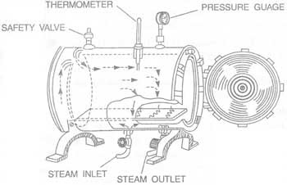
ADVANTAGES
Just one exposure will destroy vegetative & the spores. The temperature used is 121c for 15mins at 15 lbs pressure
Less time is required for complete sterilization when compared to hot air oven (1hr)

Slide 26
Articles sterilized:
1) Surgical Instrument.
2) Surgical Cotton.
3) All culture media except media contain sugar & gelatin.
4) Metallic syringes.
5) For disposing unwanted culture.
Test for efficiency:
Spores of Bacillus stearothermophilis used

Slide 27
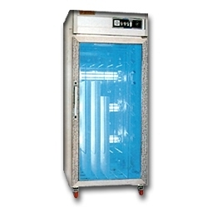
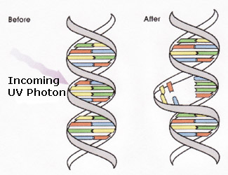
RADIATION:
It is divided into 2 types
A. Non ionizing radiation.
B. Ionizing radiation.
A. Non Ionizing radiation:
(a) U. V. rays: are used to bring down the number of microorganism present in air. So it is used for sterilization of Operation Theatres and also biological safety cabinets used in the laboratory.
Dis adv: Low-penetrating power.

Slide 28
(b)Infra red rays:
It is also a method of nonionising in which the articles to be sterilized are illuminated with infrared rays.
The temp attained is 180c and it is kept for 7-½ min.
Article sterilized: certain metallic instruments & some glassware. This is usually employed in central sterile supplying department (CSSD) E.g. Certain hospitals.

Slide 29
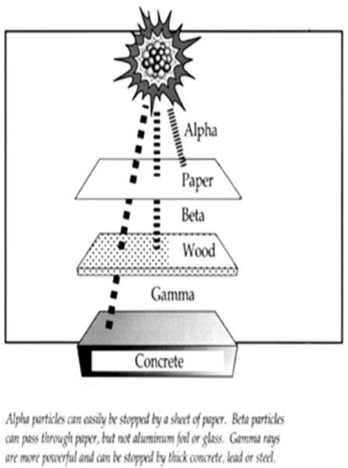
B. Ionizing Radiation:
E.g. ‘X’- rays, gamma rays, cosmic rays. When this radiation is used there is no in temperature rise.
So this method is sterilization is termed as cold sterilization.
They have very high penetrating power.

Slide 30
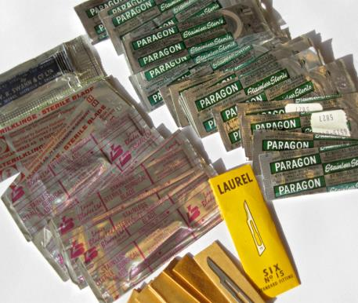
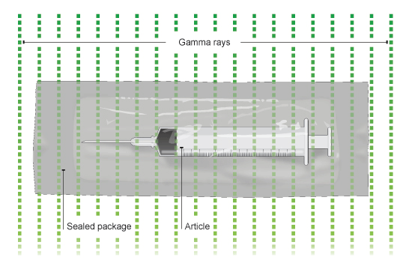
Articles sterilized: Any type of plastic disposable syringes catheters all glass materials animal feeds, cloths oils, grease, rubber material.

Slide 31
III.Filtration:
This is used to sterilize heat labile liquid or all those liquids which are affected by increase in temperature.
E.g. Serum antibiotic culture & sensitivity media sugars & gelatin. It can also be used for the extraction of exotoxins from bacteria.

Slide 32
Different types of filters are used which are classified as:
1)Candles filters
a)Unglazed ceramic filters.
b)Diatomaceous earth filters.
2)Asbestos disc filters.
3)Sintered glass filters
4)Membrane filters.
These filters are sterilized by autoclaving at 121c for 15 minutes.

Slide 33
DISINFECTANTS
Chemical methods: It can be following types:
A. Organic disinfectants – aldehydes, Alcohol
B. Inorganic disinfectants – Halogens + salts & heavy metals.
C. Gaseous disinfectants.
D. Coal Jar derivatives.
E. Dyes.
F. Surface acting agents as disinfectants.

Slide 34
A. ORGANIC DISINFECTANTS:
Aldehydes: Aldehyde compounds such as aqueous formaldehyde (formalin) and Glutaraldehydes are very effective disinfectants.
Formaldehyde:
It is very effective as it bacteriocidal fungicidal & sporocidal. It can be used in the form of solution or gaseous form.
It is not popular because of its noxious odour and contact of 18 to 30 hours is necessary for wide action.
Uses:
• Preserve anatomic specimens.
• Reduce the number of microorganism in operation theatres(fumigation)

Slide 35
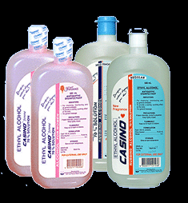
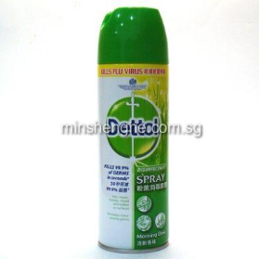
Alcohols: 3 types,
Ethyl alcohol: Used as skin disinfectant.
Isopropyl Alcohol: It is used to disinfectant clinical thermometer.
Methyl alcohol: It is usually used to disinfectant safety cabinets & incubators.

Slide 36
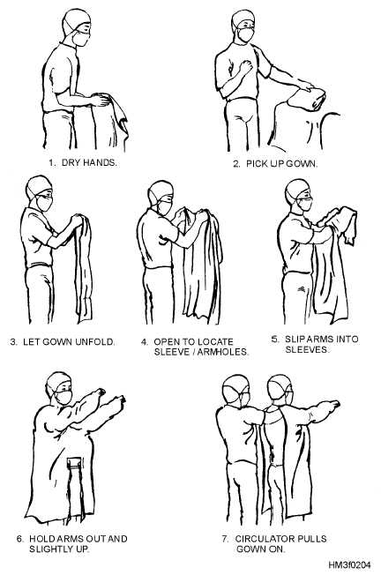
BARRIER TECHNIQUES
Gowns :•
Wear a gown to cover the body when splashes of blood, body fluid, secretions and/or excretions are expected during patient care.
•Use clean, cotton gowns with a plastic apron underneath only if disposable gowns are not available.

Slide 37
Gloves:
The latex gloves provide better tactile sensation but they are also more fragile and more frequent glove changes during the operation may necessary.
General precautions to be taken while using gloves:
Wear glove for all dental procedures.
Discard gloves whenever they have been contaminated, wash hands, and put on new gloves.
Do not leave the clinic or walk around wearing gloves.
Wash your hands after removing gloves.

Slide 38
Sterile surgical gloves.
Non sterile latex gloves.
Vinyl examination gloves.
Utility gloves.

Slide 39
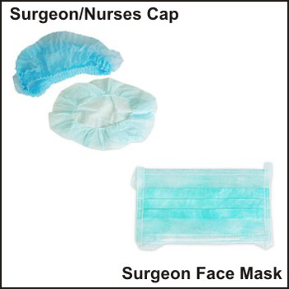
Masks & face shield:
It is used for protection against aerosol.
For TB patient’s greater filtration capacity mask should be worn.
General precautions to be taken while using gloves:
Wear glove for all dental procedures.
Discard gloves whenever they have been contaminated, wash hands, and put on new gloves.
Do not leave the clinic or walk around wearing gloves.
Wash your hands after removing gloves.

Slide 40
ASEPSIS
THE HAND SCRUB
The practice of asepsis begins with proper hand scrub.
The purpose of the hand scrub is to remove superficial contaminants, loose epithelium and to reduce bacterial counts on the skin.
Probably these actions are served by use of hand brush by mechanical action.
The use of antiseptic solution while scrubbing further helps in removing contaminants.

Slide 41
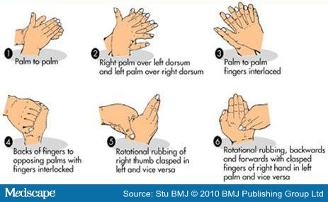

Slide 42
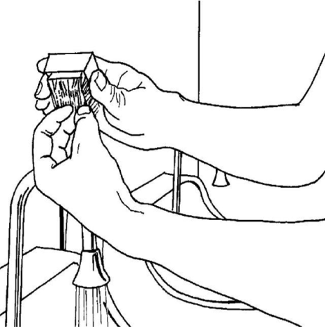
Steps in hand scrubbing.
Before scrubbing nails should be checked for cleanliness.
All gross sub nail contaminants should be removed before continuing scrubbing.

Slide 43
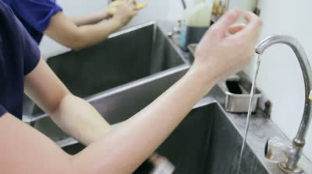
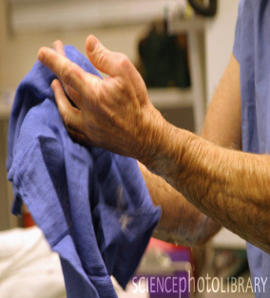
The arms are wetted several times above the elbows. The hands are kept elevated above elbow height so that direction of water flow will be towards the elbows.

Slide 44
Spaulding’s Classification
Critical items
Non critical items
Semi critical items

Slide 45
Sterilizing & Disinfecting specific Dental Armamentarium
Burs &Metal instruments - autoclaved or dry heated or chemically sterilized.
Endodontic instruments - salt / glass bead sterilizers.
Glass slabs and dappen dishes - chemically sterilized with tincture of thimerosal then alcohol

Slide 46
Gutta percha – 5.25% sodium hypochlorite for 1 min
Impression - glutaraldehyde
Cement spatula, cotton pliers, blades of scissors, silver cones by flamming several times (3-4 times)
Rubber dam & tooth swabbed with quick evaporating non staining antiseptic.

Slide 47
ISOLATION
DIRECT METHODS
Rubber dam
Saliva Ejector
High Volume Evacuators
Absorbents (Cotton Roll and Cellulose Wafers) Throat Shields
Retraction Cord.

Slide 48
INDIRECT METHODS
Patient management
Local anaesthesia
Drugs – Antisialogogues Antianxiety drugs Muscle relaxants

Slide 49
RUBBERDAM
Advantages
Adequate access and visibility in operative field
Better patient protection and management
Control of moisture in operative field
Decreased operating time.

Slide 50
Rubber Dam Sheets
natural latex rubber .
5x5 inch (12.5 x 12.5cm) or
6x6 inch (15x15cm sheets
Thin (0.006 inch or 0.15 mm)
Medium (0.008 inch or 0.2 mm)
Heavy (0.010 inch or 0.25 mm)
Extra heavy (0.012 inch or 0.30 mm)
Special heavy (0.014 inch or 0.35 mm)

Slide 51
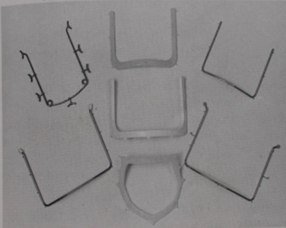
Rubber Dam Holder
It supports the edges of the rubber dam and thus retract the soft tissues and improves access to the isolated teeth.
Frame can be made of metal or plastic.
Fernauld’s Frame
Young’s Frame

Slide 52
Rubber dam retainer or clamp
Consists of four prongs and two jaws connected by a bow.
It is used to anchor the dam to the most posterior tooth to be isolated.

Slide 53
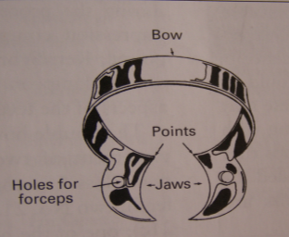
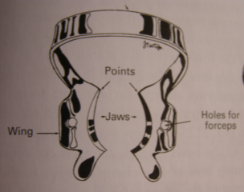
Wingless and Winged Clamp

Slide 55
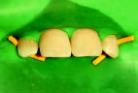
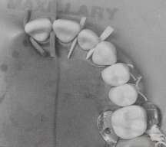
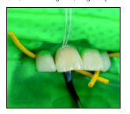
Other retainers
Elastic cord eg; wedgets (hygienic) is placed interproximally to retain the dam.
Interdental wood sticks or wedges
Dental floss/tape placed doubly through a contact and then cut to short length

Slide 56
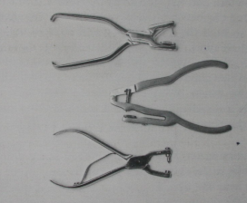
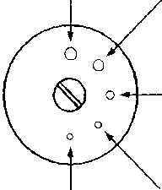
Rubber Dam Punch

Slide 57
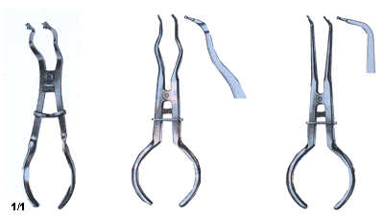
Rubber dam retainer forceps
It is used both for the placement of the retainer and its removal from the tooth.
Three widely used designs are 1.Ash or stokes 2.Ivory pattern 3.University of Washington pattern

Slide 58
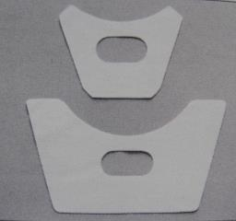
Rubber Dam Napkin
Is placed between the rubber dam and patients skin.
It prevents skin contact with rubber to reduce the possibility of allergic reactions.
Absorbs saliva at the corners of the mouth.
It acts as a cushion aiding comfort to the patient particularly when the dam is used for longer time period

Slide 59
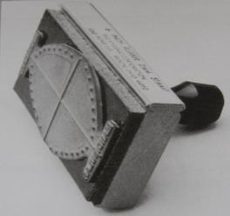
A rubber stamp is available that imprints both permanent and primary arch forms in the rubber dam.
A plastic template can also be used to mark hole positions.

Slide 60
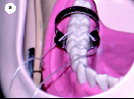
Technique I:
Clamp placement prior to RD:
As the clamp is placed first in this technique the tooth and gingival margin are clearly visible during placement and thus there is minimal risk of gingival trauma.

Slide 61
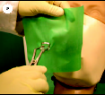
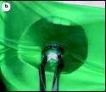
Technique 2 : Clamp and rubber dam placed together.
Winged clamp are usually used in this technique.

Slide 62
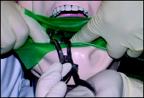
TECHNIQUE 3:
Clamp placement after the R.D.
This technique can prove difficult for an operator working alone and assistance will simplify the whole process.

Slide 63
CONCLUSION:
The sterilization and asepsis is a one of the most important step in the all minor as well as major surgical procedures. Patient & the general public should be assured the surgical care is extremely safe. All measures has to be taken to reduce the incidence of the postoperative infection and also medico legal problems.

Slide 64
References
Art and science of operative dentistry – sturdevants
Science of dental materials-phillips anusavice 11th , 12th edition
Craig restorative dental material 13th edition

Slide 65
THANK YOU

