Slide 1

FINISHING AND POLISHING
SIBAR INSTITUTE OF DENTAL SCIENCES,
GUNTUR
DEPARTMENT OF CONSERVATIVE DENTISTRY
AND ENDODONTICS
Dr. M Pragna
Reader

Slide 2
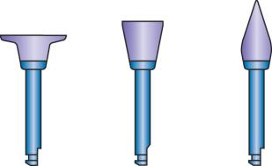
CONTENTS
Introduction
Terminology & Definitions
Theory of finishing
Principles of Tribiology
Benefits of Finishing and Polishing Restorative Materials
Principles of Cutting, Grinding, Finishing and Polishing
Bulk Reduction Process
Contouring
Finishing and Polishing instruments
Abrasion
Abrasives

Slide 3
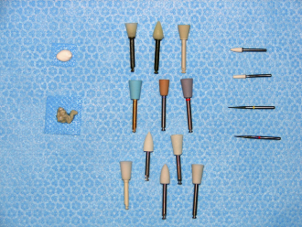
Factors affecting Finishing & polishing
Recent advances
Finishing & Polishing Procedures
- Dental Amalgam
- Composite Restorations
- Glass Ionomer Cement
- Direct Gold Restorations
- Cast Gold Restorations
- Ceramic Restorations
Air Abrasive Technology
Additional procedures
Conclusion
References

Slide 4
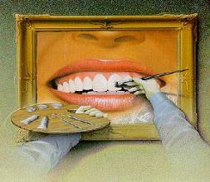
INTRODUCTION
Optimum health of the oral tissues lies on highly smooth surface of restoration in contact with the gingiva.
Finishing, polishing of dental restorations are important aspects of clinical restorative procedures that enhance both esthetics & longevity of restored teeth and maximizes oral health of the patient
Notes:
Objective of the operative dentist is to restore tooth – form function and esthetics maintainence of periodontal tisssues in good esteem.

Slide 5
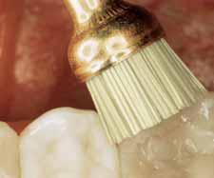
DEFINITIONS
Finishing
Process of removing surface defects or scratches created during the contouring process through the use of cutting or grinding instruments or both.
- Phillip’s
Process that involves removing marginal irregularities, defining anatomic contours, and smoothing away surface roughness of a restoration. Finishing includes the process of margination.
- DCNA 2007
Notes:
Finishing and polishing refers to gross contouring of the restoration, to obtain the desired anatomy, and the reduction and smoothing of the roughness and scratches created by finishing instruments.

Slide 6
Margination
Specific step of the finishing process that involves the removal of excess restorative material at the junction of the tooth structure and the restorative material, and the application of various finishing techniques to establish a smooth, uniform, and well-adapted cavosurface margin.
The finish lines of a preparation are often critical to the longevity of many direct and indirect restoratives because forces of polymerization, mastication & thermal expansion & contraction are transferred to the marginal aspects of the restoration.

Slide 7
polishing
The process carried out after the finishing and margination steps of the finishing procedure to remove minute scratches from the surface of a restoration and obtain a smooth, light-reflective luster.
- DCNA 2007
Process of providing luster or gloss on a material surface.
- Phillip’s

Slide 8
THEORY OF FINISHING & POLISHING
Theory behind finishing & polishing is to use a series of hard objects or abrasives, to remove material from a softer object, such that the surface scratches produced by each abrasive are sequentially replaced with one having smaller dimension.

Slide 9
PRINCIPLES OF TRIBIOLOGY
Tribology is the science of interacting surfaces in motion.
it incorporates the study and application of the principles of friction, lubrication, and wear.
In dental polishing procedures, an abrasive agent creates friction and wear when it comes in contact with the surface being polished.
Four major wear mechanisms are adhesion, abrasion, surface fatigue, and tribochemical reactions.
Notes:
Science of interacting substances in relative motion

Slide 10
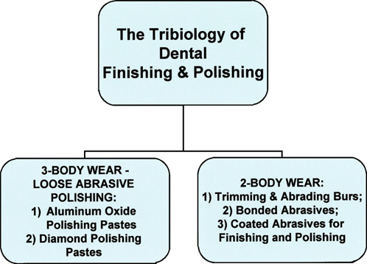
Finishing and polishing procedures in restorative dentistry follow tribiologic principles of abrasive wear in two-body & three-body configurations

Slide 11
BENEFITS OF FINISHING And POLISHING
ORAL HEALTH
FUNCTION
ESTHETICS

Slide 12

ORAL HEALTH
A well contoured and polished restoration promotes oral health by resisting the accumulation of food debris and pathogenic bacteria.
This is accomplished through reduction in total surface area and reduced roughness of the restoration.
Smoother surfaces have less retention areas and are easier to maintain in a hygienic state.

Slide 13
ORAL FUNCTION
A highly polished restoration show a very less tarnish & corrosion.
Oral function is enhanced with a well polished restoration because food glides more freely over occlusal and embrasure surfaces during mastication, and minimizes the wear rates .
Rough surfaces will develop high contact stress that can cause the loss of functional and stabilizing contacts between teeth.

Slide 14
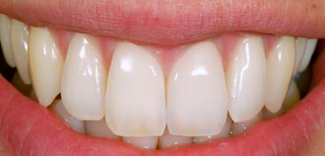
AESTHETICS
Finishing and polishing gives luster to visible surface of a restoration thus increases the optical property of materials.
A high mirror like polish is preferred in highly visible areas such as the labial surfaces of the maxillary anterior teeth.

Slide 15
CLINICAL REASONS FOR FINISHING AND POLISHING
1. Excess flash and refine the margins of the restoration
2. Risk of fracture, since a rough surface may be more likely to fracture
3. Surface imperfections, hence reducing surface area and thus reducing the risk of surface breakdown and corrosion
4. Smooth surface less likely to retain plaque

Slide 16
PRINCIPLES OF CUTTING, GRINDING, FINISHING & POLISHING
There are distinct differences in function of Cutting, Grinding, Finishing and Polishing procedures.
At times they overlap depending on Hardness , Shape & Size of abrasive particle used & Speed of hand piece .

Slide 17
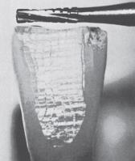
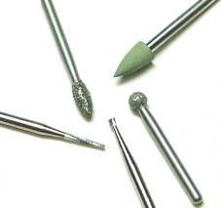
CUTTING
Refers to use of a bladed instrument or use of any instrument in a bladelike fashion.
Cutting operation may divide substrate into large separate segments or produce deep notches or grooves.
E.g. High speed tungsten carbide burs
Seperating wheel

Slide 18
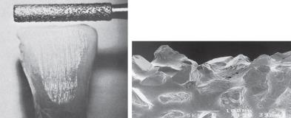
GRINDING
It is a process that removes small particle of a substrate through the
action of bonded or coated abrasive instruments.
Grinding instruments contain many randomly arranged abrasive
particle
Eg: Diamond coated rotary instrument

Slide 19
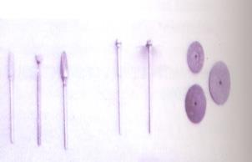
BULK REDUCTION PROCESS
Instruments used
  Diamond, carbide and steel burs
  Abrasive coated disks or separating disks
8 to 12 fluted carbide burs or abrasives with particle size of 100µm.

Slide 20
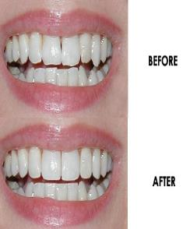
CONTOURING
Even though contouring can be achieved during bulk reduction, in some cases it requires finer cutting instruments or abrasives provide better control of contouring and surface details.
At the end of this process, desired anatomy and margins should be established.
12 – 16 fluted carbide burs or abrasives ranging 30 to 100µm.

Slide 21
FINISHING AND POLISHING PROCEDURES
Require a stepwise approach, introducing finer scratches to the surface of the substrate in order to methodically remove deeper scratches.
Finishing provides a relatively blemish – free, smooth surface.
Finishing action is accomplished using 18-30 flute carbide burs, fine & superfine diamond burs or abrasives between 8-20µm in size.
Notes:
Polishing pastes are applied with soft felt points, muslin (woven cotton fabric) wheels, prophylaxis
rubber cups, or buffing wheels.

Slide 22
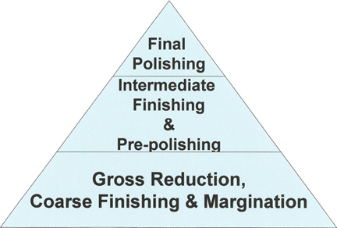
Finishing & Polishing of dental restorative materials encompasses a progression of steps from gross reduction and contouring to final polishing.
Notes:
The ‘‘triangle’’ representation reflects
empirical observations regarding the relative amount of time and effort spent on each segment
of the process. However

Slide 23
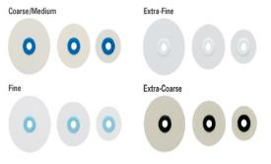

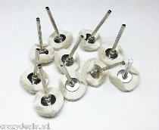
Polishing is considered to be multidirectional in its course of action.
Abrasive particles in the range of particle sizes up to 20 μm provide luster at a low magnification.
Ex: Rubber abrasive points
Fine particle disks & Strips
Fine particle polishing pastes.
Notes:
Heat generation during the cutting, contouring, finishing,
and polishing processes of direct restorations is a major
concern. To avoid adverse effects to the pulp, the clinician
must cool the surface with a lubricant, such as an air–water
spray, and avoid continuous contact of high-speed rotary
instruments with the substrate. Intermittent contact during
operation is necessary not only to cool the surface but also to
remove debris formed between the substrate and the instrument.

Slide 24




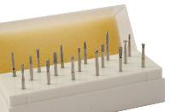
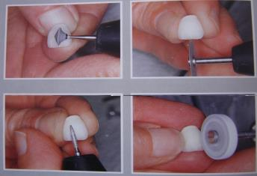
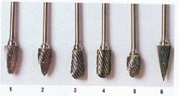
FINISHING AND POLISHING
INSTRUMENTS

Slide 25
FINISHING & POLISHING INSTRUMENTS
Finishing Burs
Diamond Instruments & Pastes
Brushes
Cloth
Felt
Rotary Rubber Instrument

Slide 26
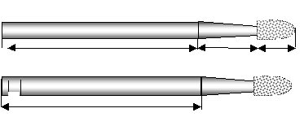
1 ) FINISHING BURS:
Stainless steel or tungsten carbide.
12-40 fluted carbide burs → depending upon Restorative material.
Plain burs – before final finishing
Burs → Straight fissure, Tapering , Flame shaped, Rounded , Wheel etc.

Slide 27
DIAMOND FINISHING BURS
Diamond instruments for dental use were introduced in the United States in 1942, before the introduction and availability of fluted carbide burs.
Finishing diamonds are used to contour, adjust, and smooth restorative materials, such as composites and porcelain.
Bonding of diamond abrasives – heat resistant resins-polyamides
Titanium nitride coatings –additional layer-to extend life of points

Slide 28
DIAMOND INSTRUMENTS CONSIST OF
THREE PARTS:
A Metal Shank Or Blank,
The Powdered Or Particulate Diamond Abrasive &
A Metallic Bonding Material
Manufactured in a variety of shapes and sizes and come in different grits, ranging from 7 to 50 micron m
Diamond burs should always be used with water spray to dissipate heat & at speeds at the lower range of high-speed turbine.

Slide 29
b) CARBIDE FINISHING BURS
Carbide burs are available in a variety of shapes for contouring and finishing.
8 to 40 fluted blades→ Straight or Twisted.
Most common fluted carbide finishing burs have 12, 20 or 40 blades for contouring and smoothing various restorative materials & tooth structures.
Notes:
Carbide finishing burs, due to their less abrasive action, may be kinder to soft tissue at the gingival margin as compared
with diamond bur or bonded abrasive contouring instruments. Finishing with diamond followed by carbide bur better performance

Slide 30
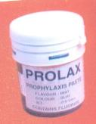
2) DIAMOND INSTRUMENTS AND PASTES:
Transparent material composed of carbon.
Super abrasive
Available commercially in the form of bonded abrasive rotary instruments, metal abrasive strips and polishing pastes.
Finishing diamonds of medium – fine grit contain diamond particles of 8-40µm in diameter.
Used with a light force and copious water spray to preserve the very fine diamond coatings.
Notes:
it is the hardest material known and is capable of abrading almost any other material.

Slide 31
Diamond polishing pastes are also available with particle sizes ranging from 2-5µm.
Diamond abrasives are preferably used on ceramic and composite materials.

Slide 32
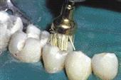
3) BRUSHES :
Either alone or in combination with the abrasive particles.
Synthetic bristles, others may have wire bristles for polishing cast restorations.
Various types of brushes are available which may be screwed, inserted into a hand piece or attached to a mandrel.

Slide 33
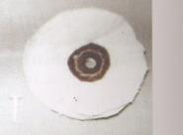
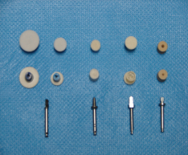
4) CLOTH :
Carried on a metal wheel may be used for final finishing, with or without a polishing medium.
5) FELT :
Attain lustre for metallic restorations usually with a polishing agent.
Available in different shapes of wheels, cones and cylinders.

Slide 34
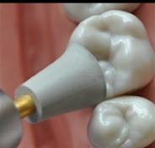
6) ROTARY RUBBER INSTRUMENTS:
Obtained in various shapes of Cups, Wheels, Cones etc.& commonly used with other abrasives or polishing pastes.
The various configurations of these flexible or rubber finishers and polishers complements the access limitations of the coated abrasive discs for such areas as anterior lingual and posterior occlusal surfaces
Notes:
The thin layer of abrasive present on these discs remains effective for a limited
period of clinical use, making these discs single-use and disposable

Slide 35
ABRASION
Wear of a material-removal that occurs whenever surfaces slide against each other
Process of finishing involves abrasive wear of the particles
Outermost particles on the surface of an abrading instrument is referred as abrasive
The material being finished is called as substrate
Abrasive wear is divided into - Two Body Abrasion
- Three Body Abrasion

Slide 36


TWO BODY ABRASION
Occurs when the abrasive particles are firmly bonded to the surface of the abrasive instrument and no other abrasive particles are used.
Eg. Diamond bur abrading a tooth
THREE BODY ABRASION
When abrasive particles are free to translate and rotate between two surfaces.
Eg. Dental Prophylaxis Pastes.

Slide 37
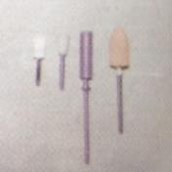
HARDNESS OF ABRASIVES
Inherent strength of cutting blades or abrasive particles on a dental instrument must be great enough to remove particles of substrate material without becoming dull or fracturing too rapidly.
Durability of an abrasive is related to the hardness of its particles or surface material.
Hardness is a surface measurement of the resistance of one material to be plastically deformed by indenting or scratching another material.

Slide 38
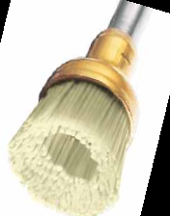
CLASSIFICATION OF ABRASIVES
According to Hardness
a) Hard abrasive - Diamond, Silicon carbide.
b) Medium abrasive - Pumice, Silicates, Zirconates.
c) Soft (Polishing) abrasive - Calcites
(Robert G Craig)

Slide 39
According to the manufacturing process:
ABRASIVE
BONDED
NON BONDED
COATED
SINTERED BONDING
RESINOID BONDING
RUBBER BONDING
VITREOS BONDING
POLISHING PASTES
DISPERSED IN WATER SOLUBLE MEDIUM

Slide 40
According to use
a) Finishing abrasive.
b) Polishing abrasive.
c) Cleansing abrasive.
(Craig, Obrien, Powers)

Slide 41
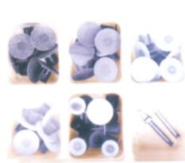
a) ABRASIVE GRITS
Derived from materials that have been crushed and passed through a series of mesh screens to obtain different particle size.
Grits classified according to particle size
A. Coarse
B. Medium
C. Fine
D. Extra fine

Slide 42

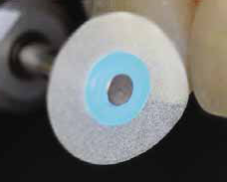

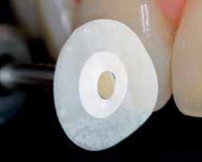
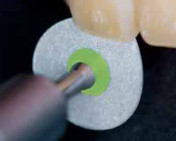


Coarse
Fine
Extra fine
Active side

Slide 43
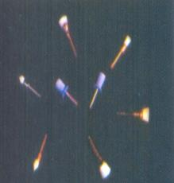
b) BONDED ABRASIVES
Abrasive particles that are incorporated through a binder to form a grinding tools such as points ,wheels ,separating discs, coated thin discs and a wide variety of other abrasive shapes.
Methods used to bond abrasives are
Sintering
Vitrous bonding
Resin bonded abrasives
Rubber bonded abrasive

Slide 44
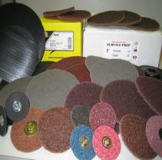

c) COATED ABRASIVES DISKS AND STRIPS
Coated abrasive discs and strips are made by bonding abrasive particles onto a thin polymer or plastic backing.
It is advantageous to use abrasive disks or strips with moisture resistant backings because their stiffness is not reduced by water degradation. Further more, moisture acts as a lubricant to improve cutting efficiency.

Slide 45
The thin layer of abrasive present on these discs remains effective for a limited period of clinical use, making these discs single-use and disposable
Particle size distributions for coated abrasive discs vary from 100 to 55 mm for coarse-grade finishing discs, to 7 to 8 mm for the ultra- or superfine grade of finishing disc
Most are coated with an aluminum oxide abrasive.
work especially well on anterior restorations, such as those involving incisal edges and embrasures.
limited extent on posteriorcomposites, especially on interproximal and some buccal–lingual areas

Slide 46
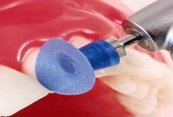

Other examples:
-The EP Esthetic Polishing System (Brassler),
-FlexiDisc (Cosmedent),
-Moore-Flex Polishing System and Moore-Silicon Carbide Discs (E.C. Moore),
-OptiDisc (Kerr Corporation),
-Sof-Lex system (3M ESPE),
-Super-Snap (Shofu),
-Rotary diamond burs

Slide 47
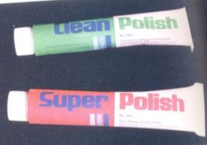
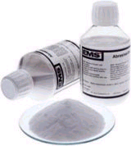
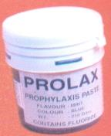
d) NON BONDED ABRASIVES
Polishing pastes → final polishing
Applied to the substrate with a nonabrasive device such as synthetic foam, rubber, felt or chamois cloth.
Abrasive particles are dispersed in a water soluble medium such as glycerin for dental applications.
Eg: Aluminum oxide < 1µm
Diamond 1-10µm

Slide 48
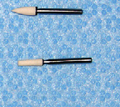
ABRASIVE STONES
Abrasive particles that have been sintered together or bonded with an organic resin to form a cohesive mass.
Color of the stones is an indication of the particular abrasive used: Silicon carbide - green,
aluminum oxide- white
Stone is concentrically fixed to the end of a rotary metal shank or blank.

Slide 49
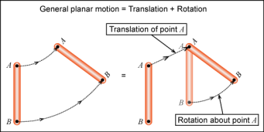

ABRASIVE MOTION
Classified - Rotary
- Planar
- Reciprocal
Burs are considered rotary
Disks are planar
Reciprocating hand pieces provide a cyclic motion and are reciprocal in relationship to their direction of motion.
Reciprocal motion cyclic and up down

Slide 50
Application Of Nanotechnology In Abrasives
Nanotechnology introduced nano silica abrasives by chemical- mechanical planarization process.
Particle size of nano silica ranges from 10-90nm and is spherical in shape.
It has been reported that polishing with nano-silica provides high polishing and low surface roughness .

Slide 51
TYPES OF ABRASIVES
NATURAL
Arkansas stone
Chalk
Corundum
Diamond
Emery
Garnet
Pumice
Quartz
Sand
Tripoli
Zirconium silicate
Cuttle
Kieselguhr
MANUFACTURED ABRASIVES:
Silicon carbide,
Aluminium oxide
Synthetic diamond
Rouge
Tin oxide

Slide 52
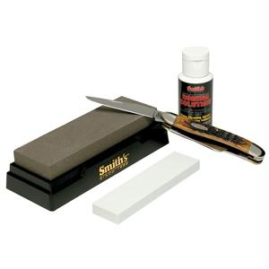
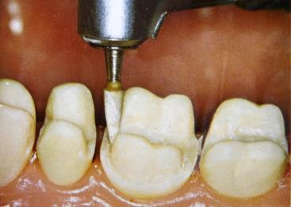
ARKANSAS STONE
Semi translucent, light gray , Siliceous sedimentary rock mined in arkansas
Microcrystalline quartz & is dense, hard & uniformly textured.
Fine grinding of the tooth enamel & metal alloys.

Slide 53

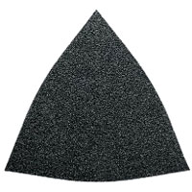
CHALK
One of the mineral forms of calcite is chalk,
white abrasive composed of calcium carbonate.
Used as a mild abrasive paste to polish Tooth enamel, Gold foil, Amalgam.
CORUNDUM
Mineral form of aluminum oxide is usually white.
Used primarily for grinding metal alloys
Commonly used in an instrument known as white stone

Slide 54

NATURAL DIAMOND
Transparent, colorless mineral composed of carbon
Super abrasive because of its ability to abrade any other known substance
Supplied as bonded abrasive rotary instruments, flexible metal- backed abrasive strips and diamond polishing pastes.
- Ceramic and Resin based composite materials.

Slide 55
SYNTHETIC DIAMOND ABRASIVES:
Advantages of these over natural include their controllable, consistent size and shape, as well as their lowest cost compared with natural diamonds.
Available as resin bonded and metal bonded diamonds.
Resin bonded have sharp edges.
Metal bonded diamonds are regular and more consistent in size.
Uses:
- Tooth structure, Ceramic materials & Resin based composite materials.

Slide 56

EMERY
Grayish- black corundum that is prepared in a fine-grain form.
Form of coated abrasive disks and is available in a variety of grit sizes.
Finishing metal alloys or acrylic resin materials.
GARNET
It includes number of different minerals like aluminium,cobalt,iron,manganese, magnesium
An abrasive that is mined , Dark red.
Low hardness compared to many other abrasives.
Grinding metal alloys & Acrylic resin materials.

Slide 57
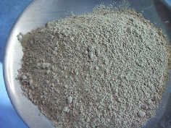
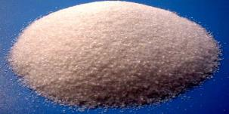
PUMICE
Highly siliceous volcanic glass that when ground is useful as a polishing agent in Prophylactic pastes ,
Finishing acrylic denture bases in the lab
QUARTZ
Hard, colorless and transparent.
Abundant & widespread of minerals.
Primarily to finish metal alloys& grind dental enamel

Slide 58
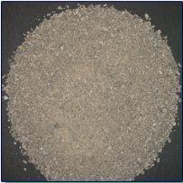
SAND
Mixture of small mineral particles predominantly composed of silica.
Applied under air pressure to remove refractory investment materials from base metal alloy castings.
Grinding of metal alloys , Acrylic resin materials.

Slide 59

TRIPOLI
Usually supplied in a bar that is applied to a rag wheel and mounted in a dental lathe or handpiece.
Used for Polishing metal alloys & some acrylic resin materials.

Slide 60
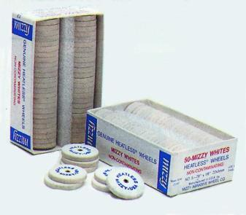
ZIRCONIUM SILICATE
Supplied as off-white mineral
Ground to various particle sizes→ coated abrasive disks and strips.
As a component of dental prophylaxis pastes.

Slide 61
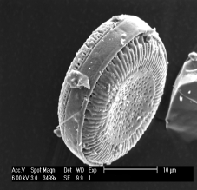
CUTTLE
Obtained by pulverizing internal shell of molluscs
Delicate abrasion operations such as polishing of metal margins, gold alloys, acrylics, composites &
Dental amalgam restorations.
KEISELGUHR
Composed of siliceous remains of minute aquatic plants known as diatoms.
Coarse keisulghr –diatomaceous earth
Mild abrasive, however the risk for respiratory silicosis caused by chronic exposure to air borne particles of this material is significant.
Notes:
filler in
many dental materials such as the hydrocolloid impression
materials.

Slide 62

SILICON CARBIDE
Extremely hard , first of the synthetic abrasives to be produced.
Used on metal alloys, ceramics and acrylic resin materials.
Notes:
The particles are sharp,
and they break to form new sharp particles. This results in
highly efficient cutting of a wide variety of materials

Slide 63
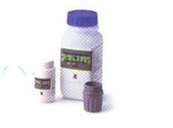
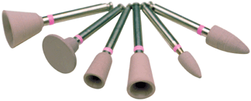
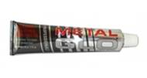
ALUMINIUM OXIDE
Second synthetic abrasive developed much harder than corundum because of its purity.
Used in dentistry to make bonded abrasives , coated abrasives and air propelled grit abrasives.
Sintered aluminum oxide is used for adjusting dental enamel and for finishing metal alloys, resin based composites and ceramic materials.

Slide 64
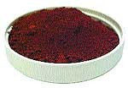
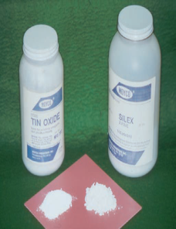
ROUGE
Fine, red abrasive component of rouge
Polish high noble metal alloys.
TIN OXIDE
Extremely fine abrasive used extensively as a polishing agent for polishing teeth and metallic restorations in the mouth.
Mixed with water, alcohol, or glycerin to form a mildly abrasive paste.

Slide 65

ABRASIVE PASTES
Contain either aluminum oxide ( Alumina) or Diamond particles.
Alumina pastes should be used with a rotary instrument and increasing amounts of water as polishing proceeds from coarser to finer abrasives.
Diamond abrasive pastes are used in a relatively dry condition.
Disadvantages :
Relatively thick & cannot gain access into embrasures.
Tend to splatter off of the instruments.
Heat is generated when insufficient coolant is used or when an intermittent polishing technique is not used.

Slide 66
FACTORS AFFECTING FINISHING PROCEDURE
HARDNESS:
Ability of a material to resist forces of indentation.
Moh’s scale.
Diamond has the maximum Moh’s rating of 10.
Silicon carbide → 9-10.
Greater the difference in the hardness between abrasive & substrate,more rapid & efficient is cutting and abrasion.

Slide 67
Relative hardness values for various Dental abrasive compounds, Natural tooth structures & Restorative materials
ABRASIVE MATERIAL | HARDNESS (MOHS’HARDNESS SCALE) | DEVICE EXAMPLES
Diamond | 10 | Diamond cutting and finishing burs, bonded elastomeric(rubberized) polishers, loose abrasive polishing paste.
Silicon carbide | 9–10 | Coated abrasive finishing–polishing discs
Tungsten carbide | 9 | Carbide finishing burs
Aluminum oxide | 9 | White stones, bonded elastomeric (rubberized) finishers–polishers, coated abrasive finishing–polishing discs, loose abrasive polishing paste

Slide 68
ABRASIVE MATERIAL | HARDNESS (MOHS’HARDNES SCALE) | DEVICE EXAMPLES
Zirconium silicate | 7–7.5 | Dental prophylaxis paste abrasive
Pumice | 6 | Dental prophylaxis paste abrasive
Enamel | 5 | Natural tooth structure
Dentin | 3–4 | Natural tooth structure
Porcelain | 6–7 | Restorative material
Gold and gold alloys | 2.5–4 | Restorative material
Resin composite Amalgam | 5–7 4–5 | Restorative material Restorative material

Slide 69
Order of hardness according to Moh’s Scale:
Diamond > Silicon carbide > Tungsten carbide – Aluminum oxide > Zirconium silicate > Pumice.
Highest is diamond (10) whereas Pumice (6) the least hardness.

Slide 70

2. SHAPE
Irregular object with sharp edges has a tendency to dig into a surface rather than a spherical object which rolls across the surface.
Sharper the abrasive→ more effective as a cutting instrument.
Some cutting instruments can be re-sharpened to enhance their cutting efficiency.
Burs and stones → cannot be sharpened ,
disposed off when they become dull or clogged with cutting debris.

Slide 71

3. SIZE
Larger particles abrade a surface more rapidly than smaller ones, because the former plough deeper grooves or cut into the surface.
Roughness of ground or finishing surface → size abrasive particles.
Particles classified into Coarse → 100µm,
Medium →10 to 100µm
Fine →0 to 10µm.

Slide 72

4. PRESSURE
Use of a greater force during finishing causes a more rapid removal of material by forcing the abrasive to cut deeper into the surface.
Care must be taken when using greater pressures as they can create additional heat and raise the temperature within the substrate.
Higher temperatures can lead to distortion or physical changes within the substrate.
Notes:
: High temperatures created during the polishing of amalgam may cause discomfort for the patient owing to the transmission of the heat to vital tissues through the thermally conductive

Slide 73

5. SPEED
Faster speeds result in faster cutting rates but higher speeds create greater temperatures and a danger of overcutting the object.
6. LUBRICATION
Several factors that can create unwanted heat at the site of finishing.
Heat should be minimized, one method is to flood the site with a lubricant that carries the heat away from the surface.
Water is the most common lubricant. `

Slide 74


FINISHING AND POLISHING OF AMALGAM RESTORATION

Slide 75


A properly contoured, polished restoration will contribute to the longevity of the restoration and the health of the surrounding Periodontium
Notes:
A properly contoured, polished restoration will contribute to the longevity of the restoration and the health of the surrounding Periodontium.

Slide 76

ARMAMENTARIUM
Mouth mirror
Explorer
Burnishing instruments
Ball burnisher – for occlusal surface
Beaver tail burnisher / sprately burnisher– proximal surface
Contouring and finishing :
Tungsten carbide finishing bur
Carborundum stones Occlusal Surface
Aluminum oxide stones

Slide 77
Cuttle fish sand paper disks – marginal areas
Rhein trimmers – excess removal in gingival area
Polishing :
Earlier - Pumice or Tin oxide were used.
Temperatures above 60º C (140F)

Slide 78
BURNISHING:
Advantages of burnishing:
Improves the marginal seal and decreases marginal infiltration.
- Kato et al (1968)
May et al (1983) suggested two times for burnishing amalgam restorations.
Pre carve burnishing – done before carving is initiated with a large egg shaped or ball burnisher.
Burnisher is moved mesiodistally & faciolingually.

Slide 79
Post carve burnishing – done after carving is completed using small sized burnisher with light strokes.
Advantages : Decrease in the size and no. of voids on the surface and marginal areas, slower rate of corrosion , denser amalgam at the margins and improvement in the marginal seal.
After 24hrs , gross contouring is done with tungsten carbide finishing bur followed by the use of Carborundum & Aluminum oxide stones.

Slide 80

Use of tungsten carbide finishing bur
Finishing bur permits smoothing with the rounded tip & finishing of the cusp slopes,margins & accessible marginal areas with the side of the bur.
A speed between 18.000 rpm and 30,000 rpm is recommended.
Positioning the instrument head for treatment of fissures

Slide 81


Finishing of the cusp slopes of amalgam restorations
with the side of the finishing bur.
Accessible proximal margins finished with the tip of finishing bur.

Slide 82


DURA GREEN STONES
High quality silicon carbide grit
Exceptional for fast contouring and finishing of amalgam.

Slide 83



Excess of amalgam at gingival
corner of restoration
Use of
amalgam knife
With excess removed

Slide 84
The rubber points should be used at low speed for following reasons:
An excessive temperature increase (> 140 ⁰F or > 60⁰ C ) can cause irreparable damage to the pulp or restoration or both.
When overheated , the surface of the amalgam appears cloudy even though it may have high polish.

Slide 85


Slide 86

SHOFU AMALGAM POLISHING KIT
An ideal assortment of abrasives impregnated with polishing compounds to provide fast and brilliant results on Amalgam restorations without pumice or tin oxide.
The Kit contains:
3 each Brownie Cups & Midi-Points
2 each Greenie Cups & Midi-Points
1 each Supergreenie Cup & Midi-Point – for super polishing

Slide 87



Brownie Cup
For pre-polishing
Greenie Cup
For polishing
Supergreenie cup
for super polishing

Slide 88

Finishing and Polishing helps in
Prevention of recurrent decay
Prevention of deterioration of the amalgam surface
Maintenance of periodontal health
Prevention of occlusal problems

Slide 89


Characteristics of a well polished amalgam restorations
1. Smooth anatomic surfaces
2. Intact contact areas
3. Correctly spaced embrasures
4. Refined margins
5. Smooth resistant surfaces
6. Functional effectiveness
7. Acceptable appearance
8. No plaque-retaining irregularities
9. Restored health of the gingival tissues

Slide 90
Hazards during finishing & polishing of amalgam restorations:
Production of aerosols
High temperatures may damage pulp
Production of mercury vapors
Notes:
Use light, intermittent pressure with rotary instruments lifting the instrument off of the restoration frequently. Heavy or prolonged pressure generates heat.
2. Use slow to moderate speed with rotary instruments. High speeds increase friction and thus generate heat. Increase speed only to produce the final high shine.

Slide 91

Finishing and Polishing of Composite Restorations
FINISHING AND POLISHING OF COMPOSITE RESTORATIONS

Slide 92

Composite resins have been widely used as an anterior restorative material and are now being used for posterior teeth also.
Attentive use of finishing and polishing methods is mandatory for their surface quality and natural appearance of the final restoration.

Slide 93
The three types of composite resins available are Macrofilled, Microfilled & Hybrid.
Classification of each composite resin depends on the particle
size of its inorganic filler.
CONVENTIONAL COMPOSITES:
They pose greatest difficulties in achieving a smooth surface because of the difference in hardness of organic and inorganic phases.
Resin matrix is soft & filler particles are hard.

Slide 94


If fine grit polishing methods are used, the softer resin matrix abrades away easily leaving behind the harder filler particles, which gives it a rough surface.
If coarse abrasives are used, the organic and inorganic phases are removed equally but the abrasive leaves behind rough marks.
This rough surface is highly conducive to picking up extrinsic stains and plaque.

Slide 95
HYBRID COMPOSITES:
These can be polished to a semi gloss but the surface is somewhat hydrophobic which makes it quite unpleasant for the patient.
MICROFILLED COMPOSITES:
Polished to the highest gloss and are considered to be esthetically best amongst all composites.
Surface of these restorations is highly smooth & chances of extrinsic staining are minimal.
Some studies indicate that coated abrasive discs are particularly effective for finishing traditional microfilled composite resin materials.
-J Esthet Dent 2010

Slide 96


Dry finishing → should be reserved for only microfilled composite resins because they contain only resin fillers, which melt & produce an artificial smear layer of resin that enhances the surface gloss.
Wet finishing → technique used for most composites, reduces heat and friction & reduces surface damage to the body & margins of the restoration.

Slide 97
ARMAMENTARIUM
Mouth mirror
Explorer
Carbide or diamond Finishing burs – for gross contouring
Stones Eg: Shofu finishing kit
Rubber Wheels, Cups, and Points
Reciprocating abrasive tips Eg: Lamineer tips, Dentatus
Reciprocating hand piece Eg: Profin Directional Reciprocating handpiece
Coated Abrasives
Eg: abrasive finishing disks and strips – used in inter proximal areas
Rubberized embedded abrasives
Eg : Silicone or Rubber Rotary Points
Polishing kit
Eg: Shofu , Super Snap , Moore flex polishing systems

Slide 98


Slide 99


SEM view of unpolished
composite
SEM view of polished composite

Slide 100
DISCS
Finishing and polishing discs are used for gross reduction, contouring, finishing & polishing restorations.
Most are coated with an aluminum oxide abrasive.
They are used in a sequence of grits, starting with a coarser grit disc and finishing with a superfine grit

Slide 101
Diamond strips help start the interproximal finishing process while maintaining the integrity of the interproximalcontact.
Aluminum oxide cups - polish gingival margins, achieve labial characterization and anatomy, and effectively reach areas such as the gingival third and the gingival margins of anterior teeth.
Aluminum oxide points -to create labial grooves in veneers, to finish and polish occlusal surfaces of posterior teeth, and on lingual surfaces of anterior teeth.
Aluminum oxide polishing paste - the last step in the finishing and polishing process.

Slide 102

SHOFU FINISHING KIT
These assortments are designed for contouring and finishing aesthetic restorations.
The Kit contains:
• Dura-Green Stones – 3 each for adjusting
• Dura-White Stones – 3 each for finishing

Slide 103

RECIPROCATING HAND PIECES
Reciprocating hand pieces especially provide the benefit of accessing interproximal and subgingival areas to remove overhangs , to finish subgingival margins without creating ditches and to create embrasures.
These move not only in a rotary motion, but in a back-and-forth reciprocating motion.
Eg: Profin® reciprocating handpiece (Dentatus, New York, NY)

Slide 104


(Lamineer tips, Dentatus) for interproximal, facial, and incisal finishing and shaping.
Lamineer tips for expanded uses

Slide 105
CLINICAL APPLICATIONS OF
RECIPROCAL HANDPIECE

Slide 106


Reshaping the gingival interproximal margins of a previously placed overcontoured allceramic crown
Reciprocating handpiece with the Lamineer being used to remove excess cement in difficult to access areas

Slide 107


Marginating the gingival margin of a posterior composite restoration with the reciprocating handpiece.
Removing stain with a reciprocating handpiece and plastic tip with prophylaxis paste.

Slide 108



Radiographic view of a mesial overhang on an amalgam restoration in the second maxillary molar.
The reciprocating handpiece with a safe-sided flat tip has access to safely recontour gingival overhang.
Radiographic view of the reshaped and marginated overhang.

Slide 109


Mechanical seating of a crown restoration using a wooden insert in a reciprocating handpiece
Preparation of proximal walls for inlay preparations for computer-aided designed/ computer-aided manufactured restorations.

Slide 110

FINISHING PROCEDURE
→ GROSS CONTOURING SHOULD BE DONE WITH A DIAMOND OR A CARBIDE BUR.
It takes 10 to 15 minutes for a composite to stabilize enough following curing to allow finishing to be accomplished without considerable damage to the
Restoration
STEP 1 :
Long, thin composite resin finishing bur trimming the facial surface

Slide 111

Removal of excess from the margins using fine fluted carbide bur.
Shaping of the gingival margin with a thin needle shaped finishing bur.

Slide 112


Fine diamond finishing bur for contouring the gingival margin.
Egg-shaped 12-bladed finishing bur completing the margin and shaping the lingual surface of the composite restoration
→ After each step rinse and dry the surface.

Slide 113


STEP 2:
Gross reduction and establishing preliminary morphology with the coarse grit (black)
STEP 3:
Establishing the final contour and form with medium grit (violet)

Slide 114


STEP 4:
Finishing the contoured restoration with fine grit (green)
STEP 5:
Final step of polishing with superfine grit (red)

Slide 115

STEP : 6
Finishing using interproximal strips with the same sequence of coarse to super fine sequence

Slide 116


POLISHING PASTE
Ultra II Diamond Polishing Paste is made of ultra-fine diamond particles ( 3μ ) in a smooth paste created to super polish all composite surfaces.
Recommended for use with the Super-Snap Buff Disk.

Slide 117
Effects Of Delayed Finishing/Polishing On Surface Roughness, Hardness And Gloss Of Tooth-coloured Restorative Materials
-European Journal of Dentistry 2010
The smoothest surfaces were obtained under Mylar strip for all materials. While there were no significant differences in surface roughness of immediate and delayed finished/polished samples, immediately finished/polished samples

Slide 118
Finishing & polishing of glass-ionomer cement
Finishing and polishing of restoration is delayed for 24hrs after insertion setting reaction not disturbed surface of material reaches ionic equilibrium.
Protective layer – when excess is trimmed(sharp gold finishing knife)
varnish/petrolleum jelly during initial setting phase to protect from moisture
Countours & embrasures- fine diamonds 12 fluted carbide finishing burs
Finishing- aluminium coated discs

Slide 119
Vaseline with soflex disks- smoothest surface
Air coolants are used- water spray appears to give rough surface because dissolution of matrix
Polyacrylic gel is also used for polishing

Slide 120
Hazards during finishing & polishing of GIC restorations:
Production of aerosols
Excess temperature, dehydration and moisture contamination may damage the restoration surface.
Use of sharp hand instruments before the material has fully set can produce marginal defects.

Slide 121


FINISHING AND POLISHING OF DIRECT GOLD RESTORATIONS

Slide 122
Finishing of a gold foil restoration is as important a step as
its preparation and condensation.
Contouring the metal and improving the marginal seal are the
main goals acquired through finishing.

Slide 123
Burnishing- ball/spratley burnisher
contouring- Moarse Scaler,jones Knife,cleiod Discoid Carver
excess gold in gingival area is removed with wedelstedt chisel
Proximal portions – cuttle fish disks used should be small- damages gingival tissue
disks should not be used- damage the cementum
Polishing - Tinoxide/extra fine silex

Slide 124
FINISHING AND POLISHING OF CAST GOLD RESTORATION
ARMAMENTARIUM
Heatless wheels
Cutting disks / carborundum disks
Garnet disk
No.2 burnisher
Rubber polishing wheel
Bristle disk – for application of tripoli
Cuttle strips
Chamois wheel and rouge – for imparting lustre.

Slide 125
Step 1.
The casting is placed on die to determine satisfactory fit.
Step 2
The Sprue should be cut
Step 3
Then the proximal and occlusal surface of the casting is burnished
with no.2 burnisher along 1mm path that is parallel with and
adjacent to margin.
Step 4
Removing remaining sprue metal with heatless stone or
carborundum disk.
Step 5
Occlusion is checked and any premature contacts are refined
Rubber pcolishing wheel is used to smoothen the occlusal and
proximal surfaces

Slide 126
Step 6:
Polishing grooves and other relatively accessible areas with rubber point.
Step 7:
Apply tripoli to occlusal surface using bristle disk.
Step 8:
Apply tripoli to proximal surface using felt wheel.
Step 9:
Finally apply chamois wheel and rouge to impart luster to the surface of the restoration.

Slide 127


Slide 128

Finished cast gold restoration

Slide 129


FINISHING AND POLISHING OF CERAMICS

Slide 130

The key features of dental ceramics:
Excellent biocompatibility
Stable color
Life like translucency
High abrasion resistance
Good machinability
Having a modulus of elasticity and thermal conductivity close to that of tooth structure.

Slide 131
Three methods for fabrication of ceramic inlays and onlays
Conventional filling Milling from a Casting by the lost
On a die using firing preformed ceramic block wax technique using
porcelain using machinable ceramic castable/pressable
- 2nd and 3rd method does not use the application of a glaze layer to attain the final finish.

Slide 132
Glazing is of two types:
a) Auto glazing
b) Over glazing
Auto glazing is a process in which a smooth surface is obtained without the use of an additional glaze.
Over glazing is the application of an external glaze layer over the surface of the completed body of porcelain.
Notes:
Auto- 955-1065 creates glaze
Over- silica and low fusing fluxes which increase transluency

Slide 133


Slide 134
The effect of polishing techniques on the surface roughness of a feldspathic porcelain
-Mario et al
Rev. odonto ciênc. 2008;23(4):330-332
The results indicate that the tested polishing techniques were not able to provide a porcelain surface as smooth as the glazed surface.

Slide 135


AIR ABRASIVE TECHNOLOGY
As an alternative to the use of rotary instrument cutting, air abrasive systems can deliver a fine, precisely controlled high pressure stream of 25 to 30 micro meters aluminum oxide particles to remove enamel, dentin and restorative materials.
Air abrasion generates minimal heat or vibration which minimizes the potential for tooth chipping or micro fracture.

Slide 136

APPLICATIONS OF AIR ABRASIVE TECHNOLOGY:
Cavity preparation
Removal of defective composite fillings
Minimal preparation to repair crown margins
Superficial removal of stains
Cleaning of tooth surfaces before adhesive bonding
Roughening of internal surfaces of indirect porcelains or composite restorations before adhesive bonding.

Slide 137

AIR ABRASIVE POLISHING:
This process is based on the controlled delivery of air, water and sodium bicarbonate slurry to remove plaque and stains from tooth surfaces.
Compared with rubber cup and prophylaxis pastes techniques, it is more time effective and it is possible to access many tooth surfaces with this technology.
It should be used with caution around cosmetic restorations as it can damage the surface.

Slide 138

Methods to assess the effectiveness of finishing systems and devices
The most common to asses the effectiveness of finishing and polishing system and devices on dental restorative materials include aided and unaided visual evaluation
Profilometer
Optical microscope
SEM ( scanning electron microscope )
reflectometer

Slide 139


Slide 140
ADDITIONAL PROCEDURES
Micro abrasion and Macro abrasion are additional procedures to cutting & grinding which are also used to achieve smooth and shiny surfaces.
These techniques are conservative alternatives for the treatment
Of superficial discolorations or enamel defects like :
Fluorosis, Amelogenesis imperfecta & at times for
carious lesions that are incipient & have rough surface.

Slide 141
MICRO ABRASION
In 1984, Mc Closky recommended a technique for removing brown stains of fluorosis which were related to enamel by using a
cotton pellet application of 18% hydrochloric acid to stained
In 1986, Croll and Cavanaugh modified the technique by using controlled hydrochloric acid – pumice abrasion on stained surfaces.
It uses a paste made of 18% HCL, Pumice slurry and water.
Acid causes dissolution of enamel and the abrasive causes removal of superficial stains and defects.

Slide 142


Slide 143
MACROABRASION
This is also a technique for the treatment of surface stains and defects but utilizes a 12 fluted carbide bur or a micron diamond point revolving at high speed to remove the defect.
Light intermittent pressure is recommended to avoid irreversible damage to the tooth structure.
Following the removal of defect, or if it is decided that the defect can no more be removed, then the remaining part is finished with a 30 fluted carbide bur.
Final polishing is done with an abrasive rubber point.

Slide 144


Slide 145
CONCLUSION
Finishing and polishing techniques are important in preparing clinically successful restorations .
Well finished and polished restrations are not only eshetically pleasing but are also conducive to oral environment
A definite sequence should be adopted in finishing and polishing of each restoration.

Slide 146
REFERENCES
Dental materials – Kenneth J Anusavice- 11th edition
Text book of operative dentistry – Vimal sikri – 4th edition
Dental materials and their selection - william .J.O’brein, 3rd edition
Restorative dental materials – Craigs ,JohnM.Powers 13th edition
Art & Science of Operative Dentistry-Sturdevant, 5th edition
Materials used in dentistry, S.Mahalaxmi
Clinical Aspects Of Dental Materials- Marcia Gladwin,michael Bagby

Slide 147
Abrasive Finishing and Polishing in Restorative Dentistry:A State-of-the-Art Review Steven R. Jefferies Dent Clin N Am 51 (2007)
Contouring, Finishing, and Polishing Anterior Composites By K. William Mopper, DDS, MS
The effect of burnishing on the marginal seal amalgam restorations Shinichi Kato et al The Journal Of Prosthetic Dentistry 1968
Burnished amalgam restorations: A two-yearclinical evaluation-
Kenneth The Journal Of Prosthetic Dentistry 1983
The effect of polishing techniques on the surface roughness of a feldspathic porcelain , Mario Cezar Silva Oliveira Rev. odonto ciênc. 2008
Effect of Different Finishing and Polishing Techniques on the Surface Roughness of Microfilled, Hybrid and Packable Composite Resins silvia helena etal Braz Dent J (2005)

Slide 148

-Richelle e.goodrich
If you avoid all of life’s abrasions you will never be polished enough to shine

