Slide 1
MYO-FUNCTIONAL APPLIANCES
Notes:
Good morning dear all, today we shall discuss about myofunctional appliances, which can be used in day to day practice in treating a lot of developing malocclusions as a part of interceptive orthodontics. However due to lack of basic knowledge of where and when these are used a lot of malocclusions were left untreated at the right time.

Slide 2
Goals of Orthodontics and Dentofacial Orthopedics
Functional efficiency, Esthetic Harmony & Structural Balance
Achieve a good occlusion
Harmonize the basal structures
Class I malocclusions
Skeletal malocclusions
Notes:
As we all know about the Jacksons triad which constitute the functional efficacy, esthetic harmony and structural balance. These are the goals of orthodontic treatment. Myofunctional appliances also were targeted at achieving good class I intercuspation for better function also jaw bases are harmonized establishing esthetic harmony

Slide 3
A skeletal Class II - fault with the maxilla
Notes:
A skeletal class II malocclusion may be due to a prognathic maxilla which means a larger sized maxilla or a maxilla which is positioned forward

Slide 4
A skeletal Class II - fault with the mandible
Notes:
Class II malocclusion also is a result of retrognathic mandible, which is either due to a small mandible or a mandible articulated posteriorly to the cranial base.

Slide 5
Components of a growing skeletal Class II malocclusion
Maxillary prognathism – 30%
Mandibular retrusion - 70%
----Mc’Namara (1981)
Mastorakos study( 1984) --- slight disagreement with Mc’Namara’s values
Notes:
From the census projected by the mcnamara and few others it is quiet evident that most of the skeletal malocclusions are due to a retrognathic mandible which can be rectified using myofunctional appliance in a right way at the right time

Slide 6
How do we alter this impaired growth of the skeletal base ?

Slide 7
Skeletal malocclusions
If your only instrument’s a hammer, then every problem looks like a nail.
--- Maslow
Notes:
If you are aiming about correction of irregularities of the teeth you might be opting for braces. But there is something beyond dentition which is causing the malocclusion those are skeletal defects as discussed previously which are dealt with myofunctional therapy

Slide 8
Skeletal malocclusions
Skeletal Class II or Skeletal Class III
Treated by ----
a) Functional appliances
b) Headgear
c) Combination
d) Camouflage
e) Surgical intervention
Growth Modulation

Slide 9
DEFINITION
Functional appliance:-by definition is one that changes the posture of the mandible,holding it open (or) open and forward (Proffit).
Notes:
Myofunctional appliances are passive or loose fitting appliances which harness the natural forces of orofacial musculature and transfer these forces to the dentition and skeletal bases

Slide 10
CLASSIFICATION
According to “ Graber”:-
1.Group- A- Teeth supported appliances,
-catlan’s appliance,Inclined planes.
2.Group –B-Teeth/tissue supported appliances.
-Activator,Bionator etc
3.Group-C- Vestibular positioned appliances
with isolated support from tooth /tissue,
-Frankel appliance, Lip bumpers.

Slide 11
ACCORDING TO PROFITT
1.Tooth borne passive-
-Andersen activator
-Woodside and Harvold activator
-Bionator
2.Tooth borne active-
-Modified activator
-Expansion activator
-Orthopaedic Corrector
-Stockli headgear activator
3.Tissue borne appliances(Passive)s
-Frankel appliance.

Slide 12
Other classifications
1.MYOTONIC APPLIANCES:-
Depend muscle mass for their
action.
2.MYODYNAMIC APPLIANCES:-
Depend on muscle activity for
for their function.
.

Slide 13
1.REMOVABLE FUNCTIONAL APPLIANCES
-Activator
-Bionator
-Frankel
-Twin Block
2.Fixed functional appliances
-Herbst
-Jasper jumper
-Forsus
(Fatigue resistant device)

Slide 14
TREATMENT PRINCIPLES
Force Application & elimination
sheilds / screens / bite planes / construction bite
Notes:
Myofunctional appliances basically work by means of force application and force elimination. Various components are incorporated in the construction of appliance which carry out force application & elimination these include, sheilds, bite planes & construction bite

Slide 15
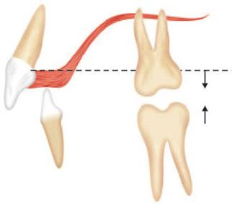
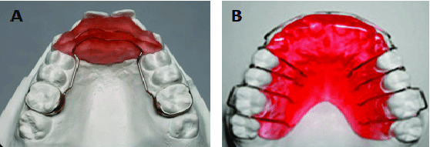
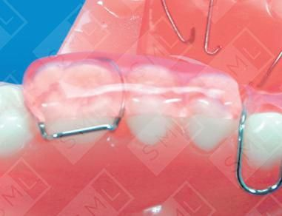
Bite Planes :-
flat/ Inclined
anterior / posterior
Notes:
Bite planes can be flat or inclined and can be used on anterior teeth or posterior teeth. Bite planes as the name indicates are the planes created interocclusally which alter the bite (occlusion)
Anterior bite plate in the first image shows disocclusion of posterior teeth which will be free to erupt in a occlusal and mesial direction. At the same time the anteriors are prevented from eruption. If the eruption of the posteriors is carried out differentially it alters the occlusion. For example in a class II occlusion if the maxillary posteriors are prevented from erupting occlusally and mesially where as mandibular posteriors erupt medially and occlusally the occlusion tend to change to a class I.

Slide 16
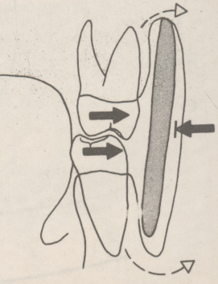
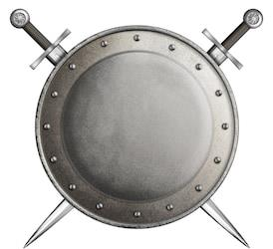
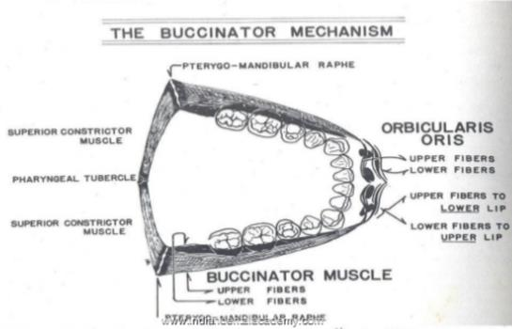
Sheilds / Screens :
EQUILIBRIUM
Notes:
From the equilibrium theory it is quiet evident that the dentition is arranged in the dental arches at neutral zone where the buccal forces from the cheek, lips and lingual forces from the tongue are equal. By sheilding of the either the lingual or buccal forces the neutral zone where in the teeth lies can be altered.

Slide 17
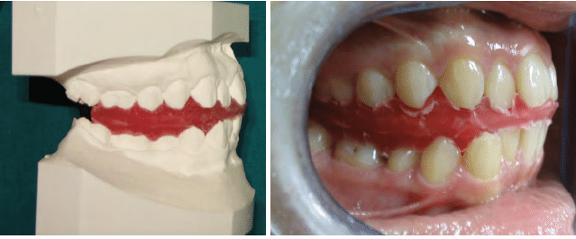
Construction bite :
Mandible is advanced as well as opened
Notes:
A Construction bite is an intermaxillary wax record used to relate mandible to maxilla in the three dimensions of space. It is an indispensable record to correct functional malocclusions like functional retrusion and functional protrusion.
As said it is a wax record, where in the patient is encouraged to bite on to the wax by advancing the mandible so that the dentition comes to class I which perse is class II due to retrognathic mandible. In this process the bite is opened as well as advanced.
Depending on the amount of sagittal advancement and vertical opening of the mandible construction bite is of different types.

Slide 18
Notes:
You might have observed in the very beginning of the presentation, “structure of the muscle” is portrayed. Muscle function or myofunctioning is very important here, especially of lateral pterygoid muscle. It is the one which is getting inserted into the articular capsule, disc and the condyle neck arising from the infratemporal surface as well as from pterygoid plates. It plays an essential role not only in the mandibular movements but also in its growth.

Slide 19
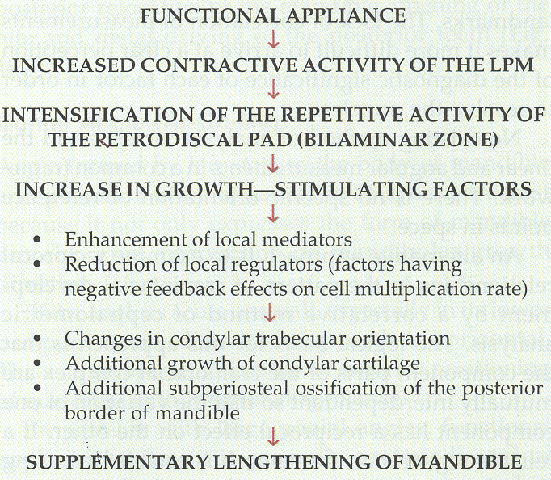
MODE OF
ACTION OF
FUNCTIONAL
APPLIANCE
Notes:
This flowchart depicts the sequence of events that occurs following insertion of functional appliance. With the functional appliance in place, mandible tends to get advanced (Forward posturing of the mandible) this results in contraction of lateral pterygoid muscle. This muscle as it is attached to the articular disc its repetitive contracture results in inflammation of retrodiscal tissue which releases growth factors.

Slide 20
Functional appliances brings about
Orthopedic changes
Dentoalveolar changes
Muscular changes
Notes:
Orthopedic changes include increase in size of mandible, restriction of growth of maxilla in skeletal Class II conditions vice versa in Skeletal Class III
Dentoalveolar changes as discussed in the bite plates brings correction of occlusion, levels curve of spee
Muscular changes include repositioning of mandible

Slide 21
What cases are suitable for Myofunctional Therapy ?
Notes:
First and foremost the patient should be growing, preferably in the period of growth spurt
Mixed dentition and prepubertal growth spurts are the ideal periods for functional appliance therapy
Deficient mandible evident from a convex profile with posterior facial divergence
Low clinical FMA is favouable, high clinical FMA patients has poor prognosis

Slide 22
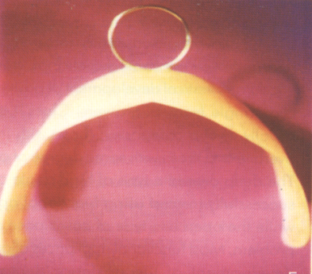
VESTIBULAR SCREEN (OR) ORAL SCREEN
Introduced by Newell -1912
Principle –
Indications –
Habit interception
Mild disto-occlusion
Mild proclination
Muscle exercise
Management :
Notes:
It works on the principle of force elimination, eliminates the forces of buccal & labial musculature
Night time wear and 2-3 hrs of day time wear
Patient instructed to maintain lip seal

Slide 23
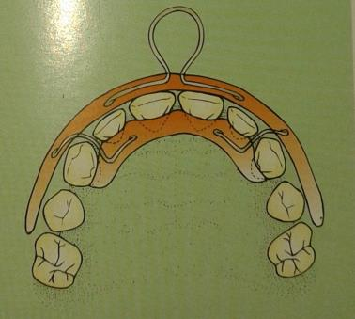
Hotz modification
Modification for tongue thrusting
Modification for mouth breathing
Notes:
Regular oral screen is incorporate with a ring on the labial surface in hotz modification this facilitates in carrying out muscle exercise
Double oral screen has a sheild on the lingual aspect of the dentition as well which obstructs the tongue thrusting as well
Oral screen is fabricated with holes which are gradually closed in mouth breathing patients

Slide 24
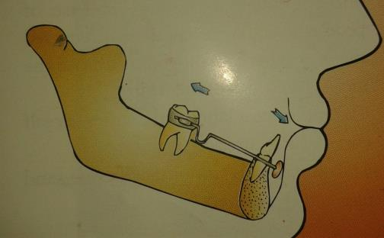
LIP BUMPER :
Indications -
lip sucking
hyperactive mentalis
anchorage augmentation
molar distalization
space regaining
Denholtz appliance
Notes:
It is a combined removable-fixed appliance. It is a modified vestibular screen, used for elimination of forces of lips on the anterior teeth as well as application of forces on the molars which can be used for molar distalization.
Lip bumper used in maxillary arch is often termed as Denholtz appliance.

Slide 25
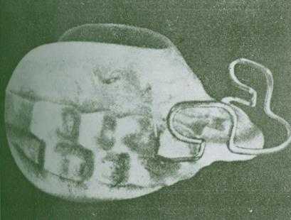
ACTIVATOR
Kingsley – 1879
DEVELOPED BY VIGGO ANDRESEN-1908
Other Names
Biomechanical working retainer
Norwegian appliance
Activator
.
Notes:
In 1879, Kingsley introduced the term and concept of "jumping the bite" for patients with mandibular retrusion.
He inserted a vulcanite palatal plate consisting of an anterior incline that guided the mandible to a forward position when the patient closed on it.
This maneuver corrected the sagittal relationship .
Impressed by Kingsley's concepts and appliances, Andresen developed a mobile, loose fitting appliance modification that transferred functioning muscle stimuli to the jaws
Appliance design : The acrylic body of the Andresen activator covers part of the palate and the lingual aspect of the mandibular alveolar ridge.
A labial bow fits anterior to the maxillary incisors and carries U-loops for adjustment.
On the palatal aspects of the maxillary incisors, the acrylic is relieved to allow their retraction.

Slide 26
Advantages :
- growth modification
- hygeine
- long intervelled appointments
- minimal adjustments
- economical
Disadvantages :
Pt co-operation
finishing & detailing
mandibular rotation

Slide 27
INDICATIONS OF ACTIVATOR
CLASS 2 DIV-1 MALOCCLUSION
CLASS 2 DIV-2 MALOCCLUSION
CLASS 3 MALOCCLUSION
CLASS 1 OPENBITE
CLASS 1 DEEP BITE
FOR POST TREATMENT RETENTION

Slide 28
CONTRANDICATIONS
In children with excess LFH-and extreme
vertical mandibular growth .
In class –1 crowding.
Has limited application in non-growing children.
In severely proclined lower incisors.

Slide 29
Mode of action :
Andersen and Haupl
activator new pattern of mandibular closure
stretching of elevator muscles
myotactic reflex
+ condylar adaptation

Slide 30
Construction bite :
Intermaxillary wax record, relating the maxilla to mandible in 3dimensions of space
H- Activator
V- Activator

Slide 31
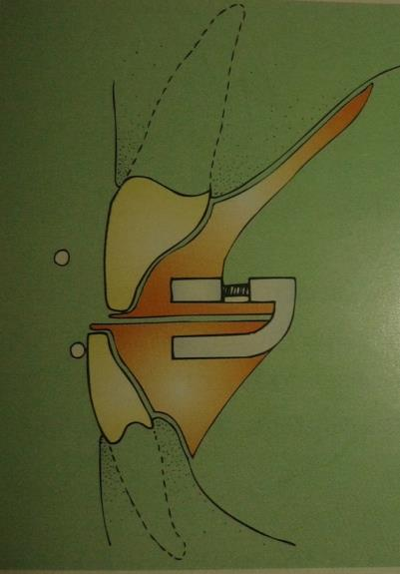
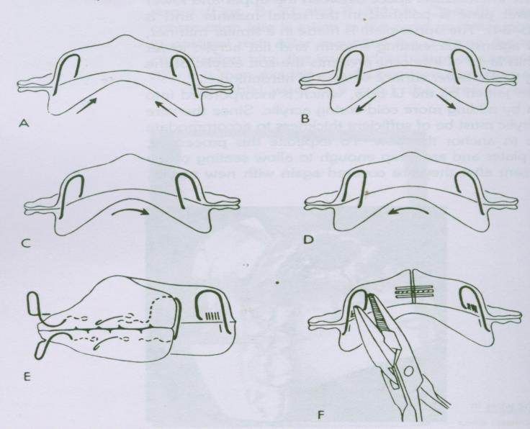
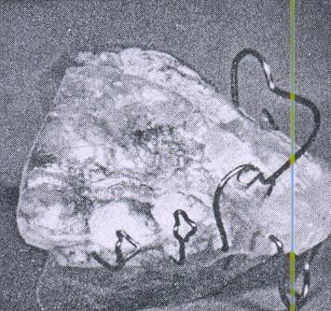
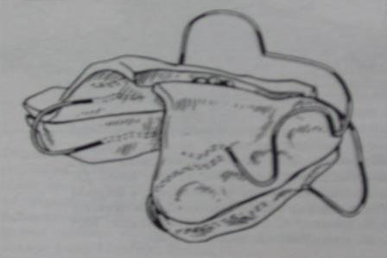
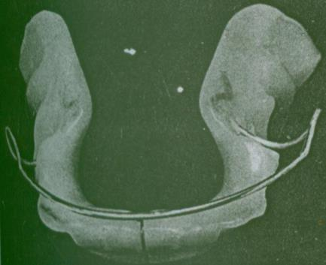
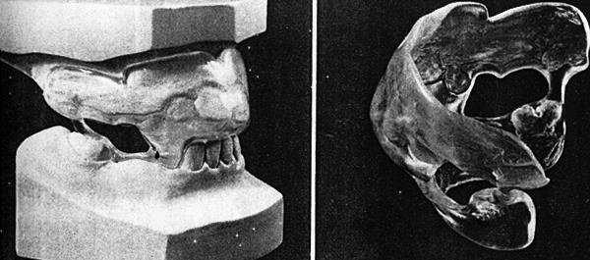
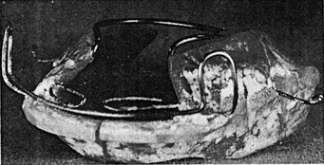
ACTIVATOR- AND ITS MODIFICATIONS
BOW ACTIVATOR
CYBERNATOR
KARWETZKY MODIFICATION
PROPULSOR
CUT OT ACTIVATOR
HERREN’S MODIFICATION
WUNDERER’S MODIFICATION

Slide 32
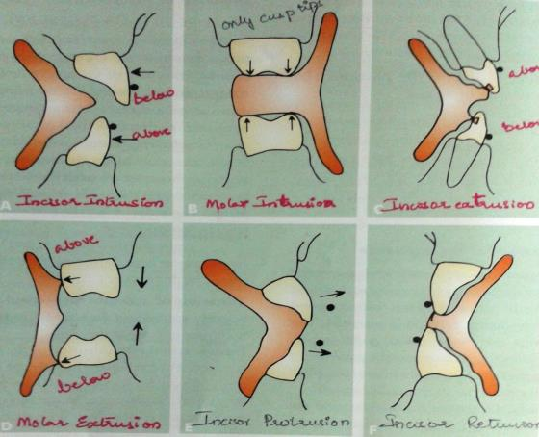
TRIMMING OF ACTIVATOR
Notes:
Trimming of activator-
For inciosr intrusion – labial bow in incisal third and acrylic trimmed from lingual aspect of incisors
Molar Intrusion – occlusal cusp tips loaded
Incisor extrusion – labial at gingival third
Molar extrusion – acrylic trimmed off and molars free to erupt
Incisor protrusion – lingual surfaces loaded with acrylic & labial bow kept away from teeth
Incisor retrusion – labial bow activated with lingual acrylic trimmed off

Slide 33
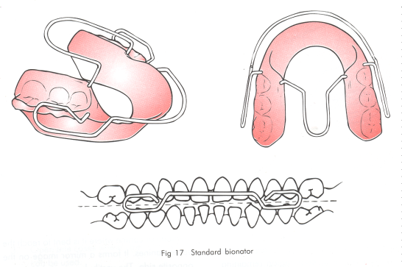
BIONATOR
Developed by-Balter-1950
HORSE SHOE SHAPED-acrylic lingual plate
Notes:
Balters (1943) introduced the bionator
His philosophy is based on the Equilibrium between tongue and circumoral muscles which infleunces the shape of dental arches and intercuspation
Good functional coordination b/w the internal and external muscles is essential for normal development of these muscles and eliminating deforming, growth-restricting aberrations

Slide 34
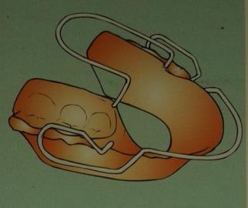
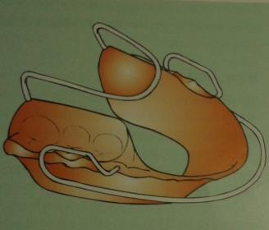
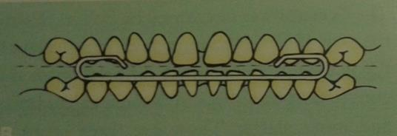
Notes:
A classic bionator is used for classII malocclusions with labial bow at the level of upper incisors
In class III bionator labial bow will be at the level of lower incisors
Where as in open bite bionator it will be bisecting the open bite

Slide 35
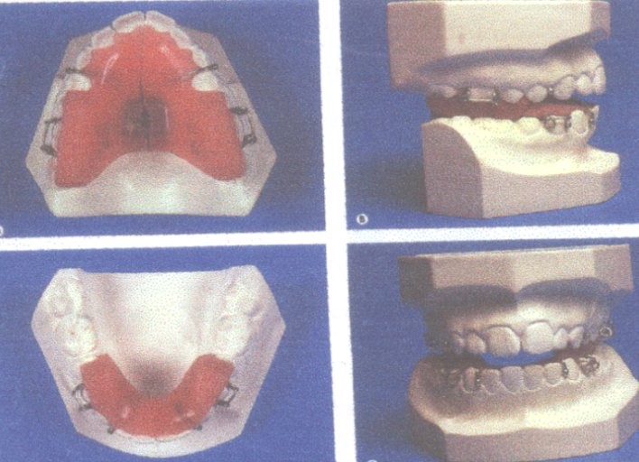
TWIN BLOCK APPLIANCE
Notes:
Developed by William Clark
The occlusal inclined plane is the fundamental functional mechanism of the natural dentition.
This appliance modifies the occlusal inclined plane and use the forces of occlusion to correct the malocclusion.
The mandible is guided forward by the occlusal inclined plane.

Slide 36
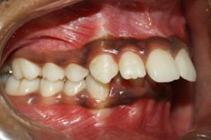
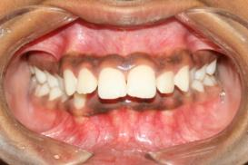
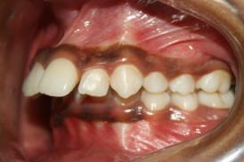
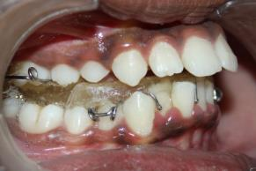
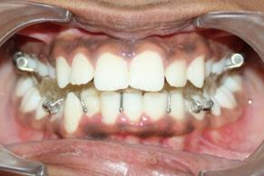
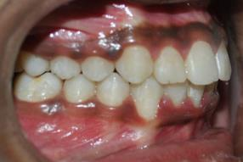
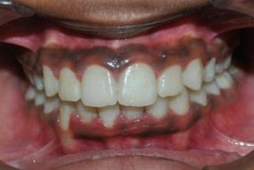
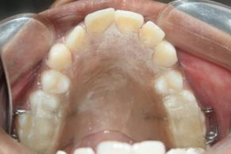
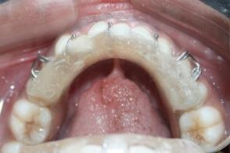
Introduced by william J.Clark in--1982
Notes:
This is a case showing patient being treated with twin block. Initially patient has a skeltal class II malocclusion which also is reciprocated in the dentition with class II molar relation. After functional appliance therapy class I occlusion was achieved.

Slide 37
FUNCTION REGULATOR
OR
FRANKEL APPLIANCE

Slide 38
FRANKEL APPLIANCE
Developed by Prof. ROLF FRANKEL of GERMANY
Also called –Vestibular Appliance and
Oral –Gymnastic appliance
(FRANKEL –recommended
certain oral excercises called
oral gymnastics-hence the name)

Slide 39
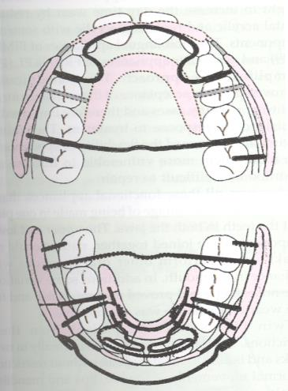
FRANKEL PHILOSOPHY
Vestibular arena of operation
Sagital correction via tooth borne maxillary anchorage
Differential eruption guidence
Minimal maxillary basal effect
Periosteal pull

Slide 40
MODE OF ACTION
- Increase in transverse and sagittal intra-oral space
Increase in vertical space
Mandibular protraction
Muscle function adaptation

Slide 41
TYPES OF FRANKEL
FR1
FR1a – mild to moderate crowding, Deep bIte
FR1b – class II With 5mm Overjet
FR1c – Class II with 7mm overjet
- FR2 - class II div I & II
- FR3 – Class III
- FR4 – Open bite and bimax Protrusion
- FR5 – long face patients

Slide 42
Parts of FR-2-Class 2-div-1&2
The acrylic components include:-
A.Buccal shields
B.Lip pads
C.Lower lingual pad
The wire components include:-
A. Palatal bow
B.Labial bow
C.Canine Extensions
D.Upper Lingual wire
E.Lingual crossover wire
F.Support wire for lip pads
G.Lower lingual springs.

Slide 43
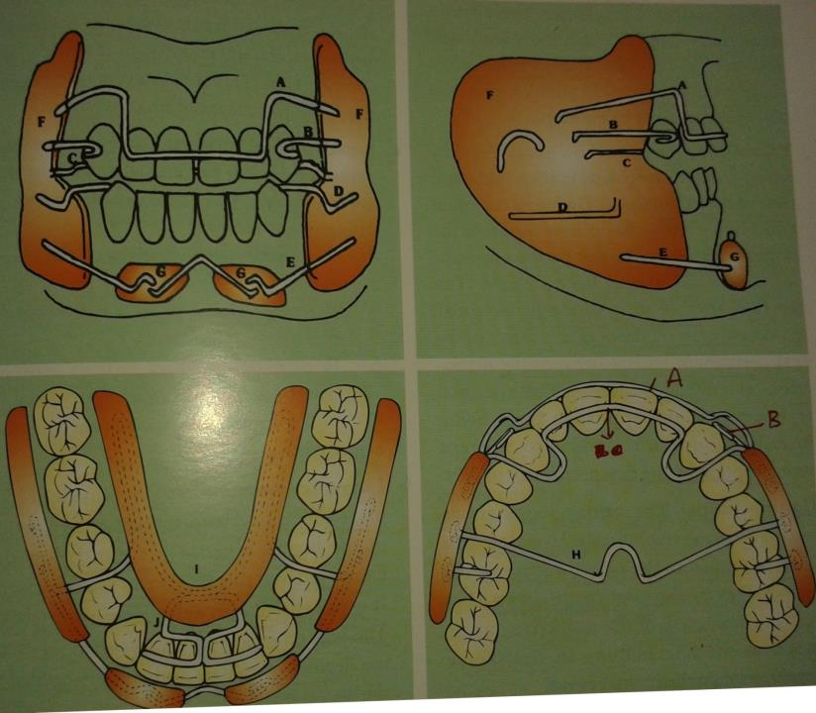

Slide 44
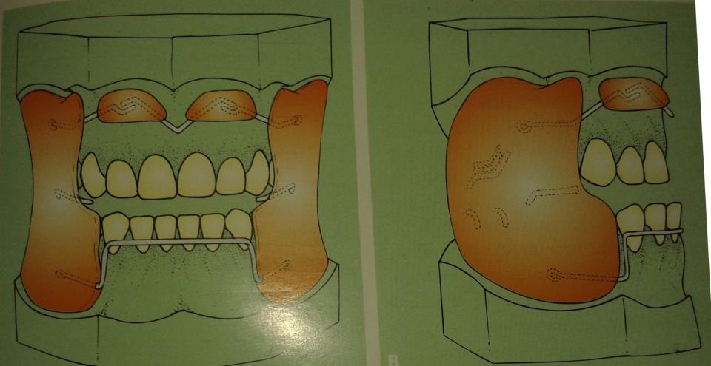
Notes:
Frankel III – Note the lip pads located in the maxillary arch, where as in FR – II lip pads are in mandibular arch. The labial bow also is reversed to mandibular arch in FR-III

Slide 45
Commonly used fixed functional appliances:-
Herbst Appliance
Jasper jumper
Forsus (Fatigue resistant device.)
MARA –Appliance (Mandibular anterior
repositioning device)
Eureka Spring
Notes:
Fixed appliances are used in case of patients who are non compliant in wearing the removable appliances. These bring about mostly dentoalveolar changes rather than skeletal changes. Used towards the end of growth period where full time wear of the appliance is highly required.

Slide 46
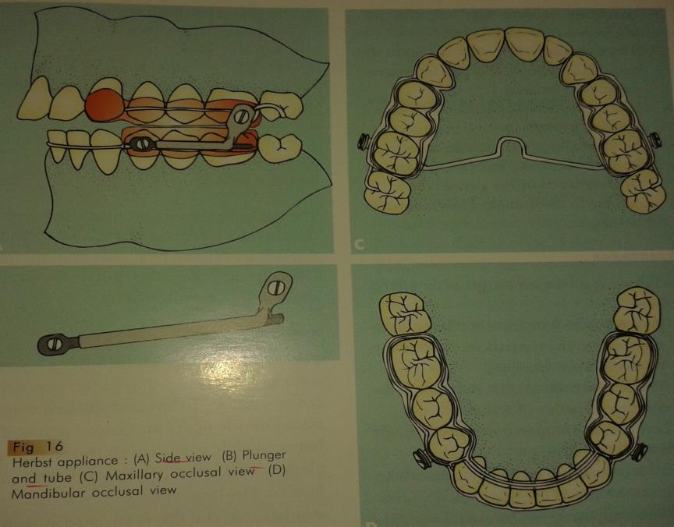
HERBST APPLIANCE
Notes:
Developed by Emil Herbst, it can be compared to a artificial joint working between the maxilla and mandible. A bilateral telescopic mechanism keeps the mandible mechanically in continuous anterior position. The devise has a tube attached to distal end of maxillary molar, into which the plunger fits it is attached to mandibular canine.

Slide 47
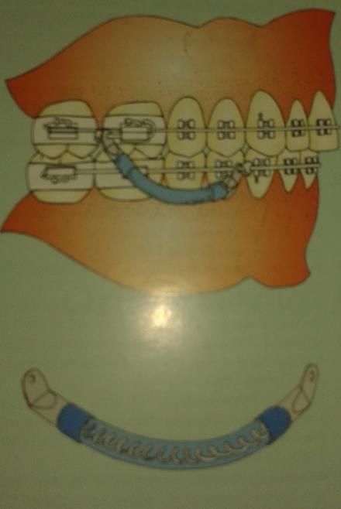
JASPER JUMPER
Notes:
It is a flexible fixed functional appliance unlike the herbst which is rigid. This flexibility allows lateral movements of the mandible.
It has a flexible open coil spring extending from posterior of maxilla to the anterior of mandible.

Slide 48
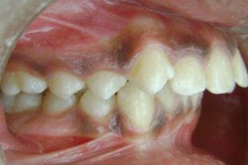
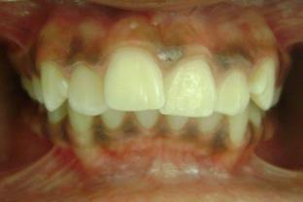
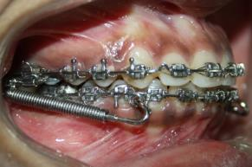
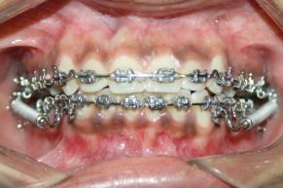
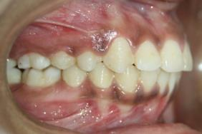
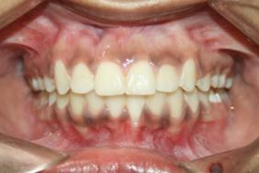
Forsus

Slide 49
CONCLUSION:
A thorough knowledge of Growth is essential for achieving orthodontic goals

Slide 50
References
Graber, Rakosi, Petrovic. Dentofacial orthopedics with functional appliances
Removable orthodontic appliances Graber and Neumann
Bishara and Ziaja : Functional appliances: A review AJO-DO Volume 1989 Mar (250 - 258)
Carels and van der Linden : Functional appliances' mode of action - AJO-DO Volume 1987 Aug (162 - 168)

Slide 51
5. Voudouris and Kuftinec : Improved clinical use of Twin-block and Herbst as a result of radiating viscoelastic tissue forces on the condyle and fossa in treatment and long-term retention: Growth relativity - AJO DO 2000;117:247-66
6 . Sessle, Woodside, Bourque, Gurza, Powell, Voudouris, Metaxas, and Altu : Effect of functional appliances on jaw muscle activity AJO-DO Volume 1990 Sep (222 - 230

