Slide 1
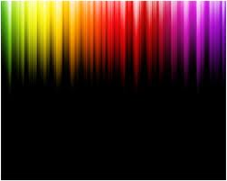

COLOR AND SHADE SELECTION
SIBAR INSTITUTE OF DENTAL SCIENCES,GUNTUR
DEPARTMENT OF CONSERVATIVE
DENTISTRY AND ENDODONTICS
Dr. C. RAM SUNIL
PROFESSOR

Slide 2
Introduction
Human eye differentiate ten million different COLORS..
To effectively overcome the challenges associated with accurate shade selection in aesthetic restorative dentistry, it is essential for dentists to understand both the science & art of color.

Slide 3
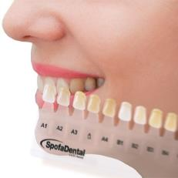
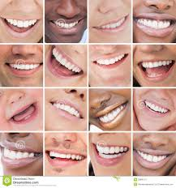
Introduction
Accurate shade matching –challenging aspects.
Wide variety of natural tooth color.

Slide 4
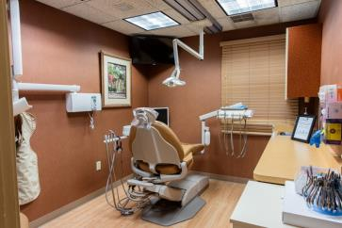
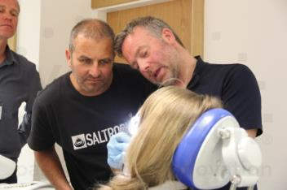
Introduction
Practitioners require an understanding of color , light and clearly communicate instructions with laboratory technicians.
Successful shade matching-integrates a number of critical factors.

Slide 5
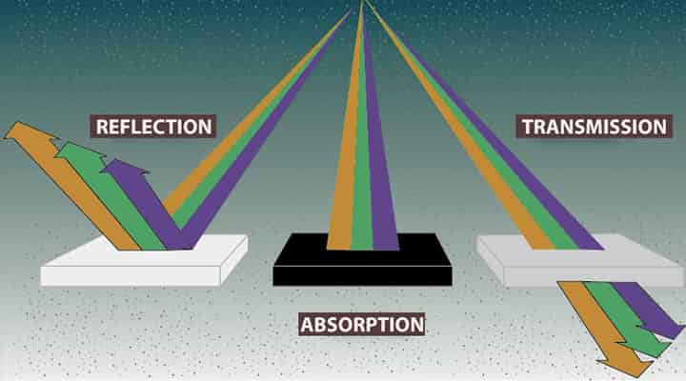
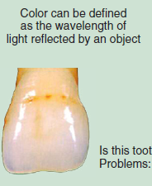
Definitions:
Color:
"Color is the sensation resulting from stimulation of the retina of the eye by light waves of certain lengths”. (Webster)

Slide 6
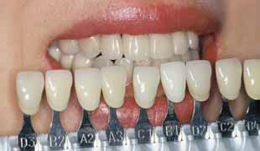
Shade:
Shade is defined as; a term used to describe a particular hue, or variation of a primary hue such as a greenish shade of yellow.

Slide 7
Light:
The entire process originates with the light source :”Color is light” (Saleski, 1972).
Light in the wavelength range of 380 nms to 780 nms is referred to as the visible light.
Wavelengths less than 380 nms are in the ultraviolet range and include cosmic rays, gamma rays and x-rays.
Wavelength above 780 nms are in the infrared range and include radar waves, TV waves and radio waves.

Slide 8
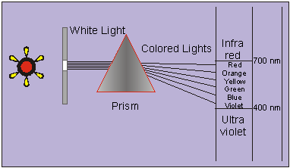
Sir Isaac Newton was the first to discover the white light is the source of all color by shining it through a prism.
Wavelength = UV – V – I– B – G – Y – O – R – IR .
780nm
380nm

Slide 9
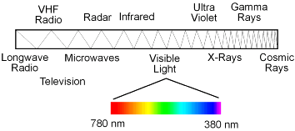
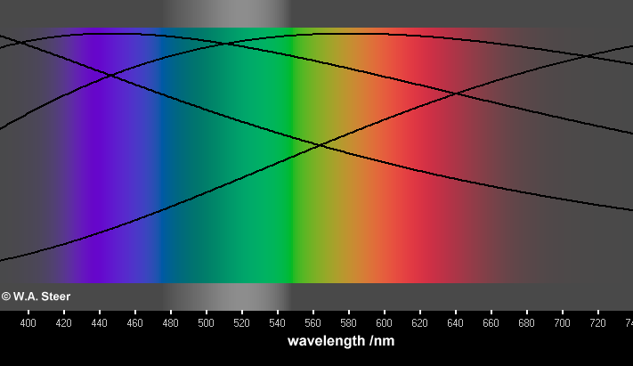
Electromagnetic spectrum 380 – 780 nm is visible

Slide 10
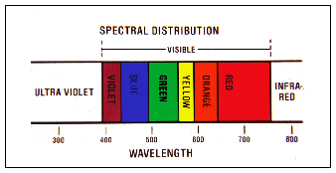
Wavelength range of different colors
380 nm - 450 nm | Violet
450 nm – 480 nm | Blue
480 nm – 510 nm | Blue - Green
510 nm – 550 nm | Green
550 nm – 570 nm | Yellow – Green
570 nm – 590 nm | Yellow
590 nm – 630 nm | Orange
630 nm – 750 nm | Red

Slide 11
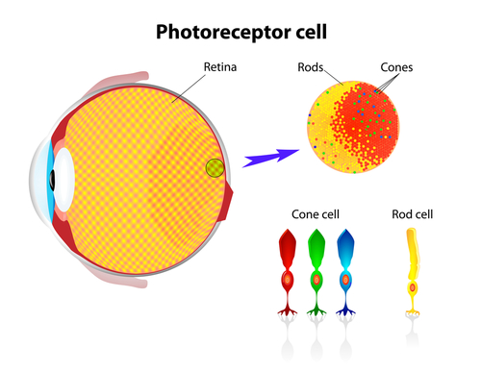
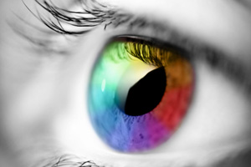
How do we see color?:

Slide 12
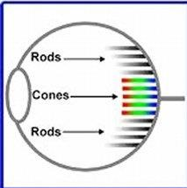
How do we see color?:
Stimulus of light
Cornea
Lens
Reaches on retina ( rods/cones)
Stimulus transmitted through optic nerve
Then sent to brain where they are computed & interpreted as color.

Slide 13
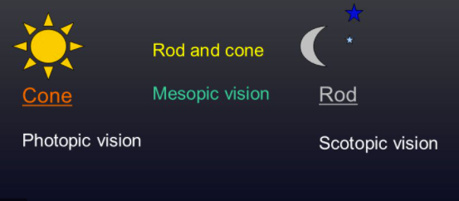
Eye :
RODS: These are located on the edges and few towards the center of the retina.
CONES: These are concentrated near the center of the retina at the fovea.
Notes:
Rods:Under low lighting conditions, only the rods are used (scotopic vision). These receptors allow and interpretation of the brightness( but not the color) of objects to be made.
Cones: are active under higher lighting conditions ( photopic vision).

Slide 14
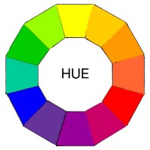
Dimensions of color:
Hue:
It refers to the dominant wavelength in the spectral distribution.
This represents the color of the material . E.g. blue, green, yellow , orange.

Slide 15
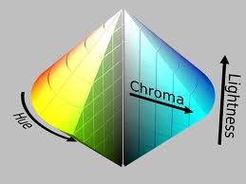
Chroma:
Chroma refers to the concentration of a color
The higher the chroma more intense the color.
Natural teeth chroma range : 0.5 to 4
chroma α 1/value.

Slide 16

Value:
High value
(light gray)
It represents the lightness or darkness of a color or the brightness of an object.
Appears brighter:High value(if more light is reflected from object)
Appears darker:Low value(if less light is reflected from object)
Low value
(Dark gray)

Slide 17
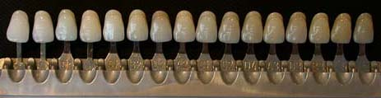
Dental shade guide tabs are arranged in decreasing order of Value.
Vita shade guide:
B1,A1,B2,D2,A2,C1,C2,D4,A3,D3,B3,A3.5,B4,C3,A4,C4

Slide 18
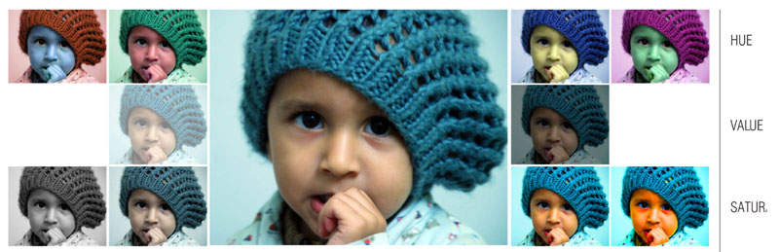
Relative clinical importance of hue, value and chroma :
Color matching authorities state that hue differences are easiest to detect and value differences the most difficult.
The authors have the opinion that- value differences are most important, and hue differences the least
Hue differences may well be recognized most easily, but a slight mismatch in hue may not be as objectionable as a slight value mismatch.

Slide 19
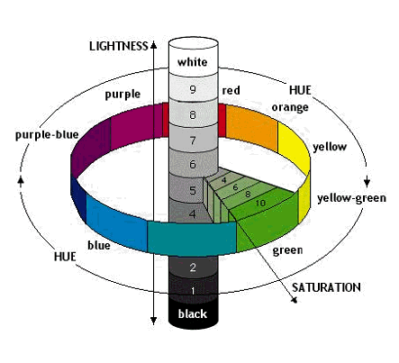
Munsell color system showing 3-d spatial arrangement of hue,value and chroma
Color organization and specification

Slide 20
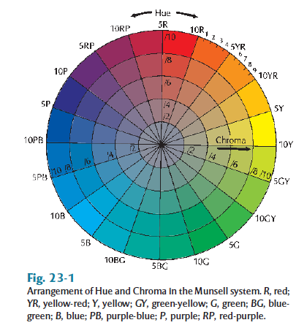
In the Munsell color system, hues are divided in to 10 gradation; yellow, yellow –red, red, red-purple, purple, purple-blue, blue, blue-green, green and green- yellow.
These are arranged in a wheel.
Each gradation is further subdivided,
for E.g. 1r, 2r ------10r, followed by
1Yr,2yr------10yr.
Munsel’s color wheel

Slide 21
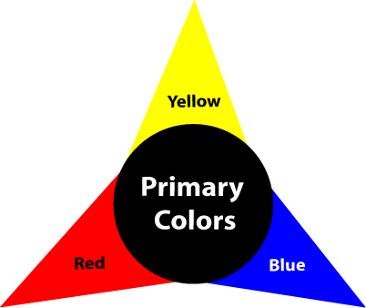
Primary Colors:
CLASSIFY COLORs:
Red, blue, and yellow comprise the three primary colors.
These three colors can approximate, through selective mixture, all of the other colors.

Slide 22
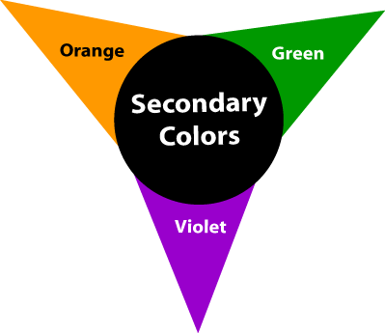
Secondary Colors:
Orange, violet,
and green are the secondary colors.
Each is placed between the two primaries that are mixed to produce it.

Slide 23
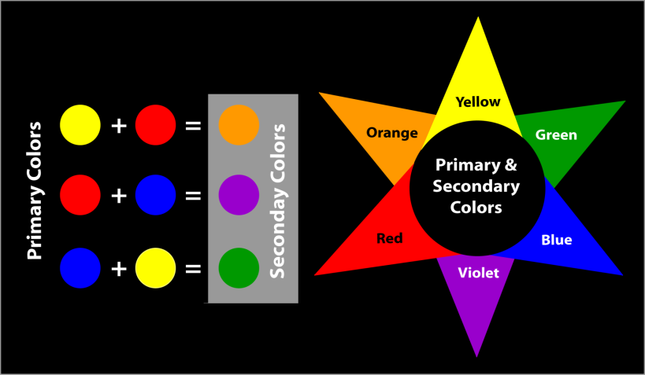
Primary & Secondary Colors:

Slide 24
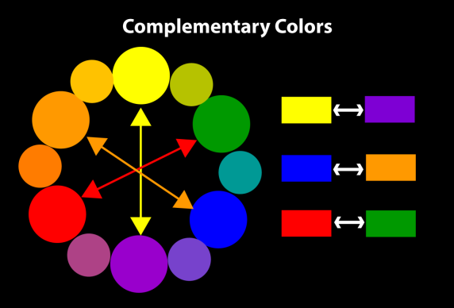
Complementary colors:
Complementary colors features hues directly opposite on the color wheel.

Slide 25
COLOUR OF NATURAL TEETH:
Natural teeth classified into three shade groups(acc to hue):
Yellowish
Orange
Reddish
Teeth are termed as polychromatic.They exhibit variations in hue,value ,chroma.
Hue:Determined by color of underlying dentin
Value:quality of overlying enamel
Chroma:is saturation of color in dentin but influenced by value and thickness of enamel

Slide 26
Color of the human teeth: acc to Clark
Dr.Clark
Hue :-6YR to 9.3 Y
Value :- 4 to 8
Chroma :- 0 to 7
Human teeth are in yellow red to yellow portion of the spectrum, relatively high in value (light or bright) and relatively low chroma (not too much color intensity)

Slide 27
OTHER OPTICAL PRPOPERTIES OF
TEETH:
Secondary Optical Properties found in Teeth
-Translucency
-Fluorescence
-Opalescence
-Transparency
-Opacity
-Metamerism
-Transmission
-Reflection

Slide 28

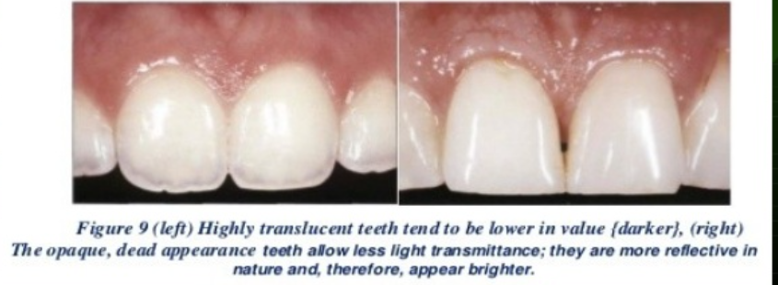
Translucency:
It is the property of materials that allow the passage of some light but disperses, scatters or reflects the rest so that objects cannot be clearly seen through them.
Ex: dental porcelain, composite resin and pigmented acrylic resin

Slide 29
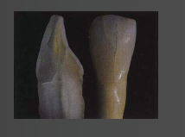
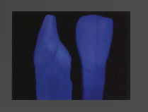
Fluorescence:
Fluorescence is the absorption of radiation of particular wavelength and its re-emission as a radiation of longer wavelength.
Natural tooth has fluorescing qualities and is believed to be because of its organic content.
Dentin is fluorescent when exposed to UV light.
Fluorescent powders are added to ceramic crowns to increase the quantity of light returned back to viewer, to block out discolorations and decrease chroma: to get life-like restorations.

Slide 30
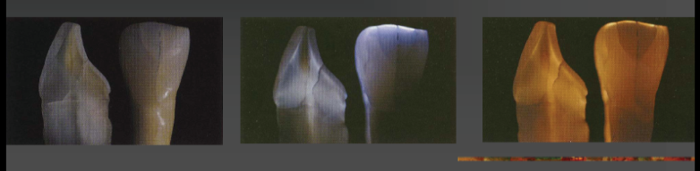
Opalescence:
Opalescence is the property by which a material appears to be one color when light is reflected from it and another color when light is transmitted through it.
Opalescence makes teeth appear bluish in reflected light and reddish orange in transmitted light.
At incisal edges of natural teeth, exhibit a light-scattering effect that creates the appearance of bluish-white colors as the teeth are seen at different angles.
Manufacturers try to match this effect when formulating dental porcelains.

Slide 31
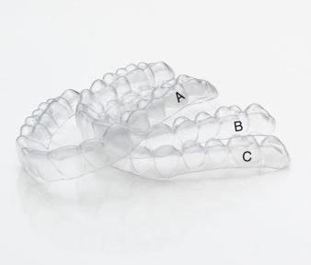
Transparency:
It is the property of materials that allow the passage of light in such a manner that objects can be clearly seen through them.
Eg: glass and clear acrylic resin.

Slide 32
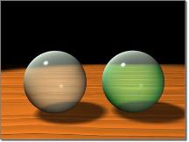
Opacity:
It is the property of materials that prevents the passage of light.
An opaque material either absorbs or reflects all of the light.
In dentistry, we are more concerned with the translucent and opaque characteristics of a restoration rather than the transparency.

Slide 33
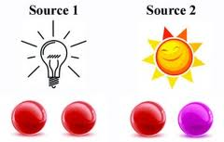
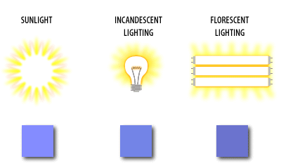
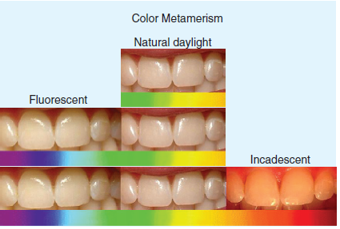
Metamerism :
The color of objects under one type of light may appear different under another light source.
This phenomenon is called metamerism.

Slide 34
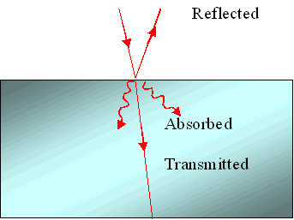
Transmission:
Light passing through an optical medium without attenuation is said to be completely transmitted.
Total transmission is undergone by perfectly transparent material.

Slide 35
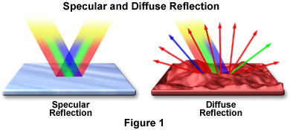
Reflection:
Reflected light rays are those rays which bounce back from the surface of the object being hit instead of being transmitted or absorbed.
Reflection can be of two types:
-Specular reflection
-Diffuse reflection

Slide 36
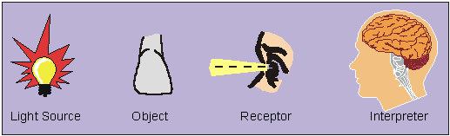
Factors affecting Color perception:
(i) The charecteristics of light source
(ii) surface viewed: the tooth
(iii) individual observer :dentist
(iv) conditions under which the object is being viewed.

Slide 37
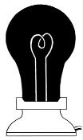
Light source
Light source is any body emitting radiation in the visible spectra range.
Primary (emitting their own radiation) / secondary (reflecting a part of the radiation from some other light source)
Natural (sunlight) / Artificial (Incandescence , Gas discharge , Photoluminescence )
Average northern day light with a slightly overcast sky having an intensity of 1500 Lux is considered ideal for shade determination.

Slide 38
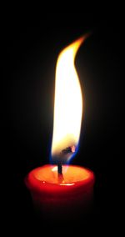
The ideal color temperature
is 5,500 ·K. Light at this temperature can be described as “white” light.
The ideal luminosity for dental
shade matching is 75 to 250 foot candles.
Note: Foot candle is equal to the light of
a candle at a distance of one foot.

Slide 39
Ideal light source in dental clinic:
The dental clinic should ideally have combination of natural daylight and color corrected fluorescent bulbs with color temp of 5000-5500k and a color rendering index of 90 or more.
Recent: Hand held LED lights (Optilume Trueshade,Shade wand) are available.

Slide 40
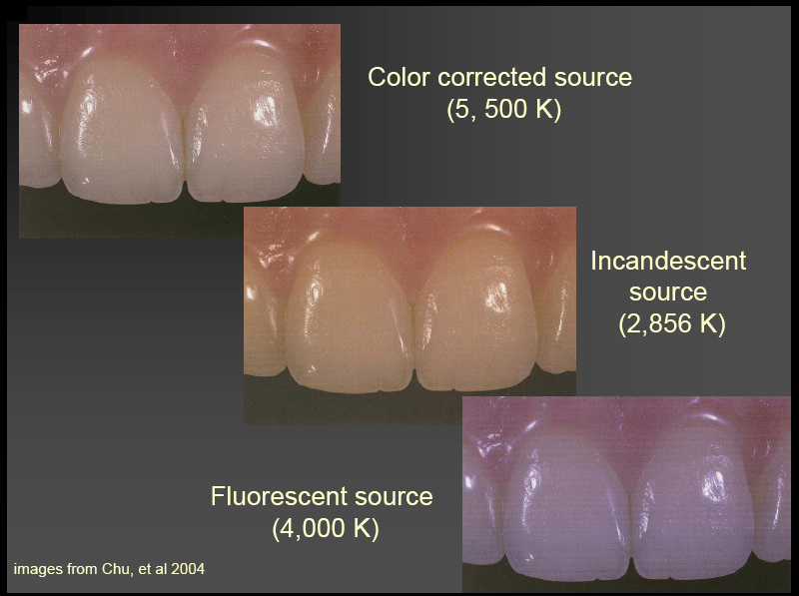

Slide 41
Color Rendering Index ( CRI)
Indicates how well a light source renders color as compared to a standard source
(Normal Daylight).
Ranges from ( 0 -100 ).

Slide 42
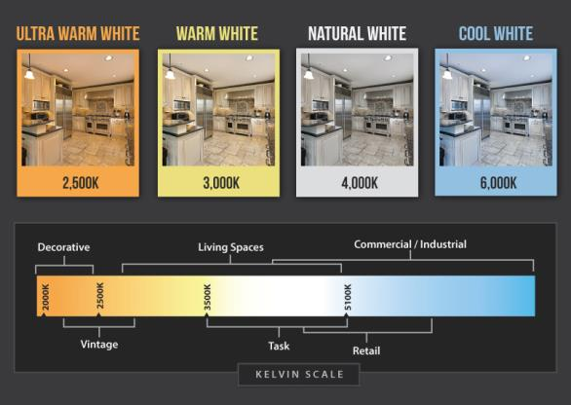
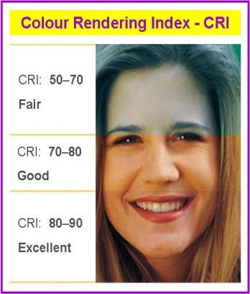
Color Rendering Index ( CRI)

Slide 43
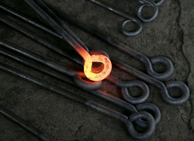
Color temperature
Another light source reference standard.
Reported in degrees Kelvin (°K)
  1000K – Red
  2000K – Yellow
  5555K – White
  6500K – Northern daylight
  8000K – Pale blue

Slide 44
Surface Viewed:
Surface of an object being viewed affects color determination through its spectral characteristics of absorption, reflection and transmission.
An analysis of a surface is done with a spectrophotometer.

Slide 45
Tooth viewed:
Teeth should be clean,free from stains,and is moist,hydrated.
The patient should be seated upright with teeth at eye level with the operator.

Slide 46
Individual Observer:dentist
Interpretation of color by the brain is subjective responsive : it differs for different observers.
Also , the color perceived is affected by the eye fatigue.
Prolonged viewing of a color for 15-30 seconds strains the cones and causes depletion of photopigments inside them. This results in a decrease in the value and chroma of a sample and the observer is no more able to differentiate precisely between closely approximating hues.
Therefore the cones can be made resensitize to the desired color by gazing at the complementary color until the eye gets fatigued to the later.

Slide 47
Individual Observer
Shade selection is affected by several factors like color blindness,aging,medications,eye fatigue.
Aging,Chronic diseases(diabetic gluacoma); medications(antihypertensives) & cr.smoking affect color perception.
To overcome the effects of eye fatigue the dentist must perform shade selection at the beginning of appointment.

Slide 48
Surrounding condition:
The conditions under which an object is being viewed also influence the interpretation of the colour. These include:
the oral background,
wet or dry conditions,
angle and intensity of illumination etc.

Slide 49
Recommended protocol for shade selection:
Brightly colored clothing should be draped(gray color) and lipstick removed. The operatory walls should not be brightly painted.
The patient should be in upright position & should be viewed at eye level so that the most color-sensitive part of the retina will be used.
The teeth to be matched should be clean. If necessary, stains should be removed by oral prophylaxis.
Shade comparisons should be made at the beginning of a patient's visit to prevent eye fatigue. Teeth increase in value when they are dry, particularly if rubber dam has been used.Moist teeth are used for shade matching.

Slide 50
Recommended protocol for shade selection:
Shade comparisons should be made quickly, with the color samples placed under the lip directly next to the tooth being matched. This will ensure that the background of the tooth and the shade sample are the same, which is essential for accurate matching.
The dentist should be aware of eye fatigue. The eyes should be rested by focusing on a gray-blue surface immediately before a comparison, because this balances all the color sensors of the retina and resensitizes the eye to the yellow color of the tooth.
Shade comparison should be made under different lighting conditions. Normally the patient is taken to a window, and the color is confirmed in natural daylight after initial selection under incandescent and fluorescent lighting.
To avoid Metamerism

Slide 51
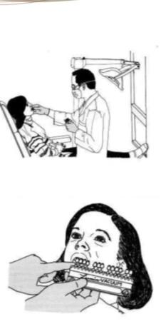
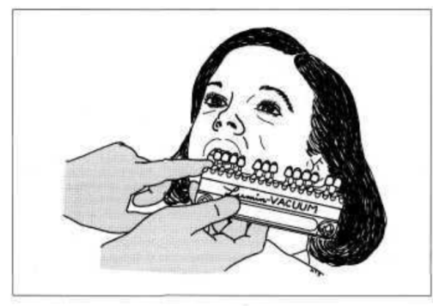
Recommended protocol for shade selection:

Slide 52
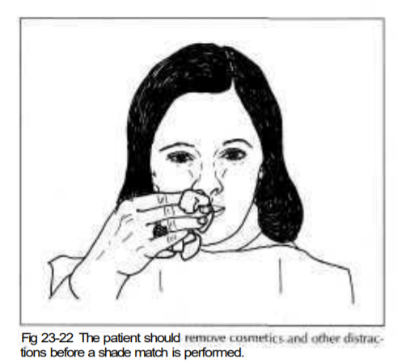
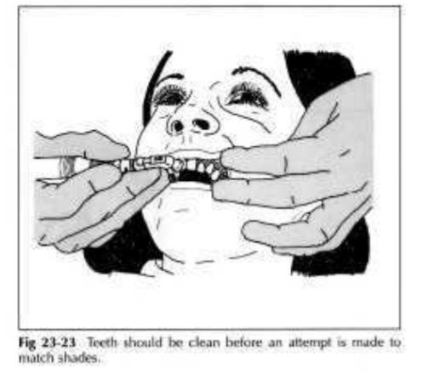
Recommended protocol for shade selection:

Slide 53
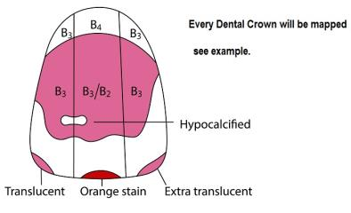
Shade Mapping
Tooth is divided into
  Three regions
  Nine segments
Each region is matched independently
Further characterizations are sketched
on diagram, may include…
  Craze lines
  Hypocalcifications
  Proximal discolorations
  Translucency

Slide 54
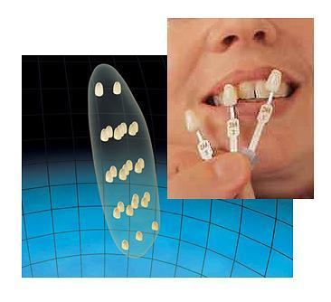
Dental Shade Guides:
Dental shade guides are a collection of various color combinations available from the manufacturers for denture teeth, restorative resins and porcelain; which aid the dentist in selecting the most acceptable color match with the tooth.

Slide 55
Inadequacies of shade guides:
Do not cover the color range of natural teeth
Not equally distributed in color space
Not logically arranged
Lack of darker and yellow reddish spectrum shades
Match neither each other nor restorative material
Different spectral curves than natural teeth
Shade tabs thicker than average porcelain veneer
Represent maxillary central incisors only.

Slide 56
Shade selection techniques:
Visual shade selection
  can perceive 300 spectral colors
  Better capable of detecting value .
Instrument shade selection
Advantages:
  Highly accurate, not influenced by surroundings, not affected by light source
  Constant repositioning, results are reproducible
  Unbiased reading of shade(more objective)
  Disdavantages:
  -Edge loss
  -high cost

Slide 57

Visual shade selection:
3 types are popular:
Vitapan Classical shade guide
Chromascope shade guide
Vita 3D Master Shade guide

Slide 58

Vitapan Classical shade guide

Slide 59
Vitapan classical shade guide:
Introduced in 1960 by Vita Zahnfabrik, Germany
16 tabs in 4 hue groups A,B,C and D
A-orange
B-yellow
C-Yellow/gray
D-orange/gray
Chroma and value are indicated by a system of nos.
Chroma increases within a specific group i.e. 1,2,3 and 4
1-least chromatic, highest value
4-most chromatic, lowest value

Slide 60
Vitapan classical shade guide:
Advantages
  Very popular available with compatible porcelain.
  Arrangement of tabs is customizable .
  For maximum available restorative materials.
Disadvantages
  No logical distribution of tabs.
  Provide 45% clinically acceptable match.
  Cant be used in porcelain color variations.

Slide 61

Chromascope Shade guide

Slide 62
Chromascope shade guide:
Introduced by Ivoclar Vivadent
Based on ivoclar dentin shades
20 shade tabs in 5 hue groups numbered as 100,200,300,400 and 500
100-white
200-yellow
300-orange
400-gray
500-brown
Five additional bleach shades available
Chroma & value are indicated by another set of nos.
10-least chromatic, highest value
40-most chromatic, lowest value
Saturation increases within each group in tens as 110,120 and so on.

Slide 63
Chromascope shade guide:
Advantages::
  Detachable shade groups
  Easy precision shade matching through removable color tabs
  Simple, consistent color-coding system
  Ergonomic handling
  Infection control through disinfecting and autoclaving
  Uniform stain uptake.
Disadvantages:
  Value differences not observed in design

Slide 64
Shade selection technique:
Determine the shade of the patient's natural tooth.
3 steps are:
1.Select one of the five shade groups on the shade guide and detach the selected group
2.Select and detach a shade tab from the chosen group
3.Hold the tab up to the natural tooth to verify the shade

Slide 65

Vitapan 3D Master Shade Guide

Slide 66

Vitapan 3D Master shade guide:
Introduced to profession in 1998 by Vita Zahnfabrik
26 tabs arranged three dimensionally.
5 basic value groups from lighter to darker
Value: 1-lightest
5-darkest
For each value, there are tabs representing diff chromas & hues
Chroma varies vertically downwards 1 to 3
Chroma:1-least chromatic
3-most chromatic
Hue varies horizontally as L, M, R
Hue: L-yellowish
M-Orangish
R-Reddish
Sequence of shade selection:
Value chroma hue

Slide 67

VITAPAN 3D-MASTER divides the tooth color space into 5 levels of value.
For each value, there are tabs representing different chromas & hues

Slide 68

Hue varies horizontally as L, M, R
(L-yellowish, M-orangish, R-reddish)

Slide 69

In the orangish(M) hue there are three levels of color samples for the chroma.
(1-least chromatic, 3-most chromatic).
Deviations towards the more yellowish hues (L) or more reddish hues (R) exist in 2 chromas.

Slide 70
Vitapan 3D Master Shade Guide
Advantages
  3D shade guide
  Logical distribution of tabs
  Significantly improved short and long range order
  Systematic shade determination
Disadvantages
  Tab arrangement cannot be customized

Slide 71


Shade selection technique for vitapan 3D master shade guide:
Determining the lightness level (value)
Hold shade guide to the patient’s mouth at arm’s length
Select group 1, 2, 3, 4 or 5
Start selection with darkest group
Selecting the chroma
On the basis of the lightness level determined
Take the middle hue group (M) for determining the chroma and spread the samples out like a fan.
Select one of the three shade samples

Slide 72

Shade selection technique for vitapan 3D master shade guide:
Determining the hue
Check whether the natural tooth is more reddish or more yellowish than the shade sample selected.
Notes:
-All shade samples belonging to one lightness level (1- 5) have the same value.
-Differences within one lightness level are only with regard to the chroma and hue.
-These are determined in stage 2 and 3.

Slide 73
Instrument shade selection:
RGB devices
Spectrophotometers
Colorimeters
Software

Slide 74
RGB devices:
They gather information regarding the color properties of the teeth.
Basically they acquire red, green, blue image information based on which the shade can be decided.
Eg: Digital cameras,
Shade scan(cynovad,Monteral, Canada)

Slide 75

Digital cameras
Based on digital camera technology .
They capture images,which contain many thousands or even millions of microscopically small light sensitive elements - Photo site
Each photo site responds to total light intensity that strikes the surface.
Sensors use filtering and image are formed in three primary colors ie,(red,green &blue).

Slide 76
Spectrophotometers:
They measure and record the amount of visible light reflected or transmitted by an object ;one wavelength at a time for each value, chroma & hue present in the entire visible spectrum.
They use a stable light source and produce most accurate color measurements.
Eg: Spectroshade(MHT, Switzerland)
VITA Easy shade(Vident)

Slide 77

Spectrophotometers:
  3 principle elements:
  a standard light source D65
  means to direct the light source to an object and receive the light reflected.
  a spectrometer that determines the intensity of received light as a function of wavelength.
Produce most accurate color measurements

Slide 78
Colorimeters:
These instrument directly measure color as percieved by the human eye.
Stores 3 data points of hue, value & chroma.
Eg: Chromascan(Sterngold, Connecticut)
Shade Vision(X Rite Inc, GrandRapids, Michigan)

Slide 79

Colorimeters :
  detector, signal conditioner and software
  3 or 4 photodiodes with filters
  Inferior to scanning devices like spectrophotometers

Slide 80
Software:
A shade analysis software utilizes a digital camera to capture images and then transfer them to computer when color analysis is managed.
Eg: clear match system (Smart Technology, Hood River)

Slide 81
Current shade measuring devices:
System | Manufacturer | Type
Shade Eye NCC | Shofu Dental | colorimeter
Easyshade | Vident Corp. | spectrophotometer
ShadeScan | Cynovad Inc. | DCI/colorimeter
ShadeVision | X-Rite Inc. | DCI/colorimeter
SpectroShade | MHT, Switzerland | DCI/spectrophotometer
ClearMatch | SmartTechnology | Software only

Slide 82


Shade communication:
Once a shade is selected, it has to be effectively communicated to the dental laboratory.
High quality digital photographs are best means.
Digital photographs taken along with the appropriate shade tab using consistent lighting helps the clinician to precisely communicate the shade to the laboratory.
Digital images are sent electronically or on a CD.
Characterization can be located on a drawing that duplicates the size,shape & contours of the required restoration.

Slide 83
Conclusion:
Teeth display variance & nuances, showing individuality in given dentition.
The clinician should have thorough knowledge about basic tooth morphology, color concepts, tooth size, their relation to each other & aim at producing optimum esthetics.
With increasing demand for esthetic restorations, accurate shade matching is of great importance in dentistry.

Slide 84
References:
Color science and Shade selection in operative dentistry: Dayane Oliveria
Shade selection in Dentistry: Ahmad Judeh
Shade selection in Aesthetic Dentistry: Deepa Ponnaiyan
Shade selection in Dentistry:A simple guide to dentists: Dr Josephine Flora A
Art & science of operative dentistry – Sturdevant’s
Textbook of operative dentistry – Vimal K Sikri
Textbook of operative dentistry – Ramya Raghu
Textbook of operative dentistry – Nisha Garg

Slide 85


