Slide 1
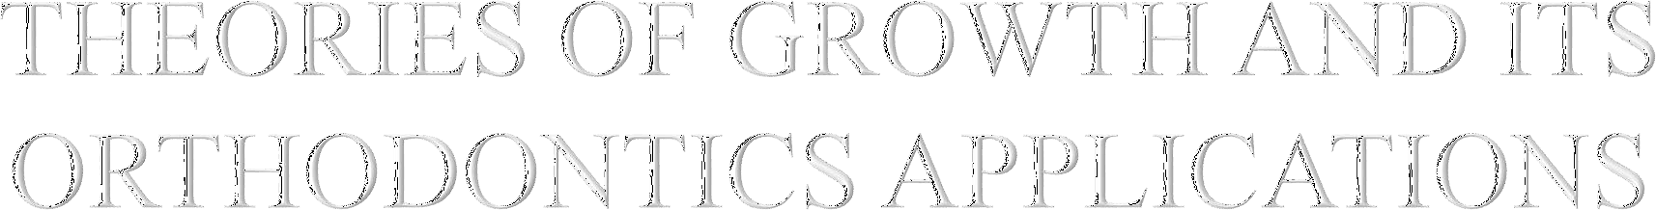

Slide 2

INTRODUCION
BASICS
  Definitions
  What is growth & development ?
  Types of growth
THEORIES OF CRANIOFACIAL GROWTH

Slide 3
Krogman
“Growth was conceived by an anatomist, born to biologist,delivered by a physician left on a chemist`s door step and adopted by a physiologist. At an early stage, she eloped with a statistician. Divorced him for a pschychologist, and is now being wooed alternately and concurrently by an endocrinologist, a biochemist, a physicist, a mathematician, an orthodontist, an eugenicist and the children`s bureau”

Slide 4

GROWTH
Todd 1931
Growth refers to increase in size
Profitt 1986
Growth usually refers to an increase in size and the number
Moyers 1988
Growth may be defined as the normal changes in the amount of living substance.

Slide 5
Growth is basically anatomic phenomenon and quantitative in nature.
Development is basically
physiologic phenomenon and qualitative in nature.
Correlation between growth & development
Development = growth + differentiation
+ translocation

Slide 6

Cellular hyperplasia: increase in the number of cell.
Cellular hypertrophy: increase in the size of individual cells.
Interstitial: growth of softtissue occurs by combination of hyperplasia and hyperthrophy , these process go on every where in the tissue.[ it occurs all points with in the tissue].
Appositional :Direct addition of new bone to the surface of existing bone and does occur through the activity of cells in the periosteum.

Slide 7
Pattern :
  arrangement of parts,values,events, or relations among
measurements.
    Growth trends
    Cephalocaudal gradient
Variability :
  Is the law of nature
    Normality
    Differential growth
Timing :
  Is variable & concerned with rate and division of growth
    Growth spurts

Slide 8
Tweed employed four angles namely: IMPA,FMA,FMIA,ANB.
TYPE A:
Maxilla and mandibule grow downward & forward in union.
No change in the size of ANB angle;25% of pts have this growth tendency.
TYPE B:
Although entire face grows downward & forward, maxilla grows more rapidly than mandible resulting in the increase of ANB angle; 15% pts fall under this category.
TYPE C:
Mandible grows rather downward & forward at a faster rate than middle third of face. This shows lessening of ANB angle in comparison of two standardized lateral ceph . These constitute 60%.

Slide 9
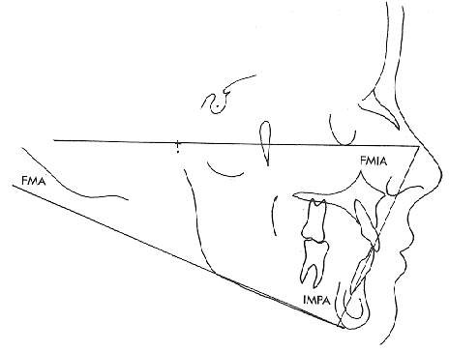
◻

Slide 10
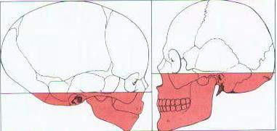
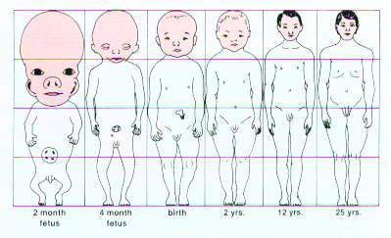
CEPHALOCAUDAL GRADIENT
Thus “Cephalocaudal gradient of growth”
, this simply means that there is an axis of increased growth extending from the head towards the feet.

Slide 11
◻ In fetal life, at about the third month of intrauterine development , the head takes up almost 50% of total body length. At this stage, the cranium is large relative to the face and represents more than half the total head . In contrast, the limbs are still rudimentary and the trunk is underdeveloped.
◻ By the time of birth, the trunk and limbs have grown faster than the head and face, so that the proportion of the entire body devoted to the head has decreased to about 30%.

Slide 12
◻ The overall pattern of growth thereafter follows this course, with a progressive reduction of the relative size of the head to about 12% the adult.
◻ All of these changes,which are a part of the normal growth pattern, reflect the “cephalocaudal gradient of growth”. This simply means that there is an axis of increased growth extending from the head towards the feet.

Slide 13

◻ Normal refers to that which is usually expected , is ordinarily seen , or is typical.
◻ Normal – Range & Ideal – Fixed value
◻ On comparison with normal, a variable can be measured.
CLINICAL IMPLICATION :
◻ Diagnosis of gross variations from central tendency of pathological condition or gross abnormal pattern of growth

Slide 14

◻ Not all tissue systems of the body grow at the same rate. Different tissues and in term different organs grow at different rates. This process is called differential growth.

Slide 15

As the graph indicates, growth of the neural tissues is nearly complete by 6 or 7 years of age.
General body tissue, including muscle, bone and viscera, show and S-shaped curve, with a definite slowing of the rate of growth during childhood and an acceleration at puberty.
Lymphoid tissues proliferate far beyond the adult amount in late childhood, and then undergo involution at the same time that growth of the genital tissues accelerates rapidly around the onset of puberty.

Slide 16
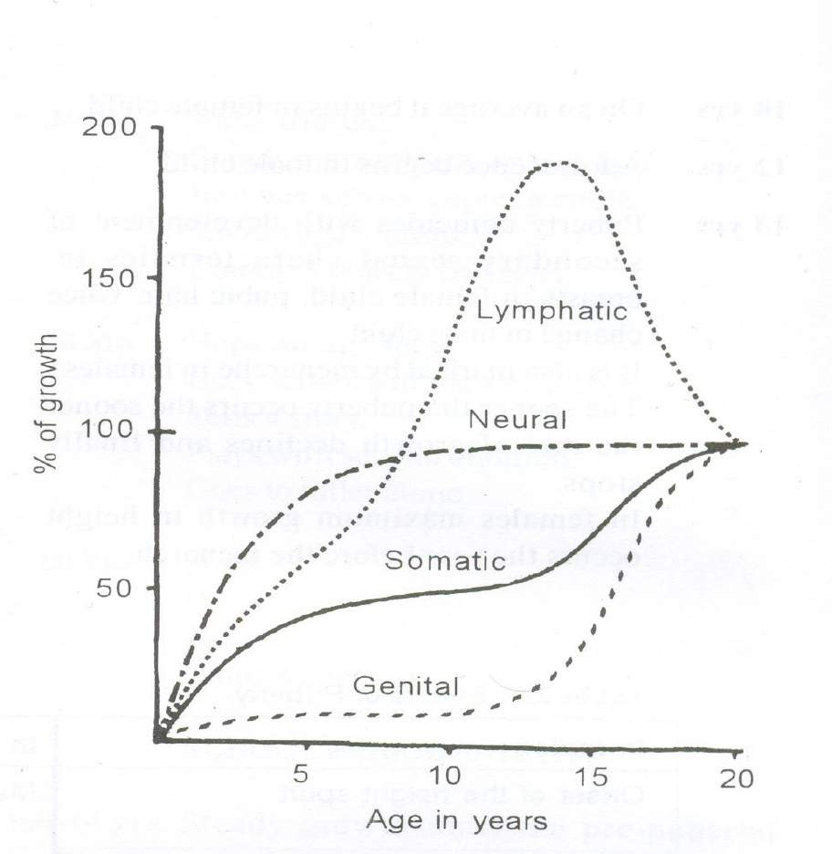
scammons growth
curve

Slide 17

Just before birth
One year after birth
Mixed dentition period
boys : 8 – 11 yrs
girls : 7 – 9 yrs
Pre pubertal period
boys : 14 – 16 yrs
girls : 11 – 13 yrs
Pubertal period
boys : till 25 yrs girls : 18 – 20 yrs
•
•
•
•
•
•

Slide 18
Growth spurts serve as excellent indicators for timing of orthodontic treatment
Correlation of
Skeletal age,
Dental age
Chronological age. With on set of puberty.

Slide 19

Importance of Growth Spurts:
Pubertal increments offers best time for,
determining the direction, patient treatment time.
predictability, growth management and total
Understanding the growth, predictability of future growth of maxilla, mandible and alveolar process helps in diagnosing and achieving excellent results of the mal- occlusion.

Slide 20
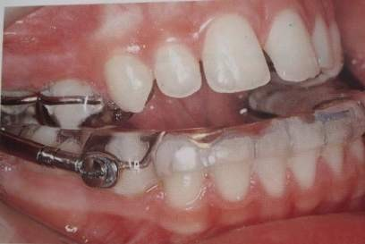
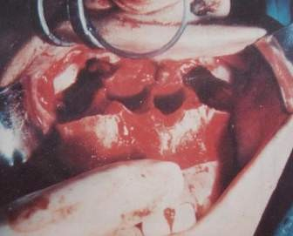
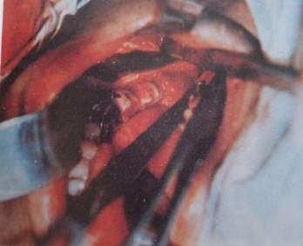
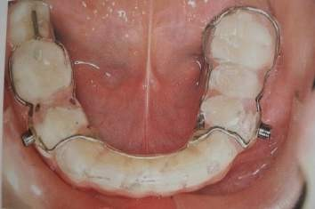
Large number of cases for the orthodontic and orthopedic correction of Maxilla and Mandible.
Growth spurts serve as excellent indicators for timing of orthodontic treatment.
For eg: orthognathic surgeries after growth spurt completion.
Growth spurt is the best period for Interceptive orthodontics.

Slide 21
For ex:
◻ classII malocclusion with mandibular retrognathism can be managed by activator thearpy.
◻ classII malocclusion with maxillary prognathism can be managed by the use of headgear.
◻ classIII malocclusion with mandibular prognathism can be controlled by chincap and headgrear.
◻ classIII malocclusion with maxillary retrognathism can be managed by nakamuras applince which promotes the growth of maxilla.

Slide 22
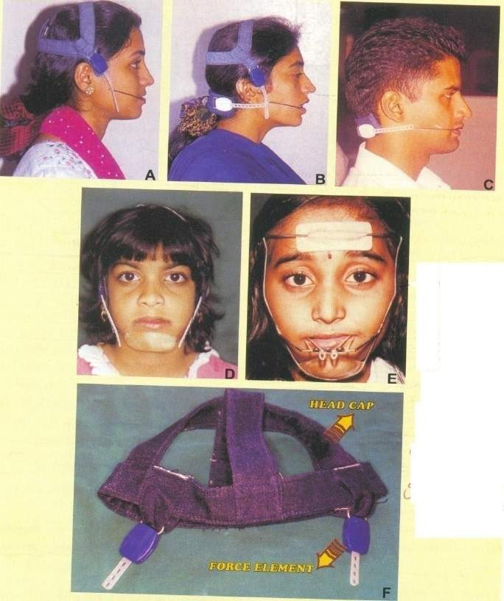
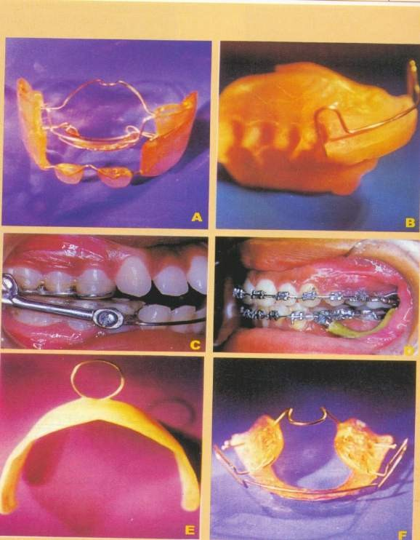

Slide 23
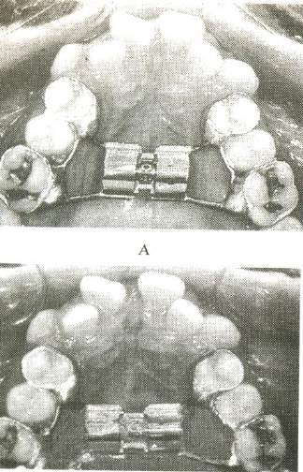
Malocclusion of dental arches can be treated taking Advantage of growth spurts during the active growth periods.
Arch expansion & rapid skeletal expansion can be undertaken during periods of maximum growth.

Slide 24
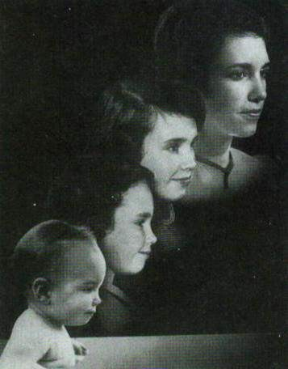
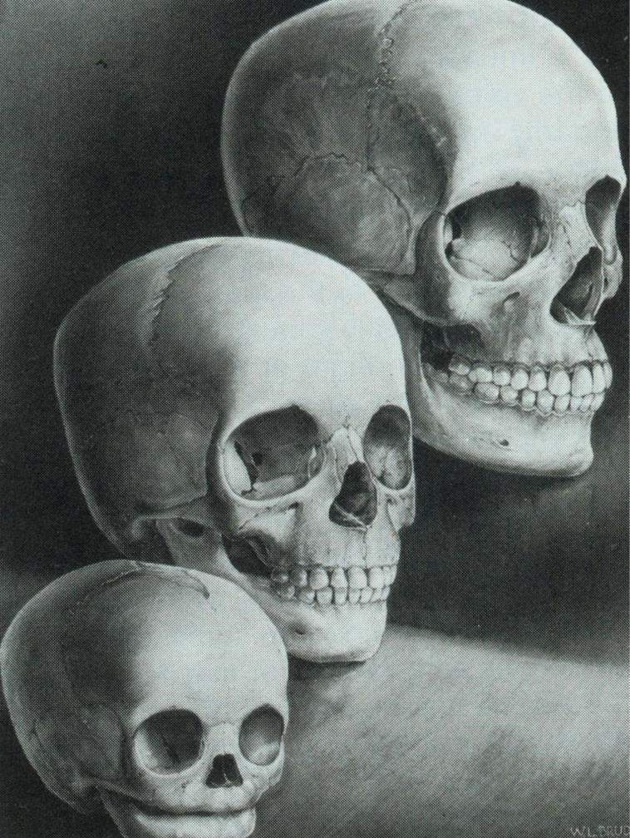
Theories of Growth and Development

Slide 25
Genetic theory – brodie 1941
Sutural theory – sicher 1955
Cartilaginous theory – scott’s 1956
Funtionalmatrix theory – melvin moss 1962
Enlow’s expanding “v” principle – enlow 1963
Enlow’s counterpart principle
Van Limborgh’s theory - 1970
Servosystem – petrovic hypothesis - 1974
Neurotrophic process in oro-facialgrowth -behrents 1976

Slide 26

◻ Mainly based on observations
No evident scientific data
Lacked scientific understanding and soon replaced by other theories.

Slide 27
◻ Sutural theory Proposed by Sicher in 1955:
According to Sicher
- “The primary event in sutural growth is the proliferation of the connective tissue between the two bones. If sutural tissue proliferates, it creates the space for appositional growth at the border of the bones”.

Slide 28
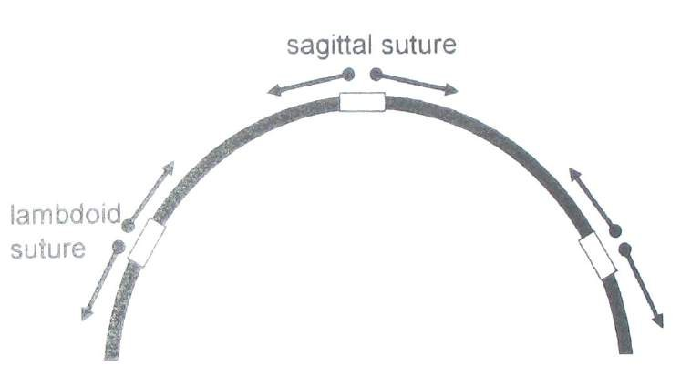
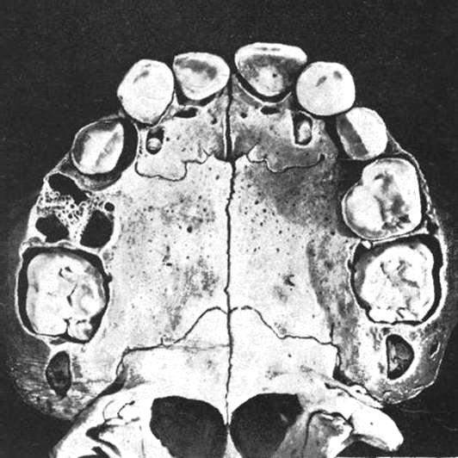

Slide 29
◻ We now know that functions of suture are :
Unite the bone
Absorb the forces,
Act as a joint
Act as a growth site and not growth centre

Slide 30
◻ Evidences Against Sicher’s Theory:
Auto transplants of sutures fail to grow in cultural medium though provided with same environment and conditions.
Extripation of sutures has no appreciable effect on growth of skeletal.
The shape and growth within sutures is dependent on external stimuli.
It is possible to bring the sutural growth to halt by mechanical stress applied across the sutures.

Slide 31
◻ Cartilagenous Theory (James Scott-1956)
The fact that, for many bones of the hand and legs, cartilage does the growing while bone merely replaces it makes this theory attractive for the bones of the jaws.
◻ According the Scott:-
Spheno-occipital synchondrosis cartilage - responsible for the growth of cranial base.
Nasal septal cartilage – Responsible for the growth of maxilla
Condylar cartilage – Responsible for the growth of mandible

Slide 32
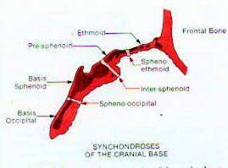
Spheno ethmoidal
Inter-sphenoidal
Spheno-occipital

Slide 33
Important growth center of craniofacial skeleton, especially cranial base.
◻ Cartilage of Nasal Septum:
◻ Spheno-occipital Synchodrosis:
Growth of maxilla is difficult to explain on the cartilage theory. Proponents of the cartilage theory hypothesize that the cartilaginous nasal septum serves as a pacemaker for other aspects of maxillary growth.

Slide 34
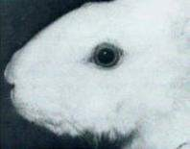
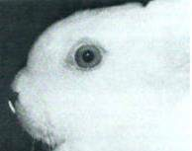
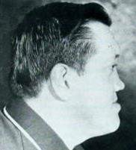
Removal of a segment of the Nasal Septal Cartilage in humans and rabbits showed mid-facial deformities.

Slide 35
- Two kinds of experiments have been carried out to test the idea that cartilage can serve as a true growth center.
◻ 1. Transplanting nasal cartilage to cultural medium or any other place did not give equivocal results, that is sometime it grew, sometimes it did not. Indicating doubtful growth potential of the nasal septal cartilage whereas, if a piece of the epiphyseal plate of a long bone is transplanted, it will continue to grow in a new location or in culture, indicating that these cartilages do have innate potential.

Slide 36
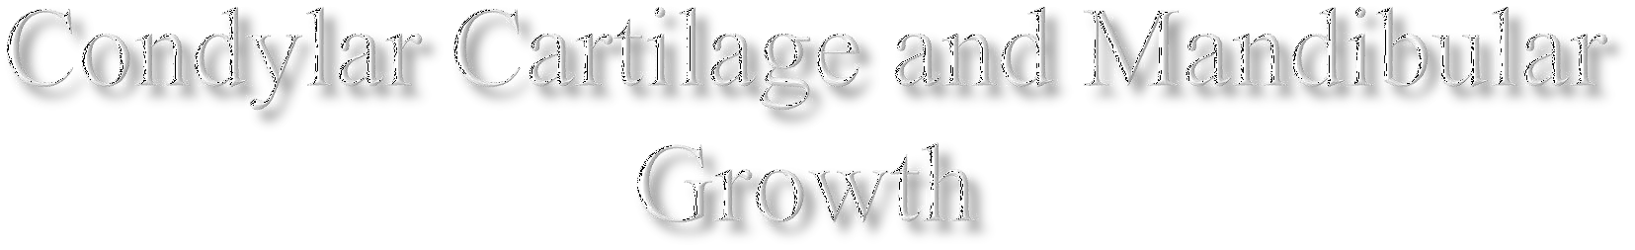
Since longtime, its being hypothesized that condylar cartilage is the growth center for the growth of mandible.
Experiments of transplanting condylar cartilage showed little or No growth potential.
It is no clear that condylar cartilage is secondary cartilage, which grows by appositions and not by intestitial deposition. Whereas, epiphyseal cartilage is primary cartilage.mandibular condylar thus do not have innate growth potential and not a growth center.

Slide 37
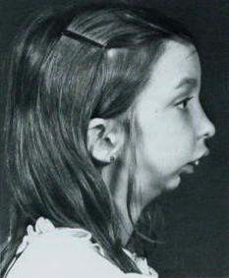

Slide 38
The fact that after the condylar fracture in children do not all together inhibit growth of mandible indicates that condyle is not a growth center.
Studies carried out in Scndinavia in 1960’s demonstrated that after the fracture of mandibular condyle in child, there was an excellent chance that the condylar process would regenerate to approximately its original size and small chance that it would overgrow after the injury.

Slide 39
FUNCTIONAL MATRIX CONCEPT
(MELVIN MOSS)
◻ This concept attempts to comprehend the relation between form & function.
◻ This concept claims that origin, form, position, growth & maintenance of all skeletal tissues and organs are always secondary, compensatory and necessary response to chronologically & morphologically prior events or processes that occur in specifically related non-skeletal t
◻ issues, organs or functioning space .

Slide 40
Functional cranial component
Skeletal unit
Functional matrices
Macroskeletal Eg-coronoid, angular
Microskeletal Eg-endocranial surface Of calvaria
Periosteal
Eg-teeth and muscles
Capsular Eg-orofacial, neurocranial

Slide 41
Skeletal unit – it protects &/or support its specific functional matrices.
Functional matrix – which carries out the function.

Slide 42
Skeletal unit:
◻ All skeletal tissues associated with a single function are called skeletal unit.
◻ The skeletal unit may be comprised of bone, cartilage and tendinous tissue.

Slide 43
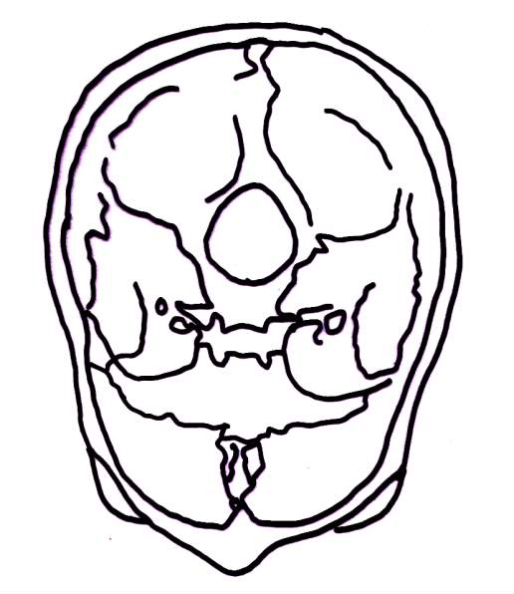
MACRO SKELETAL UNIT-
◻ Adjoining portions of number of neighbouring bones carrying out a single function eg- endocrainal surface of calvaria

Slide 44
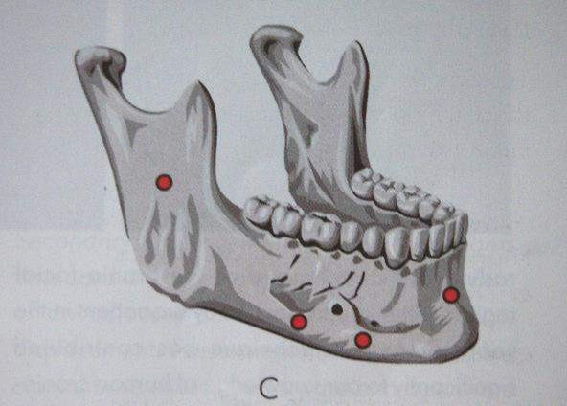
MICROSKELETAL UNIT
Bones consisting of number of small skeletal units
MAXILLA-orbital
-pneumatic
-palatal
-basal
MANDIBLE-coronoid
-angular
-alveolar
-basal

Slide 45
The Functional matrix
Divided into:
Periosteal matrix
Capsular matrix
Periosteal matrices
Act directly & actively upon their related skeletal units.
Alterations in their functional demands produce a secondary compensatory transformation of the size or shape of their skeletal units
Such transformations are brought about by the inter related process of bone deposition and resorption.

Slide 46
◻ Best explanation – coronoid process and temporalis muscle ,removal denervation and post infectively decrease in the size or total disappearance , hence in simple terms it can be stated coronoid process does not grow itself first and thus provide a platform upon which the temporalis muscle can alter its function but it is the opposite which is true

Slide 47
Capsular matrices
Act indirectly and passively on their related skeletal units producing a secondary compensatory translation in space.
The skeletal units are passively & secondarily moved in the space as their enveloping capsule is expanded. This kind of translative growth is not brought about by deposition and resorption.

Slide 48
FOUR CAPSULES ARE PRESENT-
◻ NEURO CRANIAL
◻ ORO FACIAL
◻ OTIC
◻ ORBITAL

Slide 49
◻ Each of these capsules is an envelop containing functional cranial component
◻ Sandwitched between two covering layers
◻ Capsules expands due to volumetric increase of capsular matrix
◻ This results in the translative movement of the embedded bones

Slide 50
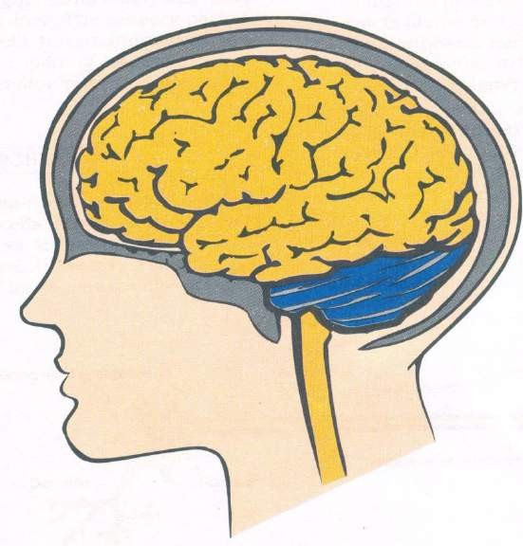
Sandwiched between-skin and dura mater
  Consists of-5 layers of scalp
-bone
-two layer dura mater
:

Slide 51
◻ Surrounded by skin and mucous membrane , Surrounds and protects oro-naso-pharyngeal space on either side.
◻ Originates by process of enclosure.
◻ Volumetric growth of these spaces is the primary morphogenetic event in facial skull growth

Slide 52
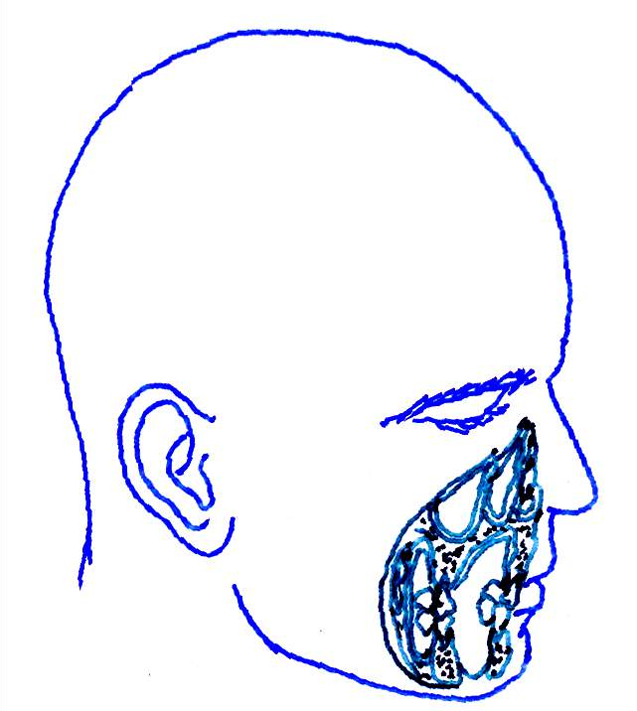
Orofacial Capsule

Slide 53
◻ Primary function is maintaining airway this is accomplished by “AIRWAY MAINTENANCE SYSTEM”-BOSMA
◻ Growth of functional spaces-increase in the size of capsule
◻ Followed by passive movement of functional cranial component

Slide 54
Functional matrix theory revisited
Melwin Moss in 1997 proposed continuation of his classical functional matrix theory with the new concept. He published series of articles in American Journal of Orthodontics in 1997.
This has lead to the inclusion of two topics:
The Mechanisms of Cellular Mechanotransduction
Biologic Network Theory

Slide 55
◻ According to this concept the mechanical stimulus is pursued by the specialized cells by process called as mechanoperception. Then these signals are transmitted through the tissues by way mechanoconduction or mechanotrasmision. Finally, these signals are transmitted to the genome of the bone were protein synthesis is taking place.

Slide 56
◻ These signals alter the protein metabolism depending upon the severity and longativity of the mechanical stimulus. In short the earlier concept of FMH theory remained same as form is determine by the function.
◻ Moss also recognizes the important role of genetics and human genome in determining the ultimate size and shape of the craniofacial skeleton. He quotes reference of human genome project which is being carried in a mega scale allover the world. According to the human genome project human chromosomes contain the genetic informations necessary for buildingup of entire human body.

Slide 57
Genes now beyond doubt have been proved to effect
the physical growth of the person, behavior of person and
psychology of person.
Thus Moss FMH revisited theory states the ultimate
growth controlling factor of the craniofacial skeleton depends on two factors.
Genetic factors
Environment factors.

Slide 58
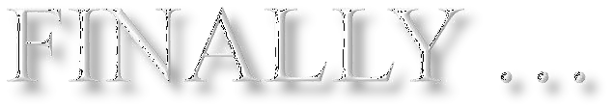
◻ Morphogenesis is regulated by both genomic and epigenetic processes and mechanisms both are necessary causes, neither alone are sufficient causes.
◻ Their integrated activities provide the necessary and sufficient causes for growth and development

Slide 59
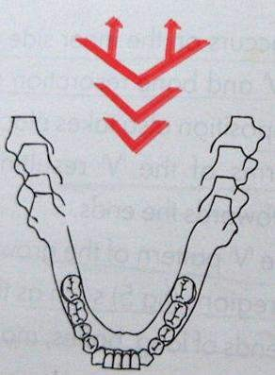
ENLOWS EXPANDING ‘V’ PRINCIPLE
Growth movements & en◻largements of these bones occur towards the wide ends
of the ‘V’ as a result of
&
differential deposition
selective resorption of bone
Bone deposition occurs on the inner side of the ‘V’ and bone resorption on the outer surface.

Slide 60
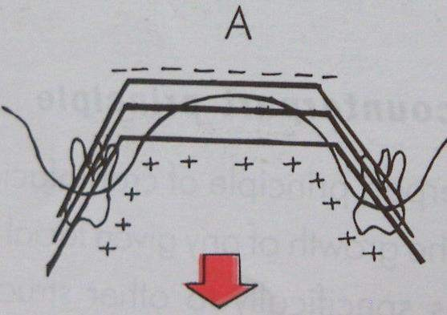
Deposition also takes place at the end of two arms of the ‘V’
◻resulting in growth movement towards the ends.
The ‘V’ pattern occurs in a number of regions such as base of the mandible, ends of long bones , mandibular body, palate etc.

Slide 61
of any given facial specifically to other structural
or cranial part and geometric
The growth
counterparts in the face and cranium
There are regional relationships through out the whole face and cranium. If each regional part and its particular counterpart enlarge to the same extent, balanced growth occurs.

Slide 62
◻ Antr – cranialbase ----- maxilla
◻ middle – cranialbase --- pharyngealspace
◻ middle – cranialbase ----- width of ramus
◻ Maxilla ---------- mandible
◻ Maxilla tuberosity ----- lingual tuberosity

Slide 63
VAN LIMBORGH’S THEORY
◻ Process of growth & development in a view that combines all the 3 existing theories.
◻ He suggested following 5 factors[multifactorial theory]
Intrinsic genetic factors
They are the genetic control of the skeletal units themselves.
Local epigenetic factors
Bone growth is determined by genetic control
originating from adjacent structures like brain,eyes etc…

Slide 64
General epigenetic factors
They are genetic factors determining growth from distant structures.
e.g. sex hormones, growth hormone etc…
Local environmental factors
They are non genetic factors from local external environment.
e.g. habits, muscle force etc.
General environmental factors
They are general non-genetic influences such as
nutrition, oxygen etc….

Slide 65
The views expressed by Van Limborgh’s can be
summarized in 6 points
  Chondrocranial growth is controlled mainly by the intrinsic genetic factors. Eg; Base of the skull
  Desmocranial growth is controlled by a few intrinsic genetic factors. Eg; calvaria.
  The cartilaginous parts of the skull must be considered growth centers.
.

Slide 66
4 .Sutural growth is controlled mainly by influences originating from the skull cartilages & from other adjacent skull structures.
Periosteal growth largely depends upon growth of adjacent structures.
Sutural & periosteal growth are additionally governed by local non genetic environmental influence

Slide 67

◻ Proposed by petrovic accordingly, the growth of
maxilla and mandible and cranial base depends upon cybernetic control. This cybernetic control is mainly by Secretion of hormones. These hormones mainly include growth hormone - somatomedin, testosterone and estrogen.

Slide 68
◻ Author describes the secretion of hormones is by the signal established independed of the feedback system.
This signal secretion is described as COMMAND .
This signal is transmitted to the Reference input elements. In maxilla they include septal cartilage, septopremaxillary frenum, the labionarinary muscles and the maxillary bones. In mandible reference input elements include muscle attachments to the mandible that is lateral pterygoid, medial pterygoid and tempralis muscles.

Slide 69
◻ The commanding signal is first established in the maxilla through the above quoted reference input elements and thus maxilla grows in sagittal and vertical direction. The corresponding actuating signal followed to the above process is felt in the mandible through the reference input elements and mandible growth occurs.

Slide 70
◻ Neurotrophism is a non impulse transmitting neural function that involves axoplasmic transport and provides for longterm interaction between neurons and innervated tissues that homeostatically regulates the morphological, compositional ,functional integrity of those tissue.

Slide 71
Neuro-epithelial trophism:Epithelial mitosis and synthesis are neurotropiclly controlled by release of neurotrophic substances by the nerve synapses. Ex;taste buds sensation.
neuro-muscular trophism:Embryonic myogenesis is independent of neural innervation and trophic control.
Neuro-visceral trophism:The salivary glands,fat tissue and other organs are trophically regulated.

Slide 72



GROWTH & DEVELOPMENT OF
CRANIAL BASE

Slide 73

FUNCTIONS
◻ Supports & protects the brain & spinal cord
◻ Articulation of skull with vertebral column , mandible & maxilla
◻ Buffer zone between the brain, face & pharyngeal region

Slide 74
◻ ANTERIOR CRANIAL FOSSA
◻ MIDDLE CRANIAL FOSSA
◻ POSTERIOR CRANIAL FOSSA

Slide 75
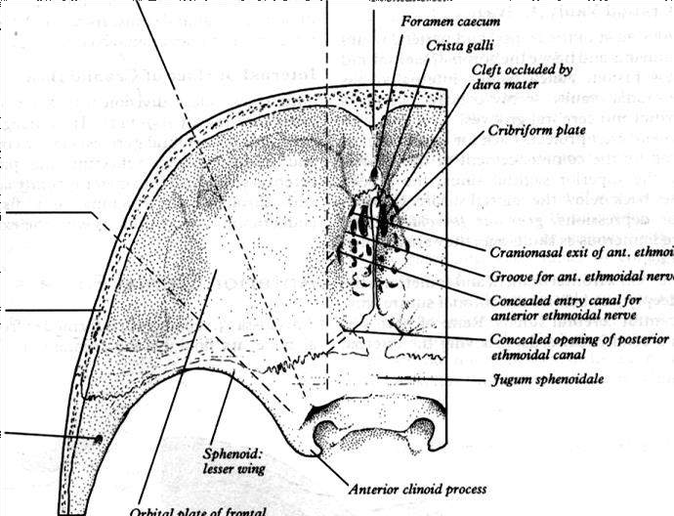
Orbital part of frontal bone
Cribriform plate of ethmoid
Anterior part of the body of sphenoid & lesser wing

Slide 76

It separates the fossa from nasal cavity & forms the roof of the nasal cavity.
A median crest like elevation
-CRISTA GALLI
THE SPHENOID BONE
Anterior part of the upper surface of its body is
termed the JUGUM SPHENOIDALE

Slide 77

It separates the orbit and its contents from the inferior surface of the frontal lobe of the brain
Its antero medial part split into 2 laminae
FRONTAL SINUS

Slide 78
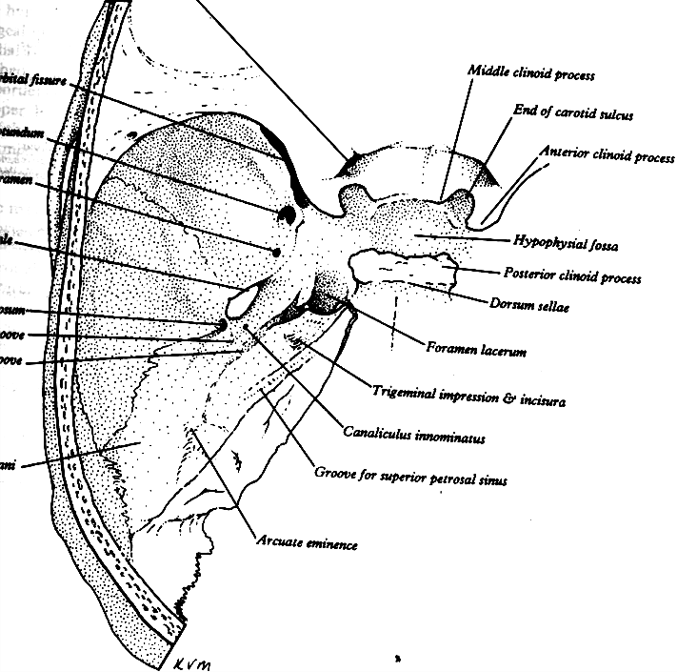
It is deeper than the anterior fossa
◻ In front it is bounded by posterior borders of the lesser wing of the sphenoid
and the body of the sphenoid,
◻ Behind by superior borders of the temporal bones & Dorsum sellae of sphenoid bone

Slide 79
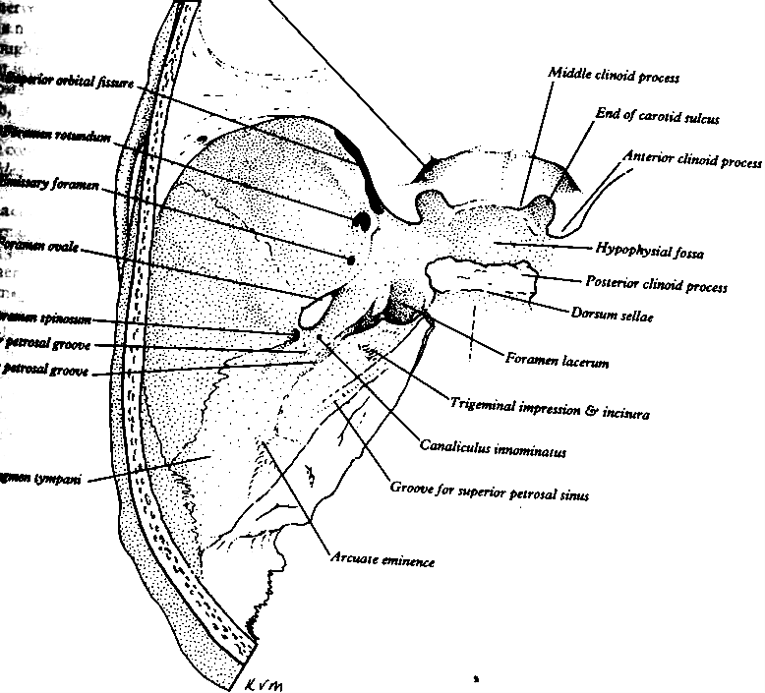
Centrally
◻ OPTIC CANAL
◻ HYPOPHYSEAL FOSSA
Laterally
◻ SUPERIOR ORBITAL FISSURE
◻ FORAMEN ROTUNDUM
◻ FORAMEN OVALE
◻ FORAMEN SPINOSUM
◻ FORAMEN LACERUM

Slide 80
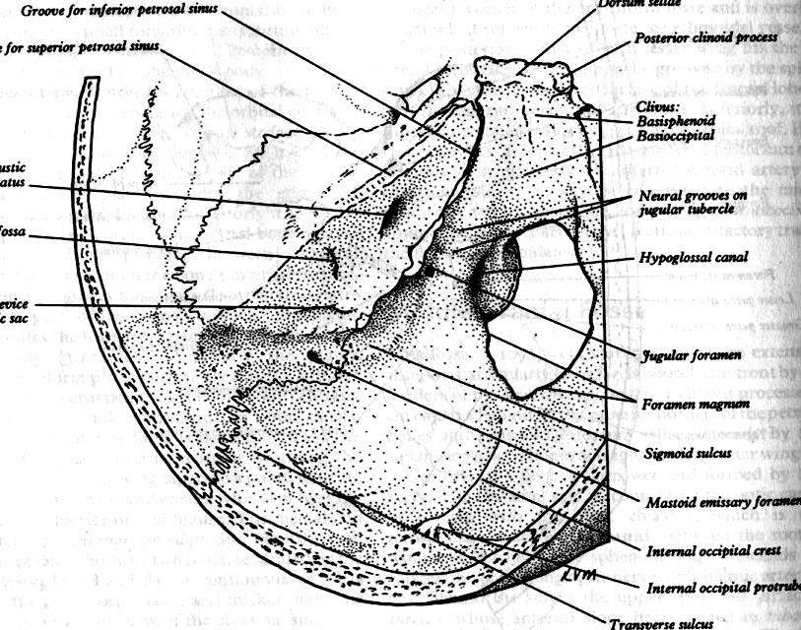
Largest and deepest of the cranial fossa
Anteriorly – Dorsum sellae & body of the sphenoid
Posteriorly –Squamous part of
the occipital bone Laterally – Petrous & mastoid parts of temporal bone

Slide 81

VARIOUS FORAMINA
◻ FORAMEN MAGNUM
◻ JUGULAR FORAMIN
◻ INTERNAL ACOUSTIC MEATUS
FACIAL CANAL
◻ HYPOGLOSSAL CANAL

Slide 82
CRANIUM
NEUROCRANIUM VISCEROCRANIUM
BASICRANIUM

Slide 83

At the cellular level
◻ Hyperplasia
◻ hypertrophy
◻ Accretion
Cranial base develops by endochondral bone formation

Slide 84

CHONDRIFICATION
Earliest evidence is seen in the late somite period
Mesenchyme derived from paraxial mesoderm
and neural crest condenses to from
ECTOMENINGEAL CAPSULE

Slide 85

CARTILAGES
◻ PARACHORDAL CARTILAGE
◻ HYPOPHYSEAL CARTILAGE
◻ OTIC CAPSULE
◻ NASAL CAPSULE

Slide 86
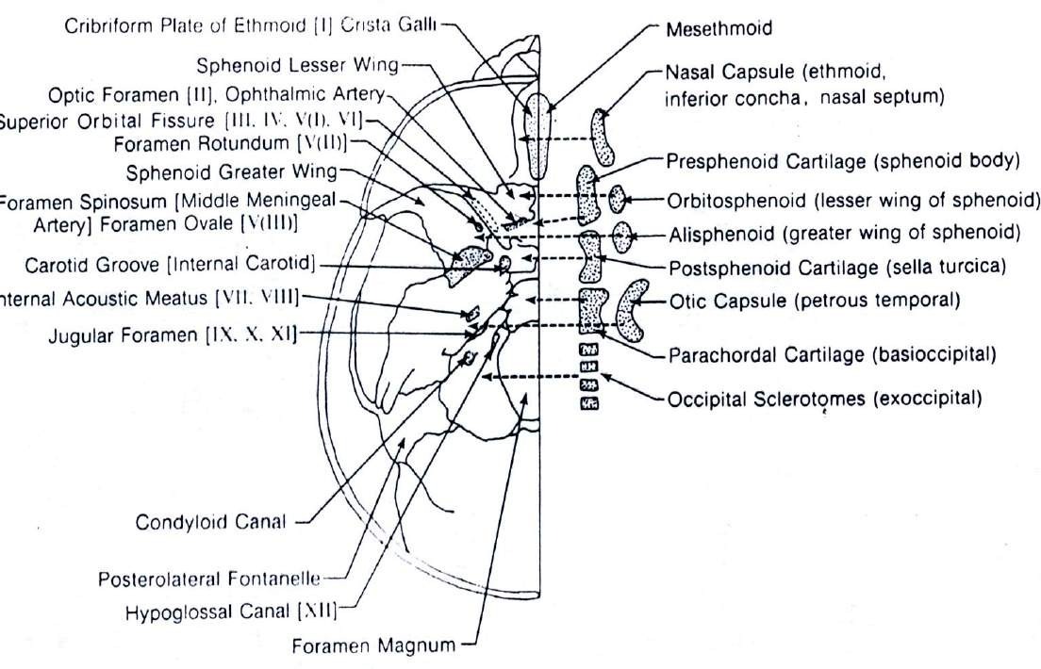

Slide 87
PARACHORDAL CARTILAGES
Chondrification centers forming around the cranial end of the notocord
Parachodal cartilages fuse with the sclerotomes arising from occipital somites surrounding the neural tube

Slide 88
HYPOPHYSEAL CARTILAGES
2 Hyphyseal cartilages – Basisphenoid 2 Presphenoid cartilages – Presphenoid
bone Orbitosphenoid – Lesser wing Alisphenoid – Greater wing
MESETHMOID CARTILAGE

Slide 90
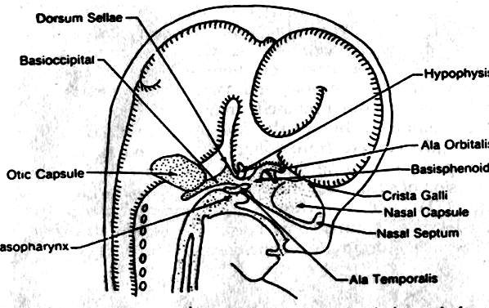
OTIC CAPSULE
Mastoid and petrous portions of the temporal bones

Slide 91

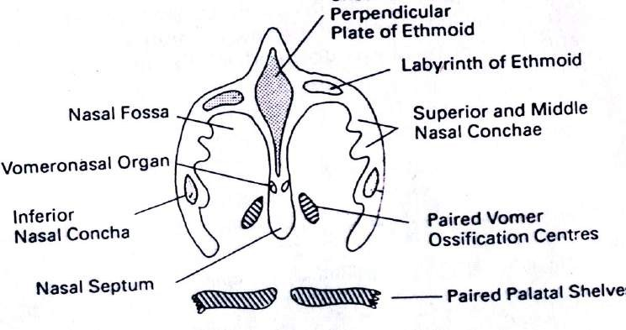
NASAL CAPSULE
Cartilages of nostrils and the nasal septal cartilage
◻ Functional matrix
◻ It helps in transferring compressive forces from incisor region to the sphenoid region

Slide 92
The separate centers of chondrification
BASAL PLATE
Cartilaginous skeletal development occurs in the 3 month
Ossification starts in the 4 month

Slide 93
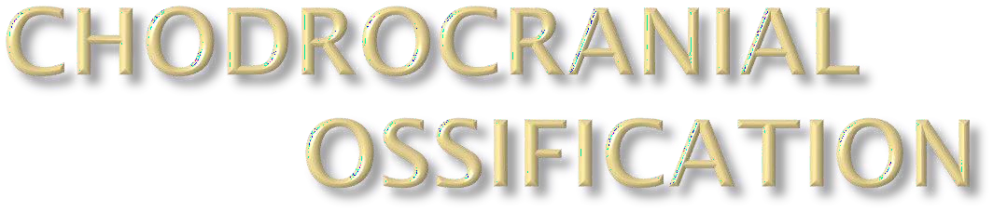
110 ossification centers appears in the
embryonic human skull
UNOSSIFIED CHONDROCRANIAL REMNANTS –
◻ Alae & septum of the nose,
◻ Spheno-occpital & spheno-petrous junctions,
◻ The apex of the petrous bone and
Between the separate parts of the occipital
bone
◻

Slide 94
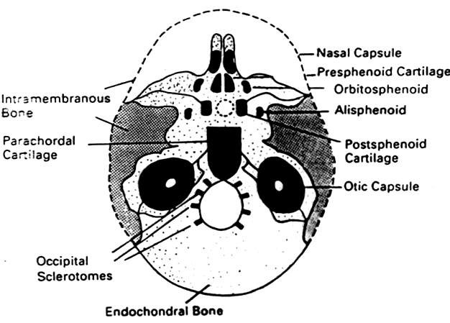
CHODROCRANIAL
OSSIFICATION

Slide 95

OCCIPITAL BONE - 7 centres
◻ Supranuchal Squamous portion –
2 intramembranous centres ( 8 ^{th} week)
◻ Infranuchal squamous –
2 endochondral centres (10 ^{th} week)
◻ Basioccipital bone – 1 endochondral
(11th week)
◻ Exoccipital bone – 2 endochondral centres
(12 ^{th} week)

Slide 96

TEMPORAL BONE - 21 centres
◻ Squamous portion-1 intramembranous centre
(8 ^{th} week)
◻ Tympanic ring – 4 intramembranous centres
(3 ^{th} month)
◻ Petrosal part – 14 endochondral centres (16th week)
◼ Styloid process – 2 endochochondral
centres(at birth)

Slide 97
ETHMOID BONE – 3 centres
◻ Perpendicular plate & crista galli –
1 endochodral centre
◻ Lateral labrynths in the nasal cartilages- 2 endochondral centres

Slide 98
SPHENOID BONE – 19 centres
◻ Basisphenoid – 3 presphenoid &
4 postsphenoid endochondral centres
◻ Greater wings – 2 centres
◻ Lesser wings - 2 centres
◻ Medial pterygoid plates –
2 intramembranous centres
◻ Lateral pterygoid plates –
2 intramembranous centres
◻ Sphenoidal conchae – 2 endochondral
centres

Slide 99
VOMER
Alae – 2 intramembranous centres
Inferior nasal concha
Lamina – 1 endochondral centre

Slide 100

BONE
-
SITE & NUMBER OF OSSIFICATION
INTRAMEMBRANOUS ENDOCHONDRAL
OCCIPITAL
_ Supranuchal
squamous (2)
Infranuchal squamous (2)
Basilar (1)
Exoccipital (2)
TEMPORAL
_ Squamous (1)
Tympanic (4)
Petrosal (14)
Styloid (2)
ETHMOID
_
Lateral labrynths (2) Perpendicular plate;
Crista (1)

Slide 101
SITE & NUMBER OF OSSIFICATION
BONE
-
VOMER | _ | INTRAMEMBRANOUS AlAE (2) | ENDOCHONDRAL
SPHENOID | _ | Medial pterygoid | Presphenoid (3)
plates (2)
Lateral pterygoid plates (2)
INFERIOR NASAL
CONCHA _
Postsphenoid (4)
Orbitosphenoid (2)
Alisphenoids (2)
Pterygoid hamulus (2
Sphenoidal conchae (2)
Lamina (1)

Slide 102
Angle at the hypophyseal fossa where prechordal & chordal parts meet each other
◻ Precartilage stage – 150°
◻ Cartilage stage – 130°
◻ Preossification stage – 115°-120°
◻ Ossification stage – 125°-130°

Slide 103
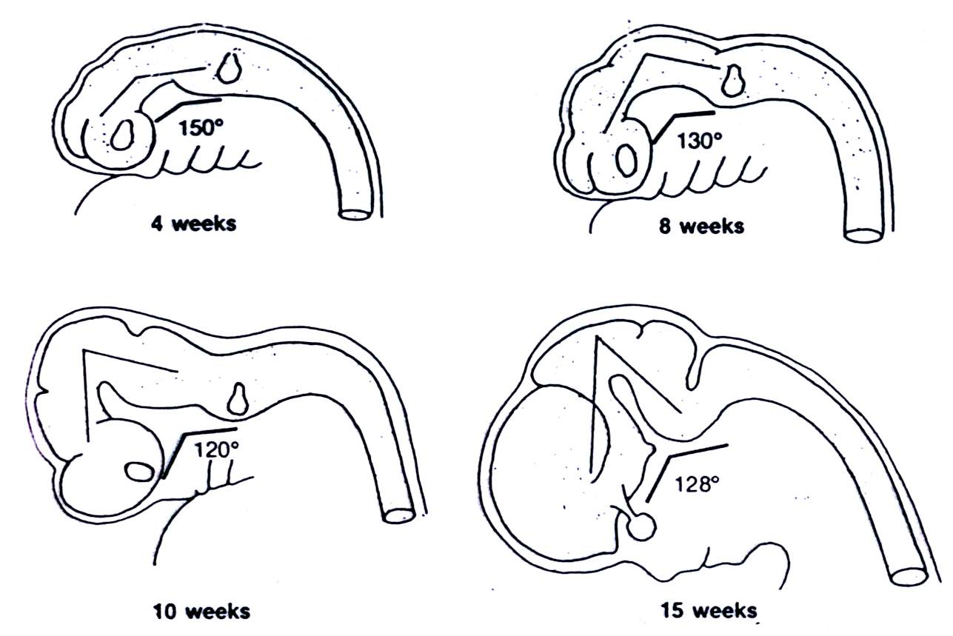
CRANIAL BASE ANGULATION

Slide 104
Highly Uneven
Anterior cranial base increases its length
and width by 7 folds between the 10th and 40thweek of I.U life
Posterior cranial base grows only 5 fold

Slide 105
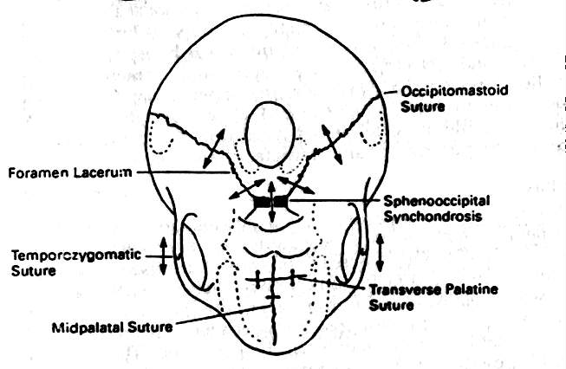
EXPANTION of cranial base occurs by
◻
Growth of the cartilage remnents of the chondrocranium
Forces from growing brain
◻

Slide 106
Cranial base acts as a template from which the face develops
The endocranial surface of the basicranium is resorptive in most areas
Remodelling is required to accomidate the massively enlarged human brain

Slide 107
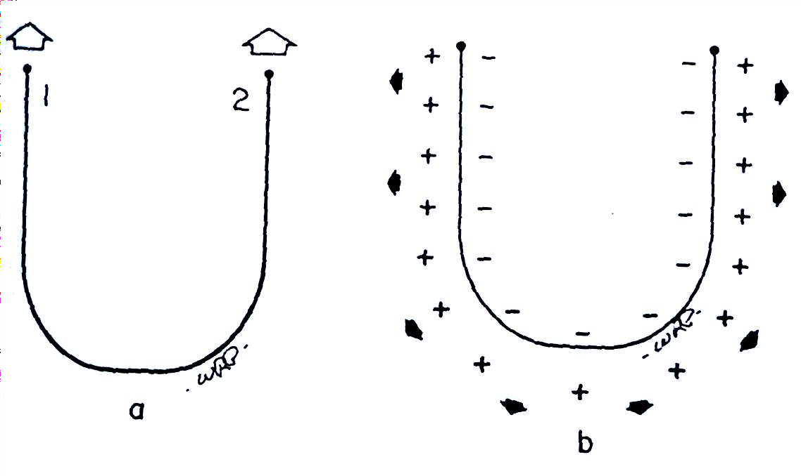
FOSSA ENLARGEMENT

Slide 108
Middle & posterior fossae – petrous elevation
Olfactory fossae – crista galli
Right & left middle fossae – Sphenoidal elevation Right & left anterior & posterior fossae – Longitudinal
middle bony ridge

Slide 109
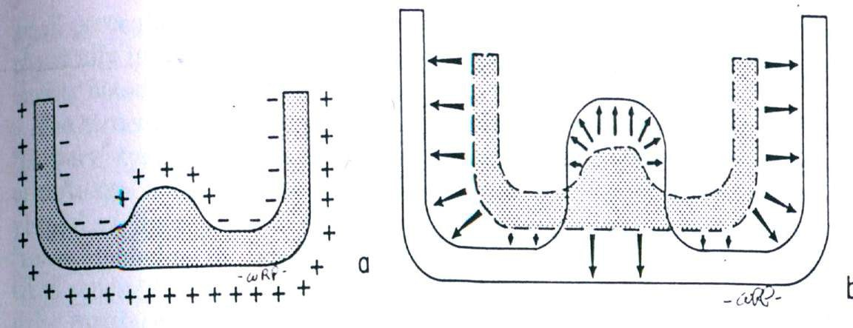
POSTNATAL GROWTH
Fossa expands outward by resorption, Partitions between them enlarge inward by deposition

Slide 110
The mid ventral segments of cranial base grows more slowly to accomodate the medulla, pons, hypothalamus & optic chiasma
Foramen Spinal Cord
Drift process
Defferential
remodelling

Slide 111
SYNCHONDROSIS
Spheno-frontal synchondrosis
Fronto-ethmoidal synchondrosis
Spheno-ethmoidal synchondrosis
Inter-spenoidal synchondrosis
Spheno-occipital synchondrosis

Slide 112
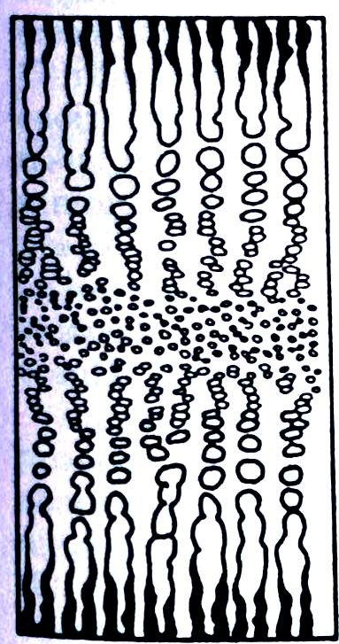
ZONES OF SYNCHONDROSIS
Familial reserve zone
Cell division zone
Hypertrophic zone
Calcified zone A growth centre
Bipolar direction of growth

Slide 113
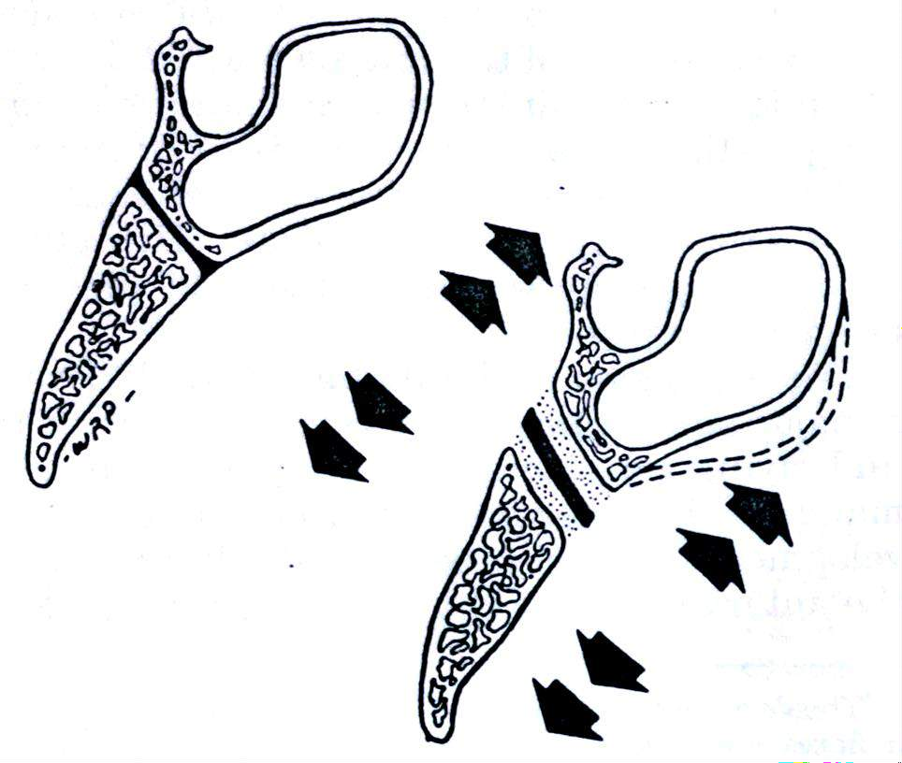
SPHENO-OCCIPITAL SYNCHONDROSIS
Major contributor in the postnatal growth
Fuses at 12-13 years in girls
,and 14-15 years in boys and ossifies at 20 years of age
Pressure adapted
bone growth mechanism

Slide 114
The interior of the sphenoid bone eventually becomes hollowed to form the
SPHENOIDAL SINUS
Sinus secondarily grows as the body of the sphenoid bone expands with the moving naso-maxillary complex

Slide 115
The size, shape and characteristics of cranial base have evolved in direct association with brain
Expansion of the middle cranial fossa
Secondary displacement effect (Anterior cranial floor & naso- maxillry
complex)

Slide 116
Frontal lobe growth completes by 5years
Temporal lobes continue to enlarge for several more years and displaces the frontal lobe forward
Foramen magnum progressively lowered by resorption

Slide 117
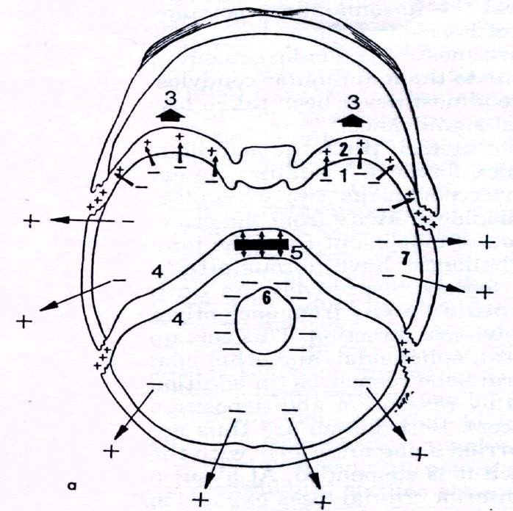

Slide 118
Configuration of neurocranium(& brain)
determines a person’s head form type
DOLICOCEPHALIC
BRACHYCEPHALIC
MESOCEPHALIC

Slide 119
Cranial base growth for Dutch boys and girls –
Monique Henneberke &
Birte Prahl Andersen
◻ S-N 153(boys)and 167 (girls)
◻ N-Ba and S-Ba 116 (boys) and (girls)
Mixed longitudinal study

Slide 120
RESULTS
The effect of orthodontic therapy on cranial base was not significant
The cranial base displayed sexual dimorphism in absolute size,timing and amount of growth.
Girls did not show growth spurts where as boys
showed growth spurts for S-N and N-Ba.

Slide 121
ACHONDROPLASIA
Deficient growth at the synchondrosis
,
Maxilla is not translated forward
This results in abnormal depression of the bridge of the nose

Slide 122
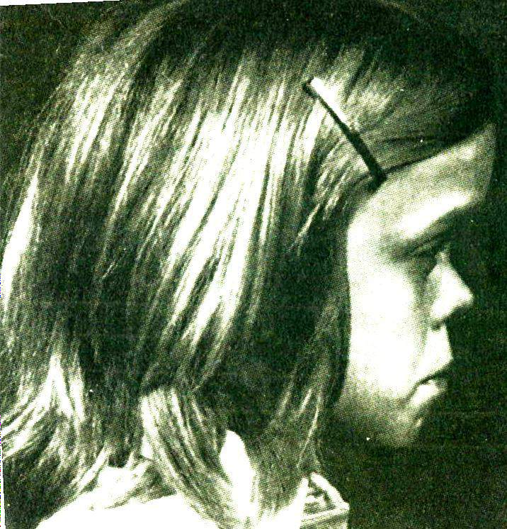

Slide 123
◻ Premature ossification or synostosis of the suture between the presphaenoid and postsphenoid parts and of the spheno- occipital suture
◻ More fragile and is commonly involved in fractures , particularly along the foramina

Slide 124
◻ Anomalous development of the presphenoidal elements
Excessive separation of orbits and abnormally broad nasal bridge. -HYPERTELORISM
◻ Pre mature fusion of spheno-occipital synchondrosis
Depressed nasal bridge and dished face.

Slide 125
◻ . ANENCEPHALY (Absence of calvaria )
Cranioschisis
INADEQUATE GROWTH OF
CHONDROCRANIUM
◻
Impacted eruption of third molars

Slide 126
CLINICAL IMPLICATIONS
CLIEDO CRANIAL DISOSTOSIS (Abnormalities of the skull, teeth, jaws and shoulder girdle )
KREIBORG,BJORK & SKIELLER conducted a qualitative screening for abnormal morphological traits in the cranial base. (8 males & 9 females)

Slide 127
RESULTS
◻ The anterior and posterior cranial base was shorter and the cranial angle smaller in the syndrome groups
◻ Patients shown small pituitary fossae and bulbous dorsum sellae
◻ The amount of bone resorption was lesser than
normal.

Slide 128
Mandible growth
Prenatal & postnatal

Slide 129

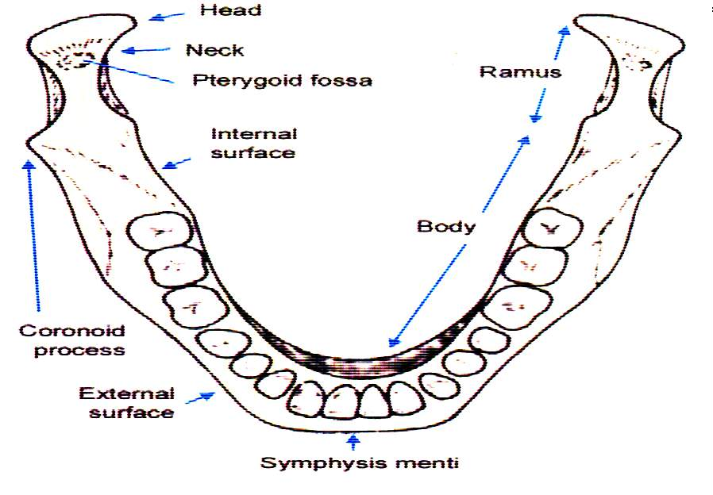
Mandible or lower jaw is the largest and strongest bone of the face. It is the only mobile bone of the craniofacial bones. It has a horse shoe shaped body which lodges the teeth and a pair of rami which project upwards from posterior ends of the body and provide attachment to muscles.

Slide 130

JOHN HUNTER (1771) compared a series of dried mandibles and concluded that in order to attain space for permanent molar teeth the mandible must grow by posterior apposition of ramus accompanied by anterior ramus resorption.
HUMPHRY (1866) studied growth of mandible by inserting metal wires in the mandible of young pigs.
BRASH (1924) fed pigs the madder plant root which labeled appositional growth

Slide 131
BJORK (1955): conducted implant studies on jaws to determine the growth pattern & rotation
,when subjected to serial cephalometric methods.
DONALD ENLOW : proposed the V principle of growth and counterpart principle.

Slide 132
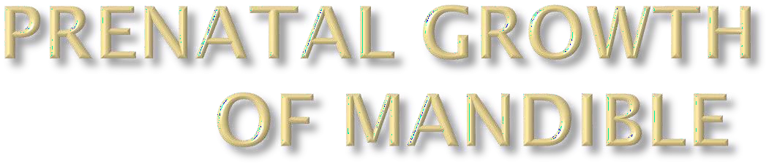
EMBRYONIC PERIOD
During 3rd & 8th week of development, a period known as the embryonic period, each of the 3 germ layers (endoderm, ectoderm & mesoderm) give rise to a number of specific tissues & organs

Slide 133
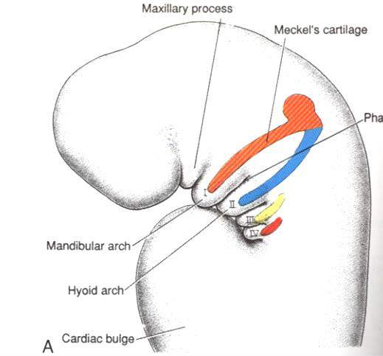
The pharyngeal arch begin to develop during the 4th week in utero
Each pharyngeal arch has specific cartilage that form the skeleton of the arch. muscles,
nerve that supplies the
muscles and artery.

Slide 134
◻ The 1st pharyngeal arch contains the Meckel’s
Cartilage.
◻ The trigeminal nerve is the first nerve of the arch.
◻ From 1st arch the muscles developing are the muscles of mastication, they are messeter, temporalis, medial pterygoid and lateral pterygoid; anterior belly of digastric, tensor palati and levator palati.
◻ Artery called the maxillary artery.

Slide 135
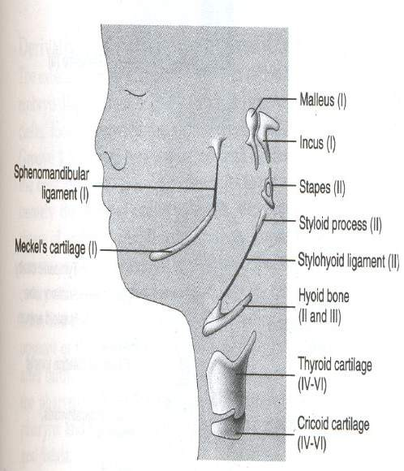
MECKEL’S CARTILAGE
The 1st pharyngeal arch is the mandibular arch which
contains the Meckel’s Cartilage.
It appears at about 6th week of
I.U. life.
The mandible makes its appearance as a bilateral structure in the sixth week of fetal life as a thin plate of bone. The mesenchymal tissue lateral to Meckel’s cartilage undergoes intramembranous ossification to produce the mandible

Slide 136




The greater part of meckel's cartilage disappears without contributing to formation of bone of mandible.
A single ossification for each half of mandible arise in region of bifurcation of inferior alveolar nerve and artery

Slide 137
SECONDARY CARTILAGE
The secondary cartilage are Condyle cartilage Coronoid cartilage Symphyseal cartilage
Condylar cartilage develops initially as independent secondary cartilage which is separated by a considerable gap from the body of mandible. Early in fetal life it fuses with the developing mandibular ramus.

Slide 138
Ossification in the downward growing secondary condylar cartilage which developed at about 12th week, appears to commence anteriorly in the fourth month of fetal life and by the end of fifth month the only part of cartilage left is beneath the articular surface of condyle. This small area persists until 20th year of life
The coronoid cartilage disappears just before birth.

Slide 139
Throughout fetal life mandible is a paired bone. Right and left half of mandible are joined in the midline by fibrocartilage in the mandibular symphysis.
Two halves of the mandible unites by ossification of symphysial fibrocartilage at the end of first year.

Slide 140
◻ The growth of alveolar bone is completely dependent on presence or absence of teeth.
◻ An alveolar process develops only during eruption of teeth and resorb following extraction.
◻ The increase in vertical height of face is the result of growth of maxillary and mandibular process.
◻ ADAPTIVE REMODELLING OF ALVEOLAR PROCESS MAKES ORTHODONTC TOOTH MOVEMENT POSSIBLE.

Slide 141
FETAL MANDIBLE
◻ The beginning fetal mandible as in the earliest growth stages of other bones of skull, initially has outside surface that are entirely depository in character.
◻ There is a marked acceleration of mandibular growth between 8th and 12th week of fetal life
◻ At about 10th week, however, resorption begins around the rapidly expanding tooth buds and is present thereafter.

Slide 142
By 13 weeks, resorptive fields are established on the
buccal side of the coronoid process
lingual side of ramus
lingual side of posterior part of corpus.
◻ The anterior edge of ramus is already resorptive and the posterior border is depository.
◻ By 26 weeks the basic growth and remodeling pattern that continues on into post natal development is seen.
◻ The entire lateral side of the anterior part of the corpus is still depository.

Slide 143
◻ The lingual side of fetal corpus in the incisor region is resorptive after about fifteenth week in most (but not all) mandible
◻ Subsequently to the deciduous dentition period of childhood growth, the alveolar bone on the labial side undergoes a reversal to become resorptive and the opposite lingual side depository
◻ From this time chin begins to take on a
progressively more prominent form

Slide 144

Of all the facial bones mandible undergoes the largest amount of growth postnatally due to cephalocaudal growth gradient.

Slide 145

According to MOSS while mandible appears in the adult as a single bone, it is divisible into several skeleton subunits
◻ Condylar process
◻ Coronoid process
◻ Angular process
◻ Ramus
◻ Lingual tuberosity
◻ Body of mandible
◻ Alveolar process
◻ chin.

Slide 146

It is a major site of growth Historically, the condyle has been regarded as a kind of cornucopia from which the whole mandible itself pours forth.
The condyle functions as regional field of growth that provides an adaptation for its own localized growth circumstances

Slide 147
◻ The condylar cartilage is a secondary type of cartilage
◻ Its real contribution is to provide regional adaptive growth
◻ Main functional role of condyle is
provides a pressure tolerant articular contact
it makes possible a multidimensional growth capacity in response to ever-changing, developmental conditions and variations.

Slide 148

◻ The condylar growth mechanism itself is a clear-cut process.
Cartilage is a special non-vascular tissue and is involved because variable levels of compression
◻ An endochondral growth mechanism is required for this part of
the mandible
◻ Endochondral growth occurs only at the articular contact part of the condyle
◻ In Figure the endochondral bone tissue (b)
◻ formed in association with the condylar cartilage (a)
◻ The enclosing bony cortices (c) are produced by periosteal-
endosteal osteogenic activity

Slide 149



◻ A unique capsular layer of poorly vascularized connective tissue covers the articular surface of condyle (layer a) .
◻ Just deep to it is a special layer of prechondroblast cells (layer b) .
◻ new developing cartilage (layer c).
◻ continually forming endochondral bone thus follows the moving cartilage (layer d).

Slide 150


The periosteum and endosteum are active in producing the cortical bone that encloses the medullary core of endochondral bone tissue.
The lingual and buccal sides of neck characteristically have a resorptive surface. This is because condyle is quite broad and neck is narrow

Slide 151

◻ The neck is progressively relocated into areas previously held by the much wider condyle
◻ What used to be condyle in turn becomes the neck as one is remodeled from the other . This is done by periosteal resorption combined with endosteal deposition.

Slide 152

◻ Explained another way, the endosteal surface of the neck actually faces the growth direction; the periosteal side points away from the course of growth.
This is another example of the V principle, with the V- shaped cone of the condylar neck growing toward its wide end.

Slide 153


What is the physical force that
produces the forward and downward primary displacement of mandible ?
◻ proliferation of cartilage towards its contact thereby pushes the whole mandible away from it.
◻ bilaterally condyle lacking mandibles occupy an essentially normal anatomic position.

Slide 154
These observations suggested conclusions.
First the condyles may not play the kingpin role
of a “master center”.
Second the whole mandible can become displaced anteriorly and inferiorly into its functional position without a "push" against the basicranium

Slide 155

◻ Mandible is carried forward and downward, in conjunction with the growth expansion of the soft tissue matrix associated with it
◻ It is a passive type of carrying
◻ The condyle and whole ramus secondarily remodels toward it thereby closing the potential space without an actual gap being created

Slide 156

◻ It is directly involved as a unique, regional growth site.
◻ It provides an indispensable latitude for adaptive growth.
◻ It provides movable articulation.
◻ It is pressure tolerant and provides a means for bone growth (endochondral) in a situation in which ordinary periosteal (intramembranous) growth would not be possible
◻ It can also, all too frequently, become involved in TMJ pathology and distress.

Slide 157


◻ The coronoid process has propeller like twist, so that its lingual side faces three general directions all at once posteriorly, superiorly and medially.

Slide 158


◻ When bone is added onto the lingual side of the coronoid process , growth thereby precedes superiorly and this part of ramus increased in
vertical direction.

Slide 159

◻ The same deposits of bone on the lingual side also bring about a posterior direction of growth movement .
◻ produces backward movement of two coronoid process even though deposits on the inside (lingual) surface.

Slide 160

◻ These same deposits on the lingual side also bring about medial direction of growth in order to lengthen corpus
◻ area occupied by anterior part of ramus in mandible 1 becomes relocated and remodeled into posterior part of corpus in mandible 2.

Slide 161
◻ The buccal side of coronoid process has a resorptive type of periosteal surface.
The remainder of most of the superior part of ramus including the whole area just below the mandibular notch (signoid), and superior portion of condylar neck grows superiorly by deposition on the lingual side and resorption from buccal side.

Slide 162



◻ At birth the two rami of mandible are quite short, they grow by the process of direct surface apposition and remodeling.
◻ THE PRINCIPLE GROWTH VECTORS ARE IN POSTERIOR & SUPERIOR DIRECTION
◻ Resorption occurs on the anterior surface of ramus while bone deposition occurs on posterior surface.
◻ Bone growth occurs at the mandibular condyle and along the posterior part of ramus to the same extent as anterior part has undergone resorption.

Slide 163

◻ The lower part of ramus below the coronoid process also has a twisted contour. Its buccal side faces posteriorly toward the direction of backward growth and thus characteristically has a depository type of surface. The opposite lingual side, being away from direction of growth, is resorptive.

Slide 164

◻ It positions the lower arch in occlusion with the upper.
◻ It is continuous adaptive to the multitude of changing craniofacial conditions.
◻ Attach the mastication muscle and must accommodate
the increasing mass of masticatory muscle inserted into it.
◻ Bridges the pharyngeal compartment.
◻ The horizontal breadth of ramus determines the anteroposterior positioning of lower arch.
◻ Height of ramus accommodates the vertical dimension and growth of nasal and masticatory components of face.
◻ Remodeling and relocation give space to accommodate erupting permanent molar.

Slide 165



◻ Th effective anteroposteral dimension of ramus and middle cranial fossa are direct counterparts to each
other.

Slide 166


◻ Greater amounts of bone additions on the inferior part of the posterior border than on the superior part.
◻ A correspondingly greater amount of matching resorption on the anterior border takes place inferiorly than superiorly.
◻ A "remodeling" rotation of ramus
alignment thus occurs.
◻ In diagram the pharynx enlarges
horizontally from a to a’ .
◻ The ramus enlarges correspondingly
from b to b’
◻ Angle c is reduced to c’ to accommodate the vertical nasomaxillary growth

Slide 167

◻ vertical lengthening of the ramus continues to take place after horizontal ramus growth slows or ceases
◻ Resorption takes place on the upper part of the posterior border.
◻ condylar growth may become more vertically directed
◻ A forward growth direction can occur on the anterior border in the upper part of the coronoid process.
◻ A posterior direction of remodeling takes place in the lower part of the posterior border.

Slide 168

◻ In fig mandible a is superimposed over b remodeling changes outlined above serve simply to alter the ramus angle without increasing its
breadth.

Slide 169

The growth and remodeling changes of both ramus and middle cranial fossa produces lowering of mandible arch to accommodate vertical expansion of nasomaxillary complex .
To bring upper and lower teeth into full occlusion the mandibular teeth must drift vertically.
One of the several reason why orthodontic purpose, often attack maxillary dentition

Slide 170

◻ The mandibular foramen likewise drift backward and upward by deposition on the anterior and resorption on the posterior part of its rim. The foramen presents a constant position about midway between the anterior and posterior border of ramus.

Slide 171

◻ A single field of surface resorption is present on the inferior edge of mandible at the ramus corpus junction. This forms the antegonial notch
◻ In vertical growth it is deep and
◻ horizontal growth shallow

Slide 172



◻ Important structure as it is direct anatomic equivalent of the maxillary tuberosity
◻ Major site of growth for mandible
◻ Effective boundary between basic parts of the mandible ramus and corpus.
◻ Grows posteriorly by deposits on the posterior facing surface.
◻ The prominence of tuberosity is increased by presence of large resorptive fields just below it which produces a sizable depression, the lingual fossa.

Slide 173


◻ The combination of resorption in the fossa and deposition on the medial facing surface of tuberoisty itself greatly accentuates the contours of both region
◻ Deposition on the lingual surface of the ramus just behind the tuberosity produces a medial direction of drift that shifts this part of the ramus into alignment with the axis of corpus.

Slide 174

The whole ramus is being located in the posterior direction at the same time. The bony arch length has been increased and the corpus has been lengthened by-
Deposits on the posterior surface of lingual tuberosity and the contiguous lingual side of the ramus.
Resultant lingual shift of this part of ramus added to become corpus.

Slide 175

The presence of resorption on the anterior border
of ramus is usually described as ‘MAKING ROOM FOR LAST MOLAR’.

Slide 176

◻ Growth of mandible continues at a relatively steady rate before puberty.
◻ On an average ramus hieght increases 1 to 2 mm per year and body length increase 2 to 3 mm per year

Slide 177


Man is one of only two species having chin
During the descent of the maxillary arch and the vertical drift of the mandibular teeth, the anterior mandibular teeth simultaneously drift lingually and superiorly

Slide 178

The remodelling process involves
periosteal resorption on the labial bony cortex
Deposition on the alveolar surface of the labial cortex
Resorption on the alveolar surface of the lingual cortex
Deposition on the lingual side of the lingual cortex(d).

Slide 179

◻ At the same time, bone is progressively added onto the external surface of the mandibular basal bone area , including the mental protuberance (chin).
◻ The reversal between these two growth fields usually occurs at the point where the concave surface contour becomes convex.
◻ The result of this two way growth process is a progressively enlarging mental protuberance

Slide 180
◻ IN 1960 BJORK & COWORKERS CARRIED OUT LONGITUDINAL STUDIES USING IMPLANTS TO STUDY JAW ROTATIONS DURING GROWTH

Slide 181

◻ INTERNAL ROTATION-CORE
◻ EXTERNAL ROTATION- SURFACE CHANGES

Slide 182

◻ MATRIX ROTATION-
Around the condyle
◻ INTRA MATRIX
ROTATION-within the body of mandible

Slide 183


◻ Low mandibular plane angle
◻ Increased internal rotation & reduced external rotation
◻ Deep bite with crowed incisors

Slide 184


◻ Lack of forward internal rotation
◻ Increased mandibular plane angle
◻ Open bite & mandibular deficiency

Slide 185

At birth
Two halves of mandible are united by fibrous symphysis menti.
Alveolar process not yet formed.
Ramus is quite short
Minimum condylar development
Coronoid process projects above condyle.

Slide 186

In infancy and children
Two halves of mandible ossifies by ossification of symphyseal cartilage
Body elongates to accommodate
erupting first molar
Development of chin occurs
Alveolar growth takes place
Mental foramen opens below the sockets of the two deciduous molar near the lower border.
The mandibular canal runs near lower border. The angle is obtuse
The coronoid process is large and projects upward above level of condyle.

Slide 187

◻ In adults
Mental foramen opens midway between upper and lower borders because alveolar and subalveolar parts are equally developed. The mandibular canal runs parallel with mylohyoid line. The angle reduces to about 110 or 120 degrees because the ramus becomes almost vertical

Slide 188

In old age
Resorption of alveolar region due to loss of teeth
Mandibular Canal & mental foramen lies closer to alveolar border. Ramus becomes oblique 140

Slide 189

GENETIC THEORY:-
This theory states that all growth is compelled by genetic influence ie: genetic encoding of mandible determines its growth.

Slide 190
◻ This theory states that the cartilage is the primary determinant of skeletal growth while bone responds secondarily & passively.
◻ According to this theory, the condyle by means of endochondral ossification deposits bone, which tends to grow the mandible.

Slide 191
◻ According to this theory, the soft tissue matrix in which the skeletal elements are embedded is the primary determinant of growth & both bone & cartilage are secondary followers.
◻ Which means the muscles, connective tissues etc. carries the entire mandible away from the cranial base . The bone follows secondarily at the condyle to maintain constant contact with the glenoid fossa.

Slide 192

This theory states that many facial bones or a part of the bone follows a ‘v’ pattern of enlargement.
Deposition is in the inner surface of of ‘v’ . Resorbtion is seen along the outer surface of ‘v’.
CORONOID PROCESS: Deposition – lingualsurface, Resorption-buccal CONDYLE PROCESS: Deposition-ant. &
post. Margins, Resorption-buccal & lingual surfaces.

Slide 193
This principle states that growth of any given facial or cranial part relates specifically to other structural & geometric counterpart in the face & cranium
Eg;- The maxillary arch is the counter part of the mandibular arch.

Slide 194

◻ SCOTT divides mandi.
Into 3 types: BASAL, MUSCULAR & ALVEOLAR
◻ The basal tubular portion of mandible serves as a protection for the mandibular canal & follows a logarithmic spiral in its downward & forward movement from beneath the cranium

Slide 195
◻ The most constant part of mandible is the arc from foramen ovale –mandible foramen – mental foramen.
◻ The U.N.C. also accounts for stress trajectory alignment & trabacular structure from condyle to symphysis . The mandi. canal & nerve are protected by this concentration of trabaculae

Slide 196
◻ PETROVIC attributes the control of growth & development to cybernetics
◻ Growth of the condyle is mainly attributed to the quantitative response to the growth of the maxilla ie: the maxilla is the constantly changing reference input & mandible is the controlled variable
◻ This means the mandible grows in response to feedback mechanism that occurs as a result of maxillary growth.

Slide 197


◻ Moss found it reasonable to speculate that the pathway of the inferior alveolar nerve follows a logarithmic spiral
◻ lateral x-rays effectively outlined the pathway of the inferior alveolar nerve.
Representative of mandible
with fetal, deciduous, mixed
and adult dentition

Slide 198

◻ These foramina are aligned on a curve that fits them all.
◻ The corpus stays in essentially a horizontal position. At the same time, the mandible moves down the logarithmic spiral course of the inferior alveolar nerve.

Slide 199



◻ The logarithmic spiral formulated by moss, which coincide with three foramina of inferior alveolar nerve and describes path of mandibular growth.
◻ As the foramina separate during growth the mandible continually assumes a position where there is lesser curvature of spiral
◻ As mandible increase in size, it does not actually grow up and out ,the whole spiral rotates clockwise and corpus remains horizontal

Slide 200
Ricketts has developed a method to determine the arc of growth of the mandible.
The principle is:
A normal human mandible grows by superior- anterior apposition at the ramus on a curve or arch which is a segmented formed from a circle. The radius of this circle is determined using the distance from mental protuberance (Pm) to a point the forking of the stress lines at the terminus of the oblique ridge on the medial side of the ramus (point Eva).
◻

Slide 201

◻ The mandibular foramen was selected as the internal structure thought to have to have some relationship with the inferior alveolar nerve
◻ A new poinl Xi for determining its position were developed. This point locates opening of mandibular canal
R1- DEEPEST POINT ON SUBCORONOID INCISURE R2- DIRECTLY OPPOSITE ON POSTERIOR BORDER OF
RAMUS
R3- DEPTH OF SIGMOID NOTCH
R4- DIRECTLY INFERIOR ON LOWER BORDER OF RAMUS
R3
R1R
1
RR11
RRR222
R4

Slide 202

◻ The second point Pm (protuberance menti) was selected because it is an identifiable and stable landmark.
◻ DC, the third point, represents the bisection of the condyle neck as high as visible in the cephalometric film below the fossa.
◻ A line from DC to Xi constitutes the condyle axis and the one from Xi to Pm the corpus axis.
◻ Consequently, these planes can be studied for dimensional and angular changes

Slide 203


◻ When an "average", mandible at time 1 was superimposed on an "average" mandible at time 2, using Xi and the corpus axis as reference, the mandibles were found to bend about one-half degree each year

Slide 204

◻ Three curves were ultimately drawn (A, B, and C ) and C was determined to best fit the true arc of growth of the mandible.
Over a period of time
In curve A – resulting mandible would be too obtuse.
In curve B – mandible was bent excessively.
In curve C - somewhere in the mandible between the condyloid and coronoid processes and between Xi and the anterior border of. the ramus.

Slide 205

◻ Analysis of the stress lines of a very old skull revealed an area at almost the center of the upward and forward quadrant of the ramus on the medial surface that appeared at the confluence of various stress lines which was given the name Eva.
The lateral surfaces also exhibited a Y- shaped convergence of several stress lines, and Ricketts reasoned that these areas were important in mandibular growth

Slide 206

◻ a new point Tr (True radius) is used as the center of a circle has a radius equal to Eva-Pm
◻ Computer analysis revealed that the predicted mandible was almost absolutely correct in size and form when compared with the
final composite.
Having satisfied himself Ricketts determined,
annual increases of 2.5 mm , when averaged over the years of time. Growth was' found to cease at 14.5 years for females and 19 for males.

Slide 207

◻ Fundamentally arcial growth is dependent on superior-anterior growth of ramus,rather than posterior growth.
◻ Clearly increase in size involved a vertical not a horizontal process.
Serial tracing aligned on arc of growth and registered at pogonion and anterior border of ramus at coronoid crest, the vertical apposition at superior border of ramus is displayed.

Slide 208

◻ The angle Ba-Pt-Gn is nearly always 90° and is virtually stable during the entire growth process. This finding is not consistent if the upward and forward growth of the ramus rigidly followed the arc and were allowed to shift the chin upward and forward without compensation somewhere.
As the arc develops, there must be a rotation clockwise in order to maintain the facial axis at a near constant.

Slide 209
This rotation is, a close parallel to the rotations of the logarithmic spiral, and the pivot points are presumably related to the neurotrophic bundle that supplies the mandible.

Slide 210
In the early 1980s,Behrents succeded in recalling over 100 individuals who had participated in
Bolton
growth study in 1930s and late 1940s, more than 40 years previously
Growth of these individuals had been carefully
evaluated and recorded, by both measurements and serial cephalometric films with known magnification.
The results were surprising :-
Facial growth has continued during adult life. There is essentially increase in all facial dimensions both size and shape.

Slide 211
Vertical changes in adult life are more prominent than anteroposterior changes, whereas width changes are least evident.

Slide 212

◻ The principles of growth and development must be understood if the clinician is to adapt them to orthodontic treatment.
◻ Growth direction is important but the amount of growth is equally important.
◻ Growth mainly occurs between mixed dentition.

Slide 213
◻ Appropriate functional appliances in a forward postural position increase the condyle cartilage growth rate and amount
◻ ln most functional appliances, flanges against the alveolar mucosa below the mandibular molars or lingual pads contacting the tissue behind the lower incisors provide the stimulus to posture the mandible to a new position

Slide 214

The lingual pad or flange determines the anteroposterior and vertical mandible posture for most functional appliances
Small lingual pad from frankel appliance
Extensive lingual flange from modified activator

Slide 215
◻ It is. possible to use a chin cup to deliberately rotate the mandible down and back, redirecting rather than directly restraining mandibular growth.
◻ This reduces prominence of chin,at the expense of incresing anterior facial height

Slide 216
CORRECTION OF ANTEROPOSTERIOR RELATIONSHIP
Mandibular advancement :-Bilateral sagittal split osteotomy of mandibular ramus performed from an intra oral approach, is the preferred procedure.
Mandibular setback :- Bilateral sagittal split osteotomy and transoral vertical oblique ramus osteotomy can be done.

Slide 217
CORRECTION OF VERTICAL RELATIONSHIP
Long face patients have excessive eruption of mandibular anterior teeth . This tooth chin problem
can
be treated by orthodontic intrusion or by anterior segmental surgery to depress elongated incisor segment. However the preferred treatment is inferior border osteotomy of mandible to reduce vertical
height
of chin at the same time it is augmented horizontally. Many patients are treated by
combination
of maxillary intrusion and repositioning chin.

Slide 218
Patients with short face are treated best by sagittal split mandible ramus surgery to rotate the mandible slightly forward and down and gonial angle area up.

Slide 219
CORRECTION OF TRANSVERSE RELATIONSHIP
Distraction osteogenesis appears to offer the possibility of augmenting the amount of both bone and soft tissue in mandibular anterior area.
Movements in the posterior region are limited by the
condyle-glenoid fossa relationship.

Slide 220

The chin can be moved in all three planes of space using an osteotomy of lower border of mandible to reposition symphysis or by adding an implant material

Slide 221

◻ Generally, if blood levels of STH or testosterone increases, the supplementary lengthening of mandible is greater than supplementary lengthening of maxilla.
◻ However if the level rises beyond a certain
harmonal level “JUMPING OF BITE “ occurs.

Slide 222
Mandibular base -determined by measuring the gonion-pogonion. Ideally the mandibular base should be 3 mm longer than Se-N until the twelfth year and 3.5m longer after the twelfth year.
It indicates an age related normal mandibular length and an average growth increment can be expected.
If the base is shorter, the growth increment is probably larger.
If it is longer, the growth increment may well be smaller.
Forecasts can be improved by using two additional measurements—the lengths of the maxillary base and ascending ramus.

Slide 223
Maxillary base – Determined by measuring distance between PNS and point A.
Because the growth potential of the mandibular base is greater than that of the maxillary base, the angle S-N-B increases, and A-N-B thus decreases.
The recognition that the mandible outgrows the maxilla by as much as 5 mm is especially important to functional appliance proponents and, of coarse, to the Class II patients being treated.
If the maxillary base corresponds to the mandibular base related norm, the facial skeleton is proportionally developed particularly if ramal length also corresponds.

Slide 224
Ascending ramus -Determined by measuring distance between gonion and condylion.
The ramus tends to be longer in horizontally growing patterns, it is shorter in vertical patterns.
If the ramus is too short in relation to the-other proportions, a large amount of growth can be expected

Slide 225

LINEAR MEASUREMENTS OF MAXILLARY AND MANDIBULAR RAMUS AND ASCENDING RAMUS ON LATERAL CEPHALOGRAM

Slide 226

◻ Various facial types (orthognathic, prognathic and retrognathic) reflect to some degree the morphology of the mandible .
In the orthognathic type of face
The ramus and body of the mandible are
fully developed
The width of the ascending ramus is equal to the height of the body of the mandible, including the height of the alveolar process and incisors.
The condylar and coronoid processes are almost on the same plane, and the symphysis developed.

Slide 227

◻ In the prognathic type
The corpus is well developed .
The symphysis is wider in the sagittal plane.
The ramus is wide and long, and the gonial angle is acute or small.

Slide 228

In the retrognathic facial type
the corpus is narrow, particularly in the molar region.
The symphysis is narrow and long, and the ramus is narrow and short.
The coronoid process is shorter than the condylar process, and the gonial angle is obtuse or large

Slide 229

Bone growth in mandible is a remodelling process represented by apposition and resorbtion.
Knowledge of general facial growth provides a background to the understanding of the etiology and development of of malocclusion, such an understanding is in turn an important part of diagnosis and treatment planning.

Slide 230

Handbook of facial growth – DONALD.H.ENLOW
Orthodontic principles and practice – T.M.GRABER
Contemporary ortodontics – WILLIAM.R.PROFITT
Facial growth and facial orthopaedics – VANDER LINDEN
Orthodontic notes – JONES AND OLIVER
Textbook of ortodontics – T.D.FOSTER
Textbook of orthodontics – SAMIR.E.BISHARA
Dentofacial orthopedics with functional appliances-
GRABER,RAKOSI AND PETROVIC

Slide 231




Slide 232

GROWTH AND DEVELOPMENT OF MAXILLA

Slide 233
INTRODUCTION
THE MAXILLA IS THE SECOND LARGEST BONE OF THE FACE AFTER THE MANDIBLE.THE TWO MAXILLAE FORM THE WHOLE OF THE UPPER JAW
THE BODY OF THE MAXILLA IS PYRAMIDAL IN SHAPE,WITH THE BASE DIRECTED MEDIALLY AT THE NASAL SURFACE AND APEX LATERALLY AT THE ZYGOMATIC PROCESS.THE BODY OF THE MAXILLA ENCLOSES A LARGE CAVITY, THE MAXILLARY SINUS
EACH MAXILLA HAS A BODY AND FOUR PROCESSES
◻ FRONTAL
◻ ZYGOMATIC
◻ ALVEOLAR
◻ PALATINE

Slide 234
MAXILLA HAS THREE OSSIFICATION CENTRES
◻ MAXILLA PROPER-APPEARS ABOVE THE CANINE FOSSA DURING SIXTH WEEK OF INTRAUTERINE LIFE
◻ TWO CENTRES FOR PREMAXILLA- THE MAIN CENTRE APPEARS
ABOVE THE INCISIVE FOSSA DURING 7TH WEEK I.U.
THE SECOND CENTRE (PARANASAL OR PREVOMERINE) APPEARS DURIND THE TENTH WEEK
AGE CHANGES IN MAXILLA
AT BIRTH
TRANSVERSE AND ANTERIOPOSTERIOR DIAMETER ARE MORE THAN THE VERTICAL DIAMETER
MAXILLARY SINUS IS A MERE FURROW ON THE LATERAL WALL OF THE NOSE

Slide 235
IN ADULT
VERTICAL DIAMETER IS GREATEST DUE TO THE DEVELOPMENT OF THE ALVEOLAR PROCESS AND INCREASE IN THE SIZE OF THE SINUS
AT OLD AGE
IT REVERTS TO INFANTILE CONDITION.
ITS HEIGHT IS REDUCED AS A RESULT OF ABSORPTION OF ALVEOLAR PROCESS

Slide 236
PRENATAL DEVELOPMENT OF MAXILLA
PRENATAL LIFE IS DIVIDED INTO THREE PERIODS
THE PERIOD OF OVUM (FROM FERTILIZATION TO THE 14TH
DAY)
PERIOD OF EMBRYO (14TH DAY TO 56TH DAY)
PERIOD OF FETUS (56TH DAY TO BIRTH)

Slide 237
PERIOD OF THE OVUM
AT THE END OF THIS OF THIS PERIOD THE OVUM IS ONLY 1.5 MM, IN LENGTH AND CEPHALOCAUDAL DIFFERENTIATION HAS NOT BEGUN
EMBRYONAL PERIOD
AS EARLY AS THE 21 DAYS AFTER CONCEPTION,THE HUMAN EMBRYO IS 3mm IN LENGTH, THE HEAD BEGINS TO TAKE SHAPE
THE MOST INFERIOR PORTION OF THE PROCENCEPHALON IS TO BECOME THE FRONTAL PROMINENCE WHICH OVERHANGS THE DEVELOPING ORAL GROOVE

Slide 238






Midsagittal section of a 3mm embryo Oral groove and foregut still seperated
Drawing of a 3mm embryo,frontal
and lateral view

Slide 239
BOUNDING THE ORAL GROOVES LATERALLY ARE THE RUDIMENTARY MAXILLARY PROCESSES.
THEY MIGRATE TO THE MIDLINE AND ULTIMATELY JOIN THE MEDIAL AND LATERAL NASAL COMPONENTS OF THE FRONTAL PROCESS
THE PRIMITIVE ORAL CAVITY (BOUNDED BY THE FRONTAL PROCESS), THE TWO MAXILLARY AND THE MANDIBULAR ARCH ARE TOGETHER CALLED STOMATODEUM
BETWEEN THE THIRD AND THE EIGHTH WEEKS OF INTRAUTERINE
LIFE A MAJOR PART OF THE DEVELOPMENT OF THE FACE TAKES PLACE

Slide 240

THE MAXILLARY PROCESS GROWS FORWARD AND UNITE WITH THE FRONTONASAL PROCESS TO FORM THE MAXILLARY JAW.THE DEPRESSION THAT FORMS IN THE MIDLINE OF THE UPPER LIP IS CALLED THE PHILTRUM AND INDICATES THE INDICATES THE LINE OF THE MEDIAL NASAL AND THE MAXILLARY PROCESS

Slide 241

THE PRIMORDIA RESPONSIBLE FOR FACIAL DEVELOPMENT ARE
READILY OBSERVED BY THE FIFTH WEEK OF LIFE
THE FUSION OF THE MAXILLARY PROCESSES OCCURS IN THE 14.5mm EMBRYO DURING THE SEVENTH WEEK. THE PRIMARY PALATE HAS FORMED AND DEVELOPS INTO PREMAXILLA AND THE ALVEOLAR PROCESS UNDERLYING IT AND PART OF THE INSIDE OF THE UPPER LIP

Slide 242
FETAL PERIOD
THE CHANGES SEEN DURING THE FETAL PERIOD ARE,INCREASE IN SIZE AND A CHANGE IN PROPORTIONS. IN THE LAST HALF OF THE FETAL PERIOD THE MAXILLA INCRASES IN HEIGHT THROUGH BONE GROWTH BETWEEN THE ORBITAL AND THE ALVEOLAR REGIONS
GROWTH OF THE PALATE
THE PALATE ARISES FROM THE MEDIAL NASAL PROCESS (THE PREMAXILLARY SEGMENT) AND THE LATERAL SEGMENTS OF THE MAXILLARY PROCESS
AS THE NASAL SEPTUM PROLIFERATES DOWNWARD AND BACKWARD,THE RAPID MANDIBULAR GROWTH CAUSES THE TONGUE TO FALL CAUDALLY

Slide 243
WITH THE TONGUE NO LONGER INTERPOSED BETWEEN THE PALATINE PROCESSES, THE ORONASAL COMMUNICATION IS NARROWED DOWN.
THE PALATINE PROCESSES CONTINUE TO GROW TOWARDS EACH OTHER ANTERIORLY AND UNITE WITH HE DOWNWARD PROLIFERATING NASAL SEPTUM TO FORM THE HARD PALATE
THIS FUSION PROGRESSES FROM ANTERIOR TO POSTERIOR AND REACHES THE SOFT PALATE.

Slide 244







EXTERNAL NARES MEDIAN NASAL PROCESS
MEDIAN PALATAL PROCESS NASAL CAVITY
NASAL SEPTUM
LATERAL PALATAL PROCESS

Slide 245
THE CUSPID,PREMOLAR,MOLAR AND LATERAL LIP PARTS OF THE UPPER ARCH DEVELOP FROM THE PAIRED MAXILLARY PROCESS. THESE ARE SOME OF THE LINES OF MERGER THAT CAN BE INVOLVED IN CLEFT LIP AND JAW.
AN OBLIQUE GROOVE IS PRESENT BETWEEN THE MAXILLARY SWELLING AND THE LATERAL LIMB OF THE NASAL SWELLING.THIS IS THE NASOLACRIMAL GROOVE, WHICH WILL SOON CLOSE,BUT THE LINE OF MERGER ESTABLISHES A DEVELOPMENTAL PATHWAY FOR THE FORMATION OF THE NASOLACRIMAL DUCT. IF THIS MERGER FAILS,A PERMANENT FACIAL CLEFT OR A FISSURE RESULTS

Slide 246
DEVELOPMENTAL ELEMENTS OF MAXILLA- DIXON
NEURAL
ALVEOLAR
ZYGOMATIC
PALATAL
CARTILAGENOUS

Slide 247

POST NATAL GROWTH OF MAXILLA
MAXILLARY TUBEROSITY
THE HORIZONTAL LENGTHENING OF THE MAXILLARY ARCH IS PRODUCED BY REMODELLING AT THE MAXILLARY TUBEROSITY

Slide 248



IT IS A DEPOSITORY FIELD WHERE THE PERIOSTEAL SURFACE RECEIVES CONTINUED DEPOSITS OF NEW BONE
THE ENDOSTEAL SURFACE OF THE CORTEX WITHIN THE INTERIOR
OF THE TUBEROSITY IS RESORPTIVE
THE ARCH ALSO WIDENS,AND THE LATERAL SURFACE IS DEPOSITORY
THE MAXILLARY TUBEROSITY IS A MAJOR SITE OF GROWTH.IT DOES NOT PROVIDE FOR THE GROWTH OF THE WHOLE MAXILLA, BUT RELATES ONLY TO AREA ASSOCIATED WITH THE POSTERIOR PART OF THE LENGTHENING ARCH

Slide 249

DISTAL MOVEMENT OF MAXILLARY FIRST MOLAR BEING AN IMPORTANT
PART OF TREATMENT PLAN, TUBEROSITY PLAYS AN IMPORTANT PART
THIS DEPOSITORY FIELD ALLOWS THE CLINICIAN TO EXPAND THE ARCH BY MOVING THE TEETH INTO AN AREA OF BONE DEPOSITION
THE WHOLE OF MAXILLA UNDERGOES SIMULTANEOUS PROCESS OF PRIMARY DISPLACEMENT IN AN ANTERIOR AND INFERIOR DIRECTION AS IT GROWS AND LENGTHENS POSTERIORLY

Slide 250

BIOMECHANICAL FORCE UNDERLYING MAXILLARY DISPLACEMENT
NASAL SEPTUM THEORY- SCOTT
CARTILAGE IS SPECIFICALLY ADAPTED TO CERTAIN PRESSURE RELATED GROWTH SITES BECAUSE IT IS A SPECIAL TISSUE UNIQUELY STRUCTURED TO PROVIDE THE CAPACITY FOR GROWTH IN A FIELD OF COMPRESSION

Slide 251
THE PRESSURE ACCOMODATING EXPANSION OF THE CARTILAGE IN THE NASAL SEPTUM PROVIDES A SOURCE FOR THE PHYSICAL FORCE THAT DISPLACES THE WHOLE MAXILLA ANTERIOR AND INFERIORLY
ANOTHER THEORY THAT MADE NOTABLE ADVANCE- FUNCTIONAL MATRIX THEORY ADVOCATED BY MOSS
THE COURSE AND EXTENT OF BONE GROWTH ARE SECONDARILY DEPENDANT ON THE GROWTH AND THE FUNCTIONING OF PACEMAKING SOFT TISSUES

Slide 252
THE BONE AND THE CARTILAGE PARTICIPATE IN GIVING ESSENTIAL FEEDBACK INFORMATION TO THE GOVERNING SOFT TISSUES
ALSO EXPLAINS THE MECHANICAL FORCE THAT CARRIES OUT THE PROCESS OF DIPLACEMENT. AS THE TISSUES CONTINUE TO GROW THE BONES BECOME PASSIVELY CARRIED ALONG WITH THE SOFT TISSUES ATTACHED TO THE BONES BY THE SHARPEYS FIBRES

Slide 253
NASOMAXILLARY REMODELLING
AN IMPORTANT CONCEPT,CLINICALLY AS WELL AS BIOLOGICALLY,IS THAT ALL INSIDE AND OUTSIDE PARTS,REGIONS AND SURFACES PARTICIPATE DIRECTLY IN GROWTH
LACRIMAL SUTURE: A KEY GROWTH MEDIATOR
LACRIMAL BONE HAS ITS ENTIRE PERIMETER BOUNDED BY SUTURAL CONNECTIVE TISSUE CONTACTS SEPERATING IT FROM SURROUNDING BONES
AS ALL THE OTHER BONES ENLARGE AND DISPLACE AT DIFFERENT RATES AT DIFFERENT TIMES, THE SUTURAL SYSTEM OF LACRIMAL BONE PROVIDE A SLIPPAGE OF THE MULTIPLE BONES ALONG THE SUTURAL INTERFACES

Slide 254

THE LACRIMAL BONE ITSELF UNDERGOES A REMODELLING ROTATION
THE MEDIAL SUPERIOR PART REMAINS WITH THE LESS EXPANDING NASAL BRIDGE, WHILE THE MORE LATERAL INFERIOR PART MOVES MARKEDLY OUTSIDE TO KEEP PACE WITH THE EXPANSION OF THE ETHMOIDAL SINUS

Slide 255

THE MAXILLARY TUBEROSITY AND THE KEY RIDGE
THE MAXILLARY TUBEROSITY GROWS IN THREE DIRECTIONS BY BONE DEPOSITION ON THE EXTERNAL SURFACE
POSTERIORLY
LATERALLY- BY DEPOSITION ON THE BUCCAL SURFACE
DOWNWARD-BY DEPOSITION OF BONE ALONG THE ALVEOLAR RIDGES THE ENDOSTEAL SURFACE IS RESORPTIVE CONTRIBUTING TO MAXILLARY SINUS ENLARGEMENT

Slide 256


A REVERSAL OCCURS IN THE KEY RIDGE
A REVERSAL OCCURS AT POINT A

Slide 257
THE VERTICAL DRIFT OF TEETH
AS A TOOTH DRIFTS VERTICALLY THE SAME PROCESS OF ALVEOLAR REMODELLING OCCURS AS A TOOTH DRIFTS MESIALLY OR DISTALLY
VERTICAL DRIFT IS DIFFERENT FROM ERUPTION IN THAT THE TOOTH DOES NOT MOVE OUT OF ITS SOCKET AS IN ERUPTION BUT THE PROESS OF DRIFT
MOVES THE TOOTH AND THE SOCKET AS A WHOLE

Slide 258

BY HARNESSING THE VERTICAL DRIFT MOVEMENT, THE ORTHODONTIST CAN READILY GUIDE THE TEETH INTO CALCULATED POSITIONS THEREBY TAKING ADVANTAGE OF THE GROWTH PROCESS

Slide 259
THE NASAL AIRWAY
THE LINING SURFACES OF THE BONY WALLS AND THE FLOOR OF THE NASAL CHAMBERS ARE PREDOMINANTLY RESORPTIVE EXCEPT FOR THE OLFACTORY FOSSAE
THIS PRODUCES A LATERAL AND ANTERIOR EXPANSION OF THE NASAL CHAMBERS AND DOWNWARD RELOCATION OF THE PALATE.THE ORAL SIDE OF THE BONY PALATE IS DEPOSITORY
THE REMODELLING PATTERNS INVOLVED ARE INDIVIDUALLY VARIABLE AND A THIN PLATE OF BONE TYPICALLY SHOWS ALTERNATE FIELDS OF DEPOSITION AND RESORPTION ON THE RIGHT AND THE LEFT SIDES PRODUCING A BUCKLING SEEN AS SEPTAL DEVIATION

Slide 260

THE BREADTH OF THE NASAL BRIDGE IN THE REGION JUST BELOW THE FRONTONASAL SUTURE DOES NOT INCREASE MARKEDLY FROM CHILDHOOD TO ADULTHOOD
MORE INFERIORLY IN THE INFRORBITAL AREA , THE MEDIAL WALL OF EACH ORBIT EXPANDS AND BALLOONS OUT CONSIDERABLY IN A LATERAL DIRECTION IN CONJUNCTION WITH THE ENLARGEMENT
OF
NASAL CHAMBERS. THE ETHMOIDAL SINUSES ARE THEREBY ENLARGED GREATLY

Slide 261

PALATAL REMODELLING
EVEN THOUGH THE LABIAL SIDE OF THE WHOLE ANTERIOR PART OF THE MAXILLARY ARCH IS RESORPTIVE,WITH BONE BEING ADDED
TO THE INSIDE OF THE ARCH,THE ARCH STILL INCREASES IN
WIDTH AND THE PALATE BECOMES WIDER
THIS IS ANOTHER EXAMPLE OF THE V PRINCIPLE

Slide 262
GROWTH ALONG THE MIDPALATAL SUTURE IS KNOWN TO PARTICIPATE IN THE PROGRESSIVE WIDENING OF THE PALATE AND THE ALVEOLAR ARCH
AS THE PALATE GROWS INFERIORLY BY THE REMODELLING PROCESS A COMPLETE EXCHANGE OF OLD FOR NEW HARD AND SOFT TISSUE
OCCURS.AT EACH SUCCEDING LEVEL THE PALATE BECOMES,LITERALLY A DIFFERENT PALATE.
IT OCCUPIES A DIFFERENT POSITION AND IS COMPOSED OF DIFFERENT BONE,CONNECTIVE TISSUE ,EPITHELIA,BLOOD VESSELS,NERVE EXTENSIONS AND SO ON

Slide 263
THE ROTATIONS,TIPPING AND INFERIOR DRIFT OF INDIVIDUAL MAXILLARY TEETH,IN COMBINATION WITH THE CHARACTERISTIC EXTERNAL BONY RESORPTIVE SURFACE OF THE WHOLE FORWARD PART OF THE MAXILLA SOMETIMES RESULT IN A LOCALIZED RUPTURE AND PROTRUSION OF A TOOTH TIP THROUGH THE BONY CORTEX.SUCH PENETRATION RESULTS IN NORMAL DEFECT CALLED FENESTRA
NATURAL INCREASE IN THE PALATAL WIDTH ARE THE RESULT OF VERTICAL DRIFT OF THE POSTERIOR TEETH WITH EXPANSION LATERALLY OCCURING TO THE V PRINCIPLE OF GROWTH. THERAPEUTICALLY INDUCED EXPANSION OF THE MID PALATAL SUTURE IS AN ENTIRELY DIFFERENT PROCESS WHICH IS CLINICALLY
IMPORTANT IN TWO WAYS

Slide 264
◻ IT IS POSSIBLE TO EXPAND THE MAXILLA INTO AN UNSTABLE POSITION.
THE LATERAL ASPECT OF MAXILLA IS RESORPTIVE AND NOT DEPOSITORY.MOVING TEETH INTO AREAS OF RESORPTION IS
PROBLEMATIC
◻ SINCE THE MIDPALATAL SUTURE PLAYS ONLY A SMALL ROLE IN THE DISPLACEMENT OF THE MAXILLARY SHELF LATERALLY IT SHOULD BE CLINICALLY POSSIBLE TO INCREASE ARCH WIDTH EVEN AFTER THE FUSION OF MIDPALATAL SUTURE.
SUCH INCREASE IN ARCH WIDTH WOULD RESULT FROM REMODELLING OF THE ALVEOLAR PROECESS LATERALLY AND INFERIORLY

Slide 265
DOWNWARD MAXILLARY DISPLACEMENT
THE PRIMARY DISPLACEMENT OF THE WHOLE ETHMOMAXILLARY COMPLEX IS IN AN INFERIOR DIRECTION IS ACCOMPANIED BY
SIMULTANEOUS REMODELLING IN ALL AREAS,INSIDE AND OUT,
THROUGHOUT THE NASOMAXILLARY REGION
NEW BONE IS ADDED AT THE FRONTOMAXILLARY,ZYGOTEMPORAL, ZYGOTEMPORAL,ZYGOSPHENOIDAL,ETHMOMAXILLARY,ETHMOFRONTAL, NASOFRONTAL,FRONTOLACRIMAL,PALATINE AND VOMERINE SUTURES
THESE MULTIPLE SUTURAL DEPOSITS ACCOMPANY DISPLACEMENT AND ARE NOT THE PACEMAKER FOR IT.

Slide 266
SUTURAL BONE GROWTH DOES NOT PUSH THE NASOMAXILLARY
COMPLEX DOWN AND AWAY FROM THE CRANIAL FLOOR.
THE DISPLACEMENT OF THE BONES IS PRODUCED BY THE EXPANDING SOFT TISSUES
THIS PLACES ALL THE BONES IN NEW POSITION IN CONJUNCTION WITH THE GENERALIZED EXPANSION OF THE SOFT TISSUE MATRIX AND MAINTAINS CONTINUOUS SUTURAL CONTACT AS THE BONES BECOME ‘SEPERATED’

Slide 267
MAXILLARY SUTURES
ACCORDING TO THE CLOCKWISE OR COUNTERCLOCKWISE ROTATORY DISPLACEMENTS CAUSED BY THE DOWNWARD AND FORWARD GROWTH OF THE MIDDLE CRANIAL FOSSA,THE NASOMAXILLARY COMPLEX MUST UNDERGO A CORRESPONDING REMODELING ROTATION IN ORDER TO SUSTAIN ITS PROPER POSITION RELATIVE TO THE VERTICAL REFERENCE LINE AND TO THE NEUTRAL ORBITAL AXIS
AS THE WHOLE MAXILLARY COMPLEX IS DISPLACED DOWNWARDS AND FORWARDS, IT UNDERGOES A FRONTAL SLIDE AT SUTURAL JUNCTIONS WITH LACRIMAL,ZYGOMATIC,NASAL AND ETHMOIDAL BONES.

Slide 268

THE DOWNWARD AND FORWARD MOVEMENT OCCUR AT THE SAME TME AND THEY ARE PRODUCED BY THE SAME ACTUAL DISPLACEMENT PROCESS
IT IS NOT POSSIBLE FOR BONE TO HAVE GROWTH JUST AT ITS SUTURES,NOR IS IT POSSIBLE FOR BONE TO HAVE GENERALIZED SURFACE GROWTH WITHOUT SUTURAL INVOLVEMENT

Slide 269

BONE ADDITIONS ON SURFACE X ENLARGE THE SURFACE AREA OF THE BONE,BUT ADDITION MUST ALSO BE MADE BY DEPOSITS AT SUTURAL SURFACE Y IN ORDER TO MAINTAIN THE MORPHOLOGICAL FORM

Slide 270
A GOOD EXAMPLE OF AN ORTHOPAEDIC FORCE SYSTEM DESIGNED TO MODIFY DISPLACEMENT AT THE SUTURES IS THE USE OF MAXILLARY ORTHOPAEDIC TRACTION,USING FACE MASK ATTACHED TO A RAPID PALATAL EXPANDER
THE REMODELING AND DISPLACEMENT CHANGES OF BOTH THE RAMUS AND THE MIDDLE CRANIAL FOSSA PRODUCE A LOWERING OF THE MANDIBULAR ARCH.THIS ACCOMODATES THE VERTICAL EXPANSION OF THE NASOMAXILLARY COMPLEX.
SIGNIFICANTLY THE AMOUNT OF UPWARD MANDIBULAR TOOTH DRIFT
CAN BE MUCH LESS THAN THE DOWNWARD DRIFT
DISPLACEMENT OF MAXILLARY TEETH.THIS IS ONE OF THE SEVERAL REASONS THAT ORTHODONTIC PROCEDURES ATTACK THE MAXILLARY DENTITION SINCE IT IS THE MAXILLA THAT CAN BE MOST READILY CONTROLLED AND ALTERED

Slide 271
THE CHEEK BONE AND THE ZYGOMATIC ARCH
THE POSTERIOR SIDE OF THE MALAR PROTUBERANCE WITHIN THE TEMPORAL FOSSA IS DEPOSITORY.
TOGETHER WITH THE RESORPTIVE ANTERIOR SURFACE,THE CHEEKBONE RELOCATES POSTERIORLY AS IT ENLARGES
THE INFERIOR EDGE OF THE ZYGOMA IS HEAVILY DEPOSITORY.

Slide 272

THE ZYGOMATIC ARCH MOVES LATERALLY BY RESORPTION ON THE MESIAL SIDE WITHIN THE TEMPORAL FOSSA AND BY DEPOSITION ON THE LATERAL SIDE.THIS ENLARGES THE TEMPORAL FOSSA AND KEEPS THE CHEEK BONE PROPORTIONATELY BROAD IN RELATION TO FACE AND JAW AND THE MASTICATORY MUSCULATURE
THE ANTERIOR RIM OF THE TEMPORAL FOSSA MOVES POSTERIORLY BY THE V PRINCIPLE

Slide 273

AS THE MALAR REGION GROWS AND BECOMES RELOCATED POSTERIORLY,THE CONTIGUOUS NASAL REGION IS ENLARGING IN AN OPPOSITE,ANTERIOR DIRECTION.THIS RESULTS IN APROGRESSIVELY MORE PROTRUSIVE APPEARING NOSE AND ANTEROPOSTERIORLY MUCH DEEPER FACE.THIS IS A MAJOR TOPOGRAPHICAL CHANGE IN THE CHILDHOOD-TO-ADULT FACE

Slide 274
ORBITAL GROWTH
THE REMODELING CHANGES IN THE ORBIT ARE COMPLEX,BECAUSE OF THE MANY SEPARATE BONES PRESENT AND THEIR DIFFERENT RATES ,TIMINGS,DIRECTIONS,AND AMOUNTS OF REMODELING
AT FIRST THE ORBIT GROWS BY V PRINCIPLE. IN ASSOCIATION WITH SUTURAL BONE GROWTH AT THE MANY SUTURES WITHIN AND OUTSIDE THE ORBIT,THE ORBITAL FLOOR IS DISPLACED AND ENLARGES IN A PROGRESSIVE DOWNWARD AND FORWARD DIRECTION ALONG THE REST OF THE NASOMAXILLARY COMPLEX

Slide 275

THE GROWTH CHANGES IN THE MALAR PROCESS ARE SIMILAR TO THOSE OF THE MANDIBULAR CORONOID PROCESS,ITS COUNTERPART. BOTH REMODEL BACKWARD ,ALONG WITH THE BACKWARD ELONGATION OF WHOLE BONE,BY ANTERIOR RESORPTION AND POSTERIOR DEPOSITION.

Slide 276

DEPOSITION TAKES PLACE ON THE INTRA ORBITAL SIDE (SUPERIOR) SIDE AND RESORPTION ON THE MAXILLARY SINUS SIDE (INFERIOR)
THE ORBITAL AND THE NASAL BONES ARE NECESSARILY DISPLACED IN THE SAME DIRECTION BECAUSE THEY ARE PARTS OF THE SAME BONE,BUT THEY UNDERGO REMODELING RELOCATION MOVEMENTS IN THE OPPOSING DIRECTIONS

Slide 277
THEORIES OF GROWTH OF MAXILLA
SUTURAL THEORY
SUTURAL THEORY PROPOSED IN THE MID 1920s
GROWTH, FORM AND DIMENSIONS OF BONE ARE GOVERNED BY INTRINSIC GENETIC PROGRAMMING RESIDING WITHIN THE PERIOSTEUM,SUTURES AND CARTILAGES
GROWTH WAS SUPPOSED TO BE SELF GENERATED
AT PRESENT THIS CONCEPT OF ‘MASTER GROWTH CENTRES HAS BEEN REPLACED BY REGIONAL ‘SITES’ OF GROWTH WHICH OPERATE UNDER THEIR OWN REGIONAL PROCESS OF GROWTH CONTROL

Slide 278


Growth sites

Slide 279
BONE GROWTH IS CONTROLLED BY GROWTH FIELDS
THEY ARE DISTRIBUTED IN A CHARACTERISTIC MOSAIC LIKE PATTERN ACROSS THE SURFACE OF THE BONE
GROWTH FIELDS HAVE PACEMAKING FUNCTIONS,THE GENETIC INFORMATION FOR WHICH RESIDES IN THE SOFT TISSUES.THE SOFT TISSUE ACTS AS A FUNCTIONAL MATRIX TO CONTROL BONE GROWTH
GROWTH CENTRES ASSOCIATED WITH THE MAXILLA 1.CRANIAL AND FACIAL SUTURES
MAXILLARY TUBEROSITIES
ALVEOLAR PROCESSES
SYNCHONDROSES AT CRANIAL BASE

Slide 280
NASAL SEPTUM THEORY-JAMES SCOTT
◻ CARTILAGE BEING A PRESSURE TOLERANT TISSUE THAN VASCULAR SENSITIVE SUTURES,IT WAS PRESUMED TO HAVE THE CAPACITY TO PUSH THE WHOLE NASOMAXILLARY COMPLEX DOWNWARD AND FORWARD
◻ EXPERIMENTAL RESULTS HAVE NOT CONCLUSIVELY PROVED THIS THEORY;IT IS CONSIDERED AS A COMPONENT OF THE
‘FUNCTIONAL MATRIX THEORY’ AND CONSIDERED TO HAVE ITS
SHARE IN DEVELOPMENT OF MAXILLA

Slide 281

Nasal septum theory

Slide 282
FUNCTIONAL MATRIX THEORY-MELVIN MOSS
◻ GROWTH OF THE FACE OCCURS AS A RESPONSE TO FUNCTIONAL NEEDS AND NEUTROROPHIC INFLUENCES,AND MEDIATED BY THE SOFT TISSUES IN WHICH THE JAWS ARE EMBEDDED
◻ MAJOR DETERMINANT OF GROWTH OF MAXILLA AND MANDIBLE IS THE ENLARGEMENT OF NASAL AND ORAL CAVITIES,WHICH GROW IN RESPONSE TO FUNCTIONAL NEEDS

Slide 283
“V” GROWTH PRINCIPLE- ENLOW
◻ MANY FACIAL AND CRANIAL BONES HAVE A “V”
CONFIGURTION
OR “V” SHAPED REGIONS
◻ SUCH AREAS GROW BY BONE RESORPTION ON THE OUTER
SURFACE AND DEPOSITION ON THE INNER SURFACE
◻ THE “V” MOVES AWAY FROM THE TIP AND ENLARGES
SIMULTANEOUSLY

Slide 284



‘v’ principle of growth

Slide 285
CLINICAL IMPORTANCE OF MAXILLA
TRANSVERSE MAXILLARY DEFICIENCY :
EXPANSION AT THE MIDPALATAL SUTURE
RAPID MAXILLARY EXPANSION
SLOW EXPANSION
IT TAKES APPROXIMATELY THREE MONTHS FOR BONY FILL IN AT
THE SUTURE AFTER EXPANSION
IDEALLY GIVEN DURING EARLY MIXED DENTITION STAGE- 8-9 YEARS.WITH INCREASE IN AGE PERISTEAL BRIDGES ARE FORMED ACROSS THE SUTURE,MAKING SKELETAL EXPANSION EXTREMELY DIFFICULT

Slide 286
HORIZONTAL DEFECTS
EXTRA ORAL FORCE TO MAXILLA CAN BE DELIVERED THROUGH HEADGEARS TO CORRECT CLASS II MALOCCLUSIONS CAUSED BY HORIZONTAL MAXILLARY EXCESS
ACTS BY COMPRESSING THE MAXILLARY SUTURE TO REDIRECT THE
FORWARD GROWTH OF MAXILLA
HORIZONTAL DEFICIENCY
A REVERSE (FORWARD) PULL HEADGEAR SEPERATES THE SUTURES AND FAVOURS THE FORWARD GROWTH OF MAXILLA
USED IN CLASS III SKELETAL MALOCCLUSIONS
MAXIMUM RESULTS CAN BE OBTAINED UPTO 8 YEARS OF AGE,AFTER WHICH THE FORWARD GROWTH DECREASES AND BECOMES ZERO BY PUBERTY

Slide 287
◻ VERTICAL EXCESS: HIGH PULL HEADGEAR IN COMBINATION
WITH A FUNCTIONAL APPLIANCE WITH BITE BLOCKS
MOST EFFECTIVE METHOD FOR A LONG FACE (SKELETAL OPEN BITE ) CASES – CLASS II
◻ VERTICAL DEFICIENCY :
SKELETAL DEEP BITE CASES
CERVICAL PULL HEAD GEAR OPENS THE BITE ANTERIORLY BY DIFFERENTIALLY ERUPTING THE UPPER MOLARS AND HENCE DO NOT PRODUCE DESIRED CHANGE IN THE ORIENTATION OF THE OCCLUSAL PLANE

Slide 288
SURGICAL CONSIDERATIONS
CORRECTION OF ANTERIOPOSTERIOR RELATIONSHIP Le FORT DOWNFRACTURE PROCEDURE IS USED TO
REPOSITION THE MAXILLA. IF THE MAXILLA IS ADVANCED A
GRAFT IS PLACED IN THE RETROMOLAR AREA
CORRECTION OF VERTICAL RELATIONSHIP
MAXILLA CAN BE MOVED UP QUITE SUCCESFULLY BUT
POSITIONING DOWNWARDS IS LESS PREDICTABLE
AS A GENERAL GUIDELINE, LONG FACE PROBLEMS ARE TREATED BETTER BY SUPERIOR REPOSITIONING OF MAXILLA
SHORT FACE PROBLEMS ARE TREATED BETTER WITH MANDIBULAR RAMUS SURGERY
LONG FACE PROBLEMS:Le FORT I DOWNFRACTURE WITH SUPERIOR REPOSITIONING OF MAXILLA

Slide 289
TRANSVERSE DEFICIENCIES
◻ EXPANSION IS DONE BY PARASAGITTAL OSTEOTOMIES IN THE LATERAL FLOOR OF THE NOSE OR MEDIAL FLOOR OF
THE SINUS
◻ BY USING BONY CUTS FOLLOWED BY RAPID EXPANSION USING A JACK SCREW

Slide 290
CLEFT LIP AND PALATE
OCCURS DUE FAILURE OF FUSION OF THE MEDIAN AND LATERAL NASAL PROCESS IN 6TH WEEK OF IU
FAILURE OF CLOSURE OF SECONDARY PALATE BY ELEVATION OF
PALATAL SHELVES CAUSES CLEFT PALATE
TREATMENT
AT INFANCY – THE COLLAPSED MAXILLARY SEGMENTS ARE EXPANDED LATERALLY,PRESSURE IS APPLIED AGAINST THE PREMAXILLA TO REPOSITION IT POSTERIORLY
IN LATE PRIMARY AND EARLY MIXED DENTITION STAGE: LATERAL EXPANSION OF THE ARCH
ALVEOLAR BONE GRAFTS IN THE CLEFT AREA BEFORE LATERAL INCISORS ERUPT STABILIZES THE CLEFT AREA AND CREATES A HEALTHY ENVIRONMENT FOR THE PERMANENT TEETH

Slide 291
CONCLUSION
THE GROWING CHILD’S TOPOGRAPHIC PROFILE UNDERGOES A
CHARACTERISTIC CLOCKWISE ROTATION.
THE FOLLOWING CHANGES ACHIEVE THIS
◻ FORWARD REMODELING OF THE NASAL REGION AND THE SUPERIOR ORBITAL RIM
◻ BACKWARD REMODELING OF THE INFERIOR ORBITAL RIM AND
MALAR AREA
◻ THE ESSENTIALLY STRAIGHT DOWNWARD REMODELING OF THE PREMAXILLARY REGION,ALL COMBINE TO PRODUCE A DEVELOPMENTAL ROTATION IN THE ALIGNMENT OF THE WHOLE OF THESE MIDDLE AND UPPER FACIAL REGIONS
ALL THESE CHANGES CAUSE A REATIVELY FLAT EARLY CHILDHOOD FACE INTO A MORE BOLD AND DEEPENED ADULT TOPOGRAPHY

Slide 292
IN GENERAL THERE IS A FORWARD REMODELING ROTATION OF THE ENTIRE UPPER PART OF THE HUMAN FACE AND BACKWARD ROTATION OF THE LOWER PART
THE DOWNWARD ROTATION OF THE OLFACTORY BULBS AND THE WHOLE ANTERIOR CRANAIL FLOOR BY THE ENLARGED FRONTAL LOBES OF THE CEREBRUM HAS CAUSED A CORRESPONDING DOWNWARD ROTATION OF THE NASOMAXILLARY COMPLEX
THESE CHANGES TOGETHER ACHIEVE A REDUCTION IN NASAL PROTRUSION AND A REDUCTION OF THE UPPER JAW.THE WHOLE FACE HENCE BECOMES REDUCED IN LENGTH AS A RESULT

Slide 293
REFERENCES
◻ CONTEMPORARY ORTHODONTICS - WILLIAM PROFFIT
◻ FACIAL GROWTH AND FACIAL ORTHOPEDICS- VAN DER LINDEN
◻ DENTOFACIAL ORTHOPEDICS WITH FUNCTIONAL
APPLIANCES- GRABER, RAKOSI,PETROVIC
◻ FACIAL GROWTH- DONALD ENLOW

Slide 294

◻ Craniofacial Embryology
-G.H.SPERBER
◻ Essencials Of Facial Growth
-D.H.ENLOW
◻ Anatomy –Gray
◻ Abnormalities Of Cleidocranial Disostosis – Kreiborg,bjork&
Skeiller (Ajo May; 1981 )
◻ Cranial Base Growth For Dutch Boys & Girls –
M.Herneberke,b.P. Andersen (Ajo November; 1994 )
◻ Contemporary orthodontics
W.R.PROFFIT

Slide 295

◻ Contemporary Orthodontics ---William R.Proffit
◻ Orthodontics Practice and Principles– TM Graber
◻ Orthodontics The Art and science-S.I. Bhalaji
◻ Textbook of Orthodontics --Gurkeerat singh

Slide 296








